Slide 1



Trasportable Tracking telescope for
Extreme Energy Events Project
M. Garbini, R. Nania, F. Noferini

Slide 2
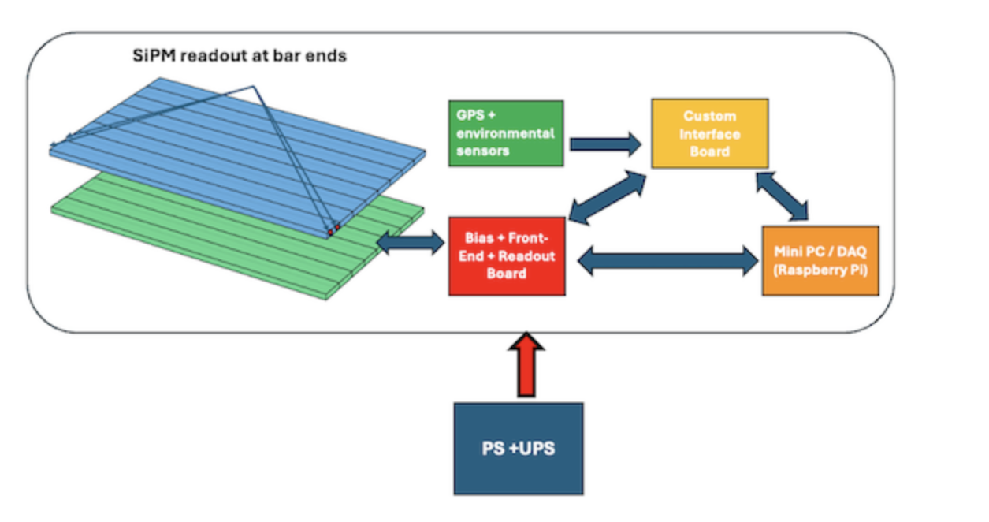
Basic design
Based on the
experience of POLA-R
8+8 scintillator bars 60 cm x 5 cm x 1 cm
2+2 SiPM per bar (64 channels)
CAEN FERS5202 x bias/readout/logic
GPS and sensors as POLA-R
Mini PC (rpi) as POLA-R
UPS system as POLA-R
Tests in Bologna & CREF

Slide 3
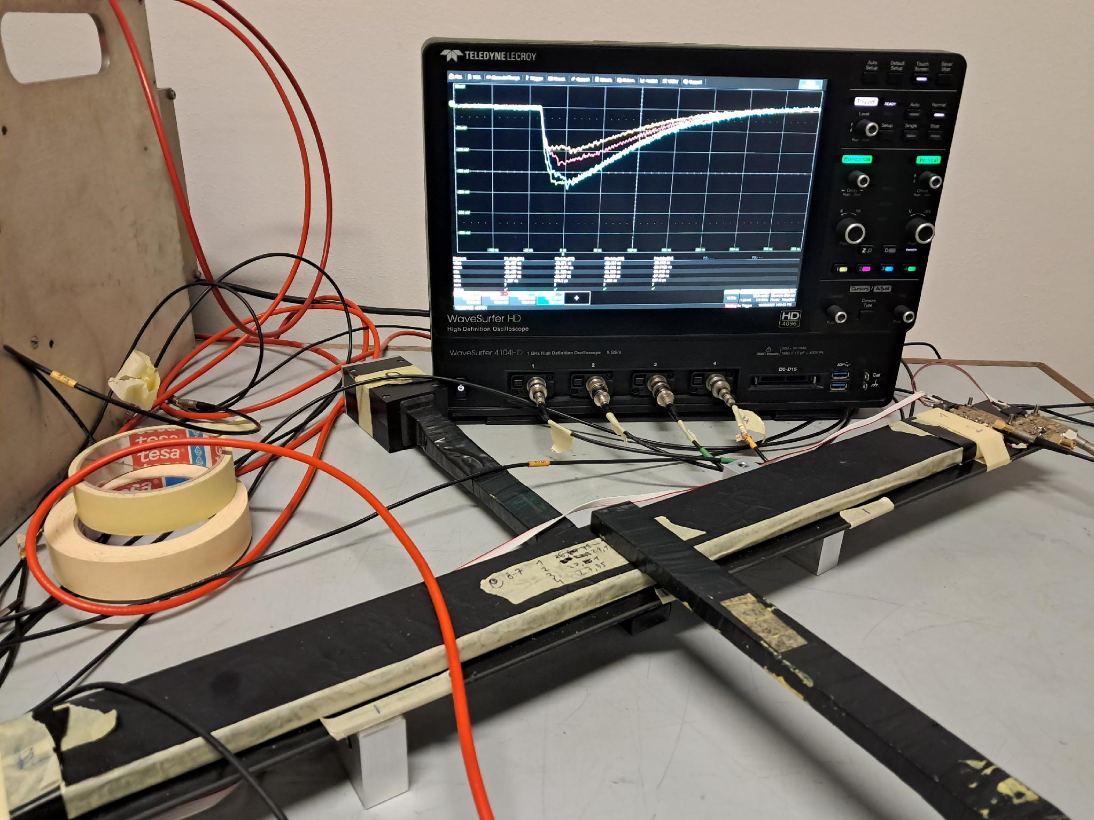
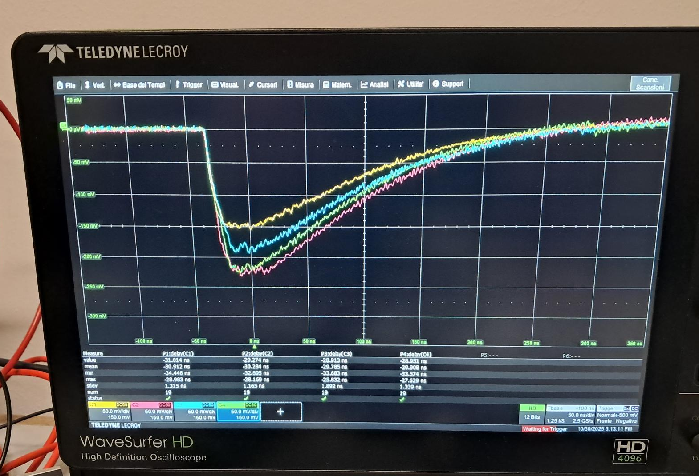
TTT Test in Bologna
External trigger using scintillators and scope acquisition
Bias and FE custom
A -30 cm
C +30 cm
0 ns
100 ns
4
3
1
2
Credits R.Nania

Slide 4
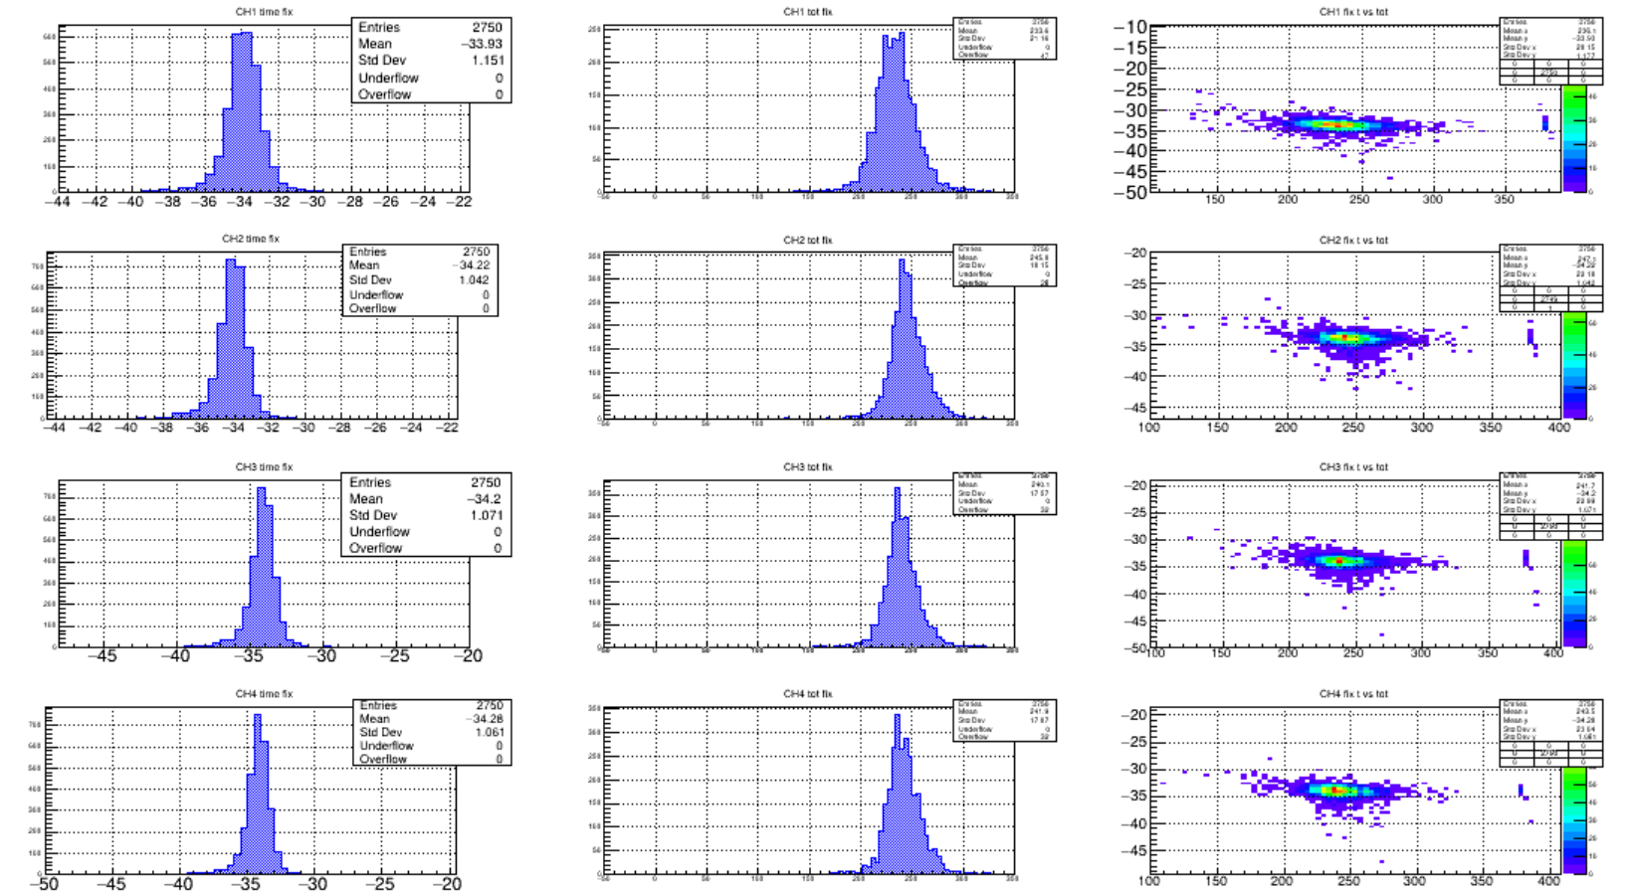
Results
Time
ToT
Time
Ch1
100
200
ToT
Ch2
Ch3
Ch4
Credits R.Nania

Slide 5
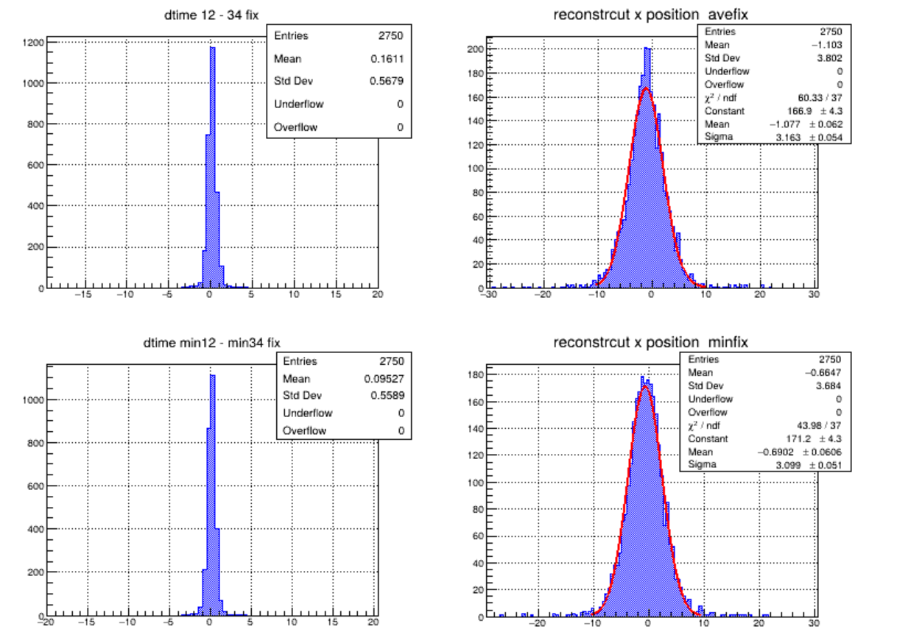
Time difference
Centre1000632ov
2750 entries
Credits R.Nania

Slide 6
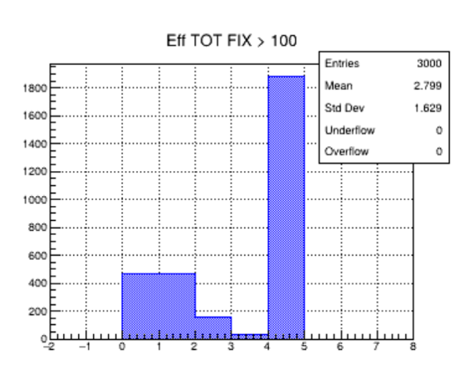
Position reconstruction & efficiency
V= 2/0,1394 = 14,48 cm/ns
External Trigger (trigger area > bar area)
Distribution of the number of over-threshold channels.
High efficiency.
Credits R.Nania

Slide 7
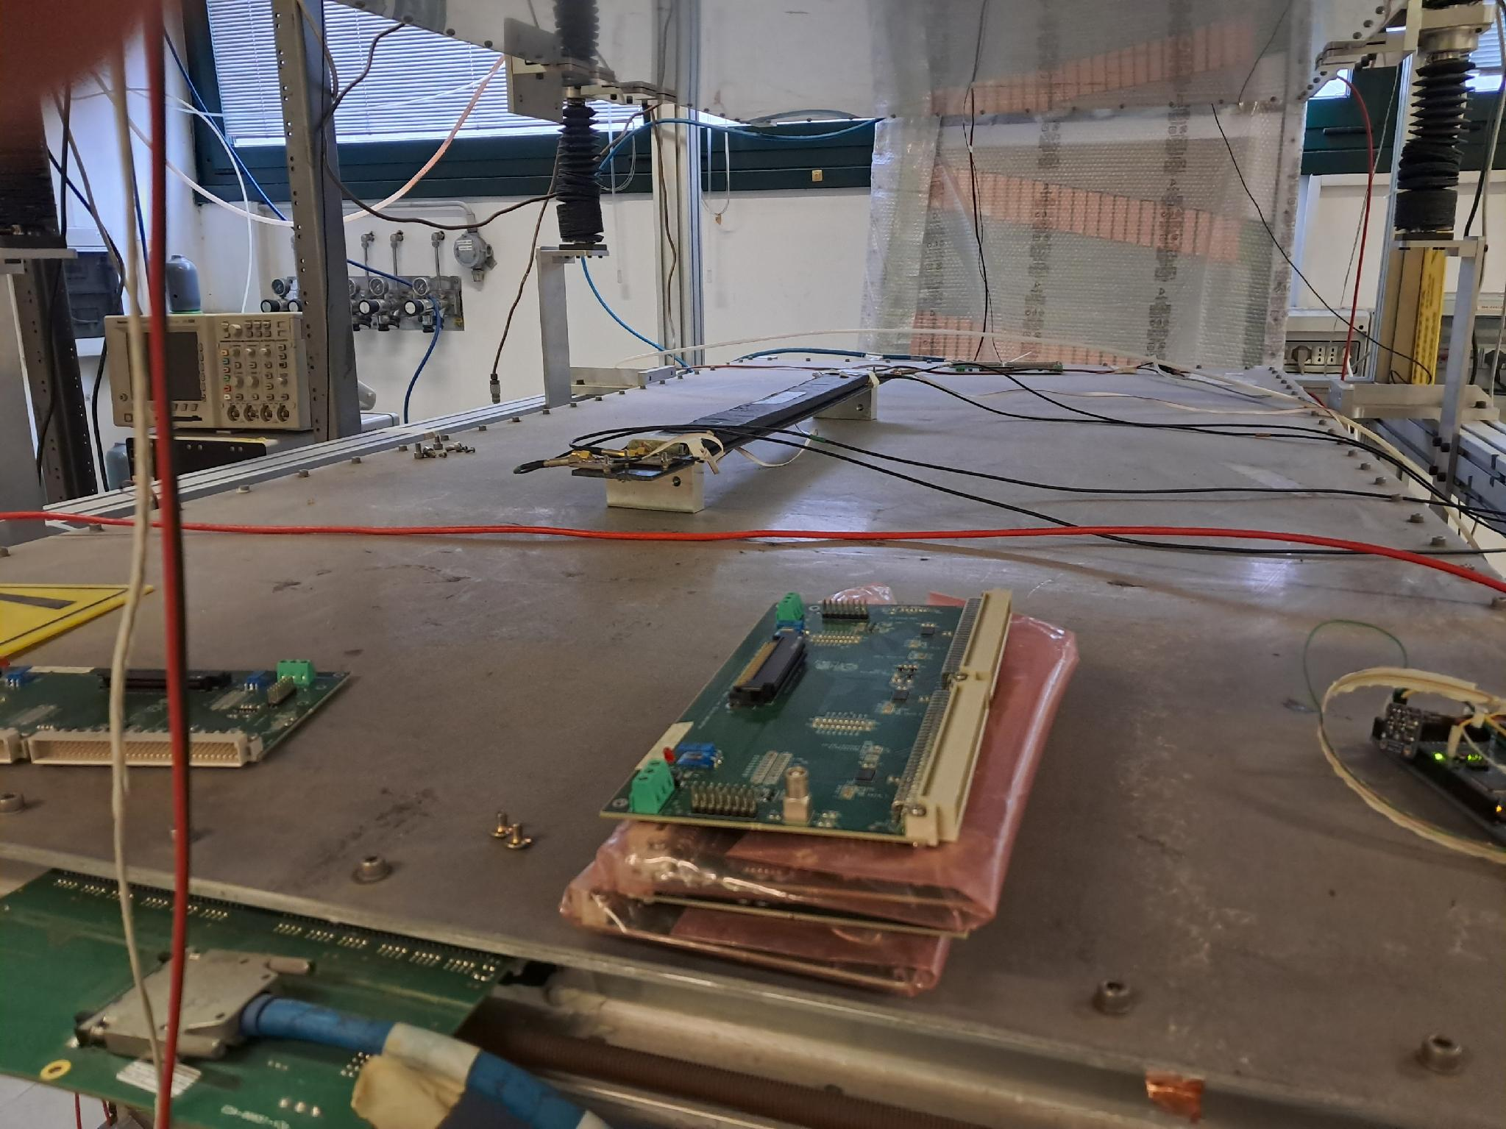
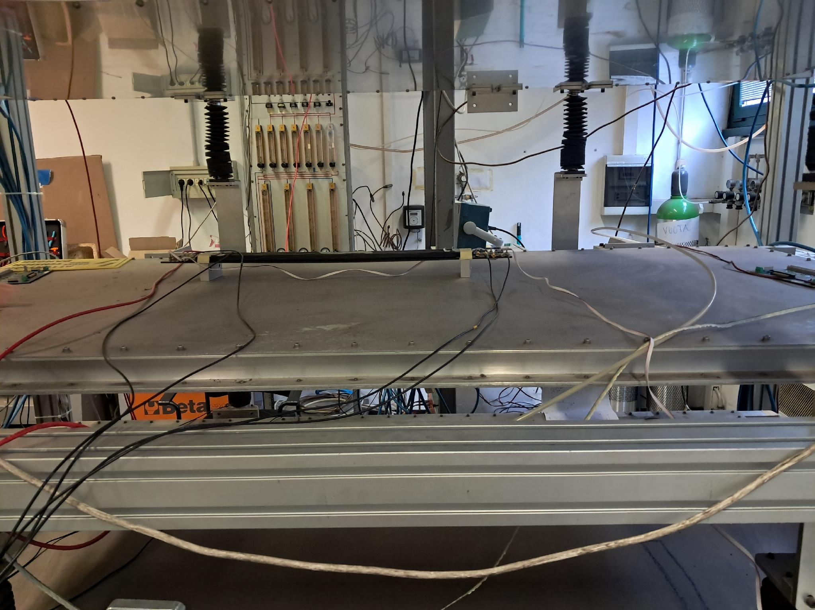
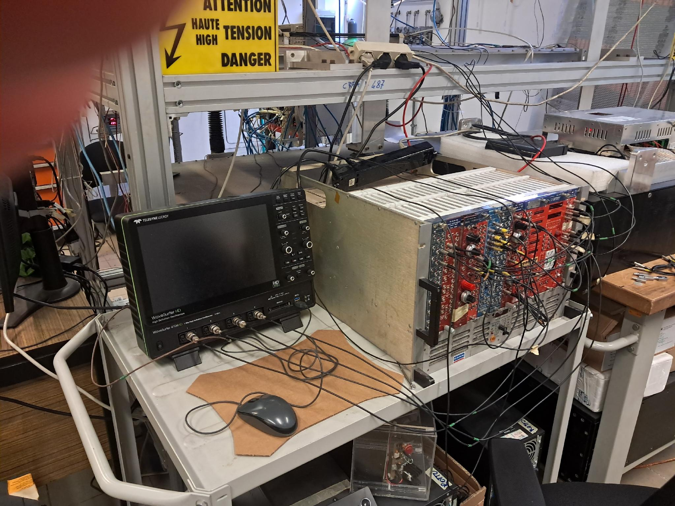
TTT-EEE test Feb 2026
Credits R.Nania

Slide 8
TTT-EEE test Feb 2026
Dati acquisiti con osciloscopio + con trigger esterno per EEE inserito sul piano 2
Programmi analisi basati su quanto gia fatto per ALICE3 TOF (Bianca).
4 file - start 16_50 circa stop 17:00 circa
N ev 1 , 984, 1000 , 986 = tot 2971 eventi
Voltage 32 V th 50 mV rate 20 Hz
53 cm circa
78 cm circa
Posizione negativo
MRPC
Credits R.Nania

Slide 9
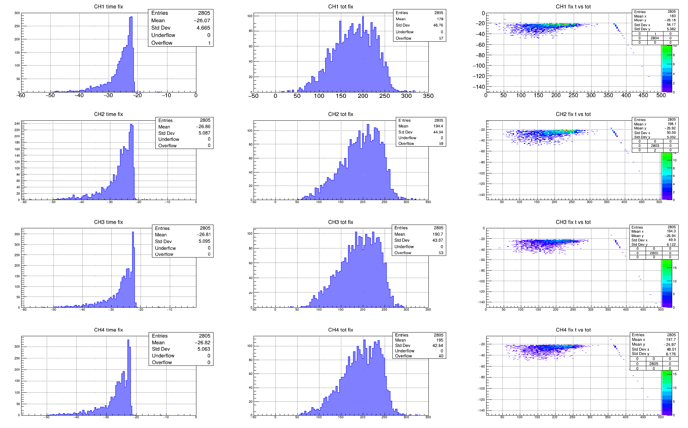
Scope Data
Time
ToT
Time
Ch1
100
200
ToT
Ch2
Ch3
Ch4
Credits R.Nania

Slide 10
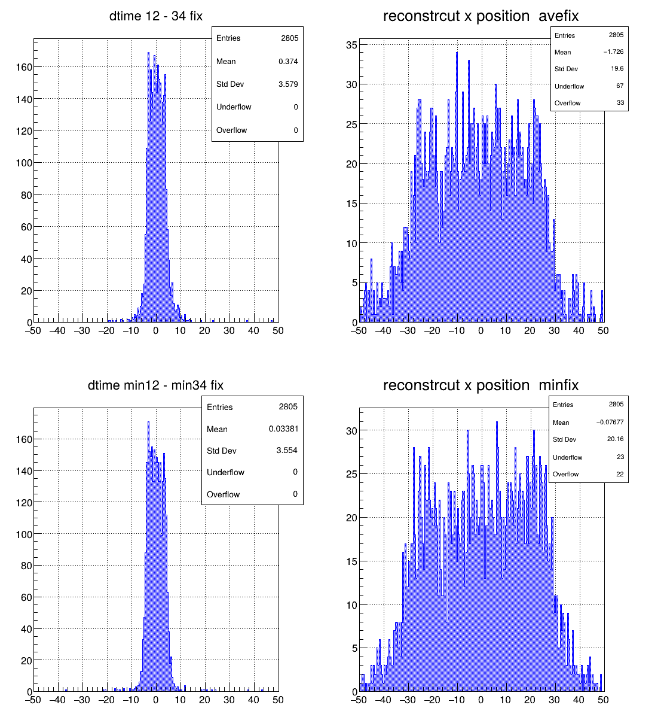
Dtime from average 12 and 34
Position reconstruction (cm)
Dtime from min 12 and min 34
Position reconstruction (cm)

Slide 11
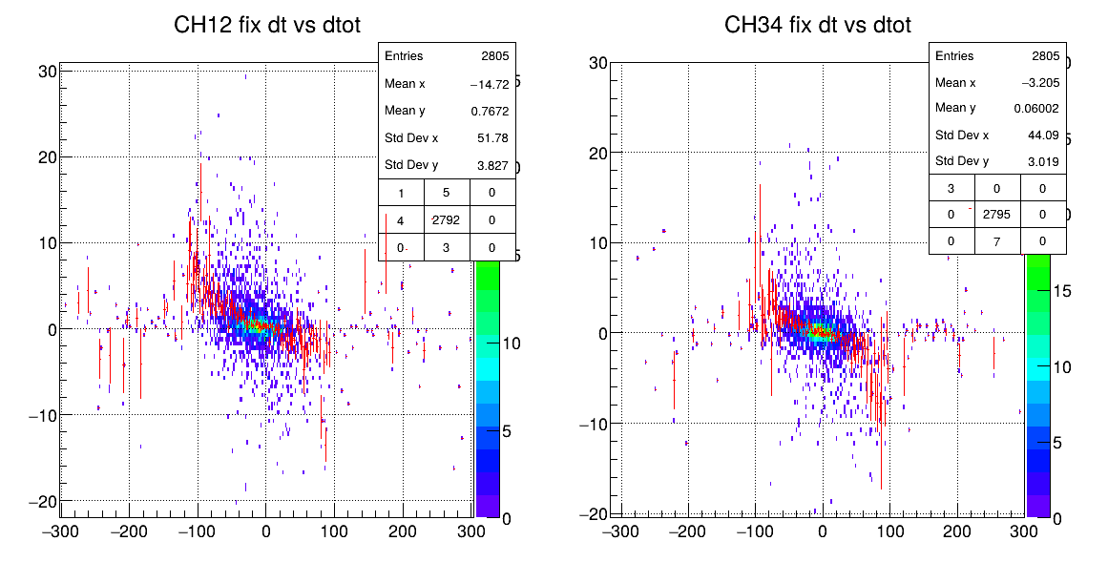
Corrections can help
Room for improvement in position reconstruction using Δt and ΔToT
Credits R.Nania

Slide 12
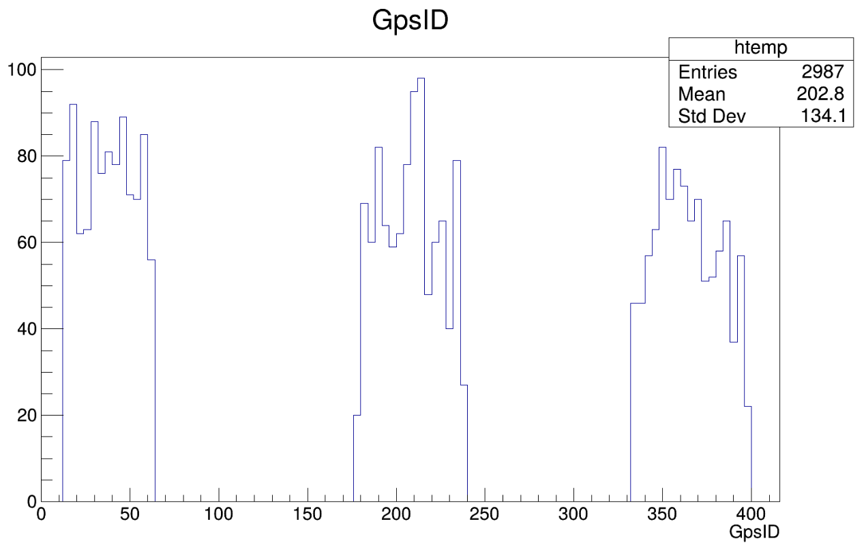
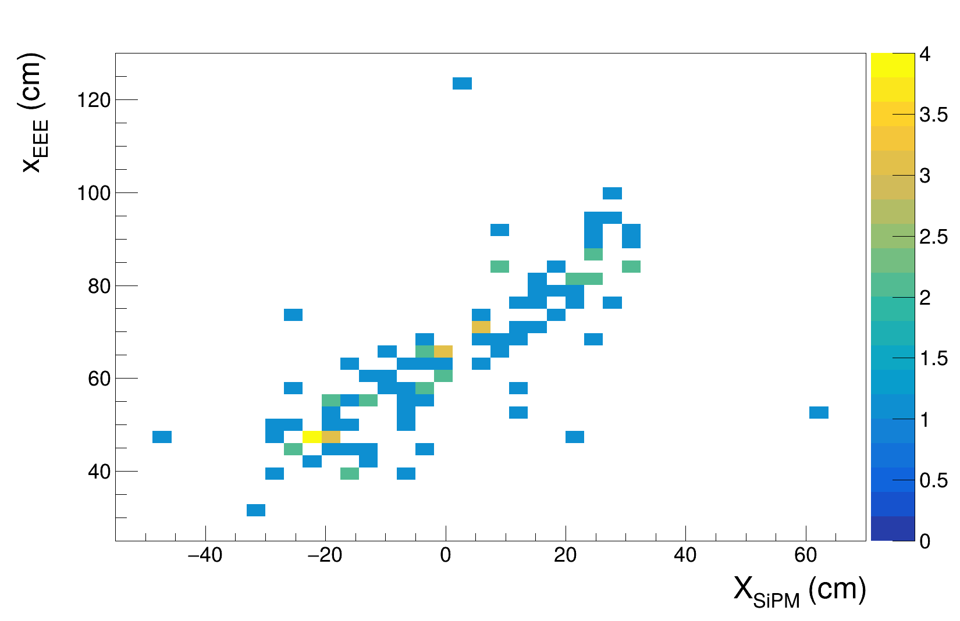
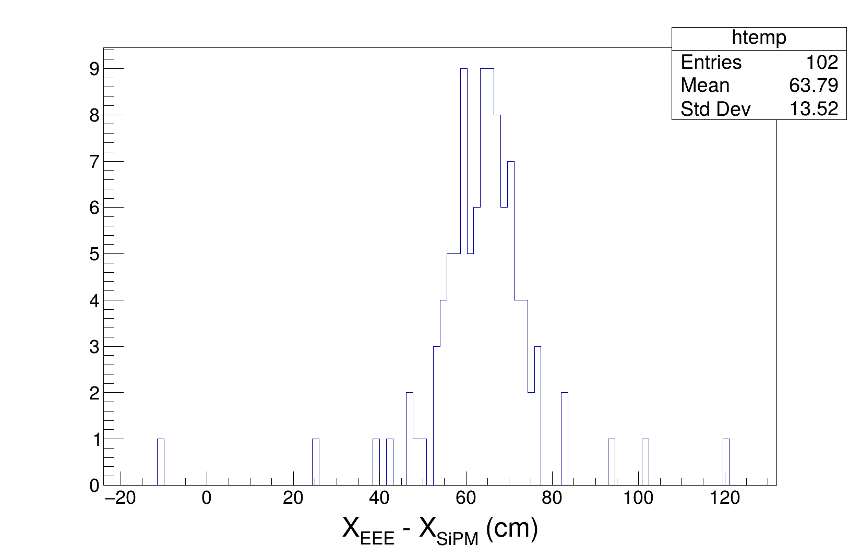
EEE data
Used the trigger sequence to align the events
X_{EEE} comes from standard EEE reconstruction
X_{SiPMs} = (t_{1} + t_{2} - t_{3} - t_{4}) * v_{drift} / 4
Shift in event index → possibly due to incorrectly generated double triggers → to be checked in the coming weeks.
Credits F. Noferini

Slide 13
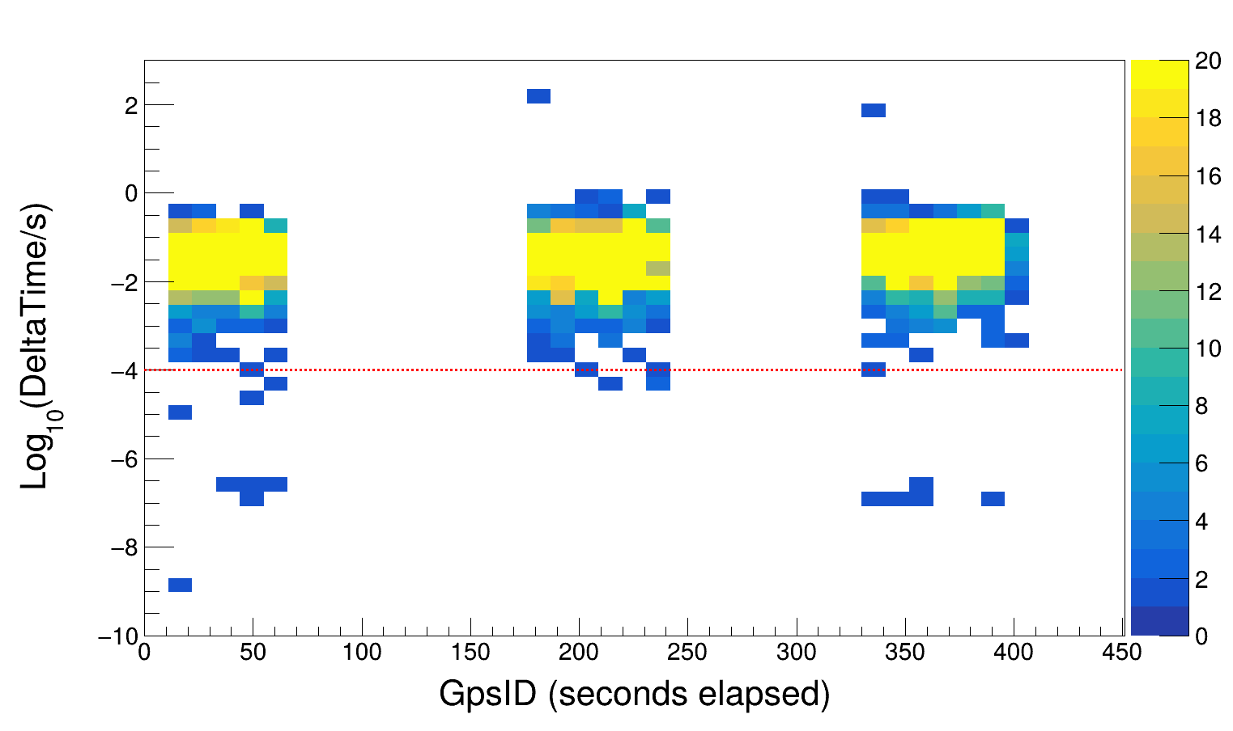
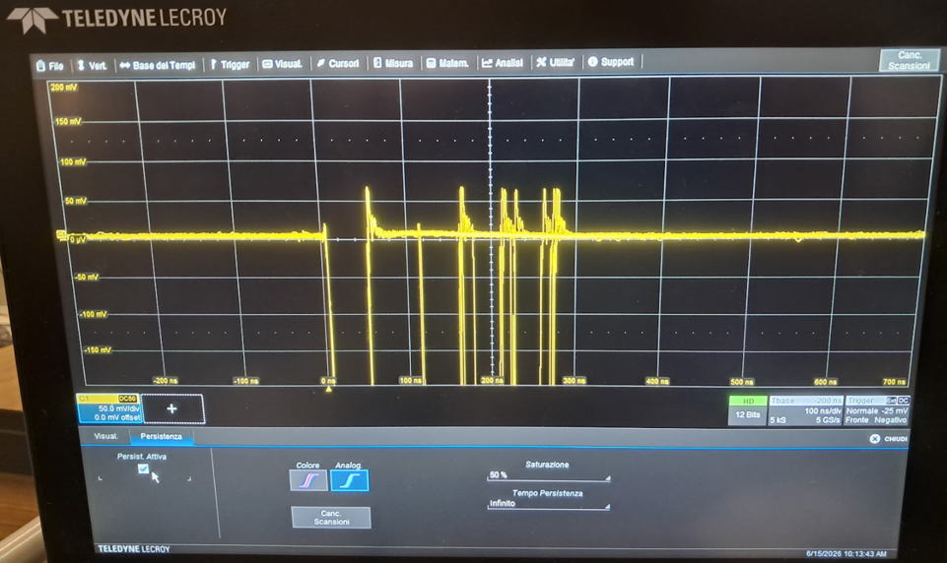
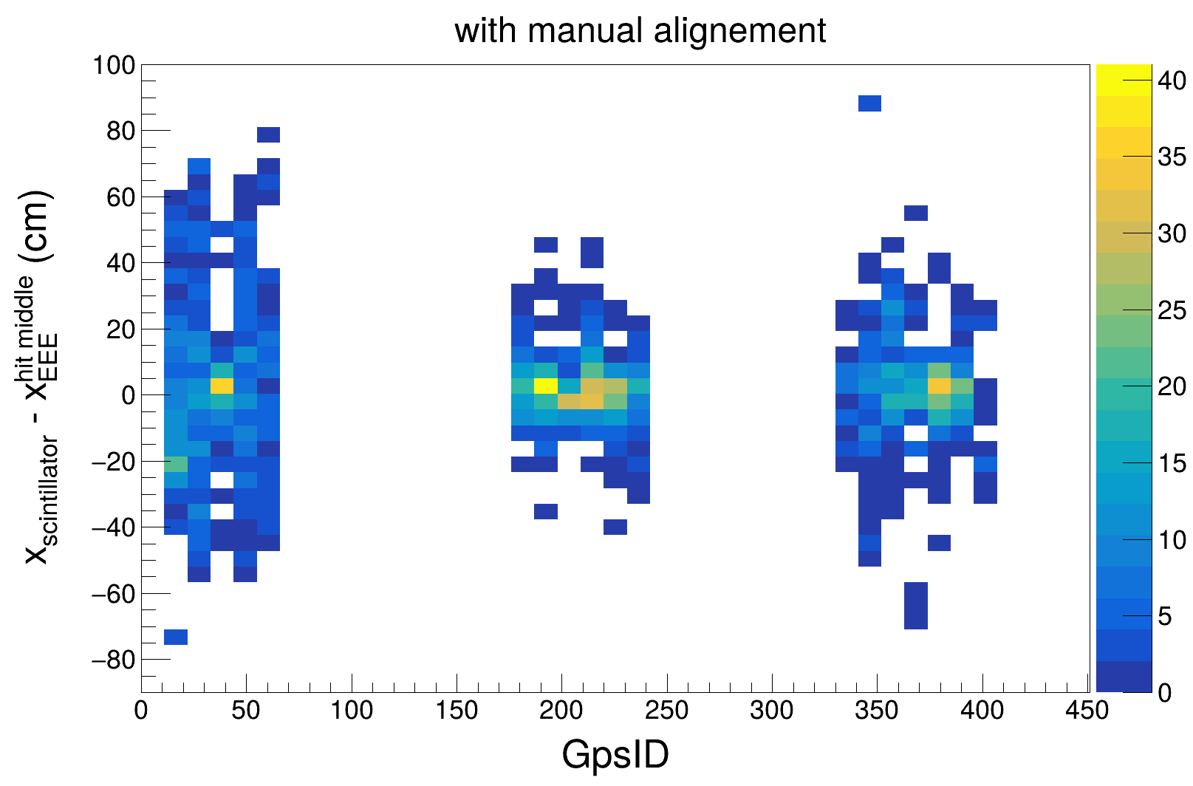
EEE/scope data
Rarely, after the main trigger (50 ns wide), we observe some re-scattering within 300 ns, especially for large signals (~5 V from the SiPM).
Cases where the coincidence module outputs 13 ns signals (it should be fixed at 50 ns), but the reason is still unclear.
Credits R. Nania& F. Noferini

Slide 14
@CREF
Setup
Ch 1
Ch 2
Ch 3
Ch 4
FERS
Left Side
Rigth
F-Up
7 cm
Up & Down->scintillator fingers ~5x2.5 cm
HV up =725 V
HV down 725 V
PwS ch 0 up
PwS ch 1 down
Up->ch0 L.E.D (Thr 70 mV)
Down->ch4 L.E.D (Thr 70 mV)
Ch 0 (5ns) AND Ch4 (5 ns)
16 ns ->scope
16 ns->T0IN FERS
NIM
Scope
PC-FERS power & readout via Januspy

Slide 15
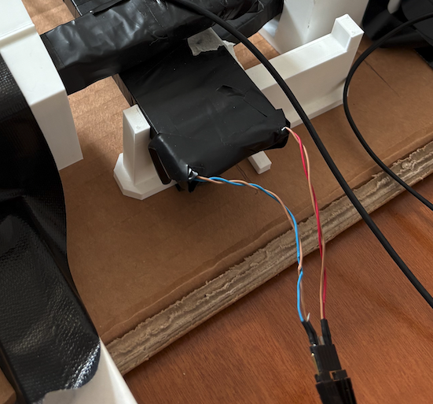
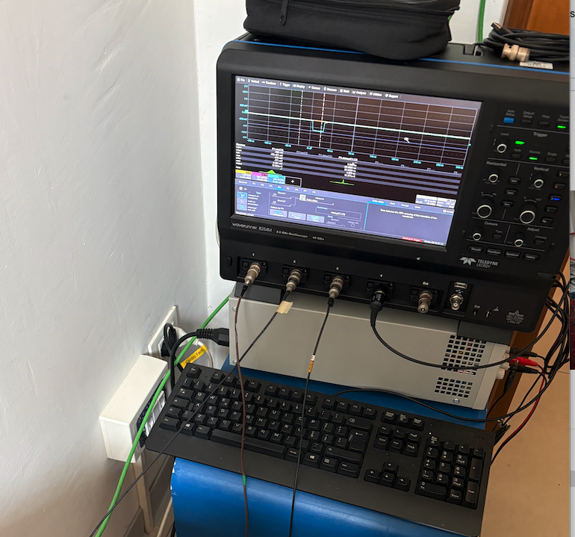
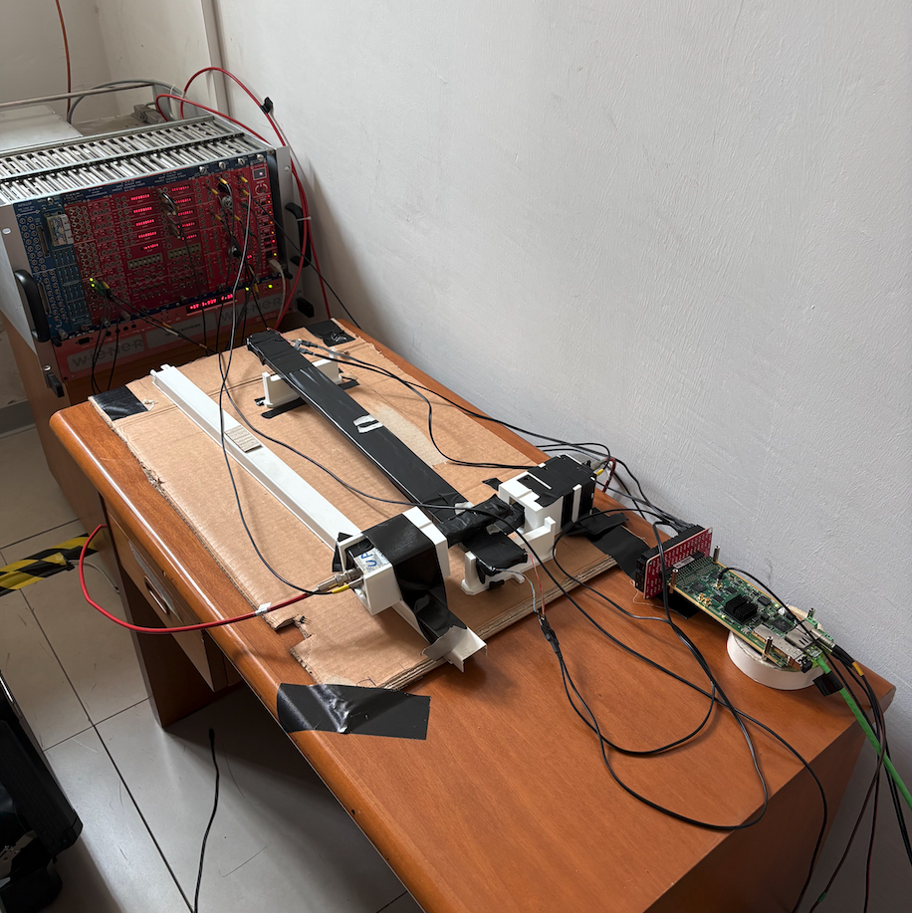
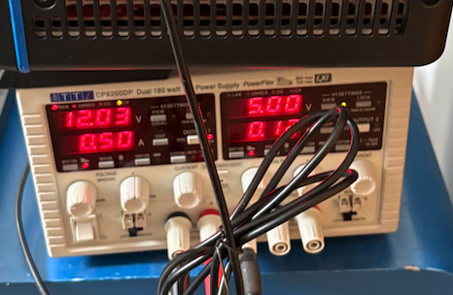
Reality
Scope
NIM (PMT Bias & Logic)
FERS BIAS (PC controlled)
Credits R. Nania& F. Noferini

Slide 16
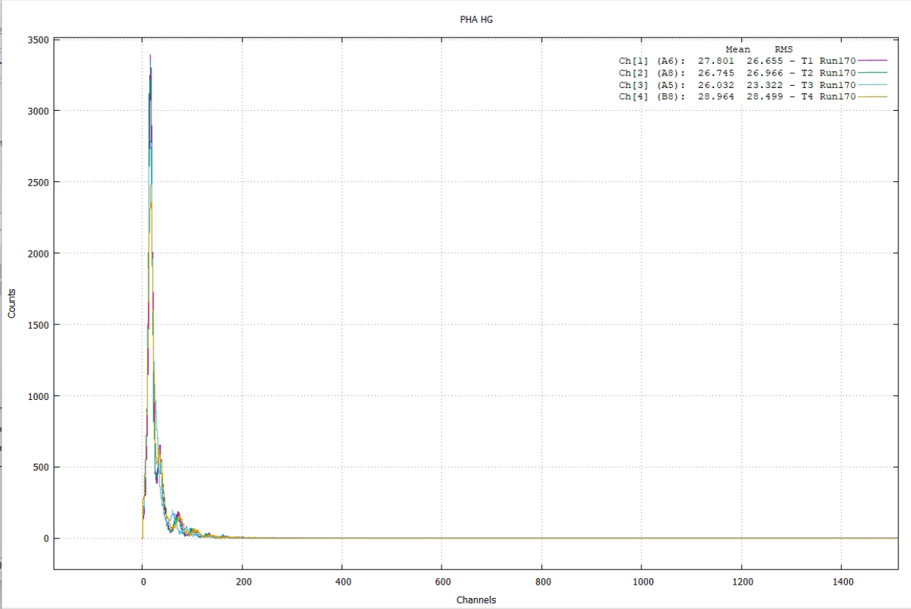
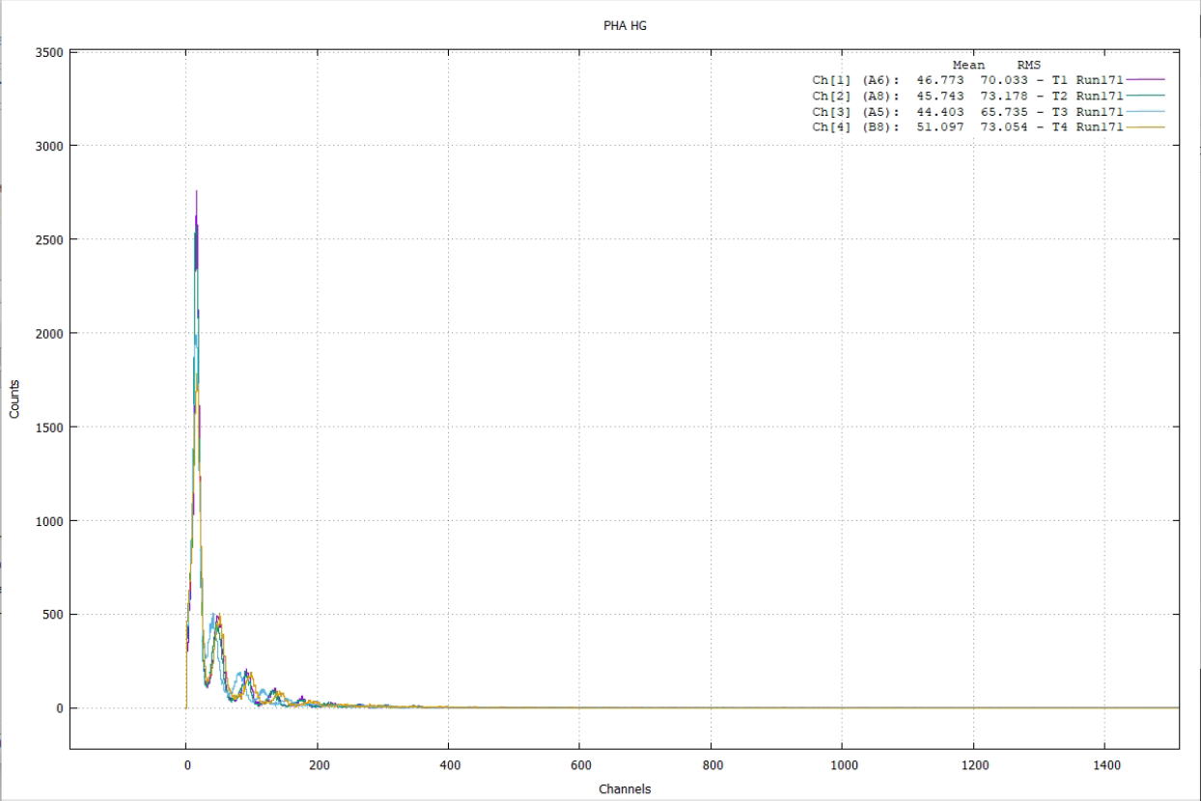
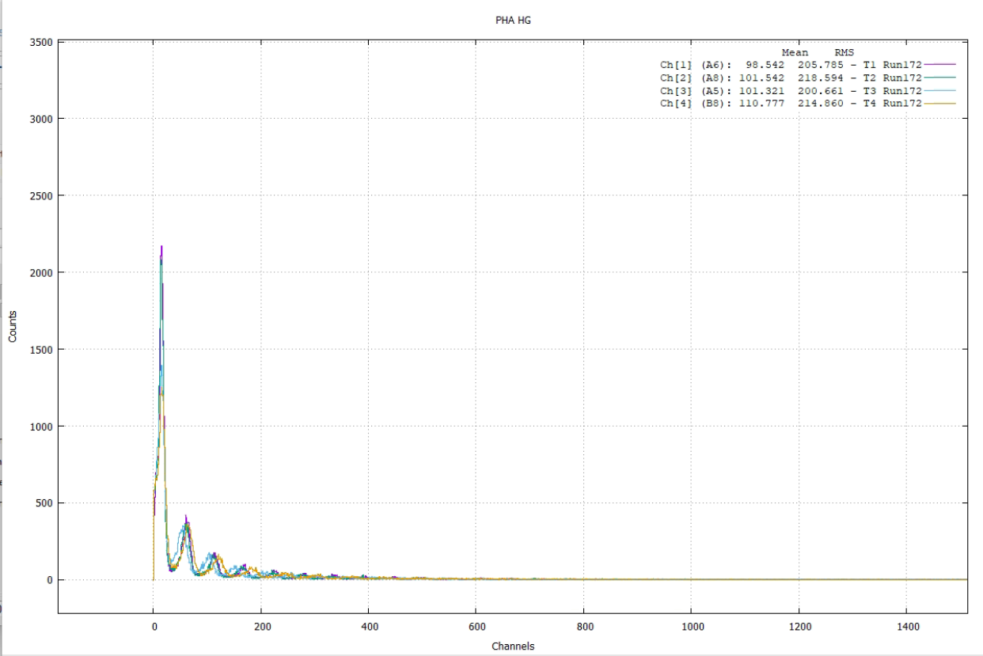
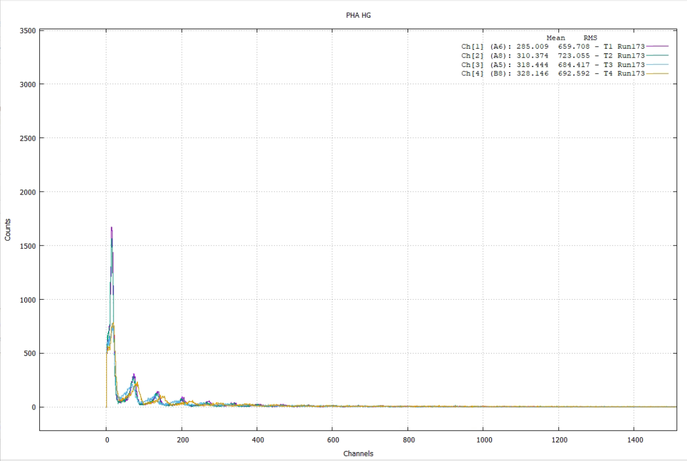
First Kiss with FERS & Janus
Using DC
Bias 29 V
Bias 30 V
Bias 31 V
Bias 32 V

Slide 17
Spectroscopy mode
Bias (V) | Run Nb | N. ev | Trigger Logic | Period trigg.
29 | 170 | 50000 | Internal Pulser | 1 ms
30 | 171 | 50000 | Internal Pulser | 1 ms
31 | 172 | 50000 | Internal Pulser | 1 ms
32 | 173 | 50000 | Internal Pulser | 1 ms
Spectroscopy Mode: This mode (also indicated as Pulse Height Analysis, PHA) works with a global (bunch) trigger, either coming from an external source or generated by a combination of the channelself‐triggers. As soon as a trigger is issued, all channels start simultaneously the A/D conversion ofthe pulse amplitude and create a data packet containing the common trigger time stamp followed by the individual energies. The packet is saved into the local memory buffer of the FERS‐5200 unit,waiting for the readout, while a new cycle can start. In Spectroscopy Mode, the A/D conversioncauses a systematic dead time and limits the maximum trigger rate. In particular, the dead time dueto conversion with Citiroc‐1A is about 10 μs.
We use the Internal pulsed (1 ms period) as bunch trigger and look to the high gain spectra. Basically we are looking to the noise and it looks like we get the noise photopeaks.
Would be nice to check with external LED pulses.
Needs to be checkrd but 31 V looks like a comfortable bias

Slide 18
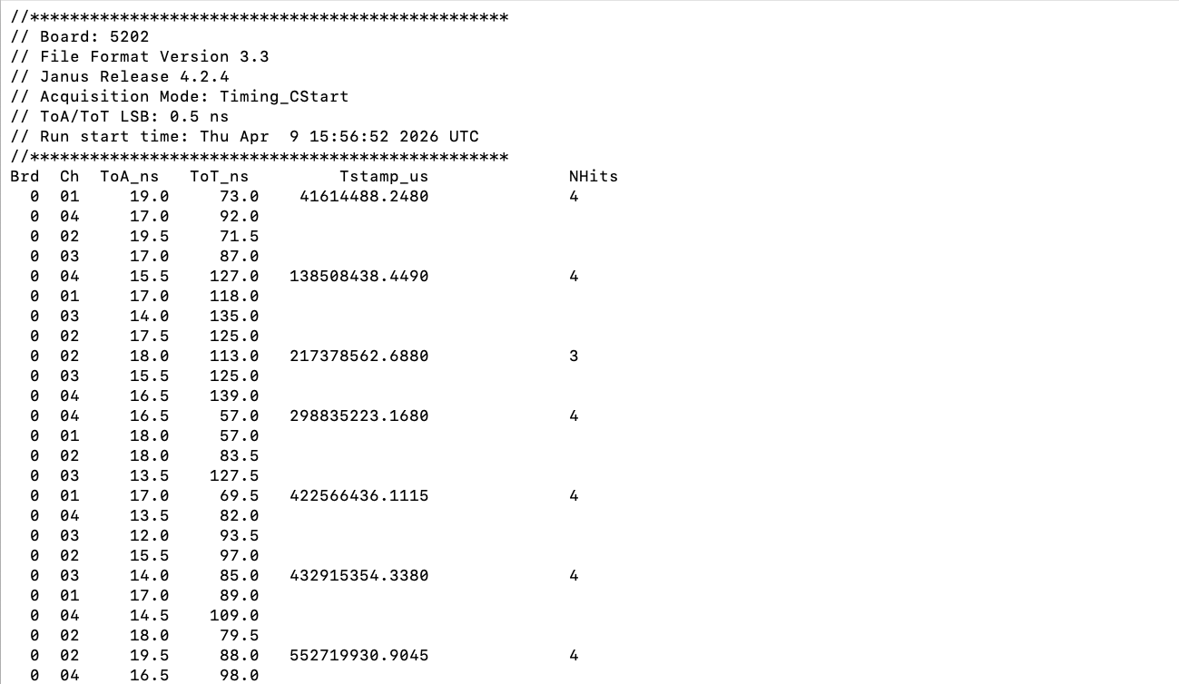
Timing Mode

Slide 19
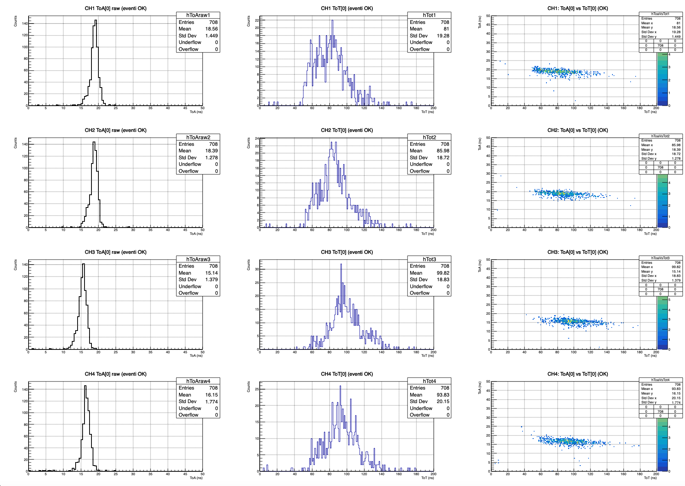
Preliminary
Only events with 4 channels

Slide 20
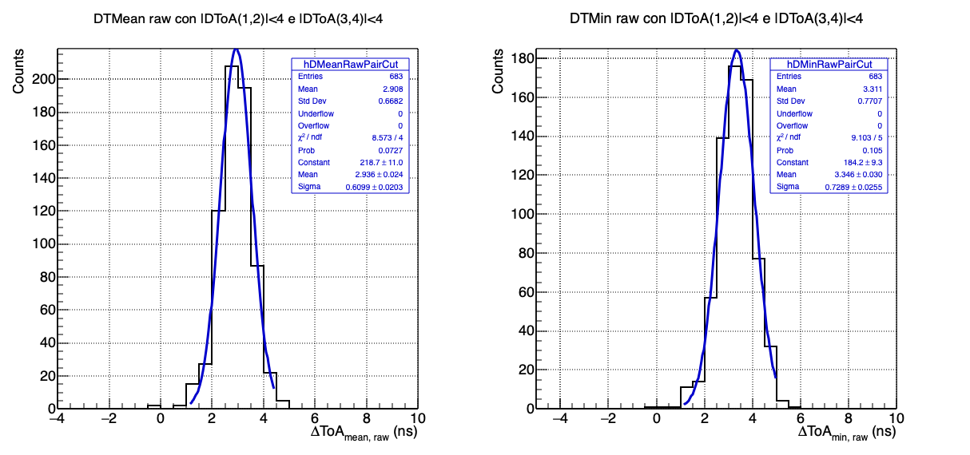
Preliminary

Slide 21
Summary
Preliminary design defined
Test ongoing in Bologna & Roma: encouraging results
Use of CAEN FERS under study (waiting for new module 50 ps time resolution)
Need for some custom board to integrate FERS and GPS/sensors
Need for Manpower

Slide 22
EXTRA

Slide 23
Rate 100sec
Rate 100sec
Th ( mV)
Voltage (V)

Slide 24
