Slide 1
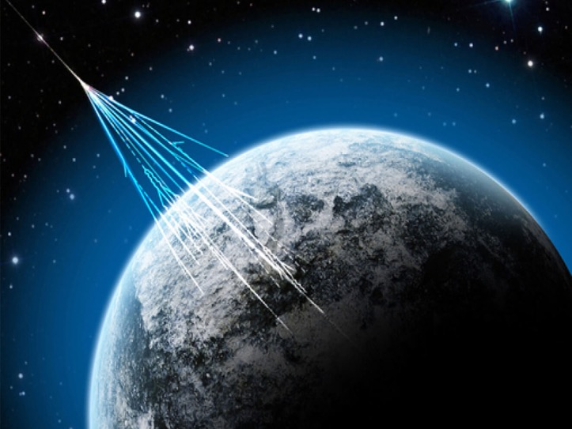







Status of the network
(Restart/Data Aquisition/Hardware)
C. Cicalò-D. De Gruttola-M. Garbini

Slide 2
Overview
Network status: | review of the situation & plans for the autumn
Run 8: | Some numbers
New Run: | dates
Tech. report | Hardware
R&D | Dedicated talks

Slide 3
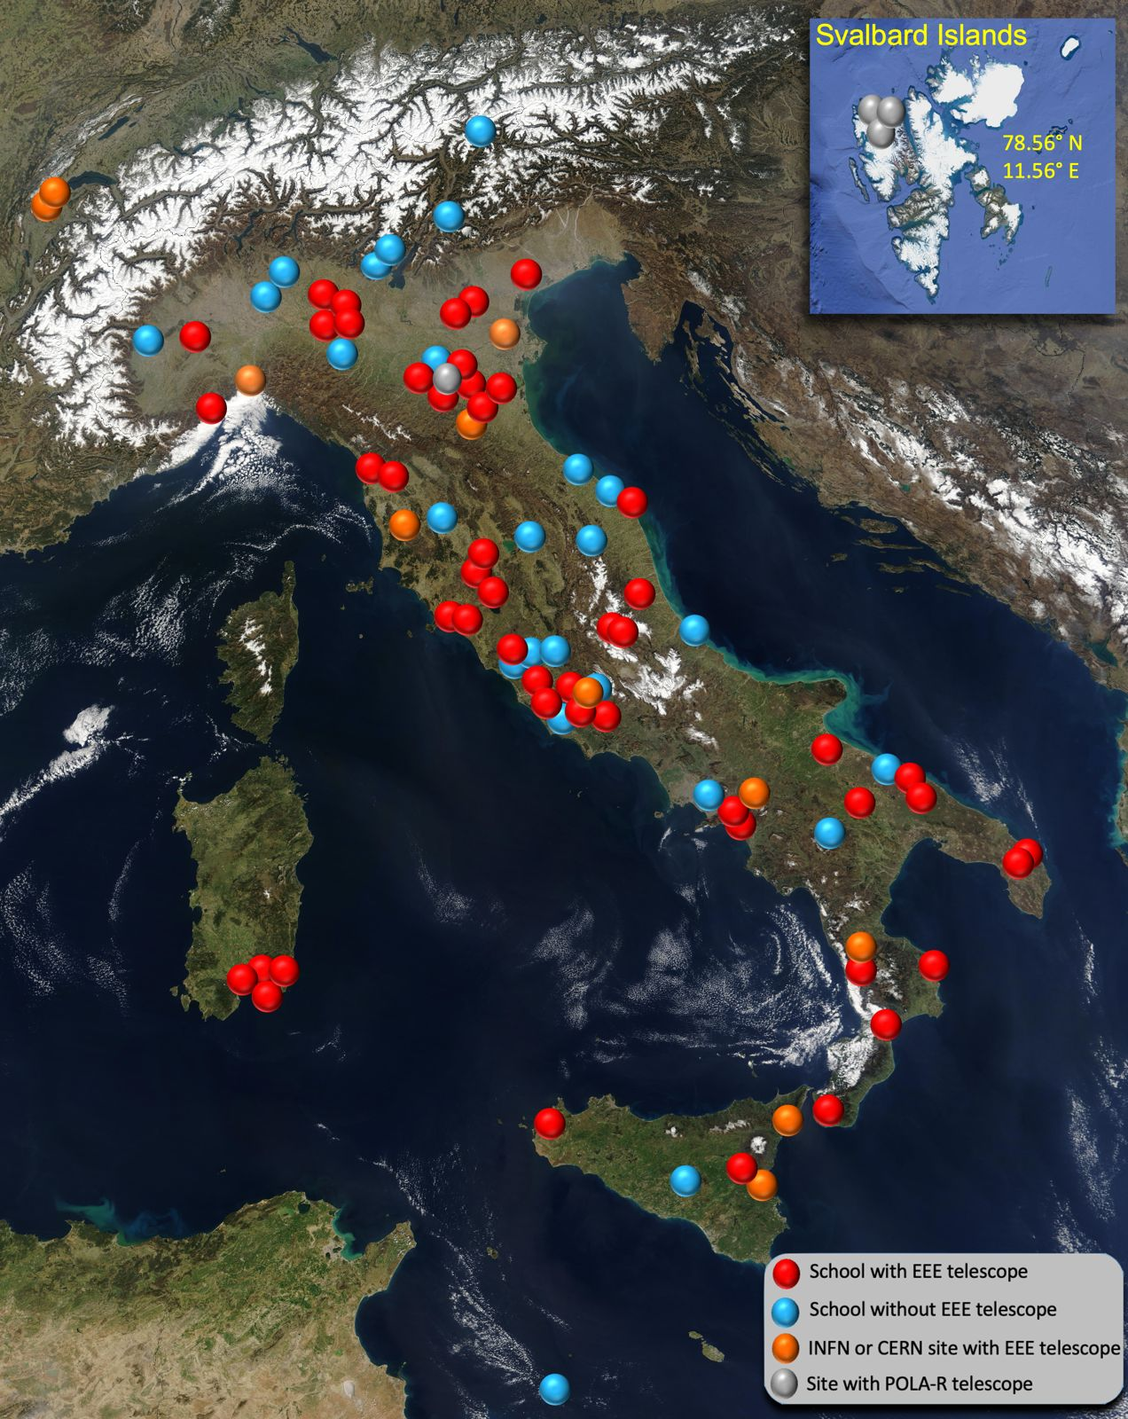
Some numbers
Overall picture:
Installed MRPC telescopes: 54 (45 +9)
Telescope to be Installed: 2
POLA-R detectors: 4
These numbers may still change: although some situations have been clarified, others are still pending;
- renewal of the CREF-School agreements.
In the following, we report the status region by region, together with the plans for next year.
We thank the local coordinators for providing the information.

Slide 4
How to read the info
OK → Telescopes on which activities restarted and data have been acquired; hardware is OK and currently shut down due to a 'summer break' or temporary issues
~OK → Telescopes on which activities restarted and some data have been acquired, but that have some issues.
~OFF = Restart initiated (bureaucracy and a few other steps underway)
OFF = Restart not yet initiated (but administrative procedures are complete)

Slide 5
Template
Region
Telescope ID | Site | Status | Note
Come compilare:
Region: area di competenza
Telescope ID-> nome telescopio
Site: School, Univ., INFN/CREF lab.
Status
OK = Telescopes on which activities restarted and data have been acquired; hardware is OK and currently shut down due to a 'summer break' or temporary issues.
~OK = Telescopes on which activities restarted and some data have been acquired, but that have some issues.
~OFF = Restart initiated (bureaucracy and a few other steps underway)
OFF = Restart not yet initiated
Also add if there is a date foreseen for the restart
Also specify if the telescope will be on during summer
Plans for 26/27:
Add text

Slide 6
Sicilia
Telescope ID | Site | Status | Note
MESS-01 | Univ. Messina | ~OFF | Telescope moved from CT to ME; chambers and mechanical structure installed, all materials available (except Desktop Computer for DAQ
PATE-01 | School | ~OK | Telescope restarted, but probable gas leakage
TRAP-01 | School | ~OK | Telescope restarted, but low DAQ rate
Plans for 26/27:
MESS-01: Restarting activities planned for July-Sept 26
PATE-01: Check of the gas tightness planned in July 26
TRAP-01: LV power supply to be replaced, efficiency measurement planned in July-Sept 26
+
CATA-01 @ INFN Catania:
Due to logistical issues, no restart is foreseen-
LAMP-01: …

Slide 7
Sardegna
Telescope ID | Site | Status | Note
CAGL-01 | School Cagliari | ~OFF | Ready for re-mounting after school restoration
CAGL-02 | School Cagliari | ~OFF | Moved from another room. To be re-mount
CAGL-04 | School Quartu S.E. | ~OK | Restarted. OFF in summer
CAGL-05 | School Cagliari | OK | Running. ON in July.
Plans for 26/27:
CAGL-01 setup and restart (Nov-2026)
CAGL-02 setup and restart (OCT-2026)
CAGL-04 restart (SEP 2026)
Change PC in CAGL-01 and CAGL-02
CAGL-04 HV Lecce module to be sent for maintenance

Slide 8
Calabria
Telescope ID | Site | Status | Note
REND-01 | Rende | ~OK | Low track reconstruction efficiency; will remain ON all the time
CARI-01 | Cariati | ~OK | Low rate; investigation underway
CATZ-01 | Catanzaro | OK | Shutdown due to summer break
RECA-01 | R. Calabria | OK | Shutdown due to summer break
COSE-01 | Cosenza | OK | Will be shutdown next week
Plans for 26/27:
Restart at the beginning of September 2026

Slide 9
Puglia 1 – Bari-BAT
Telescope ID | Site | Status | Note
ALTA-01 | School | OK | Shutdown due to summer break
BARI-01 | School | OK | Shutdown due to summer break
TRIN-01 | School | ~OK | Low rate + Shutdown due to summer break
BITE-01 | School | OFF | Installation during next school year
Plans for next months:
Restart telescopes in September
Investigate TRIN-01 problems
Start BITE-01 installation (manpower/responsible needed)

Slide 10
Puglia 2 – Lecce
Telescope ID | Site | Status | Note
LECC-01 | School | OK | Shutdown due to summer break
LECC-02 | School | ~OFF | In the process of being restored
Plans for next months:
LECCE-01 is equipped with a very old and unstable computer; the new computer has already been provided by CREF and will be installed as soon as the school is open again after the final exams.
LECCE-02 requires the replacement of the computer, the redoing of the gas lines, and a DC-DC converter (negative). As soon as the school is reopened after the final exams, part of the new gas lines will be installed. Subsequently, we will replace the section of lines connecting the MRPCs.

Slide 11
Campania&Abruzzo
Telescope ID | Site | Status | Note
SALE-01 | School | ~OK | Signal from each chamber seems to be ok, but no coincidences
SALE-02 | School | OK | ON during summer
SALE-03 | Univ. Salerno | OK | Maybe OFF during summer (too high temperature..to be checked)
LAQU-01 | School | OK | Lower rate since HFO bottle was replaced
LAQU-02 | School | ~OK | Good performance in general, but high rate of FEA failures (interface card replaced on one chamber, but huge leakeages to be cured). Telescope room not accessible till September because of building interventions
TERA-01 | School | OK | Sporadic fails on DAQ (restart always work)
Plans for 26/27:
SALE-01: use NIM crate to check missing coincidences
LAQU02: cure leakage and FEA failures
TERA-01: Check failures on DAQ
And keep the other telescopes running

Slide 12
Lazio
Telescope ID | Site | Status | Note
FERM-01 | CREF | OK
FRAS-01 | Liceo Tousheck Grottaferrata | OK | Shutdown due to summer break (low rate in the last month-> to be investigated
FRAS-02 | ITT Fermi Frascati | ~OK | “New” chambers from Villa Sora 8th of July
ROMA-01 | Liceo Albertelli Roma | ~OK | Need 1 chamber
ROMA-02 | ITIS Fermi/Hertz Roma | OFF | No feedbacl on bureaucracy
Plans for 26/27:
Restart & check school telescopes in September 2026
Define solution for ROMA-02-> Move to new site/take 1 chamber for ROMA-01?

Slide 13
TOSCANA
Telescope ID | Site | Status | Note
AREZ-01 | School | OK
GROS-01 | School | ~OK | Losses on Freon line. Waiting intervention
GROS-02 | School | ~OFF
PISA-01 | School | ~OK
SIEN-01 | School | ~OK | Some issues on gas lines. Fixed this week by SIAD technician.
SIEN-02 | School | ~OK | Several minor issues during last year. Should be ready for September
VIAR-01 | School | ~OFF | Work restarted, always been a problematic telescope
VIAR-02 | School | ~OFF | Moved to new location. Slowly setting up the telescope.
Plans for 26/27:
- All telescopes OFF during summer
- Keep working on VIAR telescopes, but serious shortage of manpower. GROS –telescopes actually very hard to maintain\fix
- GAS intervention by SIAD completed on the 3 pilot stations (Sien-01, Viar-01, viar-02)

Slide 14
Emilia Romagna e Marche
Telescope ID | Site | Status | Note
BOLO-01 | INFN-Bologna | OK
BOLO-02 | Liceo Fermi Bo | OK | Shutdown due to summer break
BOLO-03 | Liceo Galvani 1 Bo | OK | Shutdown due to summer break
BOLO-05 | Liceo Galvani 2 Bo | OK | Shutdown due to summer break
REGG-01 | IT IS Nobili R.E. | OK | Shutdown due to summer break
PARM-01 | Liceo Marconi PR | OK | Shutdown due to summer break
ANCO-01 | Liceo Rinaldini AN | OFF | No feedbacl on bureaucracy for new gases
Plans for 26/27:
Restart at the beginning of September 2026
Define solution for ANCO-01-> Move to new site?

Slide 15
Liguria&Lombardia
Telescope ID | Site | Status | Note
GENO-01 | Univ. | ~OFF | Ongoing works in the room.
SAVO-01 | School | OFF
CARC-01 | School | OFF
LODI-01 | School | OFF
LODI-02 | School | ~ON | Restarrted 25/06. Will be turned off to to high temepratures
LODI-03 | School | OFF
Plans for 26/27:
Restart other telescopes

Slide 16
Piemonte
Telescope ID | Site | Status | Note
TORI-03 | School | ~OFF
Plans for 26/27:
Restart the telescope during the next school year (manpower/responsible)

Slide 17
Veneto & Friuli
Telescope ID | Site | Status | Note
LNLE-01 | LNL | OK | On during summer
TREV-01 | School | OK | Gas cylinder replaced, gas leak tests, daq restarting 1 st July, on during summer
VICE-01 | School | OK | Hardware upgrade, restart July, during August will be off
VICE-02 | School | OK | Gas cylinder replaced, gas leak tests, daq restarting 1 st July, on during summe
Plans for 26/27:
Keep the telescopi running

Slide 18
CERN
Telescope ID | Site | Status | Note
CERN-01 | CERN | OK | Recirculation system tests + moving in a new position
Plans for 26/27:
Restart CERN-01 continue tests on recirculation system.
- CERN-02 dismounted and MRPCs at the storage: maybe we can use them as spare but they need to be tested.

Slide 19
Countability
OFF : nothing done on this telescopes
Restarted: OK or ~OK or ~OFF
NB From last year slide:
Telescopes: not counting incomplete or pending installations, relocations to be done and considering unclear situations as OFF (from 54 to 57 because of installation completed & move completed)
Year | Telescopes | OFF | Restarted (OK,~OK,~OFF)
2024 | 54 | 31 | 23
2025 | 57 | 14 | 43
2026 | 54 | 5 | 49
33 (26+7) telescopes have some data in RUN8!

Slide 20
What next?
The OFFs (nothing done):
ANCO-01 : probably the telescope is going to be moved away
LODI-01:
LODI-03:
ROMA-02: probably the telescope is going to be moved away
SAVO-01:
The ~OFFs (nothing done):
We have …. telescopes in this status: focus needed to bring them in data taking mode
The OK & ~OK telescopes need anyway continuous monitoring and maintenance and we need to schedule an efficiency measurement.

Slide 21
RUN 8

Slide 22
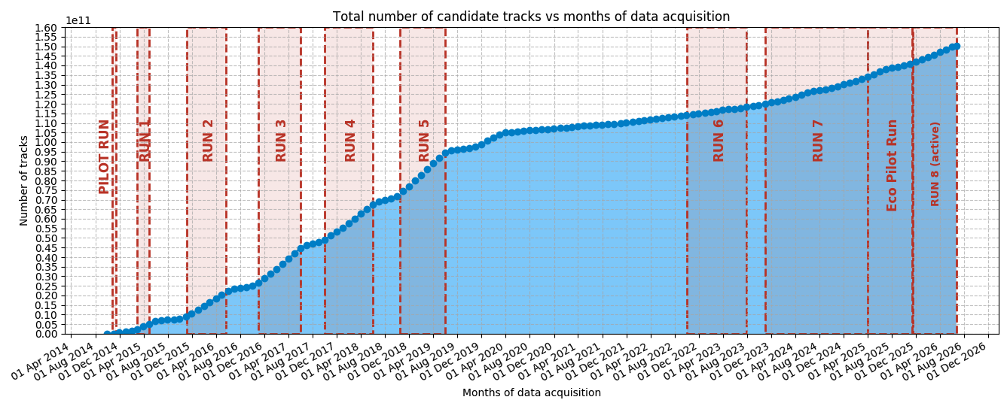
Few numbers
Start date: 14th november 2025 End date*: 15th June 2026
*: the data taking is ongoing in some sites but most of the school telescopes are off due to summer break
Telescopes: 33 + 4 POLA-R
School Telescopes: 26
Number of candidate tracks: >8x10⁹
Good participation from the schools!

Slide 23
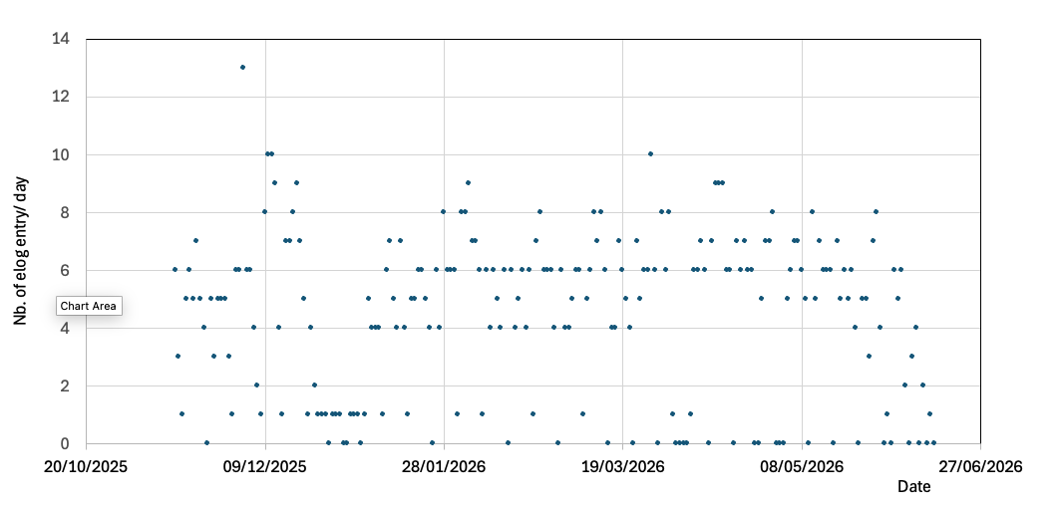
Good participation?
26 school telescopes have some data for RUN8
elog entry/day
Not many so far -> student engagement is still in its restart phase.
To be improved for RUN9

Slide 24
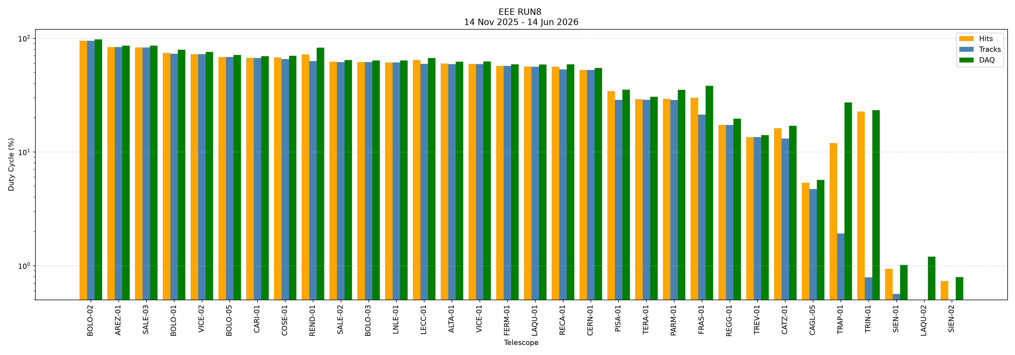
General Overview of RUN8 Duty Cycles
Duty Cycle: Defined as the number of hours during which the telescope acquired data (DAQ rate >=10 Hz, Rate of Events with Hits >=10 Hz, Rate of Events with good tracks >= 10 Hz) over the full time period (in hours)
Please note: this is a global overview and not all telescopes were operational from the beginning of RUN8.

Slide 25
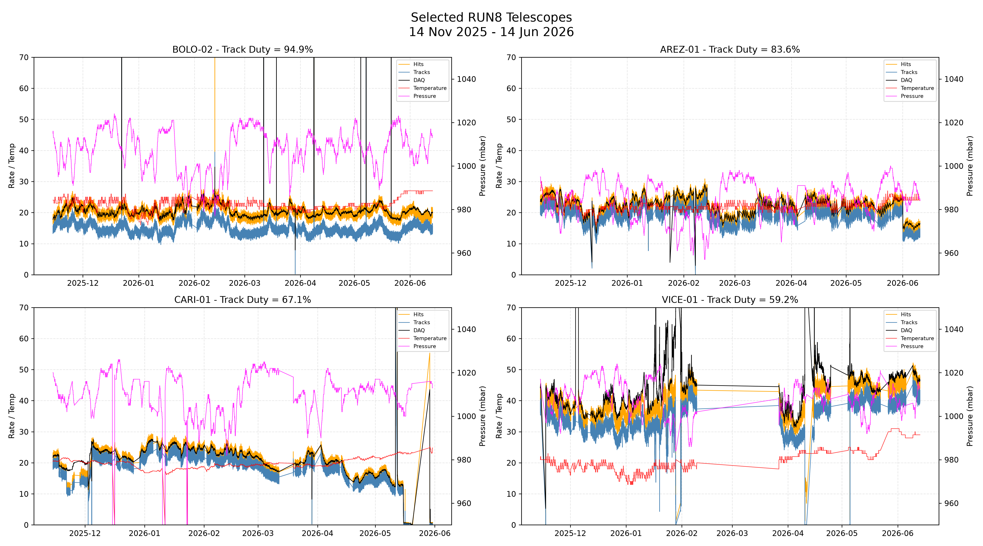
Some examples

Slide 26
Values (no need to show)
============================================================
SUMMARY
============================================================
ALTA-01 Hits = 59.90% (182874/305280 min) | Tracks = 59.25% (180866/305280 min) | DAQ = 63.36% (193429/305280 min)
AREZ-01 Hits = 83.58% (255151/305280 min) | Tracks = 83.58% (255150/305280 min) | DAQ = 86.27% (263354/305280 min)
BOLO-01 Hits = 74.23% (226619/305280 min) | Tracks = 73.18% (223394/305280 min) | DAQ = 81.02% (247349/305280 min)
BOLO-02 Hits = 94.90% (289702/305280 min) | Tracks = 94.90% (289700/305280 min) | DAQ = 97.83% (298643/305280 min)
BOLO-03 Hits = 61.81% (188701/305280 min) | Tracks = 61.60% (188064/305280 min) | DAQ = 64.41% (196640/305280 min)
BOLO-05 Hits = 68.51% (209155/305280 min) | Tracks = 68.51% (209148/305280 min) | DAQ = 71.32% (217716/305280 min)
CAGL-05 Hits = 5.37% (16392/305280 min) | Tracks = 4.71% (14379/305280 min) | DAQ = 6.02% (18364/305280 min)
CARI-01 Hits = 67.31% (205495/305280 min) | Tracks = 67.07% (204765/305280 min) | DAQ = 69.55% (212325/305280 min)
CATZ-01 Hits = 16.19% (49412/305280 min) | Tracks = 13.15% (40133/305280 min) | DAQ = 17.53% (53510/305280 min)
CERN-01 Hits = 52.56% (160466/305280 min) | Tracks = 52.56% (160465/305280 min) | DAQ = 55.06% (168093/305280 min)
COSE-01 Hits = 67.73% (206780/305280 min) | Tracks = 65.67% (200482/305280 min) | DAQ = 70.13% (214104/305280 min)
FERM-01 Hits = 57.00% (174018/305280 min) | Tracks = 57.00% (174018/305280 min) | DAQ = 58.96% (179986/305280 min)
FRAS-01 Hits = 30.00% (91597/305280 min) | Tracks = 21.34% (65157/305280 min) | DAQ = 47.11% (143812/305280 min)
LAQU-01 Hits = 56.41% (172215/305280 min) | Tracks = 56.27% (171788/305280 min) | DAQ = 59.00% (180102/305280 min)
LAQU-02 Hits = 0.28% (854/305280 min) | Tracks = 0.28% (854/305280 min) | DAQ = 1.20% (3670/305280 min)
LECC-01 Hits = 64.29% (196267/305280 min) | Tracks = 59.57% (181847/305280 min) | DAQ = 66.95% (204381/305280 min)
LNLE-01 Hits = 61.15% (186684/305280 min) | Tracks = 61.15% (186684/305280 min) | DAQ = 63.92% (195143/305280 min)
PARM-01 Hits = 29.40% (89767/305280 min) | Tracks = 28.58% (87242/305280 min) | DAQ = 35.78% (109233/305280 min)
PISA-01 Hits = 34.29% (104689/305280 min) | Tracks = 28.81% (87960/305280 min) | DAQ = 35.32% (107811/305280 min)
RECA-01 Hits = 56.15% (171427/305280 min) | Tracks = 53.20% (162416/305280 min) | DAQ = 62.33% (190281/305280 min)
REGG-01 Hits = 17.29% (52778/305280 min) | Tracks = 17.27% (52713/305280 min) | DAQ = 19.70% (60126/305280 min)
REND-01 Hits = 72.17% (220318/305280 min) | Tracks = 62.95% (192181/305280 min) | DAQ = 83.17% (253900/305280 min)
SALE-02 Hits = 62.25% (190024/305280 min) | Tracks = 61.79% (188634/305280 min) | DAQ = 65.43% (199759/305280 min)
SALE-03 Hits = 83.14% (253797/305280 min) | Tracks = 82.88% (253002/305280 min) | DAQ = 86.33% (263541/305280 min)
SIEN-01 Hits = 0.94% (2862/305280 min) | Tracks = 0.56% (1722/305280 min) | DAQ = 1.11% (3379/305280 min)
SIEN-02 Hits = 0.73% (2238/305280 min) | Tracks = 0.01% (44/305280 min) | DAQ = 1.90% (5791/305280 min)
TERA-01 Hits = 29.11% (88852/305280 min) | Tracks = 28.78% (87852/305280 min) | DAQ = 30.60% (93418/305280 min)
TRAP-01 Hits = 11.96% (36526/305280 min) | Tracks = 1.92% (5871/305280 min) | DAQ = 32.67% (99724/305280 min)
TREV-01 Hits = 13.52% (41270/305280 min) | Tracks = 13.52% (41270/305280 min) | DAQ = 14.08% (42969/305280 min)
TRIN-01 Hits = 22.61% (69036/305280 min) | Tracks = 0.79% (2413/305280 min) | DAQ = 27.12% (82800/305280 min)
VICE-01 Hits = 59.58% (181877/305280 min) | Tracks = 59.23% (180812/305280 min) | DAQ = 62.45% (190638/305280 min)
VICE-02 Hits = 72.39% (220992/305280 min) | Tracks = 72.39% (220992/305280 min) | DAQ = 75.68% (231032/305280 min)

Slide 27
RUN 9

Slide 28
New coordinated RUN
In September resume operations on the telescopes and fix small issues
Plan an efficiency measurement on the telescope running smoothly since some time!
New RUN start date → How about November 19th, in parallel with the 2026 in presence meeting?
We need to:
start operations in other telescopes by the end of the school year
complete installations by the end of the school year (2)

Slide 29
Status of Hardware

Slide 30
Please note that:
Some telescopes have been or will be uninstalled, and therefore there is a possibility of spare material
Inventory done -> keep it constantly updated to optimize the use of available materials
We kindly ask you to dedicate some time to respond to any requests regarding the materials available at the various sites
To optimize the delivery process, we will consolidate the shipments: ask in advance in case you know you need material for a telescope.

Slide 31
Status
in red: to do/critical situations
LV/HV voltage System
HV Boxes
At Centro Fermi:
  5 OK (3N,2P), ~ OK 15, KO 8 NB: 9 OK
  6P + 6N TO BE CHECKED (from dismounted or upgraded telescopes)
  Maybe also in other sites? -> Please send the information!
- Custom power supplies (Lecce) no longer available; some have been repaired (A. Corvaglia)
Some other (2 at least) PS to be repaired -> group and send to Lecce
EEE HV kit from CAEN: 1 (to be used at FRAS-02 for tests and then available)
Some LV power supply (3) available from dismounted telescopes (to be checked)
Gas System
Gas (estimated duration 13 months both)
  6/25 r1234ze + 11/25 He still on 2025 order
  27 r1234ze + 27 He 2025 on the new order (ready in a few days)
  NB: Price still stable (~1500 € for r1234ze, 300 € foe He); the new order foresees the dismounting and mounting of the bottles (“a regola d’arte”…)
  - Gas Systems 4 (3 complete 1 incomplete + 1 cabinet)
- Pressure Reducers for He : 3 in Bologna, 3 in Pisa, 3 in Genova
  - Mixer (3 available + inventory of broken in other sites TO BE DONE
  Working on a contract for gas cabinet maintenance!

Slide 32
Status
in red: to do/critical situations
  Front-End/TRIGGER/Readout Electronics
Electronics at Centro Fermi:
  ~4 Bridge,
  ~4 TDC 128 Ch,
  ~4 TDC 64 Ch
  4 mini-crate
Inventory of broken in other sites TO BE DONE
Bari-Lecce Trigger Board : 3 remaining
CERN/Catania & Bologna trigger cards available from dismounted or upgraded telescopes Inventory TO BE DONE
New FEA: ~100 on 160 at CREF (90 ok 10 no) ->Critical
Cables for new FEA: ~150 connectors available– some Cables have been produced -> we need more.
Old FEAs : some available from dismounted or upgraded telescopes but inventory to
MRPCs
no new chambers available but
  some old chambers from dismounted telescopes: CERN-02, FRAS-03, TORI-01/02
  It will be useful to have a place to store & test them…

Slide 33
Conclusions
The number of telescopes where we restarted the activities increased in the last year. We have a certain number of sites where we have at least the new gases: some work to do to bring them up, but we are on the good path.
Gas available and at the same cost!
We have most of the necessary hardware and with an optimization of resources and purchase of some elements it is possible to cover the possible needs of 2026/27.
The situation of manpower is still critical.

