Slide 1


Francesco Sylos Labini
Galaxy kinematic and dynamics
Kinematics and dynamics of the Milky Way (Gaia data)
Kinematics and dynamics of external data (HI data)
Self gravitating systems (Nbody simulations)
Large scale structure of Universe (DESI, Euclid)
Cosmological density fields (Large cosmological simulations)

Slide 2


Francesco Sylos Labini

Slide 3
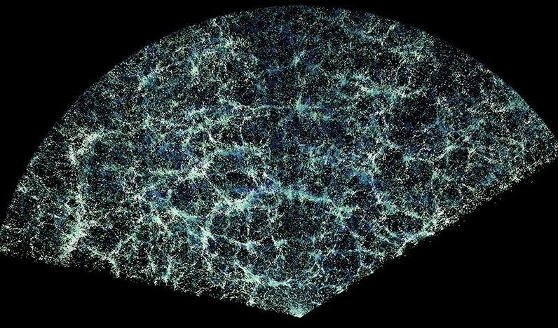
Large scale inhomogeneities and anisotropies with DESI DR1 Francesco Sylos Labini
DESI DR1

Slide 4
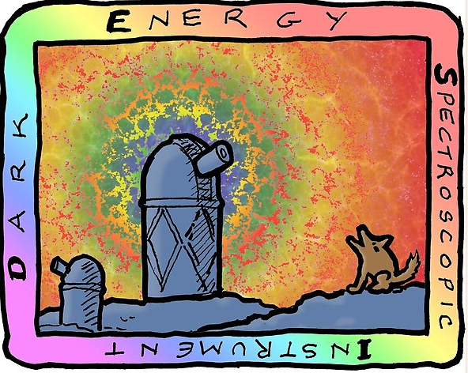
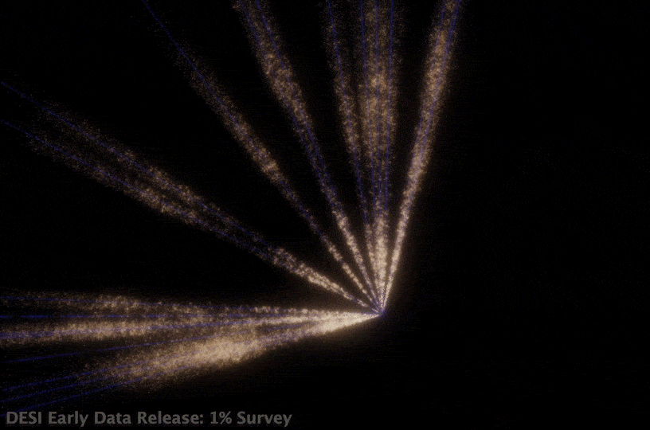
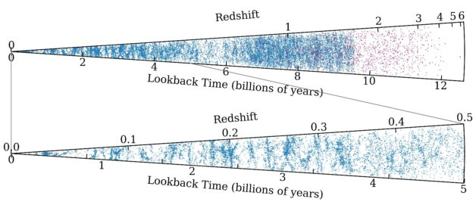
DESI EDR

Slide 5
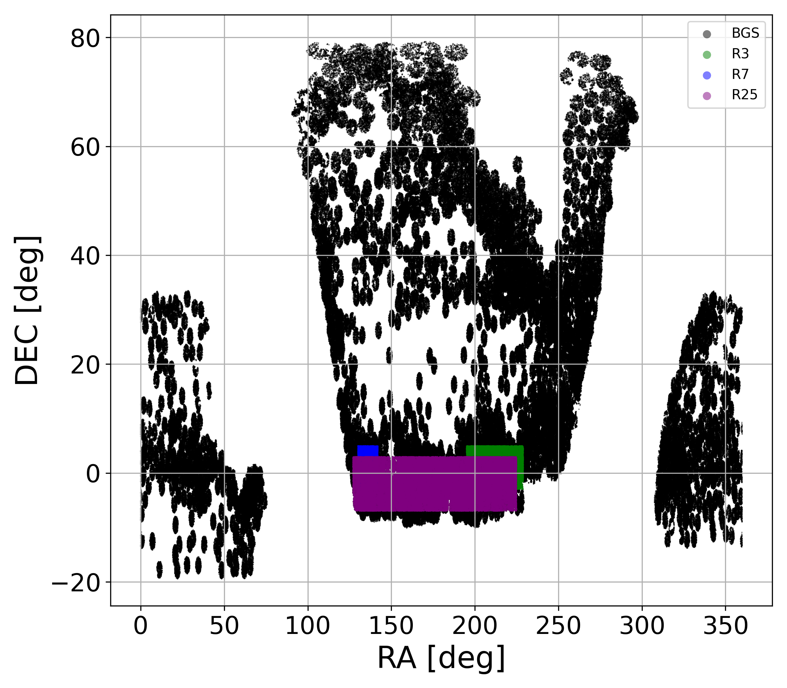
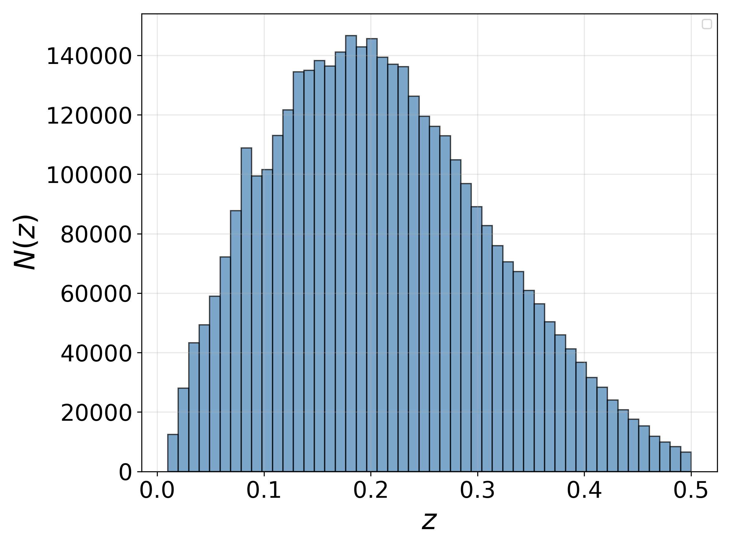
DESI DR1

Slide 6
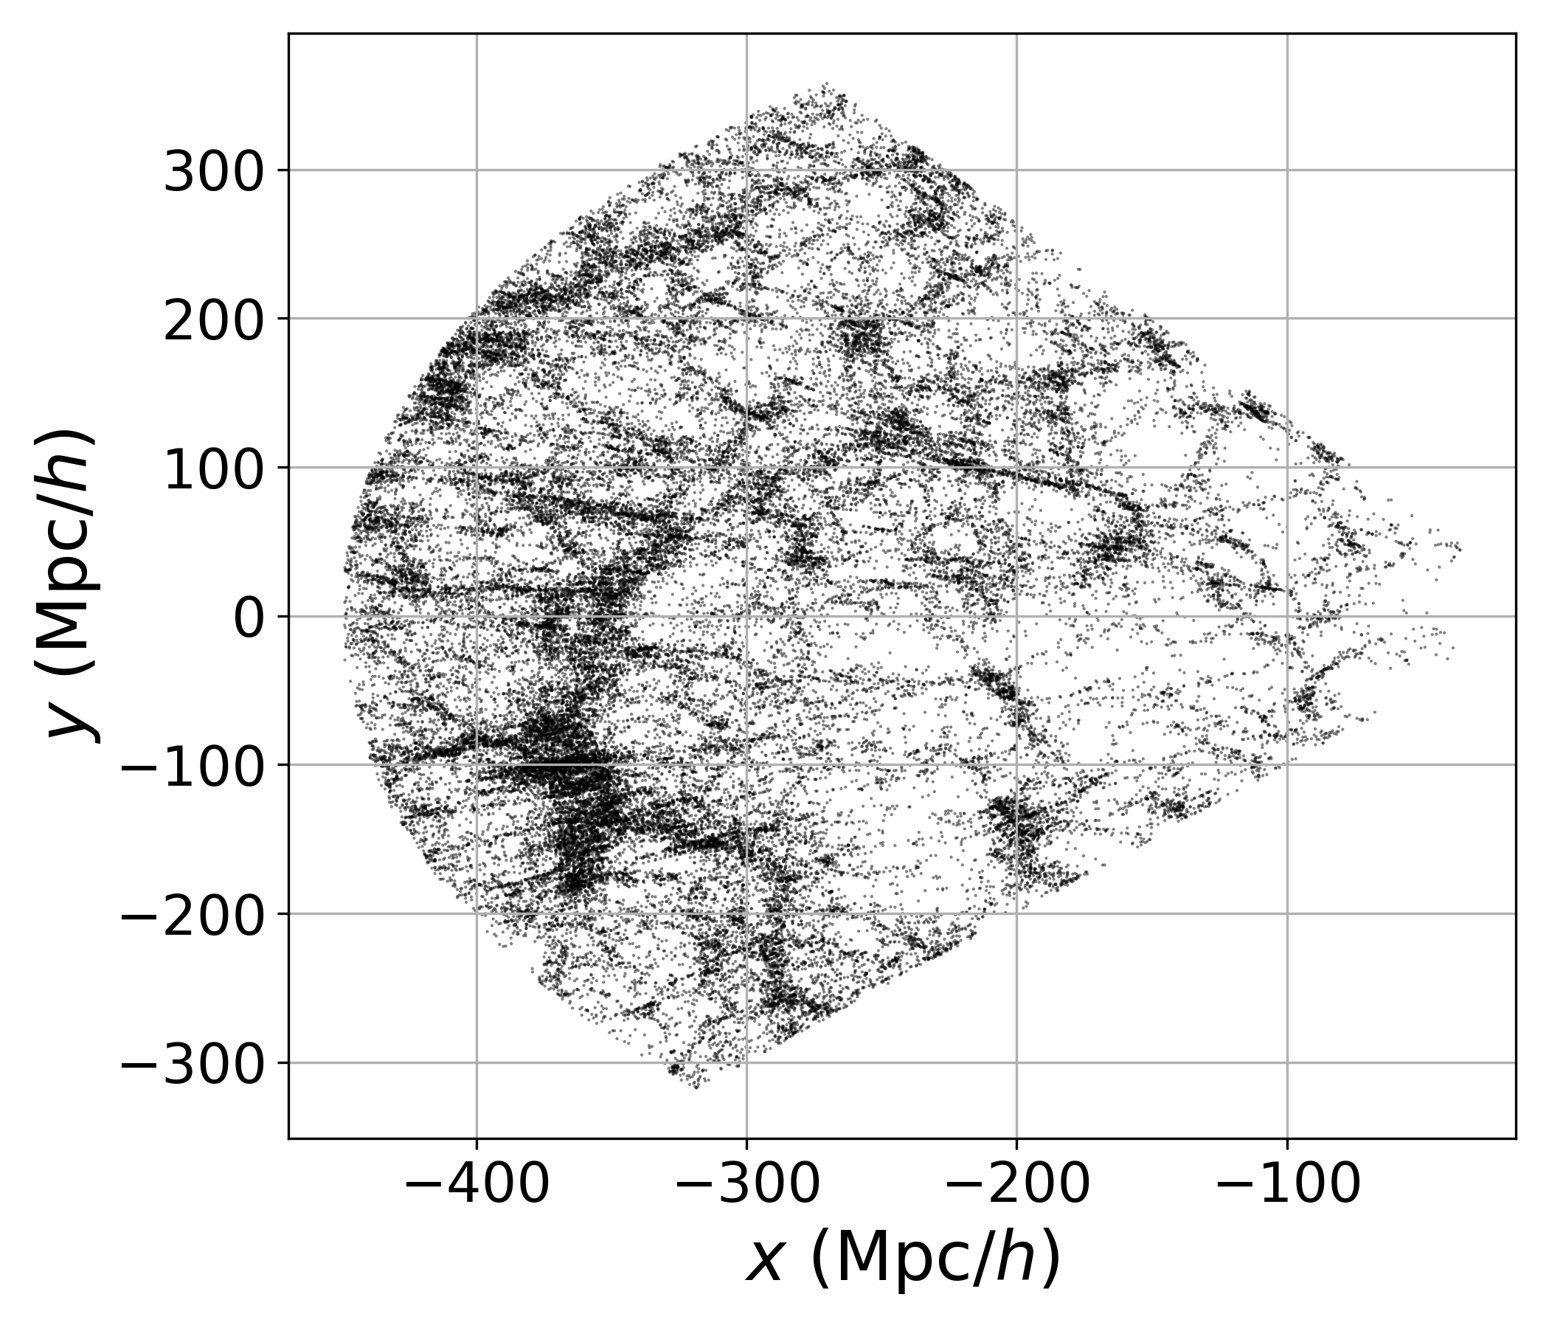
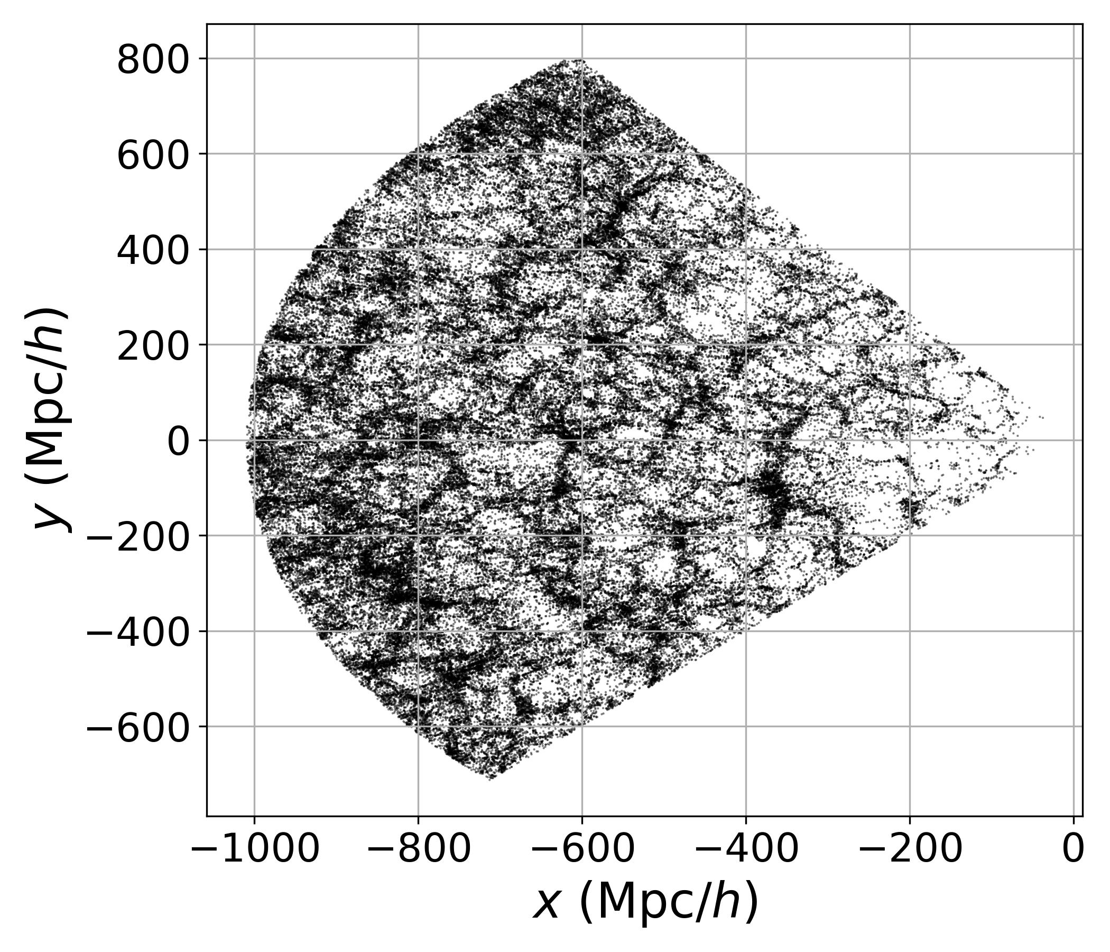
DESI DR1

Slide 7
DESI DR1

Slide 8
Long story ….
de Vaucouleurs 1970; Mandelbrot 1982; Pietronero 1987; Coleman Pietronero 1992; Davis 1997; Pietronero et al. 1997; Sylos Labini et al. 1998; Wu et al. 1999; Joyce et al. 2005; Hogg et al. 2005; Sylos Labini et al. 2007; Sarkar et al. 2009; Sylos Labini 2011; Scrimgeour et al. 2012; Pandey 2013; Alonso et al. 2014; Whitbourn & Shanks 2014; Sylos Labini et al. 2014; Conde Saavedra et al. 2015; Alonso et al. 2015; Sarkar & Pandey 2016; Pandey & Sarkar 2015; Shirokov et al. 2016; Laurent et al. 2016; Park et al. 2017; Ntelis et al. 2017; Gonçalves et al. 2018a,b,c; Heinesen 2020; Teles et al. 2021; De Marzo et al 2021; Kim et al. 2022; Andrade et al. 2022; Dias et al. 2023; Valade et al. 2024; Pashapour-Ahmadabadi et al. 2025; Einasto 2025a,b……

Slide 9


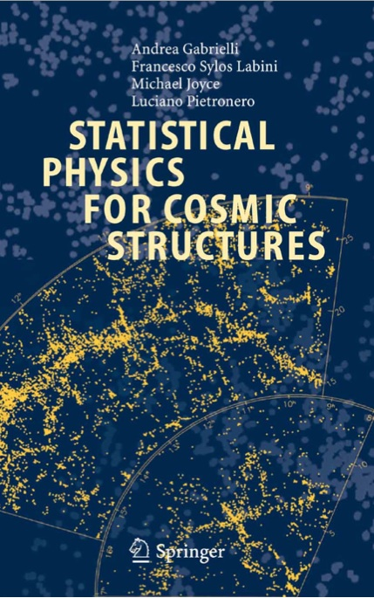
<2010

Slide 10

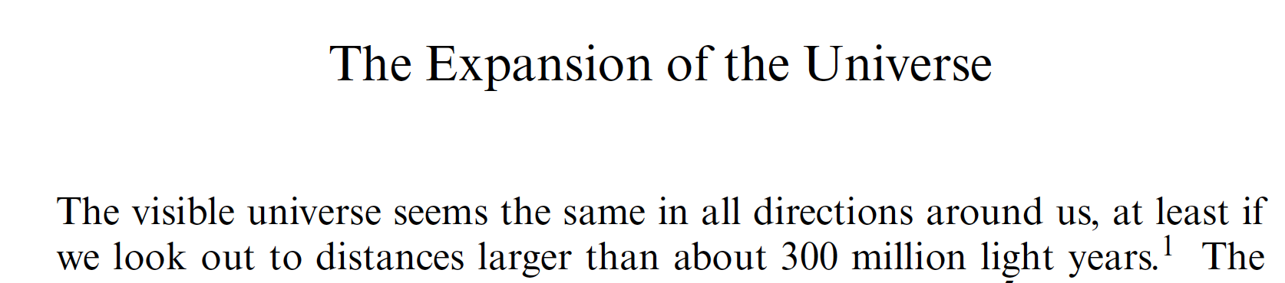
Long and important …
(2008)

Slide 11
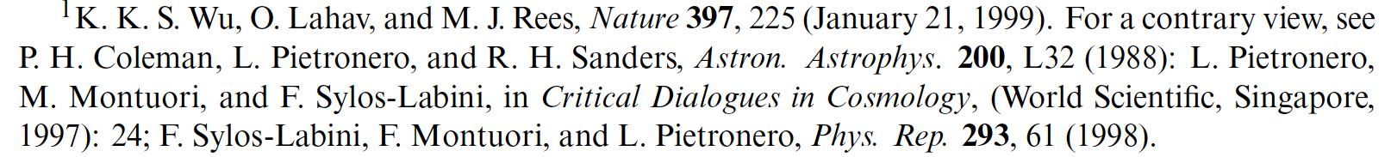
Long and important …
(2008)

Slide 12
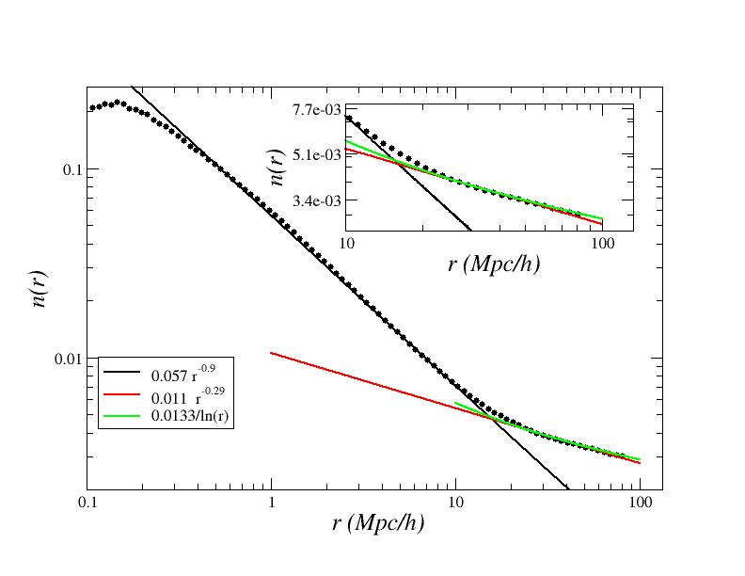
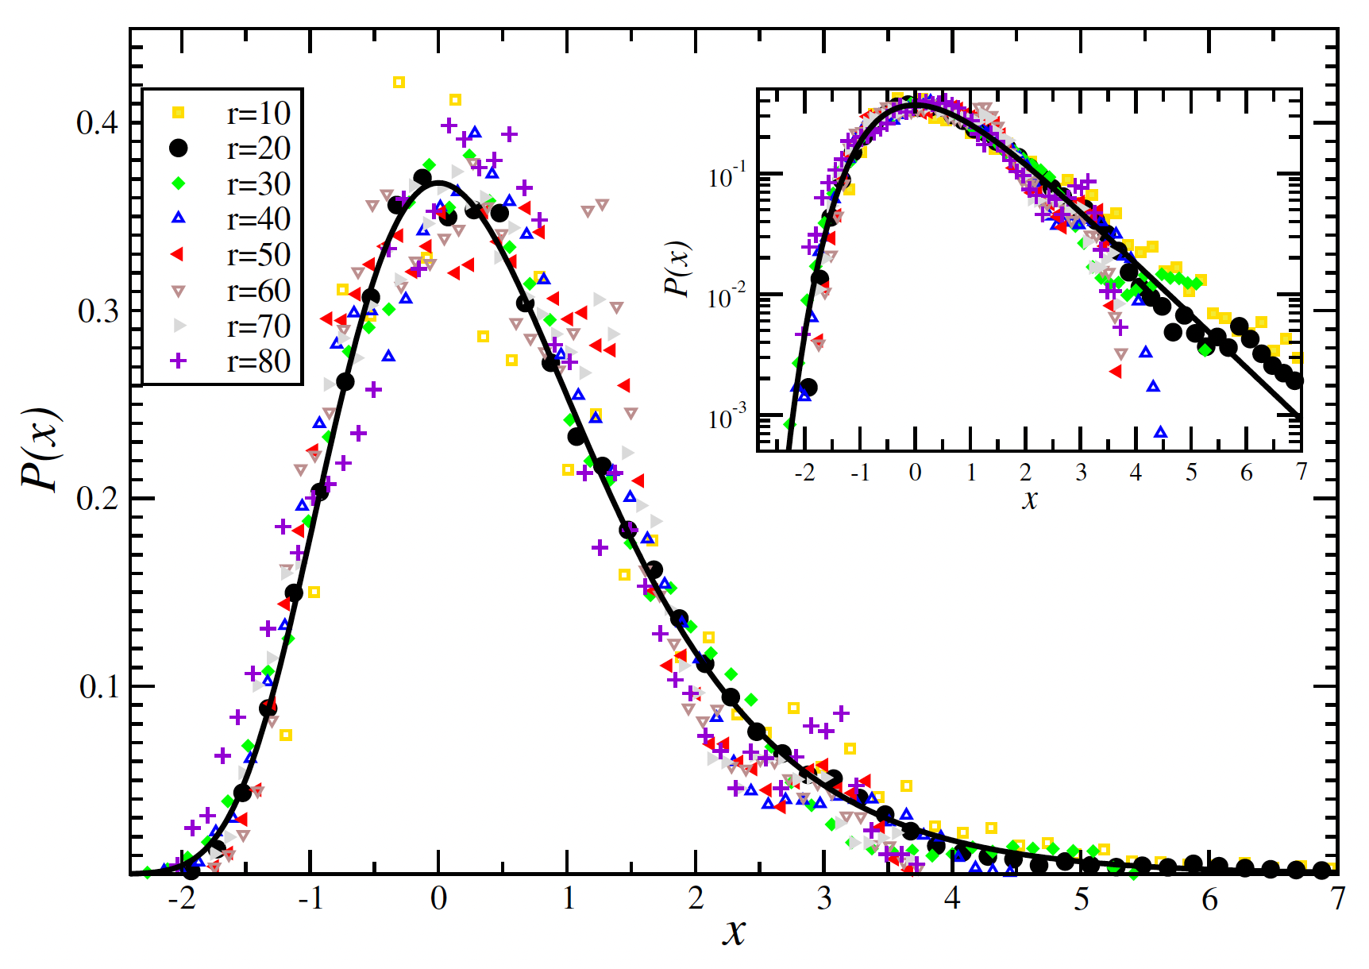
SDSS 2009-2011
Antal, T. ; Sylos Labini, F. ; Vasilyev, N. L. ; Baryshev, Y. V. Europhysics Letters, 88, 59001 (2009)
Sylos Labini, F., Classical and Quantum Gravity, 28, 164003 (2011)

Slide 13
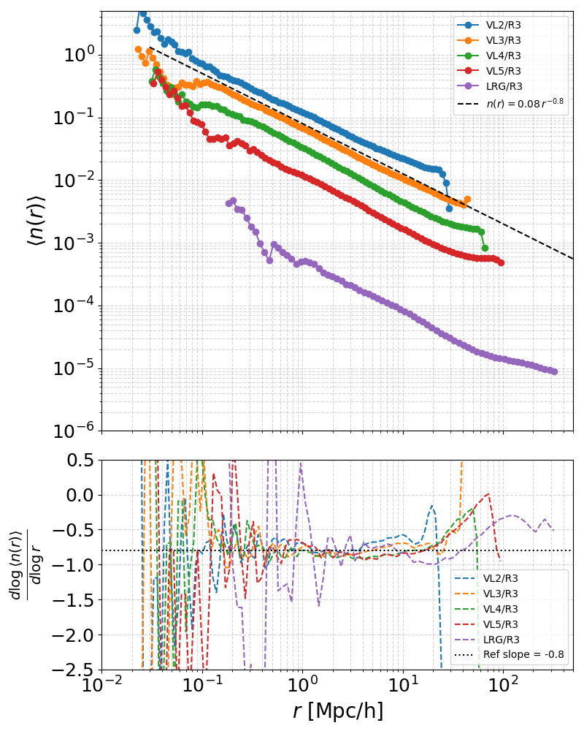
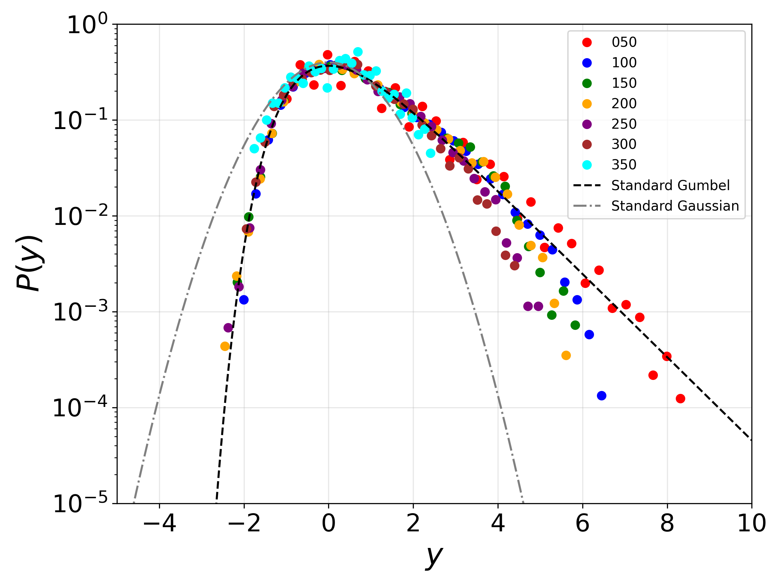
DESI DR1
Sylos Labini, F ; Antal, T Astron.Astrophys., 2026, in the press

Slide 14
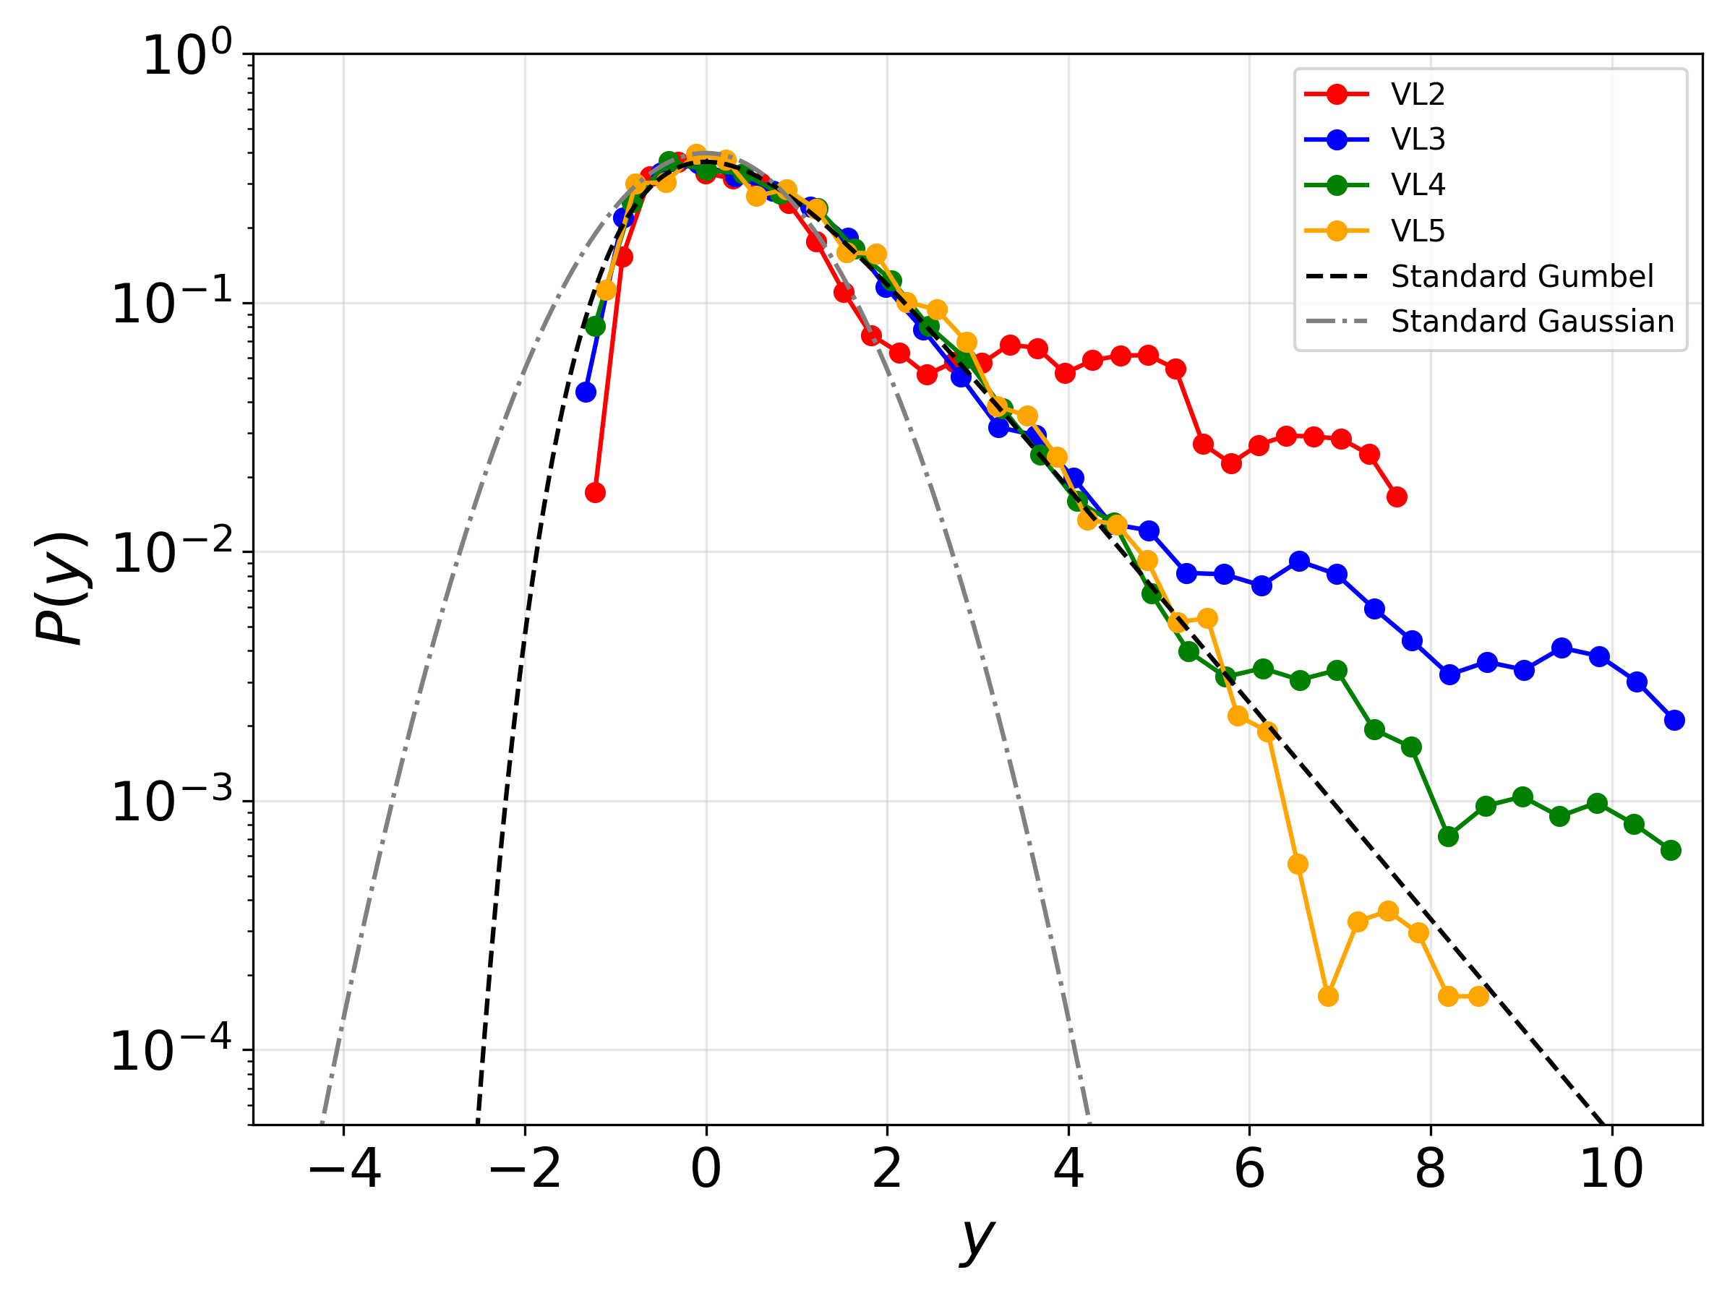
DESI DR1
Sylos Labini, Francesco ; Antal, Tibor Astron.Astrophys., 2026, in the press

Slide 15
DESI DR1
Sylos Labini, Physical Review D, 113, 2, id.023510, 22 pp., 2026

Slide 16
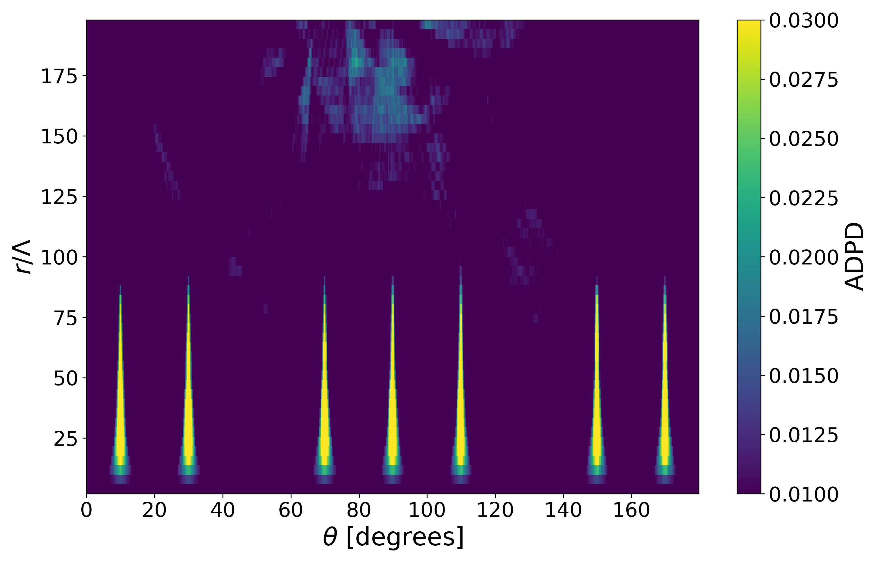
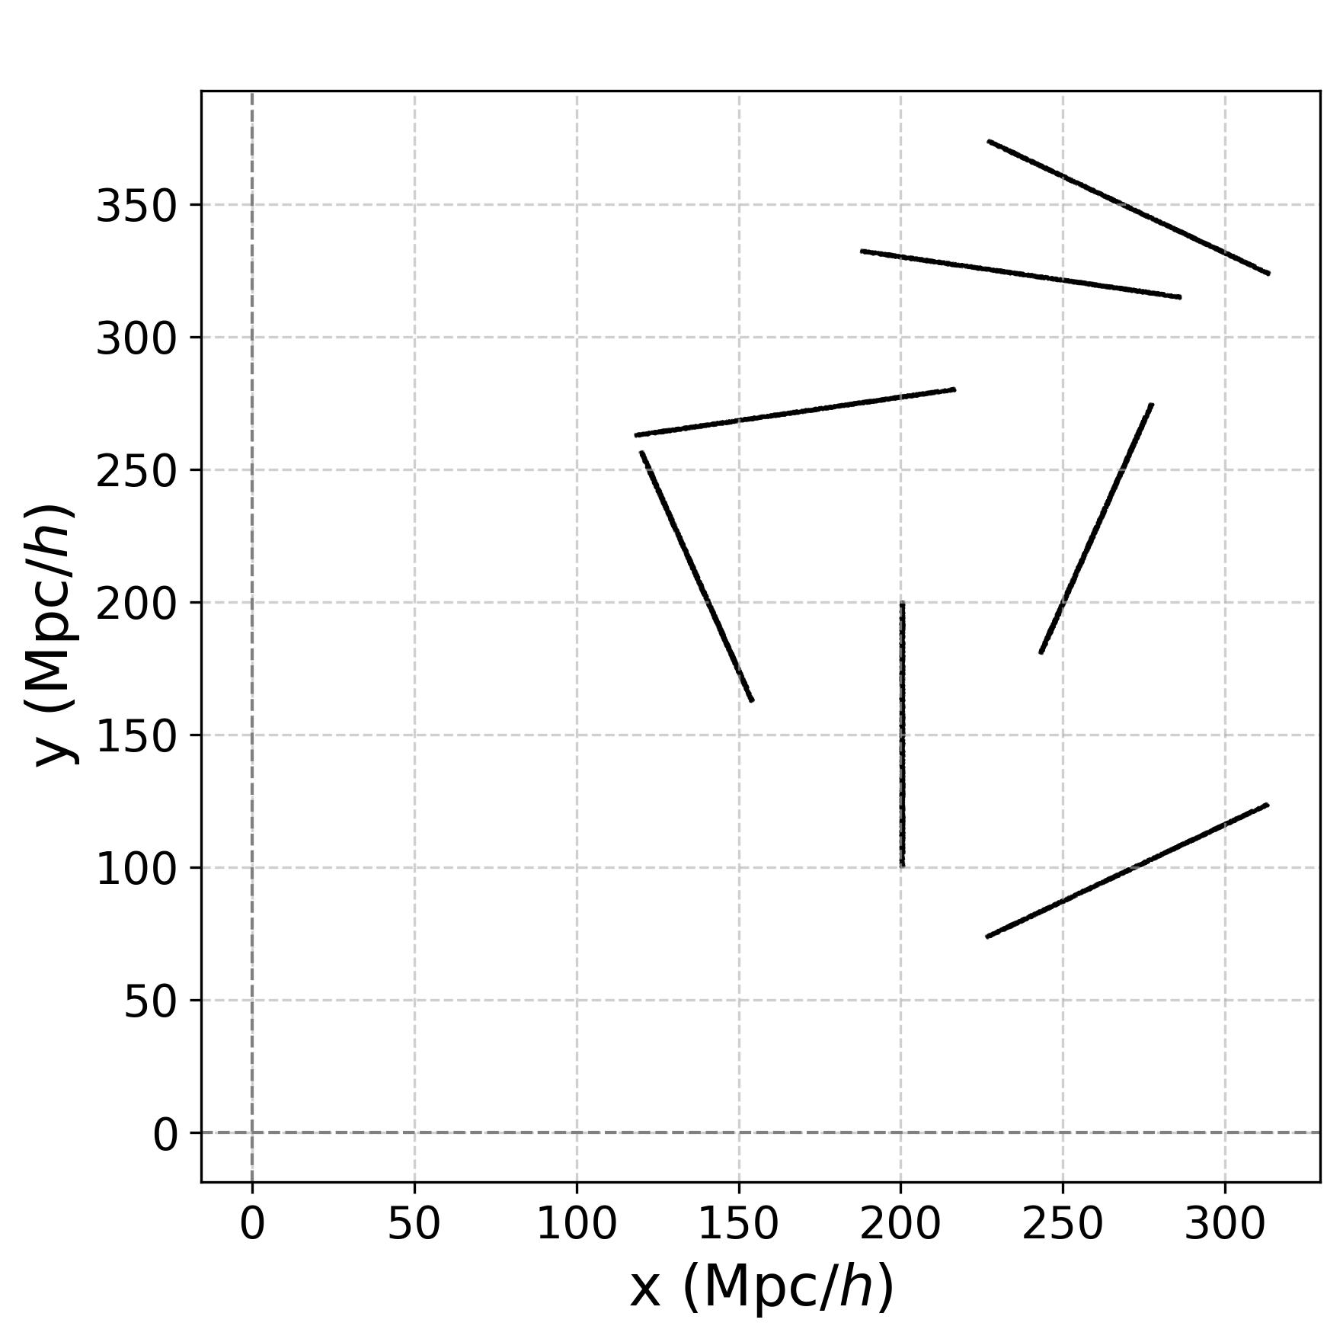
DESI DR1
Sylos Labini, Physical Review D, 113, 2, id.023510, 22 pp., 2026

Slide 17
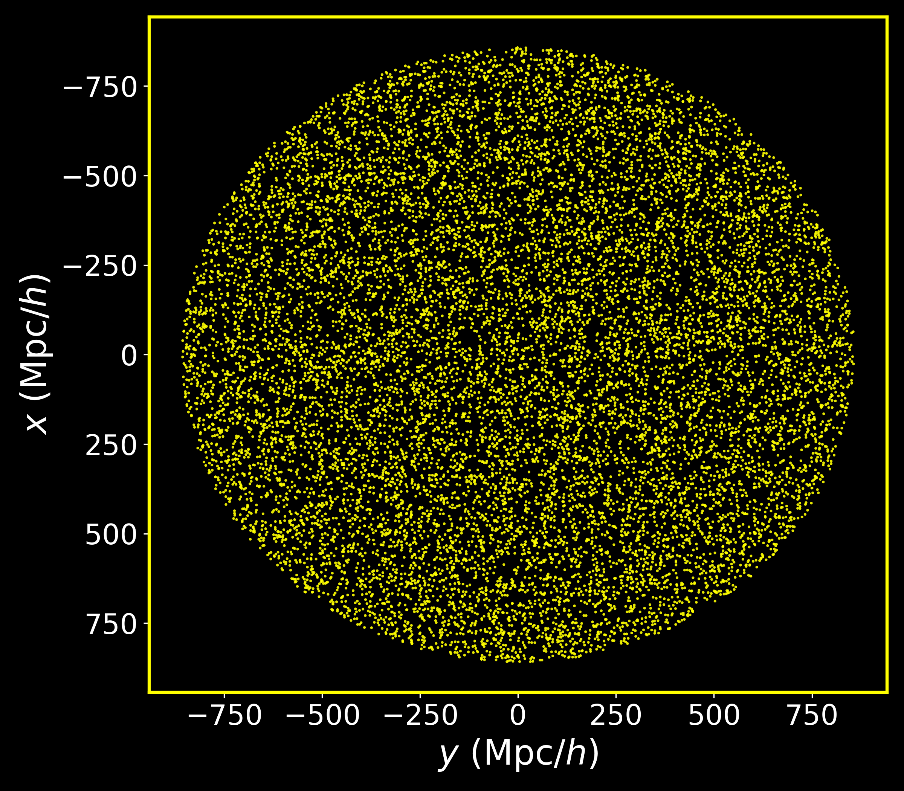
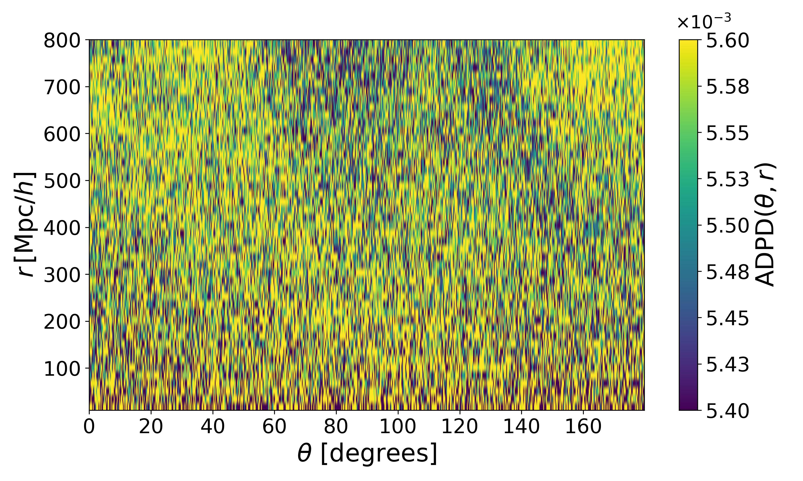
DESI DR1
Sylos Labini, F ; Galoppo M, 2026, submitted

Slide 18
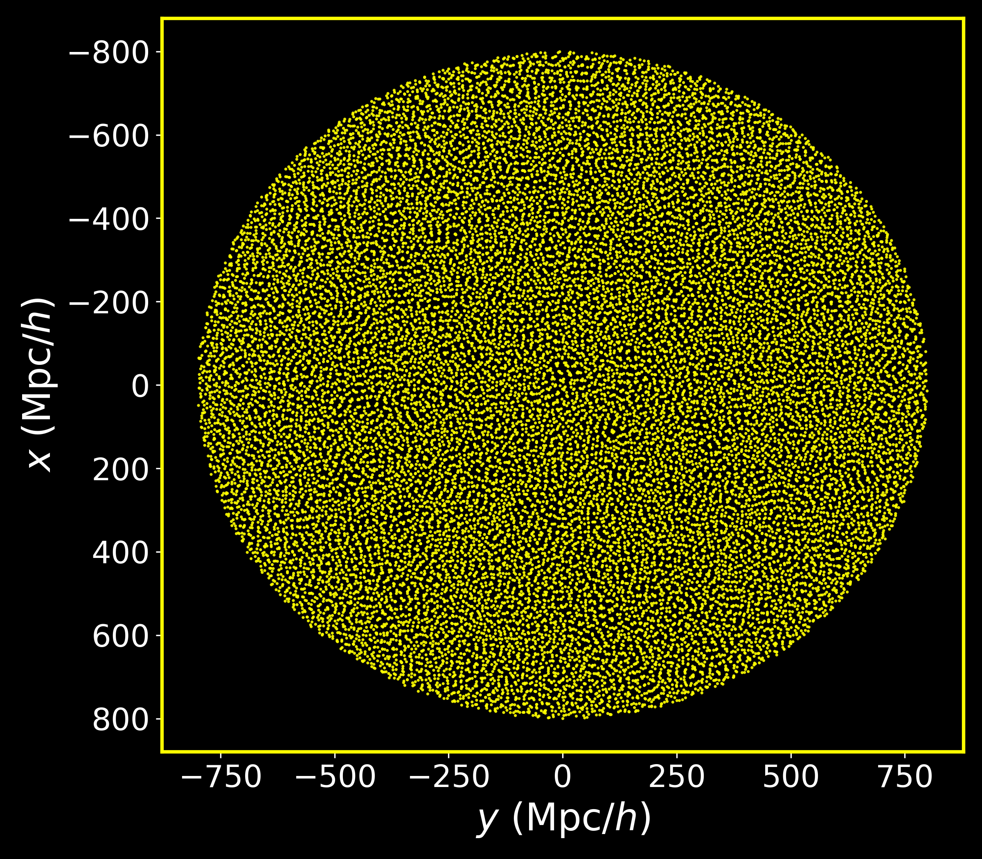
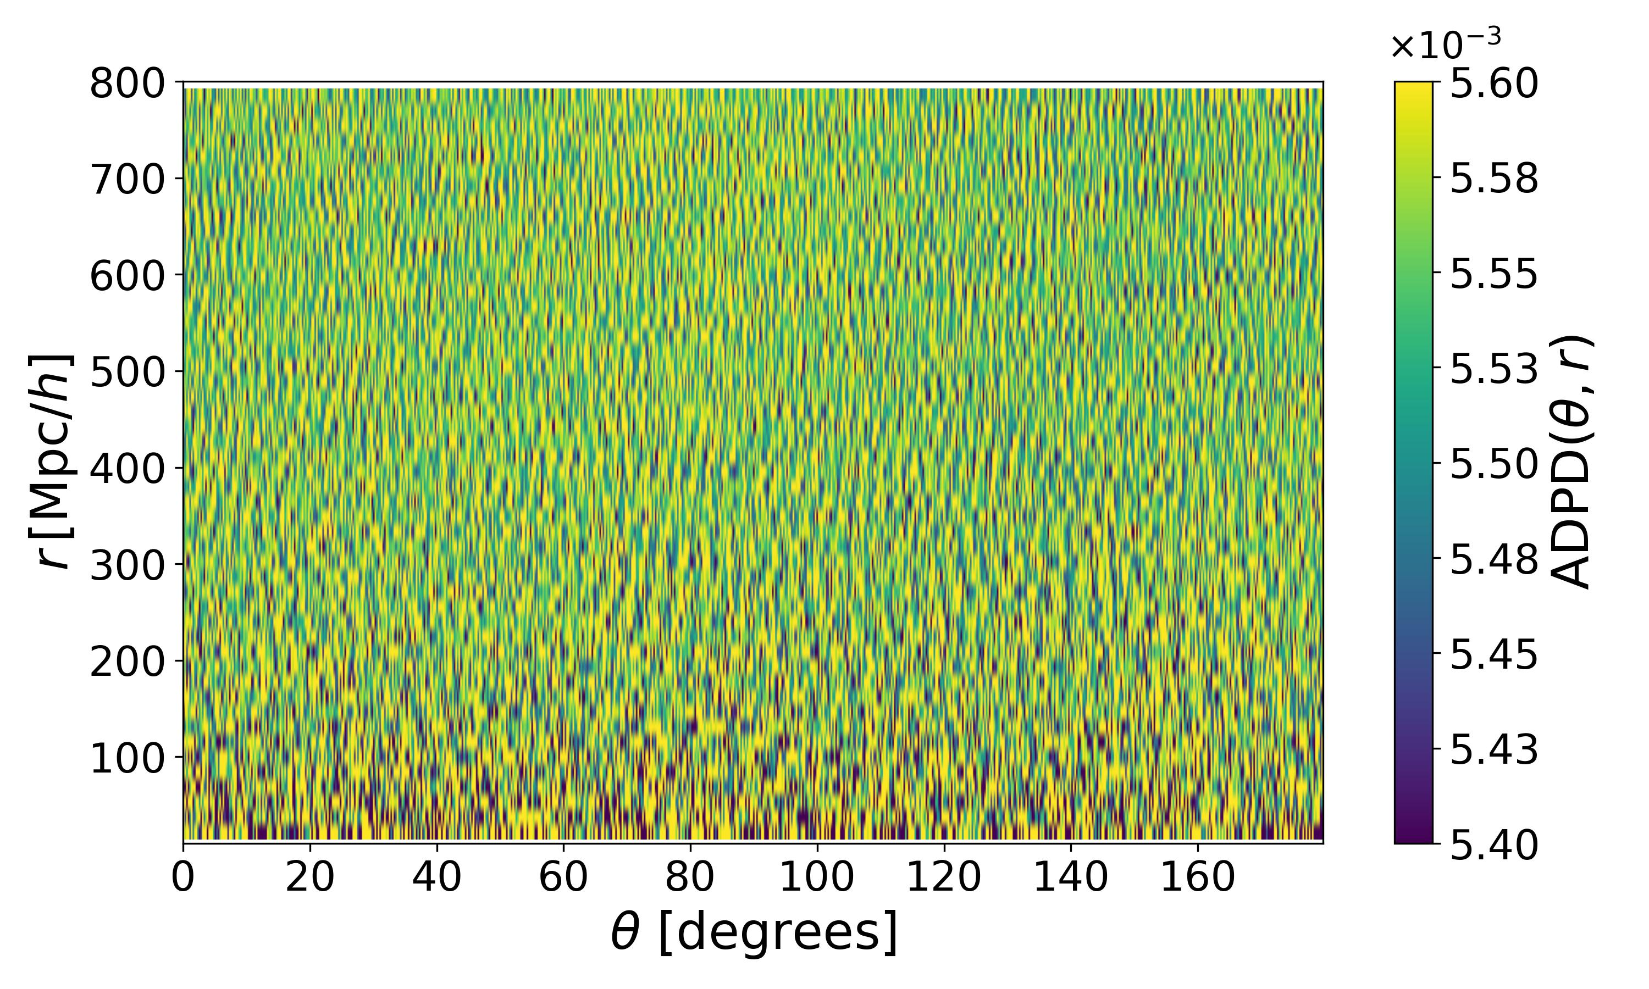
DESI DR1
Sylos Labini, F ; Galoppo M, 2026, submitted

Slide 19
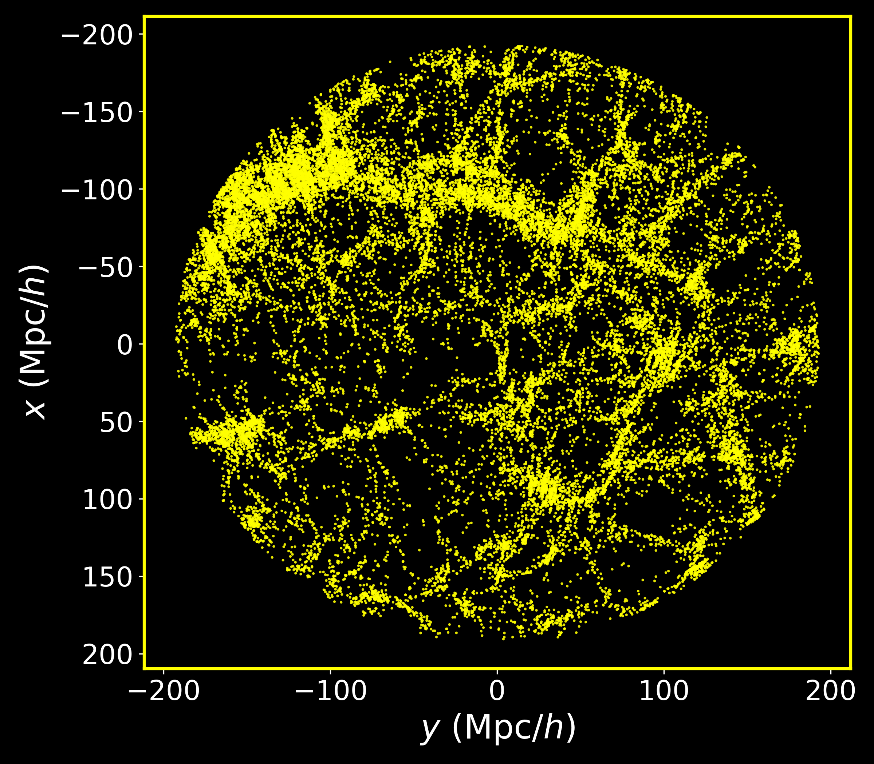
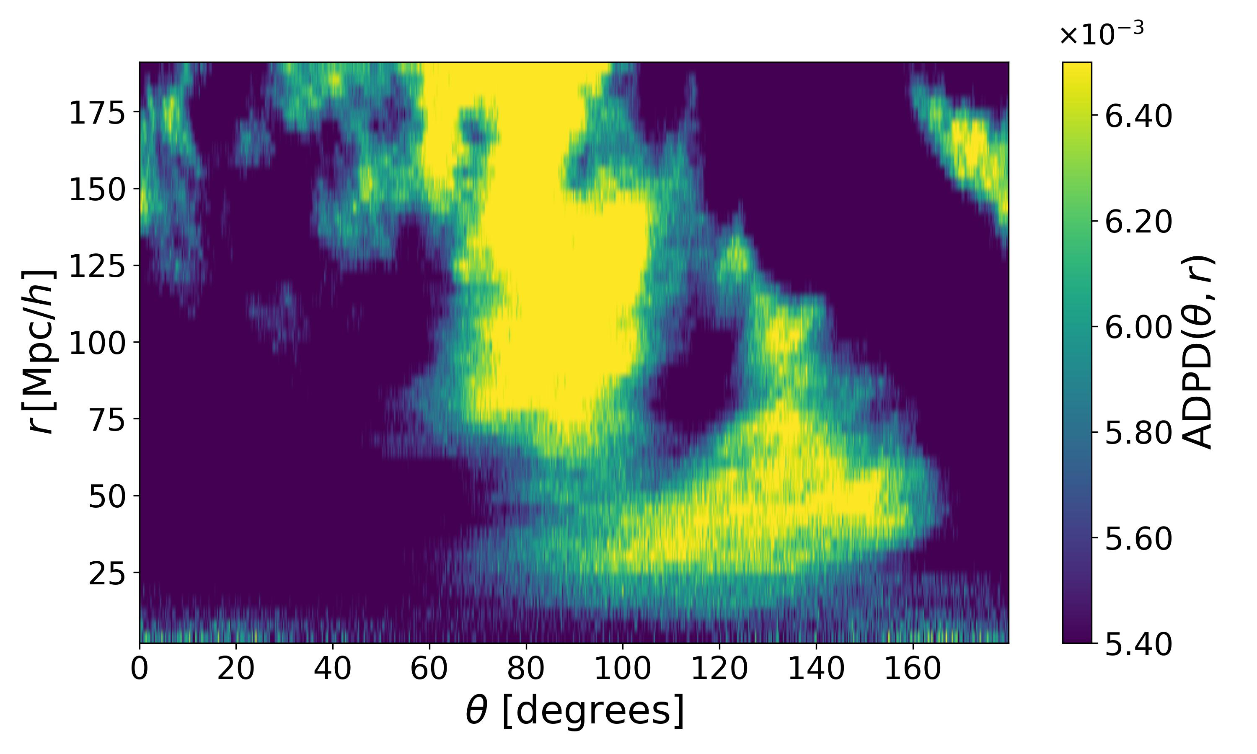
DESI DR1
Sylos Labini, F ; Galoppo M, 2026, submitted

Slide 20
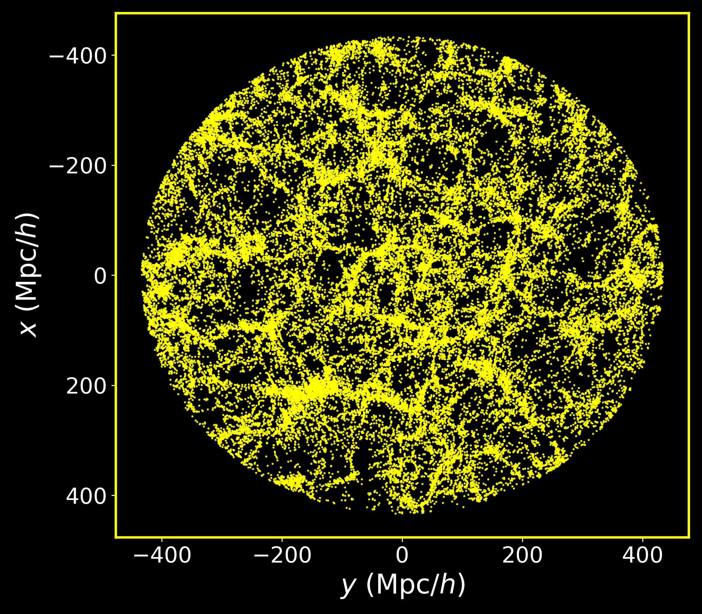
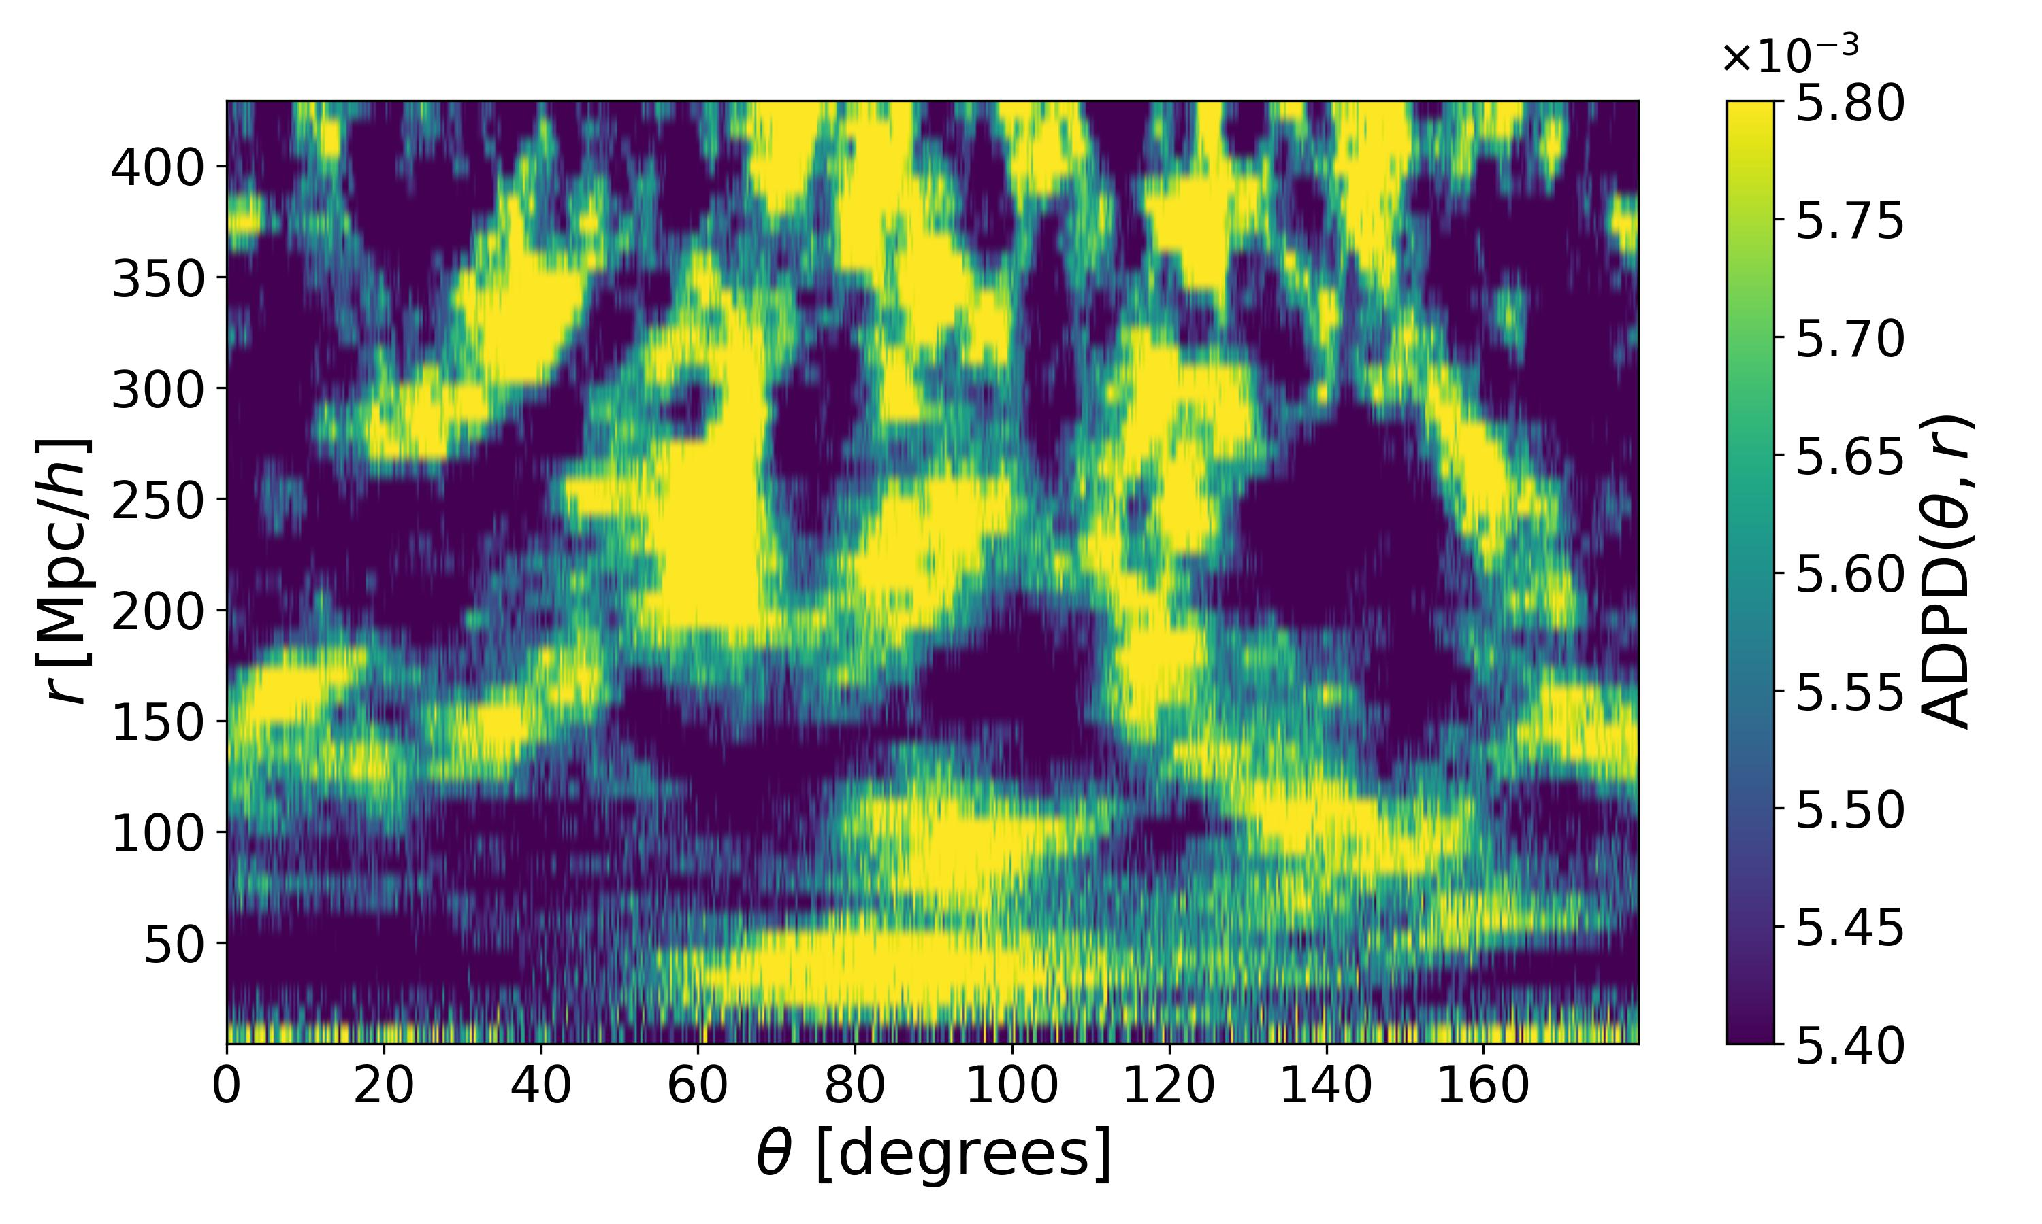
DESI DR1
Sylos Labini, F ; Galoppo M, 2026, submitted

Slide 21
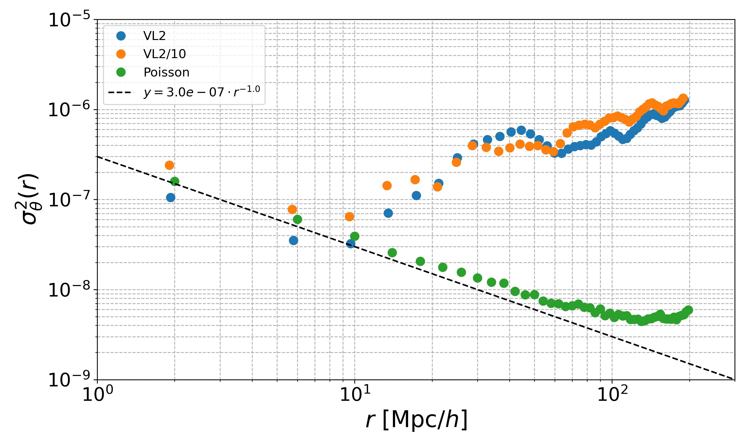
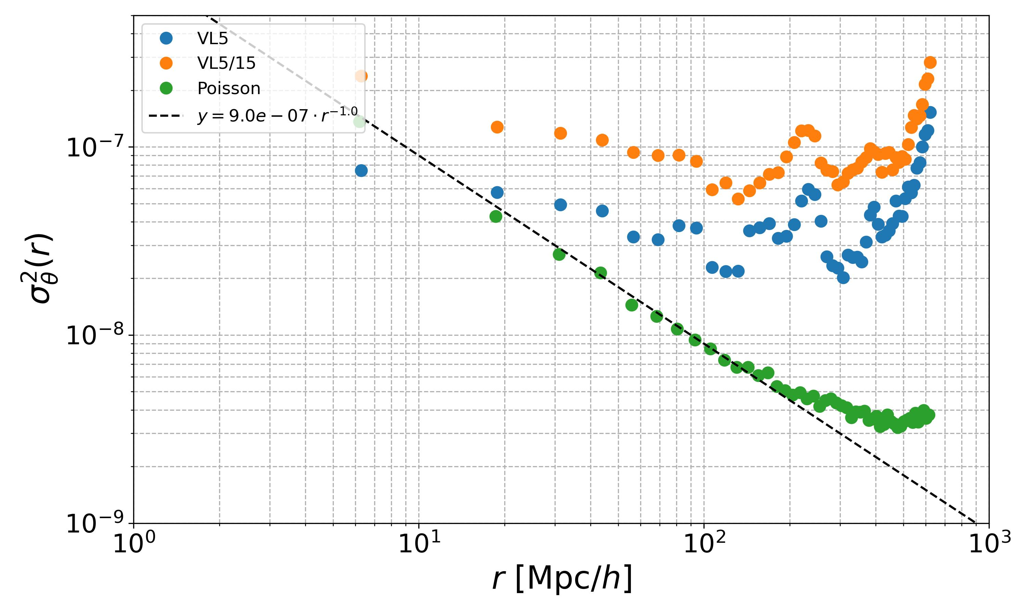
DESI DR1
Sylos Labini, F ; Galoppo M, Nature 2026, submitted

Slide 22
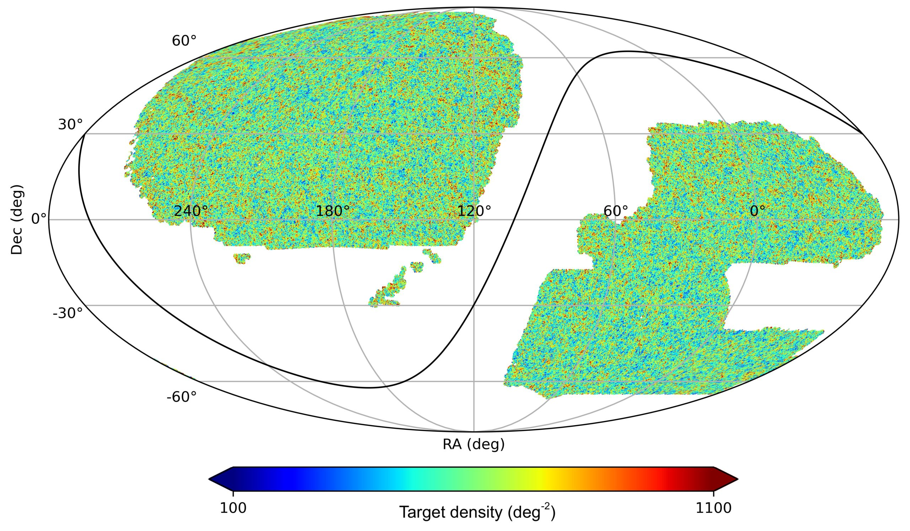
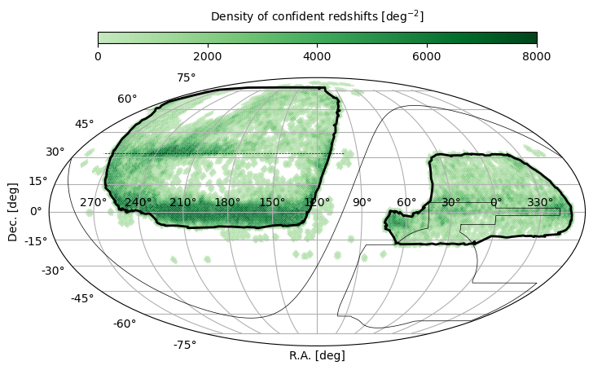
From DESI DR1 to DESI DR2

Slide 23
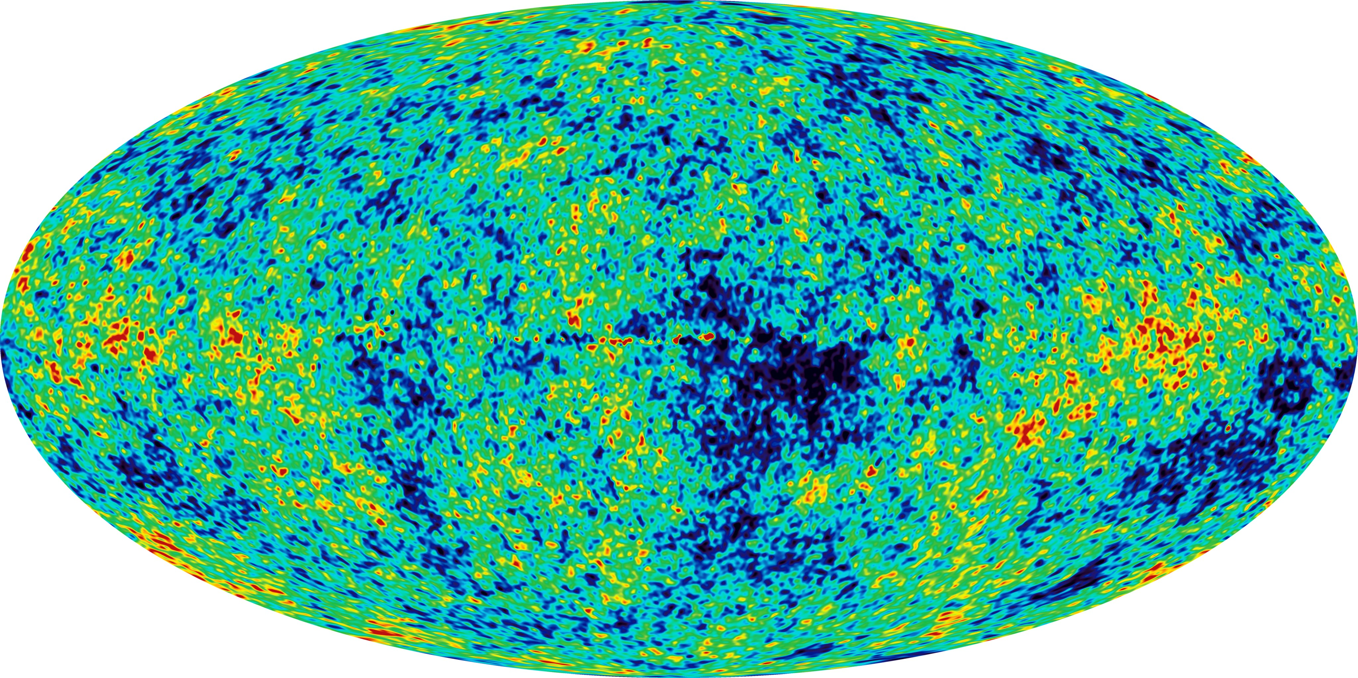
From DESI DR1 to theory …….
?

Slide 24
DESI DR1 and …..
Sylos Labini, F., Hidden role of anisotropies in shaping structure formation in cosmological N-body simulations, Physical Review D, Volume 113, Issue 2, id.023510, 22 pp., 2026
Sylos Labini, F., Antal, T. Large-Scale Galaxy Correlations from the DESI First Data Release, Astron.Astrophys., 2026, in the press
Sylos Labini, F., Galoppo M., Morphology at Fixed Power Spectrum: Zel’dovich Versus Non–ZA Constructions of Correlated Initial Conditions, Physical Review D, 2026, submitted
Sylos Labini, F., Galoppo M., Anisotropic Structures on Gpc Scales in DESI DR1: Implications for Cosmology, Nature 2026, submitted

Slide 25
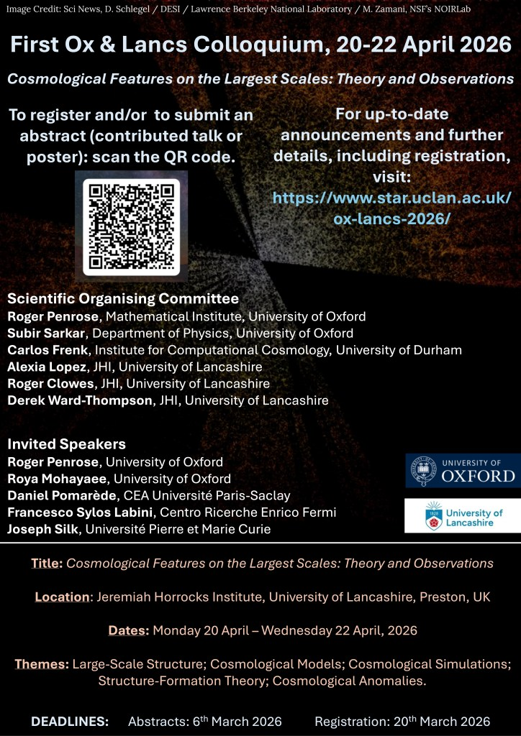

Slide 26
Galaxy kinematic and dynamics
Kinematics and dynamics of the Milky Way
Roberto Capuzzo Dolcetta (Roma 1), Martin Lopez Corredoira (IAC, Spain)
Kinematics and dynamics of external data
Giordano de Marzo (Cref), Matteo Straccamore (Cref, Sony) Sebastian Còmoron (IAC Spain)
Self gravitating systems
Michael Joyce (Paris), Capuzzo Dolcetta (Roma), Marco Galoppo (Christchurch, NZ)
Large scale structure of Universe
Tibor Antal (Edinburg), M. Galoppo (Christchurch, NZ)
Cosmological density fields Michael Joyce (Paris), M. Galoppo (Christchurch, NZ)

