Slide 1
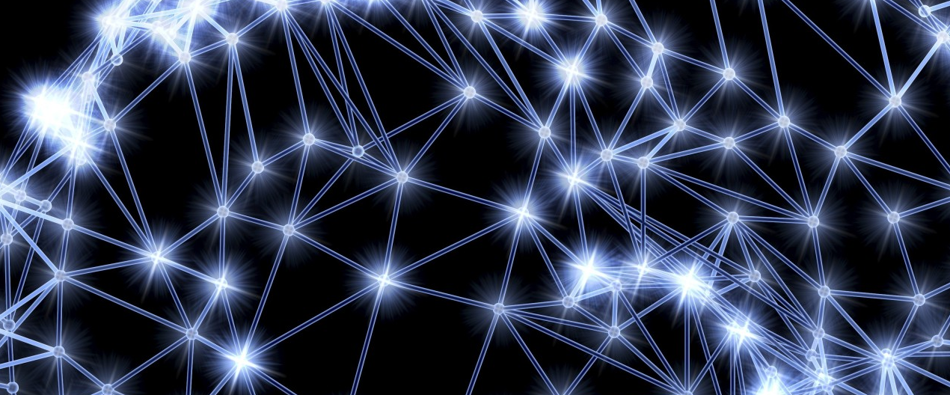




Photonic Technology & Artificial Intelligence
Dr. Romolo Savo
Computational Photonics Lab
Centro Ricerche Enrico Fermi (CREF)
Rome, IT
romolo.savo@cref.it

Slide 2

Photonic computing
Data processing by using light
www.techopedia.com
Notes:
This is an artistic representation of a photonic processor that I grabbed from the internet, it crearly shows how the common idea about photonic computing is to realize micro system that imitate the architectures of electronic processors, but have light propagating into the wires instead of electrons.
I want to show you that this is only a part of the story.
In particular here we are interested in developing strategies to efficiently process the massive amount of data required by artificial intelligence, in particular visual data, in this case photonic computing architecture may look like more like this, which is one of the experiments we have in the lab downstairs.
I will show you that there is an advantage in using free-space optical architectures, where light propagation is controlled by standard lenses or by interaction with engineered media. This advantage resides in the possibility to control millions of optical modes simultaneously and process the information the by using optical interference in free space.

Slide 3
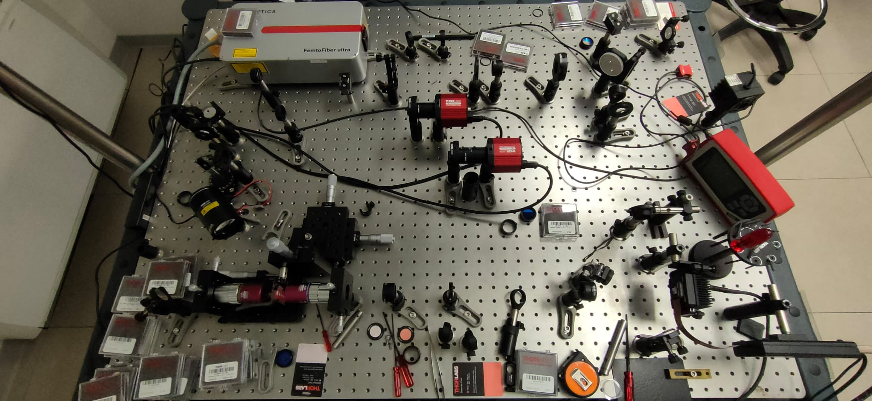
Photonic computing
Data processing by using light
@CREF
Notes:
This is an artistic representation of a photonic processor that I grabbed from the internet, it crearly shows how the common idea about photonic computing is to realize micro system that imitate the architectures of electronic processors, but have light propagating into the wires instead of electrons.
I want to show you that this is only a part of the story.
In particular here we are interested in developing strategies to efficiently process the massive amount of data required by artificial intelligence, in particular visual data, in this case photonic computing architecture may look like more like this, which is one of the experiments we have in the lab downstairs.
I will show you that there is an advantage in using free-space optical architectures, where light propagation is controlled by standard lenses or by interaction with engineered media. This advantage resides in the possibility to control millions of optical modes simultaneously and process the information the by using optical interference in free space.

Slide 4
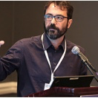
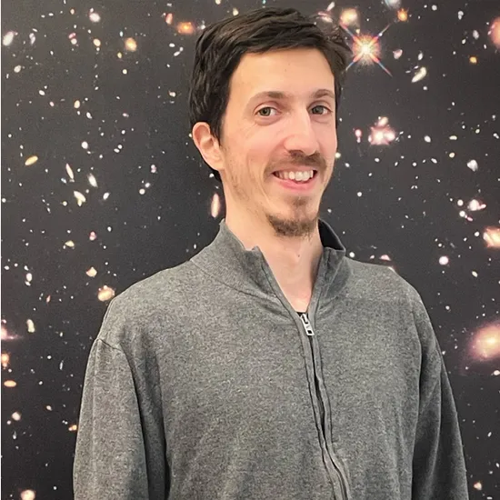
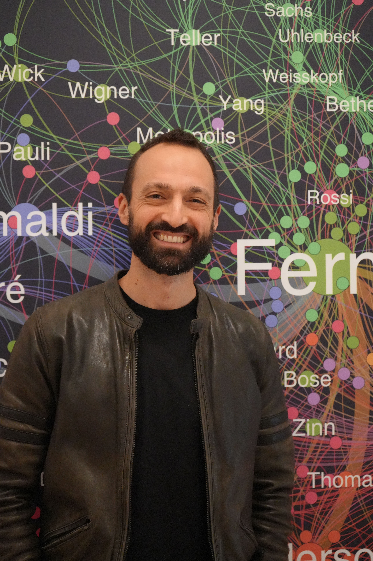
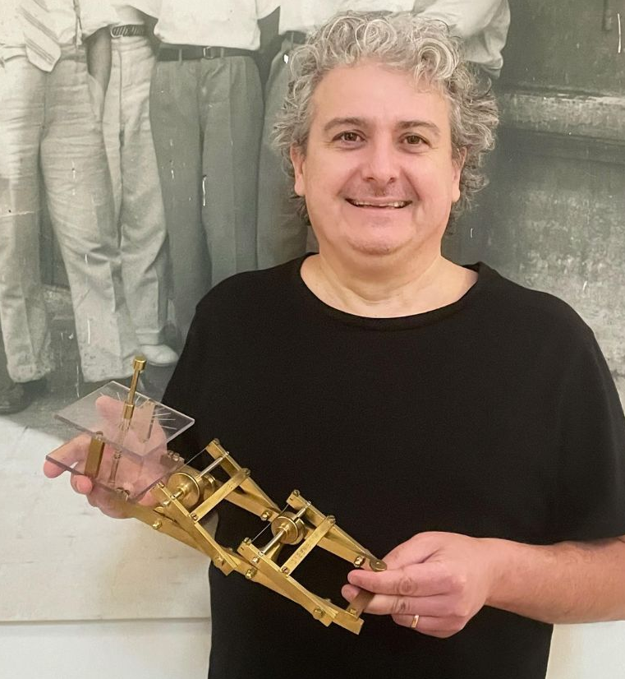
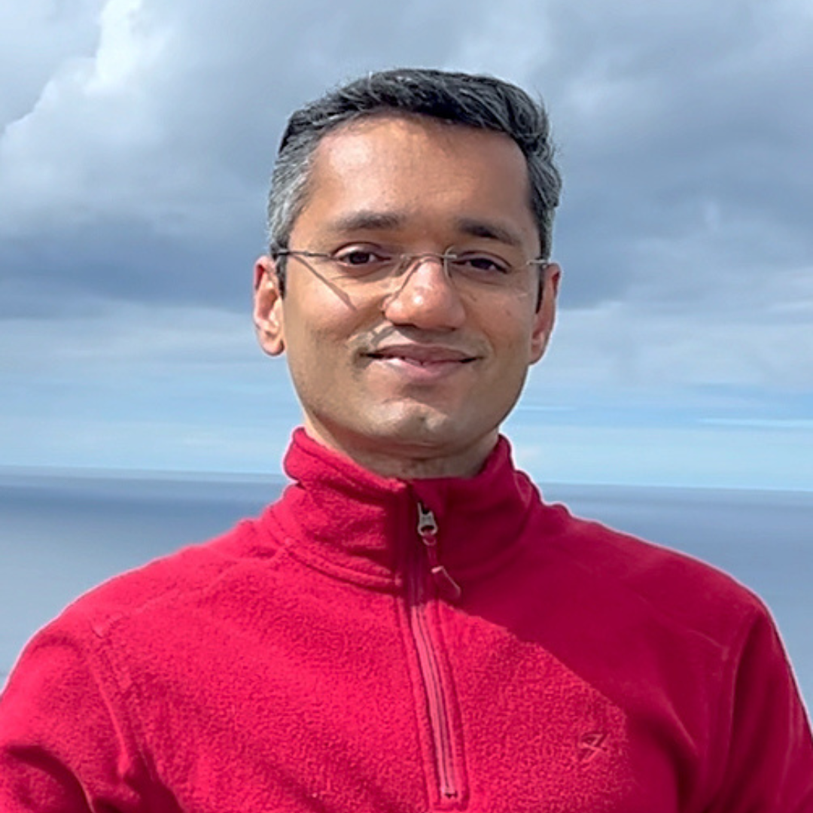
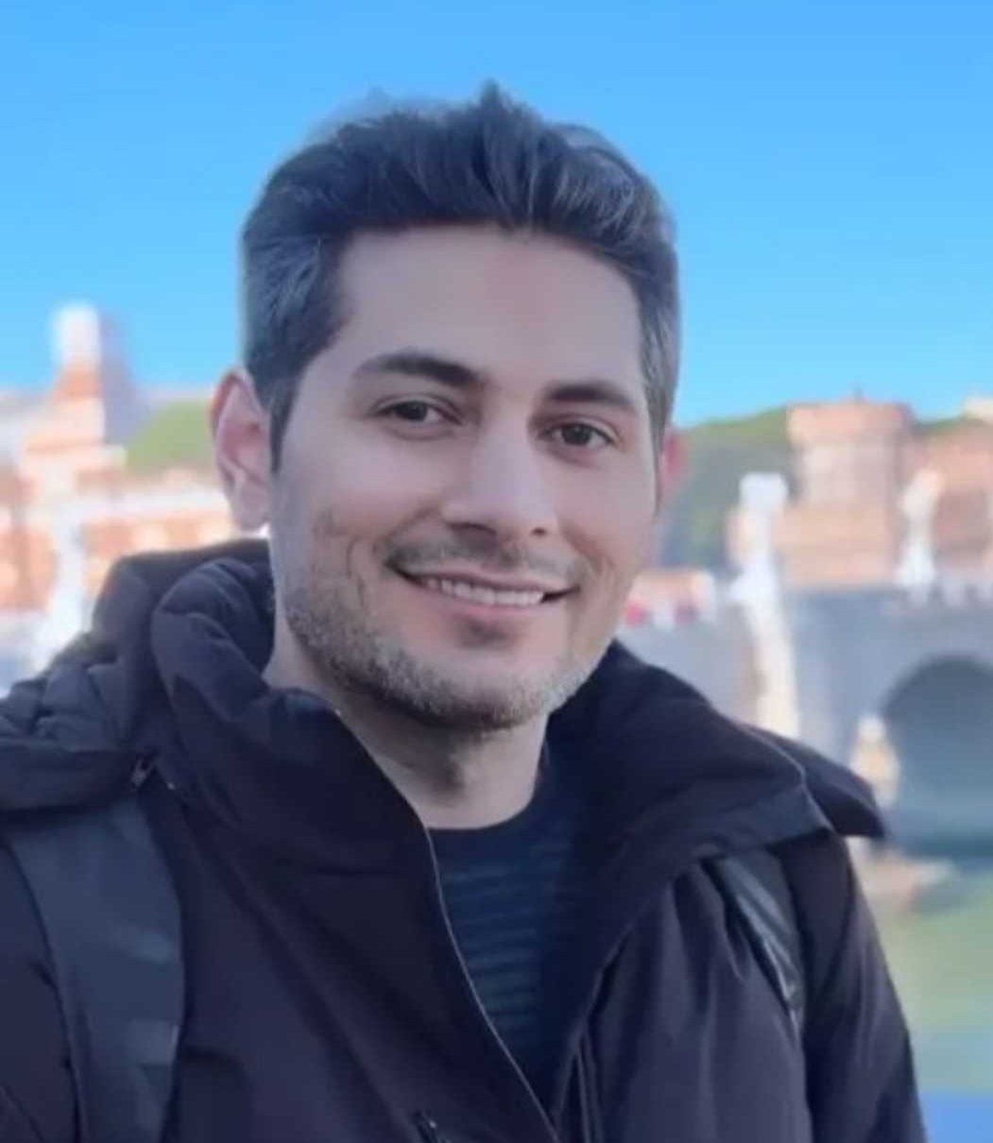
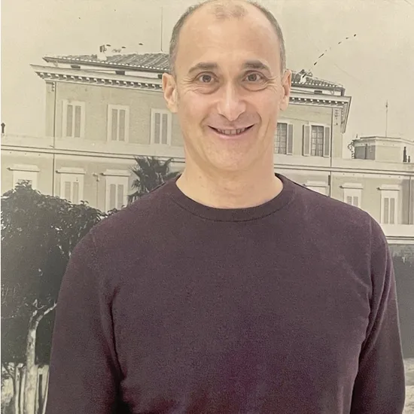
CREF staff
Prof. Claudio Conti
(Uni. “La Sapienza “)
Dr. Marcello
Calvanese Strinati
Dr. Romolo Savo
Dr. Fabrizio Coccetti
Dr. Michael Raju
Postdoc
Dr. Hamed Tari
Postdoc
Ing. Giovanni De Angelis
Extended team @ Sapienza/ CNR
Collaborations
Dr. Neda Gofraniha
Dr. Silvia Gentilini
Dr. Davide Pierangeli
Dr. Stefano Ferretti
Daniele Veraldi
Prof. Eugenio del re
Dr. Ludovica Falsi
Prof. Massimiliano Papi
Dr. Valentina Palmieri
Dr. Laura Pilozzi
Prof. Sylvain Gigan (Complex media optics team),LKB/ENS Paris
Prof. Rachel Grange (Optical nanomaterial group), ETH Zurich
Prof. Sushil Mujudmar (Mesoscopic optics lab), TATA institute, Mumbai
Notes:
Currently we are 4 permanent researchers and 2 postdocs.
Claudio Conti is the scientific responsible of the research line in photonics and supervises the activities.
I’m the responsible of the experimental research and work in tight collaboration with my postdocs Michael Raju and Hamed Tari and with Fabrizio Coccetti.
Marcello Calvanese Strinati is responsible for the theoretical research line and will present some of his excellent results
Giovanni de Angelis is a precious help for all technical aspect concerning the lab.

Slide 5
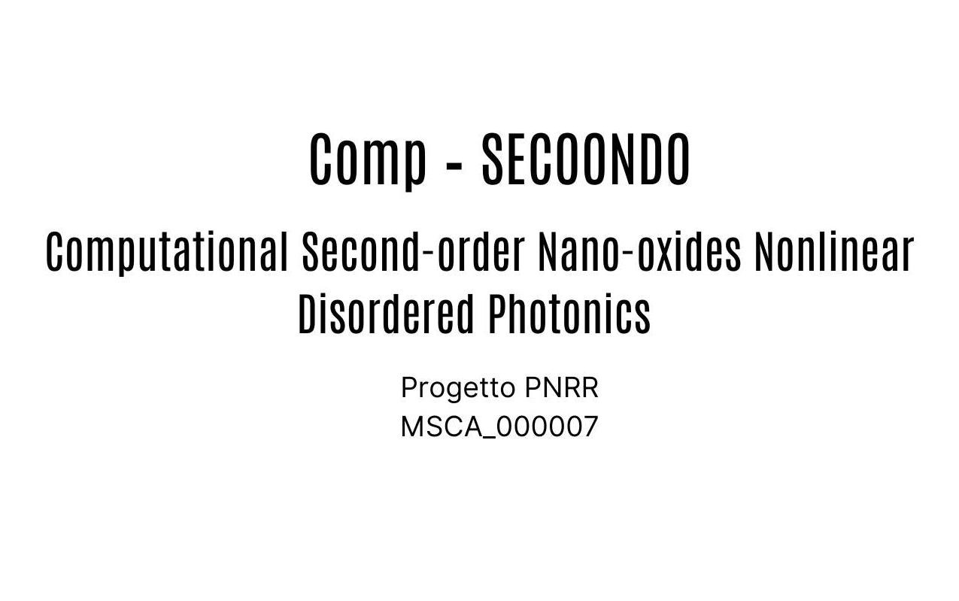
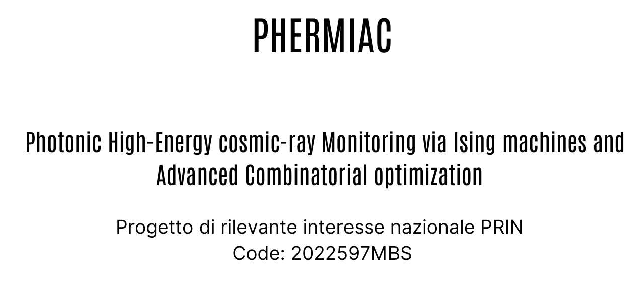
External fundings
PI: Romolo Savo, 300Keuro
PI: Claudio Conti e Fabrizio Coccetti, 120Keuro
Notes:
We have been awarded two external grants in the past 3 years that provided the resources to setup a competitive lab andto hire international researchers.
The project comp_secoondo was concluded in December and today I’m going to show last exciting results.

Slide 6
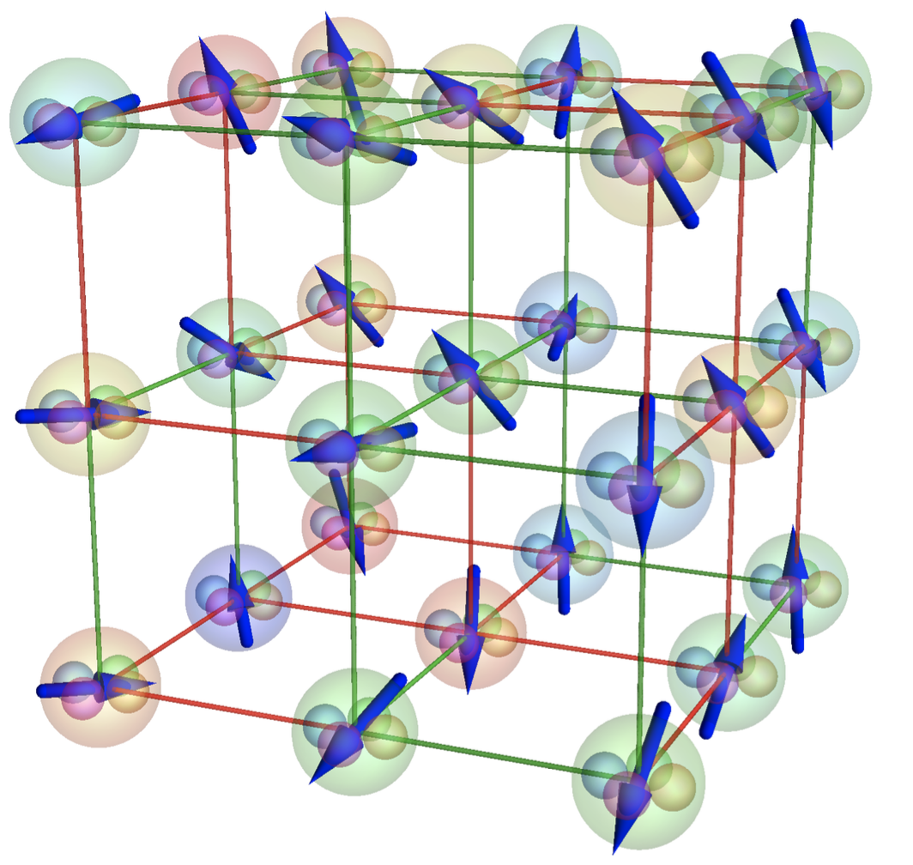
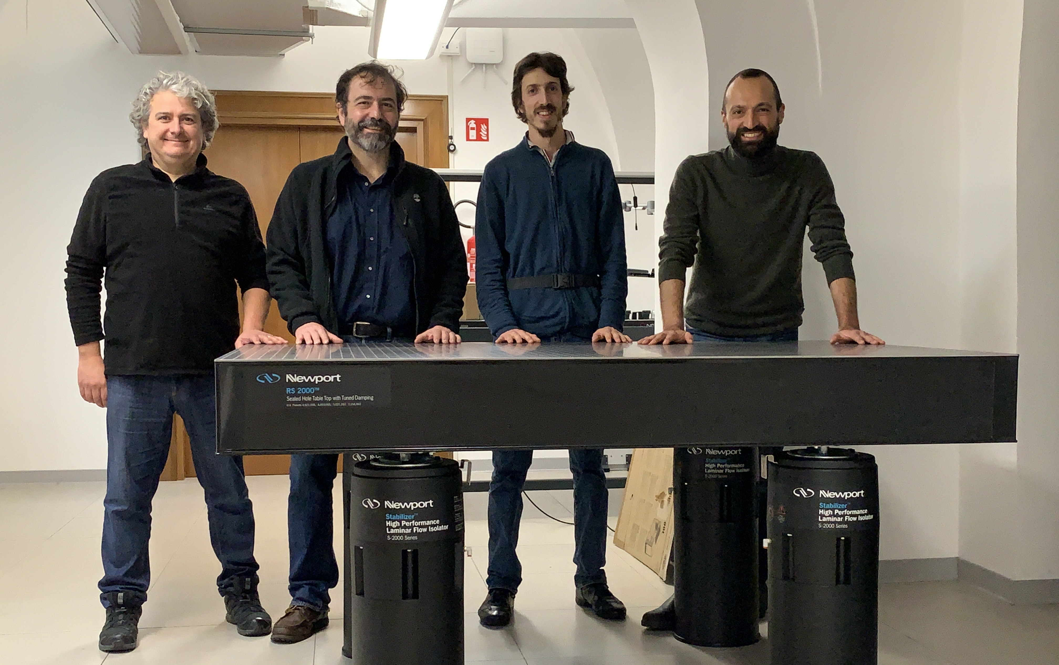
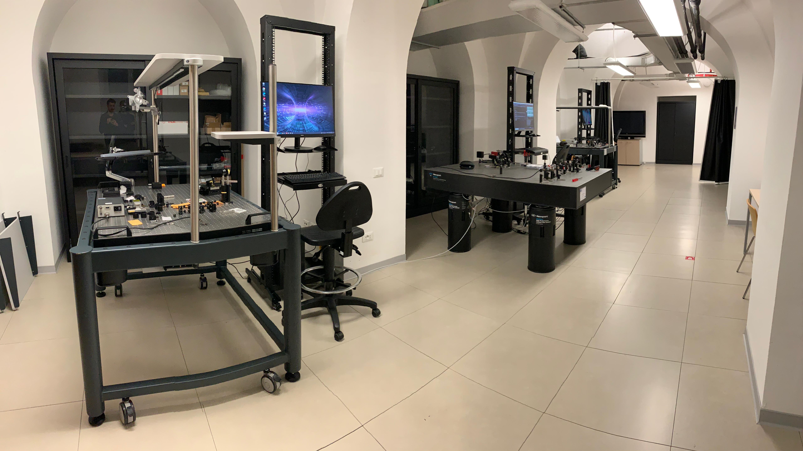
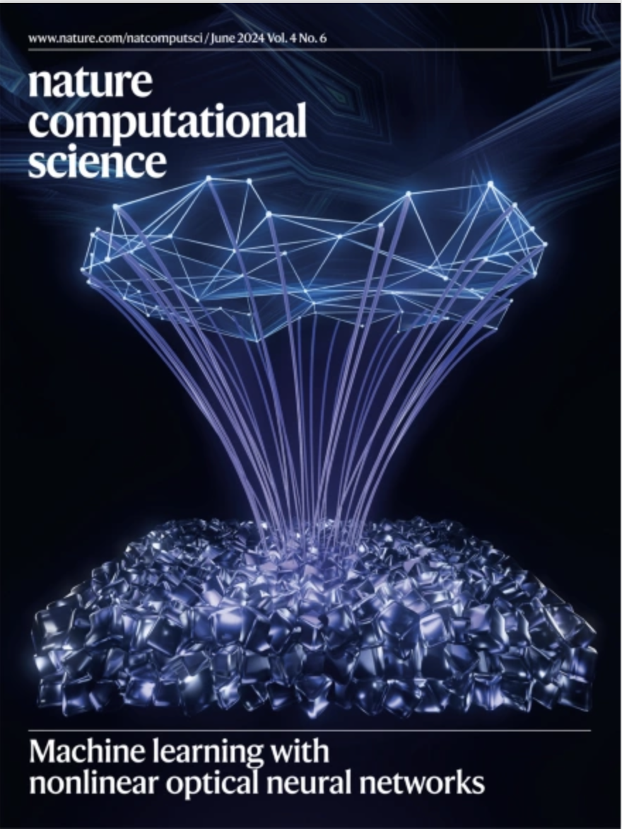
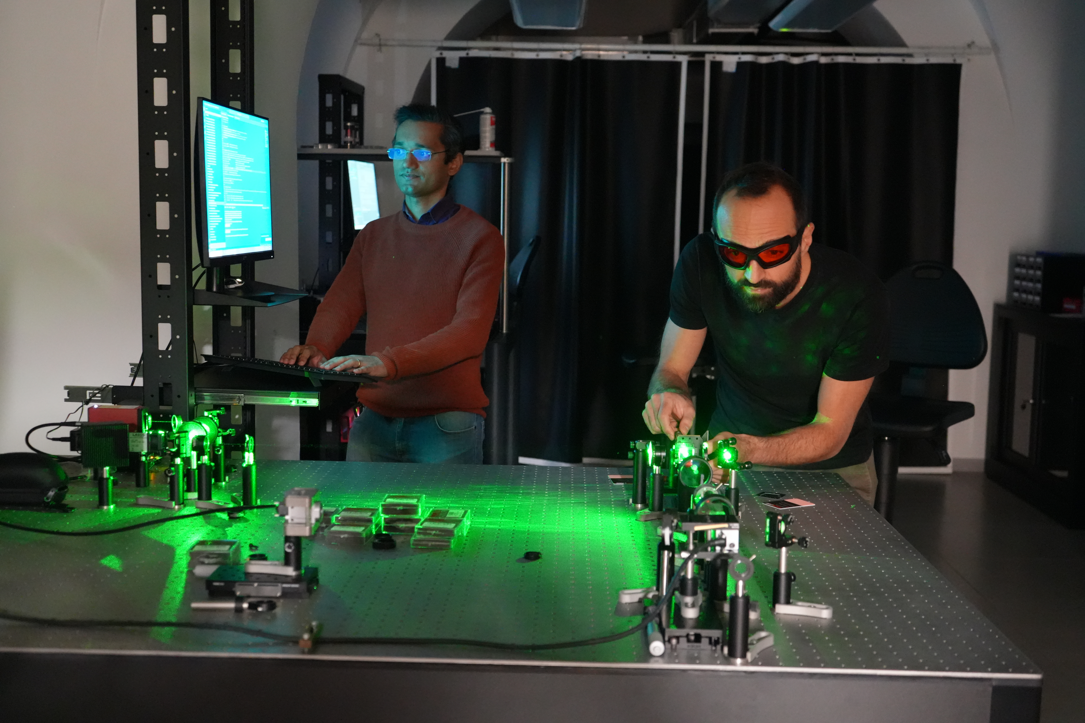
The Photonics Laboratory (R. Savo)
Theoretical activity (M. C. Strinati)
Wang, H., Hu, J., Morandi, A., Nardi, A., Xia, F., Li, X., Savo, R., Liu, Q., Grange, R. and Gigan, S., Nature Computational Science, pp.1-11. (2024).
Savo R.. IEEE ( 2024).
Savo R. Emerging Topics in Artificial Intelligence, SPIE, (2024).
R. Samanta, R. Savo, C. Conti, S. Mujumdar, arXiv:2504.14589 (2025)
H. Tari, M. Raju, F. Coccetti, C. Conti and R. Savo. In preparation
M. Raju, F. Coccetti, Morandi A., Grange R., C. Conti and R. Savo. In preparation
C. Conti, F. Coccetti, R. Savo, M. Calvanese Strinati et al. Patent submission in proccess
Started in 2022
M. Calvanese Strinati and C. Conti - Phys. Rev. Lett. 132, 017301 (2024)
M. Calvanese Strinati and C. Conti - Phys. Rev. A 109, 063519 (2024)
M. Calvanese Strinati & C. Conti, Phys. Rev. A 111, 043712 (2025)
M. Calvanese Strinati & C. Conti, Phys. Rev. A 112, 053505 (2025)
J. Tosca, M. Calvanese Strinati, C. Conti, & C. Ciuti, Phys. Rev. Lett. 134, 230404 (2025)
Notes:
We are putting a significant effort in developing high-quality ad original research lines as well as in fostering strategic collaboration to gather more international relevance

Slide 7
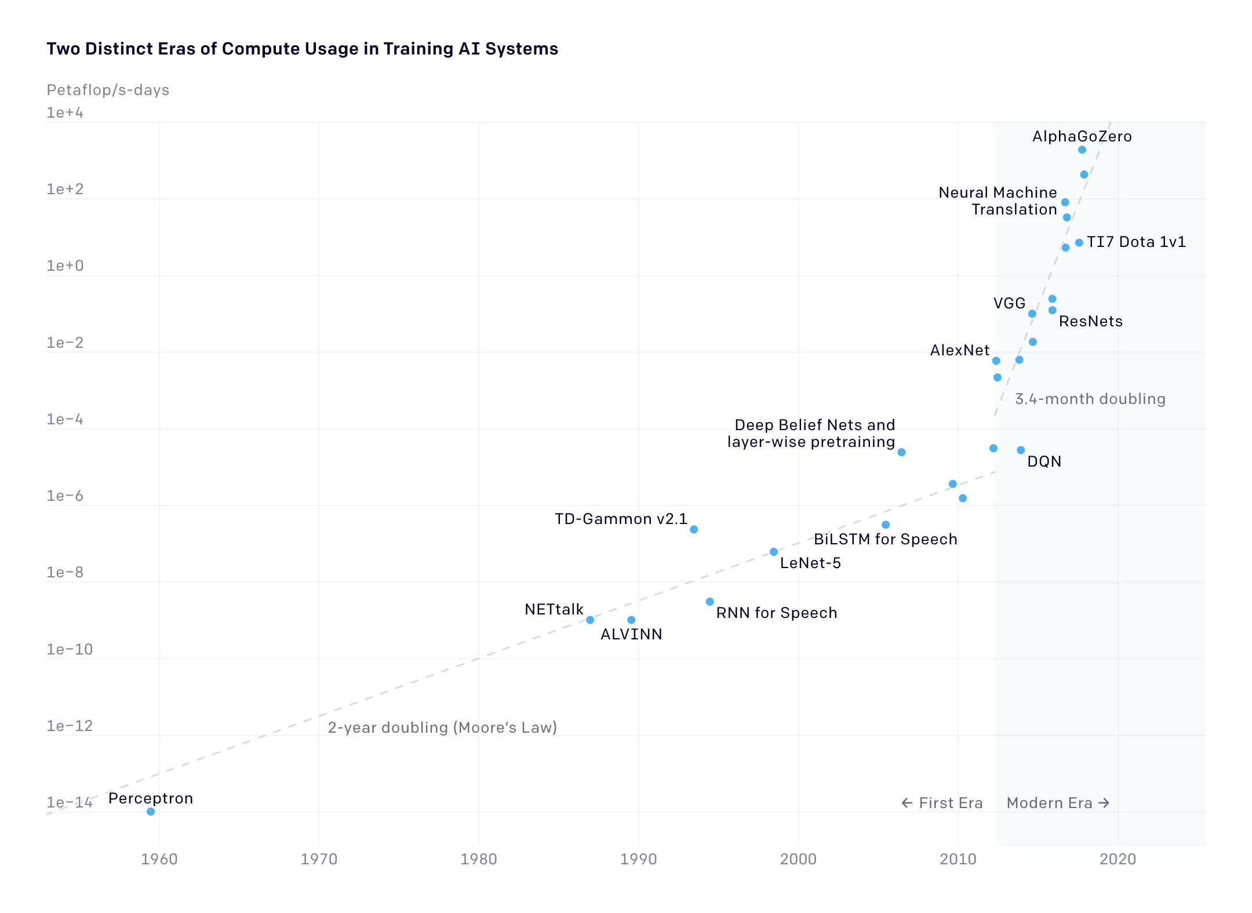
Two distinct eras of compute usage in training AI system
Need for a change of paradigm in computing architectures
https://openai.com/index/ai-and-compute/
Notes:
Photonic or Optical computing has been a topic of periodic study since the 1960s and a wide variety of optical-computing schemes and architectures have been proposed
There has been a resurgence of interest in this topic since the early 2010s, both in academia and in industry, triggered by the significant increment in the compute usage required to train AI systems
Such operations are power hungry, create CO2 emission and pose practical and ethical questions on the correct use of natural resources.

Slide 8
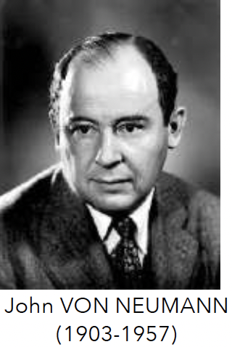
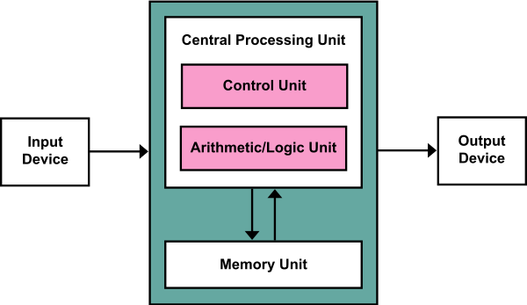
Von Neuman architecture
The Von Neumann bottleneck !
Similar for multi-processor, GPU, TPU (google)
General-purpose, not good for AI!
Notes:
Indeed, performing artificial intelligence tasks on classical computer architecture is inefficient, in terms of speed and energy consumption.
The Von Neumann architecture is thought for general purpose operation, so it’s very versatile, but it suffers from the so called Von Neumann bottleneck: the need to shuttle data between memory and processor.
This is also the case for other architecture designed more specifically for parallel computing, as GPU and TPU, they still have this requirement

Slide 9
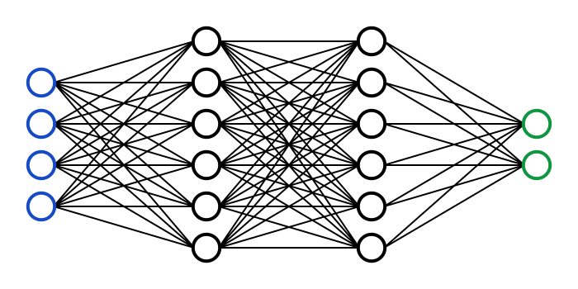
Neuromorphic architectures
Artificial Neural Networks
INPUT
OUTPUT
MEMORY
COMPUTING UNITS
Parallel processing , task-specific architecture
Good for AI!
Notes:
Neuromorphic architectures as artificial neural networks process the information in a distributed fashion, such as to avoid bottlenecks.
Moreover they are suitable for efficient parallel computing and are easily adaptable to to perform a specific task at best.

Slide 10
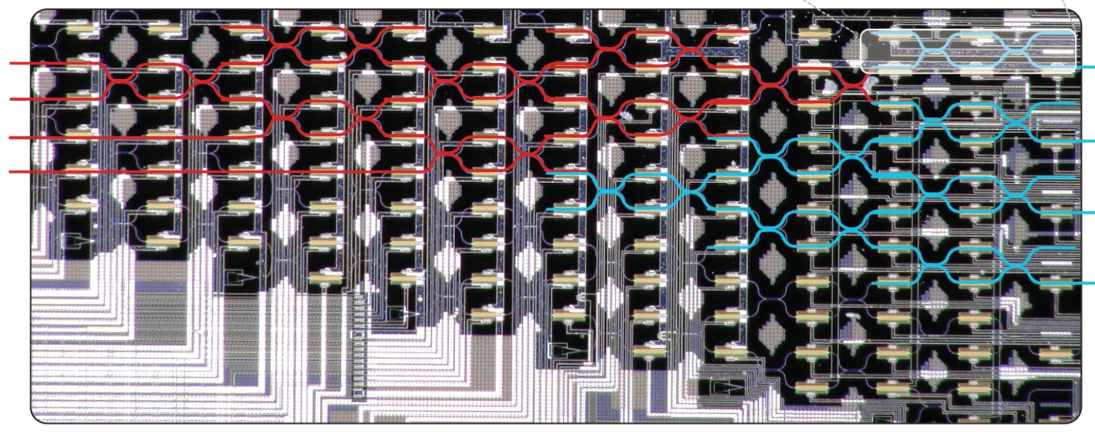

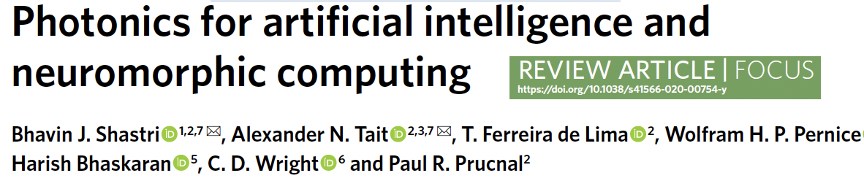




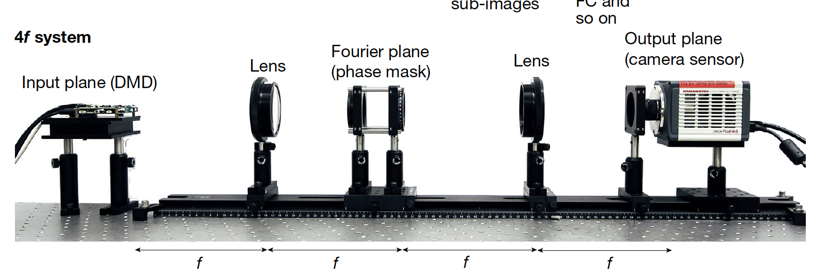
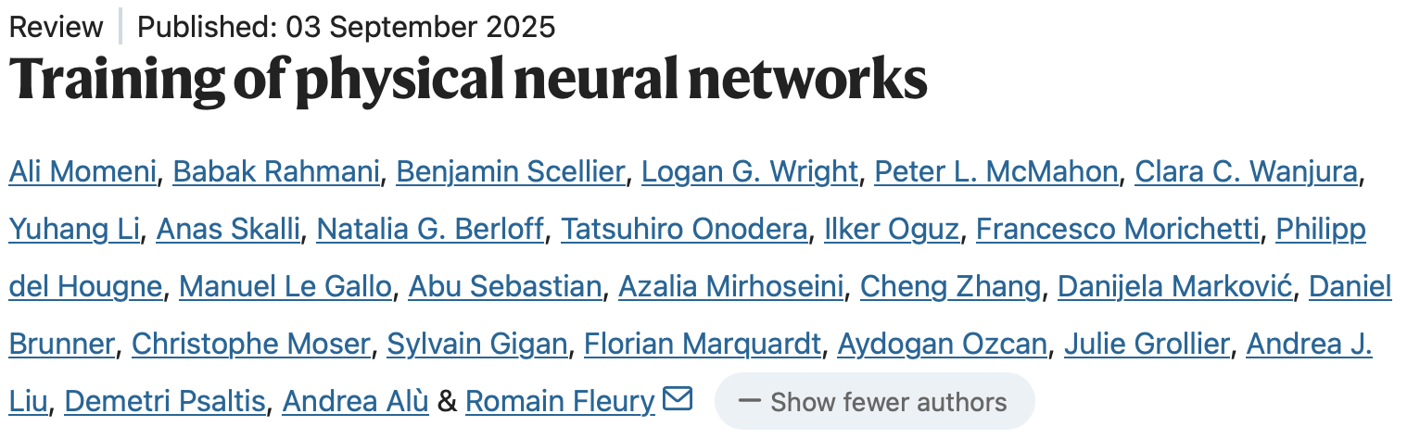
Neuromorphic photonics
Integrated systems
(2021)
Y. Shen et al., Nat. Photonics, 11, 441–446 (2017)
Free-space systems
G. Wetzstein et al., Nature, 39, 588 (2020)
Notes:
Photonic systems, but in general all physical platform based on wave propagation, are ideal system to implement neuromorphic computing architectures, thanks to to the possibility to manipulates wave modes independently and to make them interfere in a controlled way
Advantage in using photonics are in particular: larger bandwidth capability (THZ instead of GHZ), parallelisms, dissipation less dynamics providing energy saving
If the purpose is to realize scalable computing system, and not integrability, free-space optics is the way to go.
----
The potential advantage over electronics are well discussed in this paper by Peter McMahon from Cornell, where in particular he emphasizes that transferring information at the speed of light is not the point
---

Slide 11
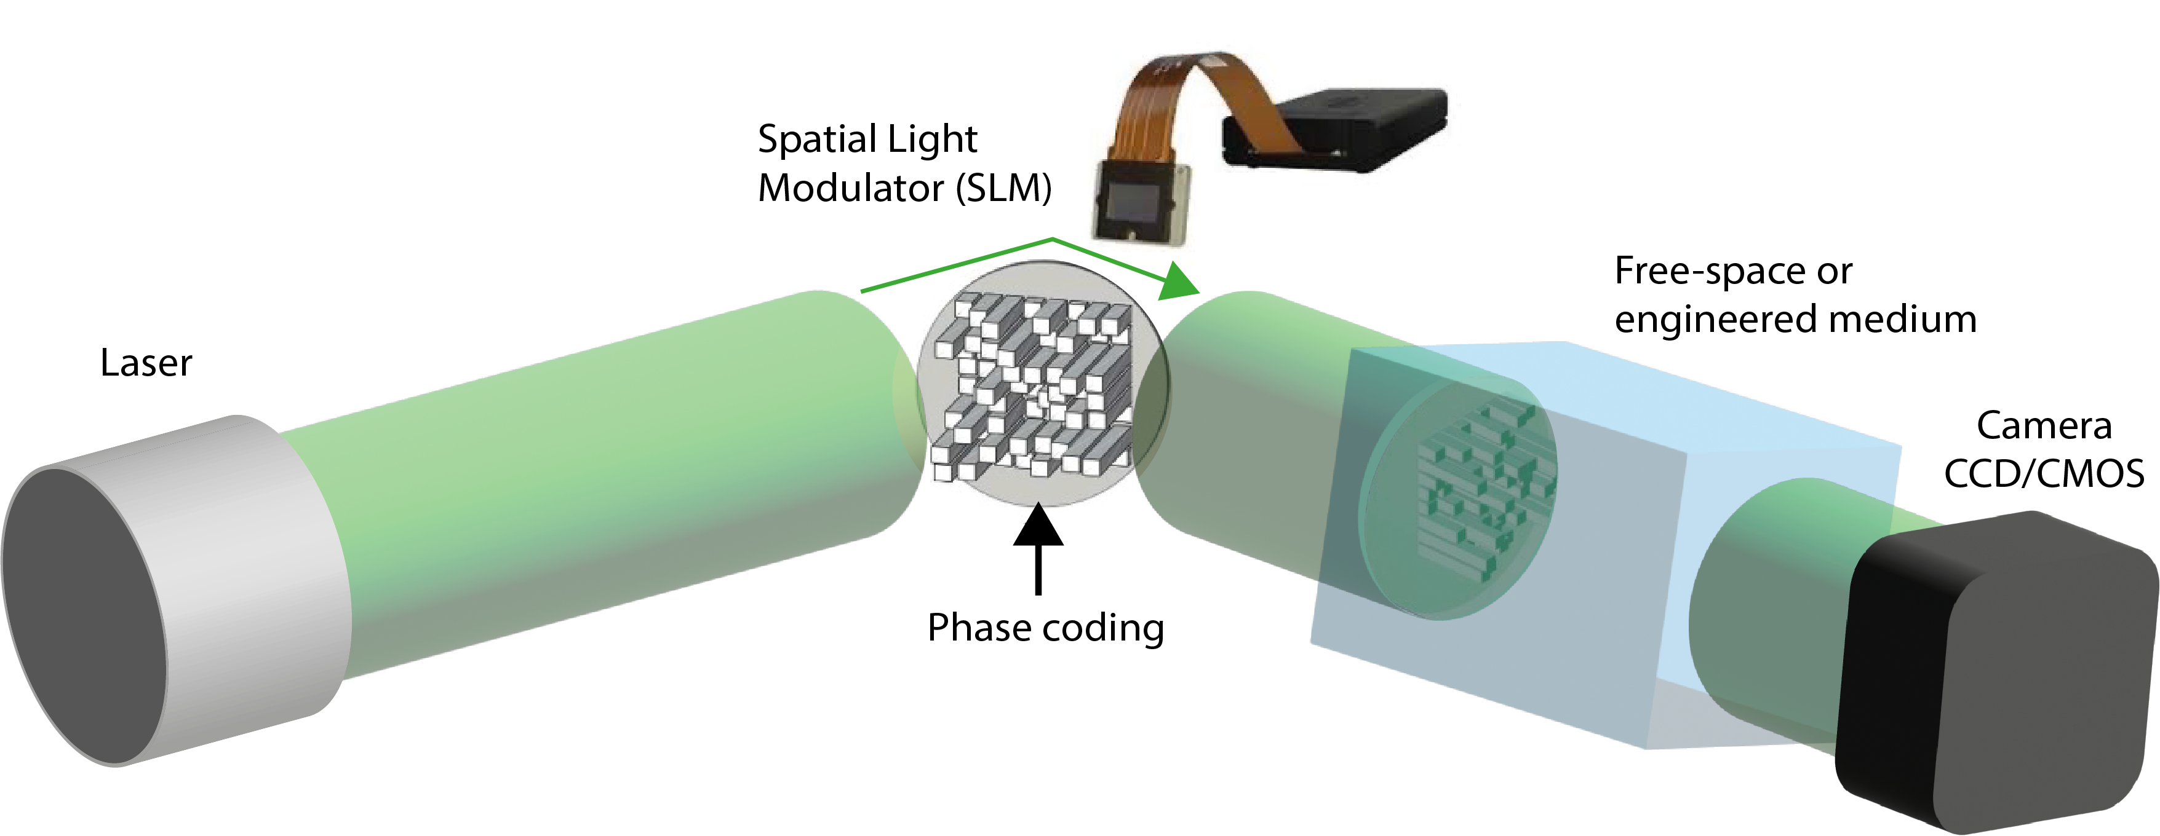















Manipulating optical information in free-space
Free space/Medium
SLM
Camera
$$T_{11}$$
$$T_{1N}$$
$$E_{1}^{in}$$
$$E_{1}^{out}$$
$$E_{2}^{in}$$
$$E_{2}^{out}$$
T has dimensions 10⁶ x 10⁶
$$=$$
$$E^{out}=T∙E^{in}$$
$$T$$
$$E_{3}^{in}$$
$$E_{3}^{out}$$
SCALABILITY !
$$T_{M1}$$
$$T_{MN}$$
$$E_{N}^{in}$$
$$E_{M}^{out}$$
SM Popoff et al., PRL (2010)
Notes:
The method we use to encode, read and process optical information is schematize here.
A coherent source illuminate the display of a spatial light modulator, which is made of micrometer size liquid crystal pixels that con modify locally the phase of the light. The sequence of this local phase values define an input vector.
Similarly the pixels of a camera sensors, define an output vector.
The propagation in between them through the platform choose, act as a matrix multiplication on the input vector.
Thanks to the high density of pixels on the input and out device such transmission matrix can reach huge dimensions, numbers that are impractical to be handled by digital processors.

Slide 12
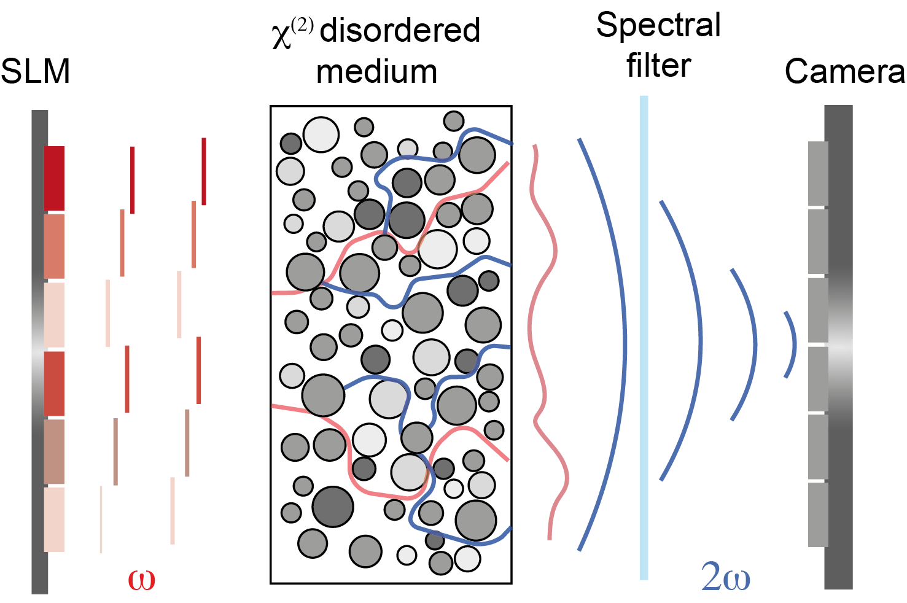
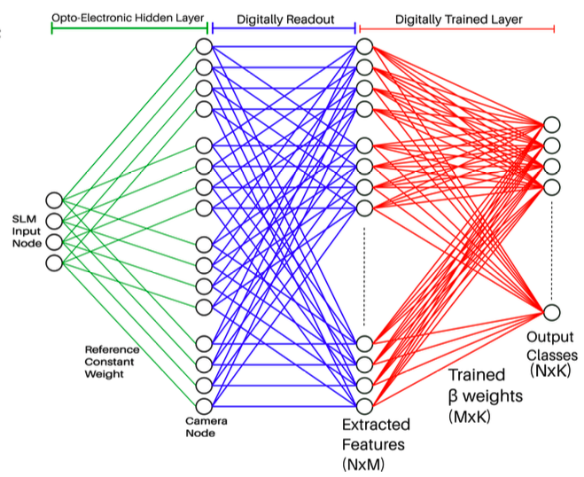
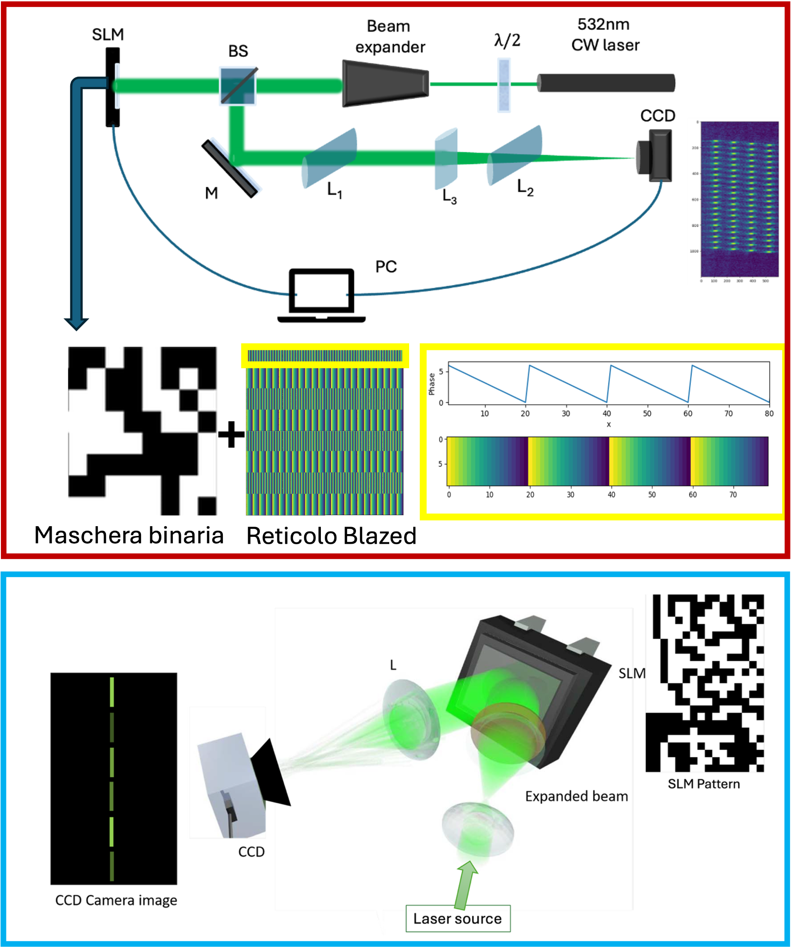
Outline
Photonic Extreme Learning Machine
Photonic Classifier of numerical Proximity
Photonic Ising machine and generalized spin system
Photonic computing with nonlinear disorder

Slide 13
Outline
Photonic Extreme Learning Machine
Photonic Classifier of numerical Proximity
Photonic Ising machine and generalized spin system
Photonic computing with nonlinear disorder

Slide 14
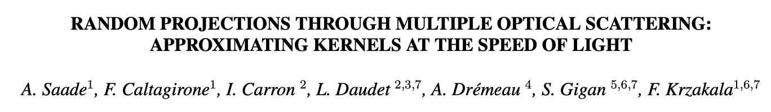
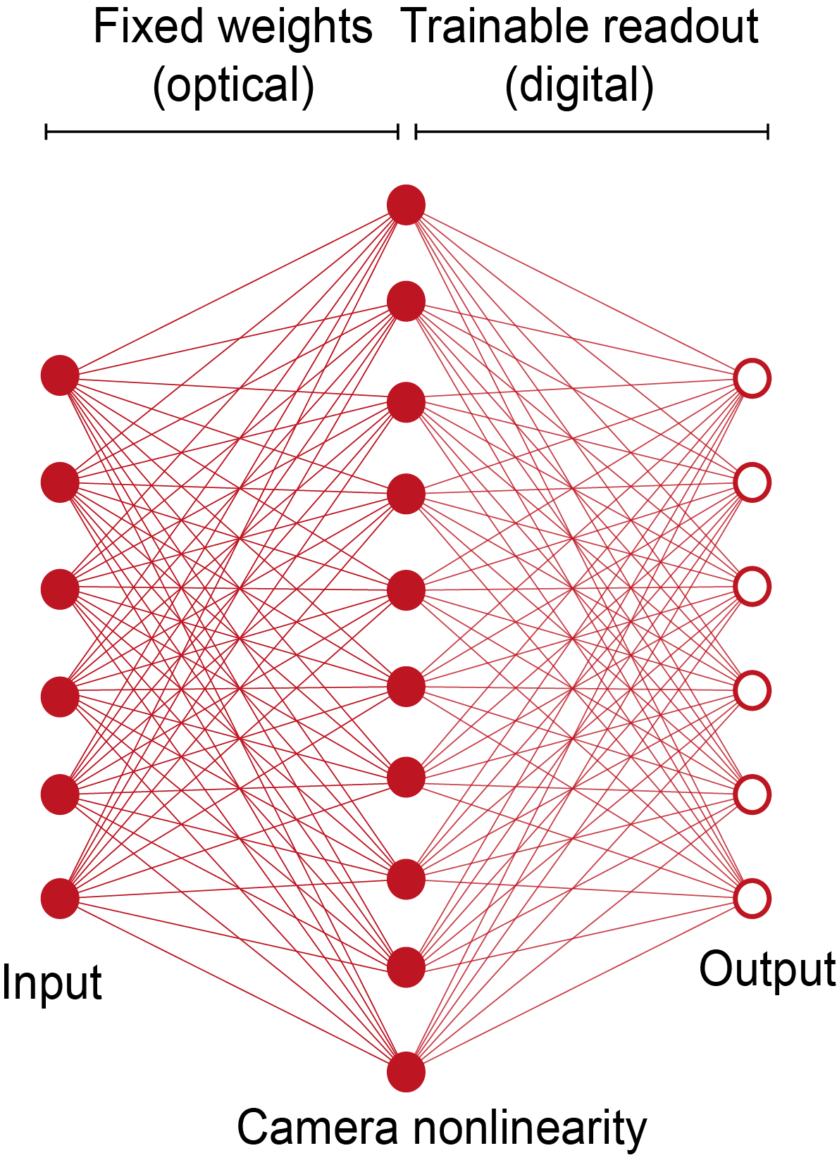
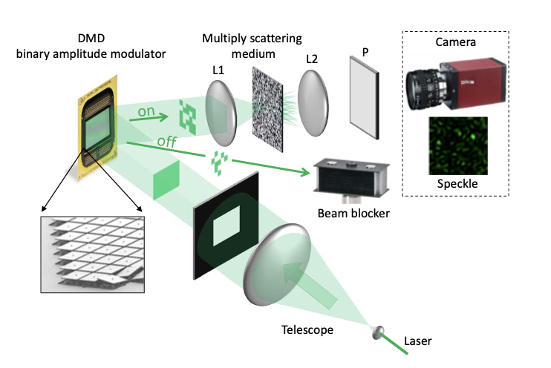
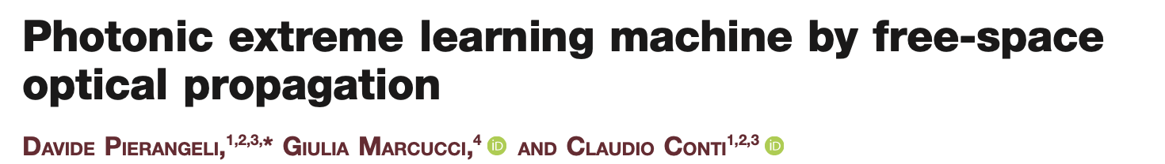
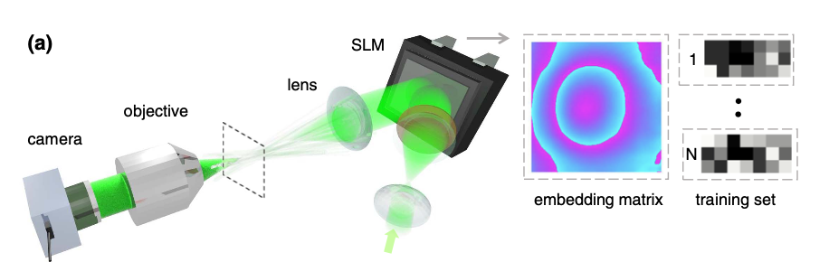
Photonic extreme learning machine (PELM)
Notes:
Extreme learning machine are a well know feed forward NN architecture employed for classification tasks.
Its peculiarity is to have fixed weights that connects to the hidden layer and only a trainable readout layer. Such properties made it attractive for a photonic implementation, reported in these seminal works.
However, these photonic extreme learner are limited to processing real numbers, encoded as the phase values on the SLM, as they are insensitive to global phase shifts.

Slide 15
Photonic extreme learning machine (PELM)
Degenerate states
Notes:
Extreme learning machine are a well know feed forward NN architecture employed for classification tasks.
Its peculiarity is to have fixed weights that connects to the hidden layer and only a trainable readout layer. Such properties made it attractive for a photonic implementation, reported in these seminal works.
However, these photonic extreme learner are limited to processing real numbers, encoded as the phase values on the SLM, as they are insensitive to global phase shifts.

Slide 16
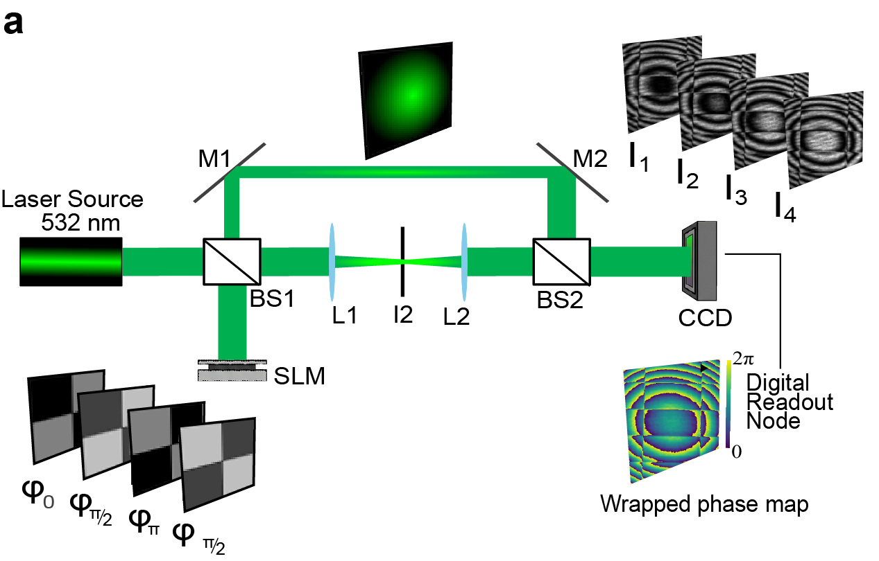
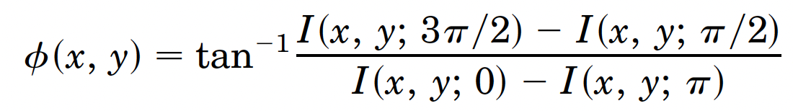

Interferometric PELM
Dr. Hamed
Tari
Cascaded nonlinearities
Interference + Camera detection
$$I\left(x,y\right)∝{2|E}_{ref}^{}||E_{sig}^{}|cosΔφ(x,y)$$
Four-phase step interferometry
H. Tari, M. Raju, F. Coccetti, C. Conti and R. Savo. In preparation
Notes:
We tackled this problem by designing and realizing an interferometric version of the extreme learning machine, which not only measure the interference of the signal bema with a reference beam, but also measure the exact phase of the detected beam.
These additional elements introduces cascaded optical nonlinearities without the use of high-power sources and a sufficient connectivity to make the previous classification problem separable in then projected space.

Slide 17
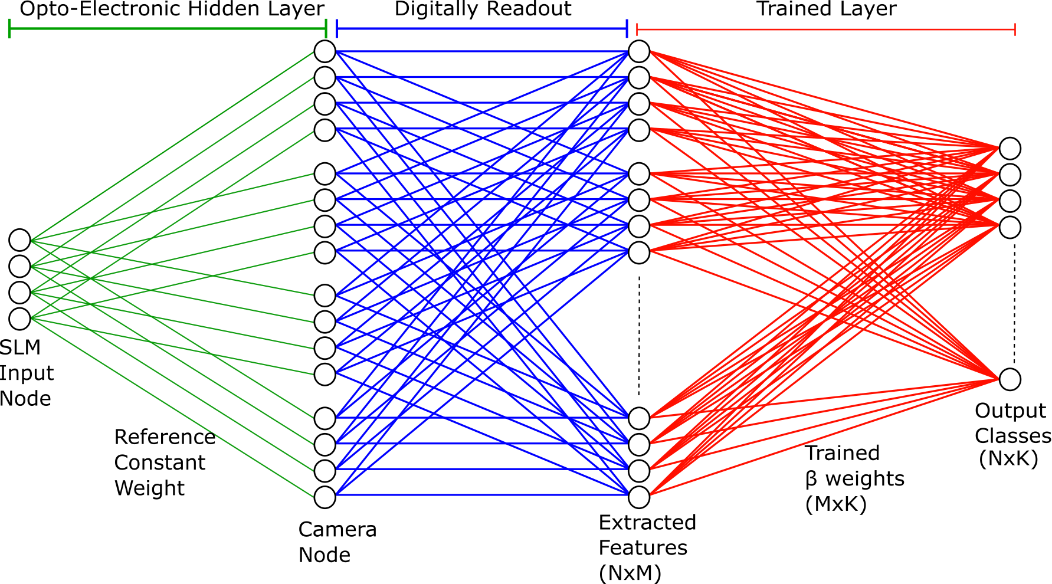
Interferometric PELM
Dr. Hamed
Tari
H. Tari, M. Raju, F. Coccetti, C. Conti and R. Savo. In preparation
Notes:
This optical implementation results in a multilayer NN architecture capable to process complex values information

Slide 18
IPELM: sensitivity to complex-value information
H. Tari, M. Raju, F. Coccetti, C. Conti and R. Savo. In preparation

Slide 19
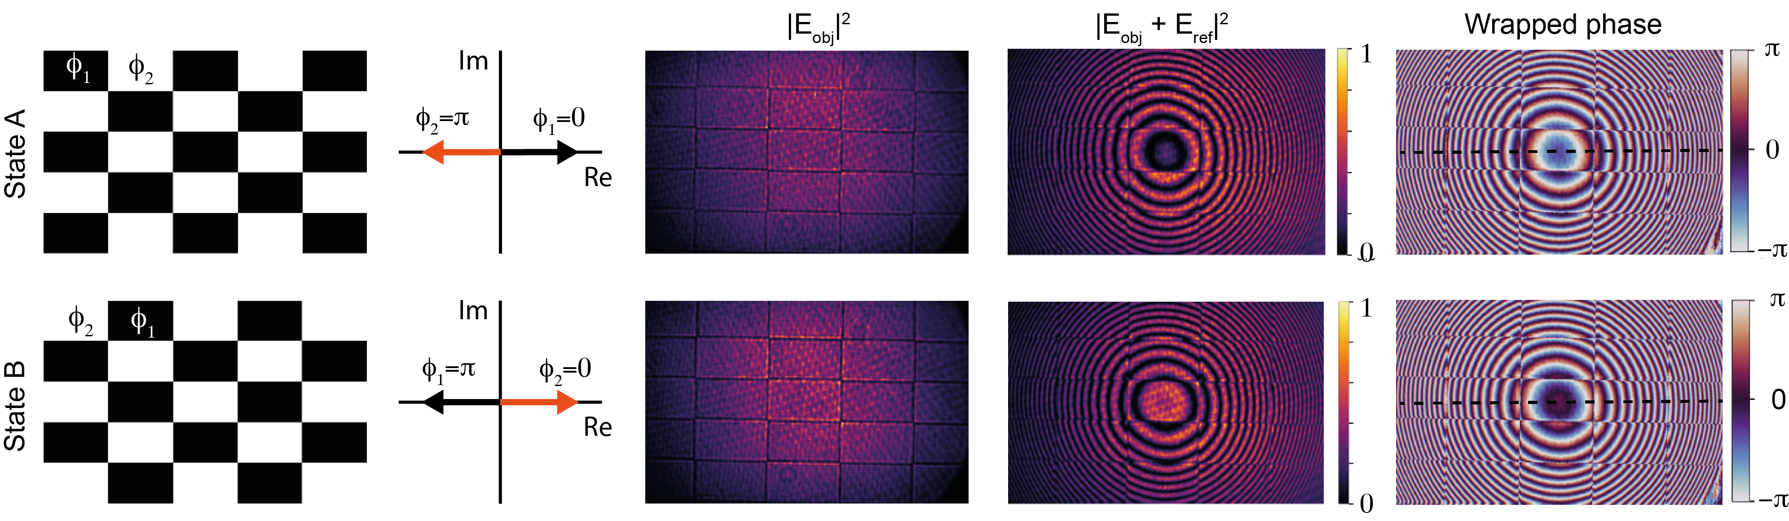
IPELM: sensitivity to complex-value information
H. Tari, M. Raju, F. Coccetti, C. Conti and R. Savo. In preparation

Slide 20
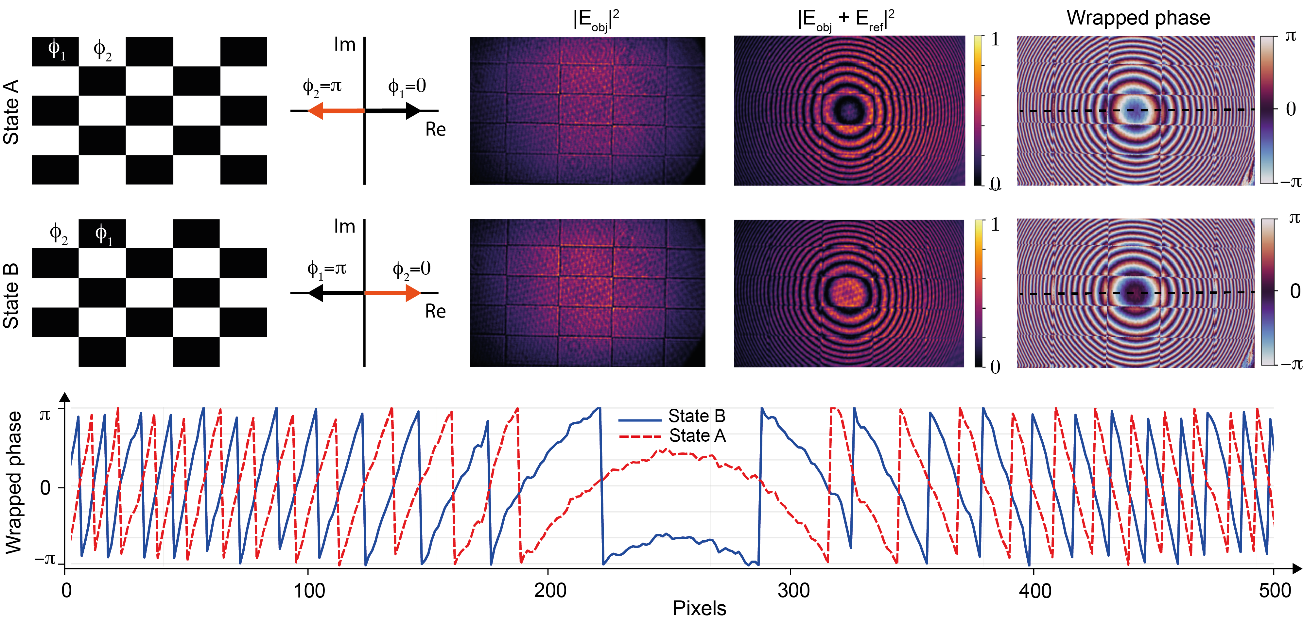
IPELM: sensitivity to complex-value information
H. Tari, M. Raju, F. Coccetti, C. Conti and R. Savo. In preparation

Slide 21
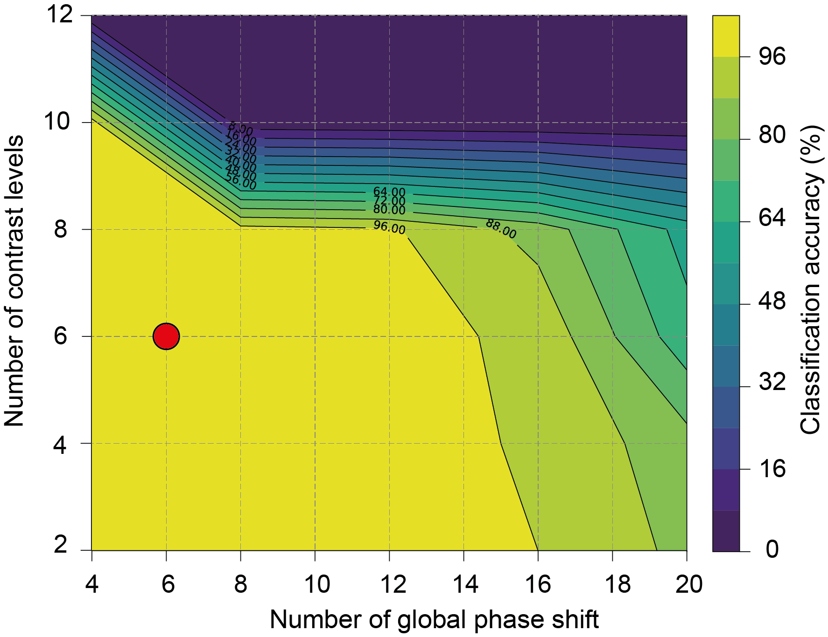
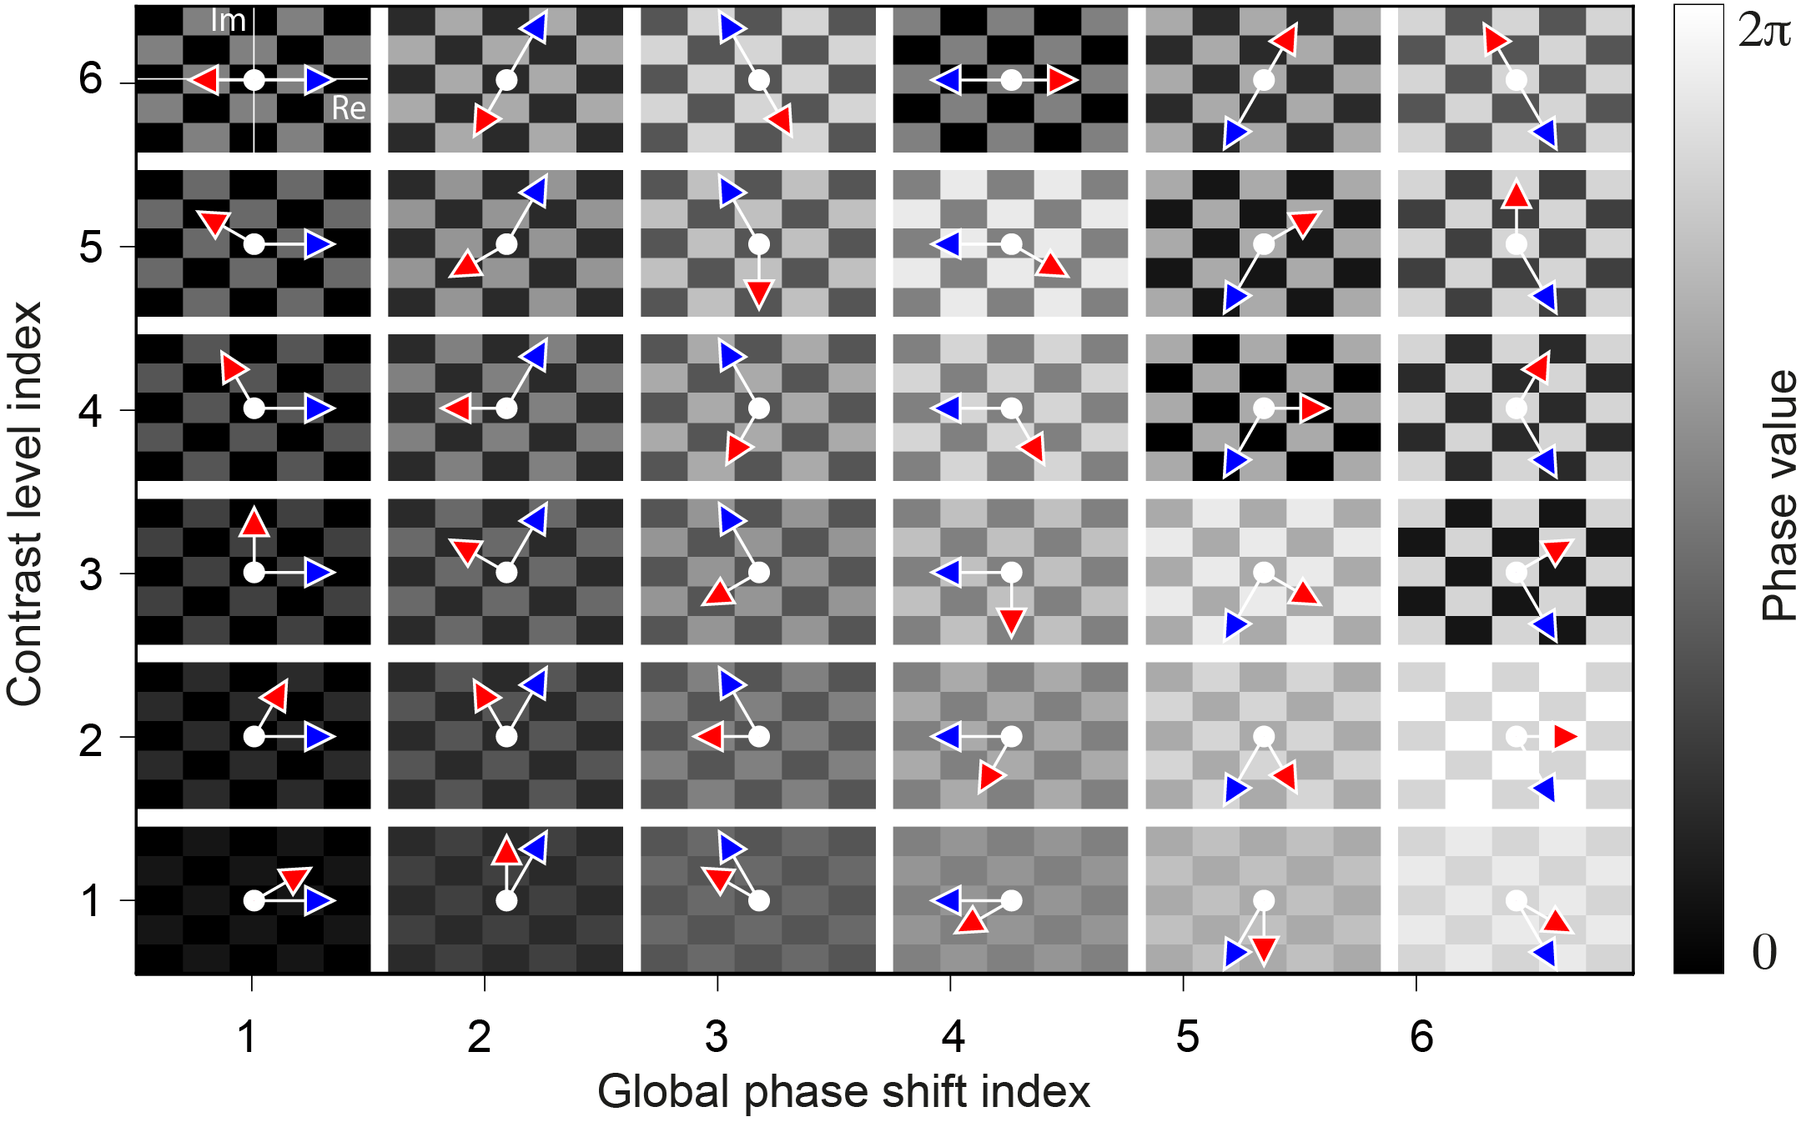
IPELM: complex-value classification capability
Dr. Hamed
Tari
H. Tari, M. Raju, F. Coccetti, C. Conti and R. Savo. In preparation

Slide 22
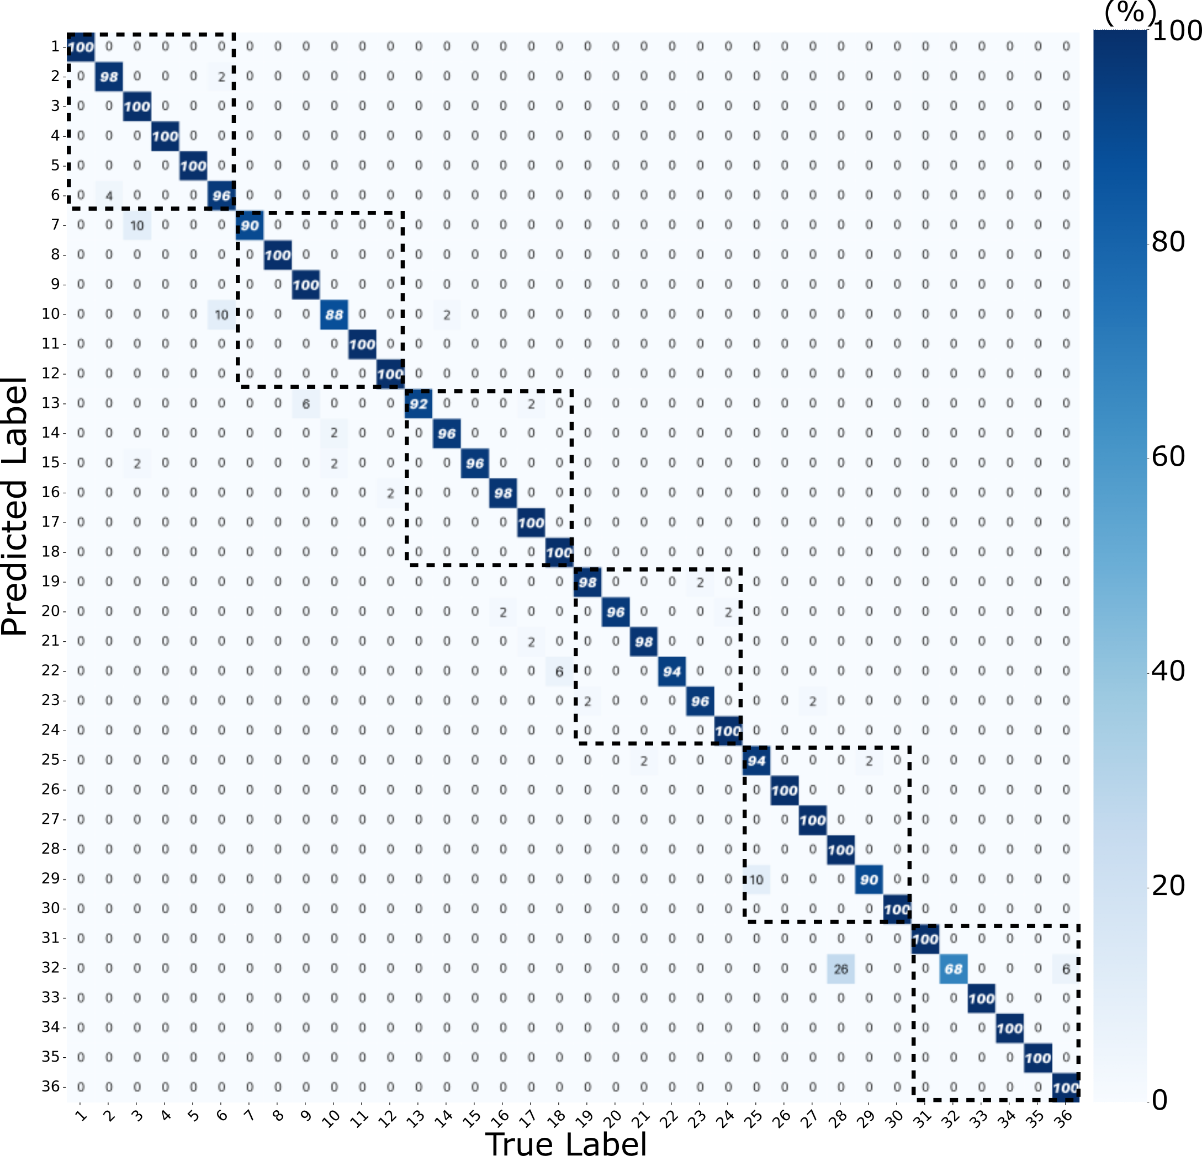
IPELM: complex-value classification capability
Dr. Hamed
Tari
H. Tari, M. Raju, F. Coccetti, C. Conti and R. Savo. In preparation

Slide 23
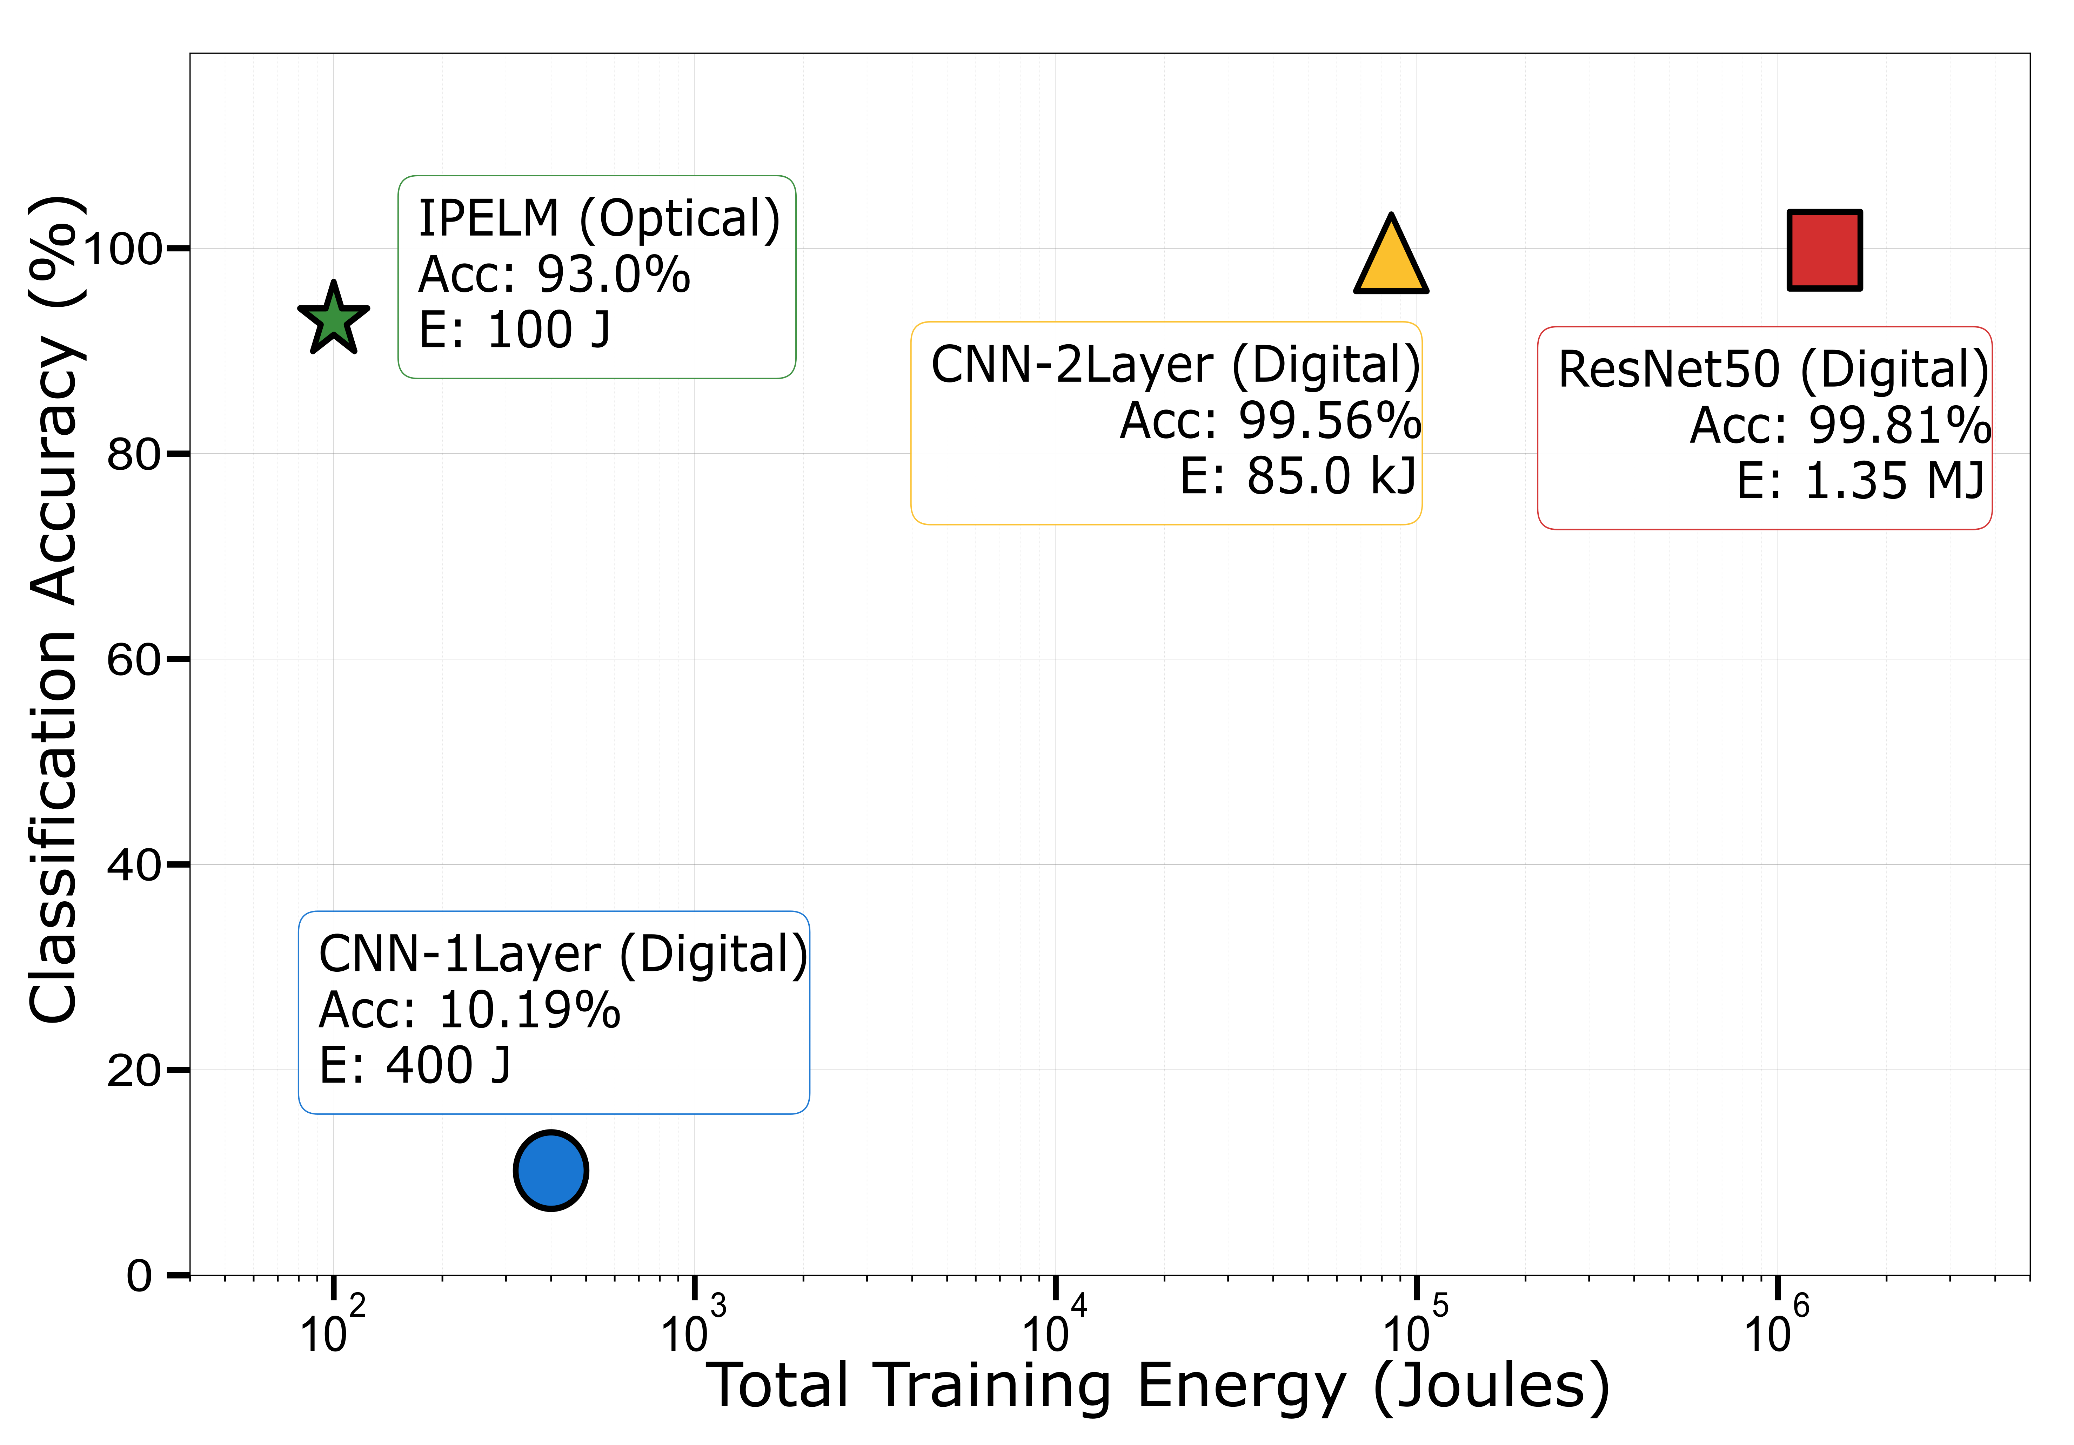
IPELM: compute resource and energy efficiency
Dr. Hamed
Tari
H. Tari, M. Raju, F. Coccetti, C. Conti and R. Savo. In preparation

Slide 24
Outline
Photonic Extreme Learning Machine
Photonic Classifier of numerical Proximity
Photonic Ising machine and generalized spin system
Photonic computing with nonlinear disorder

Slide 25
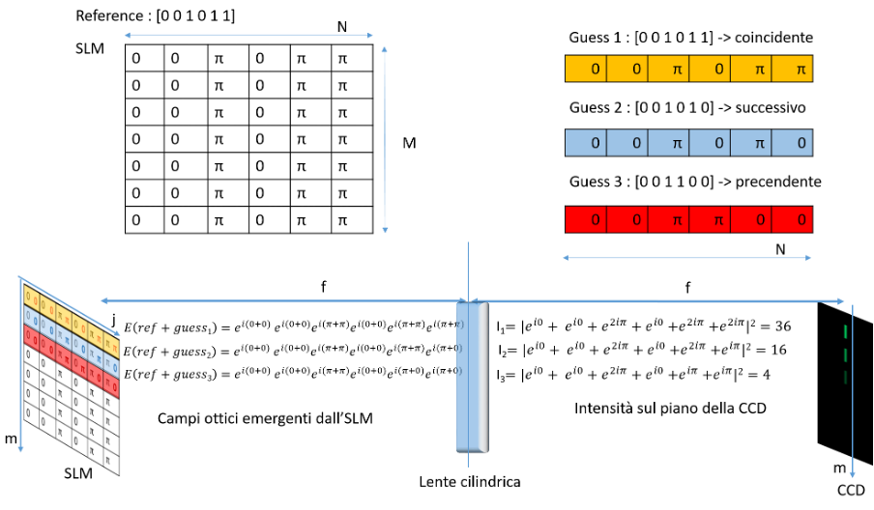













Photonic detection of numerical proximity
Dr. Fabrizio
Coccetti
Binary representation of real number by using phases on the SLM:
$0→φ=0 1→φ=π$
$$0$$
$$0$$
$$2π$$
$$0$$
$$2π$$
$$2π$$
$$0$$
$$0$$
$$2π$$
$$0$$
$$2π$$
$$π$$
$$0$$
$$0$$
$$π$$
$$π$$
$$π$$
$$π$$
Fixed
Running
Running Sum
C. Conti, F. Coccetti, R. Savo, M. Calvanese Strinati et al. Patent submission in proccess
Notes:
In this project we developed an optical system capable to detect, optically, when two numbers coincide, ore better to quantify their level of proximity.
- both phase patterns are displayed over the SLM, the reference is fixed, while the numbers to be compared, the guess, are displayed continuously and summed to the reference. Only the sum between coincident numbers results in a phase sequence made only of 0 and 2pi, which optically is a flat phase pattern
- The more digit we have at our disposal the more accurate can be the number of our interest

Slide 26
Photonic detection of numerical proximity
Dr. Fabrizio
Coccetti
Binary representation of real number by using phases on the SLM:
$0→φ=0 1→φ=π$
Flat phase
$$0$$
$$0$$
$$2π$$
$$0$$
$$2π$$
$$2π$$
$$0$$
$$0$$
$$2π$$
$$0$$
$$2π$$
$$π$$
$$0$$
$$0$$
$$π$$
$$π$$
$$π$$
$$π$$
Fixed
Running
Running Sum
C. Conti, F. Coccetti, R. Savo, M. Calvanese Strinati et al. Patent submission in proccess
Notes:
- both phase patterns are displayed over the SLM, the reference is fixed, while the numbers to be compared, the guess, are displayed continuously and summed to the reference. Only the sum between coincident numbers results in a phase sequence made only of 0 and 2pi, which optically is a flat phase pattern
- The more digit we have at our disposal the more accurate can be the number of our interest

Slide 27
Photonic detection of numerical proximity
Dr. Fabrizio
Coccetti
C. Conti, F. Coccetti, R. Savo, M. Calvanese Strinati et al. Patent submission in proccess
Notes:
- both phase patterns are displayed over the SLM, the reference is fixed, while the numbers to be compared, the guess, are displayed continuously and summed to the reference. Only the sum between coincident numbers results in a phase sequence made only of 0 and 2pi, which optically is a flat phase pattern
- The more digit we have at our disposal the more accurate can be the number of our interest

Slide 28
Photonic detection of numerical proximity
Dr. Fabrizio
Coccetti
C. Conti, F. Coccetti, R. Savo, M. Calvanese Strinati et al. Patent submission in proccess
Notes:
- both phase patterns are displayed over the SLM, the reference is fixed, while the numbers to be compared, the guess, are displayed continuously and summed to the reference. Only the sum between coincident numbers results in a phase sequence made only of 0 and 2pi, which optically is a flat phase pattern
- The more digit we have at our disposal the more accurate can be the number of our interest

Slide 29
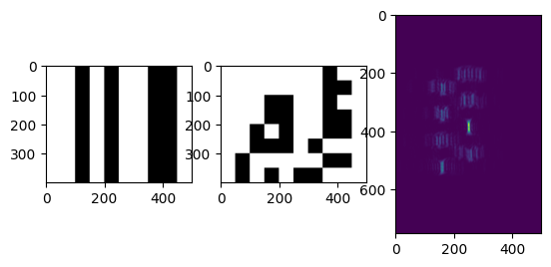
Photonic detection of numerical proximity
Dr. Fabrizio
Coccetti
Experimental results at 8 bits
Advantages:
- numbers can represent any physical quantity (space, time, mass etc.)
- implementation possible with one or more SLMs (the more the better)
- thousand of digits available (SCALABILITY)
C. Conti, F. Coccetti, R. Savo, M. Calvanese Strinati et al. Patent submission in proccess
Notes:
- both phase patterns are displayed over the SLM, the reference is fixed, while the numbers to be compared, the guess, are displayed continuously and summed to the reference. Only the sum between coincident numbers results in a phase sequence made only of 0 and 2pi, which optically is a flat phase pattern
- The more digit we have at our disposal the more accurate can be the number of our interest

Slide 30
Outline
Photonic Extreme Learning Machine
Photonic Classifier of numerical Proximity
Photonic Ising machine and generalized spin system
Photonic computing with nonlinear disorder

Slide 31
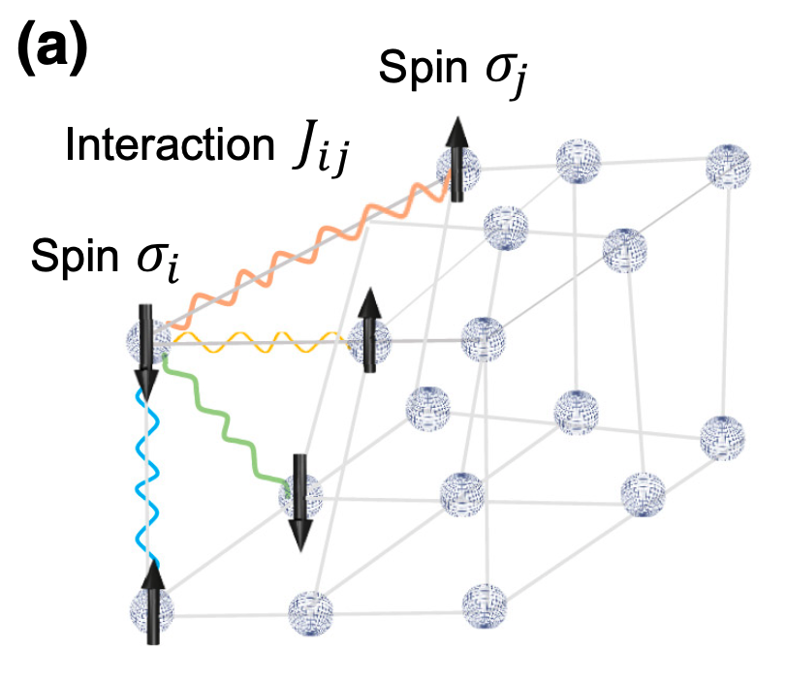
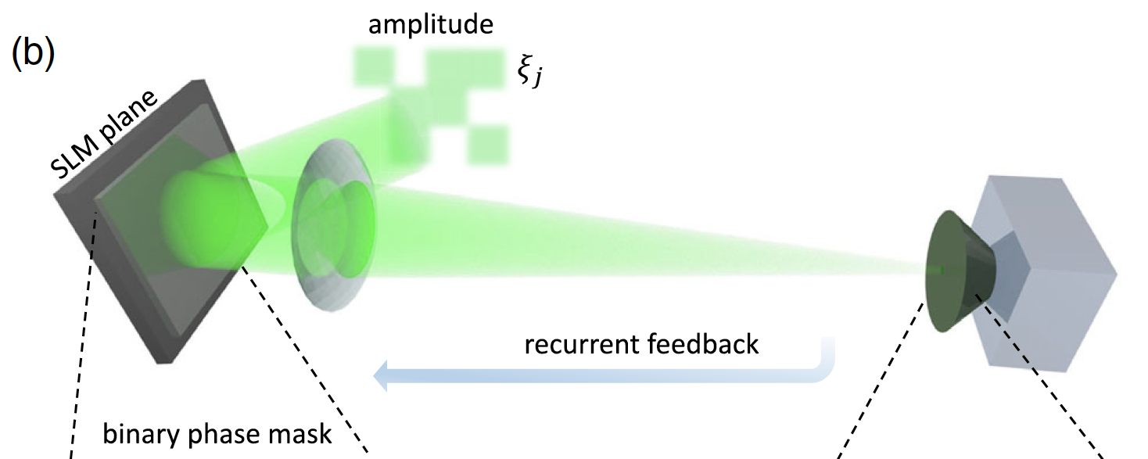
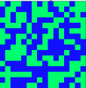
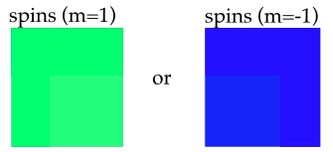
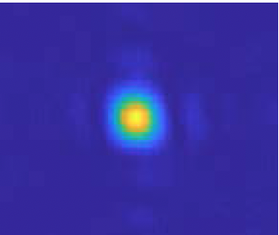
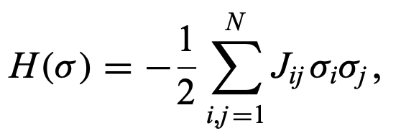


Spatial Photonic Ising Machine (SPIM)
Prof. Claudio Conti
Solving NP-hard combinatorial problems with optics
$$φ=π$$
$$φ=0$$
Solution
Target image
Two-body interaction
D. Pierangeli, G. Marcucci, and C. Conti, PRL (2019)

Slide 32

Theoretical research on generalized spin models
Dr. Marcello
Calvanese Strinati
Hyperspin machine
Coupled parametric oscillators (PO)
M. Calvanese Strinati and C. Conti - Nature Commun. 13, 7248 (2022)
Notes:
In his theoretical activity Dr. Strinati uses parametric oscillators, which have amplitude and phase, as elements to investigate generalized spin models, specifically to develop optimization architectures to be implemented in photonic and quantum platforms.

Slide 33


Theoretical research on generalized spin models
Dr. Marcello
Calvanese Strinati
Emergent equilibrium in the all-optical spatial Ising machine
M. Calvanese Strinati & C. Conti Phys. Rev. A 112, 053505 (2025)
J. Tosca, M. Calvanese Strinati, C. Conti, & C. Ciuti, Phys. Rev. Lett. 134, 230404 (2025)
Notes:
In this work they simulate the dynamics of general spatial ising machine in the presence of noise, proposing also an optical implementation, and investigate the corresponding statistics of equilibrium energy. As we see in the figures, they consider different type of coupligs , rapresented by the connectining lines, observing in both cases as exponential distribution of the energy. This shows that in the presence of stochastic fluctuations Ising Machines can also be used ad Boltzman machines.

Slide 34

Theoretical research on generalized spin models
Dr. Marcello
Calvanese Strinati
Quantum hyperspin models
M. Calvanese Strinati & C. Conti, Phys. Rev. A 109, 063519 (2024)
M. Calvanese Strinati & C. Conti, Phys. Rev. A 111, 043712 (2025)
Notes:
In this work they made a quantum mechanical analysis of a system of one to three optical parametric oscillators , by using the formalism of open dissipative systems.
In the first paper they considered a single oscillator and studies its non-gaussian properties in corrispondence of the trashold transition
In the second paper they extened this approach to two and three parametric oscillators that are coupled
N(ro) is a measurement of the entanglement.
Why? Possible quantum advantage. The stydies show that the computing complexity and thus necessary resources is extremely high already for few oscillators, menaing that a diffenret formalism is required.

Slide 35
Outline
Photonic Extreme Learning Machine
Photonic Classifier of numerical Proximity
Photonic Ising machine and generalized spin system
Photonic computing with nonlinear disorder

Slide 36

Photonic computing with $χ^{(2)}$ nonlinear disorder
Notes:
This is an asset of the

Slide 37

Photonic computing with $χ^{(2)}$ nonlinear disorder
Second harmonic generation (SHG)
$\vec{P}=ε_{0}χ^{(1)}\vec{E}+ε_{0}χ^{(2)}\vec{E}2+$…

Slide 38

Photonic computing with $χ^{(2)}$ nonlinear disorder
Nonlinear $χ^{(2)}$ photonic disorder
Second harmonic generation (SHG)
$\vec{P}=ε_{0}χ^{(1)}\vec{E}+ε_{0}χ^{(2)}\vec{E}2+$…
R. Samanta, R. Savo, C. Conti, S. Mujumdar, arXiv:2504.14589 (2025)

Slide 39








Assembling disordered nonlinear suprastructures
Barium titanate
Litium Niobate
BaTiO₃
LiNbO₃
R. Savo et al., Nature Photonics 14 740-747. 2020
A. Morandi, R. Savo et al. ACS Photonics 9, 2022

Slide 40





Assembling disordered nonlinear suprastructures
Barium titanate
Litium Niobate
BaTiO₃
LiNbO₃
R. Savo et al., Nature Photonics 14 740-747. 2020
A. Morandi, R. Savo et al. ACS Photonics 9, 2022
Rachel Grange’s group

Slide 41











Photonic computing with $χ^{(2)}$ nonlinear disorder
Jianqi HU
LKB/EPFL
Qiang Liu
THU
Rachel Grange
ETH
Sylvain Gigan
LKB/ENS
Notes:
We are an international reference in this field, nearly wo years ago we have demonstrated….and we wrote a review paper on the subject, which is on the arxiv and under review in `nature review physics

Slide 42



Photonic computing with $χ^{(2)}$ nonlinear disorder
Jianqi HU
LKB/EPFL
Qiang Liu
THU
Rachel Grange
ETH
Sylvain Gigan
LKB/ENS
Review article
Rabisankar Samanta
TAFR
Sushil Mujumdar
TAFR
Claudio Conti
Sapienza /CREF
arXiv:2504.14589 (2025)
Under review in Nature Review Physics
Notes:
We are an international reference in this field, nearly wo years ago we have demonstrated….and we wrote a review paper on the subject, which is on the arxiv and under review in `nature review physics

Slide 43






Information processing with $χ^{(2)}$nonlinear disorder
Linear speckle ($ω$)
Nonlinear speckle ($2ω$)
$$α$$
$$E_{α}\left(ω\right)=\sum_{j}{t_{αj}E_{j}\left(ω\right)}$$
$$E_{α}\left(2ω\right)=\sum_{jk}{d_{αjk}E_{j}\left(ω\right)E_{k}\left(ω\right)}$$
Linear transmission matrix
Nonlinear transmission tensor
SM Popoff et al., PRL (2010)
J. Moon et al., Nature Physics (2023)
R. Samanta, R. Savo, C. Conti, S. Mujumdar, arXiv:2504.14589 (2025)

Slide 44
Information processing with $χ^{(2)}$nonlinear disorder
Linear speckle ($ω$)
Nonlinear speckle ($2ω$)
$$E_{α}\left(ω\right)=\sum_{j}{t_{αj}E_{j}\left(ω\right)}$$
$$E_{α}\left(2ω\right)=\sum_{jk}{d_{αjk}E_{j}\left(ω\right)E_{k}\left(ω\right)}$$
Linear transmission matrix
Nonlinear transmission tensor
Focusing nonlinear light via wavefront shaping
as a complex computational task
SM Popoff et al., PRL (2010)
J. Moon et al., Nature Physics (2023)
R. Samanta, R. Savo, C. Conti, S. Mujumdar, arXiv:2504.14589 (2025)

Slide 45







Focusing nonlinear light via wavefront shaping
Dr. Michael Raju
Feedback
Focus
SLM
C1: 1050 nm
pump speckle ($ω$)
C2: 525 nm
SHG speckle ($2ω$)
10²
BG area
Focus/BG
Focus
area
SHG enhancement
10¹
Iteration
BG
Experimental setup
10⁰
0
5000
10000
15000
20000
Number of iteration
M. Raju, F. Coccetti, Morandi A., Grange R., C. Conti and R. Savo. In preparation

Slide 46

Focusing nonlinear light via wavefront shaping
Dr. Michael Raju
Emergence of phase correlations
M. Raju, F. Coccetti, Morandi A., Grange R., C. Conti and R. Savo. In preparation
Notes:
- Emerging of correlations in the phase patters unveil the presence of a competition mechanism for enhancing SHG, which changes the properties of the non liner transmission transmission tensor
-The experimental implementation affects the nature of the information processing
enhancement is associated to correlations in the phase patters
Modelling through mesoscopic wave theory
Explanation in terms of reduced number of degrees of freedom
Derivation of a more general definition of the nonlinear transmission tensor

Slide 47





Focusing nonlinear light via wavefront shaping
Dr. Michael Raju
Emergence of phase correlations
Theory
Projector operator
$$P(w) = ∫dρ s(ρ)|ρ⟩⟨ρ|$$
$$s_{w}\left(ρ\right)=\exp\left[−\frac{{\left(ρ−ρ_{0}\right)}^{2}}{w^{2}}\right]$$
Projected nonlinear tensor
$$d_{αmn}^{proj} =\sum_{j=1}^{N}{\sum_{k=1}^{N}{d_{αjk}}} P_{mj} P_{nk}.$$
$$d_{α}^{proj}=𝒫 d_{α} 𝒫^{𝒯}$$
M. Raju, F. Coccetti, Morandi A., Grange R., C. Conti and R. Savo. In preparation
Notes:
- Emerging of correlations in the phase patters unveil the presence of a competition mechanism for enhancing SHG, which changes the properties of the non liner transmission transmission tensor
-The experimental implementation affects the nature of the information processing
enhancement is associated to correlations in the phase patters
Modelling through mesoscopic wave theory
Explanation in terms of reduced number of degrees of freedom
Derivation of a more general definition of the nonlinear transmission tensor

Slide 48



Outlook: SPIM with nonlinear $χ^{(2)}$ photonic disorder
Four-body interaction in a Spin Glass
Nonlinear transmission tensor
_
$$E_{α}\left(2ω\right)=\sum_{jk}{d_{αjk}E_{j}\left(ω\right)E_{k}\left(ω\right)}$$
Projected nonlinear tensor
$$d_{αmn}^{proj} =\sum_{j=1}^{N}{\sum_{k=1}^{N}{d_{αjk}}} P_{mj} P_{nk}.$$

Slide 49
Conclusions and Outlook
Master/phd
Student
SHE?
Master/phd
Student
SHE?
Photonic Extreme Learning Machine
Photonic Classifier of numerical Proximity
Photonic computing with nonlinear disorder
Photonic Ising machine and generalized spin system
romolo.savo@cref.it
Notes:
Using light propagation in free-space and engineered media to accelerate computing tasks for machine learning
We look for having 1 or 2 students to join the group, ideally such as to balance the gender gap we currently experience

Slide 50
THANK YOU

Slide 51




Photonic computing: why?
Machine Learning
Classification
Detection
Segmentation
https://analyticsindiamag.com/top-5-image-classification-research-papers-every-data-scientist-should-know/
Natural language processing
https://techblog.smc.it/it/2020-05-25/machine-learning-industry
Artificial Intelligence in daily life, R. S. T. Lee (2020)
Notes:
One of our interest is to develop ligh-based platforms and methodology to accelerate machine learning computing operation, which requires processing massive amount of visual data.

Slide 52



Elaborating optical information with multiple light scattering
Laser source
Multiple scattering
Speckle pattern
G. Jacucci et al., Phys. Rev. A. (2022)
S. Gigan, Nat. Phys. (2022)
Animation courtesy of Jacopo Bertolotti , University of Exeter
Notes:
The computing architectures we use relies on light propagation through a complex disordered medium, whose typical example is a layer of white paint.
The refractive index fluctuations created by the randomly distributed nanoparticles prevents light from propagating freely, but force it to scatter multiple times defining a complex interference pattern.
Once the disorder is fixed, the interference is complex, but predictable.
Any information given in input is not lost, but very efficiently scrambled , or processed.
The speckle pattern being the result of the processing
I reccommend this perspective paper by Sylvain Gigan where these concepts are very well discussed

Slide 53




Elaborating optical information with multiple light scattering
Engineered photonic disorder
$$M_{11}$$
$$M_{1N}$$
Random
Matrix
i.i.d.
$$M_{M1}$$
$$M_{MN}$$
D.S. Wiersma – Nature Photonics (2013)
G. Jacucci et al., Phys. Rev. A. (2022)
S. Rotter & S. Gigan – Rev. Mod. Phys. (2017)
S. Gigan, Nat. Phys. (2022)
C. López – Adv. Opt. Mat. (2018)
Carminati, R. & Schotland, J. C.
Principles of Scattering and Transport of Light ( 2021).
Notes:
The computing architectures we use relies on light propagation through a complex disordered medium, whose typical example is a layer of white paint.
The refractive index fluctuations created by the randomly distributed nanoparticles prevents light from propagating freely, but force it to scatter multiple times defining a complex interference pattern.
Once the disorder is fixed, the interference is complex, but predictable.
Any information given in input is not lost, but very efficiently scrambled , or processed.
The speckle pattern being the result of the processing
I reccommend this perspective paper by Sylvain Gigan where these concepts are very well discussed

Slide 54




Artificial NN with $χ^{(2)}$ photonic disorder
SLM
54
Notes:
In the experimental implementation we analyse simultaneously the linear and the nonlinear speckle by keeping the number of speckle feature constant.
We tested the computing performance of the linear and nonlinear light for 14 different ML task datasets of varying complexity ,
We considered image classification, univariate and multivariate regression and graph classification.

Slide 55




Artificial NN with $χ^{(2)}$ photonic disorder
Nonlinear Transmission Tensor
Multi-layer “deep” photonic neural network
For an input size of 64 $×$64 and an output size of 3500, around 18.8 TFLOPS computation is achieved in the experimental system (equivalent to >400 GB of memory usage)
J. Moon et al., Nature Physics (2023)

Slide 56

Results on image classification
Improvement in classification accuracy from 5% to 10% on all image sets
H. Wang, J. Hu*, et al., Nat. Comp. Sci. (2024)
Notes:
All of them are marked with one standard deviation (s.d.) from ten repeated trials for each case.

