Slide 1

Quantitative MRI of the brain
Probing structure, function and energy landscapes in the ageing population
Matteo Mancini
CREF Activities Presentation Day
19/02/2026

Slide 2
Outline
The ageing brain: challenges and opportunities
Goals and impact
Updates on current research lines
Next efforts
Research outputs
Networking
Dissemination
Outreach

Slide 3
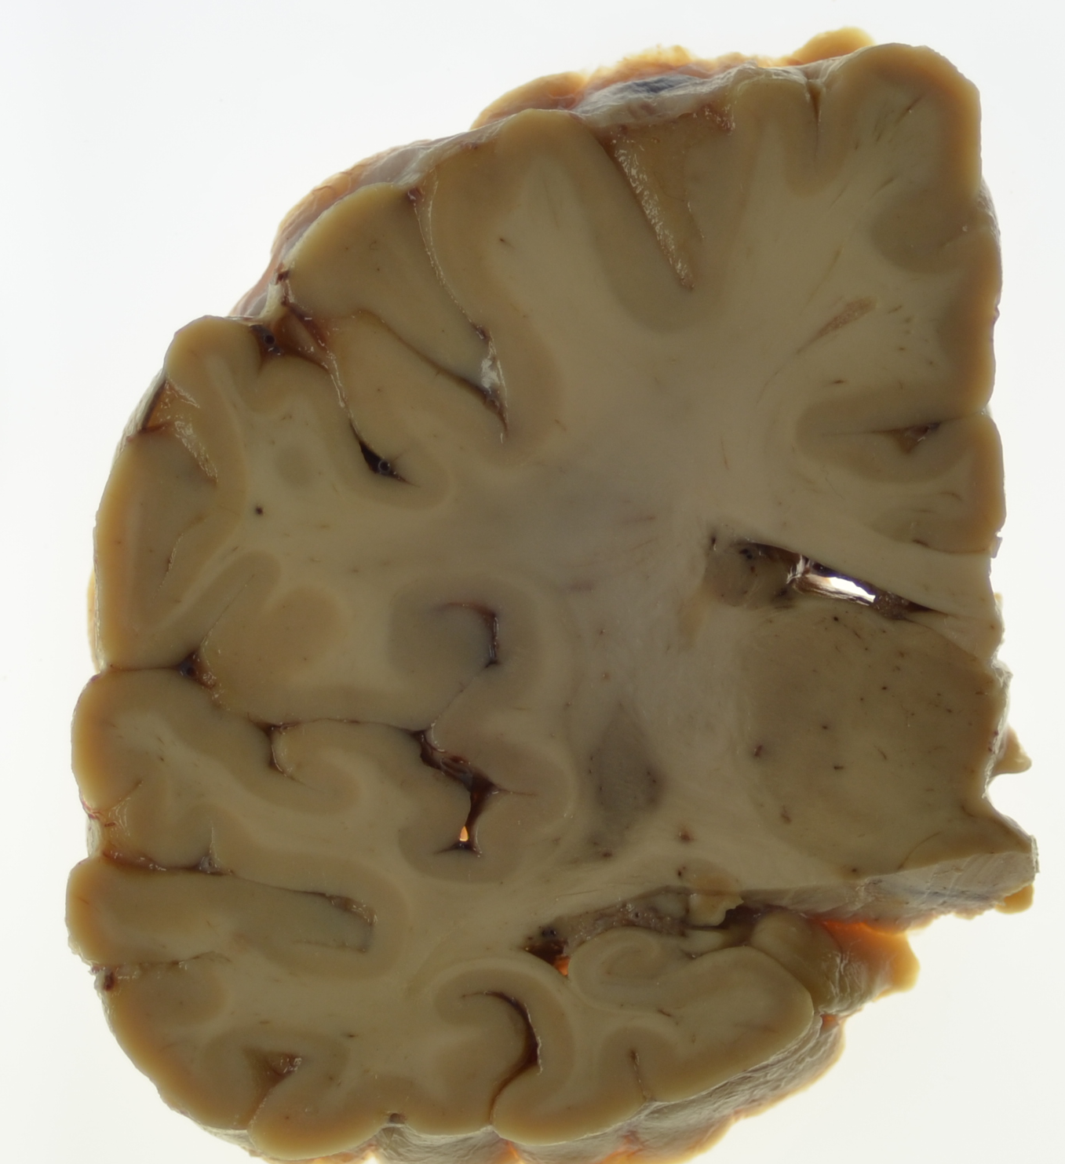
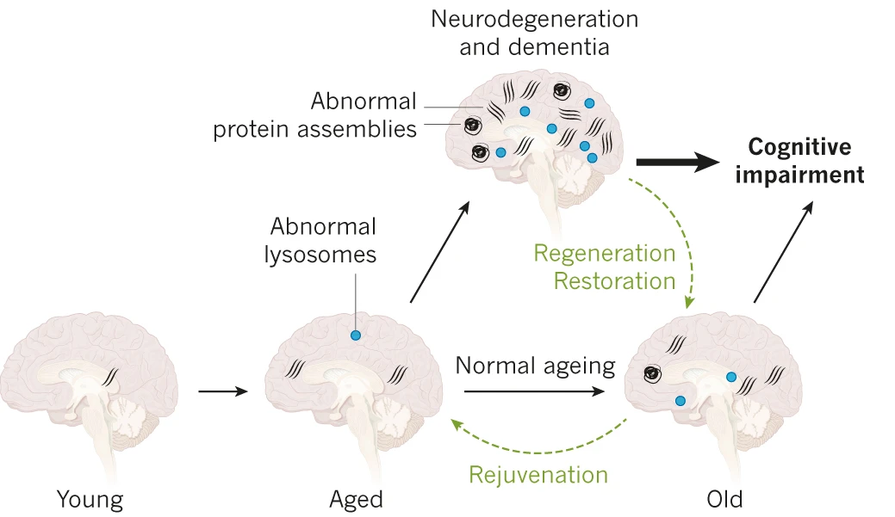
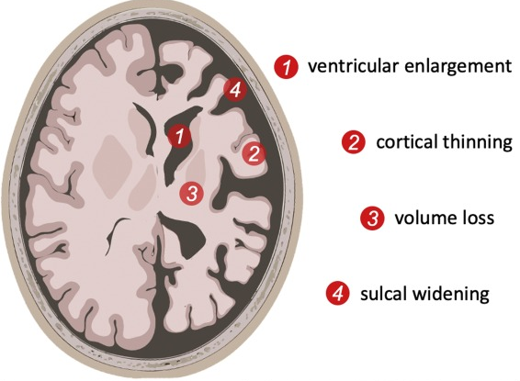
The ageing Brain: challenges and opportunities
There is a growing need for non‑invasive biomarkers to detect these changes early and to better understand their underlying mechanisms.

Slide 4
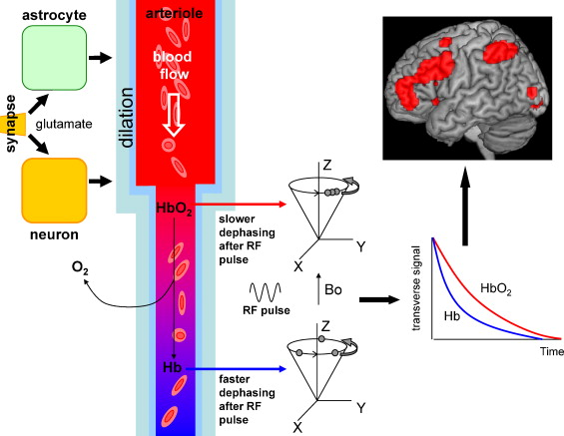
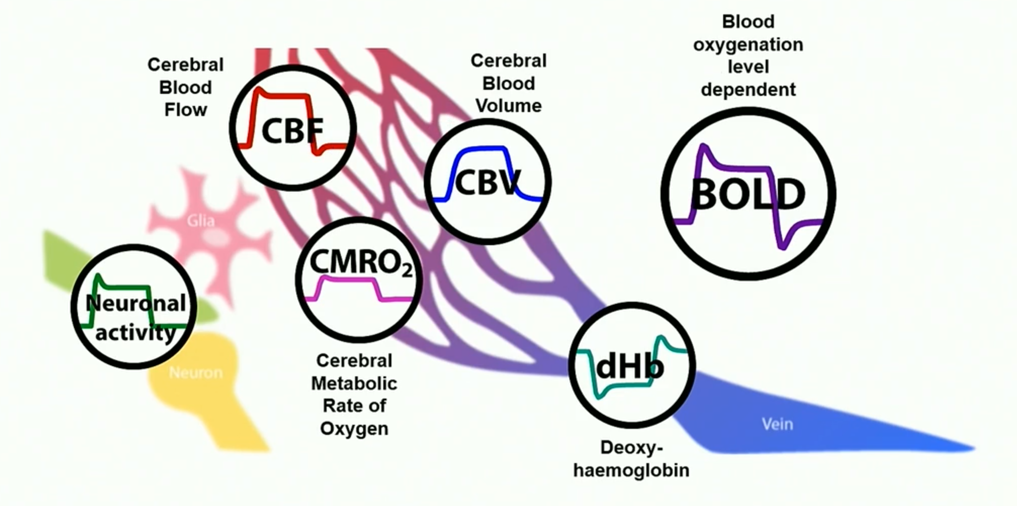
Goals and Impact
Main goal: understanding the link between metabolism and brain function and leveraging this knowledge to characterize neurodegenerative diseases.
Impact: overall characterization of brain physiology and its modulations associated with pathologies and healthy aging.
Why MRI? The magnetic resonance phenomenon offers an irreplaceable way to probe non-invasively microstructural features and physiological mechanisms in living biological tissues;

Slide 5
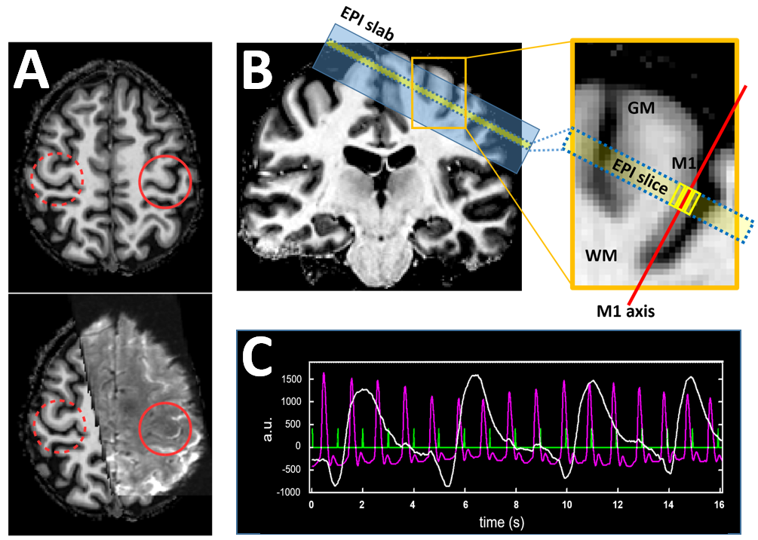
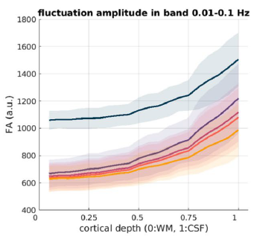
Brain function: addressing physiological NOISE
Functional high‑resolution imaging is strongly affected by noise;
We tested whether removing thermal and physiological noise improves specific measures of brain activity and connectivity;
Reducing both types of noise produced clearer, less biased connectivity patterns across cortical layers;
Giulietti, Guidi et al., submitted
Guidi, Giulietti et al., SciRep 2026

Slide 6
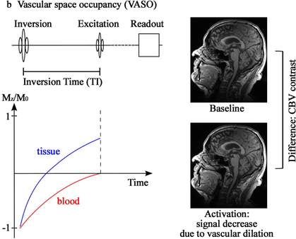
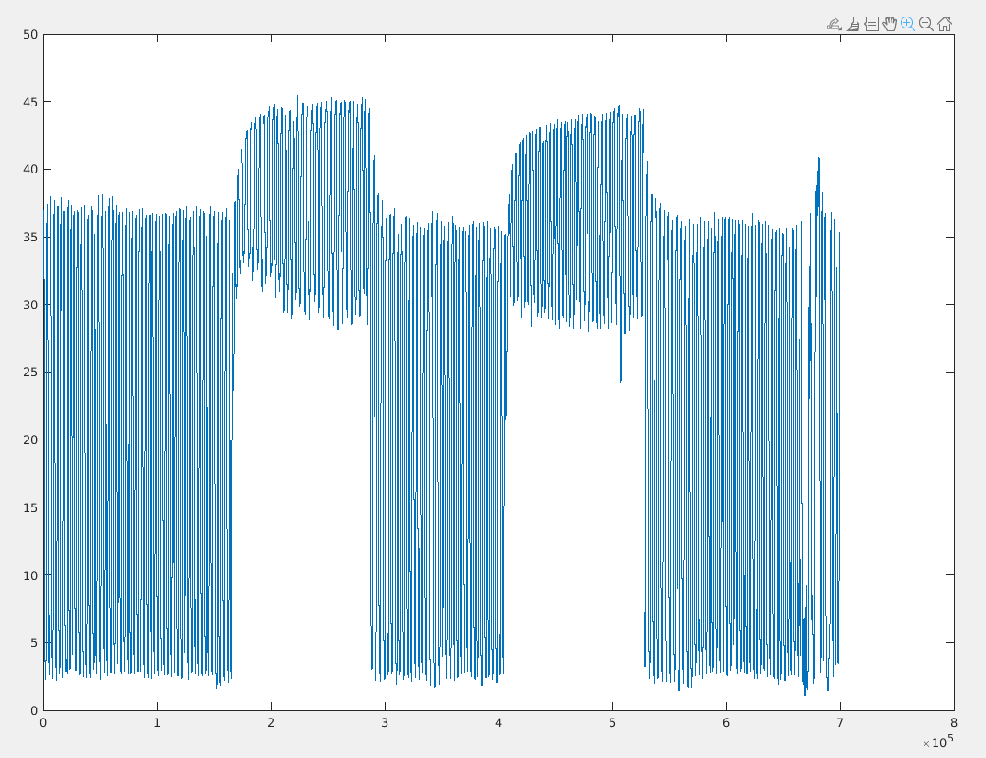
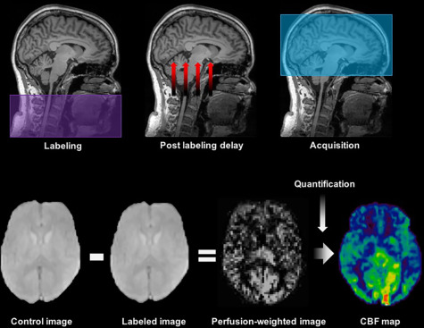
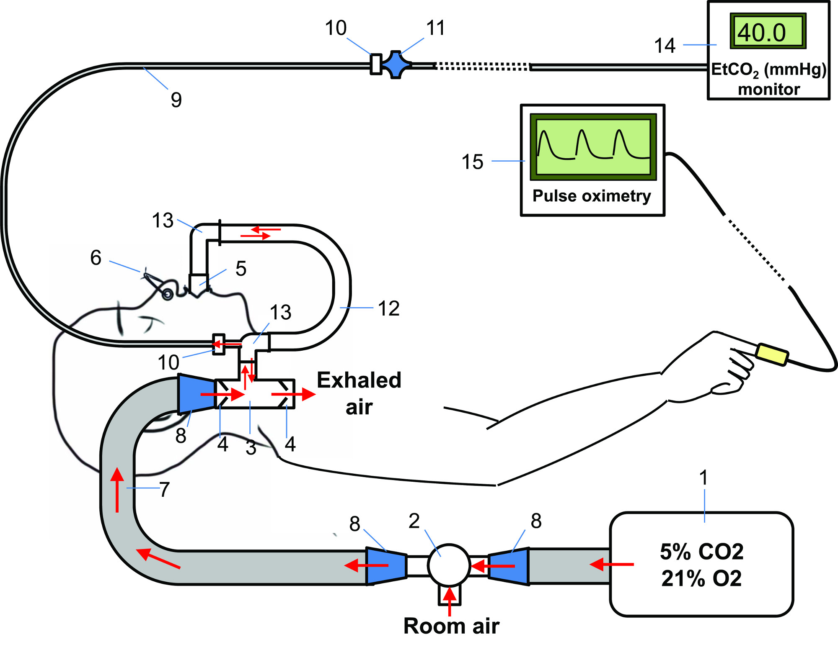
Beyond function: energy and metabolism
End-tidal CO₂
How to disentangle most of the factors underlying function?
Different techniques for different targets:
BOLD – overall effect;
ASL – cerebrovascular flow;
VASO – cerebrovascular volume;
Dataset
100 participants:
45 healthy controls;
32 mild cognitive impaired patients;
23 Alzheimer’s patients
Tailored experimental protocol:
Vasodilatory stimulus that does not affect (relevantly) oxygen consumption;
Achieved through hypercapnia – administering carbon dioxide with a block experimental design;

Slide 7
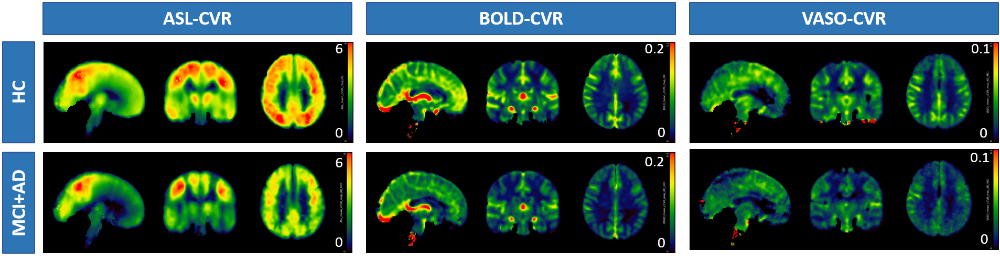
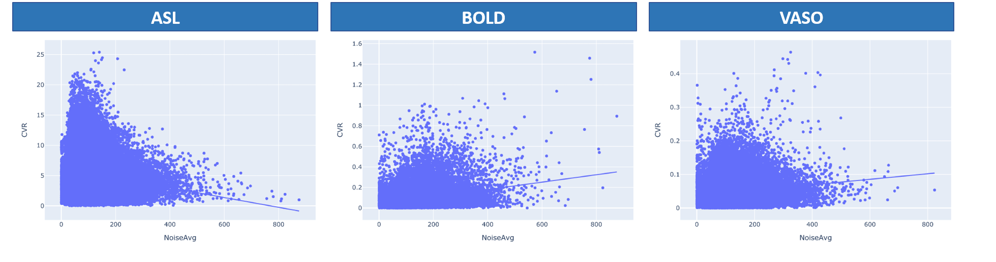
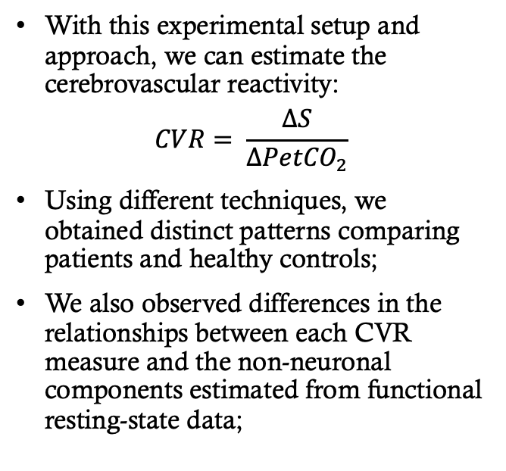
Assessing the cerebrovascular substrate: reactivity measures
With this experimental setup and approach, we can estimate the cerebrovascular reactivity:
$$CVR= \frac{∆S}{∆{PetCO}_{2}}$$
Using different techniques, we obtained distinct patterns comparing patients and healthy controls;
We also observed differences in the relationships between each CVR measure and the non-neuronal components estimated from functional resting-state data;
Guidi et al., bioRxiv 2025

Slide 8
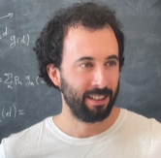
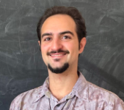
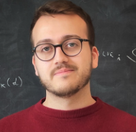
Assessing the cerebrovascular substrate: approaches from complex systems
Global functional and metabolic measures carry information about the overall organization of the brain in terms of:
Network structure;
Intrinsic timescales;
Multiscale structure;

Slide 9
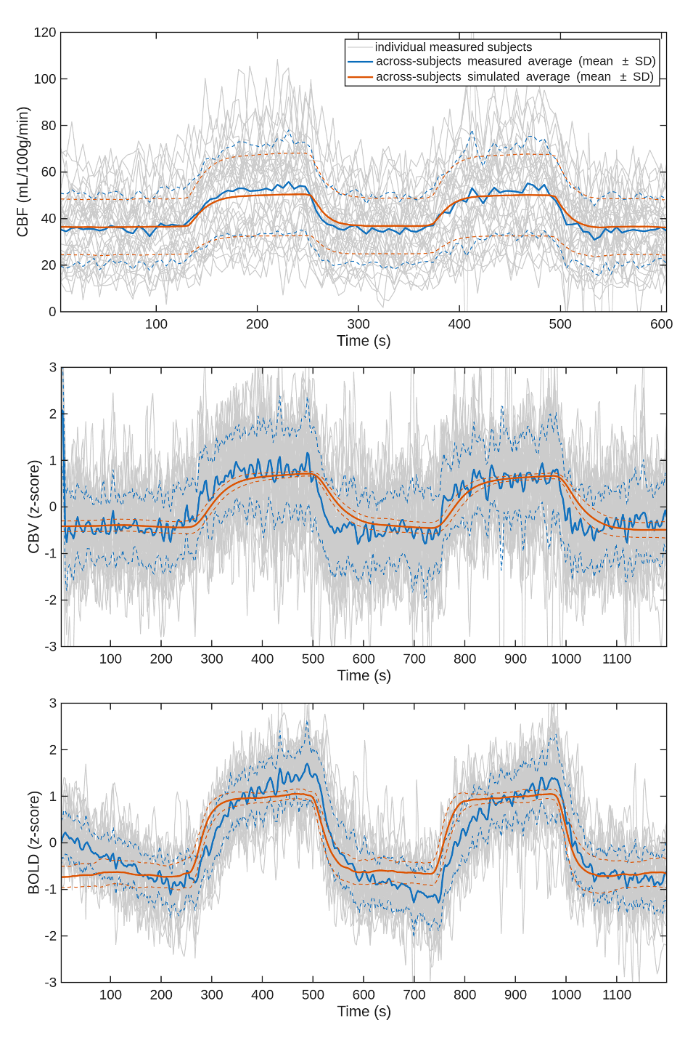
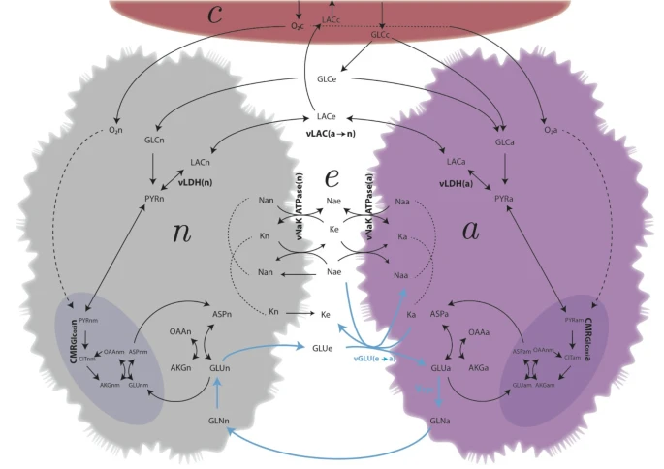
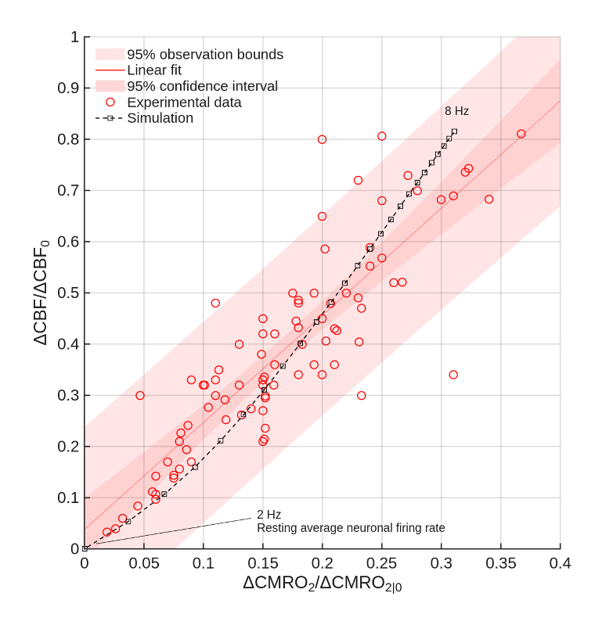
From assessing to Predicting: Modelling cerebrovascular dynamics
Vessels
Using the acquired data and a physiologically validated computational model, we estimated delay, time constant, and gain by optimizing the mapping of end-tidal gases to their arterial counterparts;
Once parametrized using CBF, the model successfully predicted CBV and BOLD responses in independent experimental sessions;
Aging was associated with heterogeneous region-specific changes in delay and substantial reductions in gain and time constant, indicating that cerebrovascular responses become weaker and less adaptable with age;
Extracellular
Neurons
Astrocytes
DiNuzzo et al., bioRxiv 2025

Slide 10
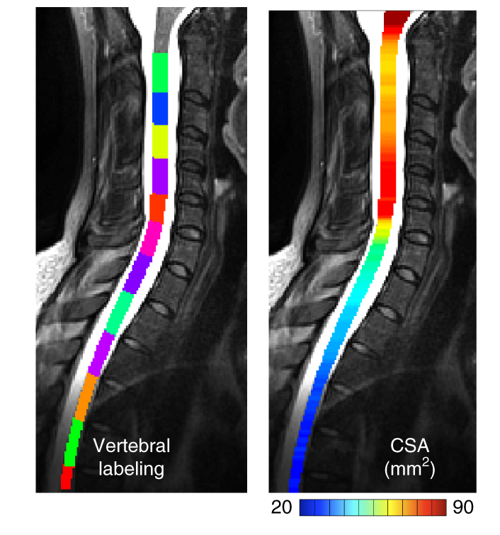
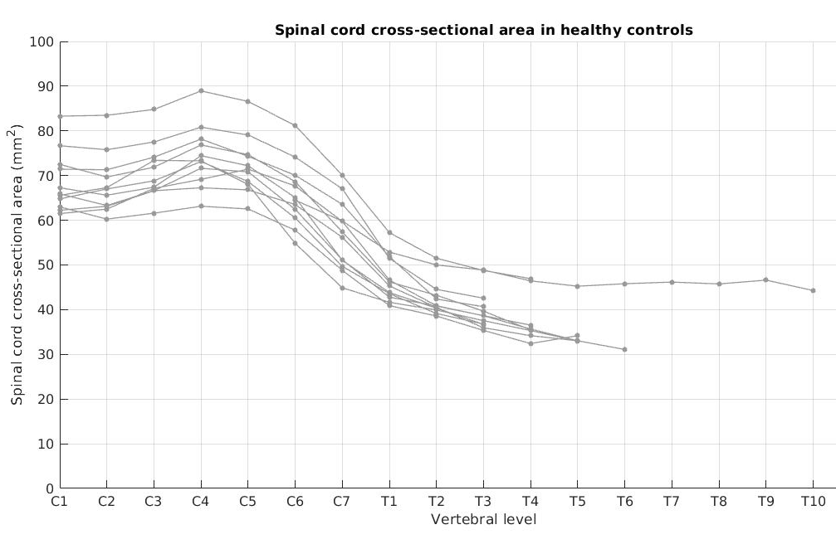
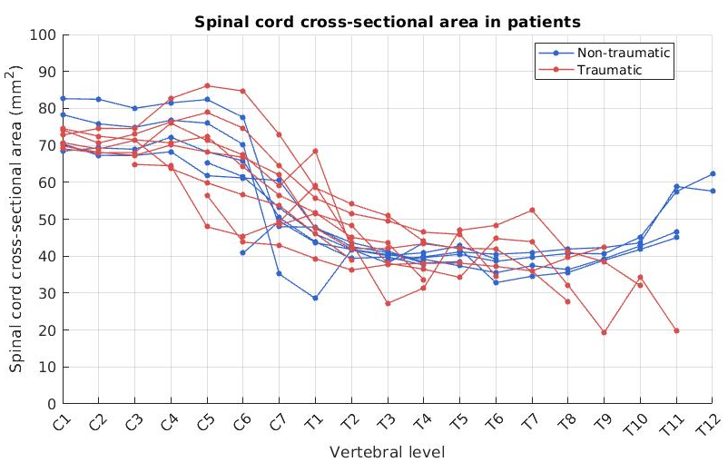
Beyond the brain: characterising the Spinal cord
Optimized experimental and spinal cord data analysis protocol for study patients with traumatic and inflammatory spinal cord injuries, both cervical and dorsal;
To characterize the extent of the damage and predict clinical outcomes, lesion segmentation is currently under development;
Lesion segmentation will allow for precise localization of the damage, enabling morphometric measurements.

Slide 11
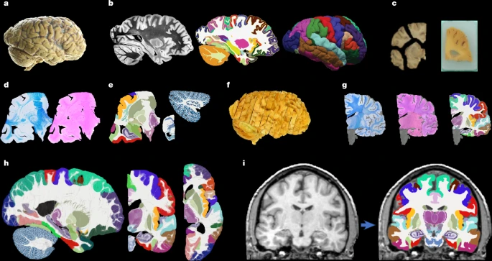

Towards multimodal efforts
Casamitjana, Mancini, Robinson et al., Nature 2025

Slide 12
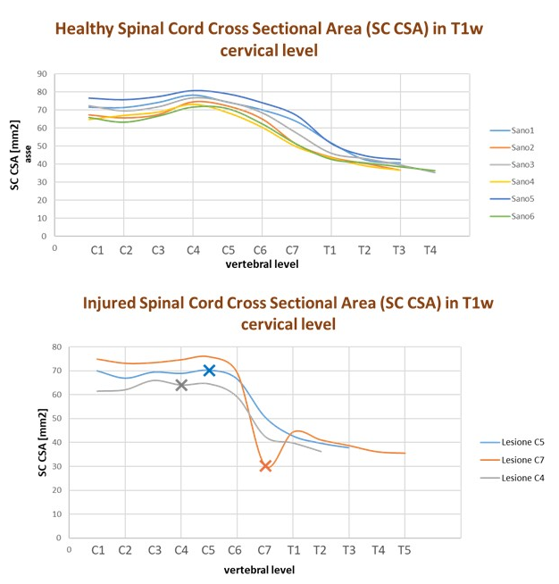
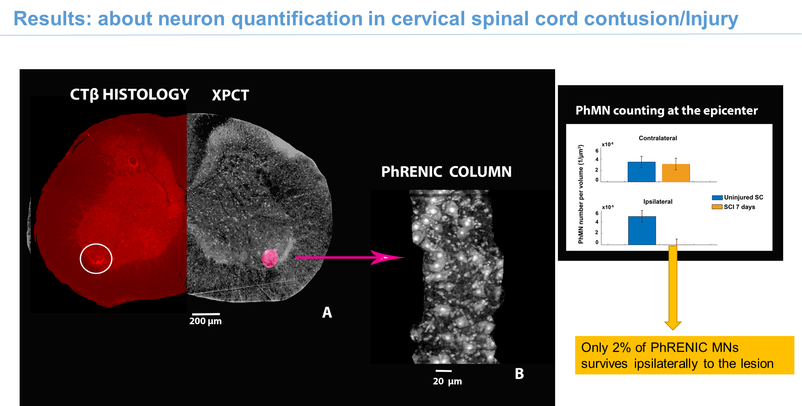
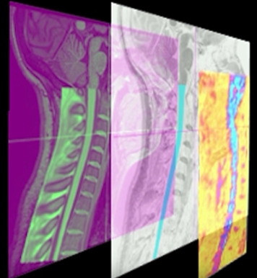
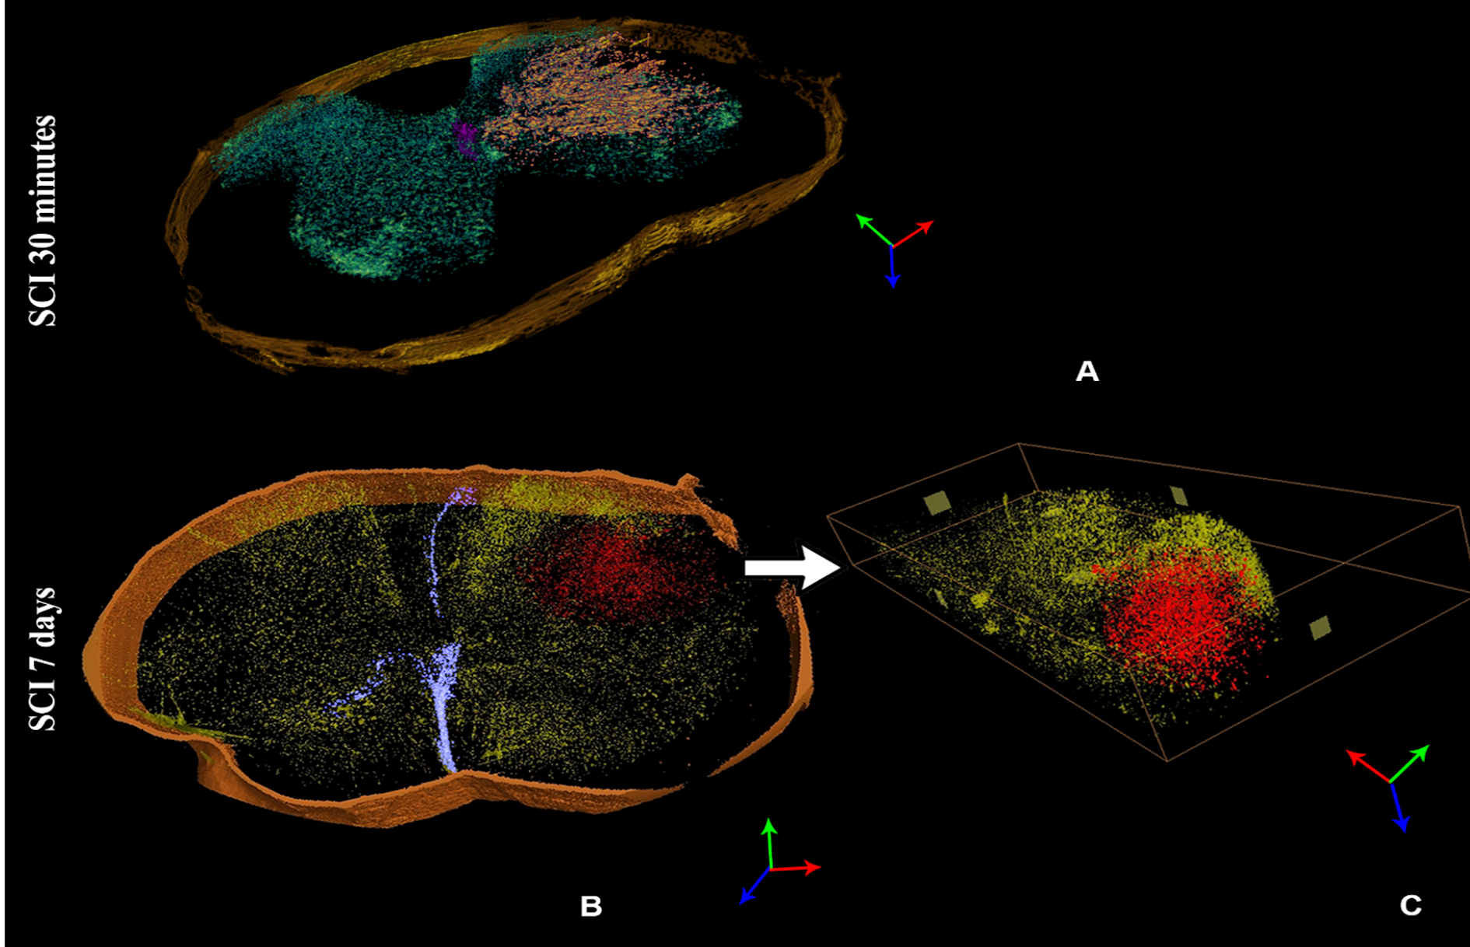
Towards multimodal efforts
HR XPCT, Hysto
& models
for metrics validation
MRI metrics in SC injury
2024-2026 NextGenerationEU and MOH PNRR, “MULTISPINE’’

Slide 13
Main Research outputs
Highlights
M. Guidi et al. Impact of thermal and physiological denoising on laminar functional connectivity. Scientific Reports (2026). In press.
A. Casamitjana et al. A probabilistic histological atlas of the human brain for MRI segmentation. Nature 648, 678–685 (2025).
F. Mangini et al. Towards whole brain mapping of the hemodynamic response function. Journal of Cerebral Blood Flow and Metabolism (2025), 45(9):1731-1747.
Preprints
M. Guidi et al. Non-neuronal signal fluctuations in Alzheimer's disease and in mild cognitive impairment. bioRxiv (2025).
M. DiNuzzo et al. Cerebrovascular response dynamics to hypercapnia in healthy aging. bioRxiv (2025).
Journal papers
F. Bencivenga et al. MOTUM. A system for motion online tracking under MRI. Imaging Neuroscience 4 :IMAG.a.1081 (2026).
L. Serra et al. Surface­-based but not voxel-­based morphometry reveals structural abnormalities in individuals with subjective cognitive decline. Journal of Alzheimer’s Disease 109 (2026).
L. Serra et al. Bridging Cognitive Reserve and Cerebellar Networks: Counteracting brain damage in patients with Alzheimer’s disease at different clinical stages. Frontiers in Cellular Neuroscience (2026). In press.
S. Bonarota et al. Integration of automatic MRI segmentation techniques with neuropsychological assessments for early diagnosis and prognosis of Alzheimer’s disease. A systematic review. Neuroimage 314 :121264 (2025).
M.S. De Simone et al. Long-term associative memory and spatial pattern separation impairments in individuals with subjective cognitive decline: A neuropsychological and medial temporal lobe subregions volumetric analysis. Cortex (2025), 192:196-212.
I. Egidi et al. Compartmentalisation of sodium in the human brain: a mini­review of 23Na MRI methods. Frontiers in Physics 13 (2025), 1487822.
M. Fratini, et al. Optimising sample preparation to enhance Contrast to Noise ratio in Xray Phase contrast Tomography White Matter Imaging of the Central Nervous System. Frontiers in Physics 13 (2025), 1479573.
R. Labounek et al. Body size and intracranial volume interact with the structure of the central nervous system: A multi­center in vivo neuroimaging study. Imaging Neuroscience 3:imag_a_00559 (2025).
S. Lasaponara et al. Changes in brain functional connectivity underlying the Space-Number Association. Journal of Cognitive Neuroscience 37 (2025), 210–226.
A. Maiuro et al. New functional MRI experiments based on fractional diffusion representation show independent and complementary contrast to diffusion­-weighted and BOLD functional MRI. Applied Sciences 15 :4930 (2025).
S. Mangia et al. Reduced removal of energy metabolism waste takes center stage in human brain aging. Scientific Reports 15 (2025), 8127.
M. Moraschi et al. Influence of scanning plane on human spinal cord functional Magnetic Resonance echo planar imaging. PLOS One (2025), 20(5).
C. Pellicano et al. Contribution of cerebellar Glutamatergic and GABAergic systems in Premotor and Early Stages of Parkinson’s Disease. International Journal of Molecular Sciences 26 :10754 (2025).
C. Perciballi et al. How spontaneous brain activity encodes the observation of grasping movements. Neuroimage 318 :121396 (2025).
M. Schettino et al. Predicting repetitive negative thinking in daily life: Insights from the brain­-based graph-­theoretical predictive modeling. Biological Psychiatry: Cognitive Neuroscience and Neuroimaging (2025).
M. Schettino et al. State-­dependent reactivity of anterior cingulate cortex neurochemistry and downstream autonomic arousal in intrusive thinking. Journal of Neural Transmission 132 (2025), 1363–1378.
V. Sulpizio et al. Unveiling the neural network involved in mentally projecting the self through episodic autobiographical memories. Scientific Reports 15 :12781 (2025).

Slide 14
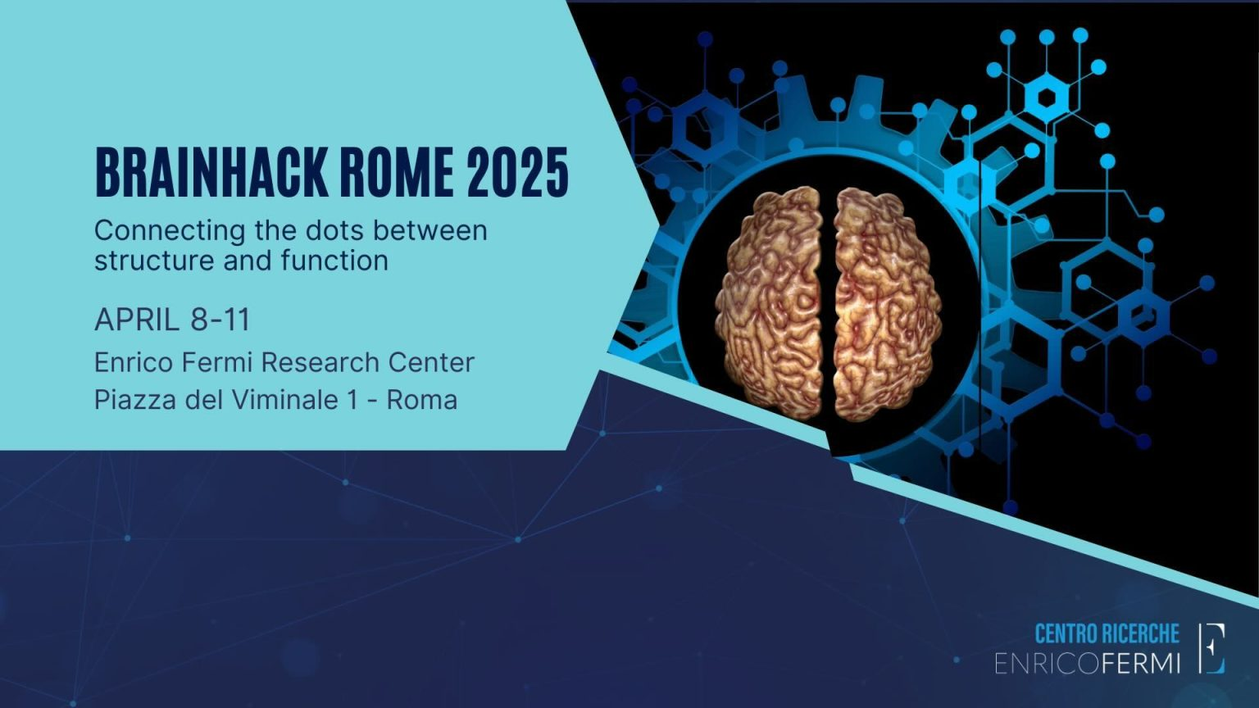
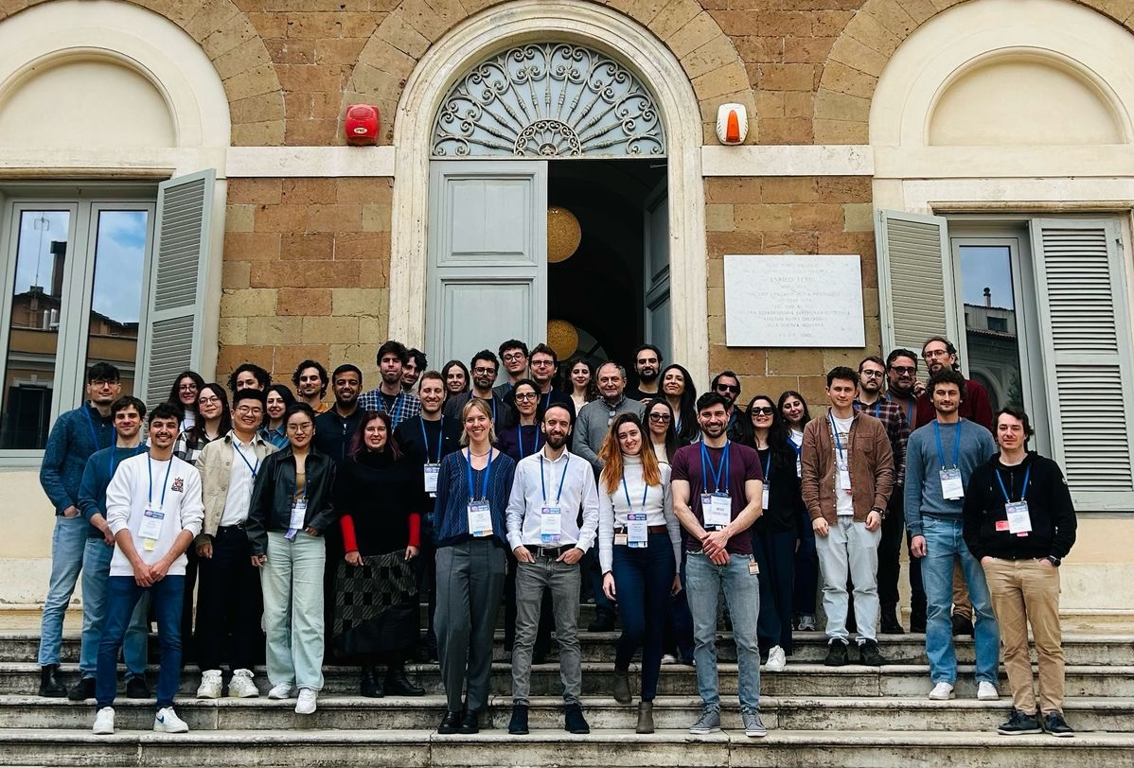
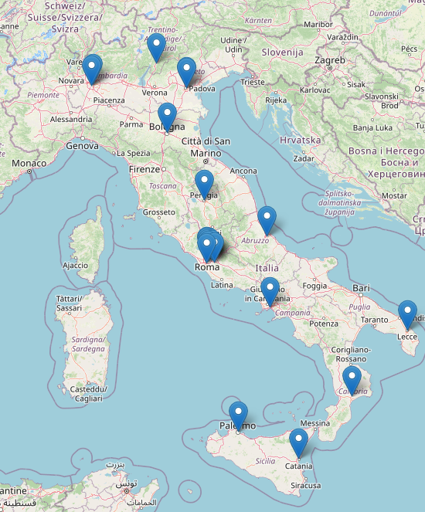
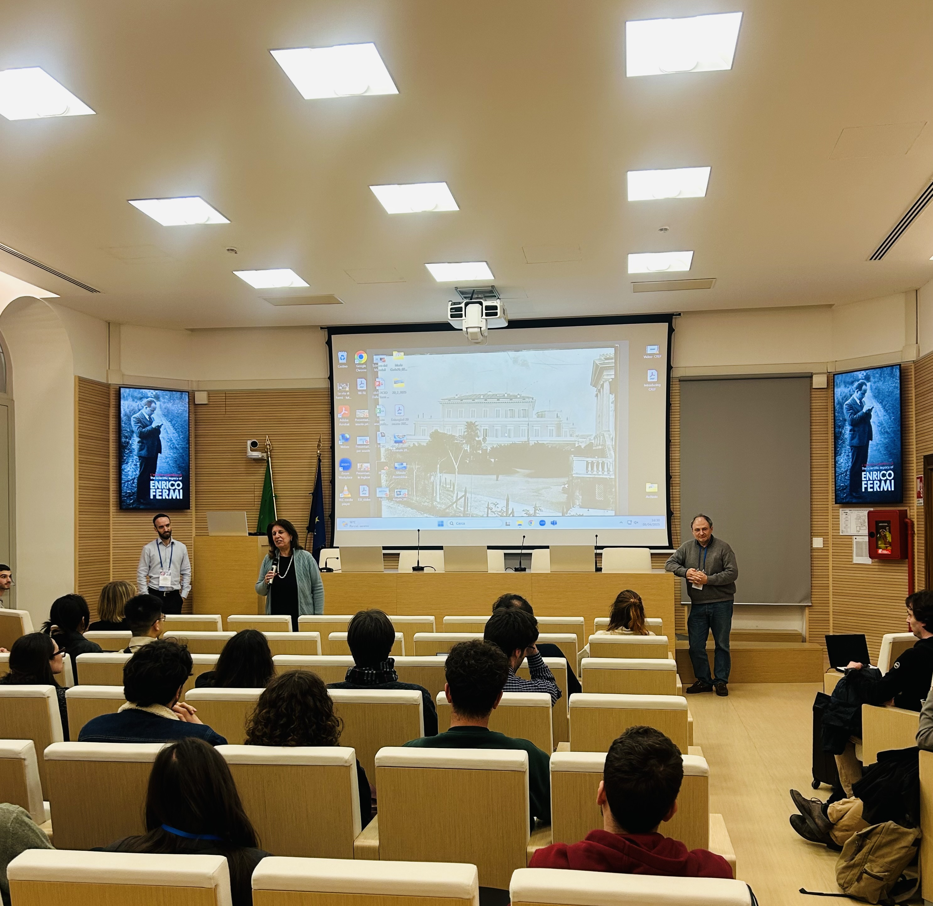
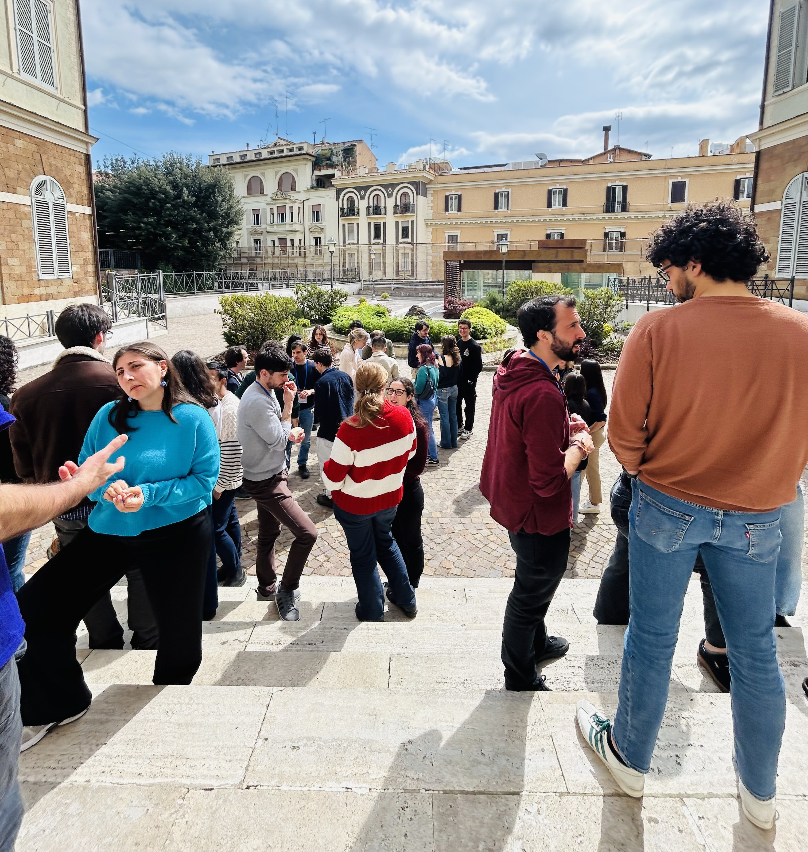
Networking
Brainhack (8th-11th April): a hackathon-like event to start new bottom-up collaborations;
40 participants from all over Italy, working together for four intensive days;
Six projects on several topics:
brain connectivity;
microstructure;
functional states;
multimodal imaging;
Proceedings submitted to Brain Structure and Function;

Slide 15
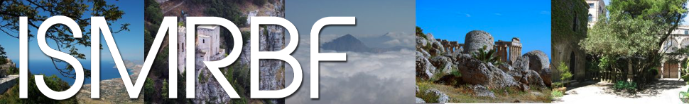
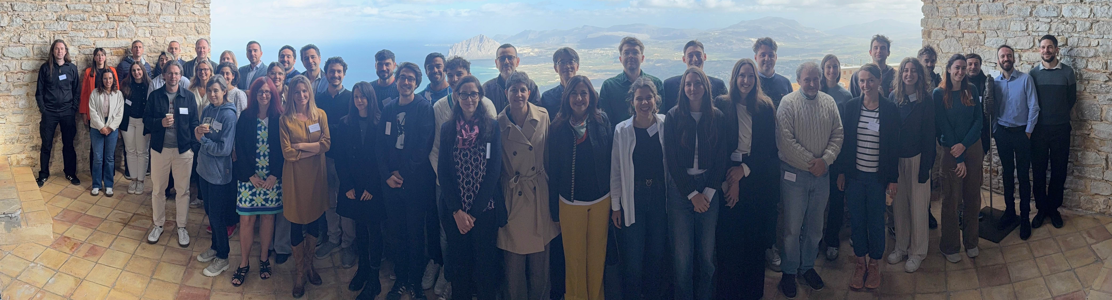
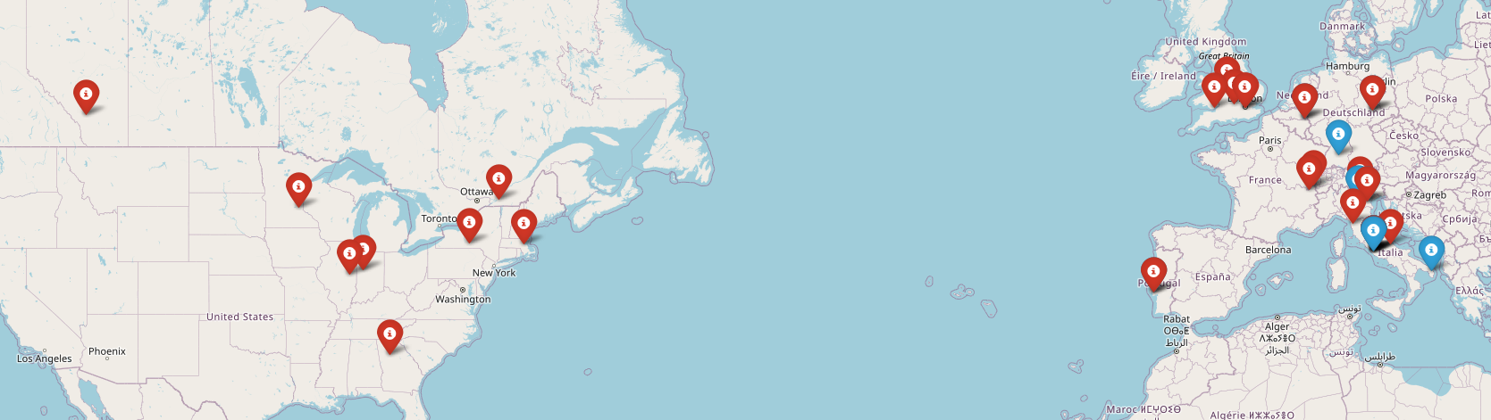
Dissemination
International School on Magnetic Resonance and Brain Function (24th -29th October):
Organised at the Centre for Scientific Culture of the Ettore Majorana Foundation in Erice, Sicily;
30 participants and 25 speakers for an intensive four-day schedule with lectures and poster sessions, covering:
MRI functional and metabolic techniques;
Microstructural modelling;
Complex system-based approaches;

Slide 16
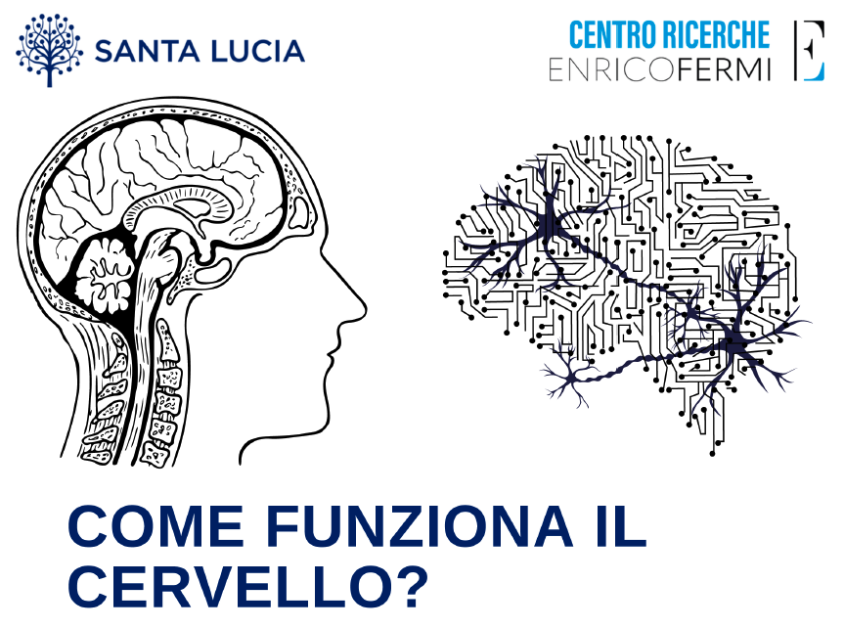
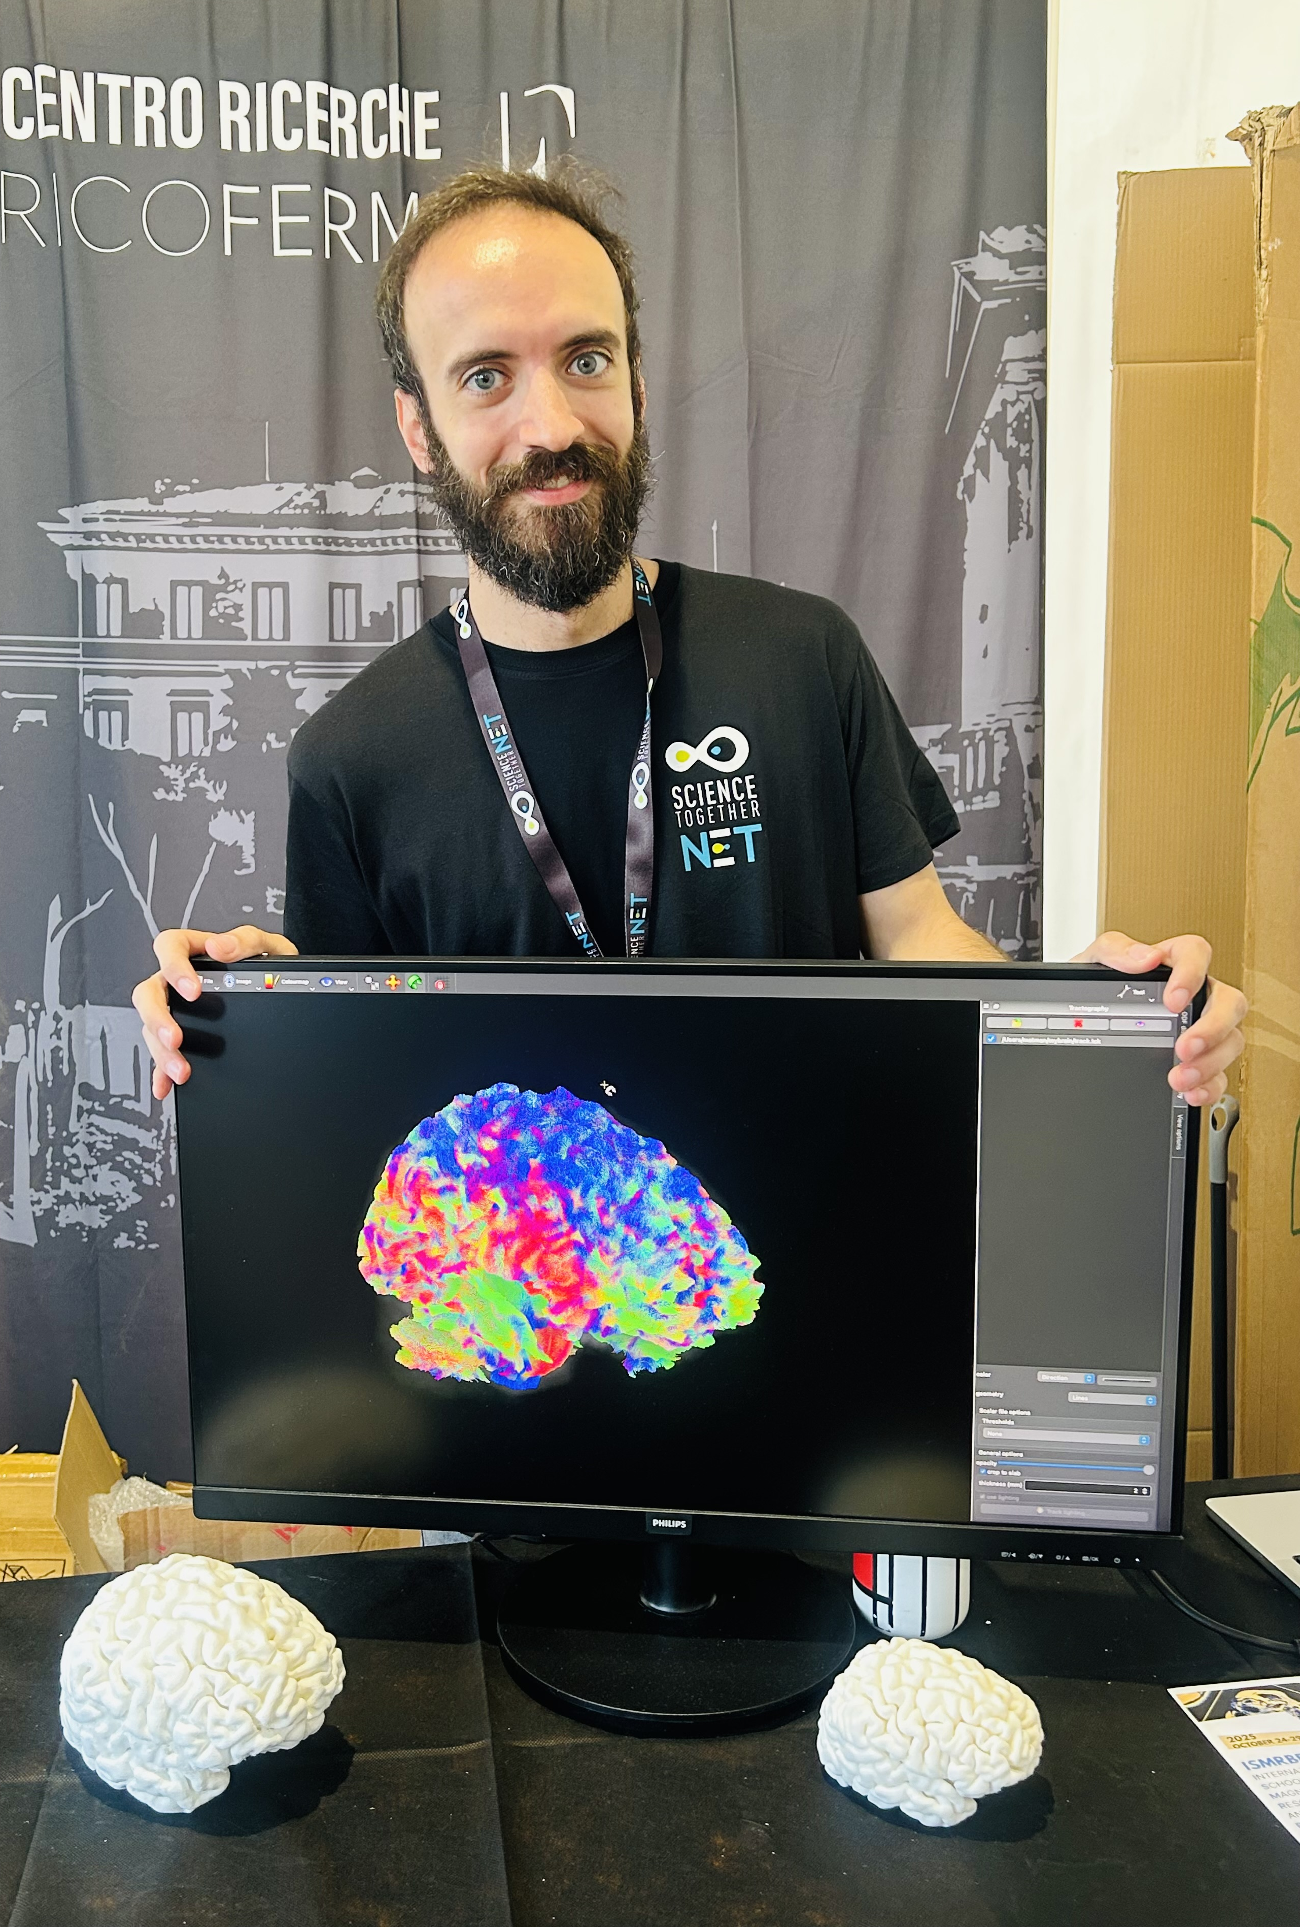
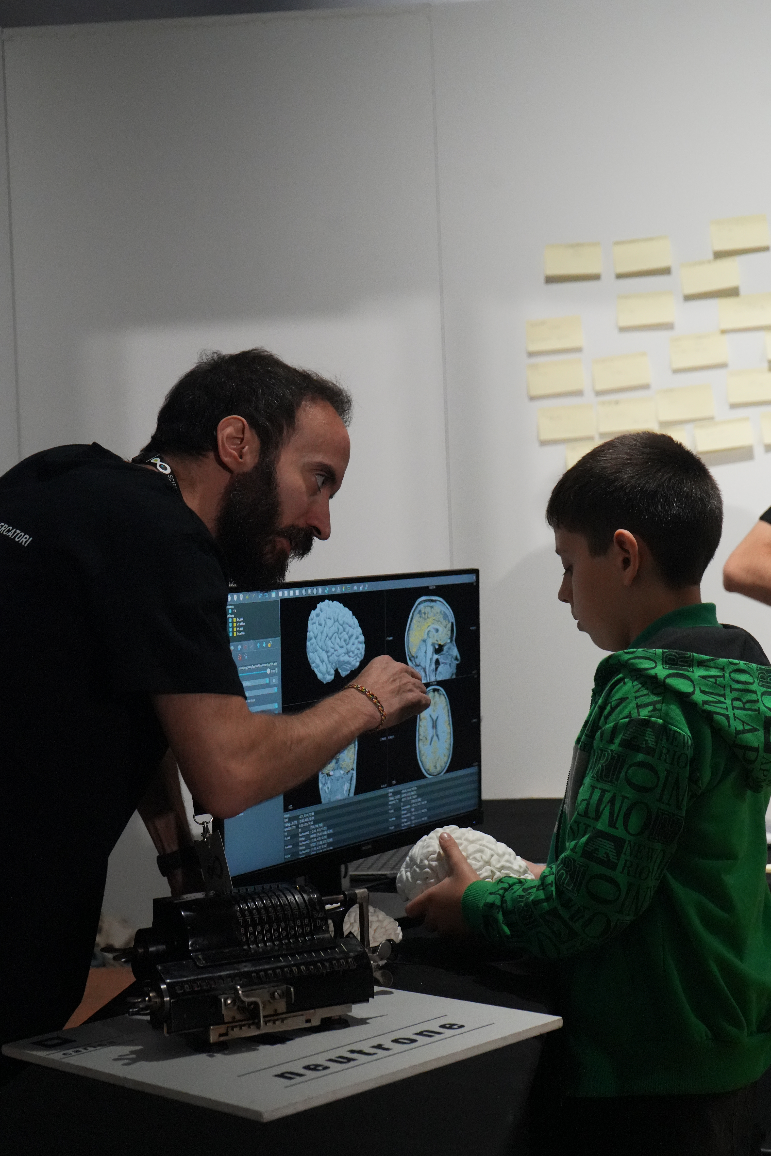
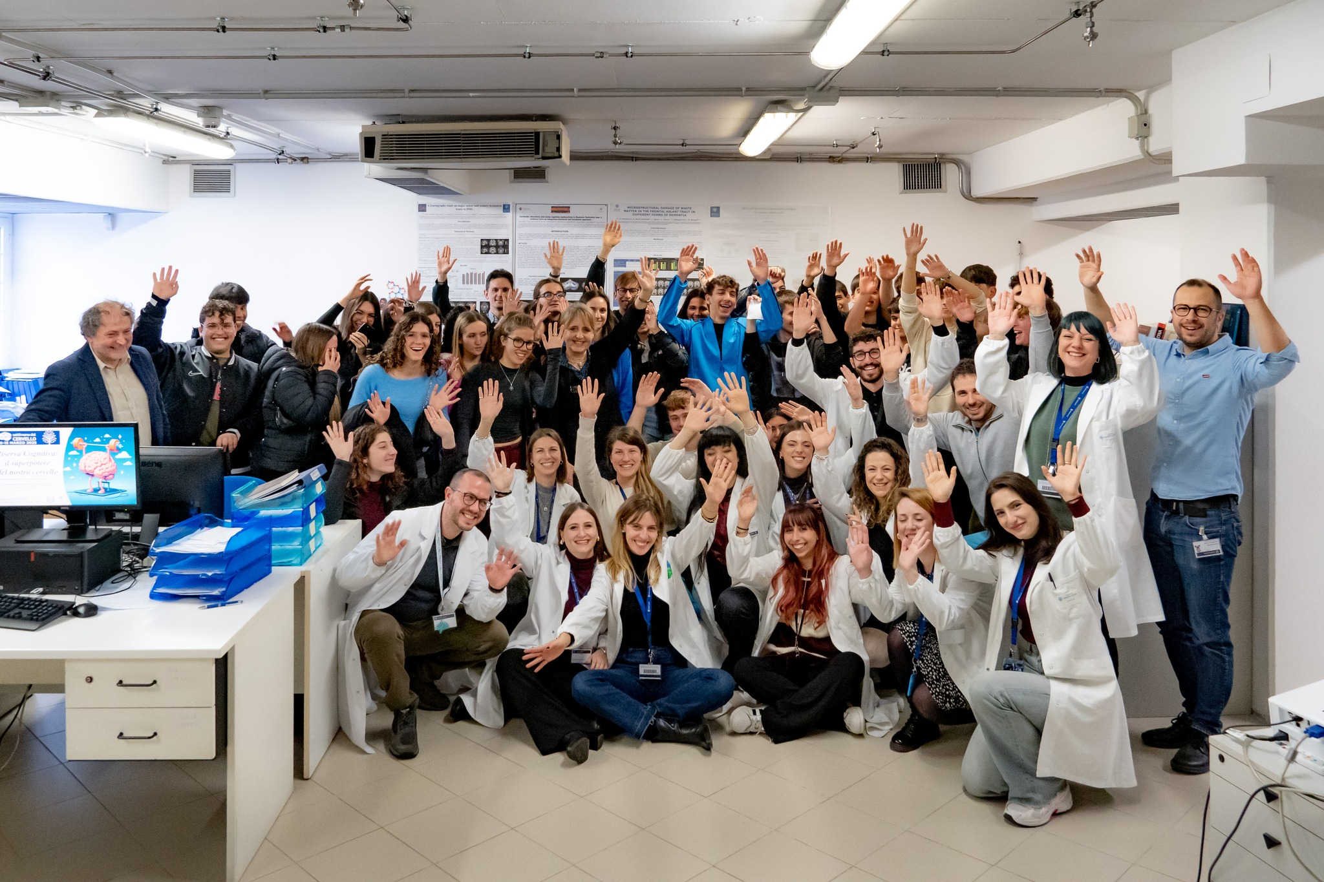
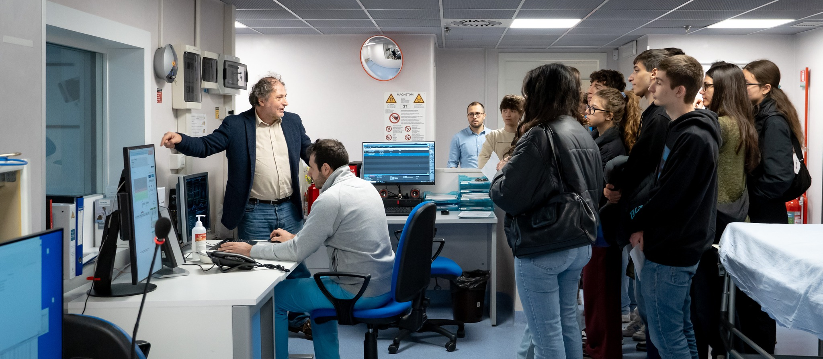

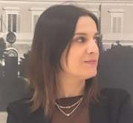
Outreach
Neuroimaging Laboratory Open Day (10th March) to celebrate the Brain Awareness Week;
European Researchers’ Night (26th-27th September);
A big “thank you” to Anna Lo Piano and Marta Pepe for the networking/ dissemination/outreach support!

Slide 17











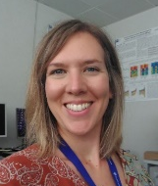
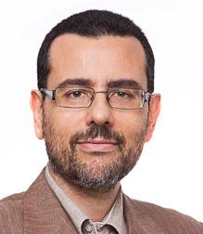
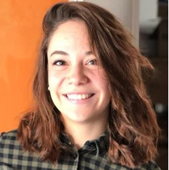
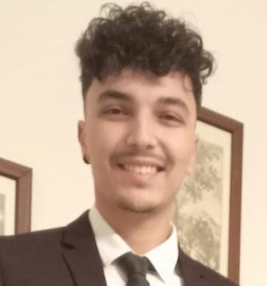
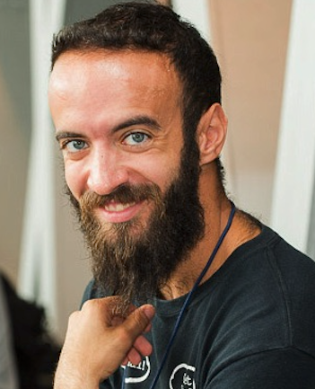

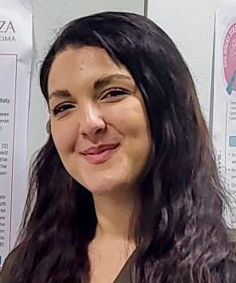
Thank you for the attention!
Collaborations:
Funding:
2025-2027 NextGenerationEU and MUR PNRR, Education and Research “From Research to Enterprise”
2024-2026 NextGenerationEU and MOH PNRR, “MULTISPINE’’
2024-2025 NextGenerationEU and MUR PNRR, ‘‘MNESYS SINVASC’’
2023-2025 MUR PRIN 2022 ‘’RECENTRE’’
2023-2025 NextGenerationEU PNRR

