Slide 1


Towards a Creativity Augmentation in AI
Alessandro Londei
alessandro.londei@sony.com

Slide 2





Creativity @ CSL Rome
Novelties exploration
Dreaming Learning
Chaotic Training
Model collapse
Continual learning
Human/AI
creativity
Arts &
Science
(Large)
Movement
Model
Theoretical
foundations
Intuition
Inspiration
Dreaming
S+T+ARTS Projects
Recombining information
Exploration of novelties
Adjacent possible
(Dreaming Learning)

Slide 3
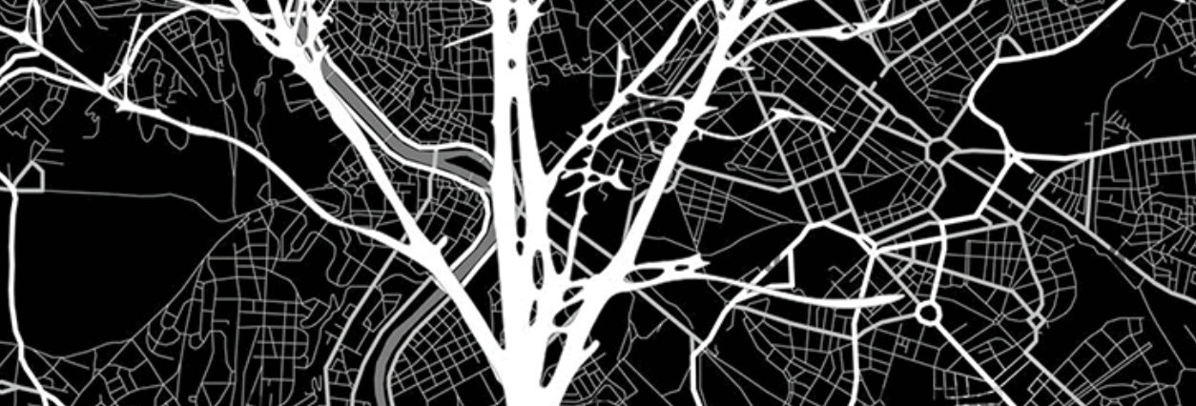
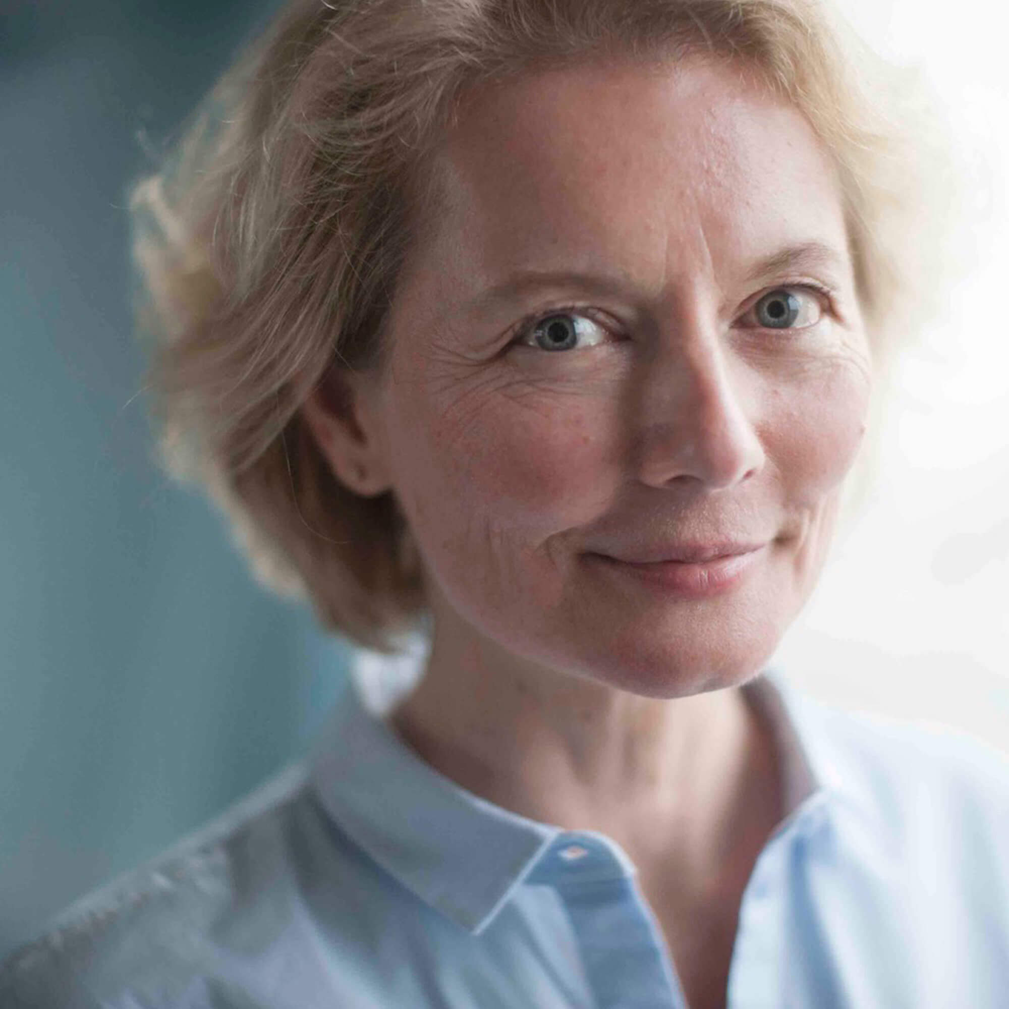
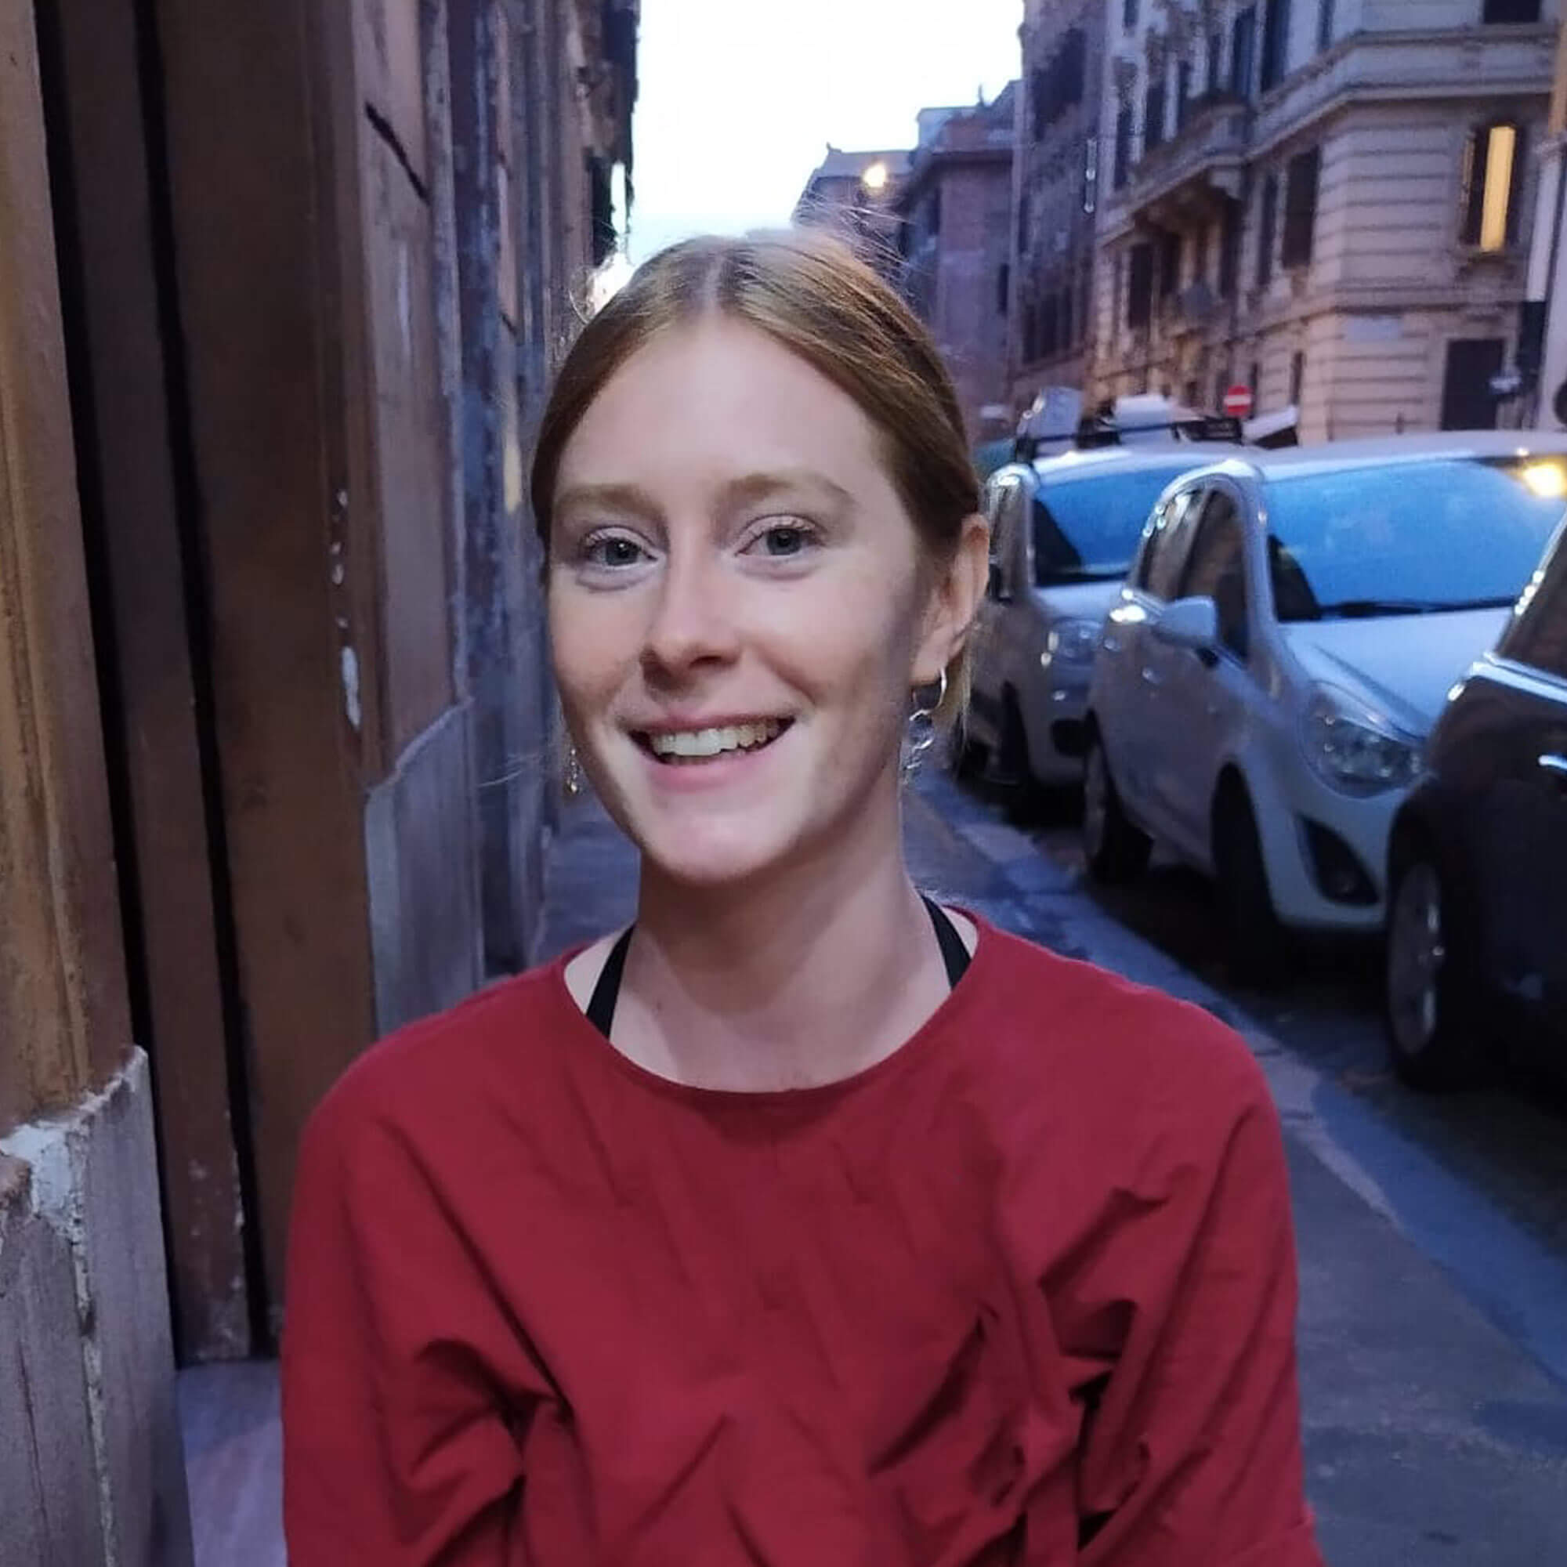
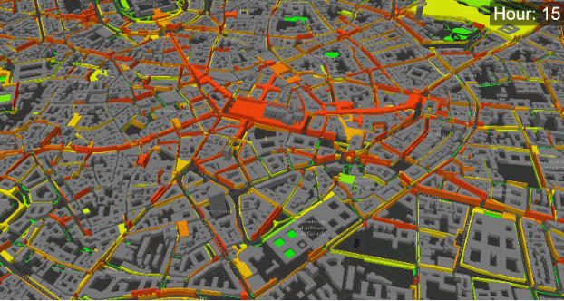
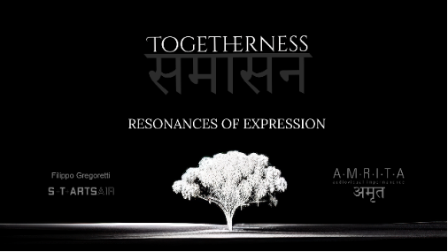
Human Creativity - S+T+ARTS Projects
Olga Kisseleva
Susi Gutsche
2021-2023
S+T+ARTS Repairing the Present
S+T+ARTS AIR
2023-2024
Michail Rybakov
Filippo Gregoretti
2025-2026
still ongoing…
Arts &
Science
(Large)
Movement
Model
Intuition
Inspiration
Dreaming
S+T+ARTS Projects

Slide 4
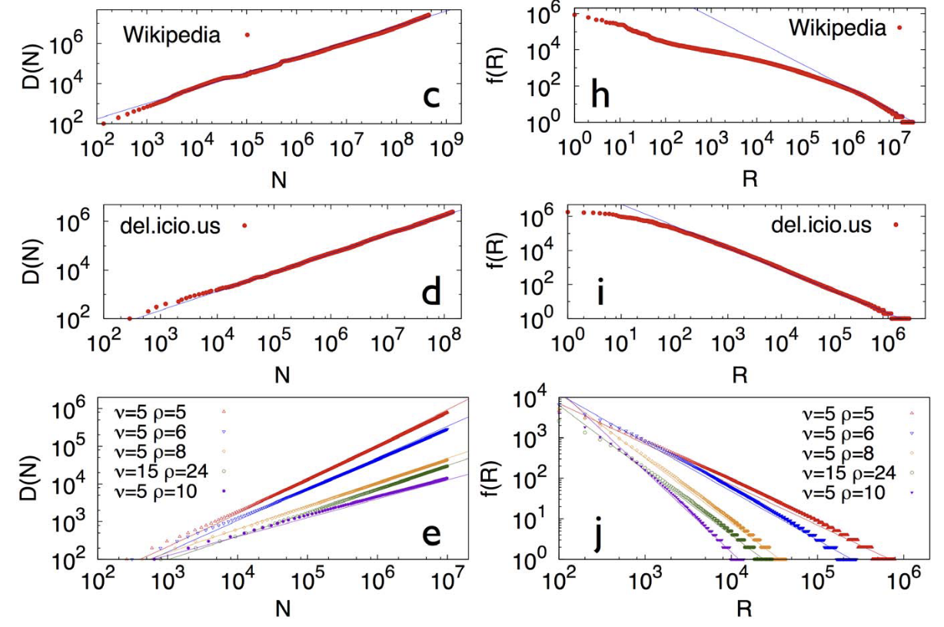
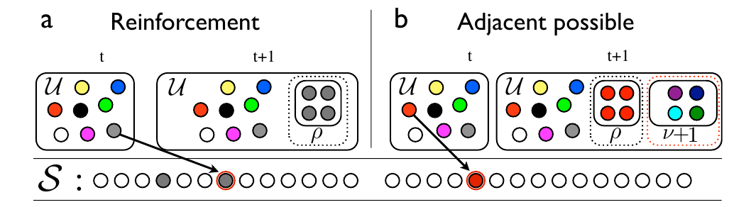
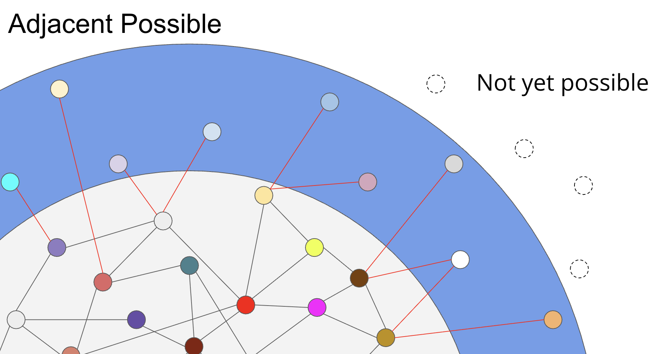
Theoretical Foundations
Innovation dynamics
Polya’s triggered urn
Novelties exploration
Dreaming Learning
Chaotic Training
Model collapse
Continual learning
Human/AI
creativity
(Large)
Movement
Model
Theoretical
foundations
The dynamics of correlated novelties
F. Tria, V. Loreto, V. D. P. Servedio & S. H. Strogatz
Scientific Reports volume 4, Article number: 5890 (2014)

Slide 5
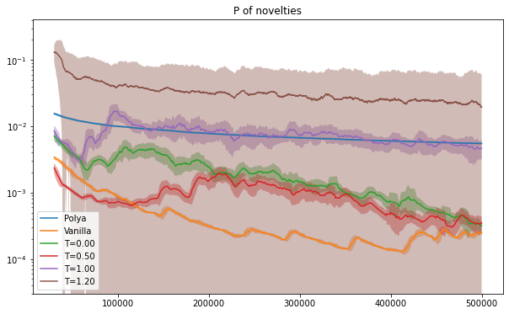
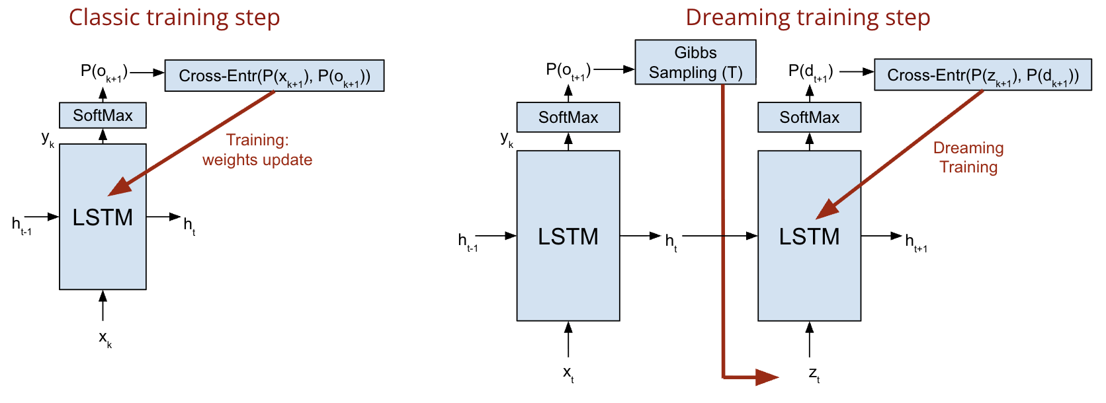
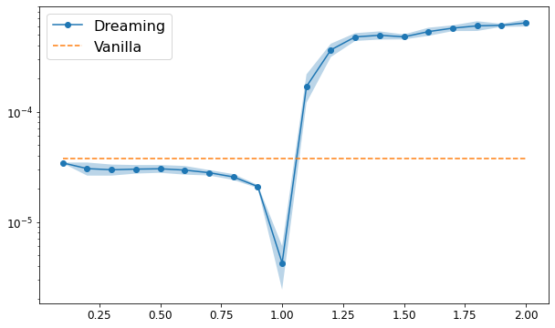
Theoretical Foundations
Dreaming Learning
Novelties exploration
Dreaming Learning
Chaotic Training
Model collapse
Continual learning
Human/AI
creativity
(Large)
Movement
Model
Theoretical
foundations
Dreaming Learning
A. Londei, M. Benati, D. Lanzieri & V. Loreto
Conference on Neural Information Processing Systems NeurIPS 2024
https://openreview.net/pdf?id=yR6U57TjvZ
MSE
Sampling Temperature

Slide 6
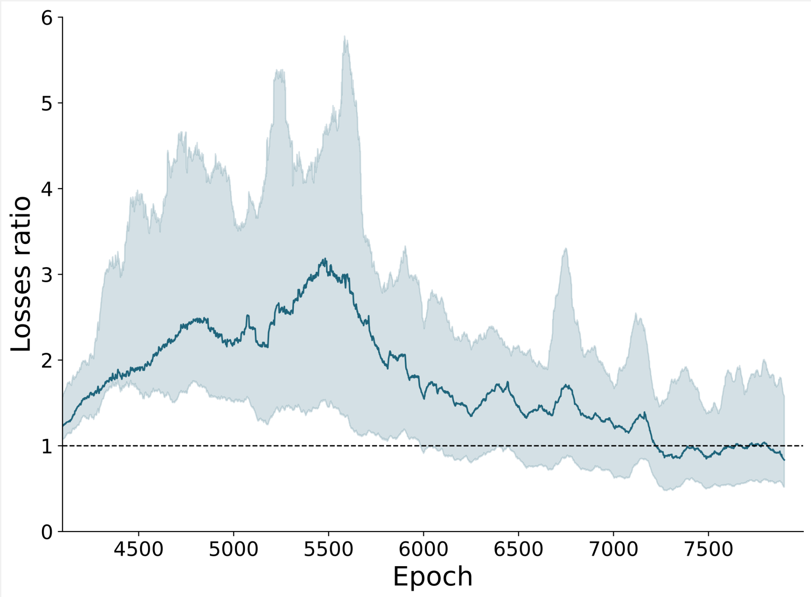
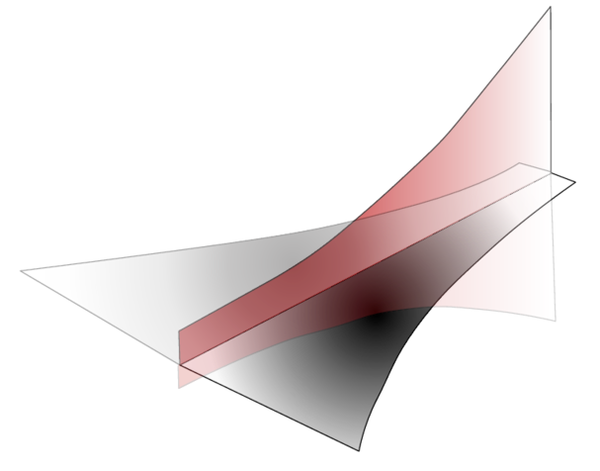
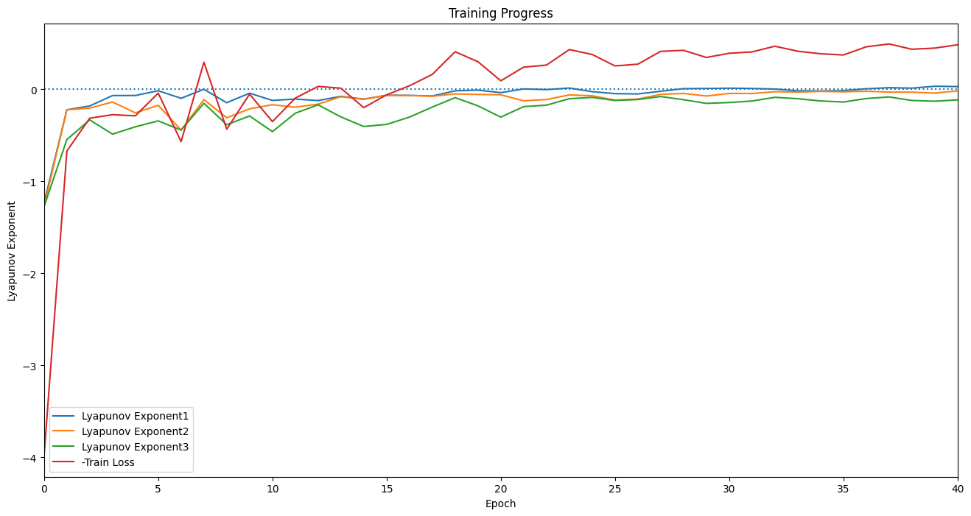
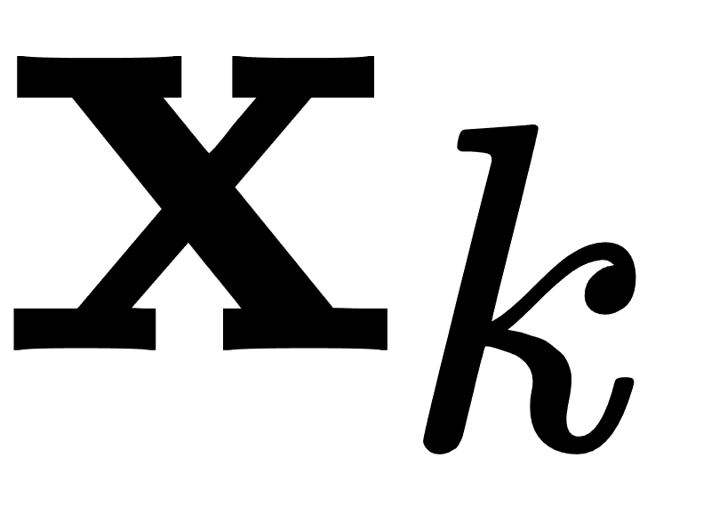
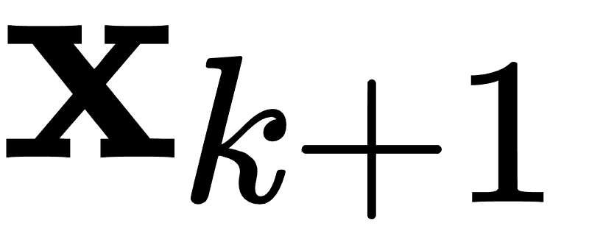
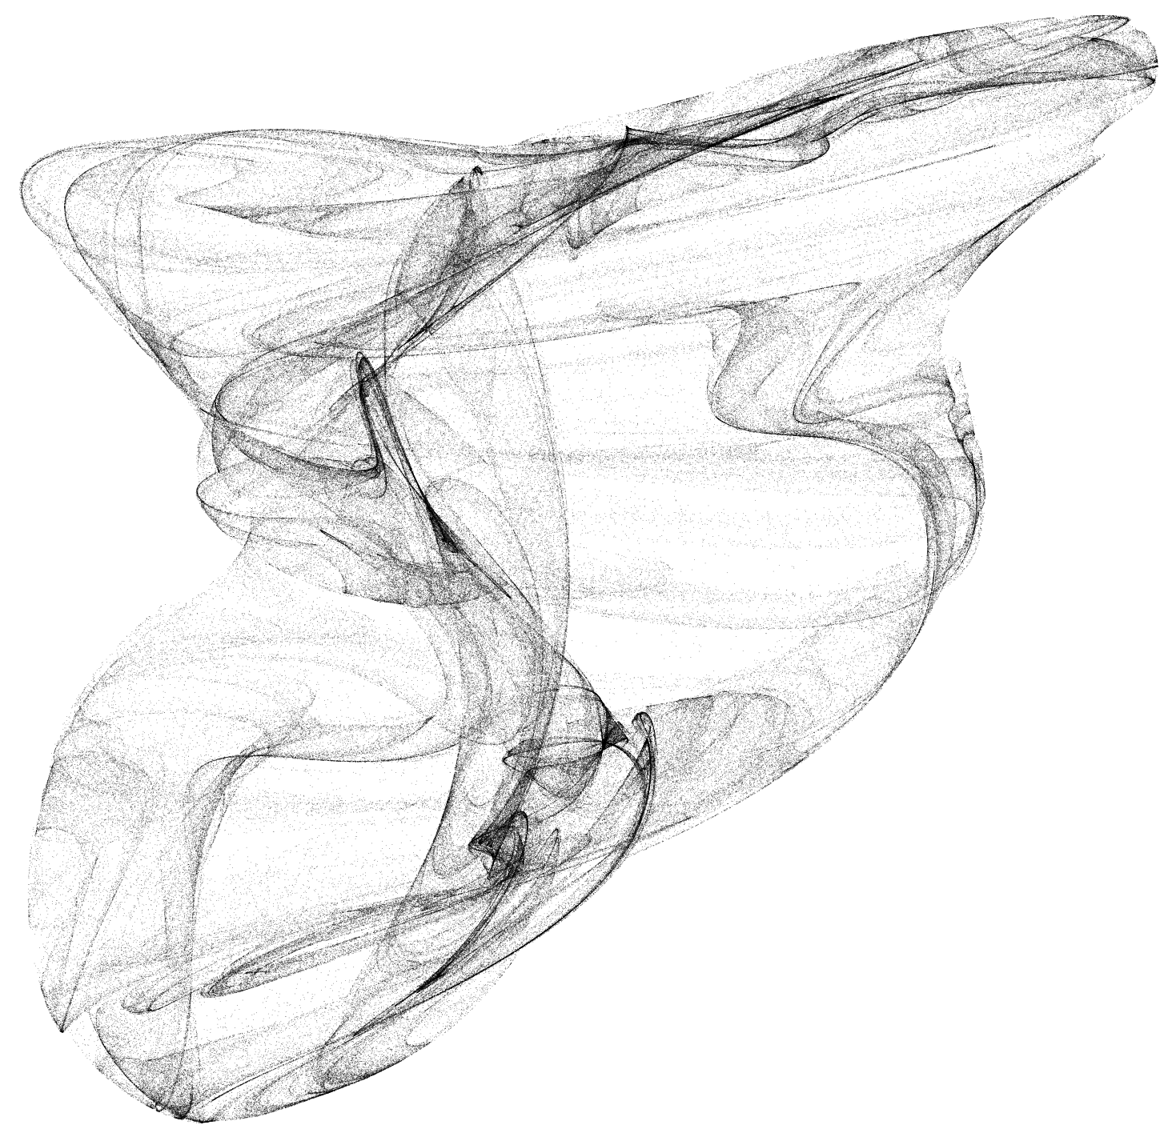
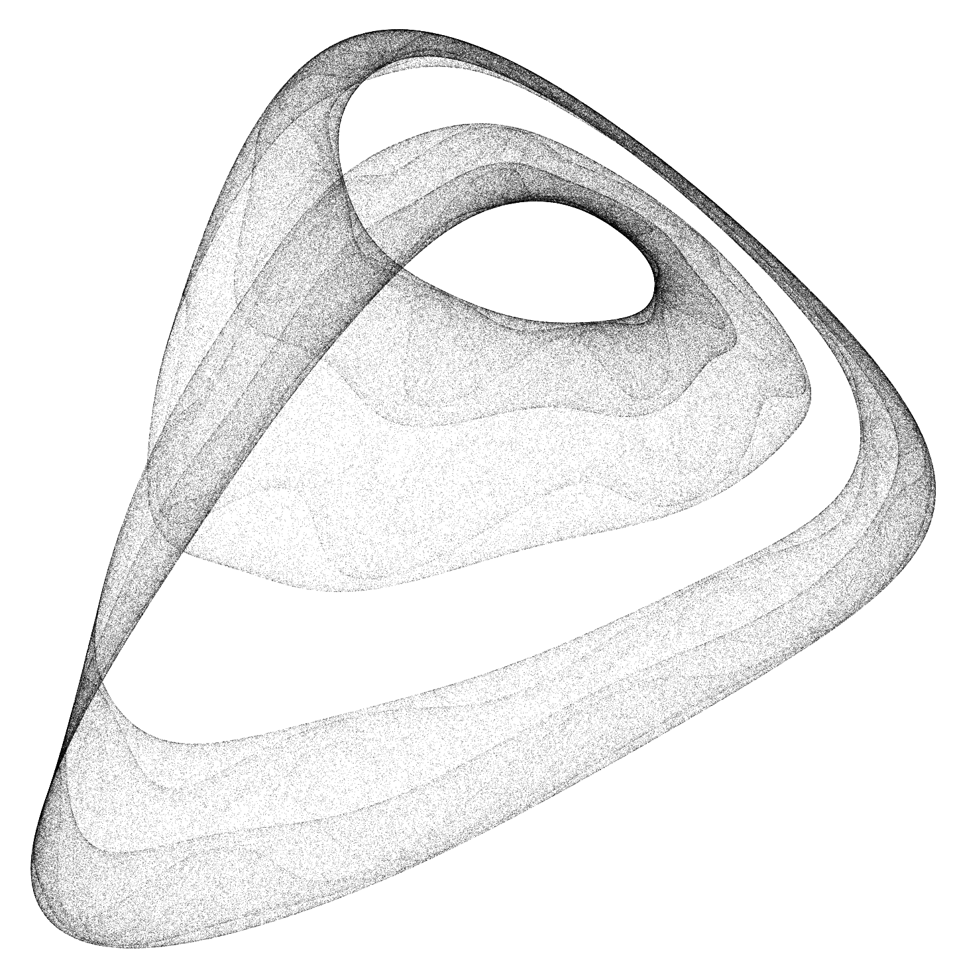
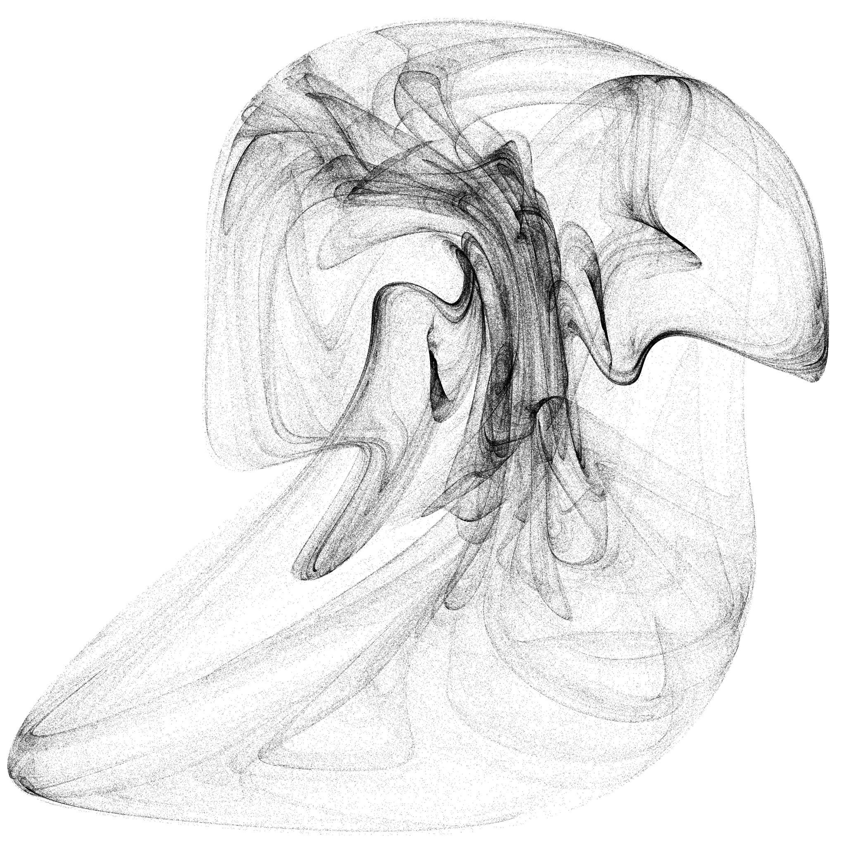
Theoretical Foundations
Lyapunov Learning
Novelties exploration
Dreaming Learning
Chaotic Training
Model collapse
Continual learning
Human/AI
creativity
(Large)
Movement
Model
Theoretical
foundations
divergence
time
convergence
Neural Network
Lyapunov Learning at the Onset of Chaos
M. Benati, A. Londei, D. Lanzieri & V. Loreto
International Conference on Machine Learning ICML 2025
https://openreview.net/pdf/b4ba221cdb8879b96aef693472a01cb64c7db693.pdf

Slide 7
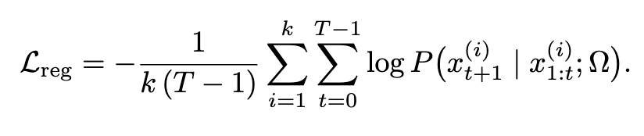
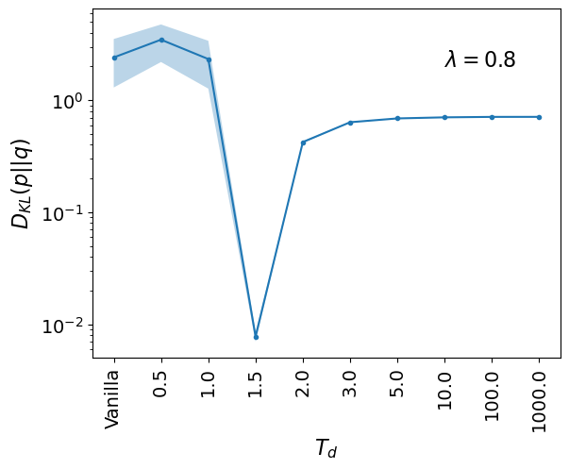
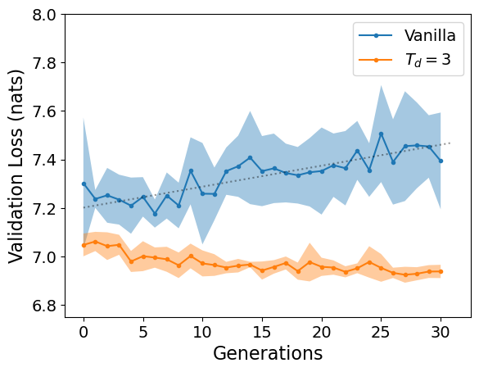
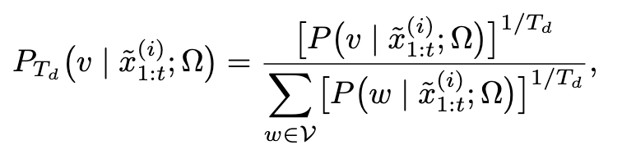
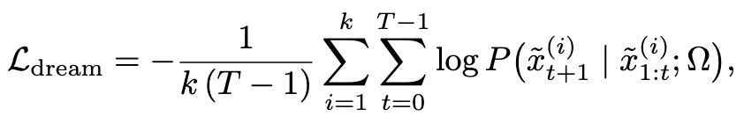

Theoretical Foundations
Model Collapse Mitigation
Applying Dreaming Learning over Generations
Novelties exploration
Dreaming Learning
Chaotic Training
Model collapse
Continual learning
Human/AI
creativity
(Large)
Movement
Model
Theoretical
foundations
Mitigating Model Collapse Through Dreaming Learning
A. Londei, M. Benati, D. Lanzieri & V. Loreto
To be published
Currently being tested on GPT3

Slide 8
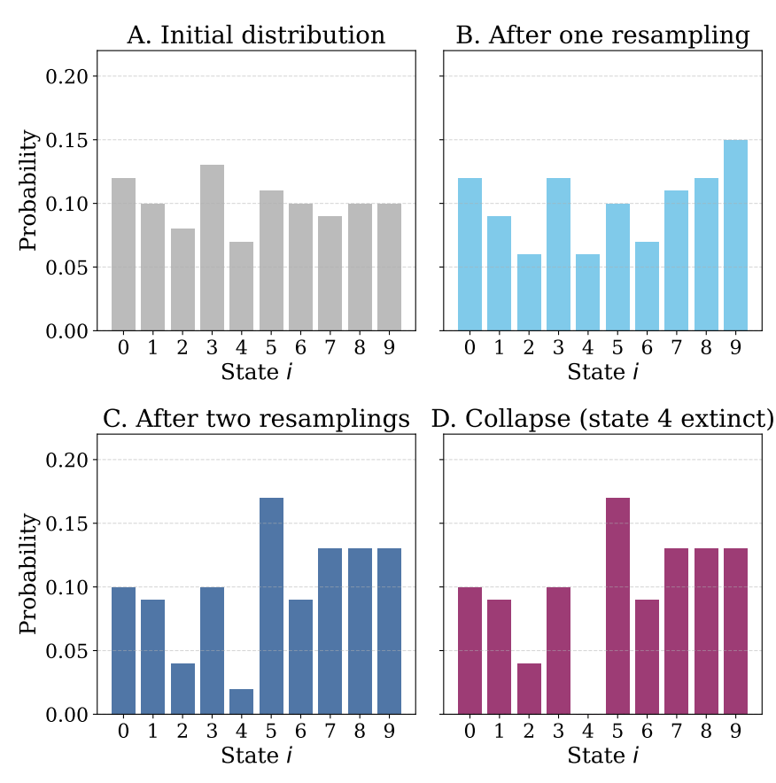
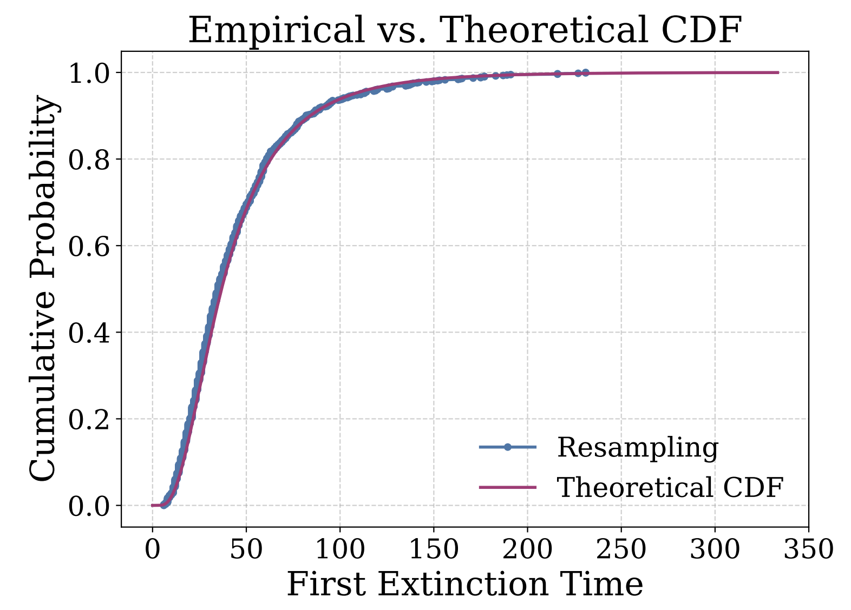
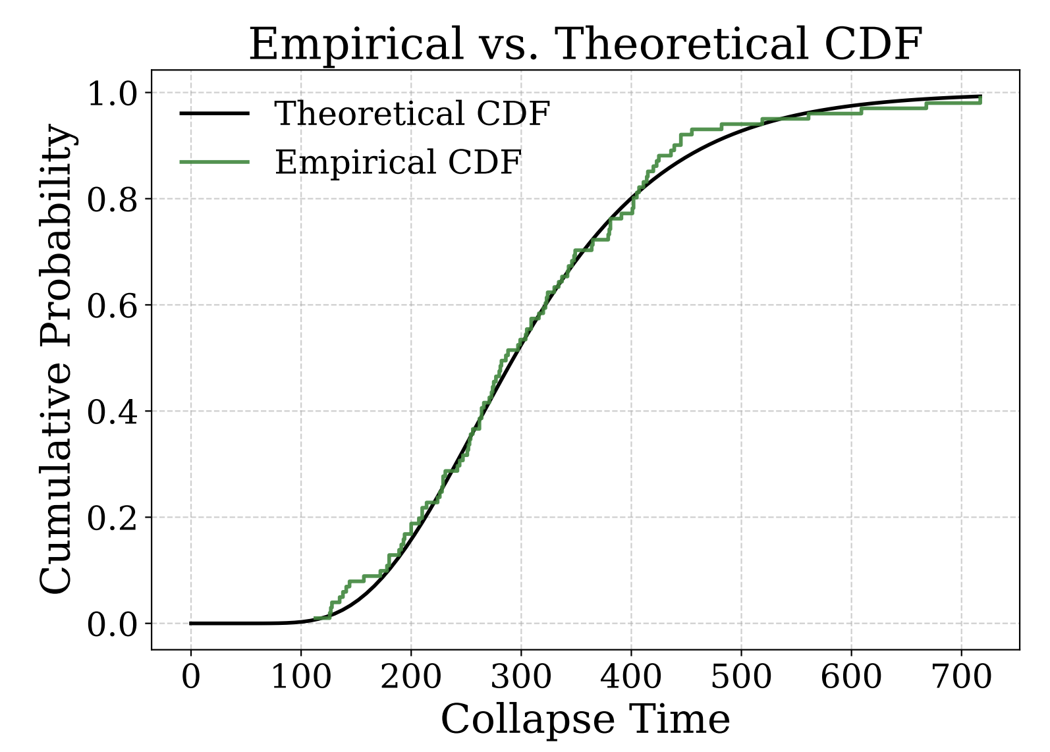
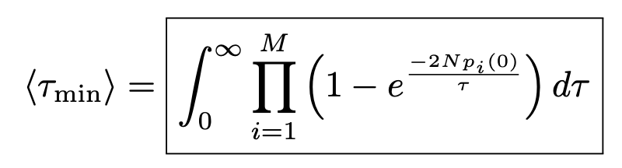
Theoretical Foundations
First-Extinction Law for Resampling Processes
Baxter’s formula scales as O(2^{M})
Our method scales as O(M)
Novelties exploration
Dreaming Learning
Chaotic Training
Model collapse
Continual learning
Human/AI
creativity
(Large)
Movement
Model
Theoretical
foundations
First-Extinction Law for Resampling Processes
M. Benati, A. Londei, D. Lanzieri & V. Loreto
Submitted to Physical Review Letters
https://arxiv.org/pdf/2509.20101

Slide 9
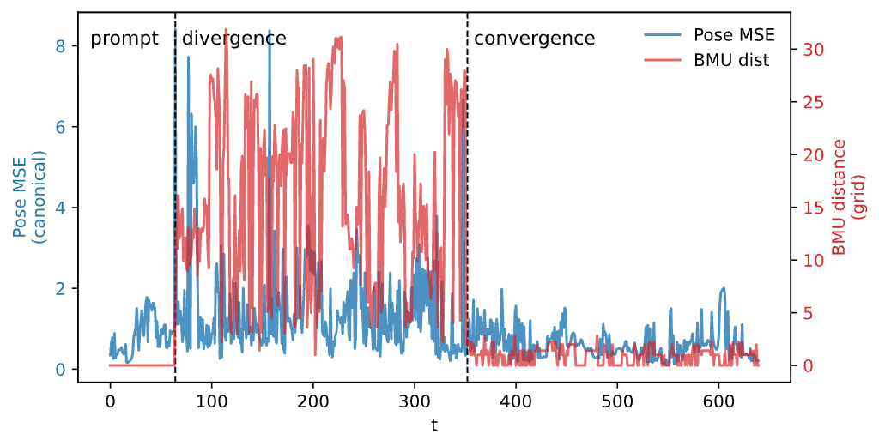
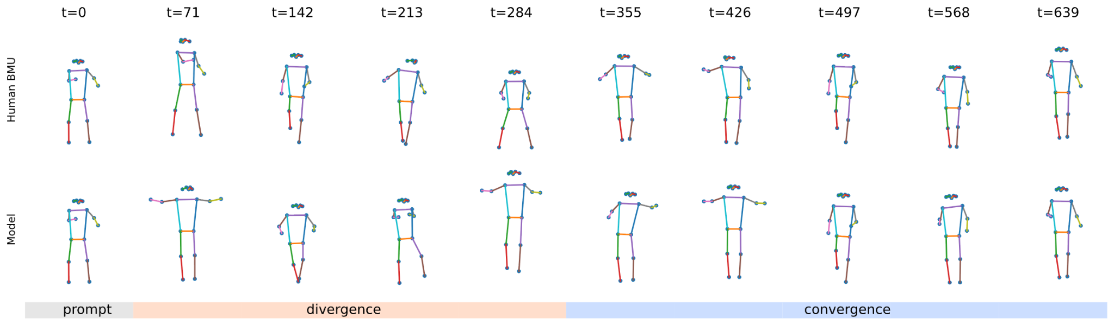
Theoretical Foundations
Human in the Loop
SOM-based Vector Quantization Tokenizer
Tokens optimization and data manifold topology preservation
Handling distance between humans and AI
Novelties exploration
Dreaming Learning
Chaotic Training
Model collapse
Continual learning
Human/AI
creativity
(Large)
Movement
Model
Theoretical
foundations
SOM-VQ: Topology-Aware Tokenization for Interactive Generative Models
A. Londei, M. Benati, D. Lanzieri
Ongoing analysis and experiments

Slide 10
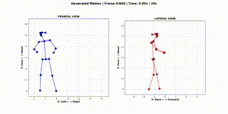
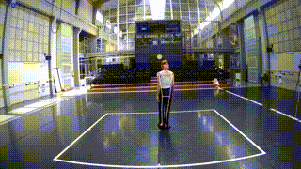
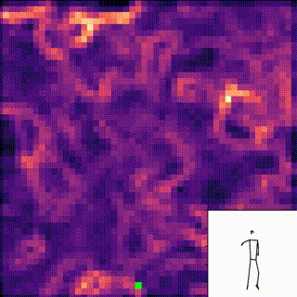
Human/AI Creativity
(Large) Movement Model
The Duetto project
LLM: tokens (words) → phrase
LMM: human poses → movement
Data collection
AI Model
AI Generation
Human/AI
creativity
(Large)
Movement
Model

Slide 11
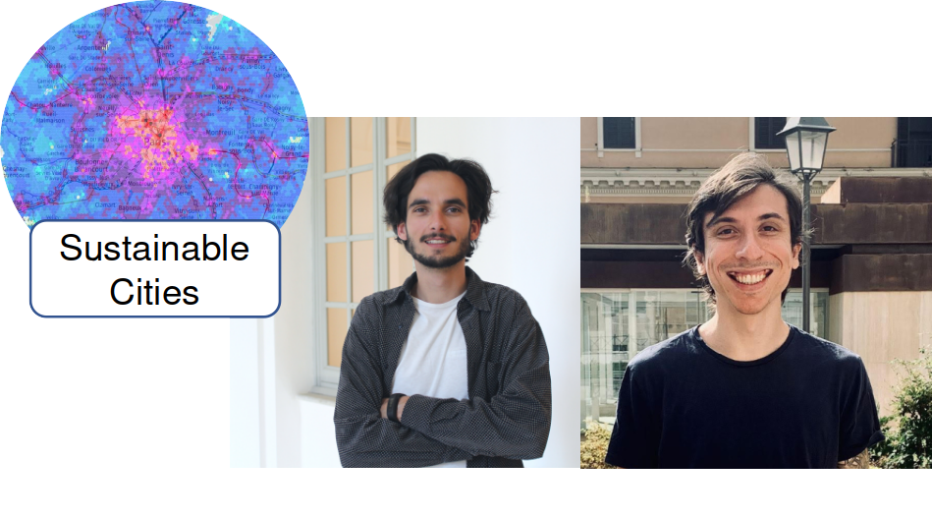
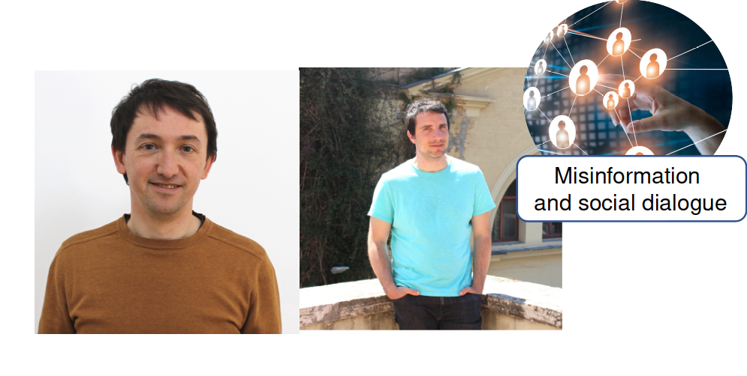
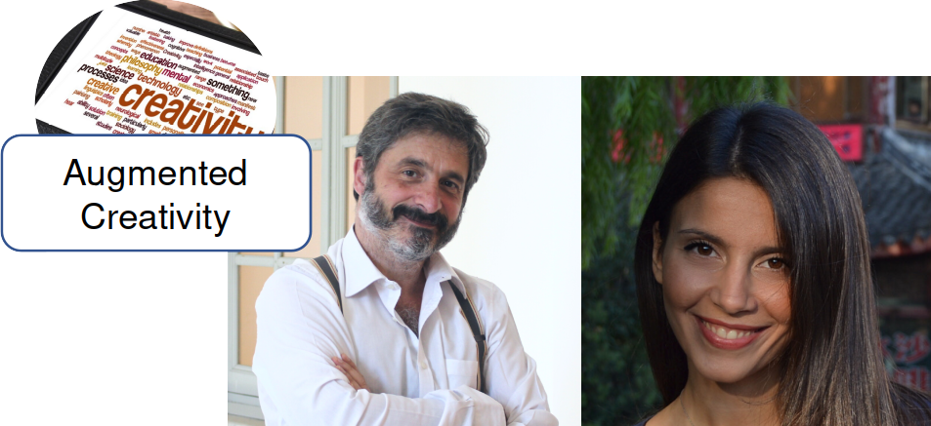

Moved (back) to Brazil
Matteo BRUNO
Hygor MELO
Emanuele BRUGNOLI
Ruggiero
LO SARDO
Communication
and events
System mgt and development
Admin and Financial
Alessandro LONDEI
Denise LANZIERI
Milena
DI CANIO
Elisabetta FALIVENE
Cinzia
DI SALVIO

Slide 12
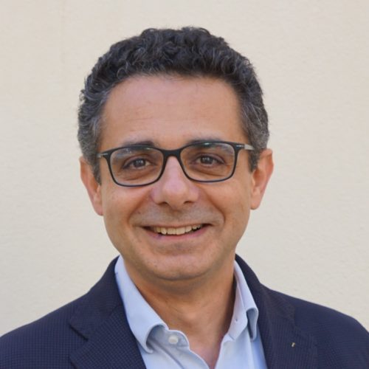
Director
Matteo BRUNO
Hygor MELO
Emanuele BRUGNOLI
Ruggiero
LO SARDO
Communication
and events
System mgt and development
Admin and Financial
Vittorio Loreto
Alessandro LONDEI
Denise LANZIERI
Milena
DI CANIO
Elisabetta FALIVENE
Cinzia
DI SALVIO

