Slide 1


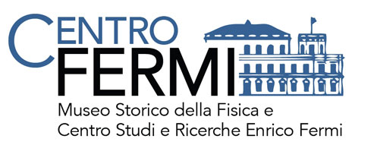

Update on coincidences
F. Coccetti, M. Garbini, F. Noferini

Slide 2
Outline
Status of coincidence studies after Run-3
  Report on the status of all our Clusters
  Comparison with previous results after:
    Changes in the analyzers
    Changes in the Top-Bottom (T-B) distances
Results from preliminary study with Corsika MC
  Energy dependence vs distance in coincs studies
  Energy dependence vs multi-track events in a single Tel

Slide 3
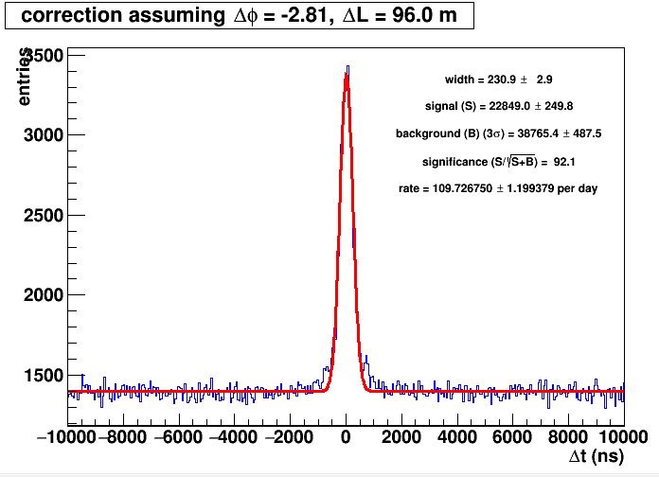
BOLO-01/BOLO-04 (nov16 – feb17)
Standard for all the clusters
SETTINGS
Analyze output from new Analyzer
Input file = coincBOLO_0104n.root
School distance = 96.0 m, angle = -160.75 deg
School orientation: tel1=277.70 deg, tel2=278.00 deg
Max Chi2 = 50
Theta Rel Range = 0.00 - 60.00 deg
Range for N sattellite in each run = (tel1) 4 – 10, (tel2) 4 - 10
Min N satellite in a single event = 0
Telescope parameters:
BOLO-01: T-B distance:100 cm
BOLO-04: T-B distance: 100 cm (120 cm in Run1&2)
STATS
Good days: 281.8 (62 Run-3)
Counts (bin counting): 31090 +/- 320
Rate: 110 +/- 1 (143.6 +/- 2.6 only Run-3)
Rate/acc = 197 +/- 4
Acc only Run-3= 0.73 m⁴ sr
Note: before of nov16 old T-B dist (skipped)
after feb17 coincs were lost (to be checked)

Slide 4
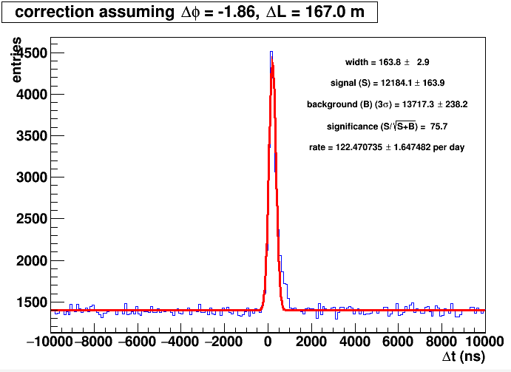
LODI-01/LODI-02 (jan16 – jun17)
SETTINGS
Analyze output from new Analyzer
Input file = coincLODI_0102n.root
School distance = 167.0 m, angle = -106.78 deg
School orientation: tel1=250.00 deg, tel2=0.00 deg
Max Chi2 = 50
Theta Rel Range = 0.00 - 60.00 deg
Range for N sattellite in each run = (tel1) 4 - 10, (tel2) 4 - 10
Min N satellite in a single event = 0
Telescope parameters:
LODI-01: T-B distance: 93 cm
LODI-02: T-B distance: 104 cm
STATS
Good days: 99.5
Counts (bin counting): 13460 +/- 200
Rate: 135 +/- 2
Rate/acc = 185 +/- 3
Acc = 0.73 m⁴ sr
Note: angle w.r.t. North has to be provided for LODI-02

Slide 5
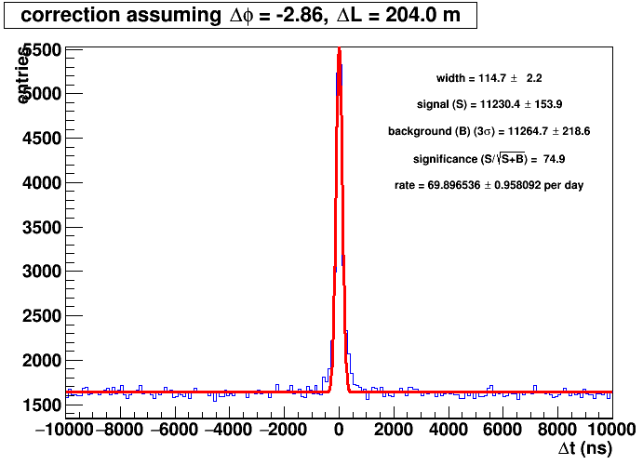
LAQU-01/LAQU-02 (feb15 – jun16)
SETTINGS
Analyze output from new Analyzer
Input file = coincLAQU_0102n.root
School distance = 204.0 m, angle = -164.05 deg
School orientation: tel1=-94.10 deg, tel2=49.10 deg
Max Chi2 = 50
Theta Rel Range = 0.00 - 60.00 deg
Range for N sattellite in each run = (tel1) 4 - 10, (tel2) 4 - 10
Min N satellite in a single event = 0
Telescope parameters:
LAQU-01: T-B distance: 100 cm
LAQU-02: T-B distance: 100 cm
STATS
Good days: 160.7
Counts (bin counting): 1900 +/- 170
Rate: 80.5 +/- 1.3
Rate/acc = 110.2 +/- 1.8
Acc = 0.73 m⁴ sr
Note: after jun16 coincs were lost (to be checked)

Slide 6
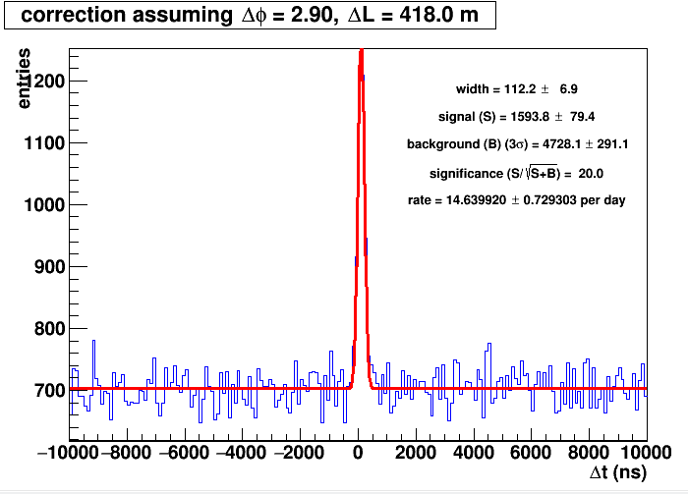
GROS-01/GROS-02 (jan17 – jun17)
To be checked!!!!
SETTINGS
Analyze output from new Analyzer
Input file = coincGROS_0102n.root
School distance = 418.0 m, angle = 165.88 deg
School orientation: tel1=144.74 deg, tel2=289.54 deg
Max Chi2 = 50
Theta Rel Range = 0.00 - 60.00 deg
Range for N sattellite in each run = (tel1) 4 - 10, (tel2) 4 – 10
Min N satellite in a single event = 0
Telescope parameters:
GROS-01: T-B distance: 100-110 cm
GROS-02: T-B distance: 100-110 cm
STATS
Good days: 108.9
Counts (bin counting): 1690 +/- 125
Rate: 15.5+/- 1.2
Rate/acc = 21.2 +/- 1.6
Acc = 0.73 m⁴ sr
Note: before jan17 T-B dists were at 110 cm
later rate unstable on GROS-02

Slide 7
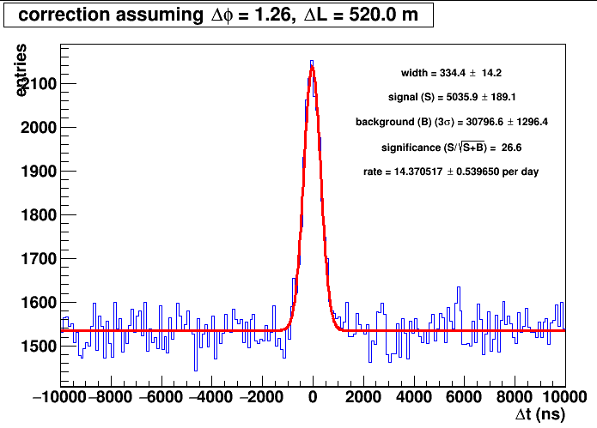
CAGL-01/CAGL-02 (oct14 – jun17)
SETTINGS
Analyze output from new Analyzer
Input file = coincCAGL_0102n.root
School distance = 520.0 m, angle = 72.19 deg
School orientation: tel1=233.00 deg, tel2=100.00 deg
Max Chi2 = 50.000000
Theta Rel Range = 0.00 - 60.00 deg
Range for N sattellite in each run = (tel1) 4 - 10, (tel2) 4 - 10
Min N satellite in a single event = 0
Telescope parameters:
CAGL-01: T-B distance: 100 cm (140 in Run1&2)
CAGL-02: T-B distance: 100 cm (140 in Run1&2)
STATS
Good days: 350.4
Counts (bin counting): 5060 +/- 190
Rate: 12.4 +/- 0.5 (18.4 +/- 1.9 only Run-3)
Rate/acc = 25.2 +/- 2.6
Acc only Run-3= 0.73 m⁴ sr

Slide 8
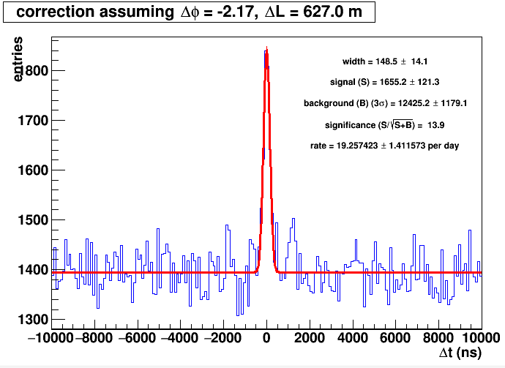
FRAS-02/FRAS-03 (nov15 – jun16)
SETTINGS
Analyze output from new Analyzer
Input file = coincFRAS_0203n.root
School distance = 627.0 m, angle = -124.50 deg
School orientation: tel1=178.00 deg, tel2=215.00 deg
Max Chi2 = 50
Theta Rel Range = 0.00 - 60.00 deg
Range for N sattellite in each run = (tel1) 4 - 10, (tel2) 4 - 10
Min N satellite in a single event = 0
Telescope parameters:
FRAS-02: T-B distance: 80 cm
FRAS-03: T-B distance: 70 cm
STATS
Good days: 86.0
Counts (bin counting): 1900 +/- 170
Rate: 22 +/- 2
Rate/acc = 22 +/- 2
Acc = 1.02 m⁴ sr
Note: no coinc in Run-3

Slide 9
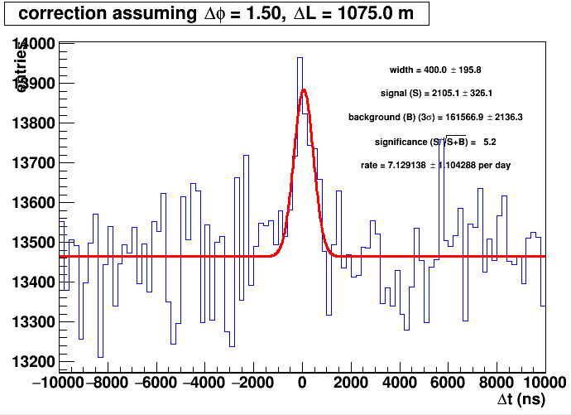
TORI-03/TORI-04 (oct15 – jun17)
SETTINGS
Analyze output from new Analyzer
Input file = coincTORI_0304n.root
School distance = 1075.0 m, angle = 85.75 deg
School orientation: tel1=27.00 deg, tel2=297.00 deg
Max Chi2 = 50
Theta Rel Range = 0.00 - 60.00 deg
Range for N sattellite in each run = (tel1) 0 - 10, (tel2) 0 - 10
Min N satellite in a single event = 0
Telescope parameters:
TORI-03: T-B distance: 100 cm
TORI-04: T-B distance: 100 cm
STATS
Good days: 295.2
Counts (bin counting): 2220 +/- 370
Rate: 7.5 +/- 1.3
Rate/acc = 10.3 +/- 1.7
Acc = 0.73 m⁴ sr
Note: runs with Hytech kept

Slide 10
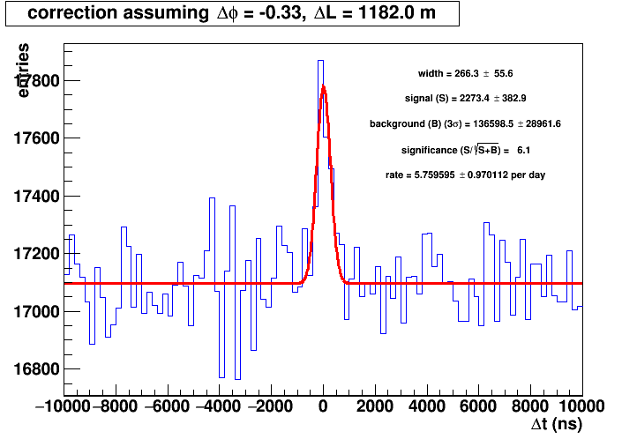
SAVO-01/SAVO-02 (nov14 – jun17)
SETTINGS
Analyze output from new Analyzer
Input file = coincSAVO_0102n.root
School distance = 1182.0 m, angle = -18.90 deg
School orientation: tel1=56.00 deg, tel2=170.00 deg
Max Chi2 = 50
Theta Rel Range = 0.00 - 60.00 deg
Range for N sattellite in each run = (tel1) 4 - 10, (tel2) 4 - 10
Min N satellite in a single event = 0
Telescope parameters:
SAVO-01: T-B distance: 92 cm
SAVO-02: T-B distance: 87 cm
STATS
Good days: 394.7
Counts (bin counting): 2430 +/- 420
Rate: 6.2 +/- 1.1
Rate/acc = 7.1 +/- 1.2
Acc = 0.86 m⁴ sr

Slide 11
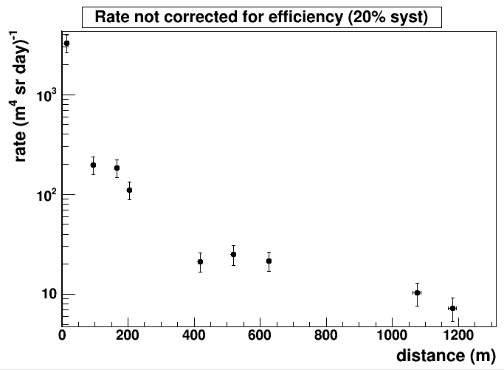
Status
To be checked
SALE-01/SALE-02

Slide 12
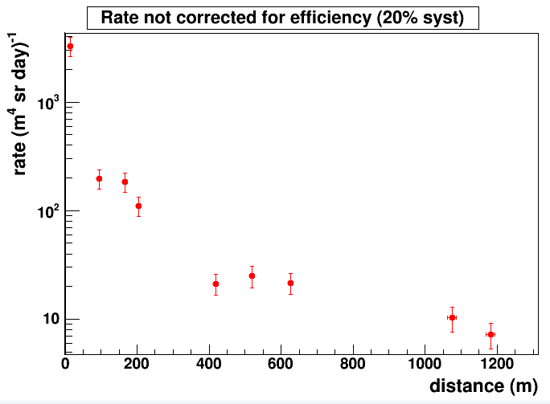
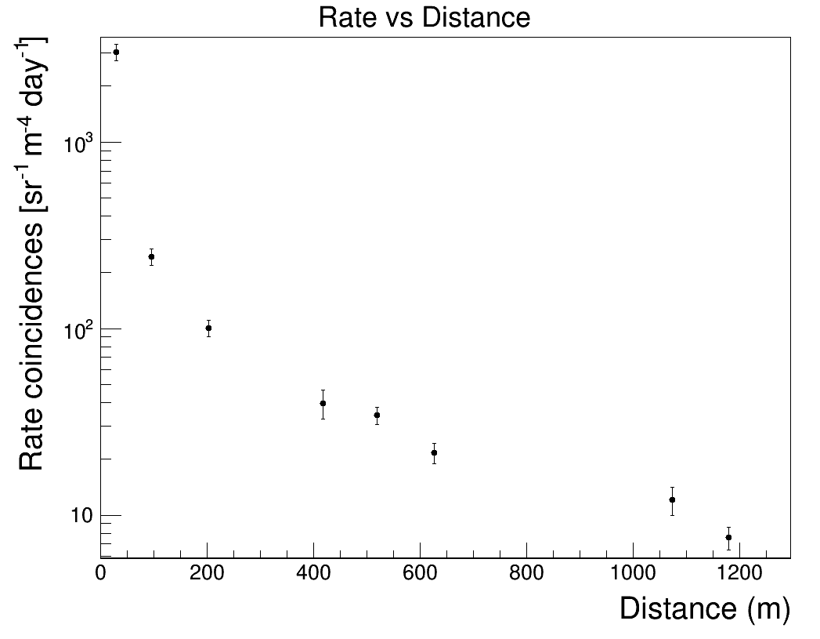
Old vs New
(new → new analyzer + new T-B dist + Run-3)
To be checked

Slide 13
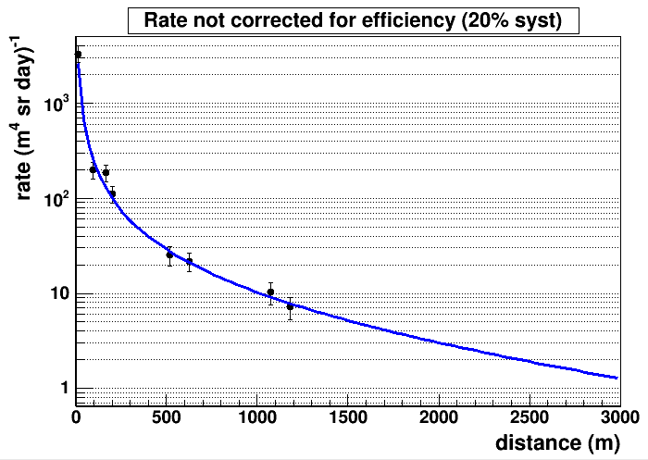
Extrapolation at higher distances
F(x) = A e^{-Bx} x^{C}

Slide 14
Corsika simulations
INPUT
Realistic flux of cosmic rays
10¹⁴ < E < 10¹⁶ eV
T-B distance for all telescopes = 100 cm
11 telescope 200m-spaced
No simulation of the material in front of the telescopes

Slide 15
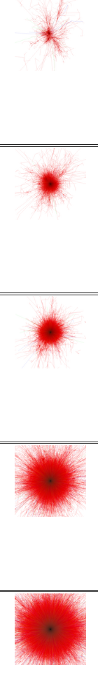
Simulation setup
(20 days of cosmic flux)
11 telescopes 200m-spaced to cover from 200m to 2000m
Statistics for 200 m → 10 pairs → 200 days
2000 m
200 m
200 m
200 m
200 m
200 m
200 m
200 m
200 m
200 m
200 m
Tel-1
Tel-2
Tel-3
Tel-4
Tel-5
Tel-6
Tel-7
Tel-8
Tel-9
Tel-10
Tel-11
Shower generated randomly:
Energy
Direction (θ,φ)
Position core (x,y)

Slide 16
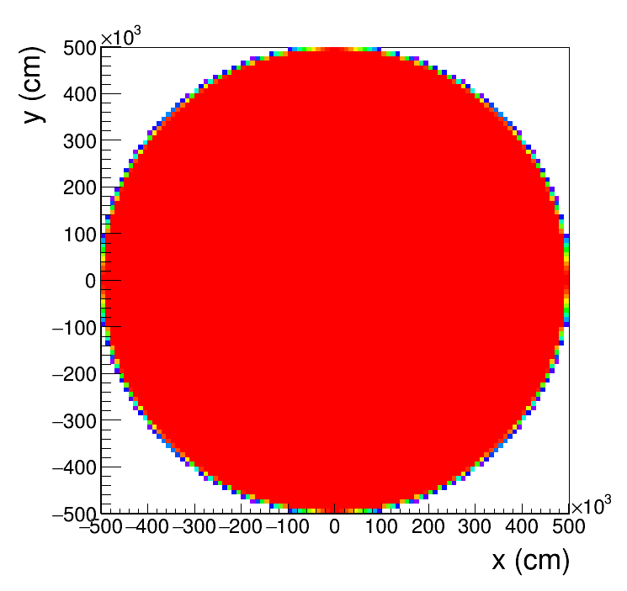
Simulation setup
(20 days of cosmic flux)
11 telescopes 200m-spaced to cover from 200m to 2000m
Shower generated randomly:
Energy
Direction (θ,φ)
Position core (x,y)

Slide 17
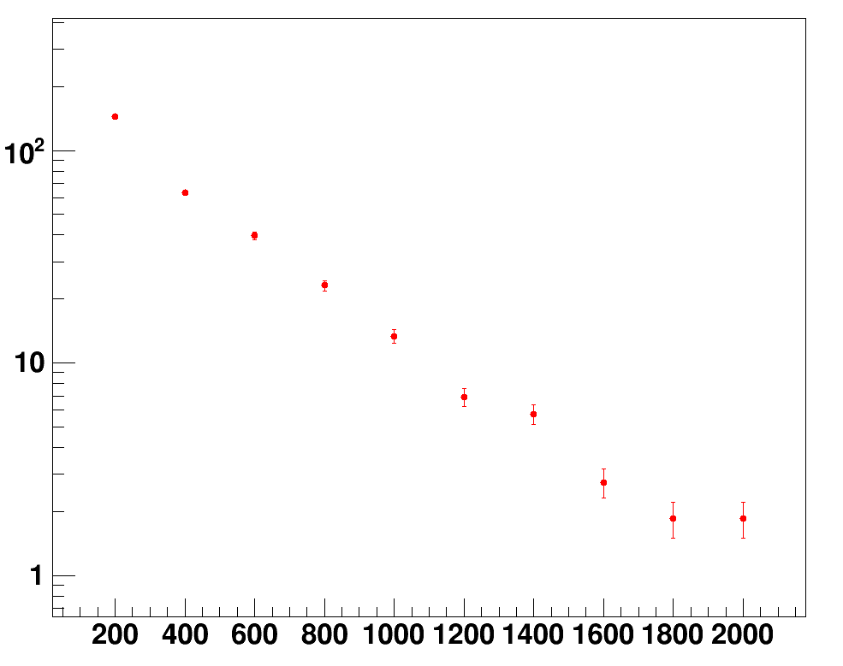
Comparison with Corsika sims
Corsika sims
F(x) = A e^{-Bx} x^{C}
Very preliminary!!!!

Slide 18
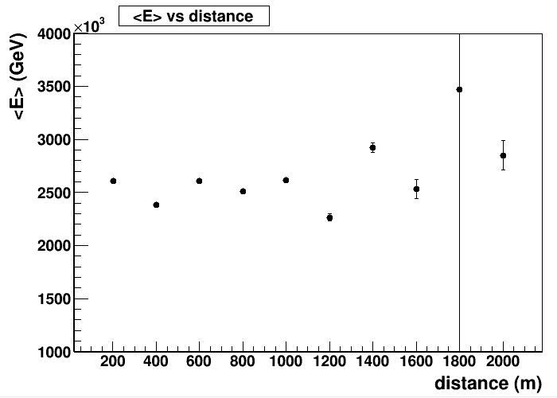
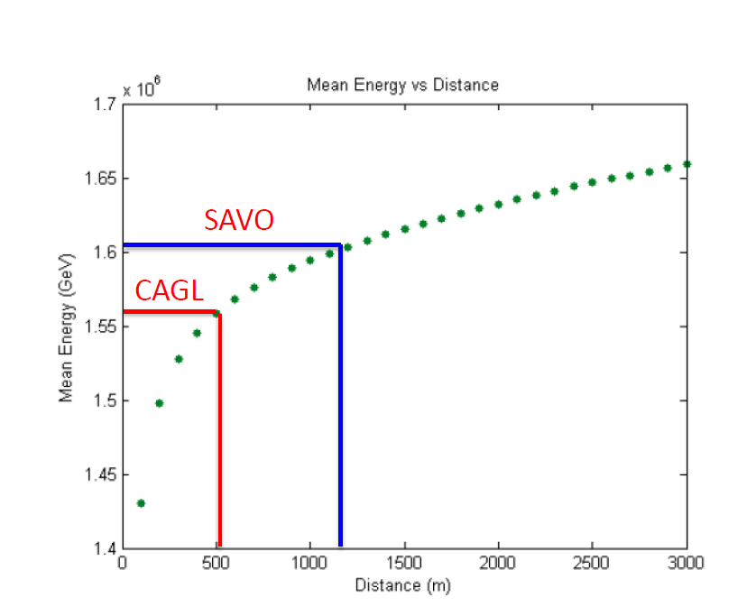
Mean energy vs distance
<E> ∼ 2.5 10¹⁵ eV
Old Corsika simulations
New simulations differs by a factor ∼1.7 w.r.t. older ones
(it may be due to low energy cutoff in the newest).
In both cases no significant dependence on the distance observed
→ The shape of the lateral distribution has a small dependence on the energy.

Slide 19
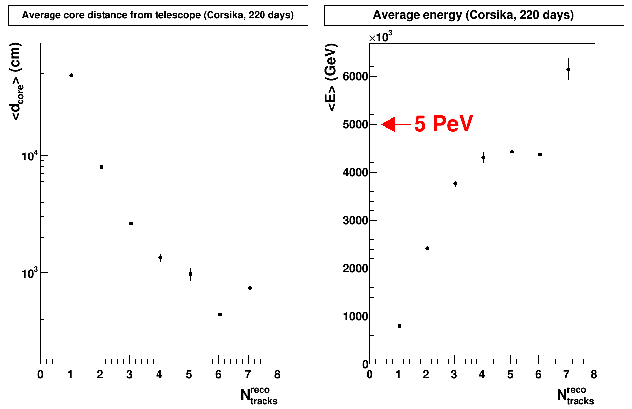
Energy vs multi-track events in a single telescope
20 days x 11 telescopes
Track density has a strong dependence on the energy of the primary cosmic ray.
Very preliminary!!!!

Slide 20
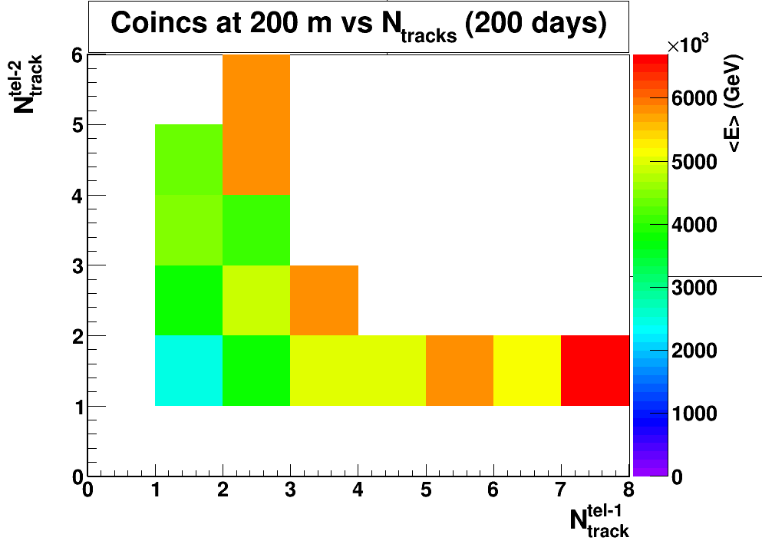
Combining coincs and multi-track
(20 days) x (10 tel pairs at 200m)
For pairs with a small distance we could add the multi-track information (very preliminary)
Very preliminary!!!!

