Slide 1

The Extreme Energy Events experiment:
  The future
M. Abbrescia for the
Extreme Energy Events collaboration

Slide 2
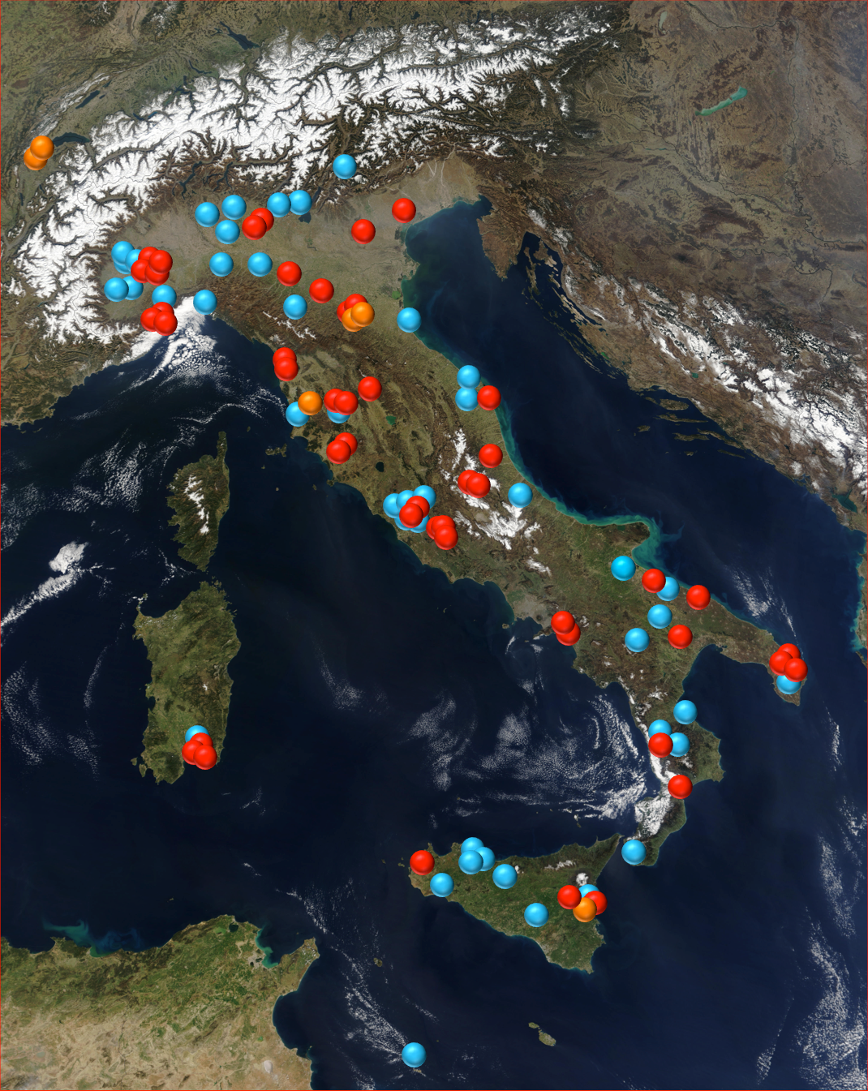
Present status
47 telescopes at High Schools
+ 2 telescopes at CERN
+ 4 at INFN Units
Total: 53 telescopes
+ ≈ 50 schools on the waiting list
Largest (in terms of area)
system using MRPCs
Largest cosmic rays experiment
in Europe
Stations in operation at schools
Stations in operation at research
centers
Schools on the waiting list

Slide 3
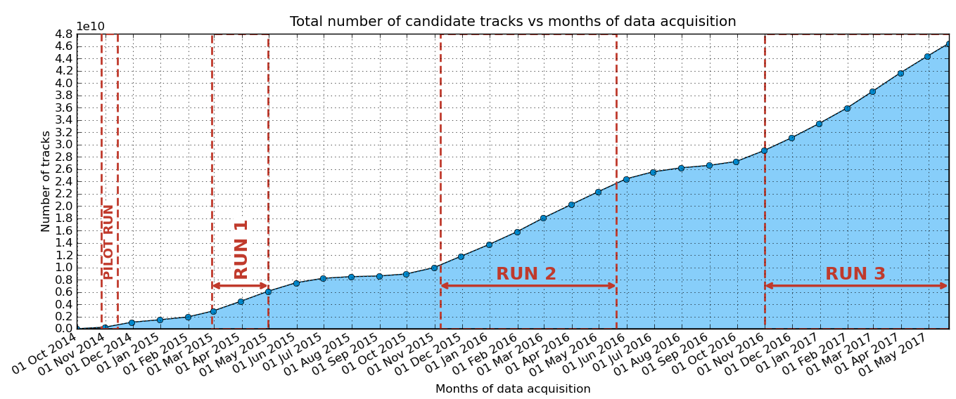
Data taking
Almost 50 billion events collected since the start of organized data taking
More than 20 billion events collected during Run-3 only!

Slide 4
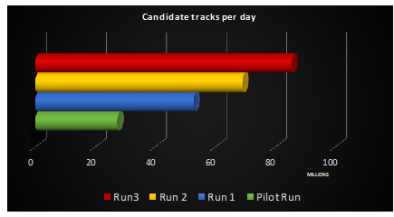
Improvements in the data flow
Overcome the100 MEvents/day threshold (during March and April)
New reconstruction algorithm: Analyzer v.2.0
New data transfer tool: SyncThing
New automatic elog

Slide 5
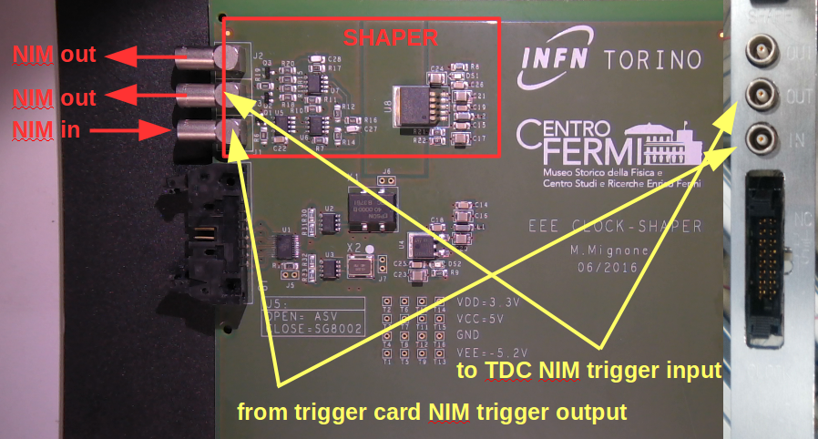
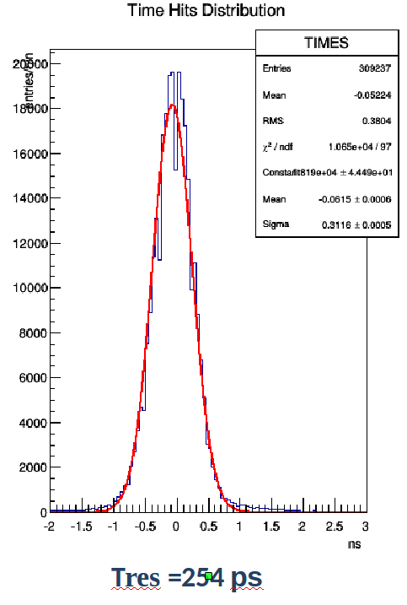
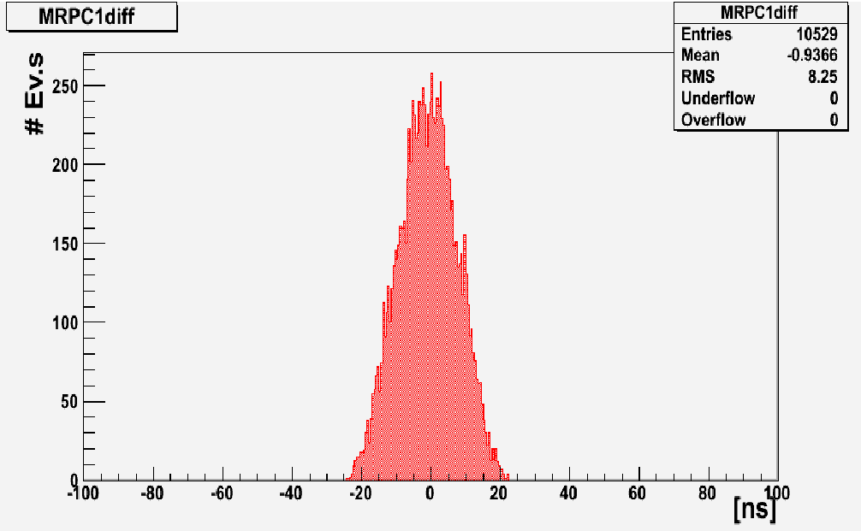
EEE clock distribution card
Designed at INFN Torino
Distributed the same clock to the two TDCs of the EEE readout
Essential to exploit time info from the middle chamber
Built and installed in all EEE telescopes
σ_{t} ≈ 8 ns
σ_{t} ≈ 0.25 ns

Slide 6
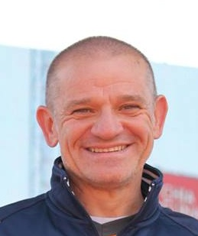
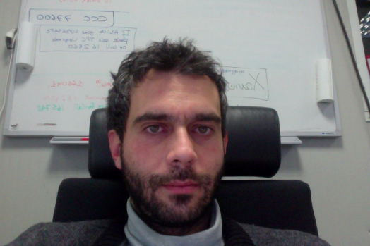

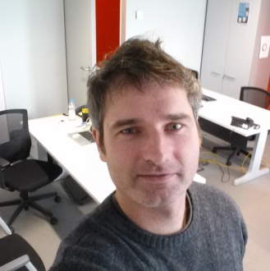
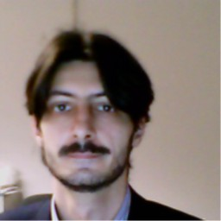
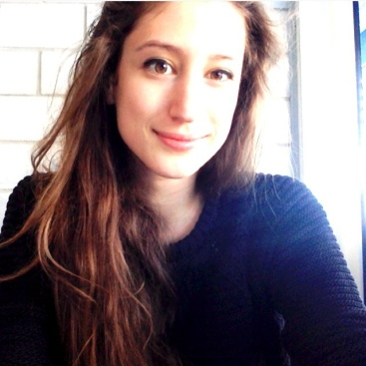
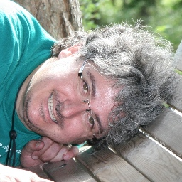
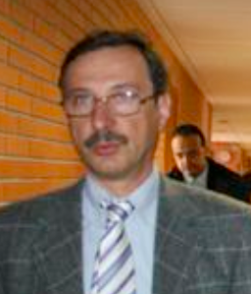
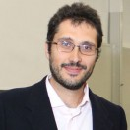
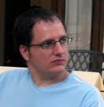
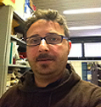
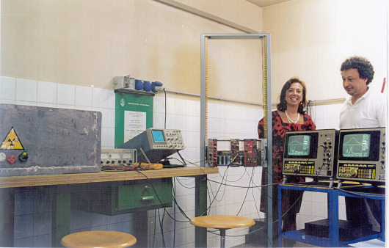

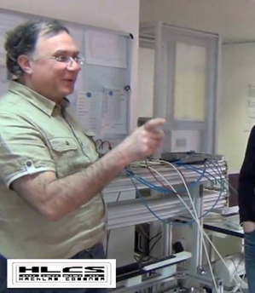
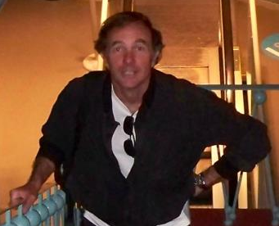
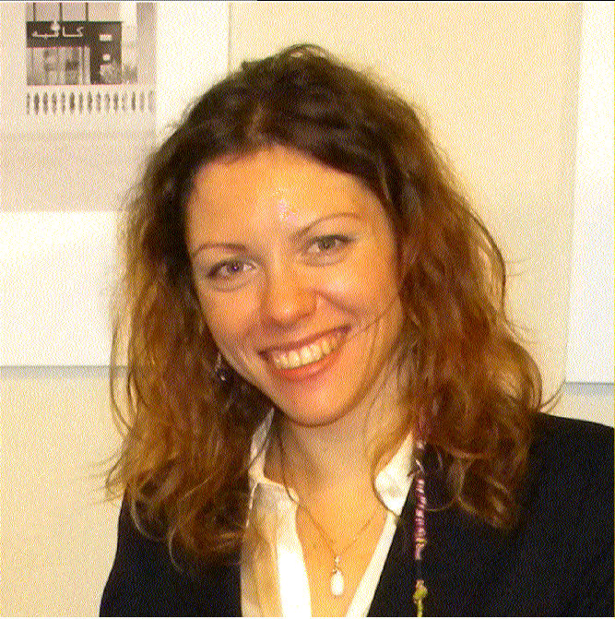
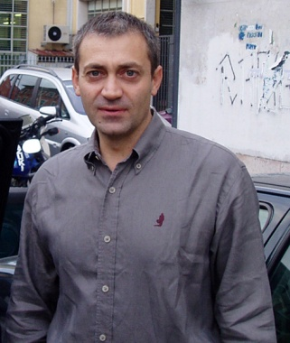
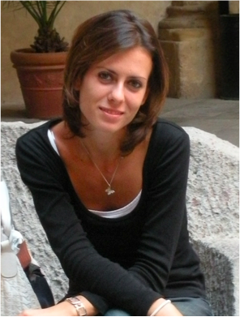
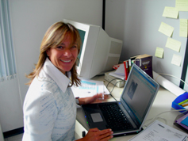
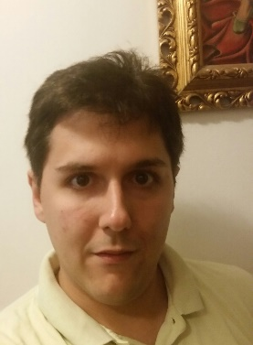
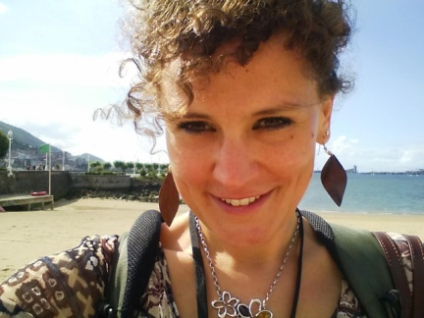
The EEE crew…
Corrado, Daniele, Edoardo, Federico, Fabrizio, Francesca, Francesco Nof., Francesco Noz., Giovanni, Ivan, Laura, Luca, Marco B., Marco G., Marco P., Marco S., Marcello, Maria Paola, Nicola, Paola, Rosario, Silvia M., Silvia P., Stefano…

Slide 7
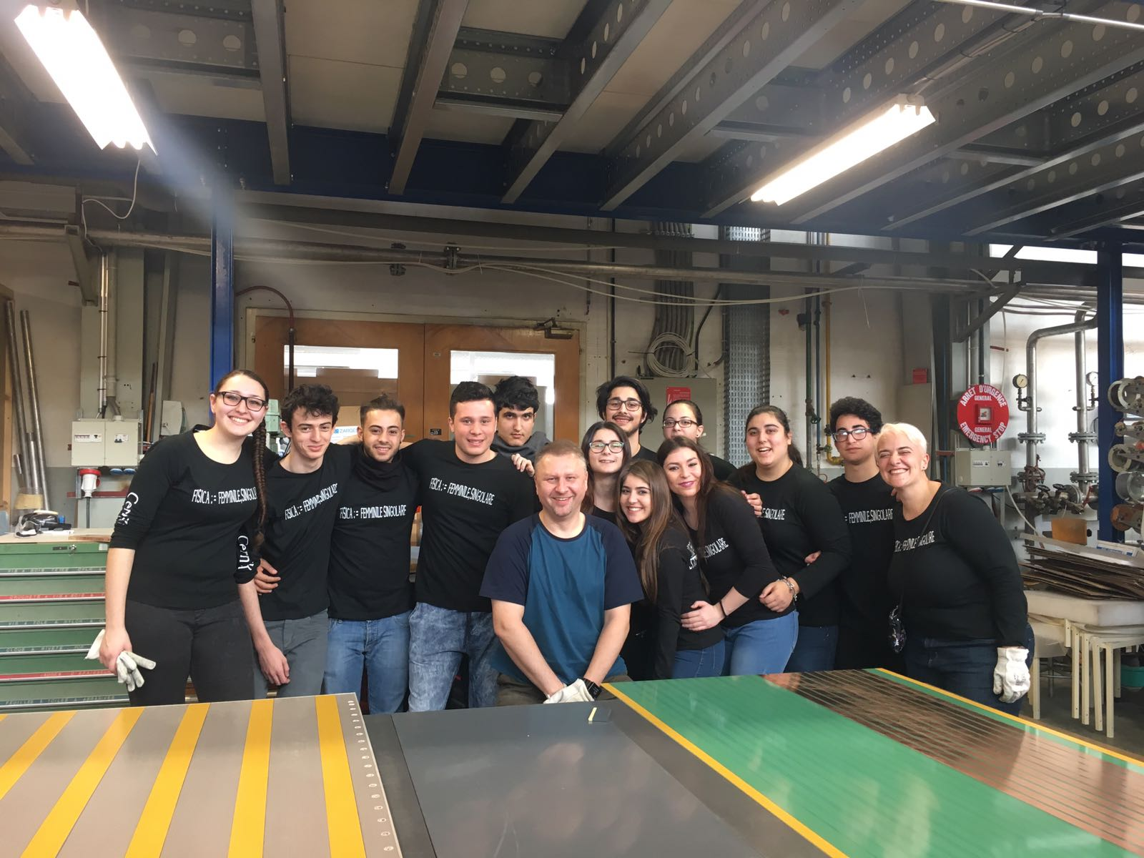
EEE network upgrade
Plan to build another 20 telescopes
Will increase the capability of the EEE network to study the high-energy part of the cosmic rays spectrum
Huge effort for 2017-18!
First bunch already almost completed
20-27 February → Lampedusa
12-18 March → Genova
23-29 April → SIEN-02
7-13 May → TORI-05 + Moscow
21-27 May → LODI-03
10-14 July → LODI + Korca
(spare chambers)
25-29 September → CAGL-04
Lampedusa: the southermost point of Italy

Slide 8
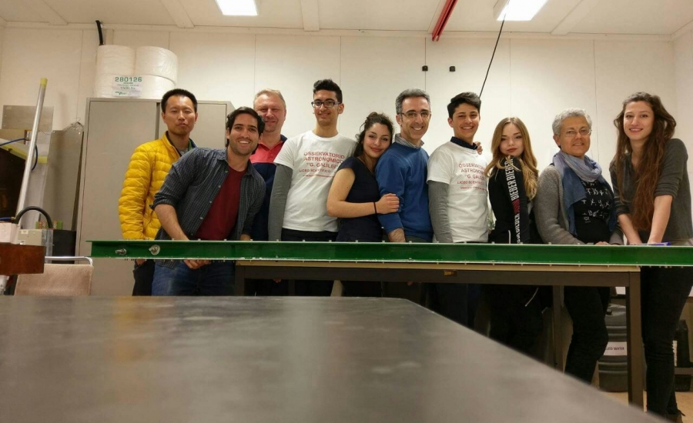
EEE smallest (but great) town
Plan to build another 20 telescopes
Will increase the capability of the EEE network to study the high-energy part of the cosmic rays spectrum
Huge effort for 2017-18!
Liceo Scientifico “Patrizi” di Cariati

Slide 9
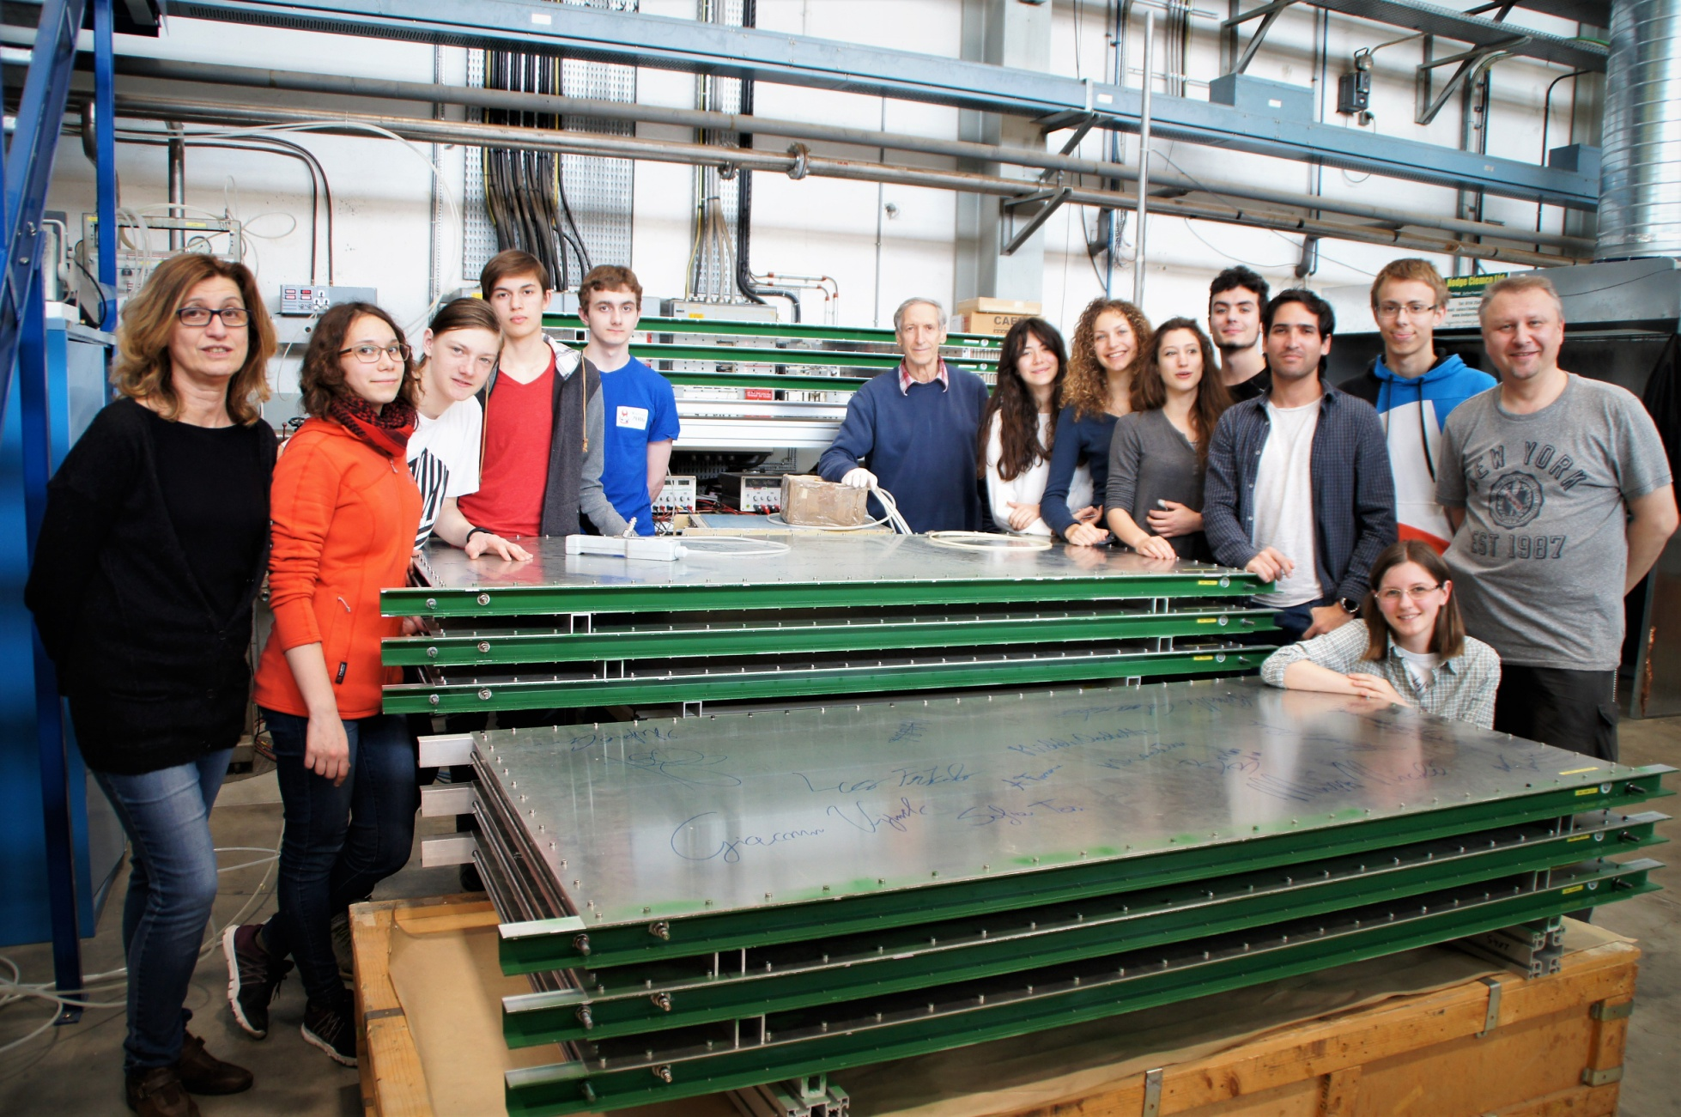
EEE arrives to Moscow
Mixed team of teachers/students from Gobetti Segrè Lyceum in Turin and the Lyceum for Chemical Physics in Moscow

Slide 10


External collaborations
EGO-VIRGO collaboration interested in having one (or more) EEE telescopes hosted at their lab in Cascina
As a veto for cosmic ray showers in coincidence with possible signals coming from gravitational waves
  There is a similar device at LIGO
  There is some literature on that
Possibility to sign up an agreement
University of Santiago de Compostela (Spain) interested in anaylizing EEE data looking for correlations between the cosmic rays flux and temperature and pressure conditions in the throposphere
An agreement being signed up
And, of course, Polar QuEEEst!

Slide 11
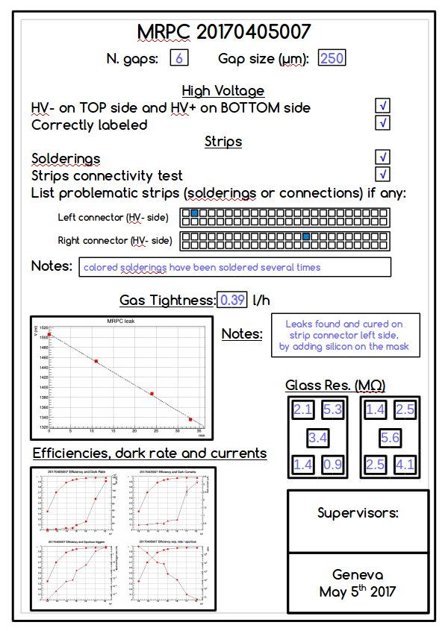
New chambers for new telescopes
250 µm gap chambers
Conceived for new eco-friendly gases
Reduce operating voltage
Improved front-end boards
Amphenol cables and connectors
replaced by Nugent ones
Pre-production boards under test
New test protocol at CERN
Tests on electrical (strip) connectivity
Tests on gas tightness
Tests on current, rate and efficiency
Everything stored in a dedicated DB

Slide 12
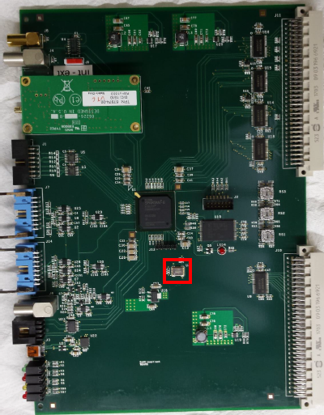
New trigger/GPS cards
Developed between Bari and Lecce INFN sections
Joins the functionalities of the present trigger and GPS boards (+ GPS interface)
Additional functionalities:
-clock distribution
counters accessible via VME
trigger logic programmable via VME
Already installed (as trigger card only) at LODI-02
To be soon deployed at FRAS-02, SIEN-01, TORI-02, VICE-01

Slide 13

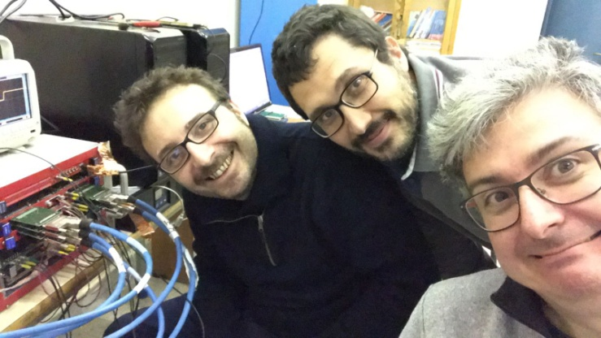
EEE: the taskforce
A task force of hardware experts, to intervene where setting up/commissioning/reparation of an EEE telescope is needed
Started activity at beginning of 2017
Already interventions at:
TREV-01 (commissioning, now telescope
taking part to the data taking)
VICE-01 (telescope set-up, waiting for trigger card)
ROMA-01, ROMA-02 (testing and repairs)
FRAS-02, FRAS-03 (small repairs, now both telescopes taking part to the data taking)
Programming interventions at COSE-01,
LECCE, etc.

Slide 14
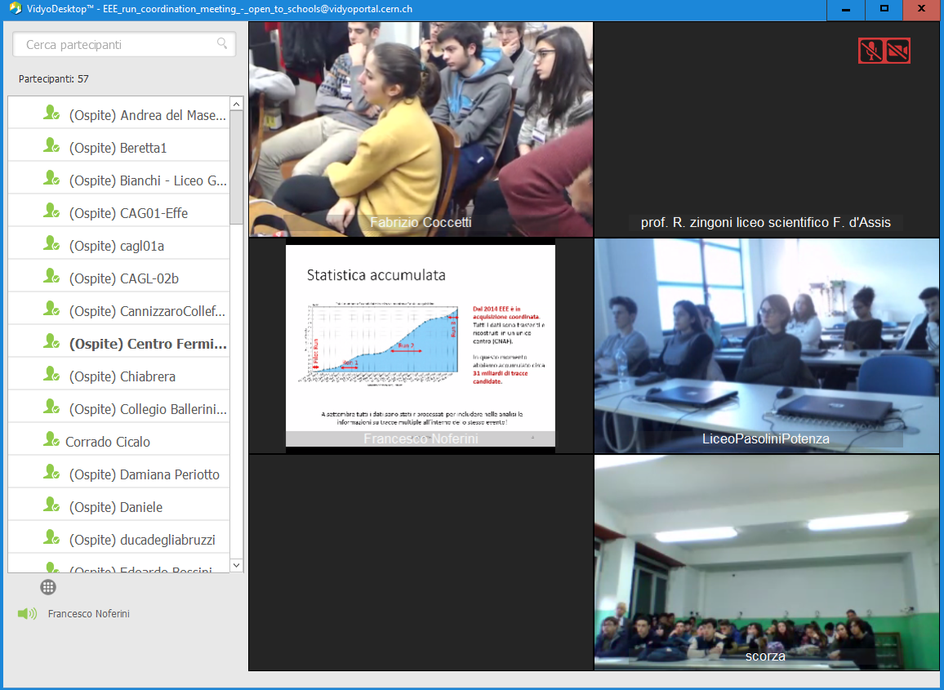
EEE meetings with schools
Since end of 2016 monthly EEE run coordination meetings open to schools
Using dedicated Vidyo virtual rooms
Around 50-60 schools connected → hundreds of participants!

Slide 15
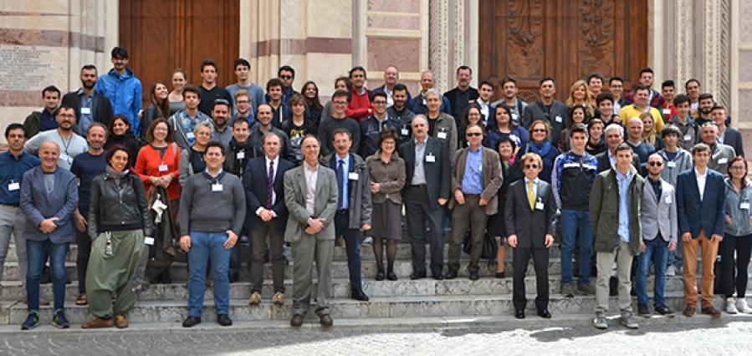
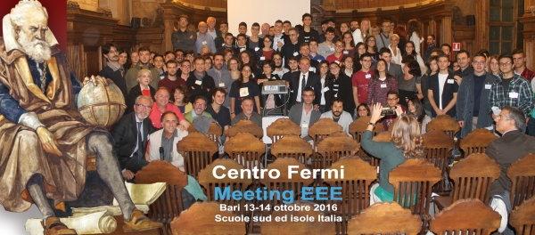
EEE plenary meetings
Bologna, November 6-7
North Italy schools
Grosseto, April 15-16
Center Italy schools
Bari, October 13-14
South Italy schools
Erice 2017:
May, 29, 30 and 31
December, 6, 7 and 8

Slide 16
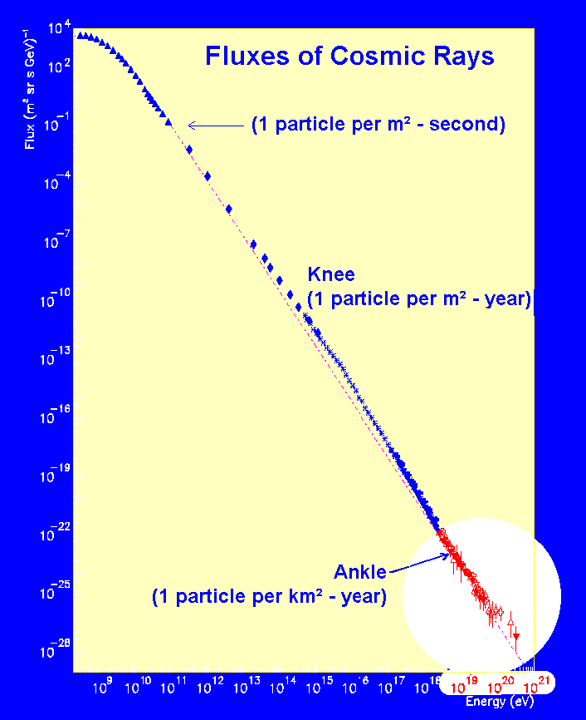
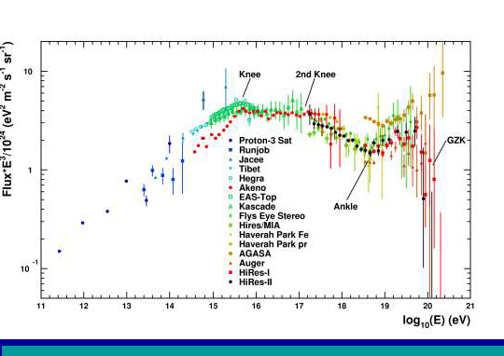
EEE: goal of the project
Aims at covering the most interesting, and still unexplored, region of the cosmic ray spectrum:
  E > 10¹⁸ eV
  Extragalactic sources
  GZK cutoff
  (Greisen, Zatspein and Kuz’min)

Slide 17
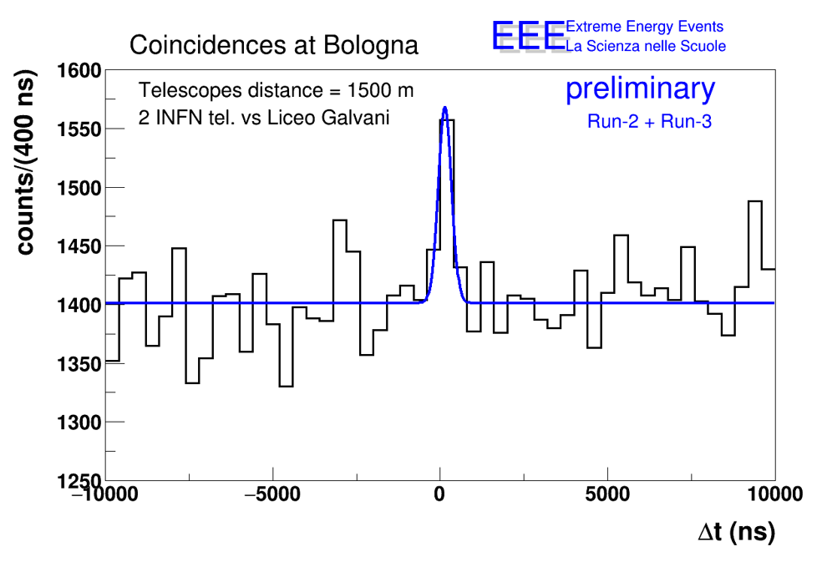
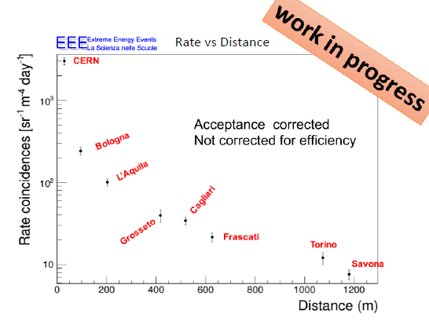
EEE coincidences searches
Detected coincidences at 1.5 km
Higher distance → higher energy
Coincidence rate vs. distance
Each cluster is sensitive to showers
of Energy high enough to involve both
stations
Need an accurate Monte Carlo
Simulate shower development
Simulate environmental effects

Slide 18
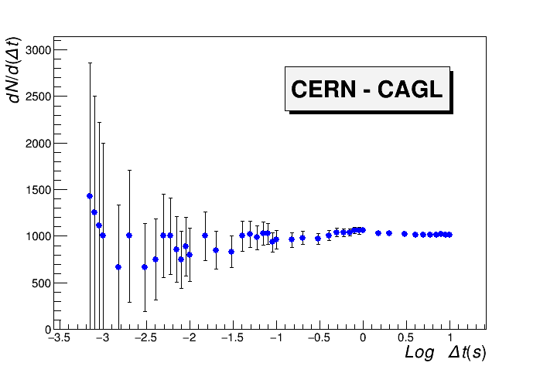
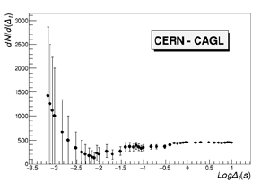
EEE: long distance correlations
Strategy: correlations between individual showers in telescopes clusters
Shower rate: 0.001 - 0.04 Hz (depending on cluster and S/N ratio)
Spurious rate in 1 ms: 10⁻⁸ - 10⁻⁷ Hz (0.001 - 0.01/day)
Number of events dN/d(Δt) for decreasing time window
No cut on relative angle between showers
Cut on relative angle< 10
Cut on the relative angle
Not the same results for all pairs of clusters: studies ongoing!
10 ms

Slide 19
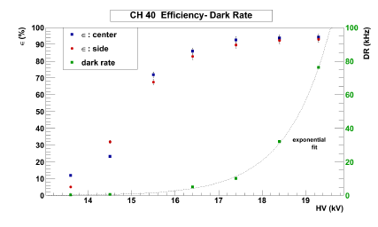
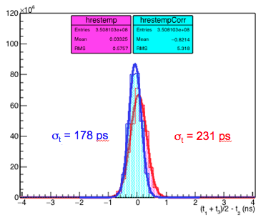
EEE chamber performance
Efficiency measurements
…and counting rate
Efficiency HV scan performed last year (middle chamber)
To be repeated for all chambers
Time resolution measurements
With time slewing corrections, improving time resolution about 20%

Slide 20
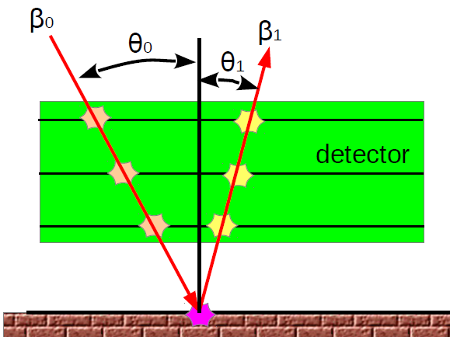
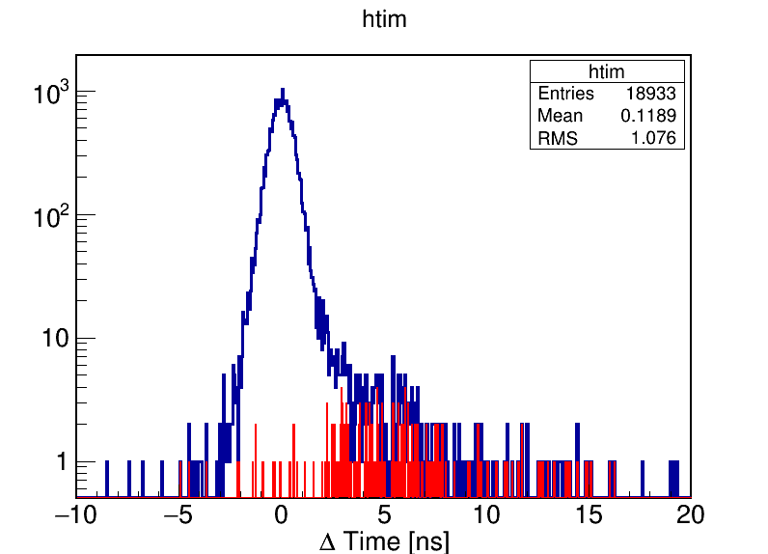
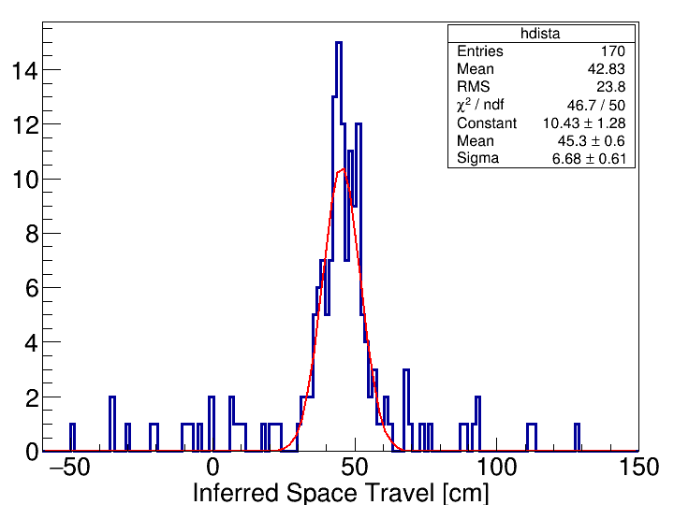
Backscattered events
coincidences
β₀>0 & β₁>0
170 Backscattering events:
β₀>0 && β₁<0
Large time difference due
to Time Of Flight
Inferred distance to the ground:
46 cm below the telescope

Slide 21

Being up h24…
The 2016 new year Forbush: at 24.00 of 31/12/2015 our telescopes -in schools- were up and running!
New year!

Slide 22

The future: Run-4
Start: 2 October 2017 – End: 31 May 2018
Commissioning week: 25 September 2017 – 1 October 2017
Schools are called to:
(help) fix all issues in their telescopes (particularly in the Long Shutdown)
  50 cm distance between chambers
  2 l/h gas flow
Complete the measure of the telescope angle wrt. North
Start measures of the gas consumption
Telescope startup and shutdown responsibility of the schools
Read emails, diffuse them and react
Take part and present to the EEE Run meetings open to schools
Keep the telescope in operation
Monitor the telescopes (ALL)

Slide 23


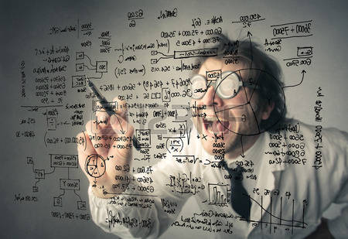
Conclusions
The EEE experiment is an innovative
approach to:
  scientific research + scientific communication
Its stations, located in high schools, take data almost continuosly
  incredible enthusiasm by students and
  teachers
EEE produces -a lot of- physics!
  detectors performance similar to LHC
  very interesting observations of
  cosmics phenomena
But, above all…

Slide 24
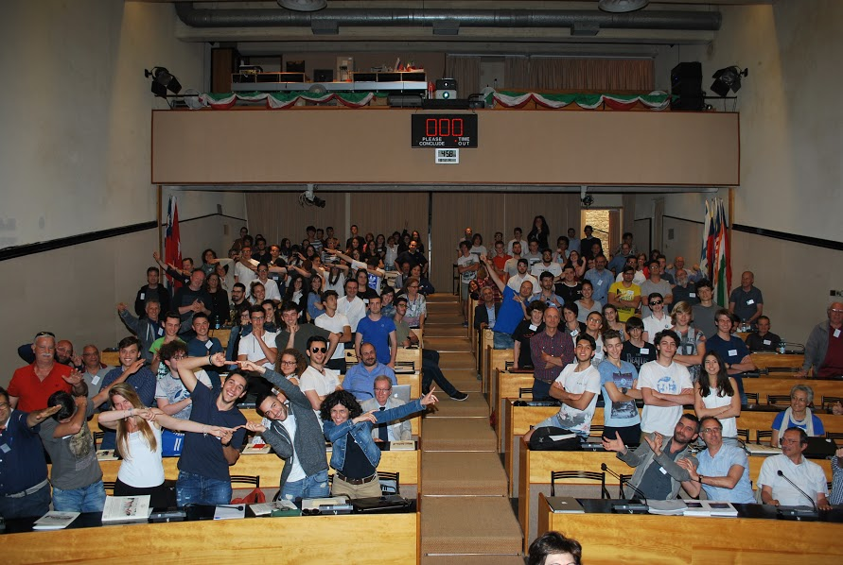
… it is a lot of fun!

Slide 25
The End:
Thanks for the attention
Questions?

