Slide 1
Run 3 operation
(ITIS Galilei AREZZO)

Slide 2
Run 3 operations and issues
Polarity change before the start of the RUN3 (10/2016)
Change of the gas flux chamber order: from “Bottom- Mid-Top” to “Top-Mid-Bottom” (6/2/2017)
End of SF6 (16/2/2017)
Voltage reduction (13/5/2017)

Slide 3
Temperature and rate
During RUN2 it was observed a correlation between indoor temperature and rate
Not so good reconstruction parameters
MRPC3 found with half of the strips with inverted polarity
Intervention performed at the beginning of RUN3

Slide 4
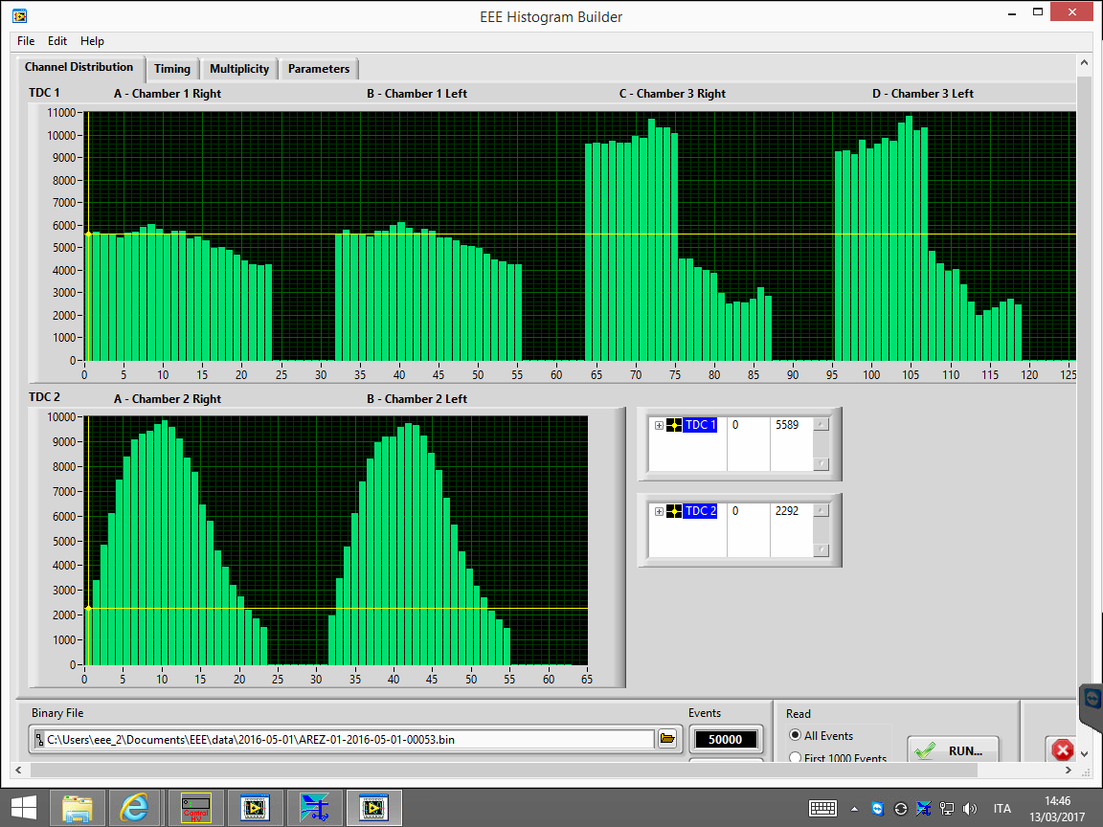
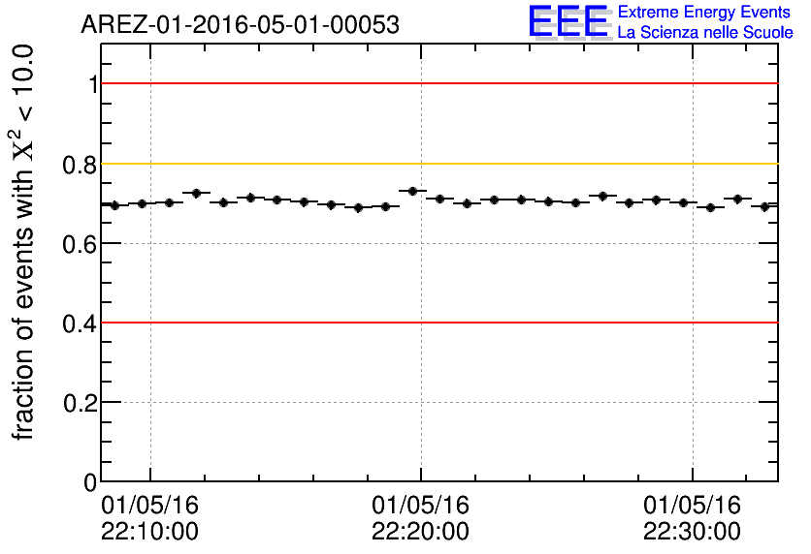
Channel distribution before polarity change in MRPC3 with correspondent Chi2 plot

Slide 5
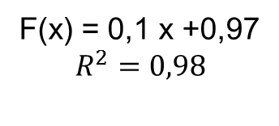
MRPC3 current vs temperature
F(x) = 0,1 x +0,97

Slide 6
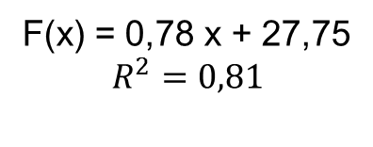
Rate in function of temperature
F(x) = 0,78 x + 27,75
Arezzo, 16 marzo 2017

Slide 7
After the intervention
There is a decise improvement in the reconstruction parameters
During RUN3 it is still present a correlation between indoor temperature and rate
Is it possible that a gas flux problem is the cause?

Slide 8
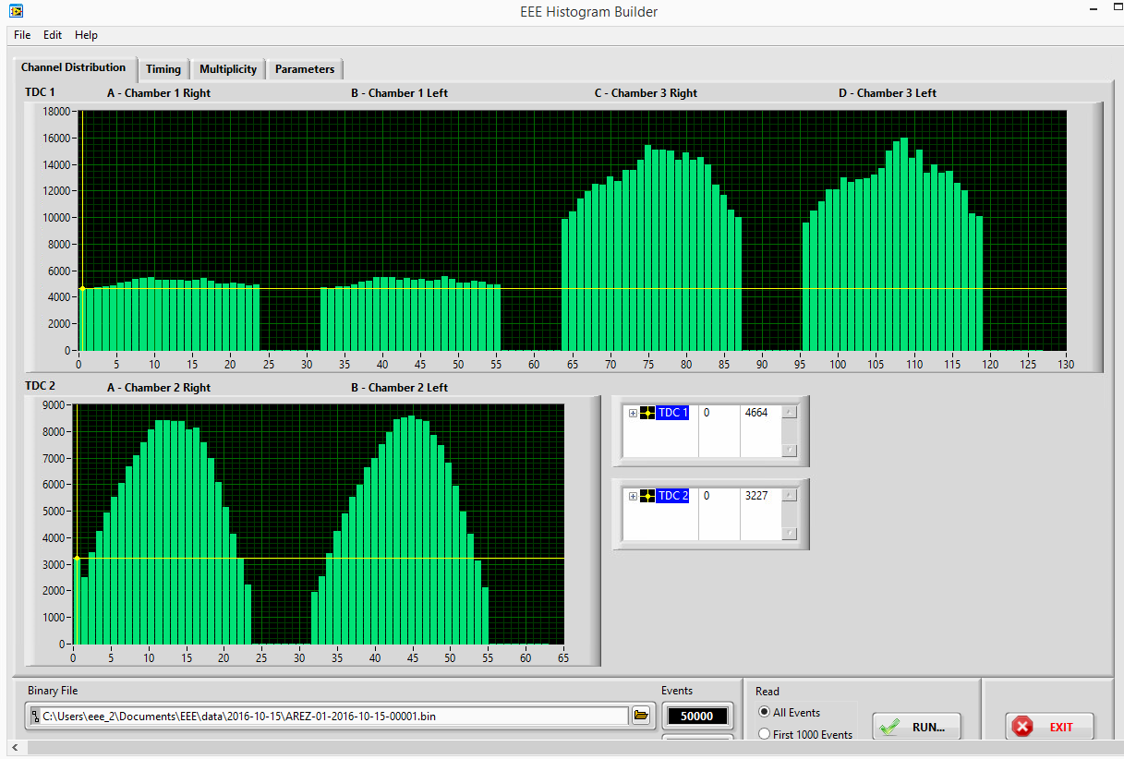
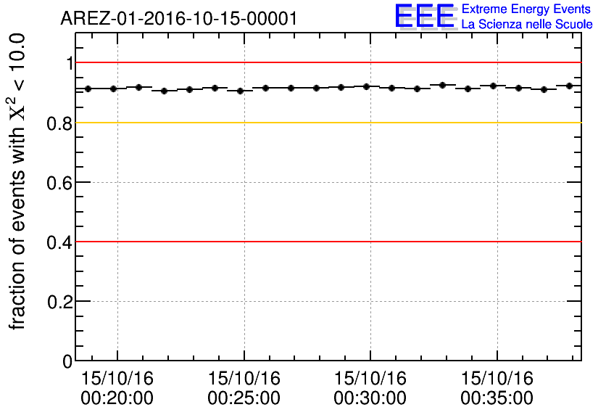
Channel distribution in MRPC3 with correspondent Chi2 plot after polarity change

Slide 9
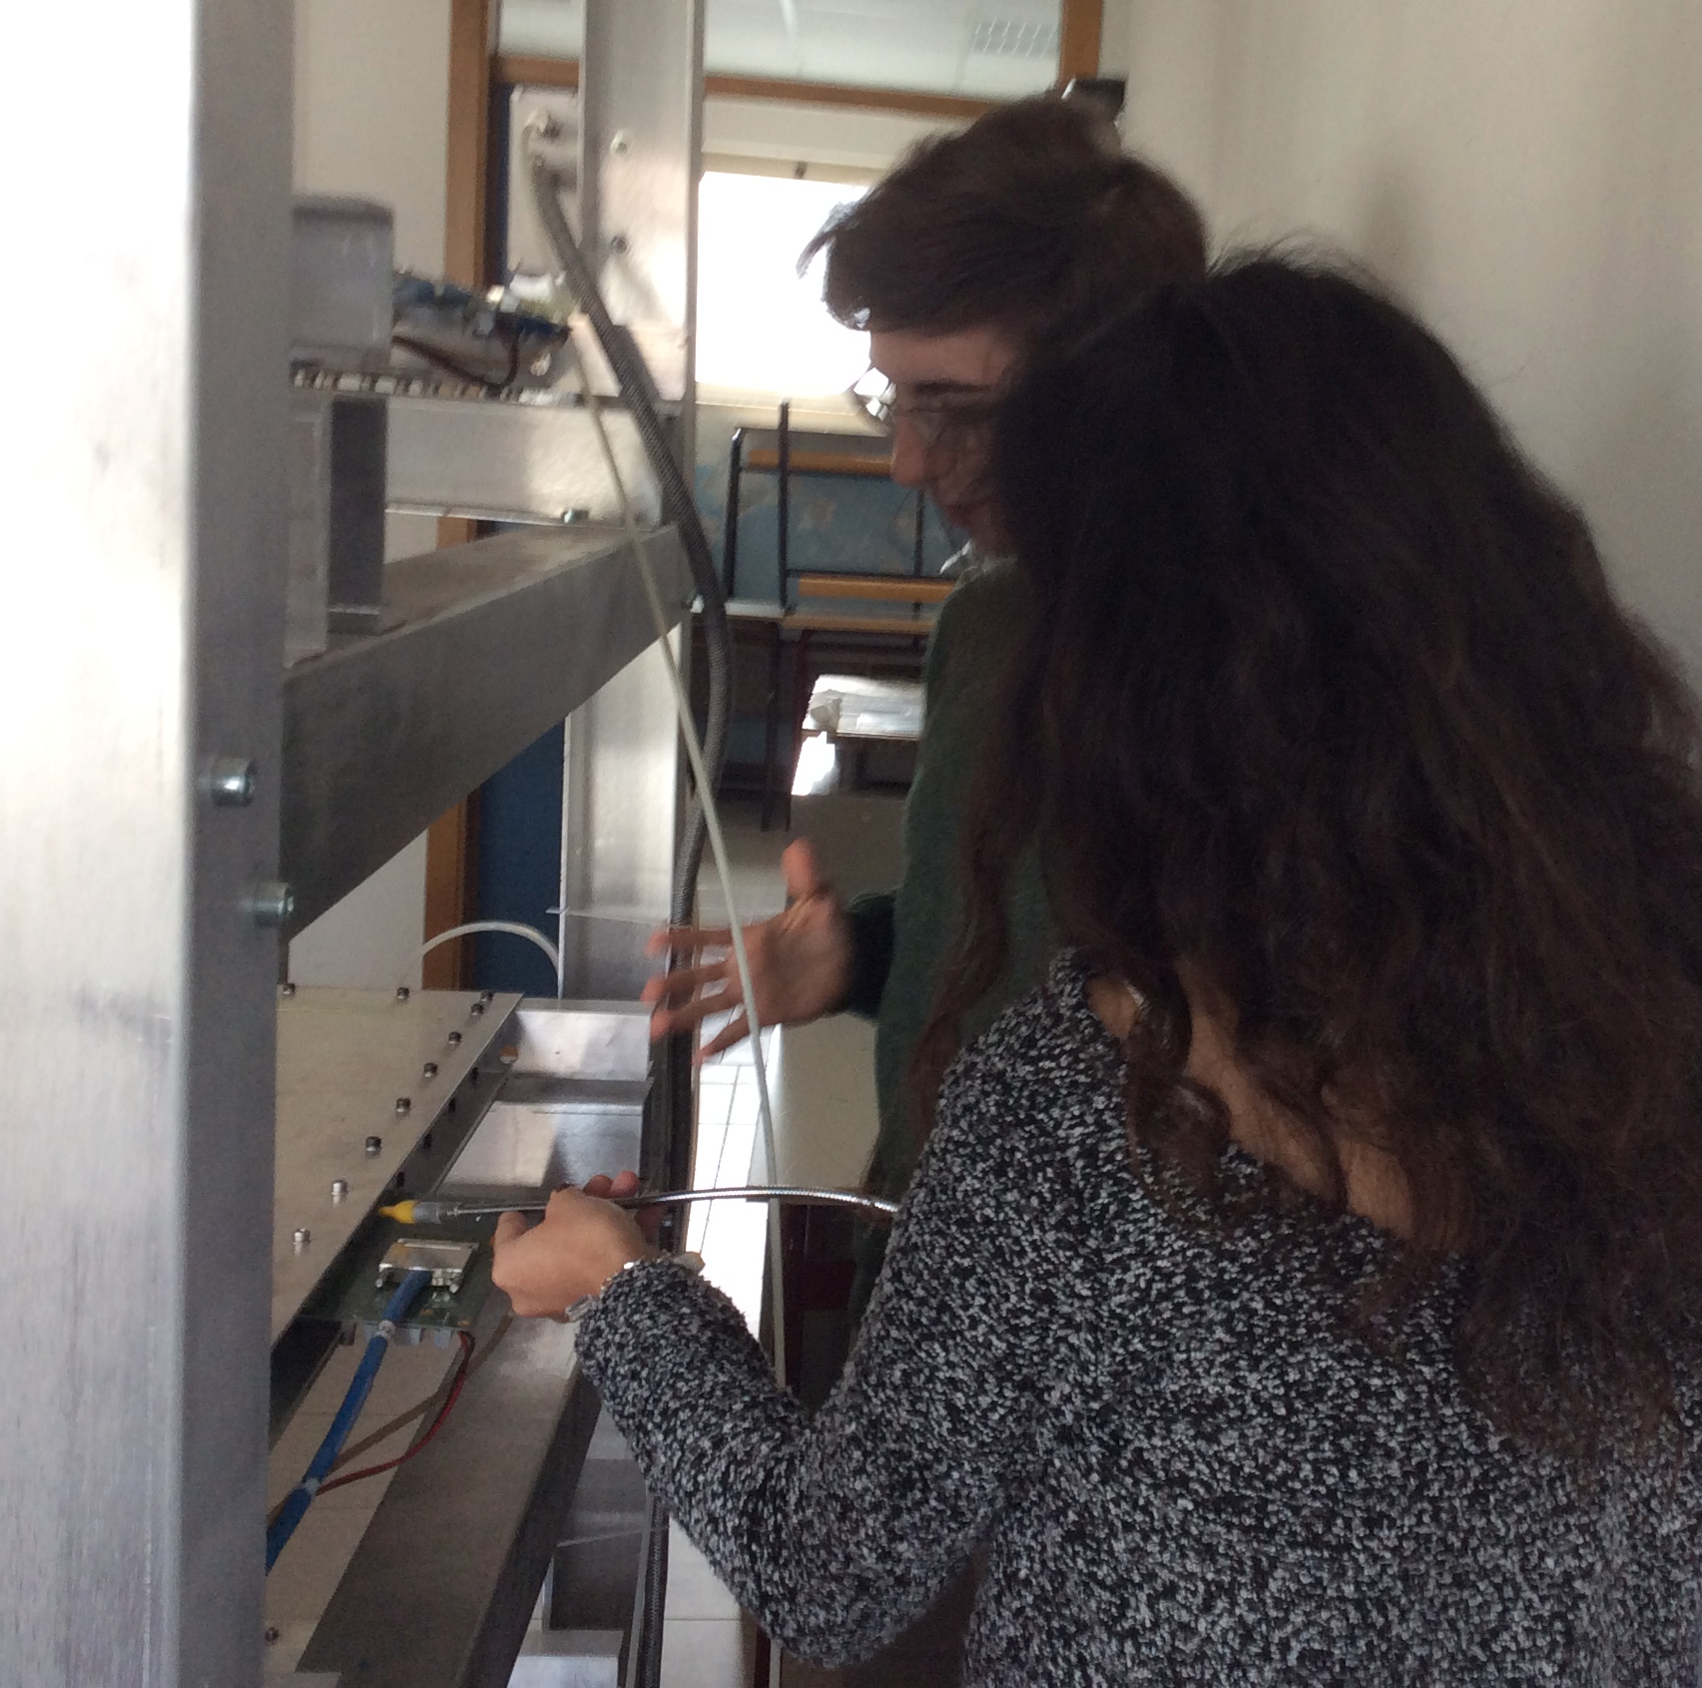
Leak search
Students using a leakseeker to discover possible leakage of MRPC
2 leaks in MRPC3
1 leak in MRPC1
Small leaks in MRPC2
Inversion of the flux line in order to place
the leaking chamber in first position

Slide 10
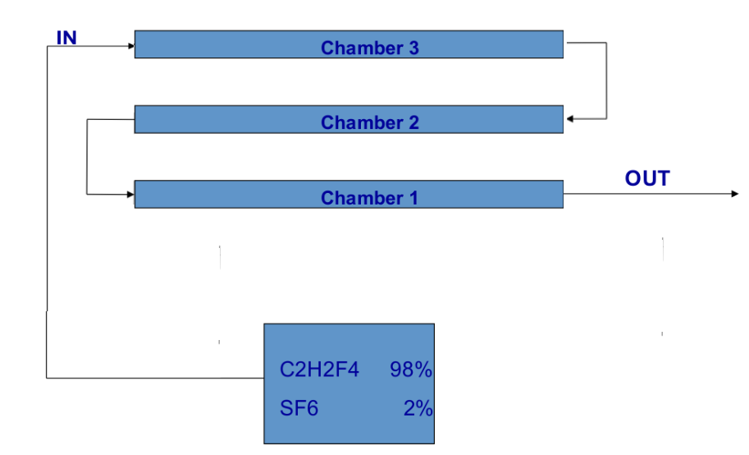
Flux Chamber Inversion
Changing their order in the flux line

Slide 11
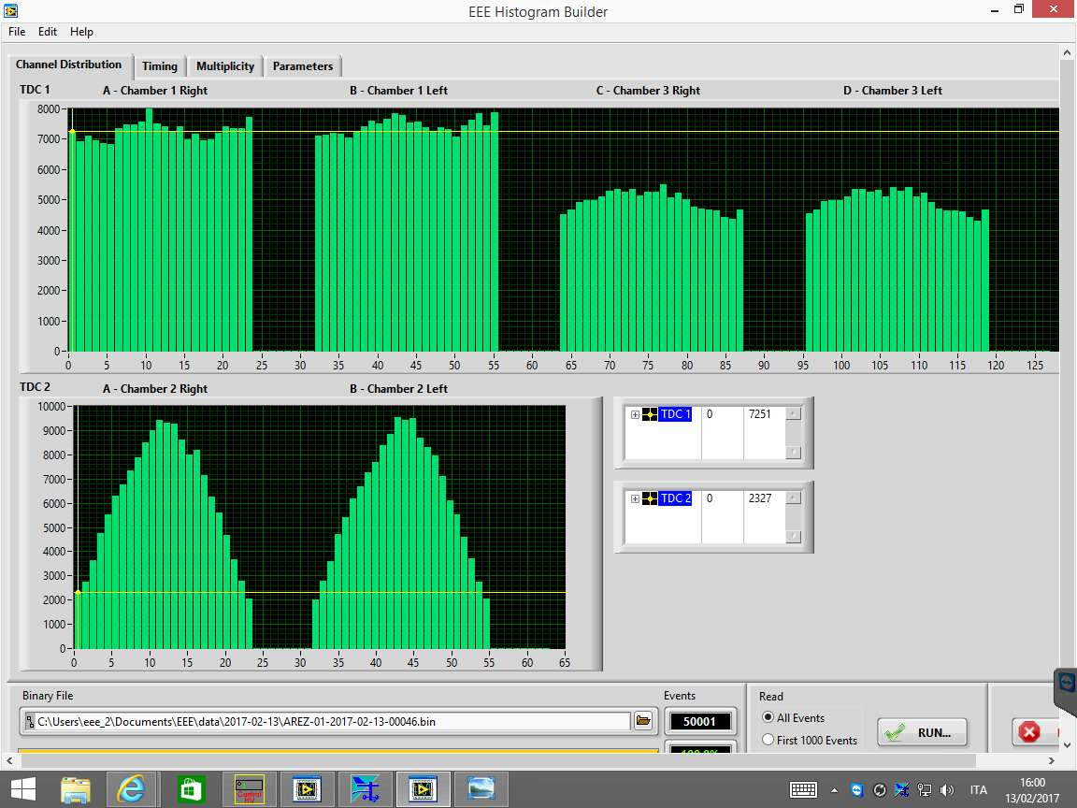
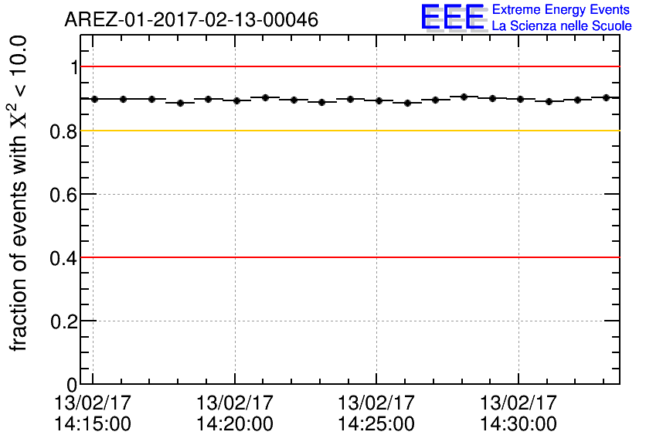
After flux chamber inversion

Slide 12
After the flux inversion
After the inversion, a small correlation between indoor temperature and rate has been found
Waiting to return to normal operation (re-sealing operation performed few days ago).

Slide 13
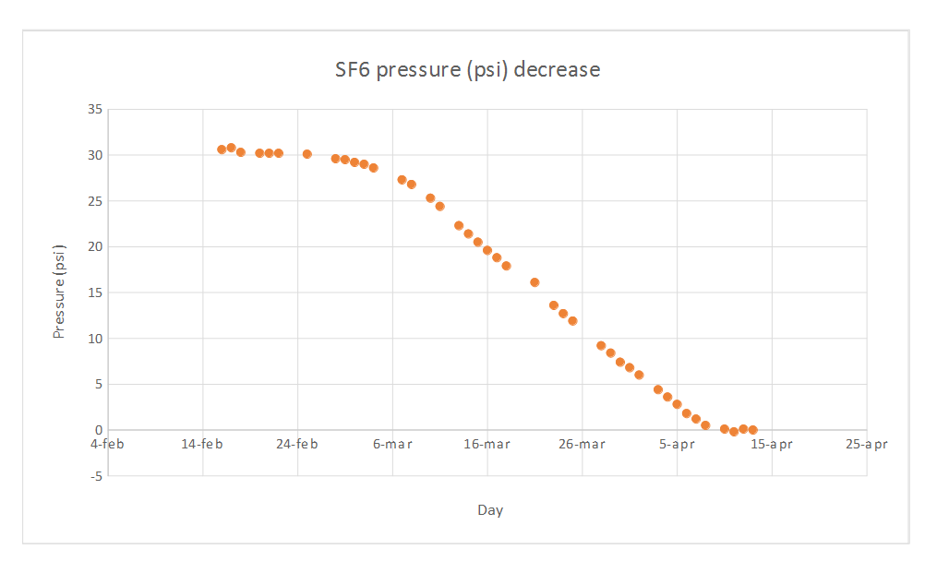
SF6 End

Slide 14
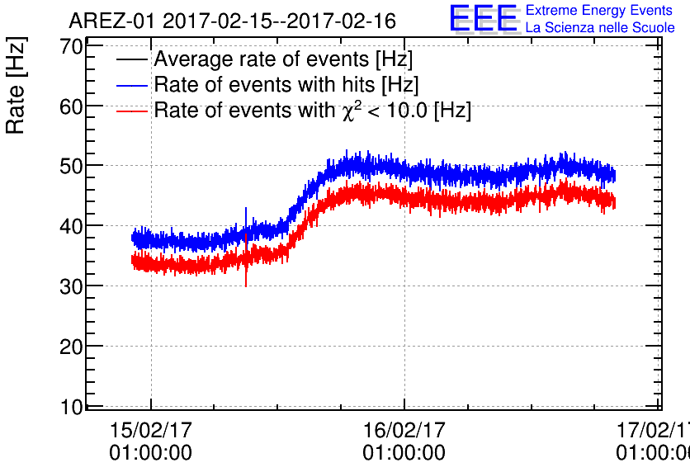
SF6 End
Sharp increase in rate of the events

Slide 15
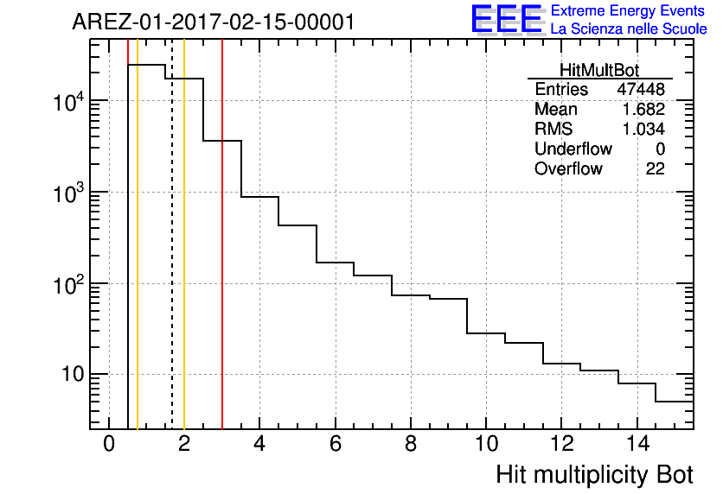
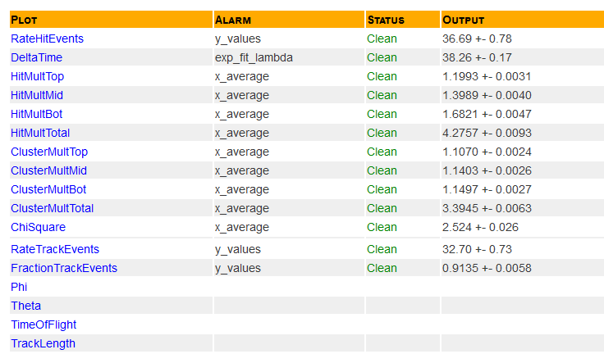
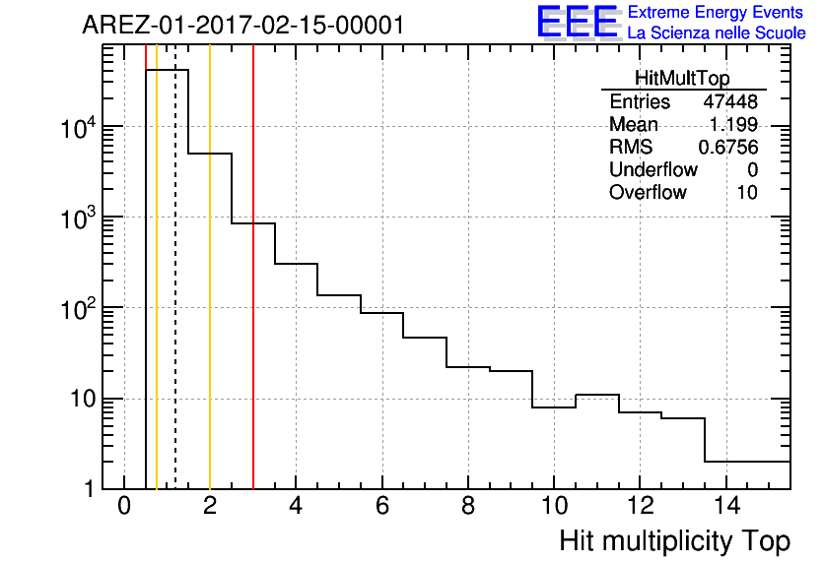
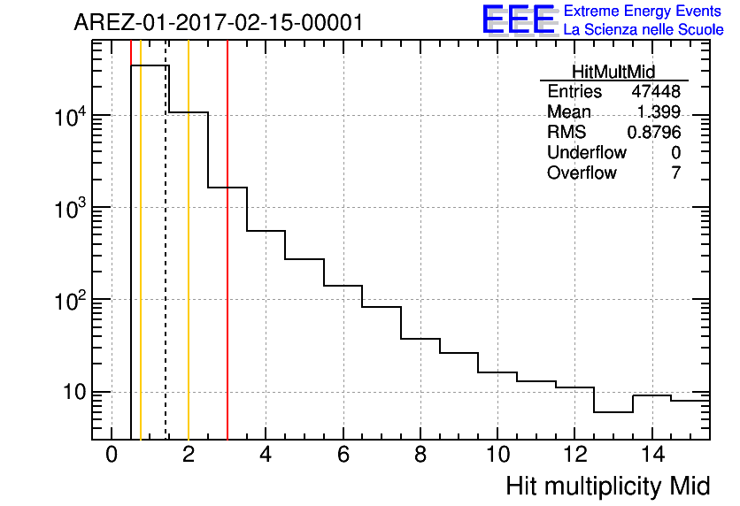
SF6 End
Multiplicity before 16/2

Slide 16
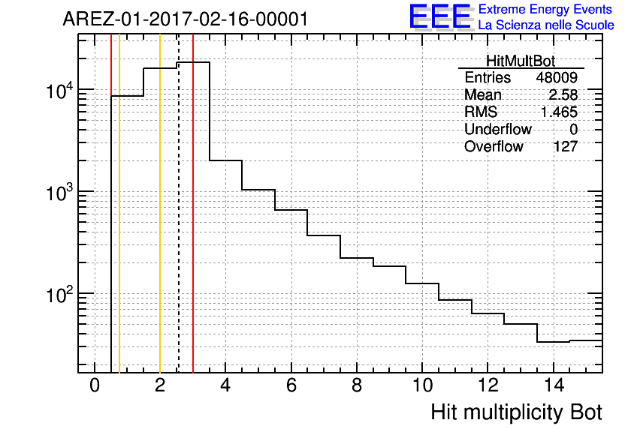
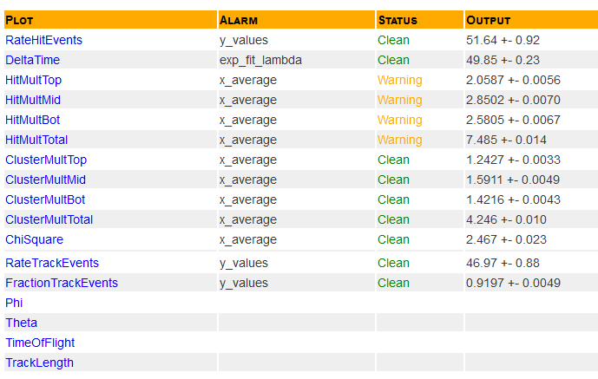
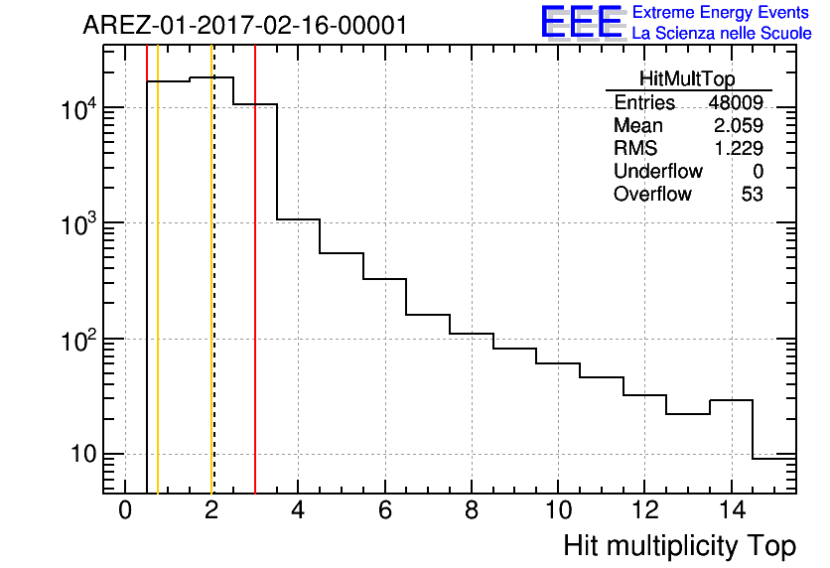

SF6 End
Multiplicity after 16/2

Slide 17
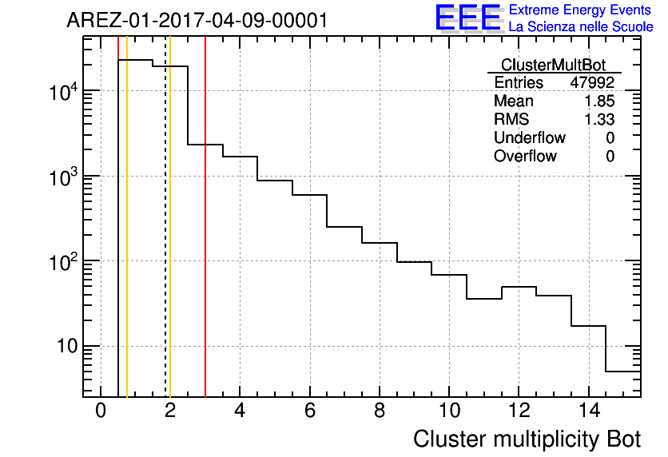
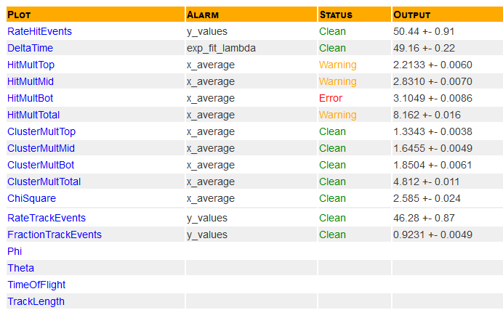
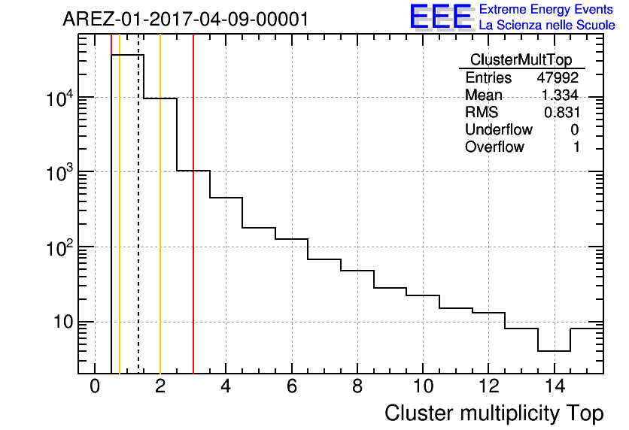
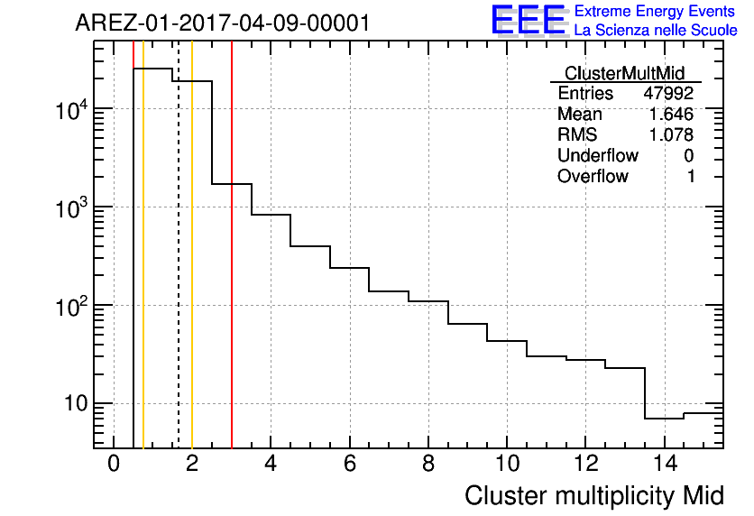
SF6 End
Cluster Multiplicity ante 10/4

Slide 18
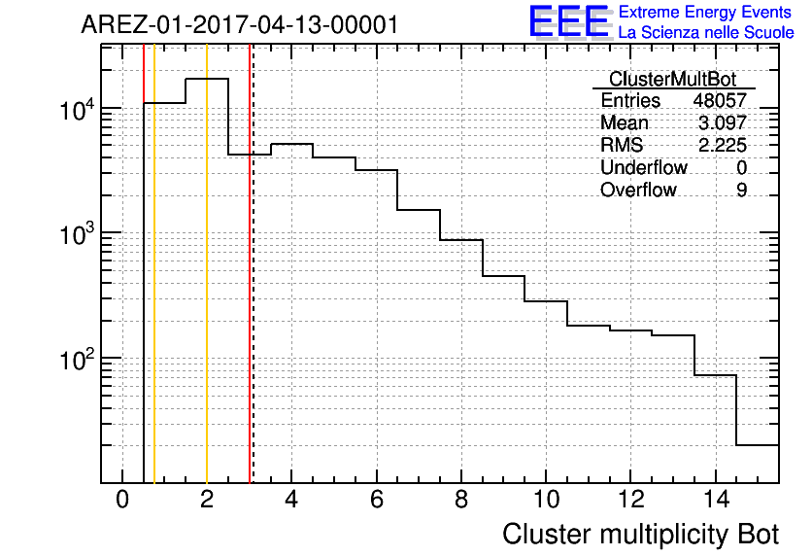
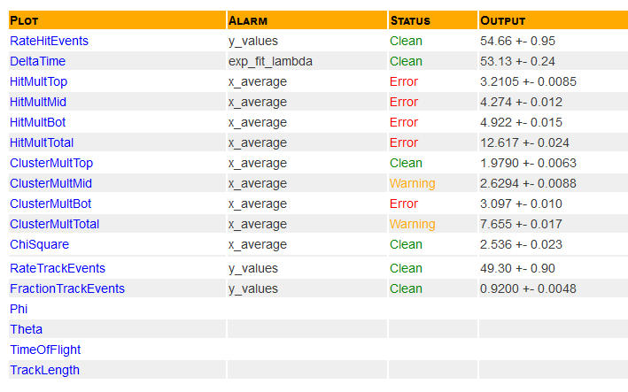


SF6 End
Cluster multiplicity after 13/4

Slide 19
SF6 end
File dimension increase (about 300%!)
Disk space problem

Slide 20

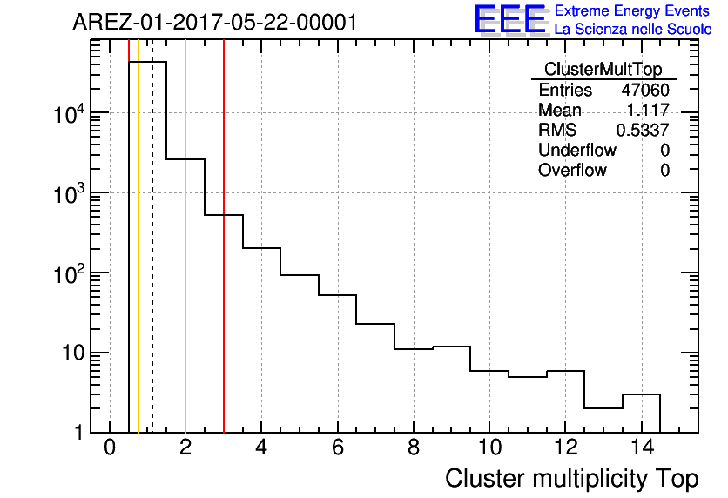
Temporary Solution
HV voltage reduction (~400 V)
Strong reduction of clusters
Consequent file dimension reduction
Lower rate

