Slide 1
"Cosmic pi vs. EEE: different tools for the same goal"
Liceo scientifico statale Giuseppe Peano
Monterotondo(Rm) Italy

Slide 2
Placement of the EEE detector inside buildings: consequence of concrete on the flow of cosmic rays
The measurements were obtained with:
Pion - Muon detector BL4S "Cosmic pi"
These are counting measurements,
We did not detect either energy or particle type,
Lack of coincidence.

Slide 3
"Cosmic pi vs. EEE: different tools for the same goal"
How the project begun...
CERN offers high school students from all over the world the opportunity to conceive and carry out a scientific experiment on a beamline of the CERN accelerator, by joining the competition "Beamline for Schools" (BL4S)

Slide 4
The dream ... of team “Peano”
"[We want to come to CERN] because it is a place where people meet, cooperate and engage beyond their nationality and their own cultural patterns contributing to the development and to the wellness of society” Team Peano
Our project "Beamline use for the study of GMR" ended up in the 30 finalist teams, coming from all over the world!
Our team, together with the other 29 finalists, has been awarded by CERN for his effort and excellent work, by receiving a CosmicPi particle detector .

Slide 5
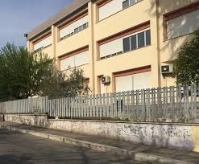
Data were collected in a six-months time gap, and the CosmicPi particle detector installed on the three floors of the school’s building for two months each; data were collected for 6 hours per day.
Concrete, being a low atomic material Z, behaves as a weak screen against the muons and pions of cosmic rays. The effect is measurable given the thickness of the concrete.
The school is spread over three floors:
  Ground floor
  First floor
  Second floor
The position of the detector on each floor was not the same.
On the ground floor it was placed at the main entrance, on the first and second floors in the physics and chemical laboratories located on the opposite side of the building.

Slide 6
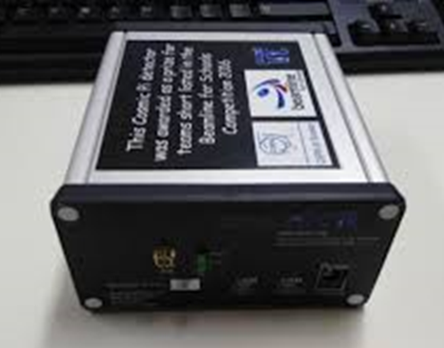
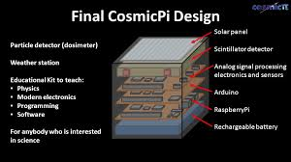
CosmicPi detector
We measured the number of events and converted the results into a particle flow per m² per second

Slide 7
Placement of the detector on the top floor
Flux= (170 ± 18) particles /m²/s

Slide 8
Placement of the detector on the first floor
Flux = (154 ± 17) particles /m²/s -9,4% compared to the top floor

Slide 9
Placement of the detector on ground floor
Flux = (114 ± 12) particles/m²/s -32,9% compared to the top floor

Slide 11
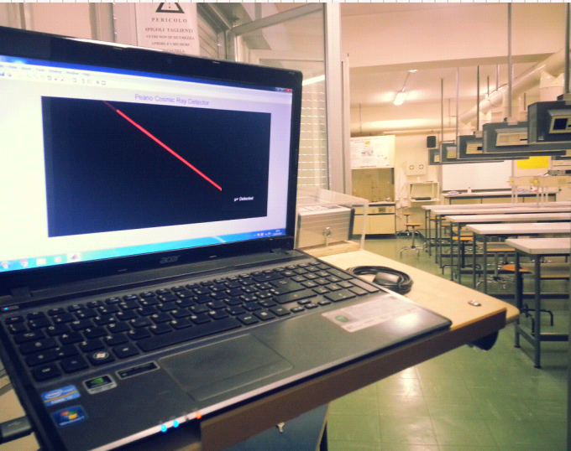
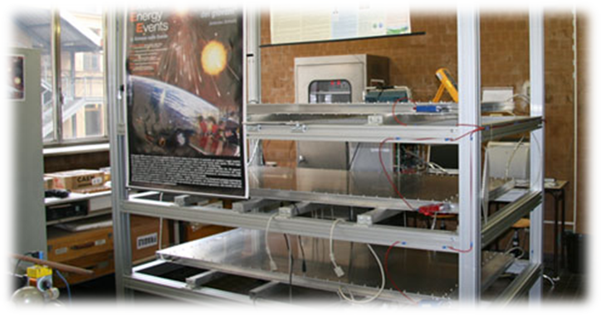
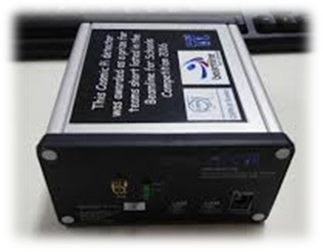
Differences between ‘’Cosmic pi’’ and ‘’EEE’’ detectors
The CosmicPi, compared to the EEE telescope, does not have three detectors. Therefore, we study a nearly total solid angle, while with the EEE we investigate a much lower solid angle lower. The muon is detected when the three signals on the three plane of the detector (MRPC) coincide, in space and time coordinates that are compatible with the existence of a trajectory.
The time interval between the second and first plane and the time interval between the third and the second plane must be consistent; since the three detector’s planes have finite dimensions, not all the particles can be detected. On the other hand the Cosmic PI can detect all signals, since the detector is constituted by a single plane and the limitations dictated by the trajectory and flying times bust not be accomplished.

Slide 12
Differences between ‘’Cosmic pi’’ and ‘’EEE’’ detectors
"CosmicPi" measurements are complementary to those that can be obtained with EEE.
The Cosmic PI reveals muons and pions, while the EEE telescope reveals only muons.
The dimensions are considerably different.
We have not yet been able to compare data with an EEE telescope for logistic issues, but our goal is to do it within the next year, thanks to the physics students that will take part in the cosmic rays project.

Slide 13
Thanks for your attention

