Slide 1

Lateral distribution of a muon beam
I.I.S. Maserati Voghera
2016/2017

Slide 2
Introduction
In the past December and January we analyzed the data related to the distribution of the beam n° EEE_400019 provided by the Centro Fermi website. Our group is composed by 30 boys and girls of the 1° to 4° year of high school. The students have worked individually managing the data in an autonomous way.

Slide 3
Preliminary work
During an introductory lecture we analyzed the material at the website http://eee.centrofermi.it/monitor related to the beam EEE_300490
Then we downloaded on pen drives the data related to the beam EEE_400019
We could rely on the availability of a laboratory with 30 personal computers for 3 afternoon sessions of 3 hours each
Every PC was supporting the following software tools:
Google Earth Pro
MS Excel

Slide 4
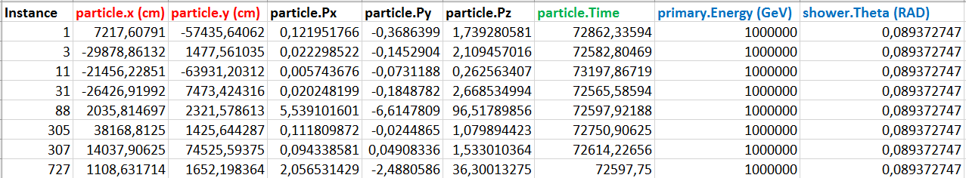
Analysis of the beam I
We started from the data reported above
- Coordinates of the ground impact
- Duration of the trajectory, expressed in nanoseconds
- Energy of the primary proton and its inclination

Slide 5
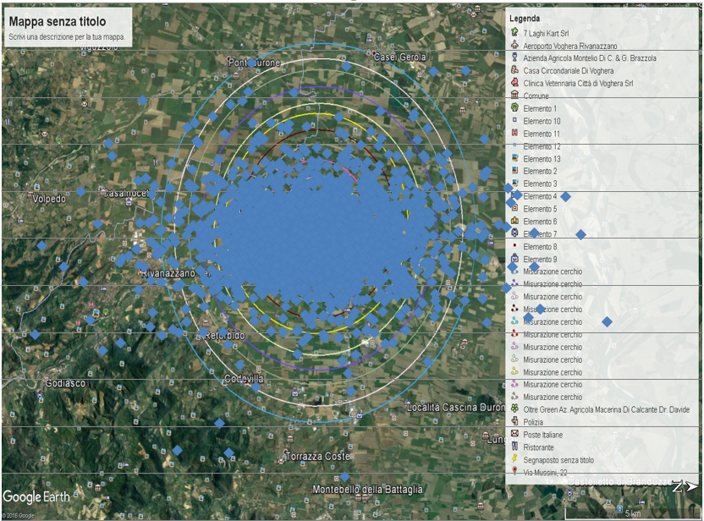
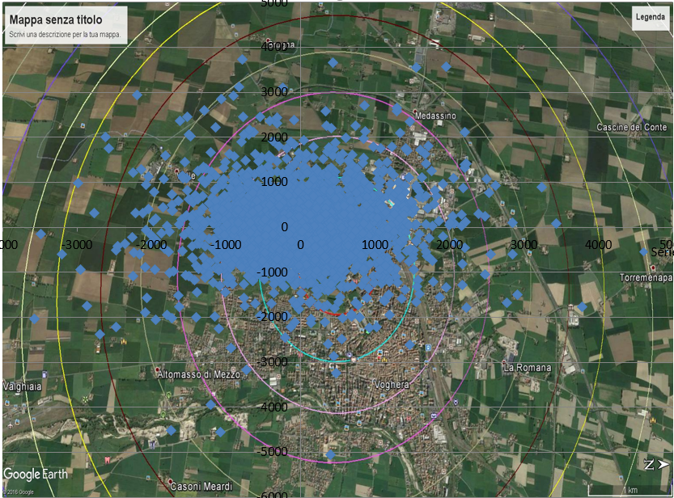
Analysis of the beam II
Conversion of the muon coordinates from cm to m.
Distribution of the ground impacts of the muons
Representation of the distribution on the map of Voghera (downloaded from Google Earth Pro), where we drew concentric circles.

Slide 6
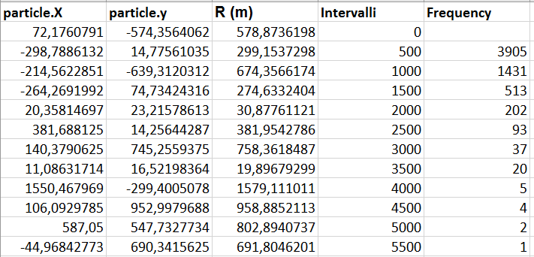
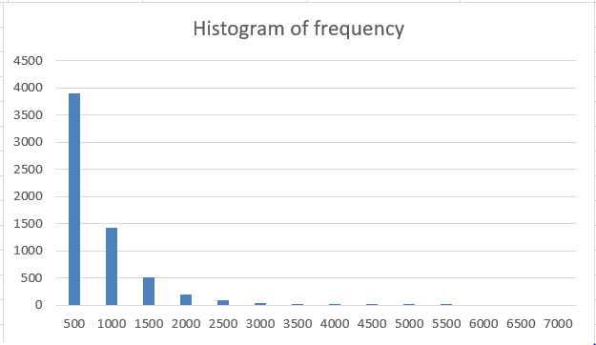
Analysis of the beam III
We computed the distance of each impact from the center by means of Pithagora’s theorem.
Then we computed the number of muons fallen into each annulus.
x = R(m) y = frequency

Slide 7
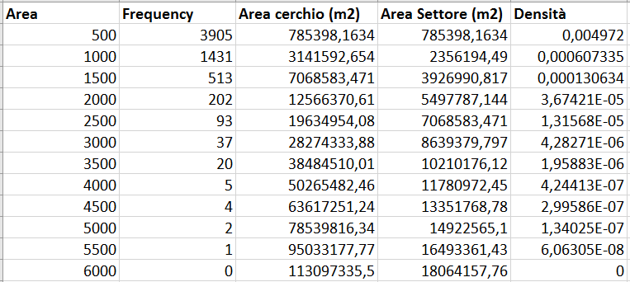
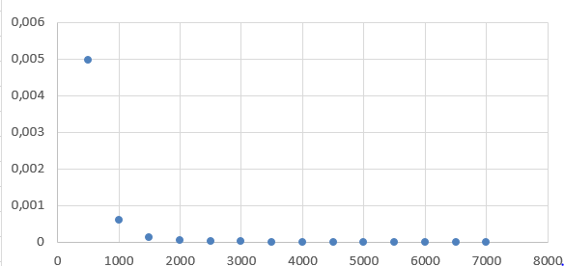
Analysis of the beam IV
We computed the area of each annulus.
Then we determined the muon impact density dividing the number of impacts by the area of the impact zone.
x = R (m) y = density (n/m²)

Slide 8
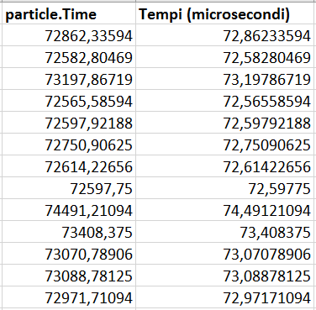
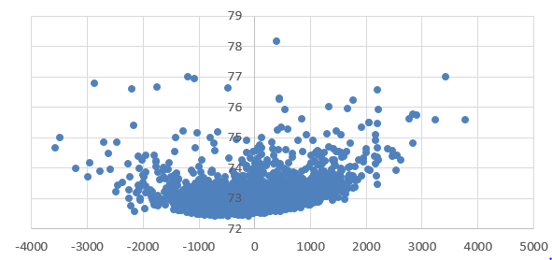
Analysis of the beam V
We converted the falling time of each muon from nanoseconds into microseconds.
Then we built a graph in the x-t coordinates.
x = particlex (m) y = times (µs)

Slide 9
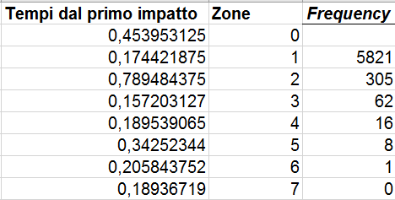
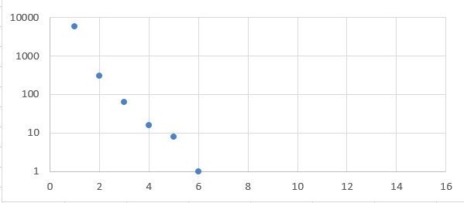
Analysis of the beam VI
We then determined the minimum and maximum times.
We divided this range into equal time intervals
We computed the number of muons for each time interval.
Finally we built the graph (in log-coordinates) of the obtained data.
x = times (µs) Y = frequency

Slide 10
Remarks and difficulties
We faced a number of difficulties, namely:
Problems related to the compatibility of the different versions of the Excel software.
Difficulties in downloading a map from Google Earth Pro that was suitable for the representation of the Excel data.

