Slide 1
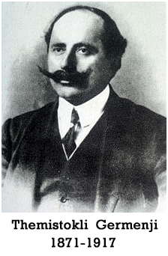
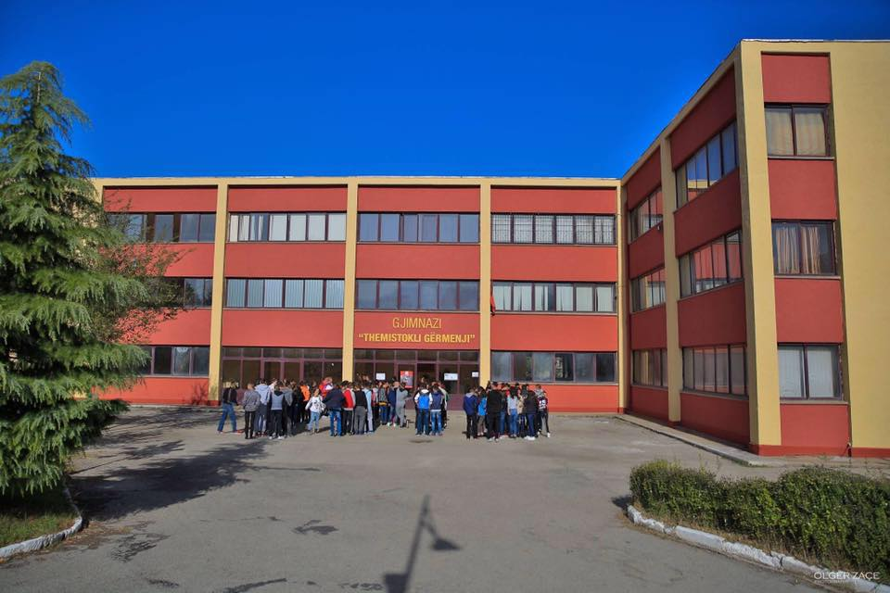
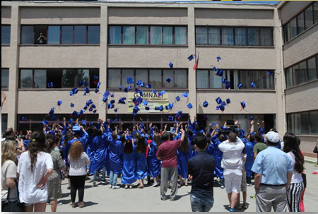
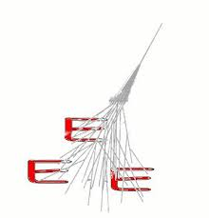
HIGH SCHOOL
“THEMISTOKLI GËRMENJI” - KORÇË

Slide 2
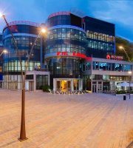
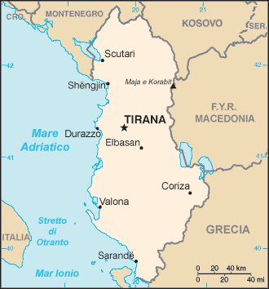
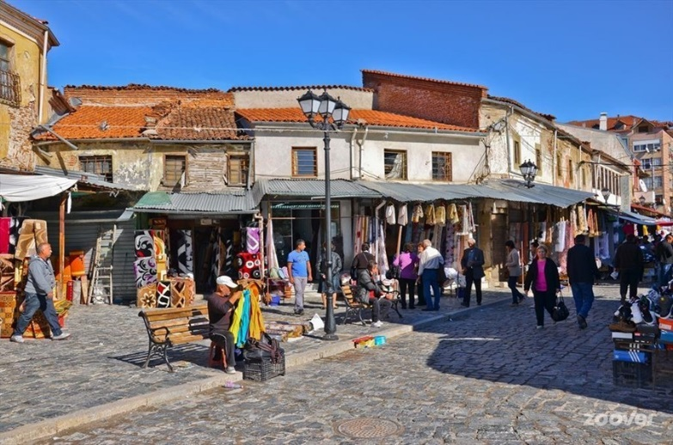
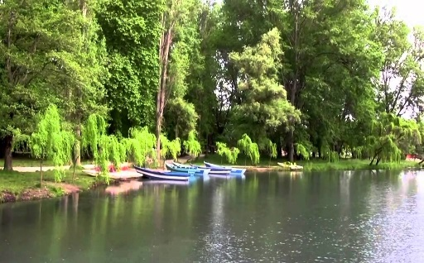
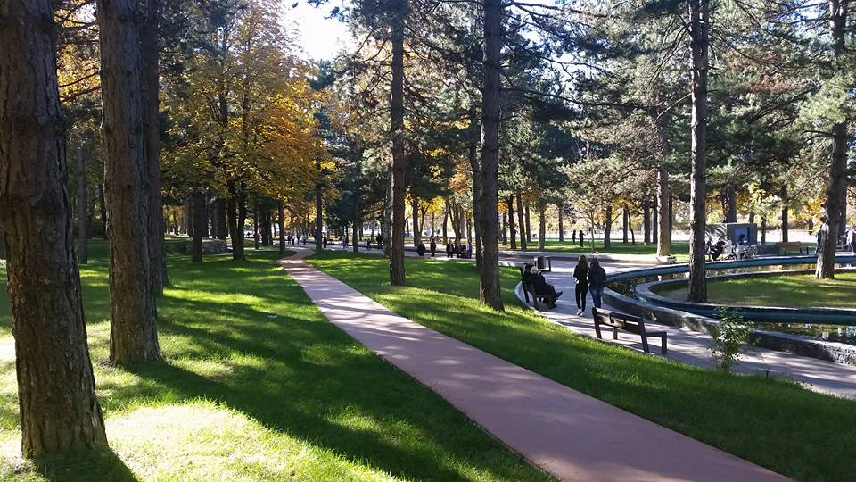
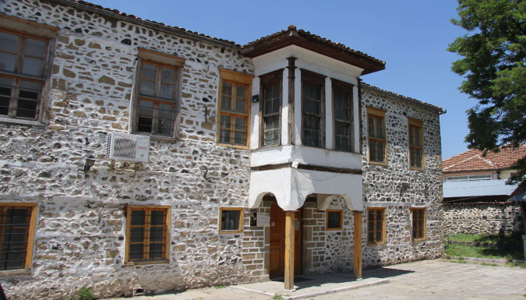
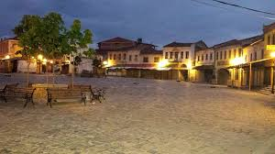
SOME VIEWS OF THE CITY
7° convegno EEE Erice 29-31 Maggio 2017

Slide 3
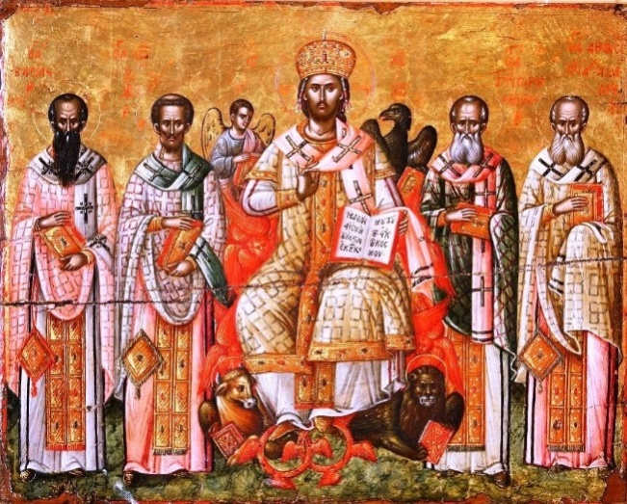
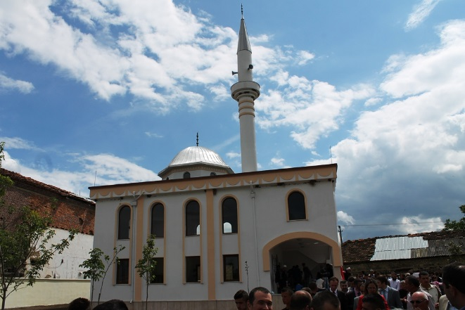
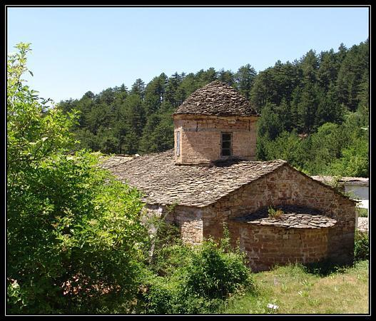
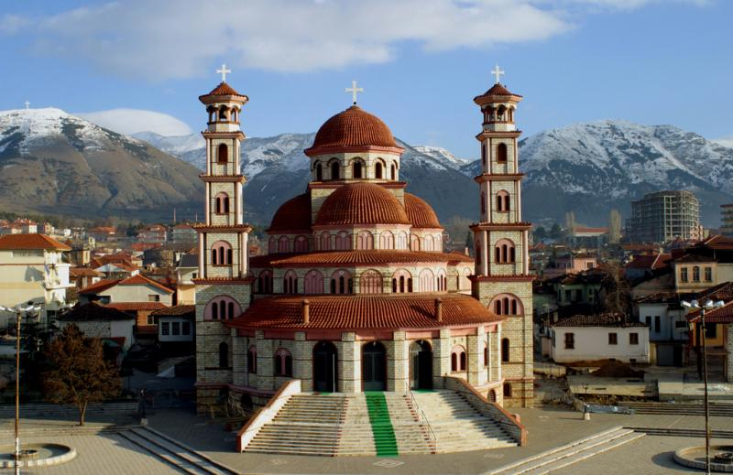
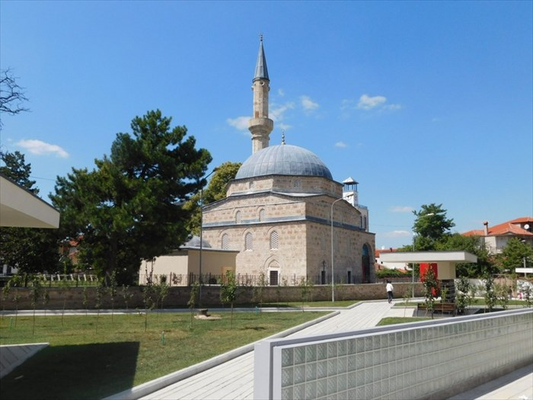
SACRED ART OF KORÇA
7° convegno EEE Erice 29-31 Maggio 2017

Slide 4
CHARACTERISTICS OF THE BILINGUAL ITALIAN-ALBANIAN SECTION
Functional since 2000;
Common project of Italian and Albanian Ministries of Education;
For students from 15 to 18 years old;
Subject taught in Italian: Maths, Physics, Biology, Italian Literature, History, History of Art.
7° convegno EEE Erice 29-31 Maggio 2017

Slide 5
FINALITIES OF THE BILINGUAL ITALIAN-ALBANIAN SECTION
To make the formation course more suitable for the university courses in Italy and for the labour market;
To help teacher’s updating, through exchanging methods and experiences;
To organize periodical seminars;
To provide the opportunity of applying an European course of formation, which consists of dialogues and respect of identity.
7° convegno EEE Erice 29-31 Maggio 2017

Slide 6
OUR ACTIVITY ON EEE PROJECT
We have become part of EEE project in March 2017;
The work started on a theoretical course on Physics of
Particles;
Subsequently, we have been trained on EEE project
and on the features of telescopes;
We have also partecipated in three masteclasses on line.
In July 2017 we will go to the CERN to construct two
«spare» detectors which will be used for the EEE project.
7° convegno EEE Erice 29-31 Maggio 2017

Slide 7
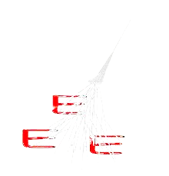
ATTAINED ADVANTAGES OF EEE PROJECT
To work in a «true» scientific project, a unique
opportunity for a general high school in our area;
To reinforce the connection between the albanian and the
italian scolastic system, abov all, in the scientific area;
To increase the contact among the albanian and italian
students;
To provide the opportunity of partecipating in seminars
and scientific activities in Italy.
7° convegno EEE Erice 29-31 Maggio 2017

Slide 8
FUTURE DEVELOPMENTS
At the moment our school has no telescope.
We are waiting to have a cosmic box in a short time ;
By means of a cosmic box , in the future, we aim to find
the relationship between th cosmic rays and the hight
above s.l. ;
In the same time, we intend to coordinate our work with
that of other schools, in order to analyze the data of EEE
telescopes
7° convegno EEE Erice 29-31 Maggio 2017

Slide 9
ACKNOWLEDGMENTS
We would like to give thanks to:
Centro Fermi, in particular to the prof.ssa Cifarelli, prof. Zichichi and dct. Nania for providing the opportunity to be part of EEE project and for welcoming us in Erice;
The Embassy of Italy in Tirana, in particular Mr. Ambassador Alberto Cutillo and the headmaster of the Italian-Albanian section Prof.ssa Lucia Cucciarelli , for their trust in our work and for economical support as well;
The headmaster of our school, Entela Kuruni fot making in our disposition the facilities of the school;
The teachers Paolo Maggioli e Petrika Naska for giving their support in all stages of the work.
7° convegno EEE Erice 29-31 Maggio 2017

