Slide 1
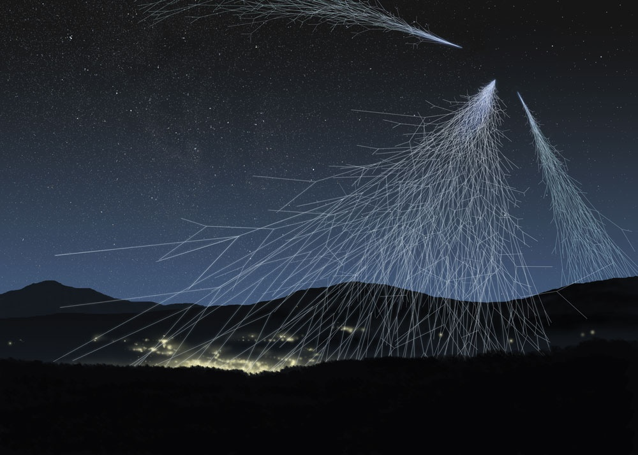


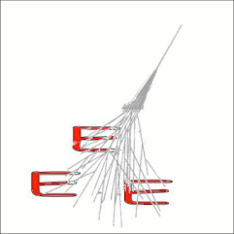


EXTREME ENERGY EVENTS
Kenneth Abalu – Giammarco Cafaggi, 3 H
Scientific High School “A.BAFILE”, L’Aquila a.s. 2016-17
FROM UNIVERSE TO SCHOOLS, THE LONG WAY OF COSMIC RAYS.

Slide 2
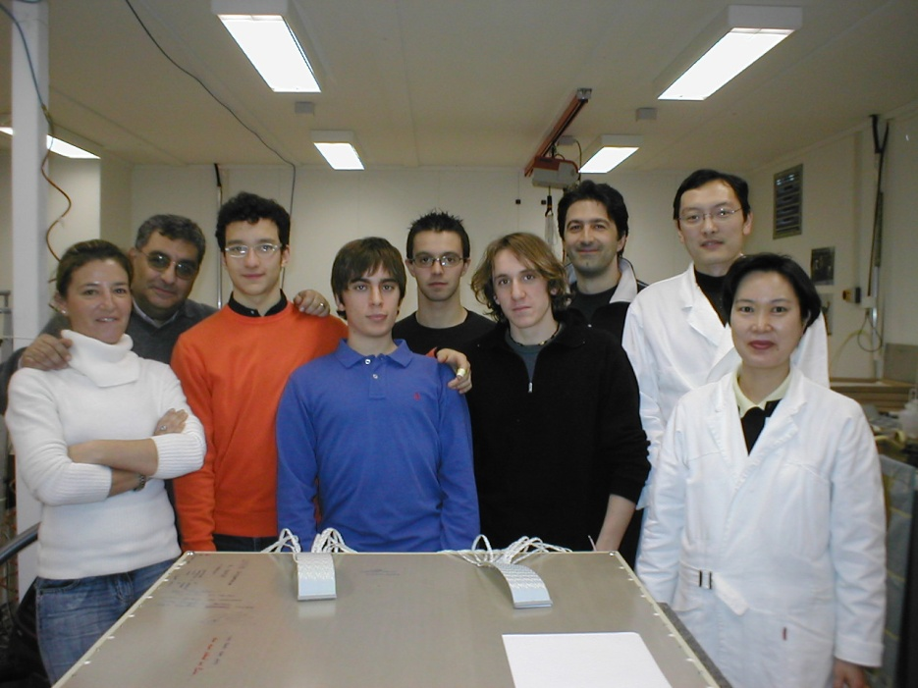
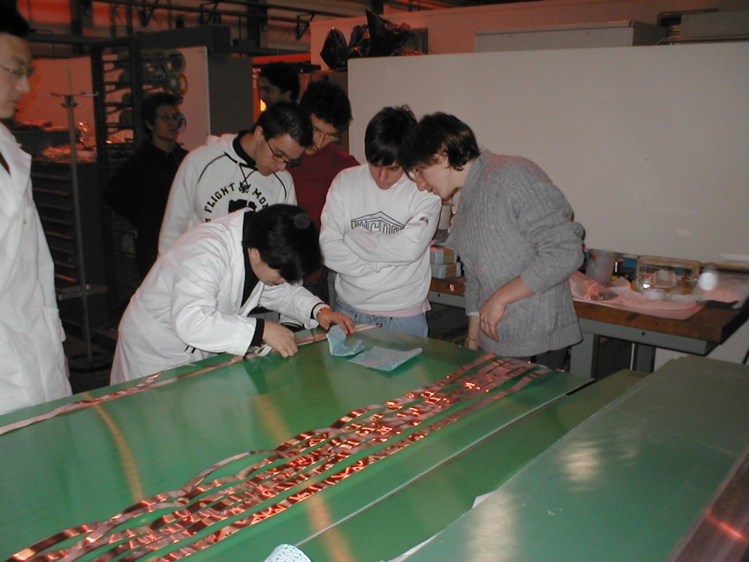
THE PROJECT IN OUR SCHOOL
2004-2005: Participation in the project and MRPC detectors construction
2005: Installation of the telescope anc start of data acquisition
MRPC detectors construction,
CERN - Ginevra
Working group

Slide 3
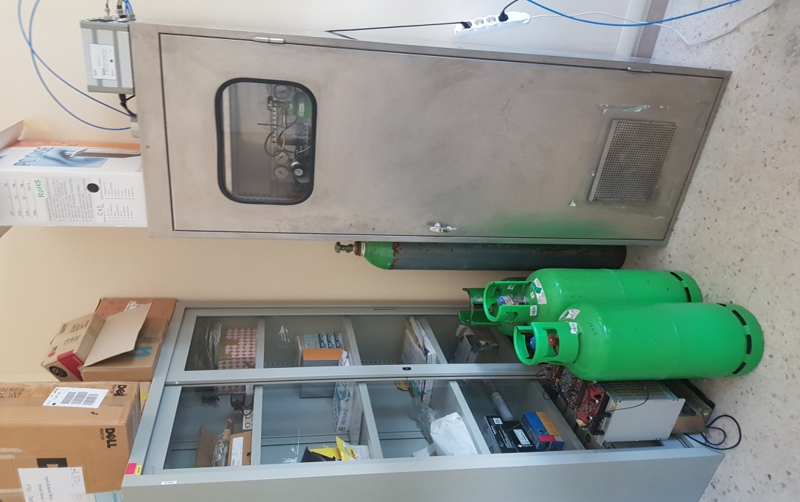
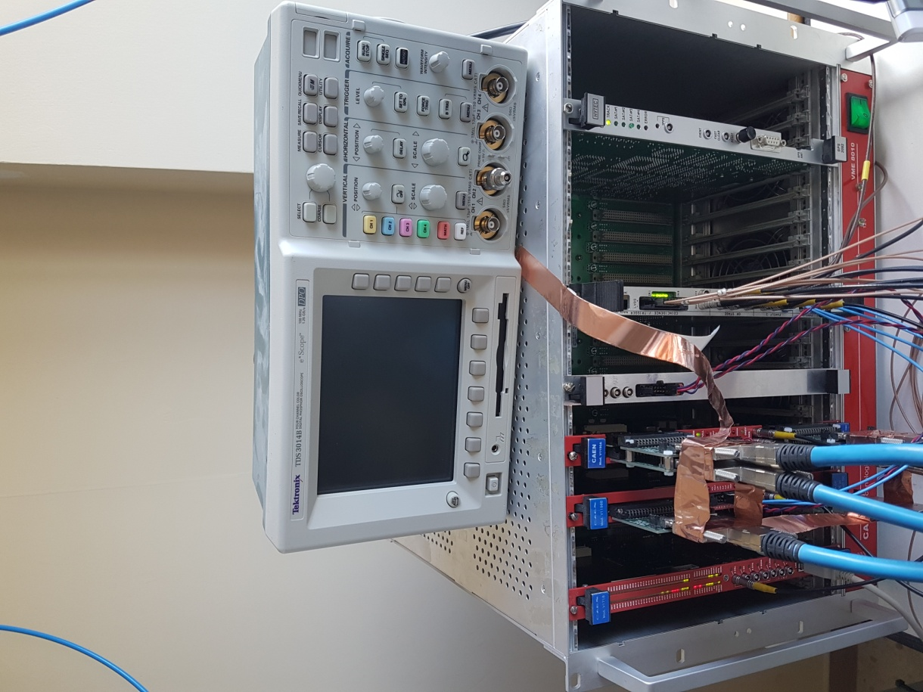
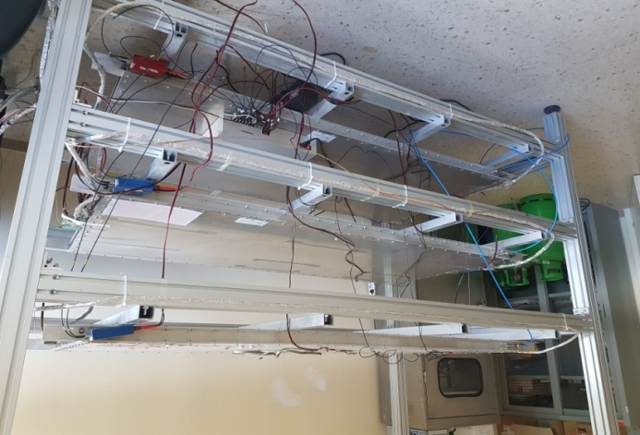
OUR DETECTOR
Each telescope is composed of 3 multigap Resistive Plate Chambers (MRPC)
There is also a gas station and a small weather station.

Slide 4
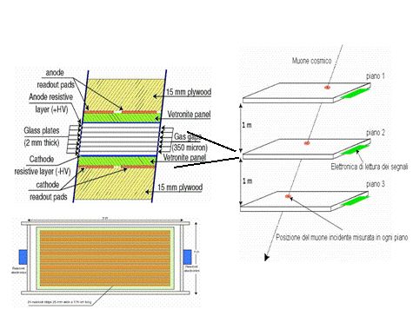
INTERNAL STRUCTURE OF OUR DETECTOR

Slide 5
OUR ACTIVITY
It started in 2015 thanks to the students of the last year who shown us their activity
It consists of a daily report of the values provided from the 3 chambers of our detector
We also check if gas, LV, HV values and rate of data acquisition are stable.
During the last two years, we measured the efficiency of the central chamber in our detector.
When it is needed, we replace the gas bottles.

Slide 6
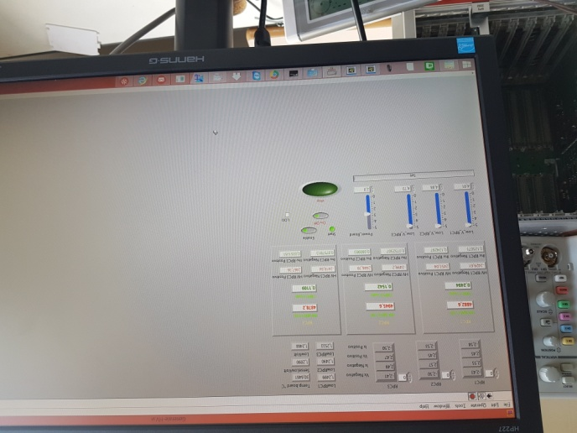
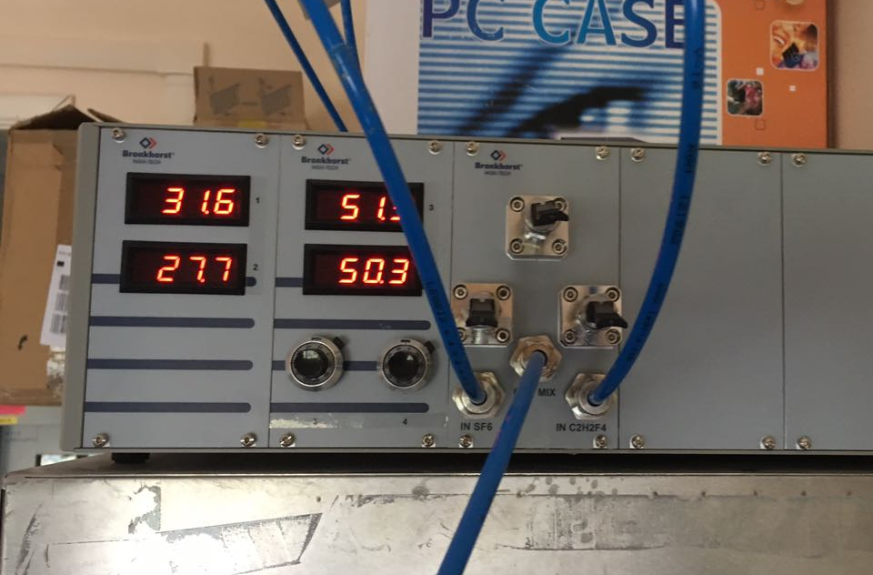
DAILY REPORT
Every day we report our telescope parameters in a dedicated e-logbook
Freon and SF6 mixer; set and check of pressure and flow

Slide 7
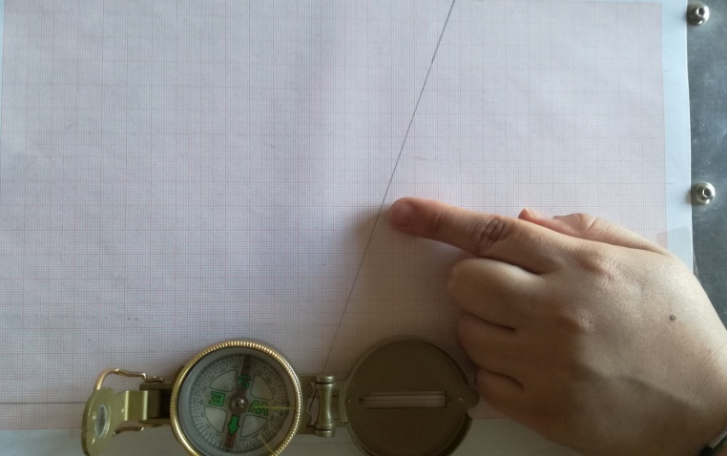
ANGLE OF THE TELESCOPE
Each year, we measured the angle of our telescope.
There’re many ways to measure the angle. We’ve chosen the one referred to the magnetic north.

Slide 8
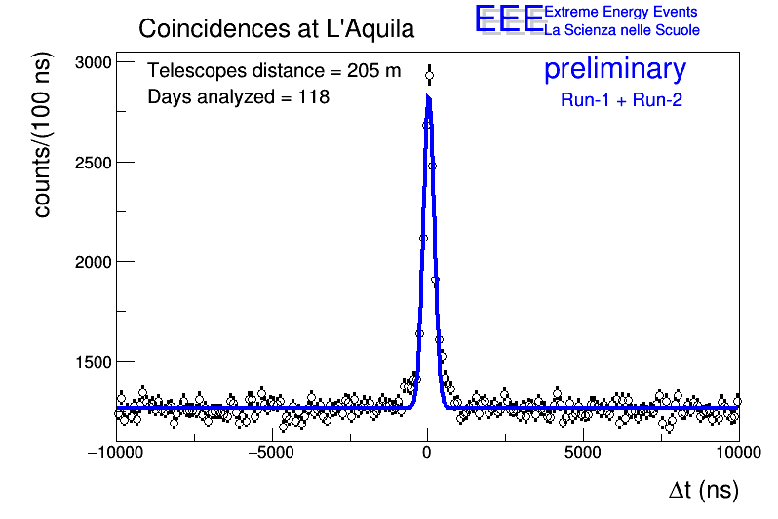
COINCIDENCES BETWEEN SCHOOLS
This plot shows us the number of coincidences between muons of a showerin the two telescope in our town (“A.Bafile”- “A.D’Aosta”).
This is possible thanks to the GPS provided to all the telescope in Italy; the CNAF allows a robust data transfer and reconstruction

Slide 9
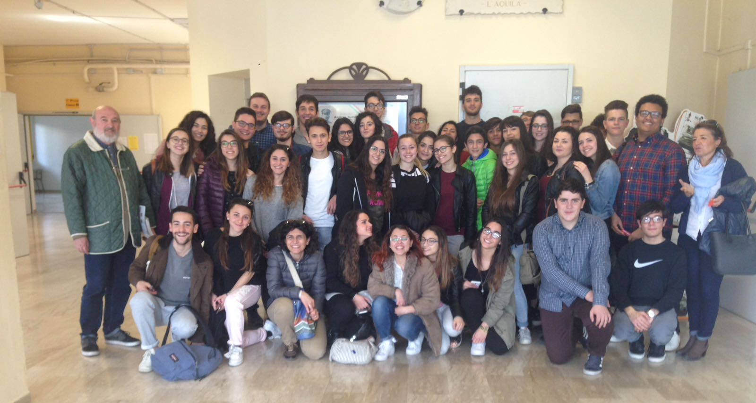
NEW PARTNERSHIP
Scientific High School “G.Galilei”- Lanciano, Chieti
After the meeting carried out in Bari (October 2016) a new partnership was born between our school and the Scientific High School “G.Galilei” , Lanciano (CH). They are still waiting to receive their telescope.

Slide 10
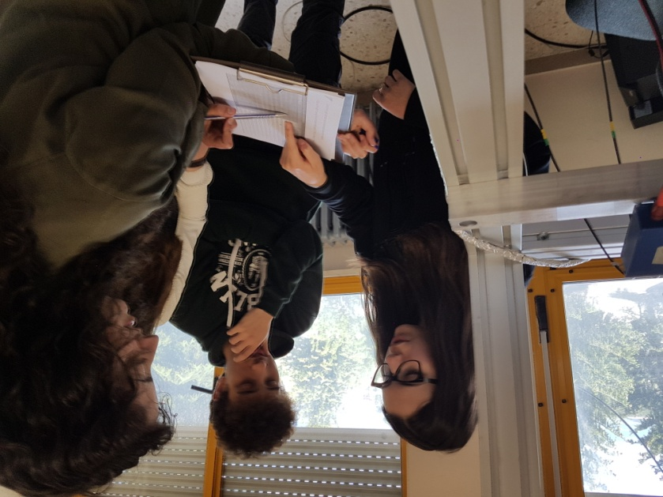
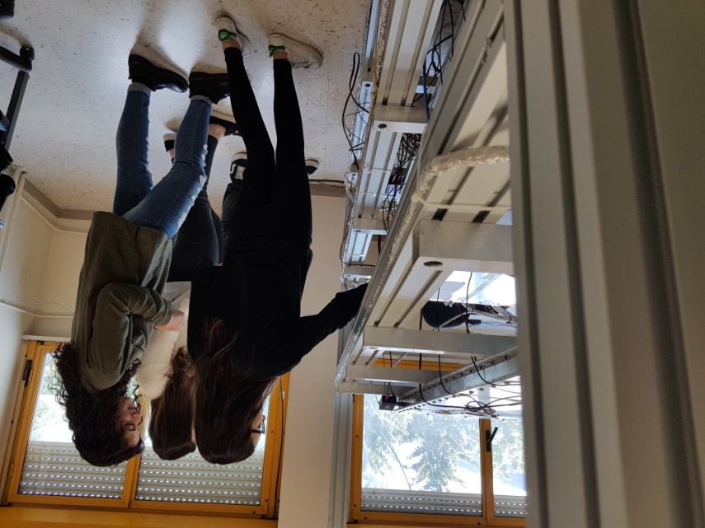
In April they came to our shool to see how we are working.
We showed them the daily report activity and how the angle of the telescope is measured.
.
On that occasion we also organized a conference to explain what cosmic rays are and to watch a video about detector’s construction process.

Slide 11
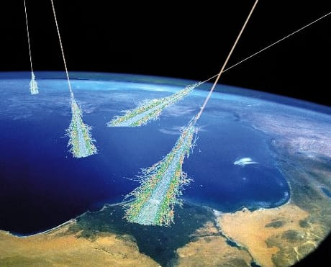
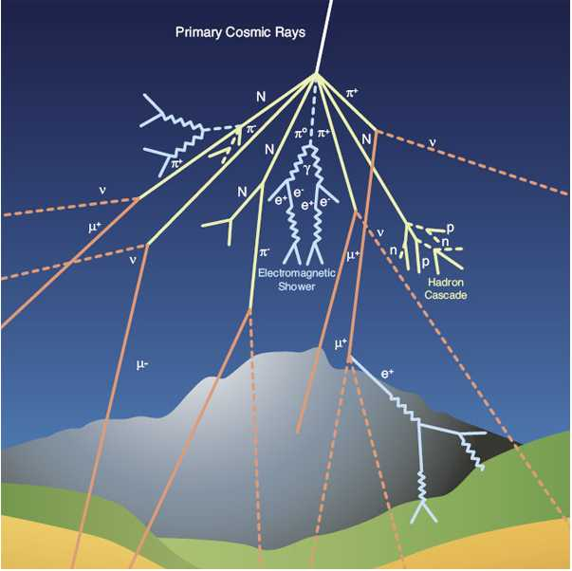
OUR FEELINGS
The research activity increases our interest in physics and it makes us part of a bigger research project, which will help us for our future choices.

Slide 12

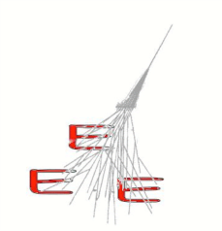
SPECIAL THANKS TO :
Prof. Sabina ADACHER, Headteacher
Prof. Antonella MATARESE, Physics teacher
Dott.Daniele DE GRUTTOLA, Fermi Centre referent
Prof. Antonino ZICHICHI
Acknowledgement - prof. Gabriella Di Lellio, English teacher
And thanks for your attention
Notes:
DOTT. AL POSTO DI PROF

