Slide 1
A collaborative experience
Liceo Scientifico G. Banzi Bazoli - Lecce
Istituto di Istruzione Secondaria Superiore E. Fermi - Lecce

Slide 2
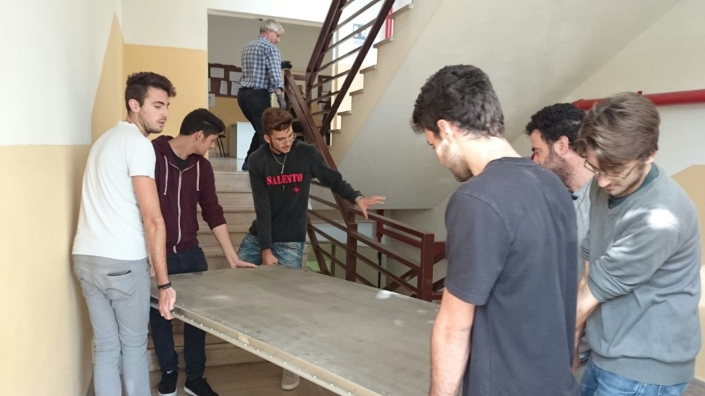
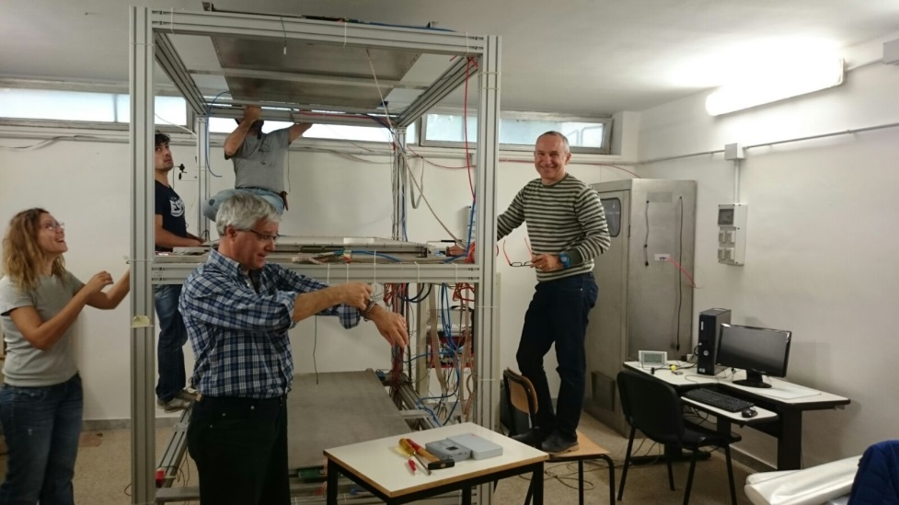
The detector at Liceo ʺBanziʺ
The MRPCs at Liceo “G. Banzi Bazoli” were replaced in December 2015, because of high currents absorbed by previous detectors (about 10 years old).
Last year, at power-up after the summer break, the DAQ shown some small problems that were fixed soon
So, after a short period of ups and downs, in the first months of the 3rd run, the detector started to work properly. During the run every change of cylinders was timely and some more problem has solved just by PC or crate reset.

Slide 3
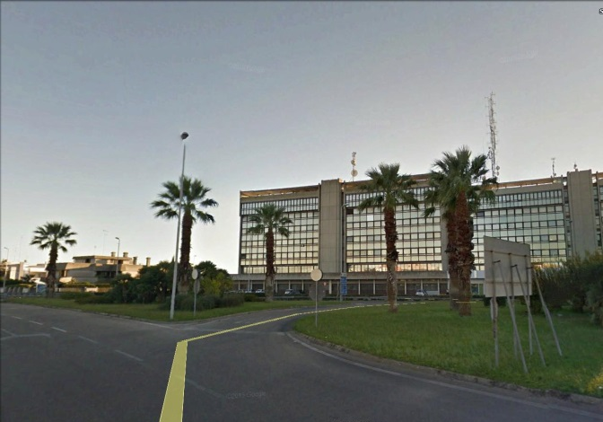
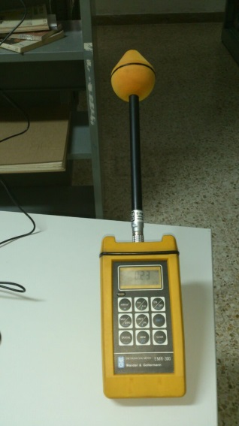
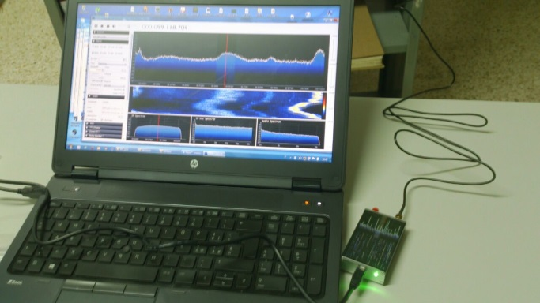
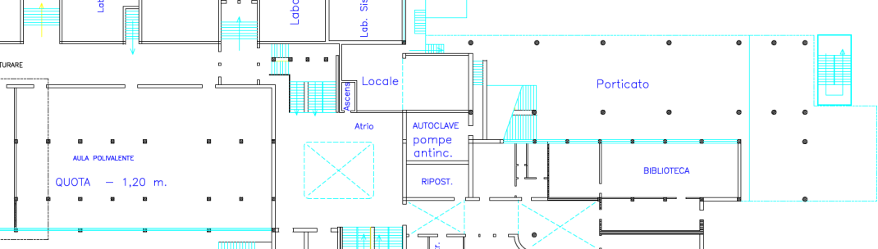
The detector at IISS ʺFermiʺ
After an in-deep investigation done with the help of technician from the University we reach the conclusion that the noise on the detector at the IISS “Fermi” is due to an external em source
An antenna of a local FM radio station located about 50m from the school, produces a background em noise in the room where is placed the detector, with the mean electric field of about 1V/m.
We plan to continue measurements on the detector and in the while a survey of the mean em field in the school was done in the last days, to find a more suitable location for the detector. A room in the basement of the school was identified, the mean electric field there is about 0.2V/m. Better measurements will be done in next days
0.74
0.22
0.13
0.71

Slide 4
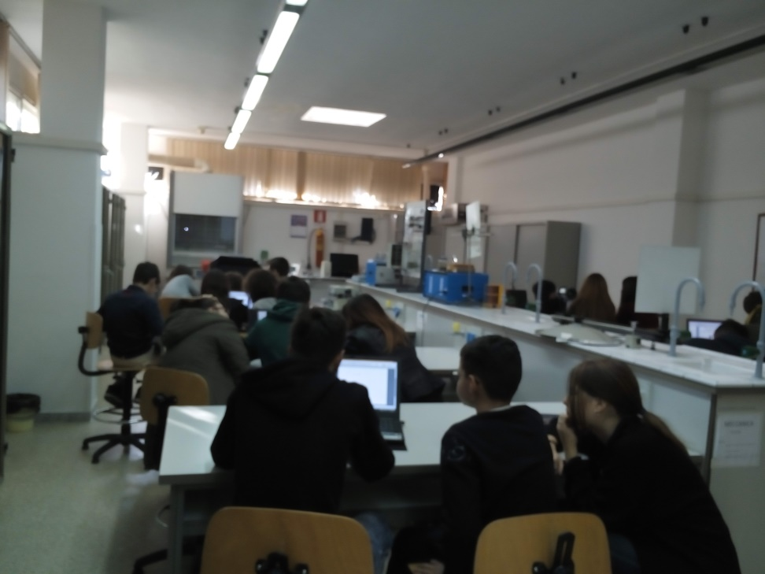
A collaboration between schools
To involve the IISS “Fermi” in the EEE activities, although its detector is useless, a collaboration with Liceo “Banzi” has developed.
It was not a specific project but an exchange of skills among already prepared students, to form a single working group.
EEElogbook was compiled in turn by the students of the two schools and for the exchange of files an e˗collaboration environment was implemented.
Groups from both the schools met periodically to take stock of the situation
This experience has surely enriched all the students from the point of view of the skills and the communication of a scientific topic both

Slide 5
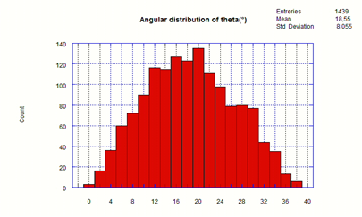
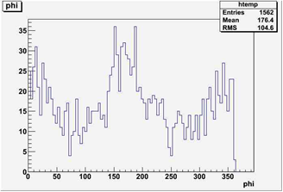
Some results
On the side, the graphs of angular distributions of events recorded during May is shown
For the same event file, the distribution of the φ angle of the tracks is represented in the reported graph, where it is well apparent that most of muons crossed the detector on the major-axis, as expected

Slide 6
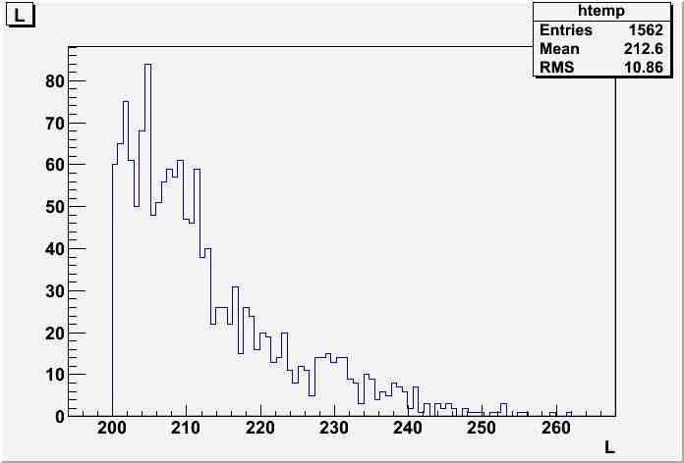
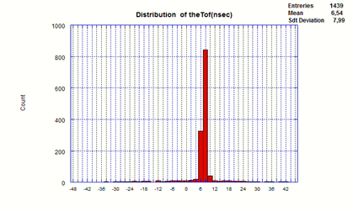
Some results
In this graph is reported the distribution of the length of the muon tracks, it can be seen that most of them have crossed the detector along a path of about 205cm slightly above the minimum length of the track of about 200cm (next the distance between detectors has reduced to about 100cm)
The distribution of particles' time of flight is compatible to the distance between detectors and speed of the light

Slide 7
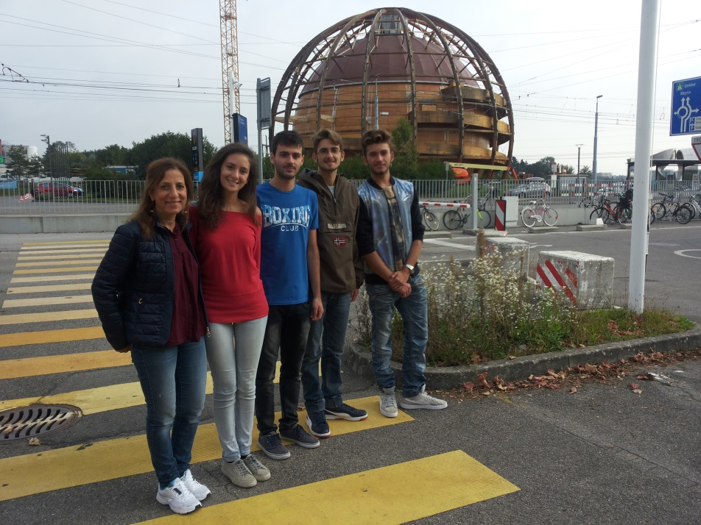
Conclusions
This experience made us to understand that science can bring young people together, to share a learning experience totally different from usual lessons in class.
Being responsible for a work or part of it, has been a very instructive novelty.
We learn to split the data processing and analysis job and we learn to use all the e˗tools to collaborate remotely.

