Slide 1
measures of position of detectors at lecce
Liceo Scientifico G. Banzi Bazoli - Lecce
Istituto di Istruzione Secondaria Superiore E. Fermi - Lecce

Slide 2
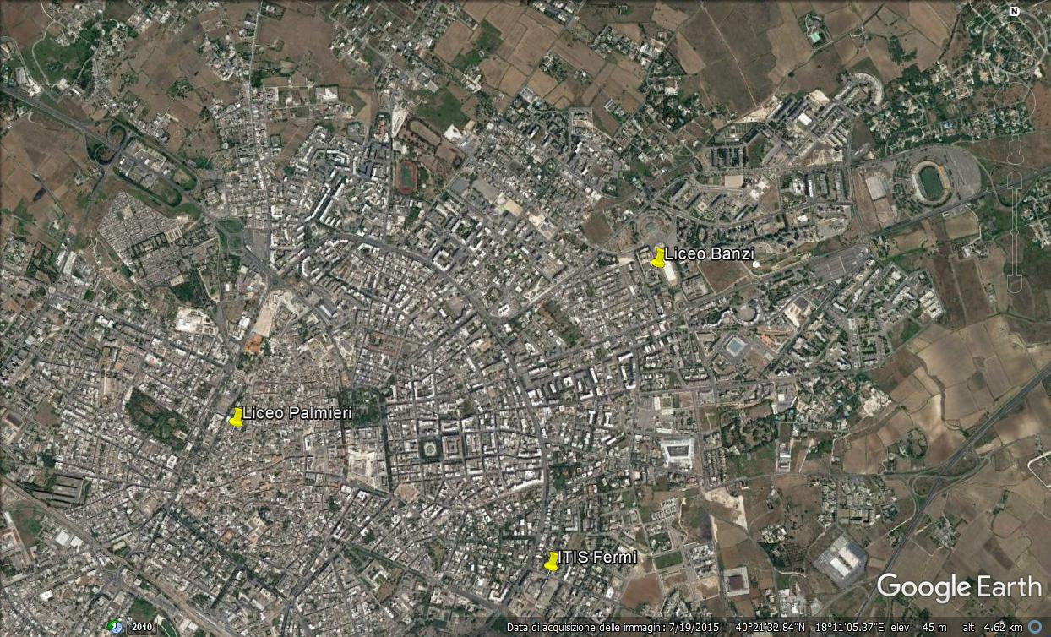
The choose of the method
The first problem to be faced was to choose the method to be used in the different locations in Lecce
We have immediately ruled out the approach based on the detection of the sun shadow because of disposition of the detectors in the schools.
Therefore, the most suitable method seems to be to determine the orientation of the detector with respect to the wall and that of the wall respect to the geographic north

Slide 3
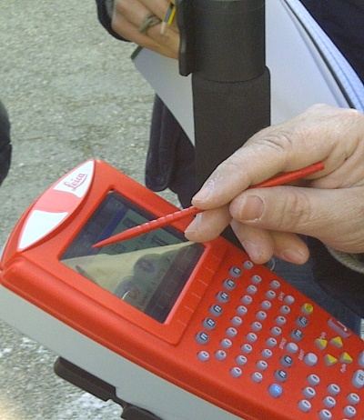
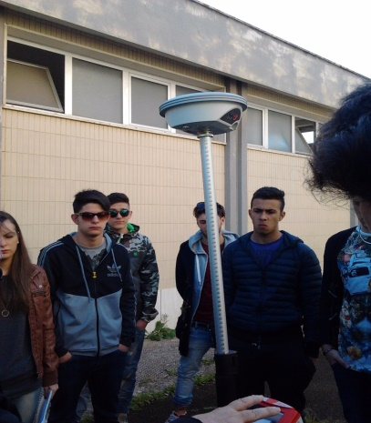
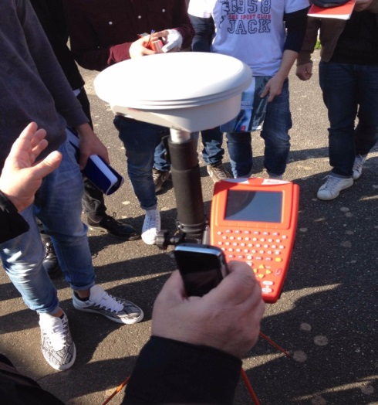
The method
The telescope orientation measurement for all the schools from Lecce was made starting from the measurement of the angle between the detector’s right-left (R-L) vector and the closest wall
The difficulties were
  locate the R-L vector
  get a laser distance meter with an error of less than or equal to 2mm
First we tried to measure the inclination of the wall with respect to the geographic North by using the compass internal of a cellphone, however, this approach would have caused an error of the order of set tens degrees. Moreover it need to know the local declination angle
Therefore we asked for the help from a topography teacher from of the Istituto Tecnico per Geometri “Galilei” from Lecce

Slide 4
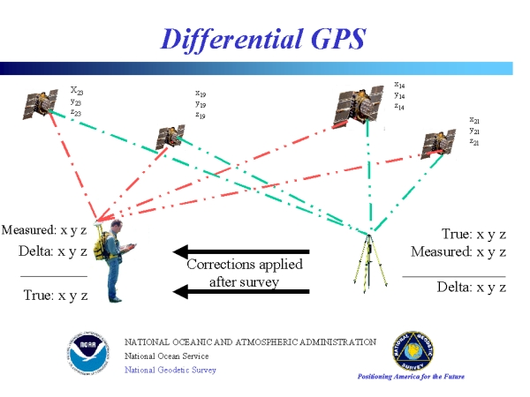
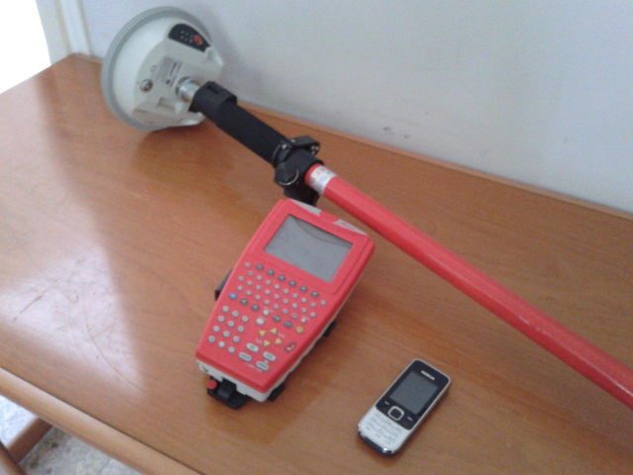
The Differential GPS
The suggestion was to use a Differential GPS (DGPS) receiver to measure the inclination of the wall with respect to the North
The DGPS is an enhancement of the GPS that improve location accuracy to few centimeters
The presence of the atmosphere is a component of the propagation delay of GPS signals, and therefore the ground position measurement has a reduced accuracy, with an error that can reach even 5÷6m.
DGPS uses a correction signal transmitted by ground radio from a fixed station whose position is known with high precision, the signal is the difference between the position of the beacon as detected by the GPS and the “absolute” position of the beacon
The signal, integrated with the GSP information, increases the accuracy of the position measurement.

Slide 5
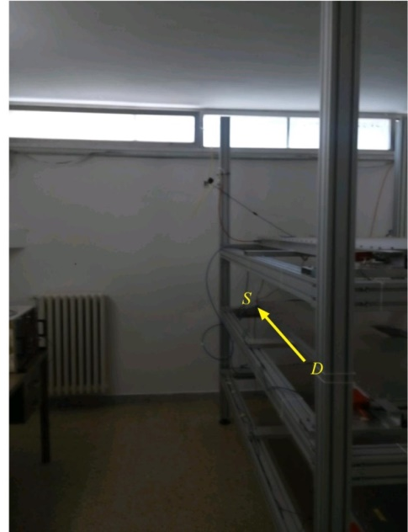
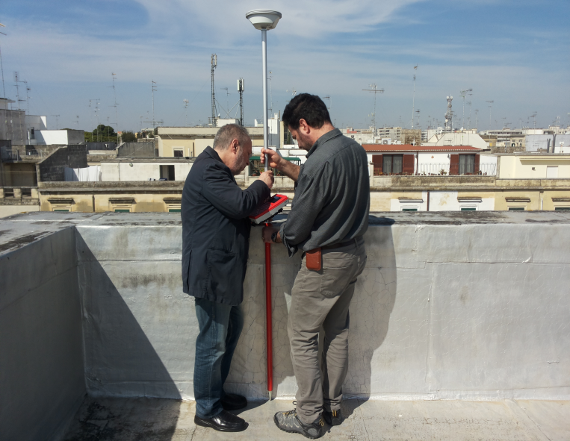
Accuracy
The measurement of the angle between the geographic North and the wall was made with a Leica Geosistems DGPS, model "GS09".
The geographic coordinates of two points on the terraces of the three schools were measured.
In this way we identify the direction of a straight line
Accuracy on points position is 2cm, which results in a total maximum error of 0.14 ° on the angle measurement

Slide 6
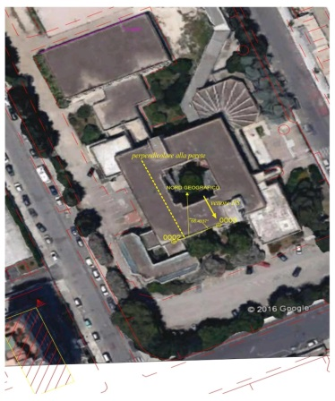
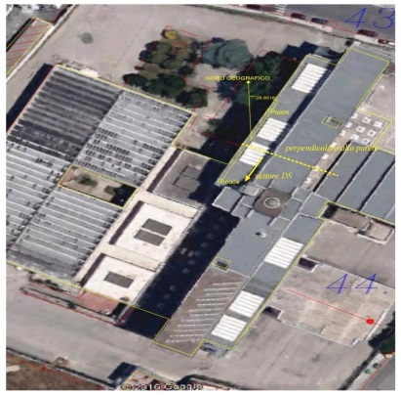
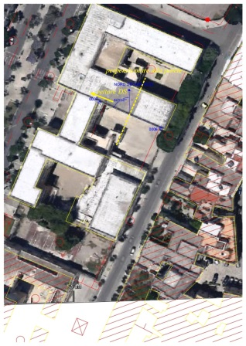
The measure
Next table shows the angle between the geographic North and the detector’s R-L vector for the three schools in Lecce:
School | Liceo “G. Banzi Bazoli” | IISS “E. Fermi” | Liceo “G. Palmieri”
Angle in degrees | 157.67 ± 0.38 | 118.46 ± 0.14 | 295.47 ± 0.17

Slide 7
Conclusions
A very simple method to measure the orientation of the detector with respect to the geographic north has shown
The method is especially useful for a detector located in a room without a windows or when the sun shadow is not accessible
Teachers of topography from all the Istituto Tecnico per Geometri schools are able, in principle, to do a similar measurement
Moreover in this way it’s possible to involve more schools to EEE activities

