Slide 1
I.I.S. A. Volta
LODI
Extreme Energy Events project
Notes:
1
1

Slide 2
E.E.E. Analyzer
Data conversion and analysis
Notes:
I’m Fabio Pinciroli from IIS Volta and I’m here to present my software, EEE Analyser, which provides data conversion and analysis features for the data produced by the E.E.E. project telescopes.
ATTACCO: SPECIFICALLY

Slide 3





Angular distribution graphs
Raw data in .XLS
Statistics
DQM report
Notes:
From .BIN to:
-ANGULAR DISTRIBUTION GRAPHS
-RAW DATA IN .XLS FORMAT
-STATISTICS
-DQM DATA FOR THE DAY
ATTACCO: IN MORE DETAIL…

Slide 4
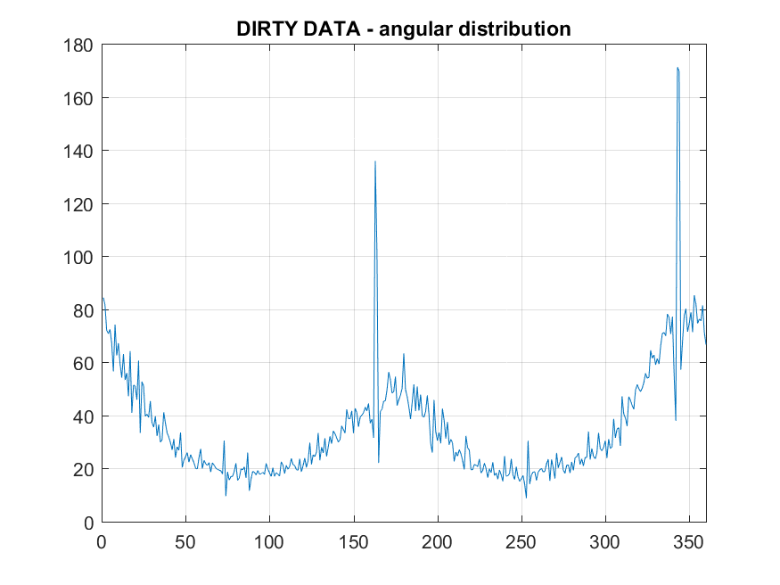
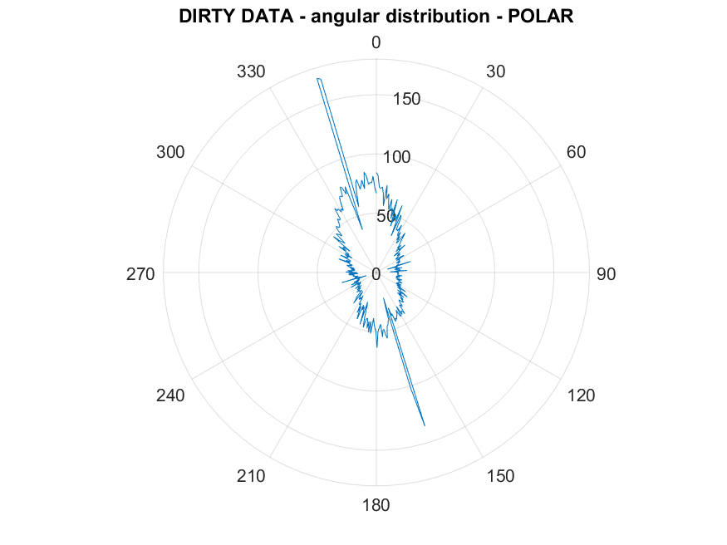
Angular distribution graphs
Corrected for anisotropy of the telescope
Cartesian plot
Polar plot
Notes:
The angular distribution graphs are plotted in both cartesian and polar form and already corrected for anisotropy as my collegue said. Plots are made for filtered and unfiltered data, more on this later.
ATTACCO: NEXT UP

Slide 5
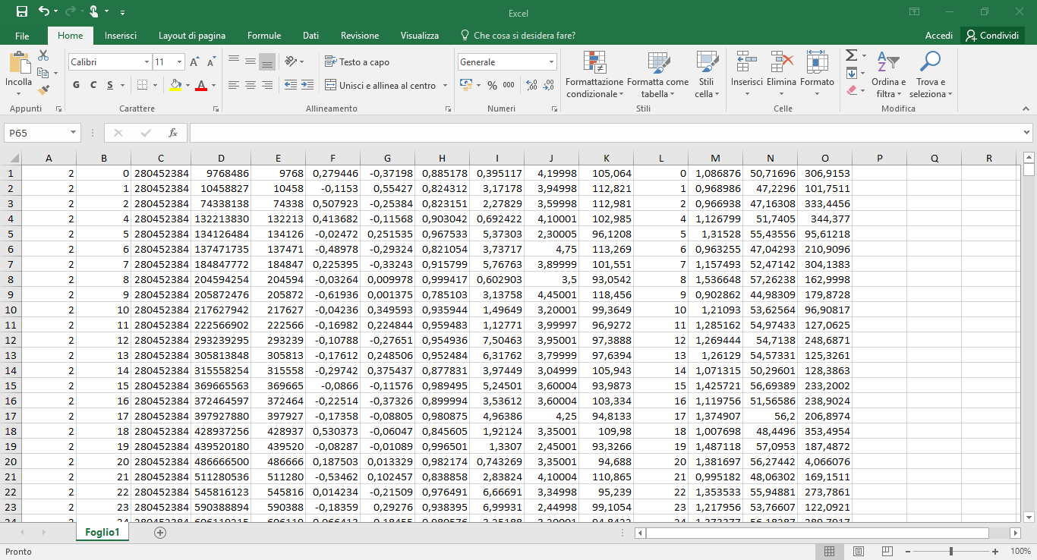
Excel export
Compatible with common software
Notes:
The main functionality bof the software, the excel exports. The data extracted from the .bin file is saved as .xls files for compatibility, and is provided both as raw data and filtered for chi^2 bigger than 10 and negative time of flight.
ATTACCO: THEN

Slide 6
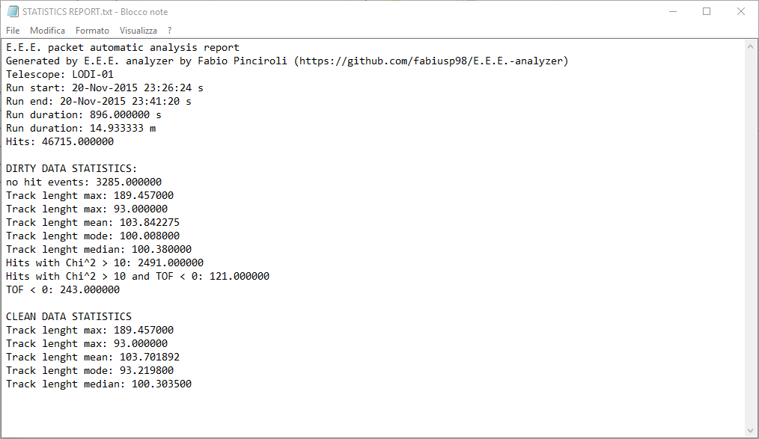
Statistics
Extracted from the file
Notes:
The statistics, convenience data derived from the file such as the date and time, number of hits, etc
ATTACCO: ALSO

Slide 7
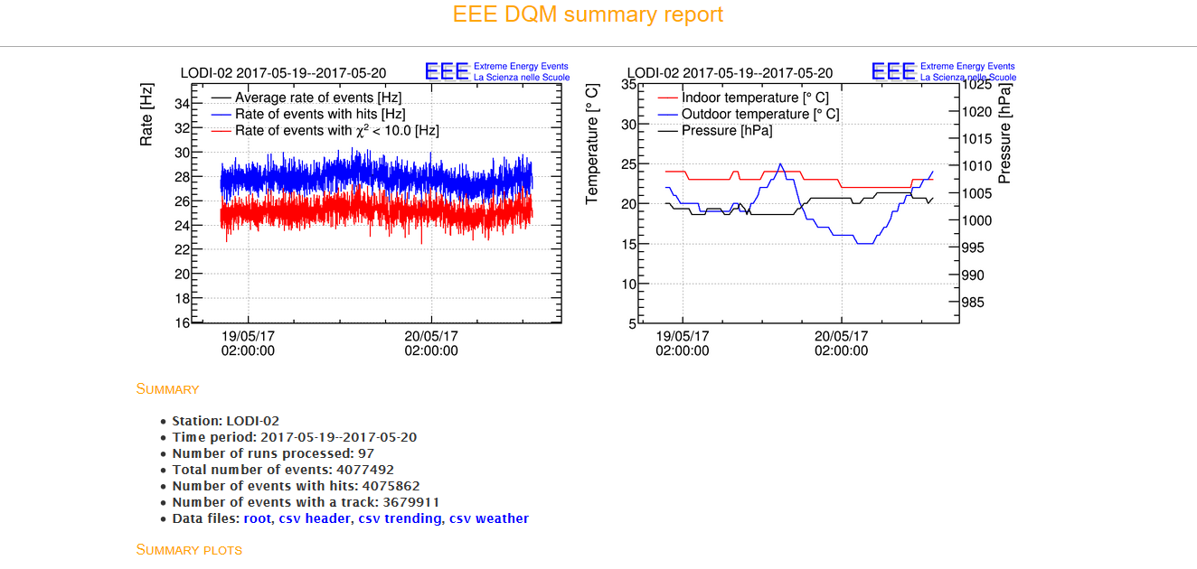
DQM report
From the day
Notes:
The software can download the dqm data for the day of the acquisition directly from the I.N.F.N. website, the page is then readable offline.

Slide 8
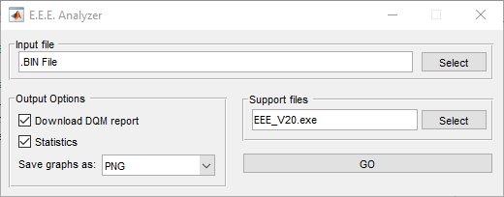
Simple to use and fast
Total runtime for file: 22 seconds
Test machine: Intel Core I7 2600 (3.4 ghz), 20 GB of ram, dqm fetched from local disk
Notes:
The software is easy to use and fast: it has a simple GUI and can convert a file in less than 22 seconds. Full user and developer documentation will soon be available.

Slide 9
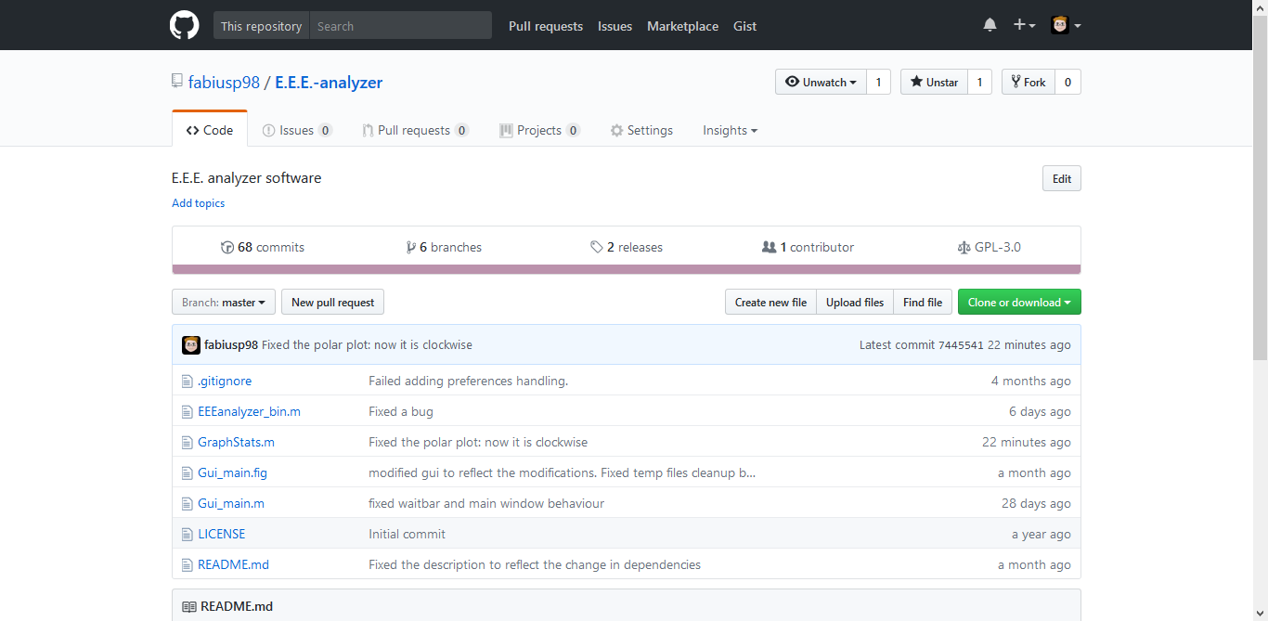
Open source
https://github.com/fabiusp98/E.E.E.-analyzer
Distributed under GPL 3
Notes:
The software is open source, the source code and precompiled binaries are available at this adress, soon along with the full documentation.

Slide 10

Notes:
Any questions? - DOMANDE

Slide 11
Anisotropy
Analysis of the shape of the telescope
Notes:
I’m Fabio Pinciroli from IIS Volta and I’m here to present my software, EEE Analyser, which provides data conversion and analysis features for the data produced by the E.E.E. project telescopes.
ATTACCO: SPECIFICALLY

Slide 12
OUR WORK:
A study about the receiving anisotropy of the telescope
Calculation of the maximum angle (theta)
Calculation of the receiving balance function of the telescope

Slide 13
Anisotropic receiving of the telescope
If the chambers of the telescope were circular, receiving would be isotropic.
Because of the rectangular shape of the chambers, receiving from directions similar to that of the long side of the chambers is advantaged if compared to receiving from directions similar to the one of the short side of the chambers.
A balance function depending on the azimuth angle of reception (PHI) has been calculated.

Slide 14
How to use the balance function
The number of beams counted for each azimuth angle PHI is divided by the value of the function in that direction.
If we find, for certain direction, that the number of beams, corrected with the balance function, is higher then the number in the similar directions, we can suppose that a beam source is present in that direction.
I.I.S. A Volta Lodi – EEE project

Slide 15
Preliminary study about the maximum zenith angle (theta)
Theta can not be assumed for all values from 0 to 90 degrees: the maximum value of theta due to the shape of the telescope has been calculated .
The maximum theta value is a function of the azimuth angle phi.
I.I.S. A Volta Lodi – EEE project

Slide 16
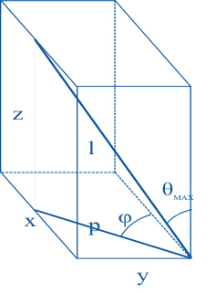
Theta max is obtained by heading the track (l) of an imaginary cosmic ray towards an angle of the lower chamber and imagining to “lean” it in a point that belongs to two opposite sides of the upper chamber; this operation has to be repeated for the four angles of the lower chamber.

Slide 17
θ (theta) is measured between the vertical axis and the muon track
ϕ (phi) is measured counter-clockwise between the horizontal axis and the projection of the muon track on the rectangular base of the telescope
The measures are the same as the ones of our telescope:
  x = 82 cm
  y = 160 cm
  z = 104 cm

Slide 18
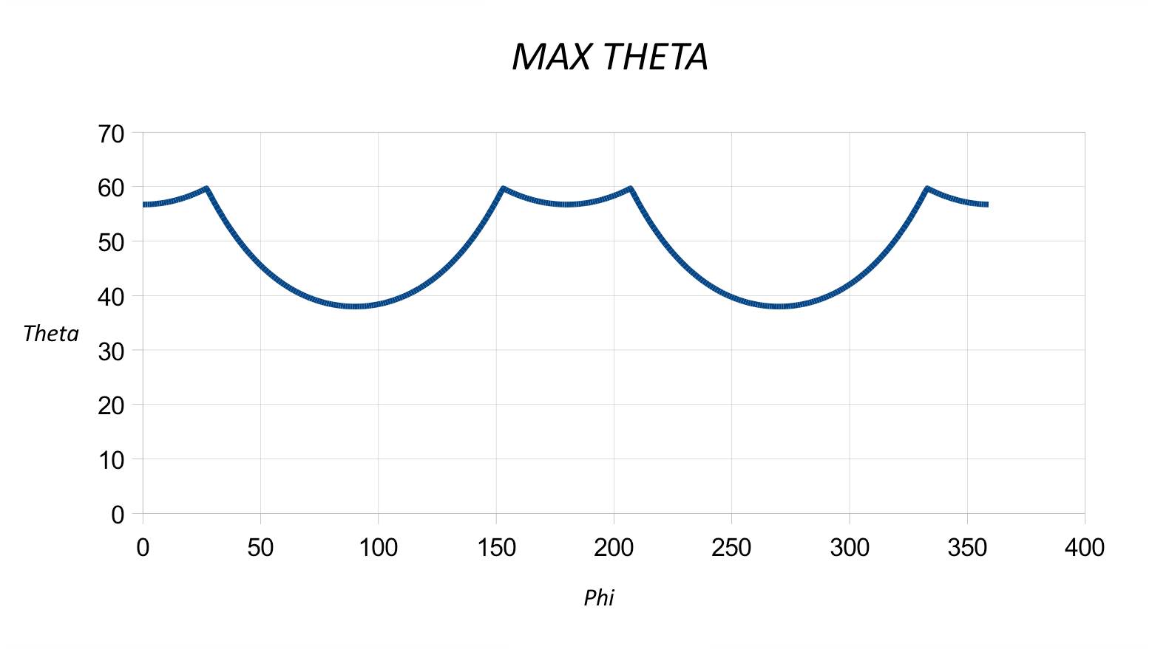

Slide 19

Theta maximum’s graphic
The highest minimum are the directions of the longest sides (0° e 180°)
The lowest minimum are the directions of the shortest sides (90° e 270°)
The four maximum are the directions of the diagonals

Slide 20
Calculation of the reception balance function of the telescope

Slide 21
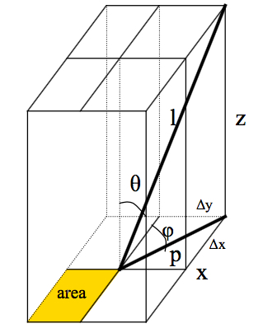
When a cosmic ray hits the telescope, it has to pass through the surface of all the three chambers in order to be revealed; hence it has to enter from a point that belongs to the surface of the upper chamber and come out from a point that belongs to the lower chamber. Based on the direction of the ray, different shadow zones can be formed (“L” shaped or, for some phi values, a simple rectangle) which have to be subtracted from the area of the lower chamber to obtain the area of possible reception.
The ratio between the area of the lower chamber where is possible that the ray hits the telescope and the total area, has been calculated. It depends on the direction, identified with phi and theta angles.

Slide 22
l is the lenght of the muon track
P is the projection of the track on the base area
x, y, z are the dimensions of the parallelepiped; they consist of numerical data
Δx and Δy are the dimensions of the shadow zones in which the ray can’t hit the chamber; the two shadow zones are overlied and form an “L” shaped region
“Area” is the part of the base where the ray can hit the chamber
Δx, Δy and the area depend on phi and theta

Slide 23
The calculation
The function of two variables has been calculated with Excel: obviously, it can’t be calculated for all the infinite pairs of possible phi and theta values
The calculation has been done for phi values form 0° to 360°, delayed by 1° each
As far as theta is concerned, the calculation has been done for each value of cos(theta) that differs from 1 (theta = 0°) to 0,725 (theta = 43,53°) , which is the maximum angle that can appear, (when the cosmic ray covers the diagonal of the parallelepiped) with a pace of 0,025

Slide 24
The calculation
The pace is uniform in cos(theta) instead of theta because we have supposed that the cosmic beams arrive with the same frequency from all the directions so, all the emisferic surfaces of equal area are crossed by the same number of rays. The emisferic surface has been divided into meridians (one for each degree) and into parallells; the parallels separates the surface in spherical segments with an area= 2.π.R.h where R is the radius of the hemisphere and h is the height of the spherical segment: (cos(teta1)-cos(teta2)).R
Each spherical segment is divided in 360 equal parts
Actually, we can’t reach the value of theta = 43,53° for every phi angle: we arrive at a value of maxtheta, which has been calculated separately

Slide 25
The result
The function obtained is represented by the multiple graphic, drawned for many different values of cos(theta): 1.000, 0.975, 0.950, 0.925, 0,900 ...

Slide 26
The balance function
Adding the values of every curve, for each azimuth angle, we obtain a function depending only on the azimuth angle phi.
The function represents the compensation curve of the telescope’s anisotropy, and is drew in the picture.

Slide 27
Balanced distribution
Distribution with anisotropy of the chambers
Balance function
Balanced distribution
I.I.S. A Volta Lodi – EEE project

Slide 28
RESULTS
We still haven’t reliable results because the number of converted files that we can use isn’t enough yet to be considered a dependable sample. The analysis about the directions where the rays come from is going to be object of study during the next year.
I.I.S. A Volta Lodi – EEE project

Slide 29
Notes:
Any questions? - DOMANDE

Slide 30
I.I.S. A. Volta
LODI
Extreme Energy Events project
Notes:
30
30

