Slide 1
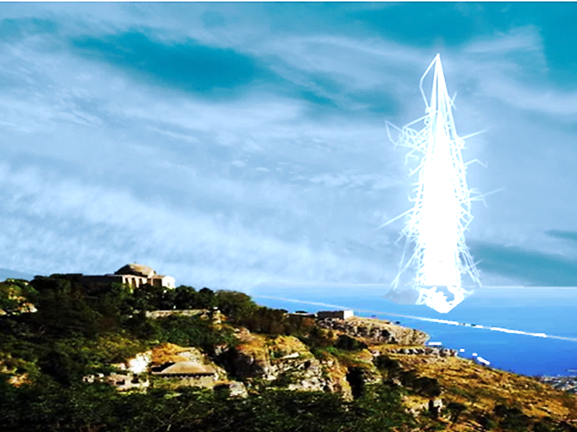
The schools’ presentation
7th Conference
of the
Centro Fermi’s Projects
PROJECT EEE
ERICE 29-31 May 2017

Slide 2
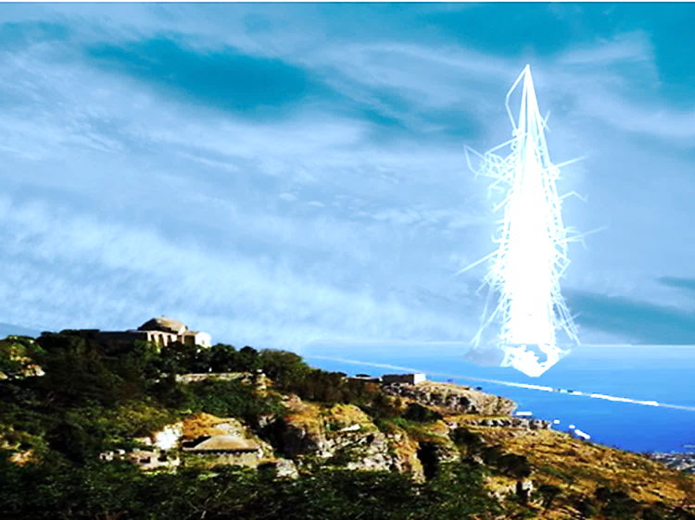


Liceo Statale
Regina Margherita
Salerno

Slide 3

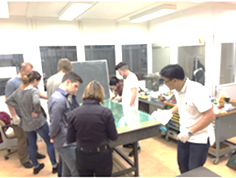
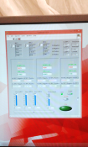
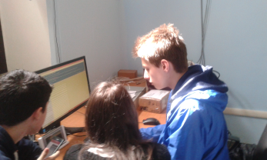

SALE-02-REPORT:
FROM THE CONSTRUCTION
TO THE DATA ACQUISITION

Slide 4


Tutors:
Prof. Salvatore De Pasquale
Dr. Daniele De Gruttola
Reference: Prof. Marilena Loia
Speakers: Students
Maria Carmen Falivene
Tatiana Tumbarello

Slide 5
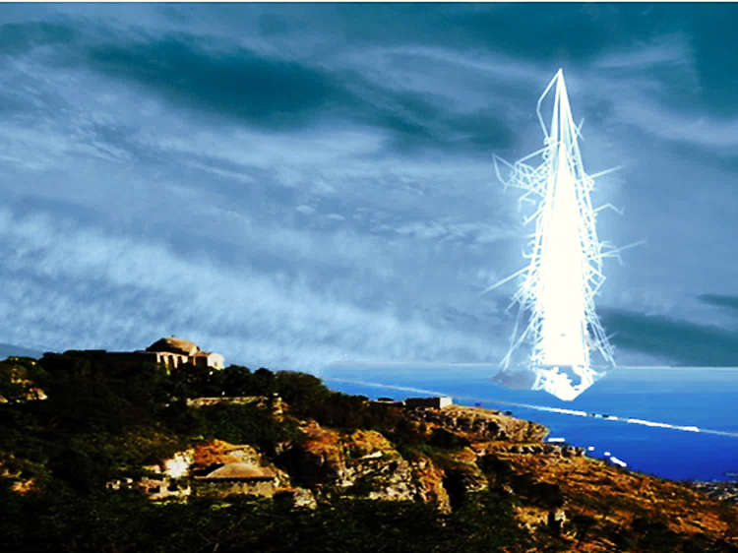
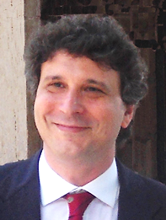
Our journey in the world of research began in April 2015 with a series of lectures by Prof S. De Pasquale.
He introduced and explained to tutors and students the characteristics of the EEE project, highlighting the problems of identifying ionizing particles and teaching the methodology of collecting and analysing data.
ERICE 29-31 May 2017

Slide 6
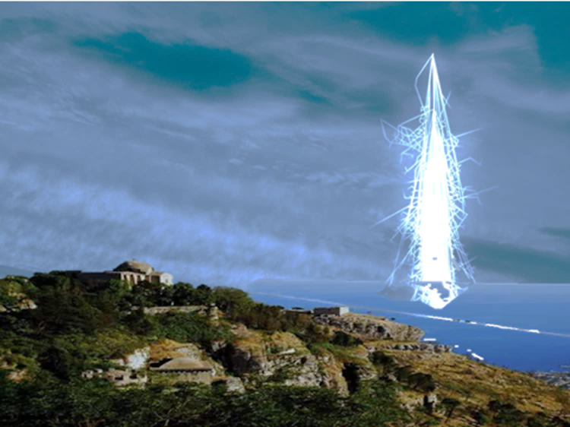
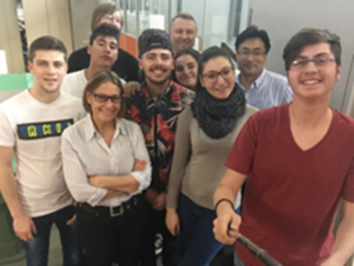
The research continued in May 2015 at the CERN in Geneva.
Six students from the school, supervised by Prof. M. Loia, have had the opportunity to complete an educational course at the largest laboratory of molecular physics.
ERICE 29-31 May 2017

Slide 7
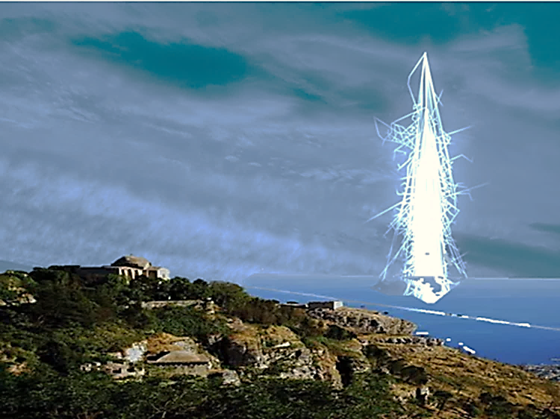
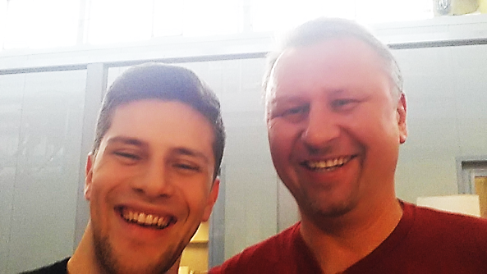
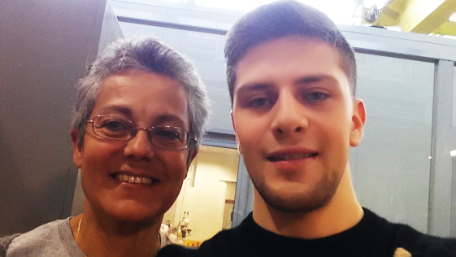
The students and Prof M Loia built the “telescope”, guided by a highly specialist team, Dr. Raman Zuyeuski , Dr. Despina Hatzifotiadou and Dr. Richard Forster.
The students with the specialist team successfully completed the work on the telescope ahead of schedule.
ERICE 29-31 May 2017

Slide 8
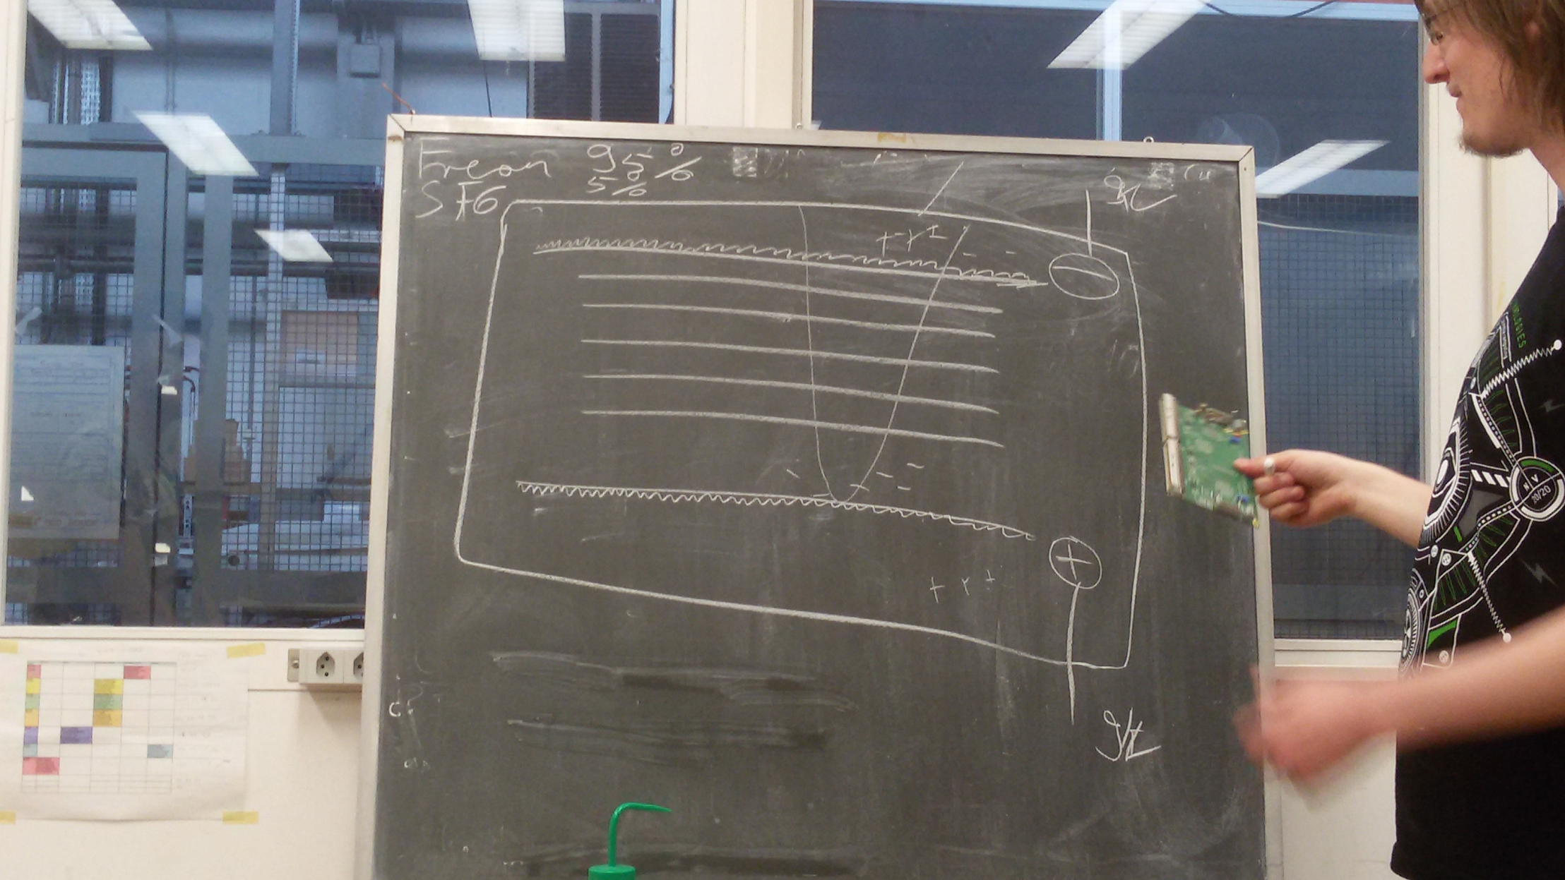
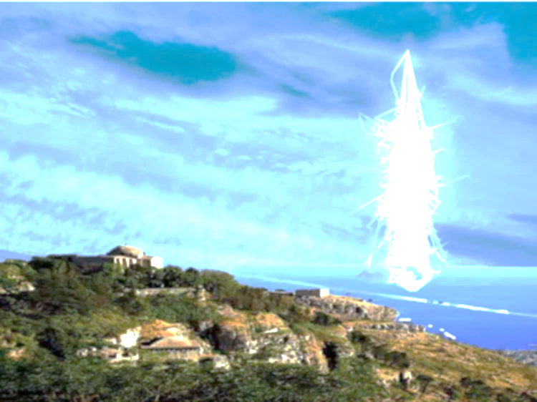
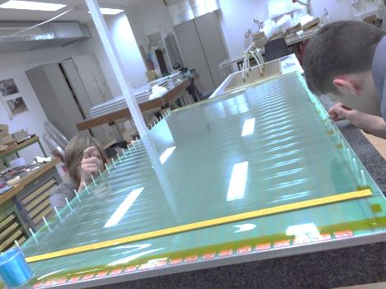
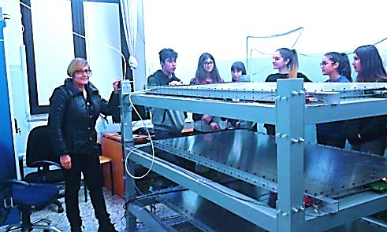
We also learnt how we could build a highly technical instrument, the “telescope”, using simple materials such as, a fishing line, glass and fibre glass, copper adhesive strips and honeycomb and aluminun panels.
ERICE 29-31 May 2017

Slide 9
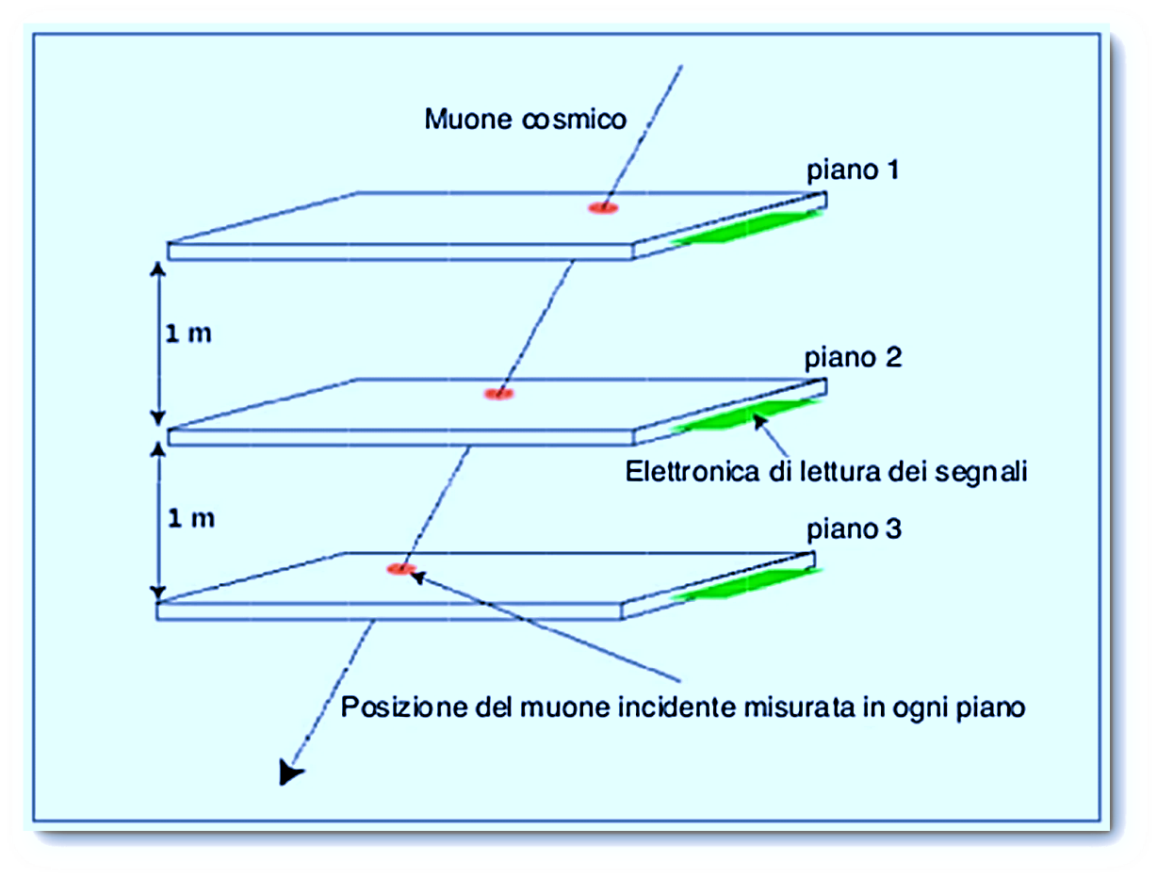
The telescope is made of three chambers, the Multigap Resistive Plate Chambers,
able to capture particular particle called muons from cosmic rays.
ERICE 29-31 May 2017

Slide 10

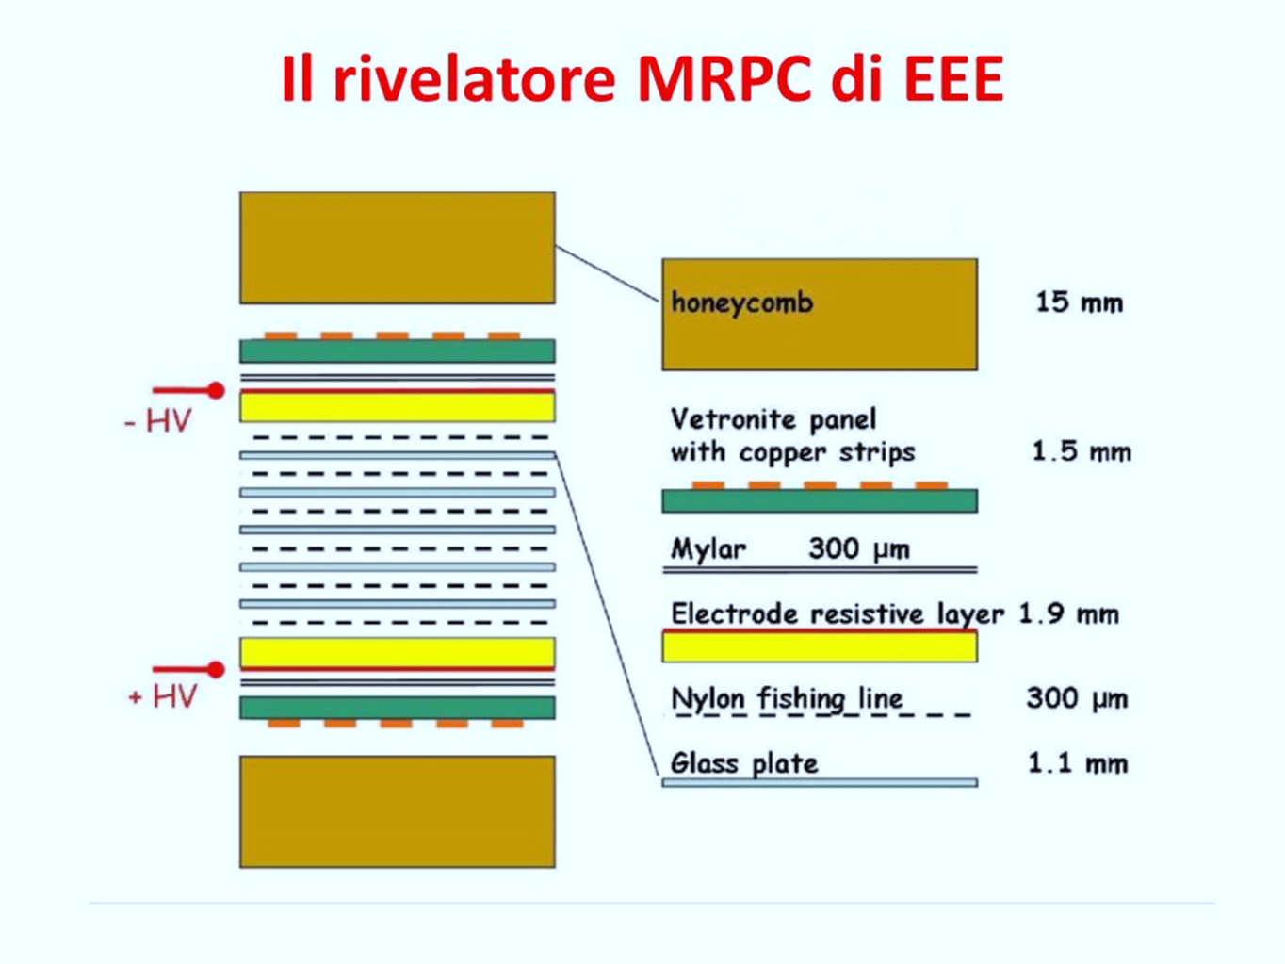
Multigap Resistive Plate Chambers
ERICE 29-31 May 2017

Slide 11
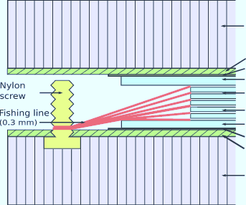
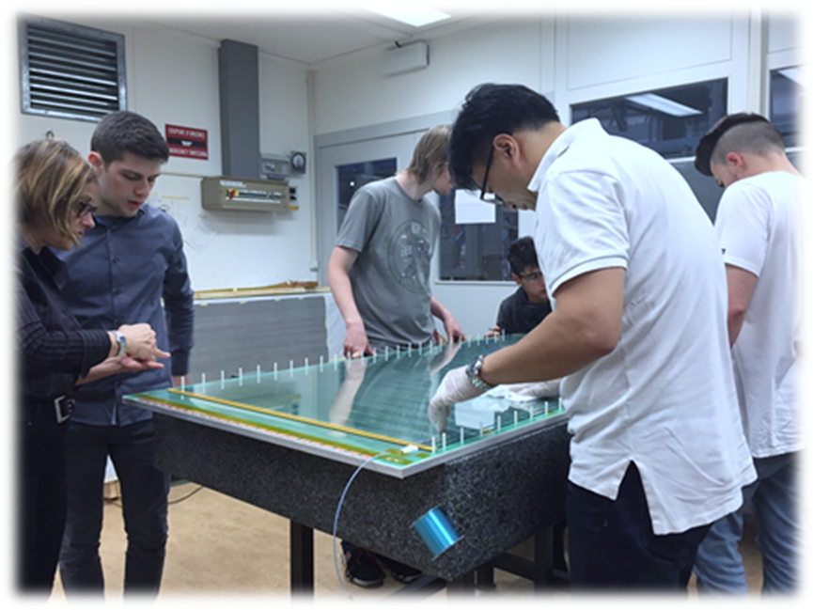
Each layer is separated by a fishing line laid in a zig-zag pattern to provide gaps between layers and to avoid the layers touching each other.
ERICE 29-31 Maggio 2017

Slide 12
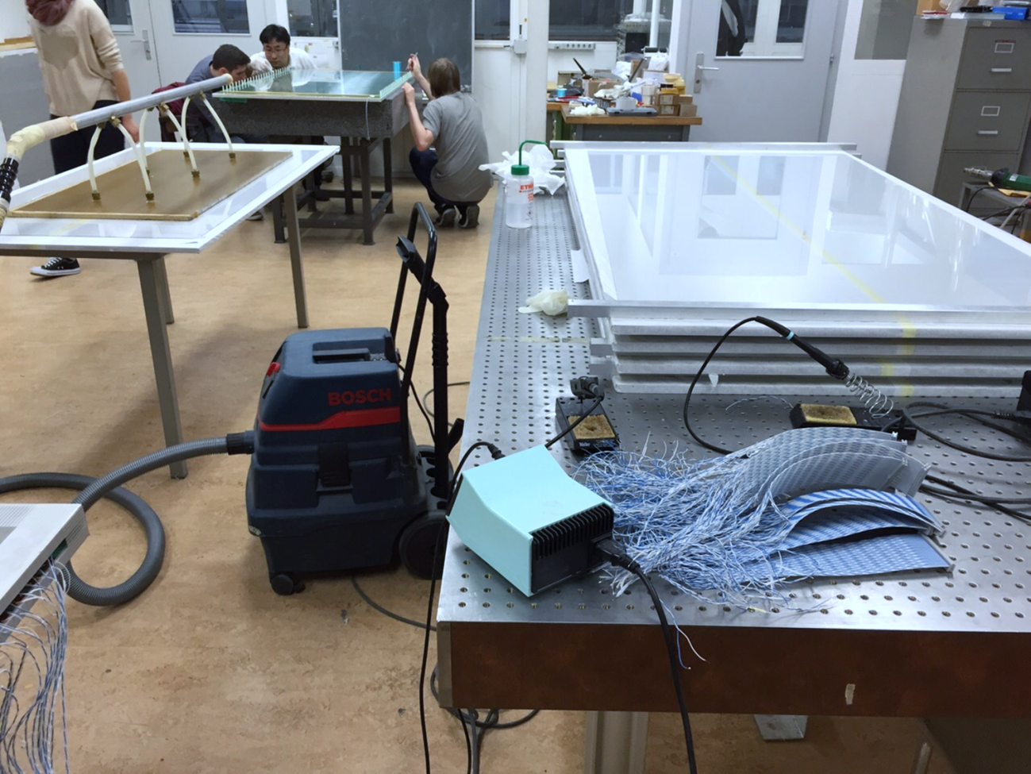
Each chamber has been constructed in the form of a sandwich with 7 layers of glass, each layer has a thickness of 1.5mm.
ERICE 29-31 May 2017

Slide 13
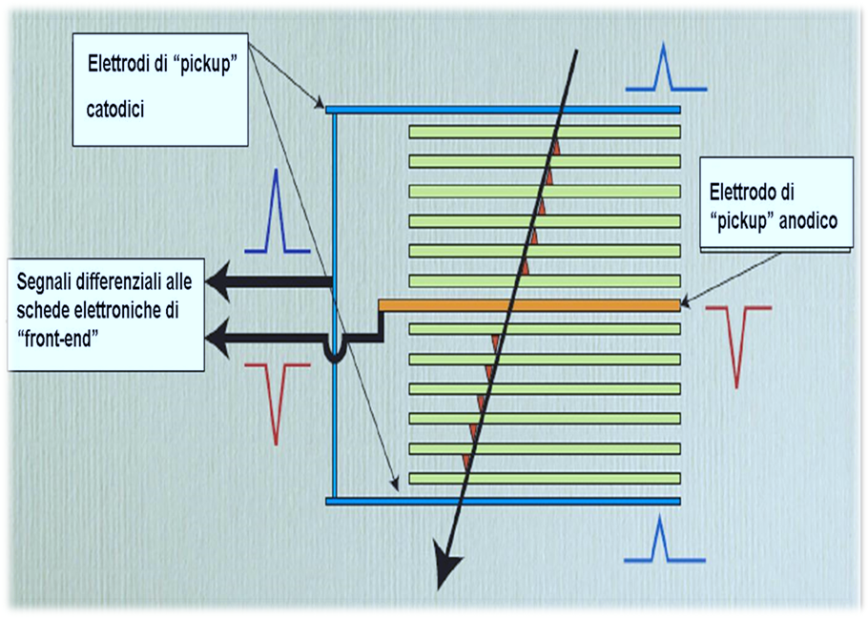
The gaps were created to allow the flow of gasses (freon and Sulfur hexafluoride) necessary for the ionising process through the passage of cosmic muons.
ERICE 29-31 May 2017

Slide 14
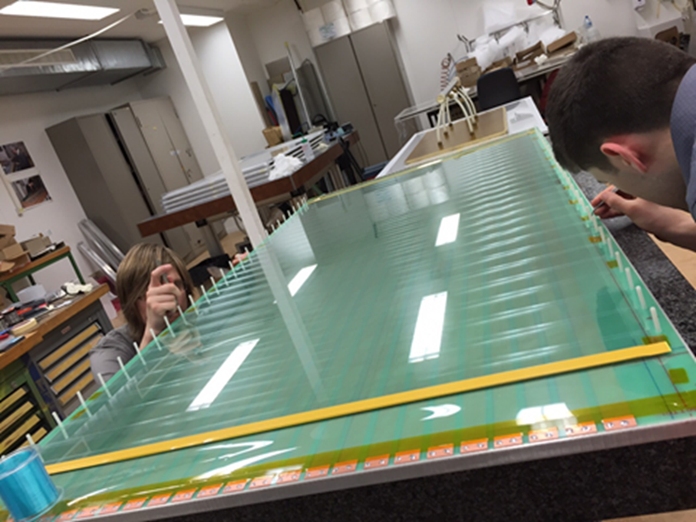
The two external terminal plates, are larger and coated with mylar film, a resistive layer. These two external plates will be able to apply a voltage of 10,000 volts.
ERICE 29-31 May 2017

Slide 15
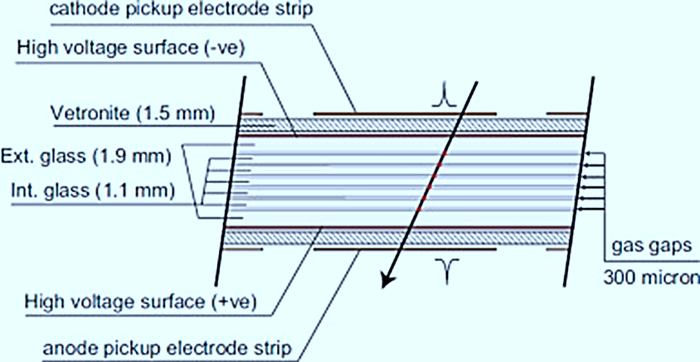
These glass plates are incapsulated between the 2 vetronite panels that serve to isolate the high voltage layers in each chamber
ERICE 29-31 May 2017

Slide 16
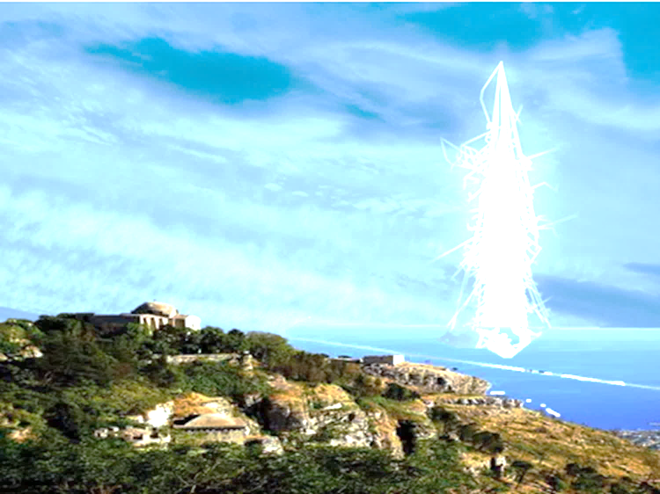
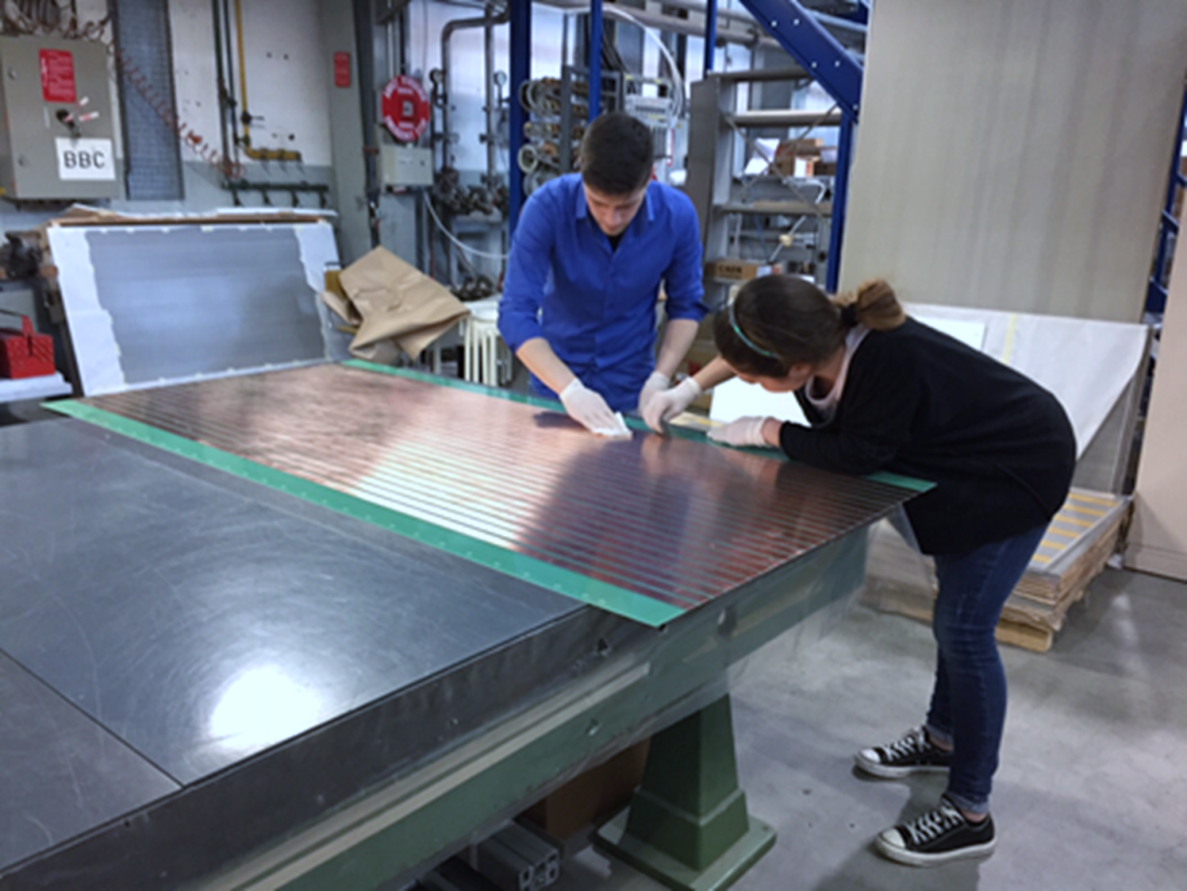
Adhesive copper strips are applied on the vetronite panels. Each of the 24 strips is 25mm thick and represents a reading of electrodes.
ERICE 29-31 May 2017

Slide 17
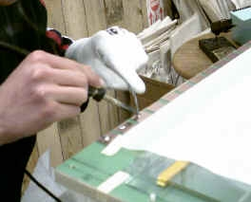
The copper strips, both with cathode and anode, are solded to a twisted pair cable. These strips communicate with two printed circuit boards that are mounted at the edge of each chamber.
.
ERICE 29-31 May 2017

Slide 18
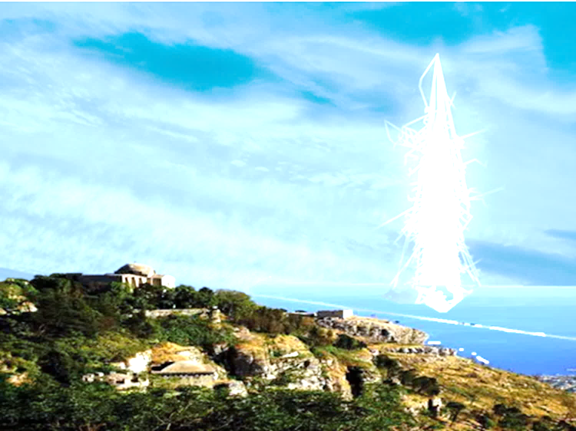
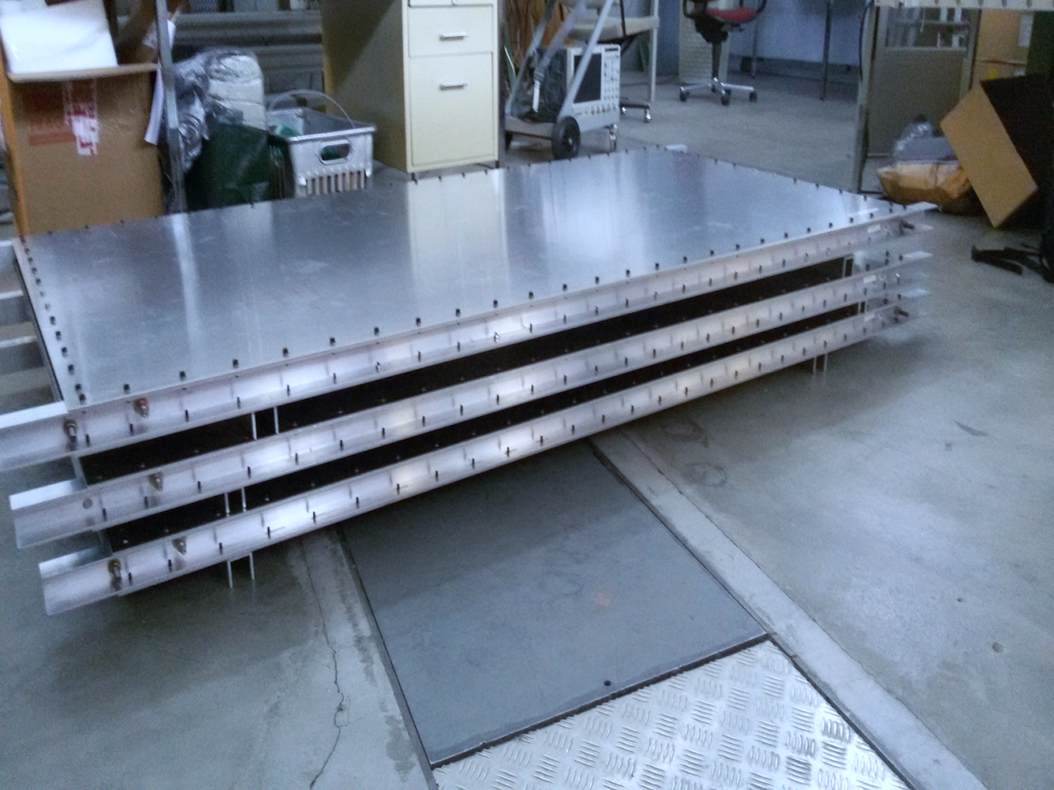
2 honeycomb panels are the top and bottom support of the sandwich. All this structure is enclosed in aluminum panels measuring
2m x1m.
ERICE 29-31 Maggio 2017

Slide 19

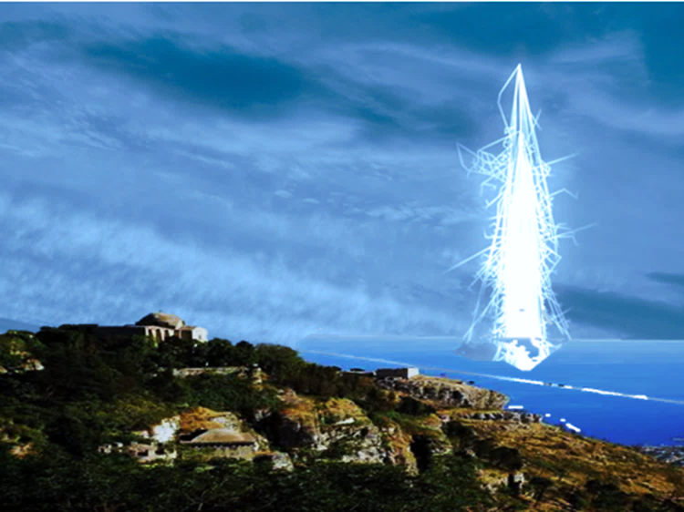
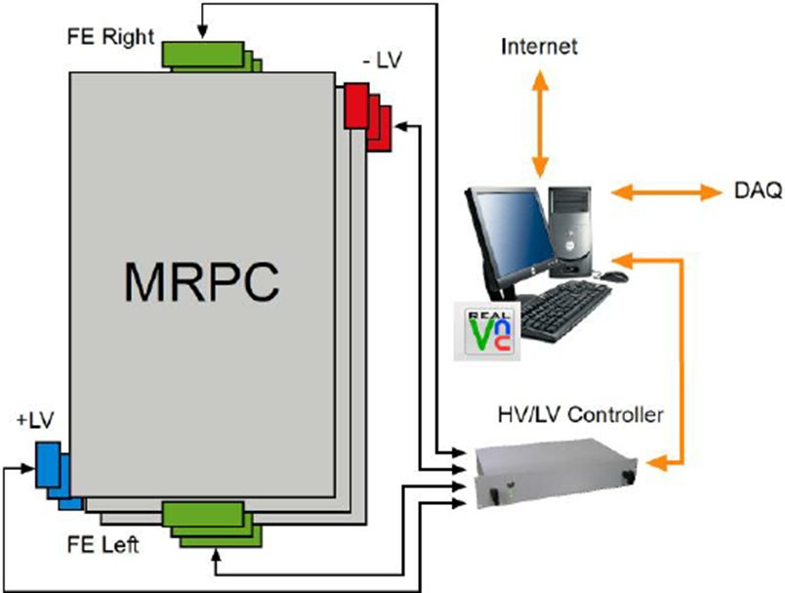
The work continued in our school with the installation of the telescope and all its instruments, such as GPS, computers, gas chambers, and all the equipment needed to operate it.
.
ERICE 29-31 May 2017

Slide 20
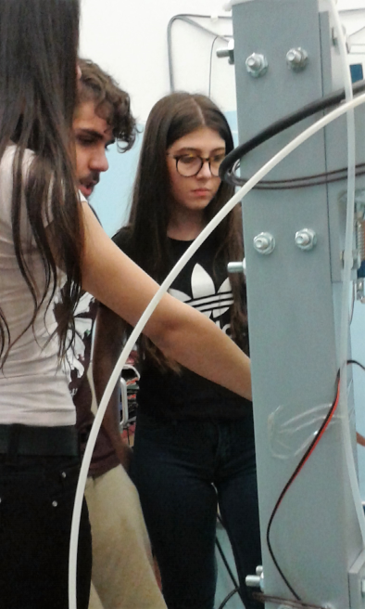
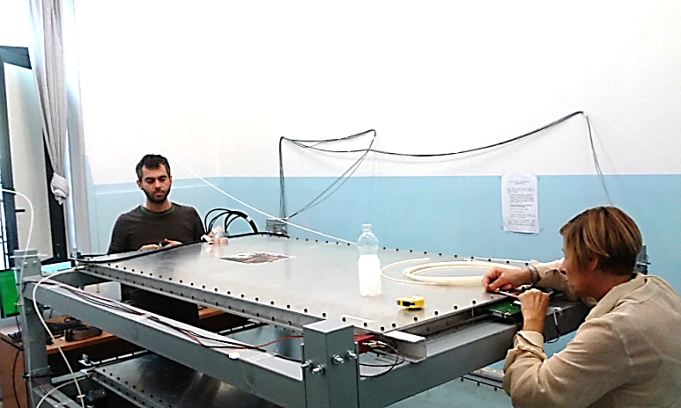
The installation was completed in December 2016 thanks to the work of our tutors and all the participants of the school.
ERICE 29-31 May 2017

Slide 21
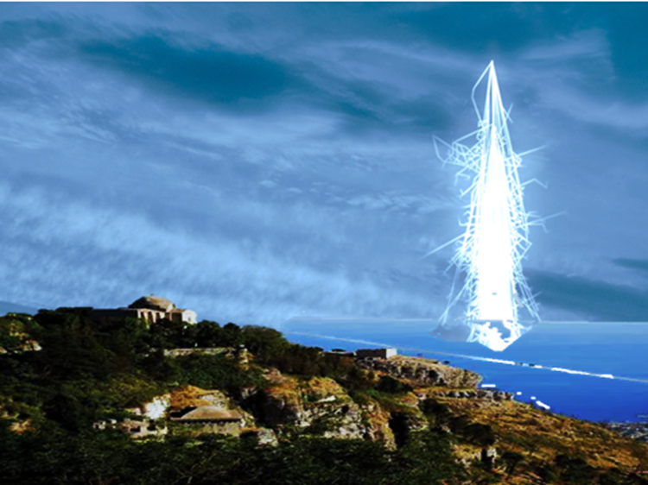
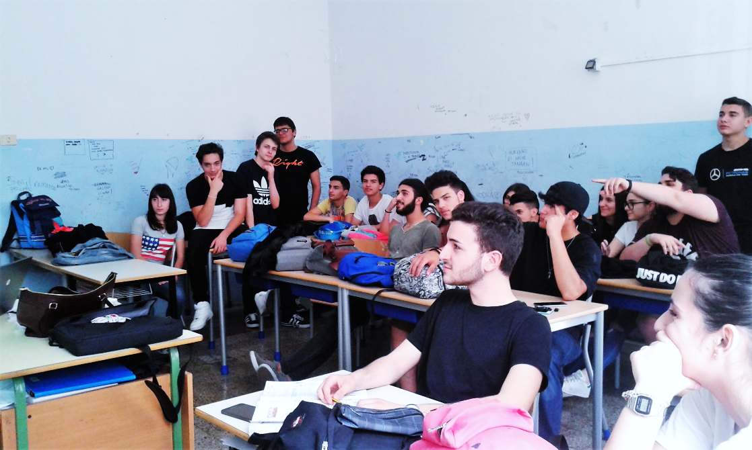
Dr De Gruttola’s seminars have aimed to explain the functionality of the telescope and the overall objective of the project to all participants.
ERICE 29-31 May 2017

Slide 22
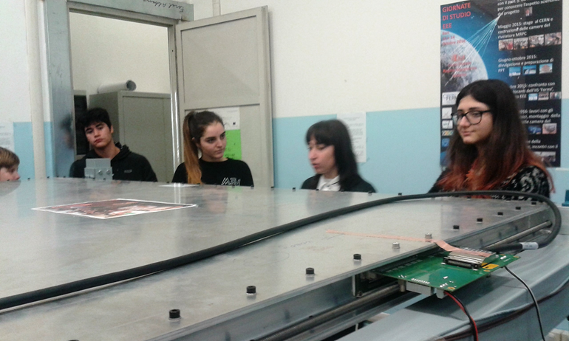
The participants have been both tutors and students of class IV S, who started this project in class II, the new students of class III S, who have contributed to this project at a later stage. All the students completed this specific activity on the Work Esperience scheme.
ERICE 29-31 May 2017

Slide 23
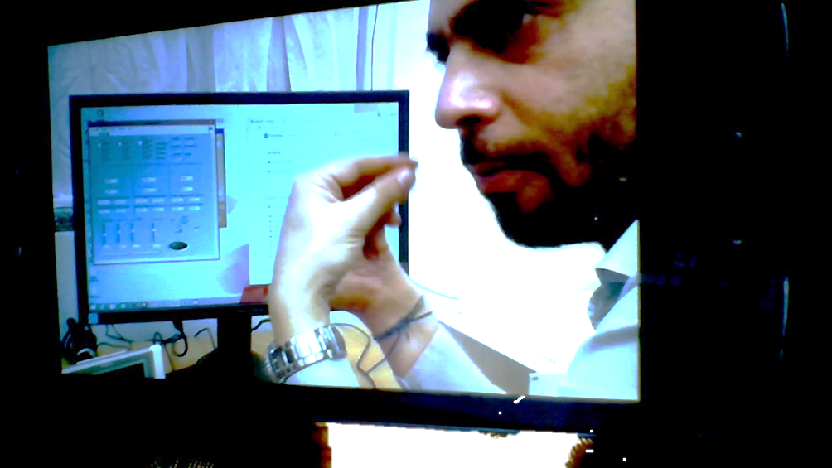
Dr De Gruttola has taught us how to read, collect and enter data online on the research computer network.
The next step of the research should be the comparison, analysis and interpretation of data and this will be the most interesting and exciting part of the project.
ERICE 29-31 May 2017

Slide 24
EEE
SCHOOLS NETWORK
WORK ESPERIENCE
(ASL)
ERICE 29-31 May 2017

Slide 25

SCHOOL NETWORK
Incentive
Interaction
Growth
Comparison
ERICE 29-31 May 2017

Slide 26
S Fermi catanzaro
Catanzaro, 25-27 novembre 2015
L. S. ’’Regina Margherita’’ (SA)
L.S.“E. Fermi” (CZ)
ERICE, 29-31 may 2017

Slide 27
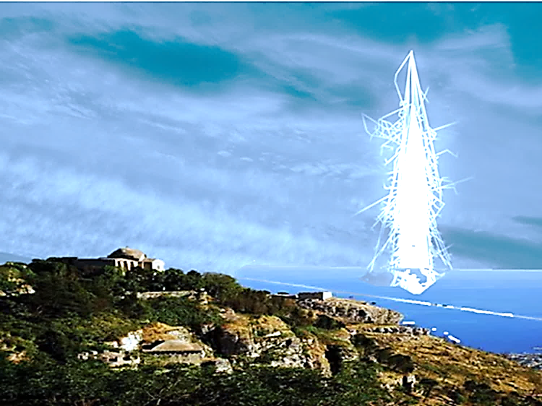
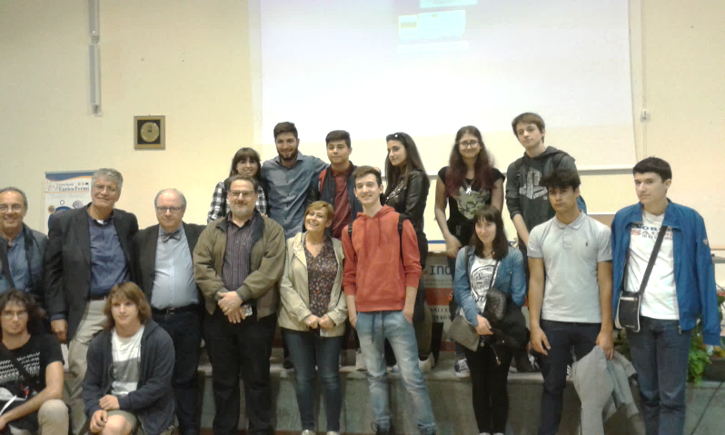
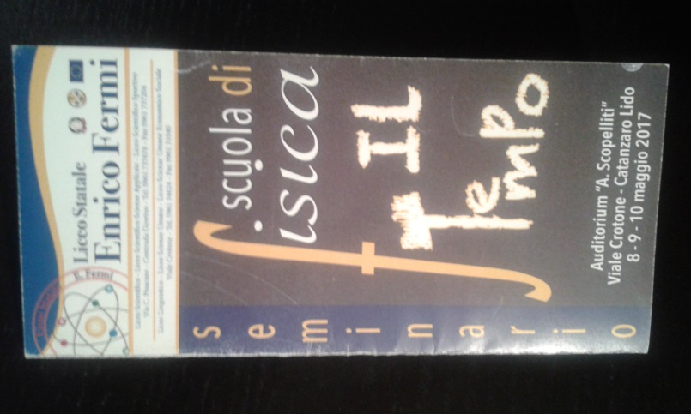
S Fermi catanzaro
Catanzaro
8-10 maggio 2017
Seminar
THE TIME
At the school of physics
ERICE, 29-31 may 2017,

Slide 28
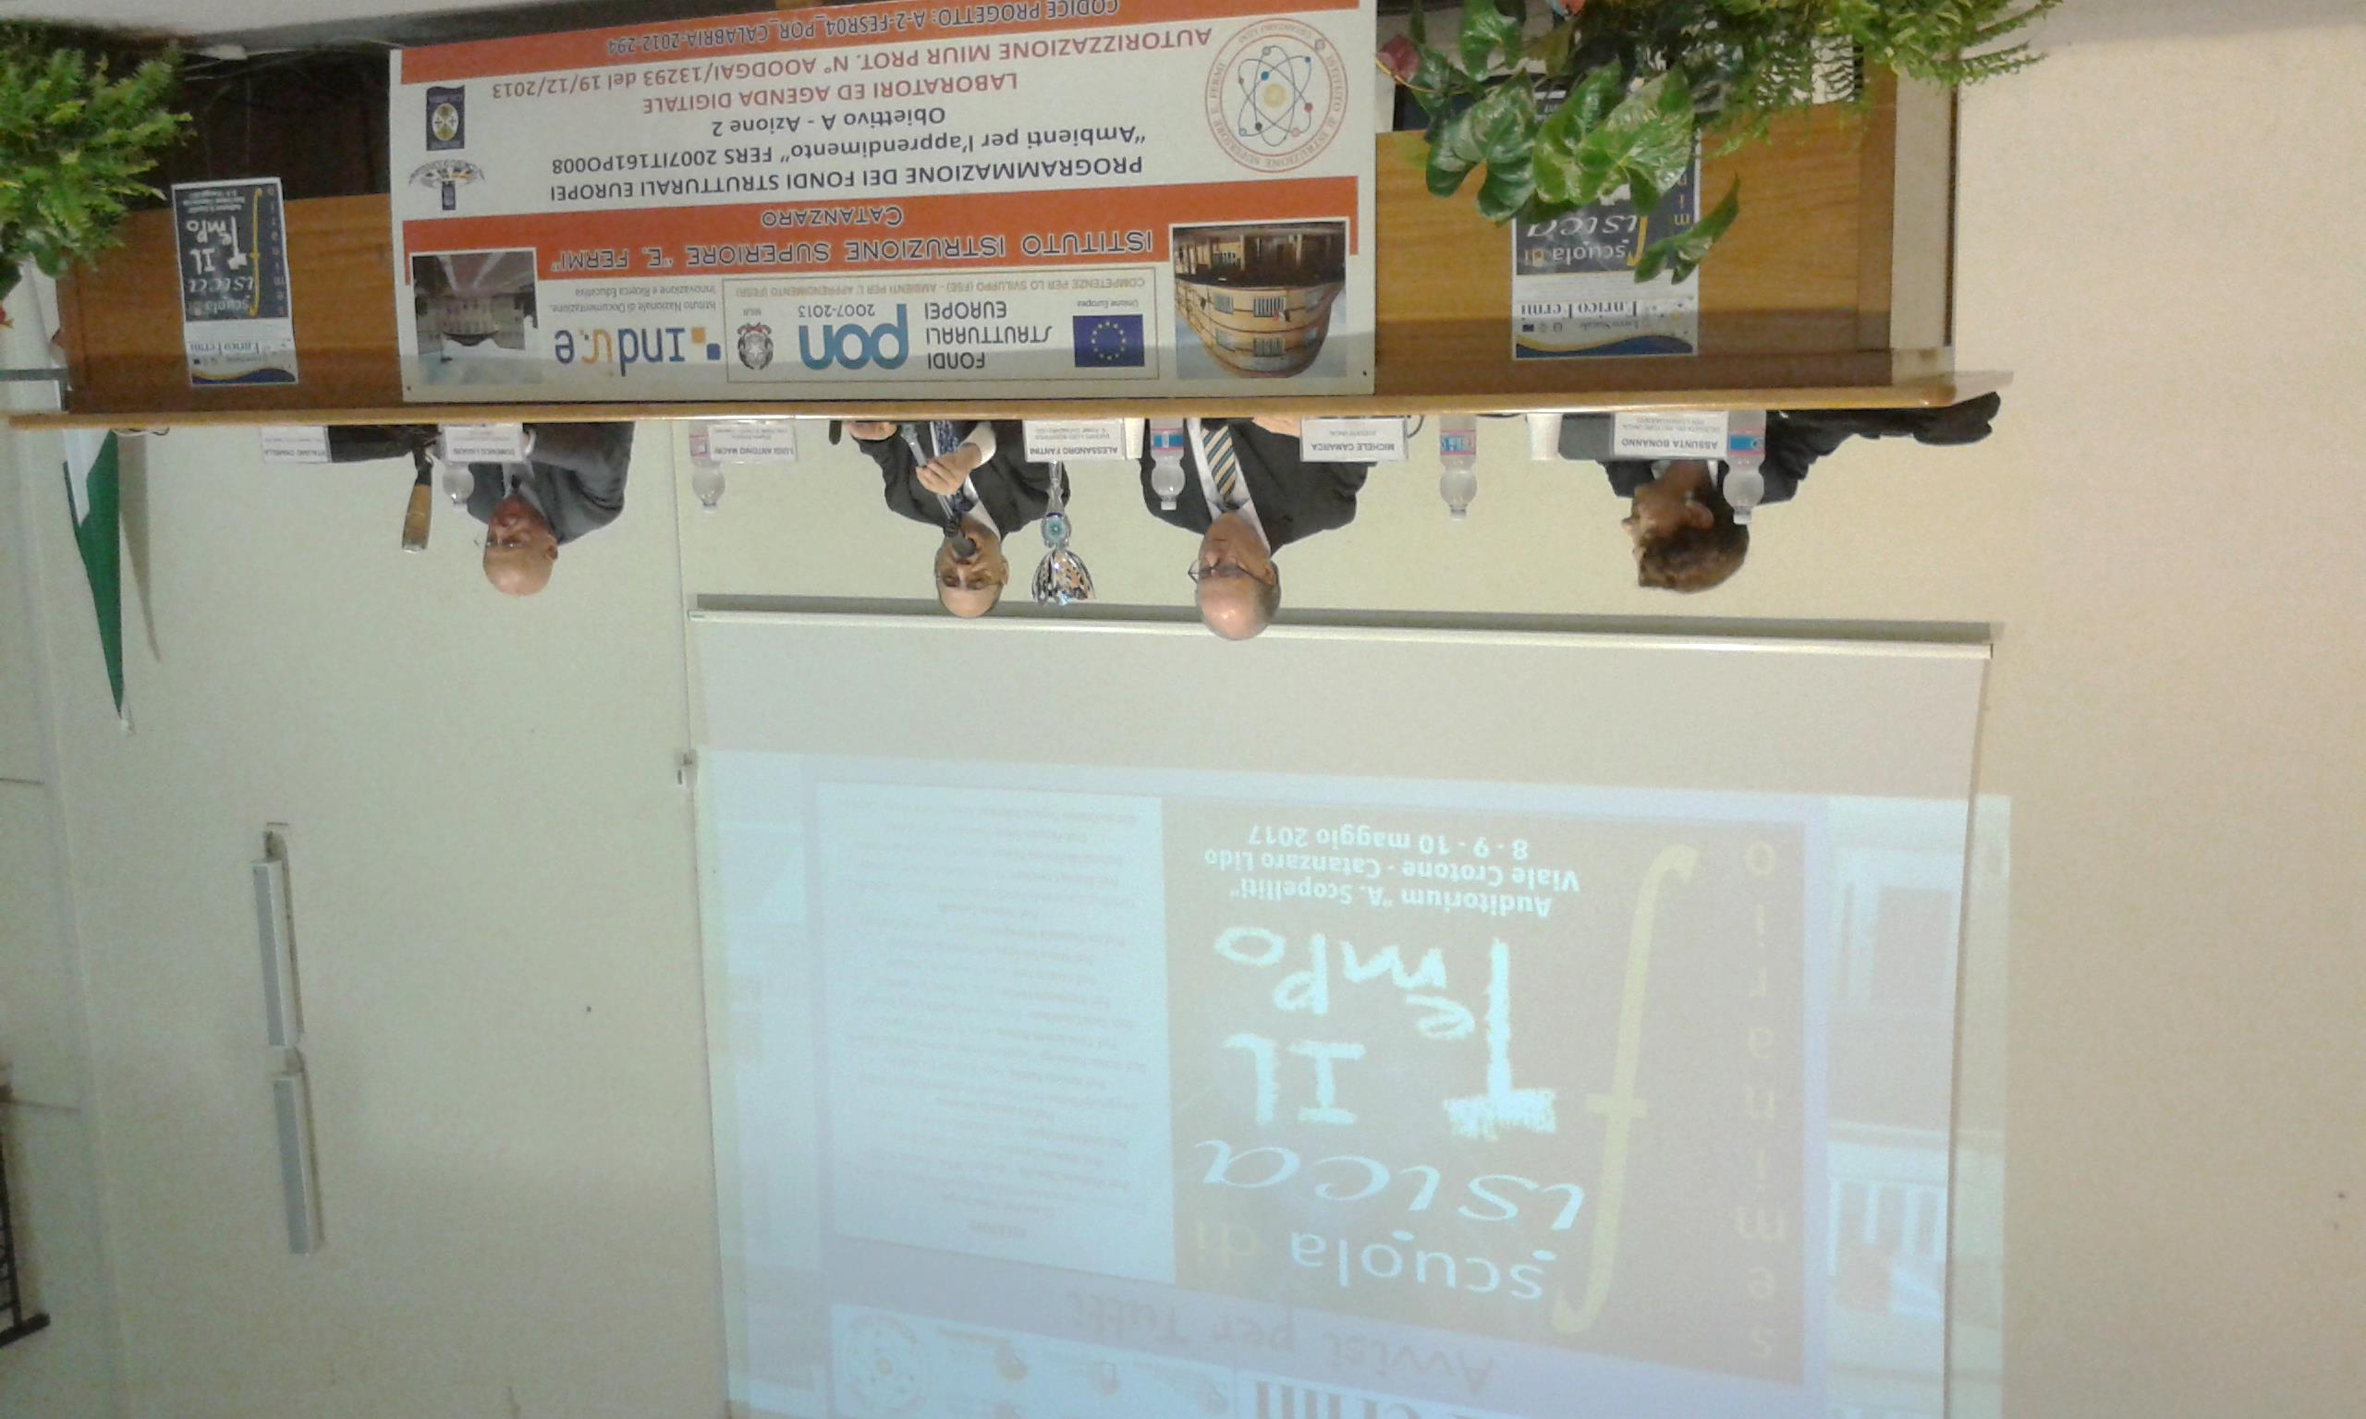
foto

Slide 29
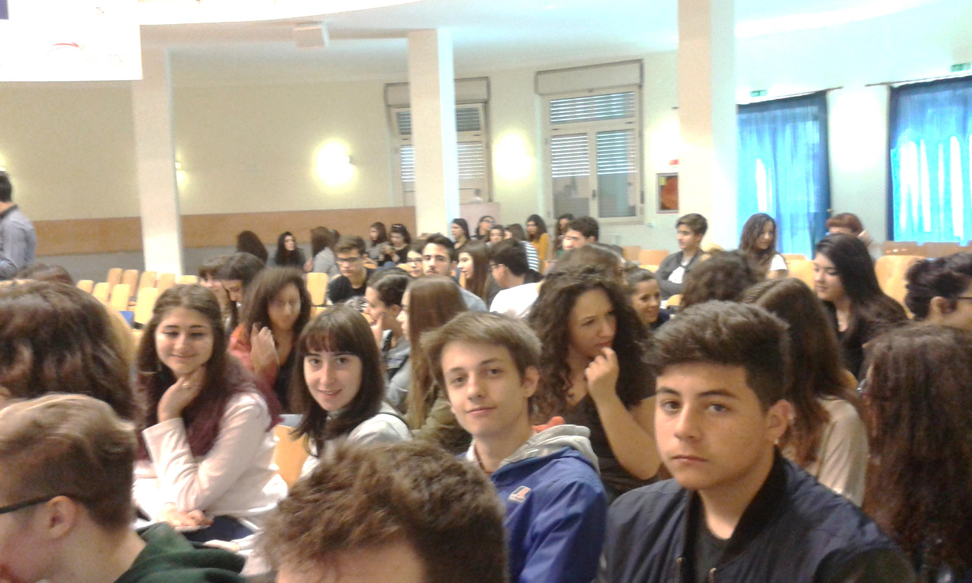
foto

Slide 30
Work Experience (ASL)
Everybody can work
Teamwork
Mentoring
Positive feedback
ERICE 29-31 Maggio 2017

Slide 31

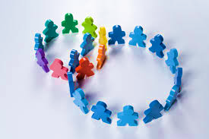
S Fermi catanzaro
Active Awareness
Participation for all
ERICE, 29-31 maggio,

Slide 32
S Fermi catanzaro
WORKING TOGETHER ..
EEE
To Learn
ERICE, 29-31 maggio,

Slide 33
EEE
Emotional involvement
Educational value
Critique
New teaching method
The beauty of research
ERICE 29-31 May 2017

Slide 34
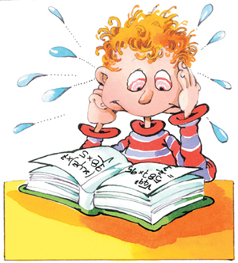
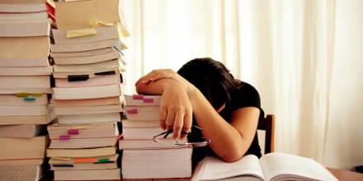
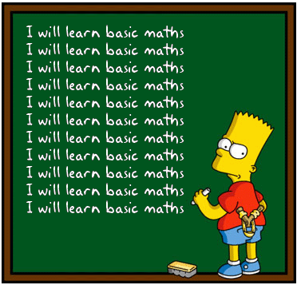
ERICE 29-31 May 2017

Slide 35

TO STIMULATE AND VALUE CURIOSITY
IS TO ENCOURAGE
KNOWLEDGE AND AWARENESS
ERICE 29-31 May 2017

Slide 36
WE-ASL
Management
EEE
Internet connection problems
Coordination
School Network
Organisation
Overhead costs
Traditional thinking
Breakage of crate
Electric system problems
Experience outside the school
PROBLEMS
ERICE 29-31 May 2017

Slide 37
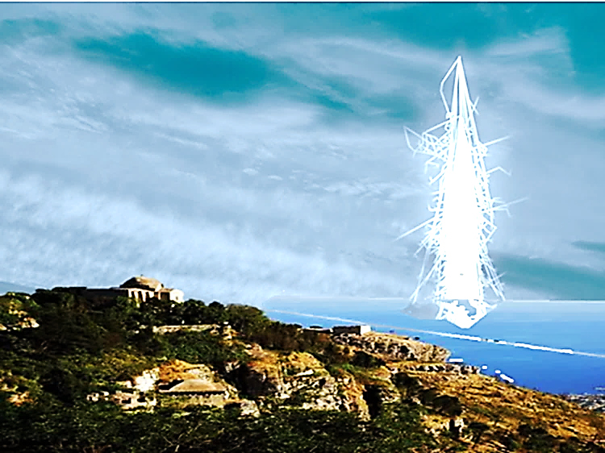

First Measure
Daily Reports
Videoconference Participation
20 February 2017
Students of III and IV classes
All the students of the Applied Science Course

Slide 38
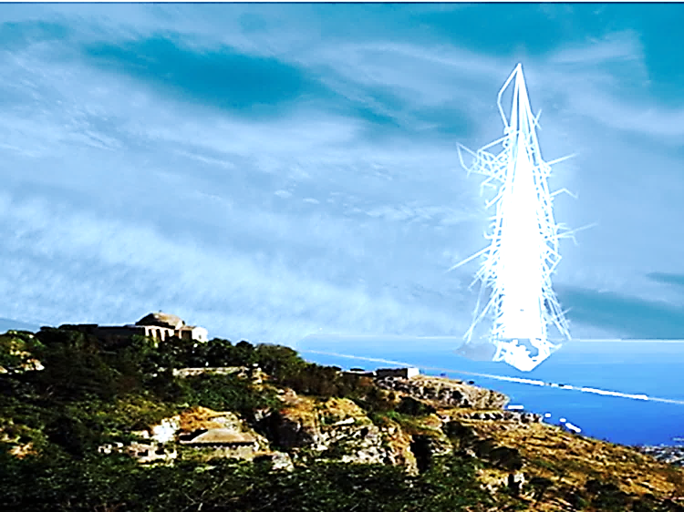
LIVING SCIENTIFIC RESEARCH
TO CARRY OUT THE RESEARCH
TO BE THE RESEARCH
A life without research is not a worthy life.

Slide 39
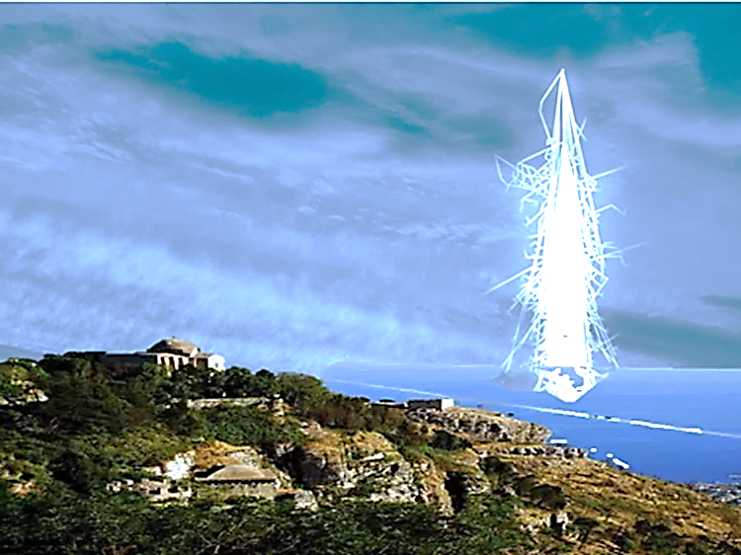
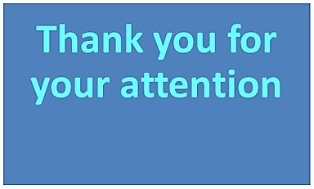
The next objective of the work
Interpretation of data
Analysis of data
Thesis

Slide 40



to live this experience and guided us with patience.
all of those who have allowed us
A special thank you to

