Slide 1
The waiting
Referente: prof. giovanni guido
Alunno portavoce: vallenzasca davide

Slide 2
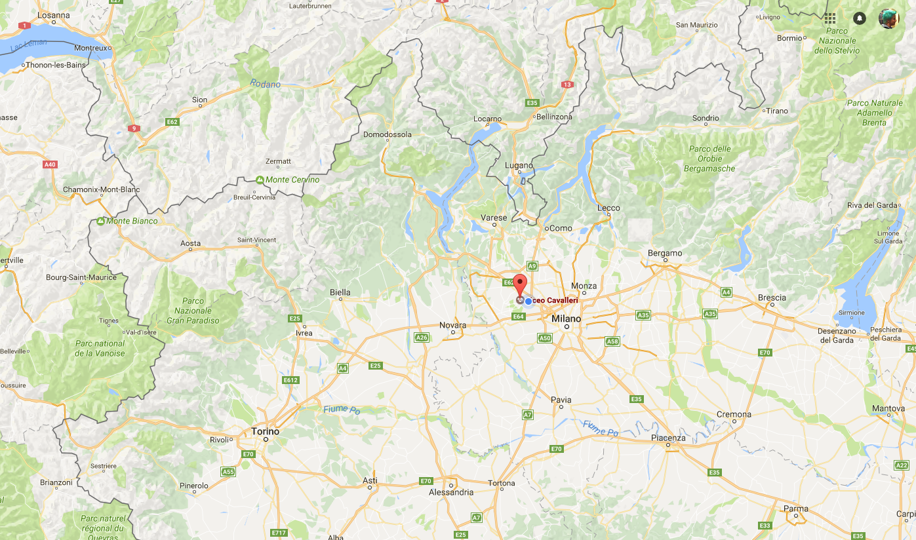
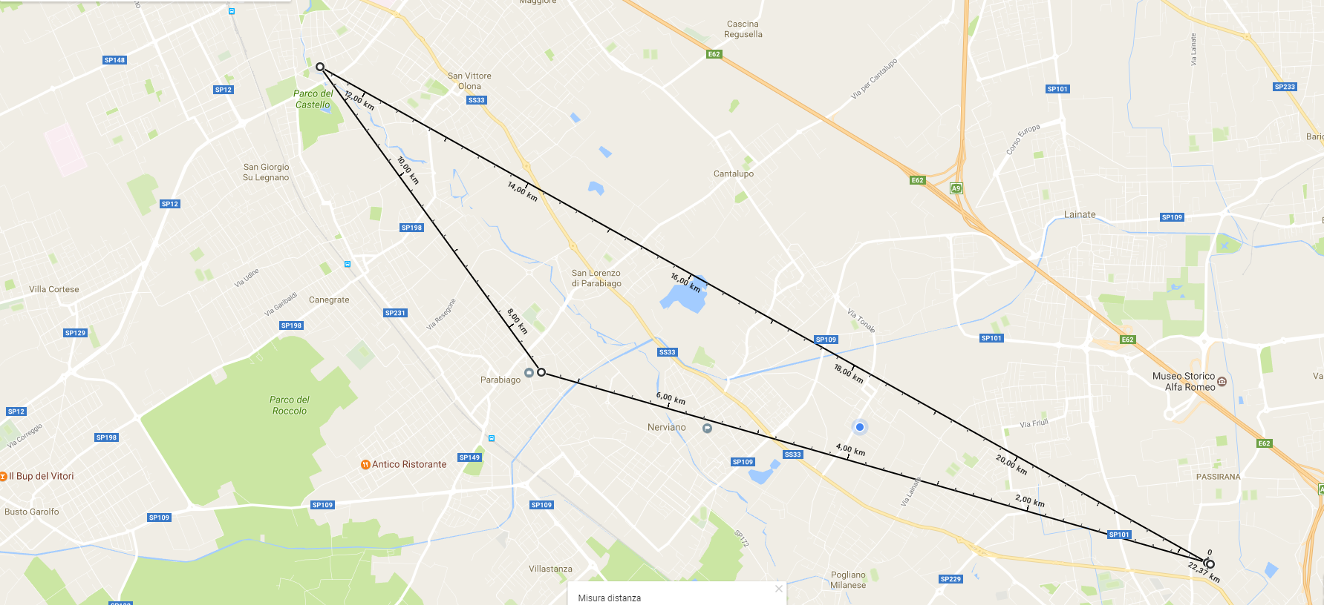
The school
4,1 Km
10,9 Km
Our school
7,4 Km

Slide 3
How the idea started
The idea started when our headmaster, who was on holiday in Catanzaro, heard about the partecipation of Liceo E.Fermi to the EEE project
So he proposed the idea to our coach who decided to enlist our school to the project, thanks also to the teacher of liceo E. Fermi Fantini’s assistence

Slide 4
Group of work
Our team is composed by 7 students:
Massari Lorenzo ~ 4ª
Belloni Dario ~ 4ª
Nebuloni Samuel ~ 3ª
Bianchi Rachele ~ 3ª
Correddu Luca ~ 3ª
Vallenzasca Davide ~ 5ª
Alessio Dario ~ 4ª

Slide 5
Activities
Theorical deepening
CERN’s «beam line for schools» project
«Scuola di fisica» organized by liceo Fermi (CZ)

Slide 6
Theorical deepening
In this year we, thanks to our teacher, have made a theorical deepening on modern physics, focusing on:
Composition and origins of cosmic rays
Description and principles behind the instrumentation
Lorentz’s transformations and relativity for the muons
Wave-particel dualism
Standard model
Pions’ decay
Trying a new didactic model of hadronic particles
Our purpose is to create a core of well prepared students that will transmit their knowledge to new students that will join the project in the next years, in order to have a team with a strong theorical base working on cosmic rays.

Slide 7
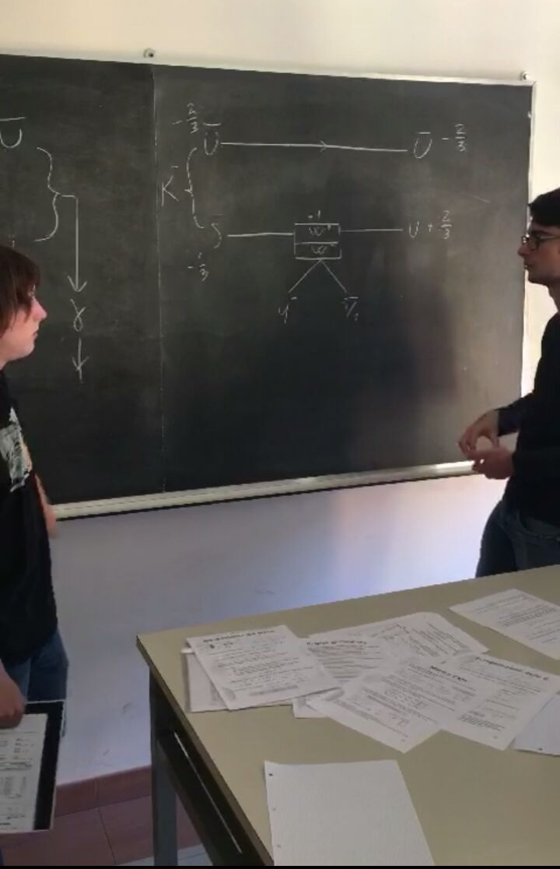
CERN’s «beam line for schools» project
We have also joined a CERN project that invited students to develop an experiment to act on a part o cern’s particles accelerator. We, together with our teacher, have developed an experiment to show the possibility of detect a background of neutral lattice of mesons (quark-antiquark) which partecipate to strong interctions so as a lattice of Bosons (W⁺ + W⁻) for weak interactions with excess of gamma rays emission.

Slide 8
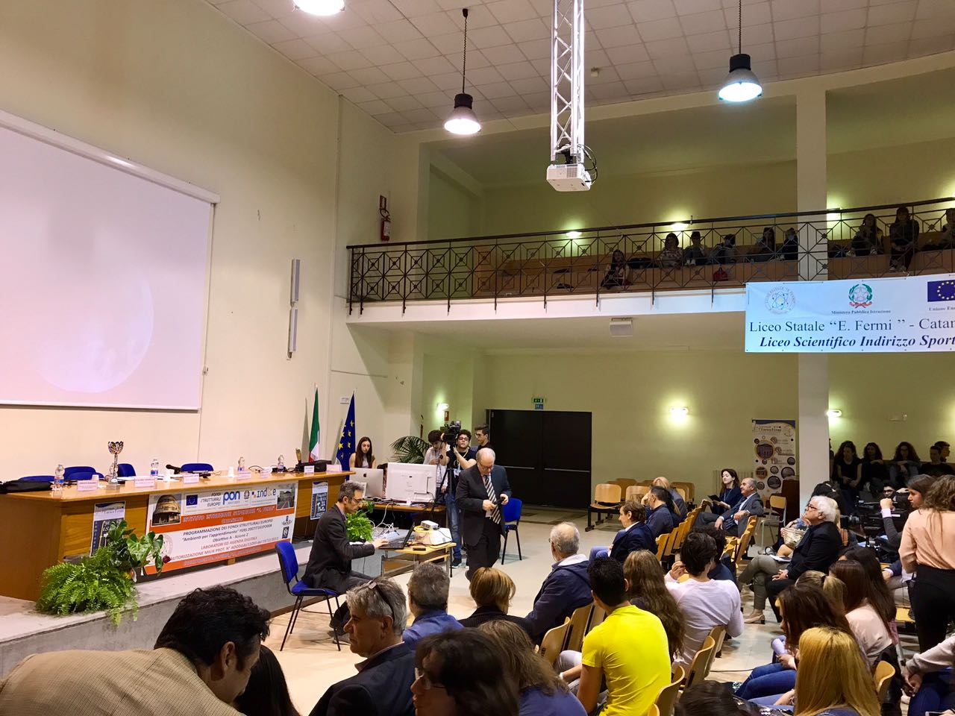
«Scuola di fisica» organized by liceo Fermi (CZ)
We also joined «scuola di fisica», 3 days of conferences that dealt with the theme of «Time» from different points of view.
In that occasion, we also had the possibility to see a telescope and how the acquisition of data works.

Slide 9
Expectations…
Recive a telescope
Being part of a school network
…AND OBSERVATIONS
There is lack of assistence for schools in the EEE project without a telescope yet, for what concerns how to be an active part of the project and on how the project itself should work

