Slide 1

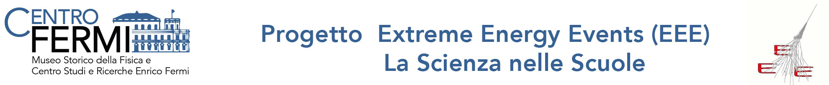




I.I.S. CORRIDONI CAMPANA
Notes:
1
1

Slide 2

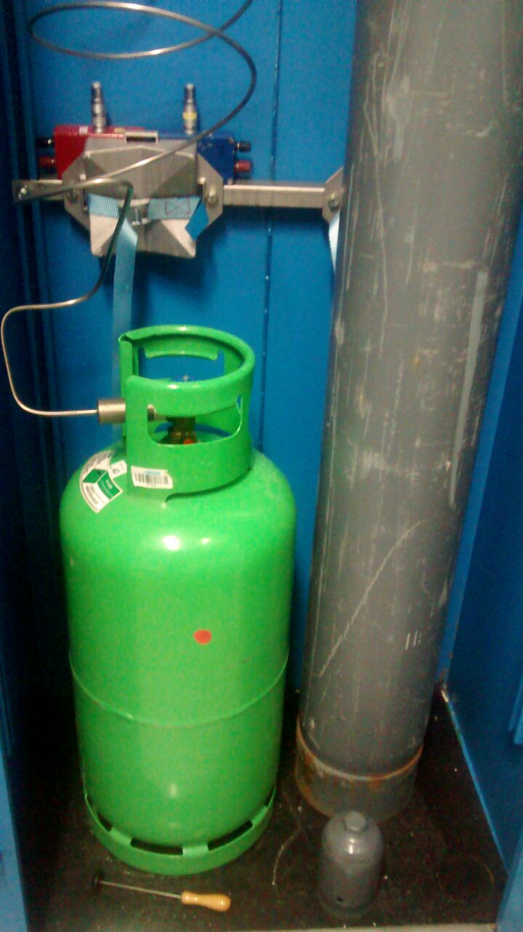
The Gas Tank Problem:
We tried to calculate the amount of liquid gas in a tank through the formulation of a phenomenological theory.
The tanks connected to the telescope.
Notes:
2
2

Slide 3

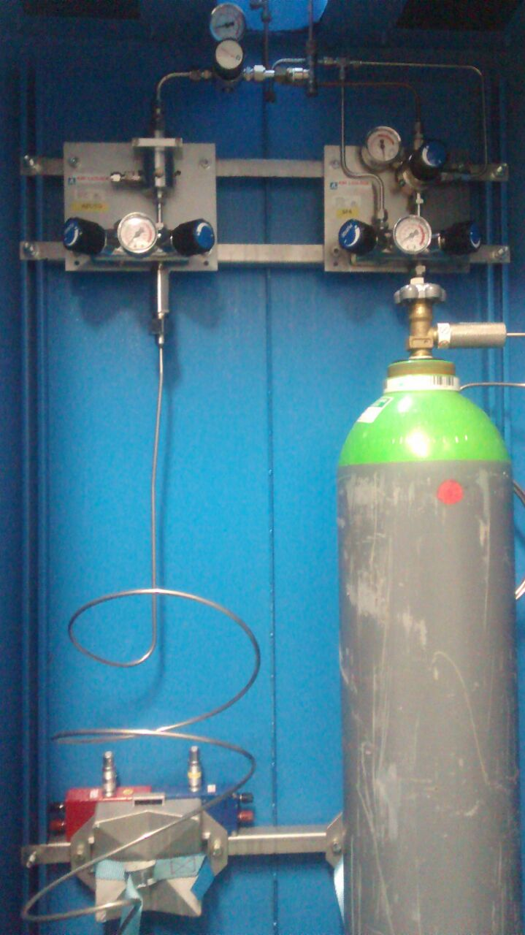
The Gas Tank Problem:
The telescope cannot operate without the gas mixture, the exhaust of which implies the suspension of data taking.
Notes:
3
3

Slide 4

The Gas Tank Problem:
It is not immediately possible to calculate the amount of liquid gas in the tank since:
The mass of the cylinder cannot be measured, because it is connected to the telescope through metal tubes.
It is useless to measure the pressure, as it is dependent only on the temperature in the condition of equilibrium.
Notes:
4
4

Slide 5

The Solution:
Beating the tank you get a sound and not a noise.
HYPOTHESIS!
The sound frequency depends on the
Quantity of liquid inside the tank.
Notes:
5
5

Slide 6

The Solution:
The idea is to experimentally determine f(m), where f is the frequency and m the amount of liquid in the tank, invert it and get so m(f), which allows us to understand how much liquid is inside the tank.
Notes:
6
6

Slide 7

Technical Equipment:
Hardware:
For sound recording we used the internal microphone of a laptop, but you can also use an external microphone connected to the pc of the telescope.
Notes:
7
7

Slide 8


Software:
http://www.audacityteam.org/
To perform the sound frequency analysis we used the open source software Audacity.
Notes:
8
8

Slide 9

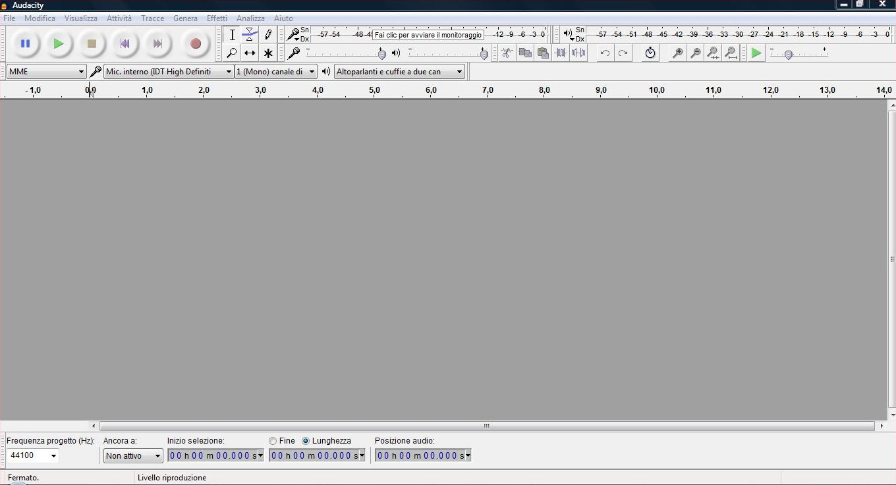
The Audacity Software Layout:
Notes:
9
9

Slide 10

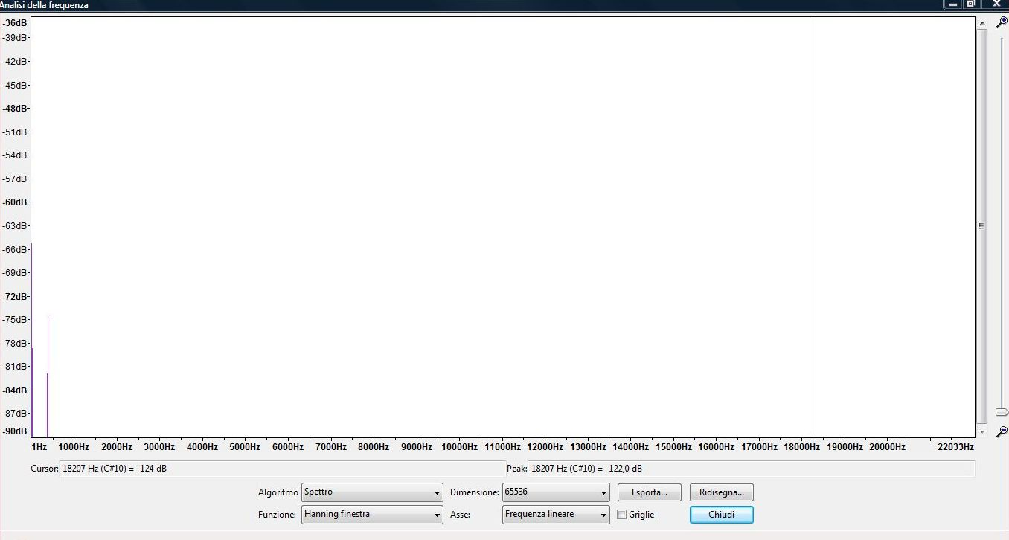
The software contains a spectrum analyzer with 1 Hz sensitivity.
System test through the analysis of the sound emitted by a diapason of known frequency. (384 Hz)
Notes:
10
10

Slide 11

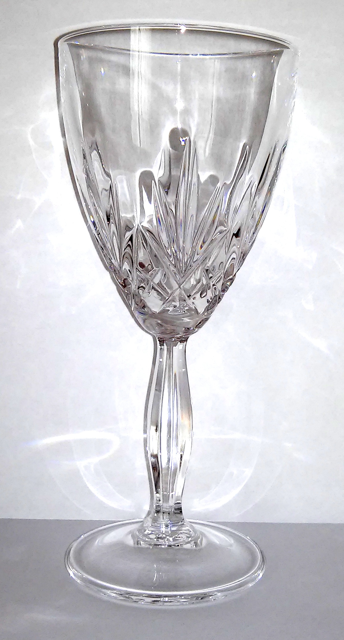
The Glass Simulation:
Not being able to fill and empty the Tank in relation to our experimental needs we tried the model with a crystal glass and water.
Notes:
11
11

Slide 12

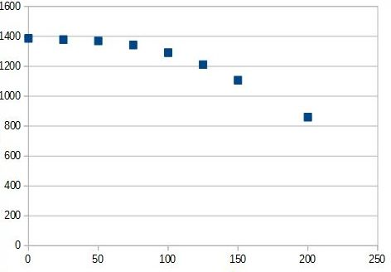
The Glass Simulation:
We recorded the sound of the glass with different amounts of liquid inside, we analysed the spectrum and we isolated the principal frequency.
Notes:
12
12

Slide 13

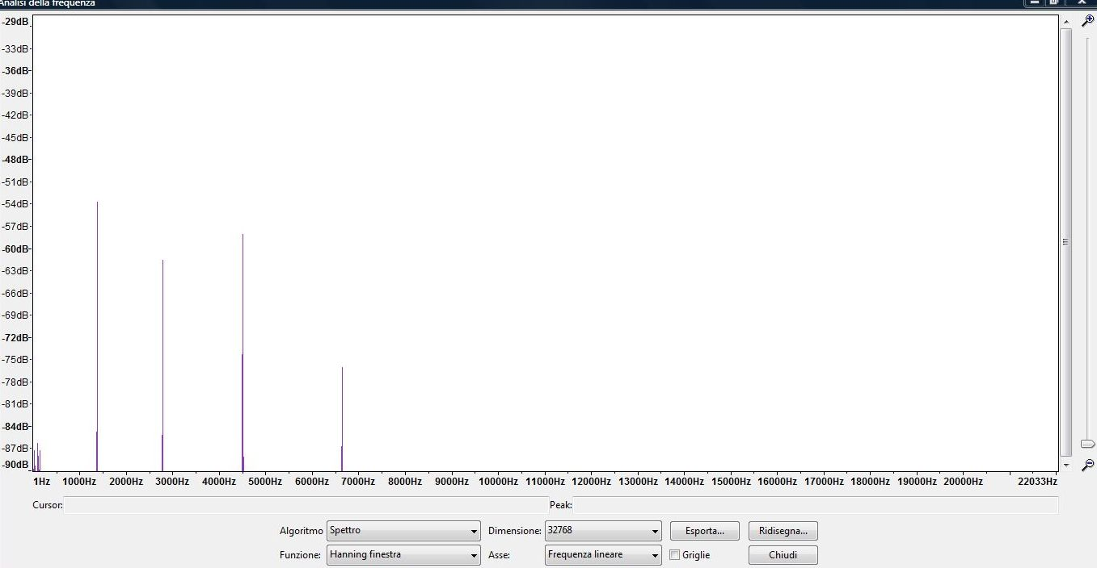
Analysis of the glass spectrum:
The fundamental frequency is 1381 Hz.
Notes:
13
13

Slide 14

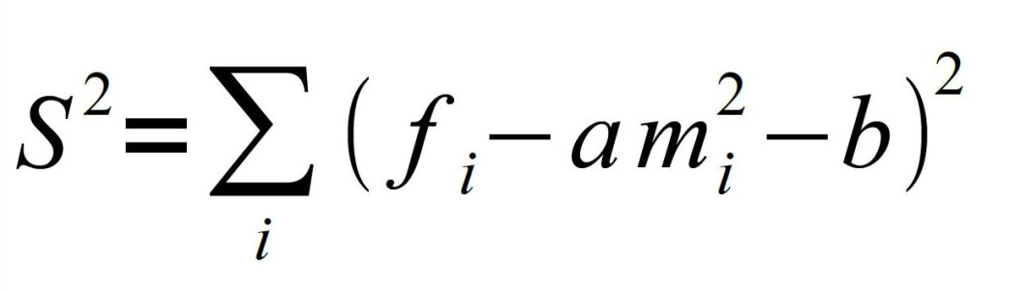
Taking a series of points (m; f) related to the glass I can approximate the curve with a parabola through the least squares method, i.e. determine the coefficients a, b such that S² is the least where f_{i} is the experimentally detected frequency and m_{i} is the mass of the water in the glass.
Notes:
14
14

Slide 15

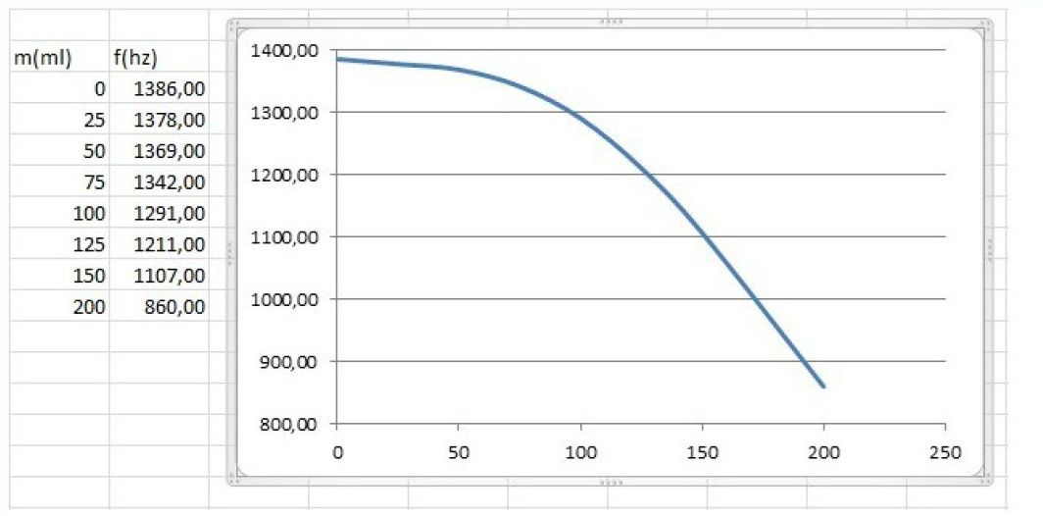
Once the curve is obtained, the amount of liquid in the glass results from the frequency given.
Notes:
15
15

Slide 16

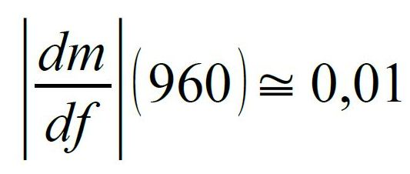
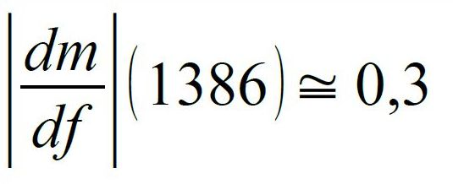
The curve equation is:
By inverting it you get:
To control how the mass varies in relation to any variations in frequency we calculate:
It is interesting to note that a tool that measures the mass from frequency will have a sensitivity many times greater when the container is full than when it is empty.
Notes:
16
16

Slide 17
The Tank:
The idea is to apply the glass model to the tank and draw its curve f(m) using the same method as the glass one.
The inverted curve will allow us to understand
when the tank is running out and to avoid the
telescope being left without gas for long
periods of time.
Notes:
17
17

Slide 18
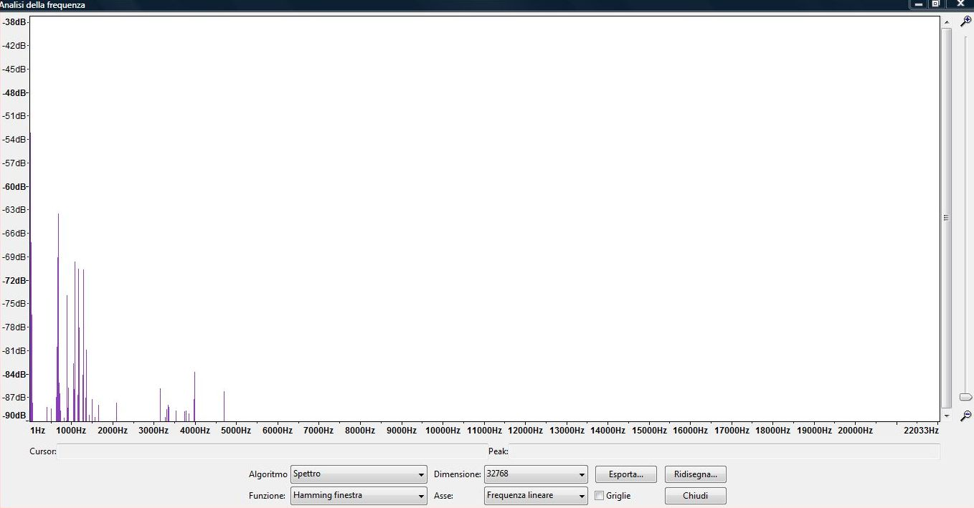
Analysis of the tank spectrum
The frequency of the peak is 678 Hz.
Notes:
18
18

Slide 19
THE END

