Slide 1
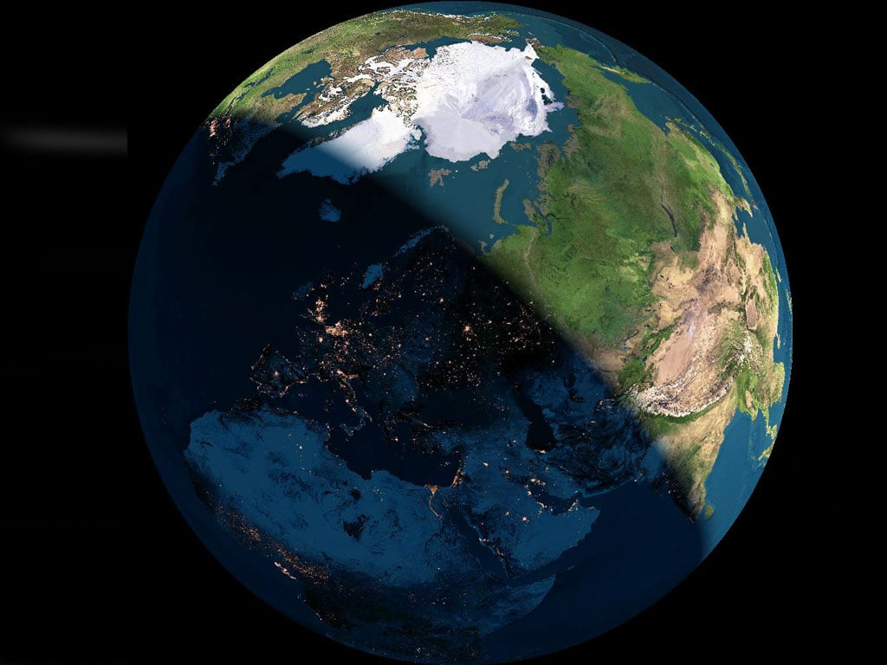
Investigation of the diurnal variation of cosmic rays at large latitudes by EEE detectors
An update report
F.Riggi
Dept.Physics and Astronomy and INFN Catania
&
Centro Fermi
EEE Analysis Meeting, Nov 27, 2025

Slide 2
A brief recall of previous report: Cosmic Ray variations
Periodic variations:
Long term variations (11 / 22 years, solar cycle)
Short term variations (27 days, average Sun rotation period)
Diurnal modulations
The diurnal variation of CR flux measured at ground is an important – although with small amplitude – feature of the data collected by a CR detector.
Both charged particles and neutrons undergo these variations.
Periodic variations occurring within a day (diurnal variations) are associated to changing conditions in the Interplanetary Magnetic Field (IMF) and Earth’s magnetosphere.

Slide 3
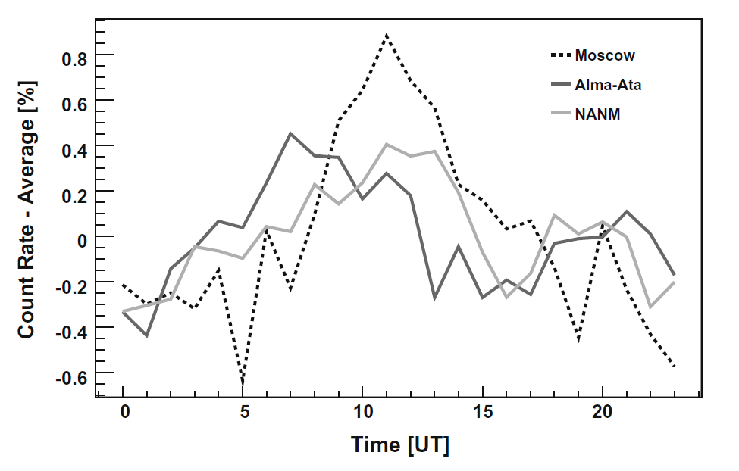
Features of diurnal variations
Diurnal variations have been observed since a long time.
Observed amplitudes of the order of 0.1-0.3 %.
Phase (local time for the maximum) around 12h-14h local time, with large dispersion around it.
Although largely studied, diurnal variations are still an important topic for CR investigations, even today.
Detailed features depend on
Coordinates of the observation site (especially latitude)
Solar cycle, year (long term trends)
Sun magnetic polarity
Secondary particles being detected (neutrons, muons)
Maylian, Advances in Space Research(2010)

Slide 4
Analysis of cosmic rays diurnal variations in EEE
Due to the small expected effect (0.1 % or less) a stable and long dataset is required
Good candidate: POLA-R detectors
Relatively stable for long periods
Three independent detectors in the same site
Good counting rate (of the order of 30 events/s)
Peculiar location at high latitude
About six years of data available
Preliminary results on this analysis presented during last meeting
Comments and suggestions taken into account to update and complete the analysis

Slide 5
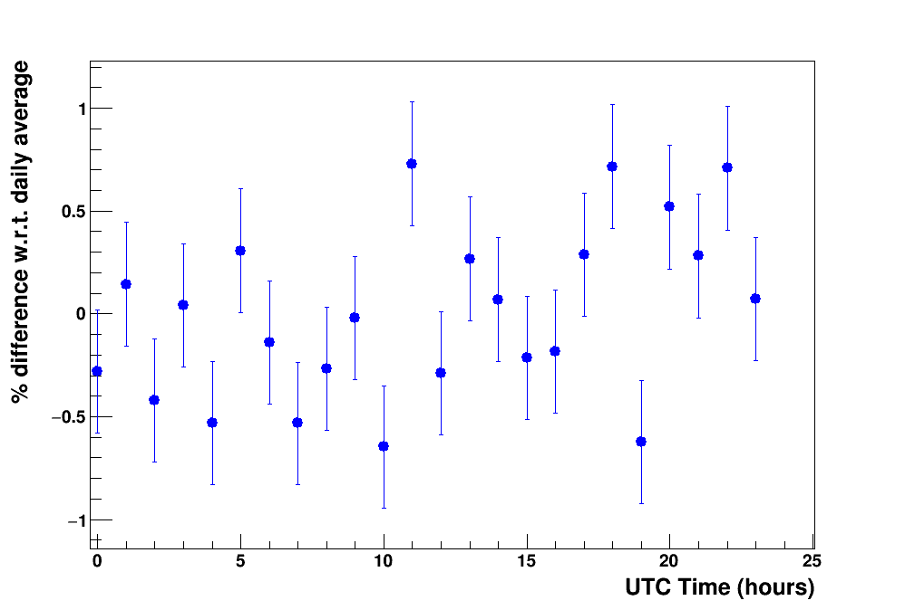
Analysis strategy
● Daily averages considered, with selection of full-coverage days
● Evaluate the hourly difference w.r.t. average
1 day
● Statistical fluctuations in each point of the order of 0.3-0.5 % (about 100k events collected in 1 hour).
● No defined trend seen in a single day, due to the small expected effect (0.1% or less).
● Increase statistics over many days

Slide 6
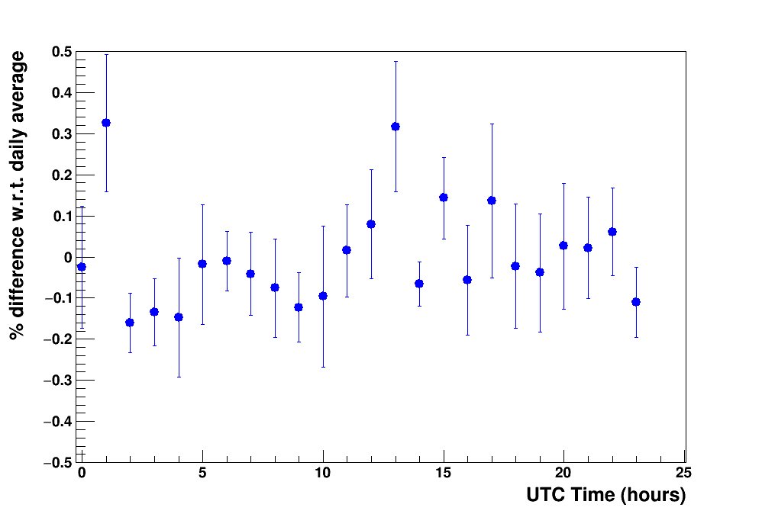
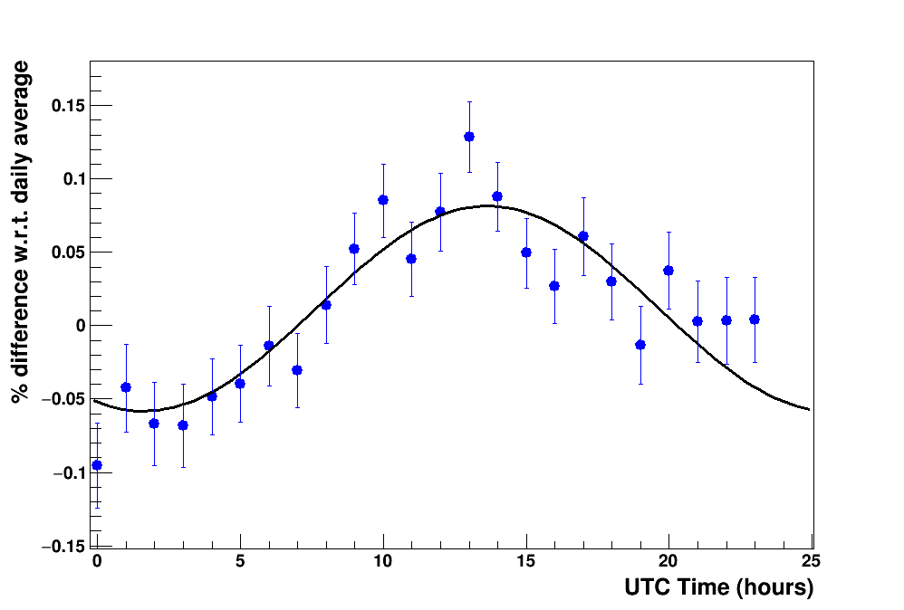
Increase statistical significance
10 days
POLA-01 data 2024
1 year

Slide 7
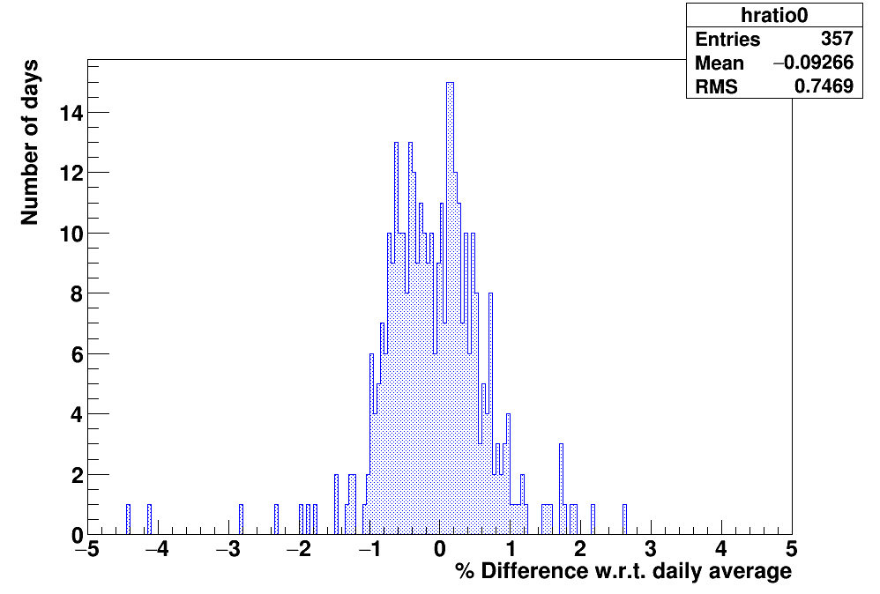
Mean and Error estimate
● For each of the 24 hourly interval (0-24), distribution of the differences w.r.t. daily average evaluated day-by-day.
● Cut within (-1.5 %, +1.5%), about 3 σ
● Extract centroid and its error RMS/√N_{entries}
UTC time=
00:00 – 01:00

Slide 8
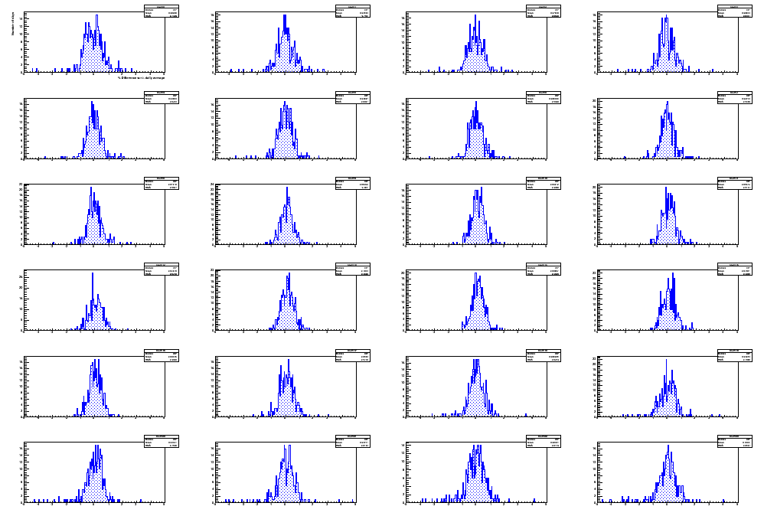
Error estimate
Procedure replicated
for all 24 1-h intervals
and for each day
00:00 – 01:00
01:00 – 02:00
23:00 – 24:00

Slide 9
Amplitude and phase extraction
Amplitude and phase extracted by a single harmonic fit
F(t) = A + B cos ( ω (t - φ) )
ω = 2 π /24, φ in hours
Amplitude B = (0.070 ± 0.007) %
Phase φ = (13.6 ± 0.4) UTC time
Local Time ~ 14h 25’
2024 data (POLA-01)
φ
B

Slide 10
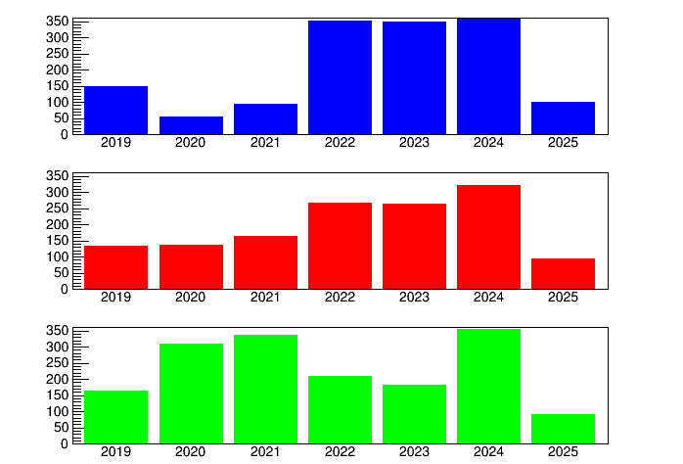
Available days for analysis
● June 2019 – April 2025, about 6-years
● Data corrected for pressure variations
● Only days with full 24-hours coverage selected, for a proper evaluation of daily averages
POLA-01
POLA-03
POLA-04

Slide 11
Daily average rates
POLA-01
POLA-03
● Diurnal variations with respect to these daily averages investigated along the 6-years period
● Preliminary analysis had been carried out for the separate years 2019, 2020,… 2025
POLA-04
AVERAGE

Slide 12
POLA-R results over the years: Running average
● New analysis carried out for all years with a running average (1-year integration time, 6-months steps)
● Effective time evaluated taking into account missing days
integration time
…
2019
2020
2021
2022
2023
2024
2025
Effective times ….

Slide 13
POLA-R results vs time
● Is there any variation of amplitude and phase along the time?
● Nearly constant trend, however detailed analysis for the 6-years period shows some trend..
POLA-01 data, 2024
Time bin=11:00-12:00 UTC

Slide 14
POLA-R results over the years: Amplitude
Increasing trend generally observed, from 2019-2020 (as low as 0.02) to 2025 (0.08-0.10)

Slide 15
POLA-R results over the years: Phase
Clear shift of the phase observed, from 2019-2020 (early morning) to 2024 (early afternoon)

Slide 16
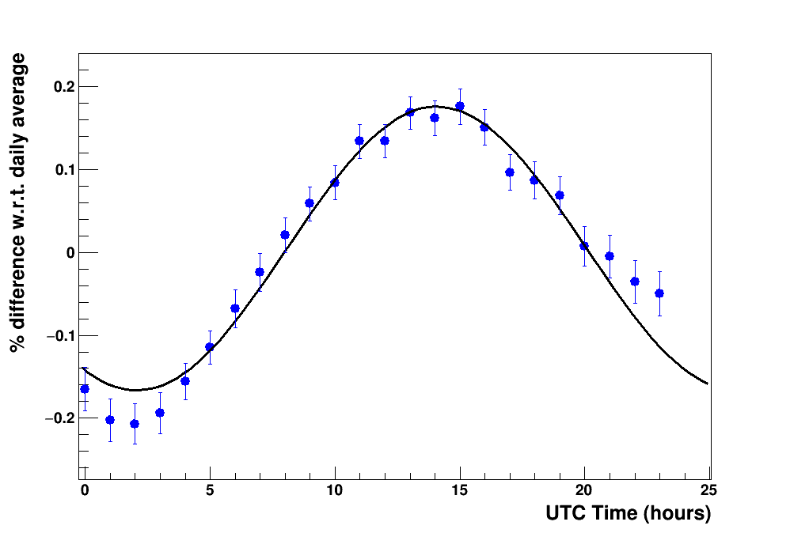
Comparison with neutrons at high latitudes
Barentsburg Neutron Monitor
(not far from POLA-R detectors)
Same analysis strategy applied
A long (22-years) period considered
To compare muon and neutron results, the average from the 3 POLA-R detectors considered
2024 data (BARE NM)
Amplitude B = (0.171 ± 0.006) %
Phase = (14.1 ± 0.2) UTC time
Local Time ~ 15h 10’

Slide 17
Neutron and muon comparison
● Amplitudes for neutrons are generally higher (0.1-0.2 %) than for muons (0.05-0.1 %)
● Increasing trend of the amplitude over the last years (Solar Cycle 25) both for neutrons and muons
● Overall amplitude trend for neutrons consistent with an 11-years period (sunspot cycle)

Slide 18
Neutron and muon comparison
● A dip in the phase observed near 2019-2020, more pronounced for muons
● Overall phase trend consistent with a 22-years period (magnetic field cycle)
Findings about amplitude and phase trends in agreement with what observed by other authors

Slide 19
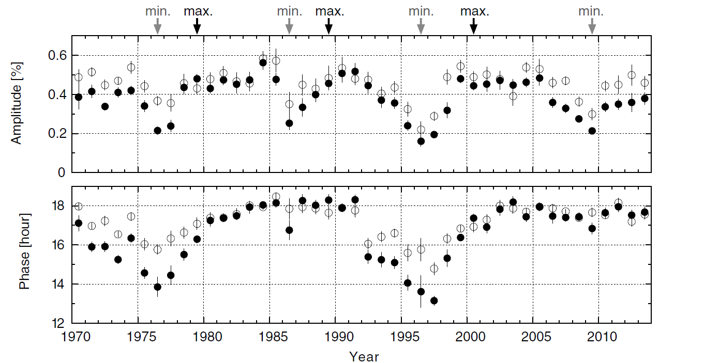
Neutron and muon comparison
● Nagoya Muon Telescope
○ Neutron Monitor
11 years
22 years
Munakata et al., ApJ 2014

Slide 20
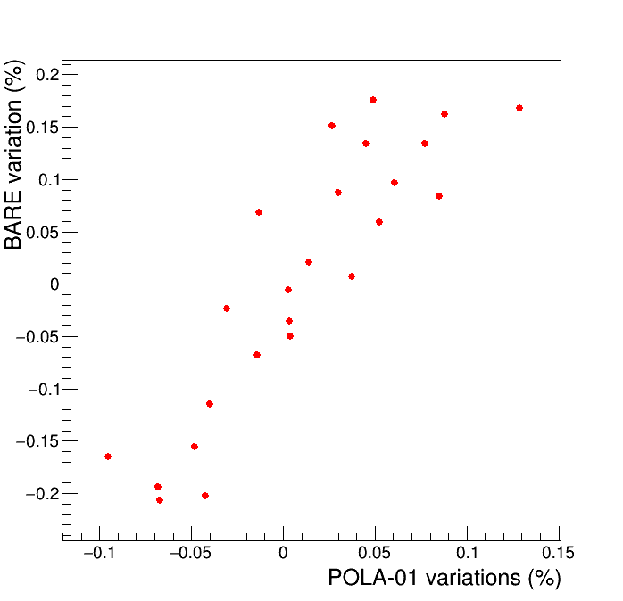
Correlation among POLA-R detectors and with Barentsburg NM
Diurnal variations in the three POLA-R detectors are reasonably correlated among them and with the Barentsburg NM
POLA1-POLA3: r=0.63+/-0.13
POLA1-POLA4: r=0.86+/-0.06
POLA3-POLA4: r=0.49+/-0.16
POLA1-BARE: r= 0.89 +/-0.05

Slide 21
Checks of the temperature influence
To investigate possible influence of temperature variation along the day, a correlation analysis of the temperature-rate diurnal variation carried out, with the same analysis strategy
No apparent correlation is seen
Correlation factor= 0.09 +/-0.21

Slide 22
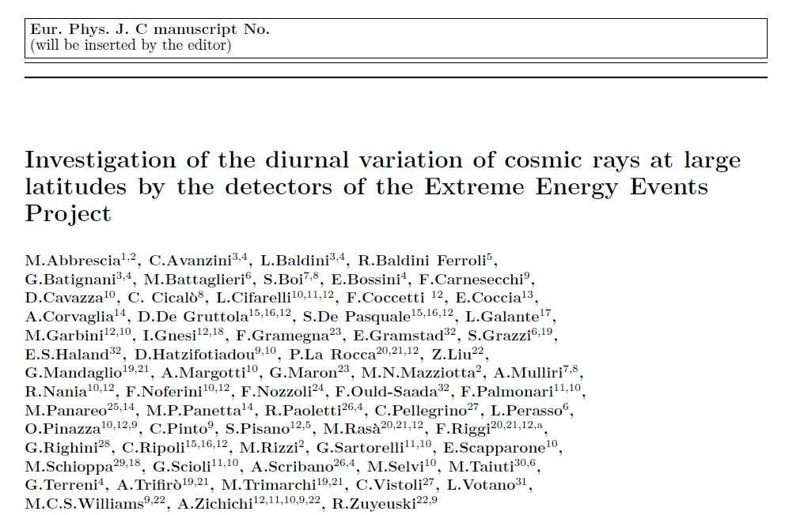
Draft preparation
If no major objections will come to this analysis, a paper draft is being finalized and will soon be circulated..

Slide 23
Organization of the paper
Abstract
1 Introduction
2 Experimental setup
2.1 The observation site
2.2 The POLA-R detectors
2.3 Corrections and data selection
3 Analysis of diurnal modulation
3.1 Procedure
3.2 Results
4 Concluding remarks
+ 12 figures

Slide 24
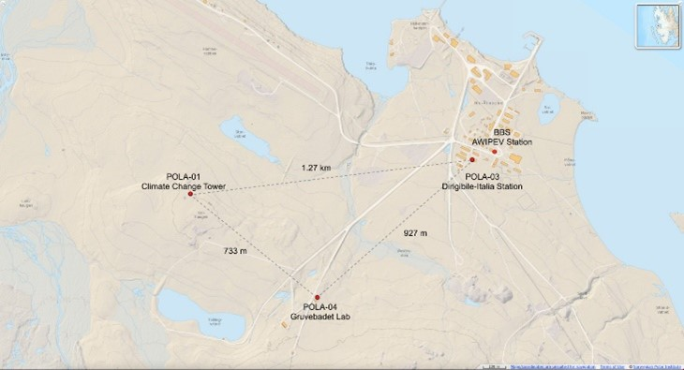
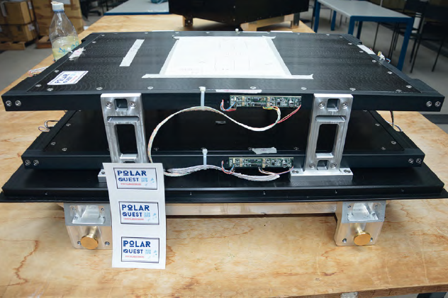
List of figures / 1 & 2
Fig. 1:
Fig. 2:

Slide 25
List of figures / 3
POLA-01
POLA-03
POLA-04
POLA-Average

Slide 26
List of figures / 4

Slide 27
List of figures / 5

Slide 28
List of figures / 6

Slide 29
List of figures / 7

Slide 30
List of figures / 8

Slide 31
List of figures / 9

Slide 32
List of figures / 10

Slide 33
List of figures / 11

Slide 34
List of figures / 12

