Slide 1
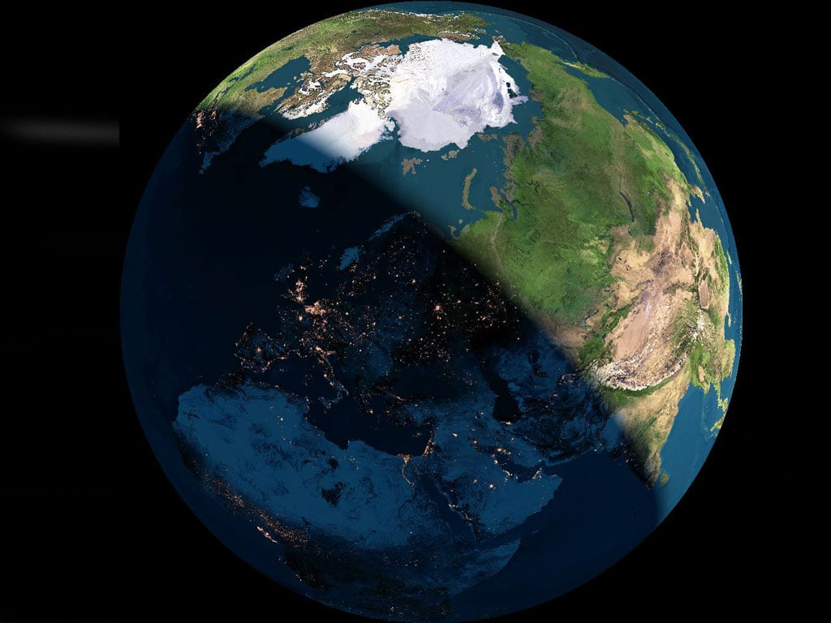
Diurnal analysis of cosmic ray data from POLA-R detectors
A preliminary report
F.Riggi
Dept.Physics and Astronomy and INFN Catania
&
Centro Fermi
EEE Meeting, July 7-8, 2025

Slide 2
Cosmic Ray variations
The flux of cosmic rays in the eliosphere and at the top of the Earth’s atmosphere changes over time, with transient (Forbush, Ground Level Enhancement) and periodic variations.
Periodic variations:
Long term variations (11 / 22 years, solar cycle)
Short term variations (27 days, average Sun rotation period)
Diurnal modulations
All these variations in CR flux are influenced by multiple factors, including solar activity, interplanetary field and geomagnetic activity

Slide 3
Diurnal variations
The diurnal variation of CR flux measured at ground is an important – although with small amplitude – feature of the data collected by a CR detector.
Both charged particles and neutrons undergo these variations.
Periodic variations occurring within a day (diurnal variations) are associated to changing conditions in the Interplanetary Magnetic Field (IMF) and Earth’s magnetosphere.
Two main aspects characterize the origin of such variations:
Radial convection (highest CR flux with solar wind directed towards the Earth)
Inward diffusion along the IMF (dispersion of CR in all directions)
Interplay of these two factors determine the amplitude (% variation w.r.t. daily average rate) and phase (time at which maximum is observed) of the diurnal modulation

Slide 4

Diurnal variations
Maximum expected to happen at 18 local time. However, due to Earth magnetic field bending, maximum occurs a few hours earlier.
Orbital speed, 30 km/s
06:00 Loc.Time
Earth
Sun
00:00 Loc.Time
12:00 Loc.Time
ω
View from above ecliptic plane
CR particles co-rotate with the interplanetary magnetic field (IMF). At Earth (1 A.U, from Sun), speed of corotation: 400 km/s, along the Earth orbital movement
18:00 Loc.Time

Slide 5
More information on the physics behind
M.A.Forman and L.J. Gleeson, Cosmic-ray streaming and anisotropies, Astrophys. Space Sci. 32, 77–94, 1975.
J.W.Bieber and M.A.Pomeranz, A unified theory of cosmic ray diurnal variations, Geophys. Res. Lett. 10, 920–923, 1983.
L.Dorman, Cosmic rays in magnetospheres of the Earth and other planets, Springer, 2009.

Slide 6
Features of diurnal variations
Diurnal variations have been observed since a long time.
Observed amplitude of the order of 0.1-0.3 %.
Phase (local time for the maximum) around 12h-14h local time, with large dispersion around it.
Thompson, Phys.Rev.54(1938)

Slide 7
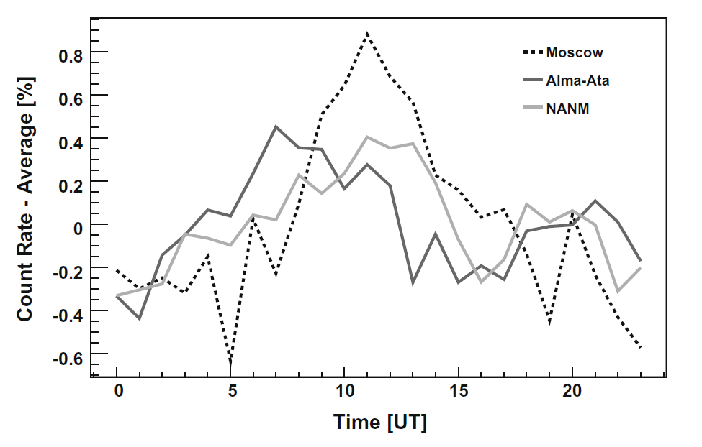
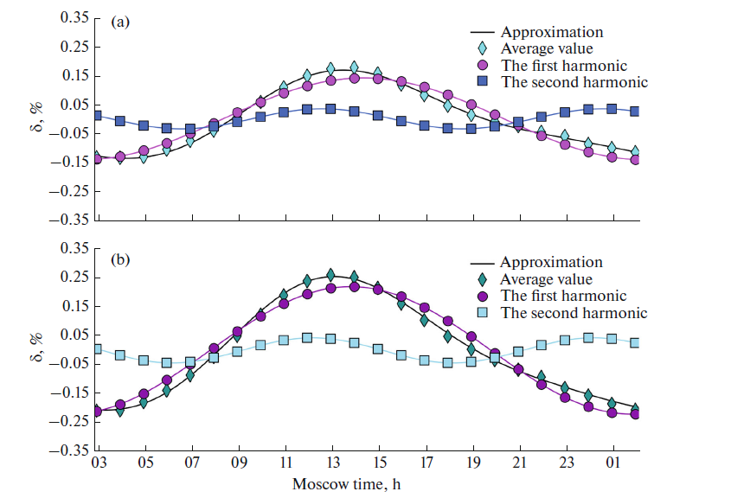
Features of diurnal variations
Although largely studied, diurnal variations are still an important topic for CR investigations, even today.
Detailed features depend on
Coordinates of the observation site (especially latitude)
Solar cycle, year (long term trends)
Sun magnetic polarity
Secondary particles being detected (neutrons, muons)
Maylian, Advances in Space Research(2010)
Kuzmenkova, Bull.Russian Acad. (2023)

Slide 8
A possible diurnal analysis in EEE?
Due to the small expected effect (0.1 %) a stable and long dataset is required
Good candidate: POLA-R detectors
Relatively stable for long periods
Three independent detectors in the same site
Good counting rate (of the order of 30 events/s)
Peculiar location at high latitude
About six years of data available

Slide 9
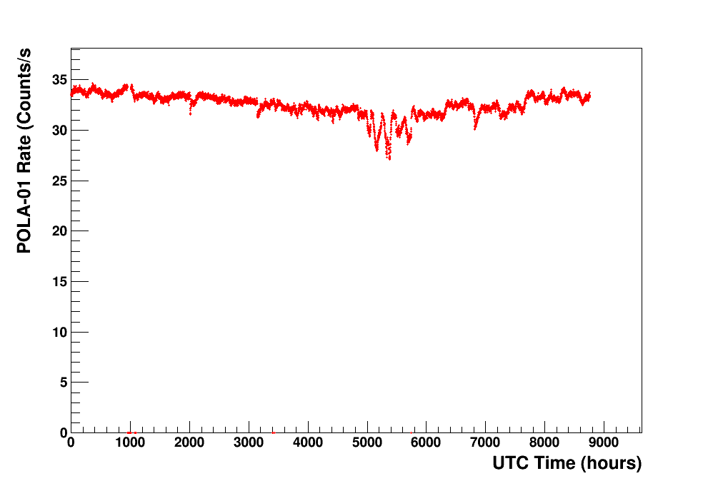
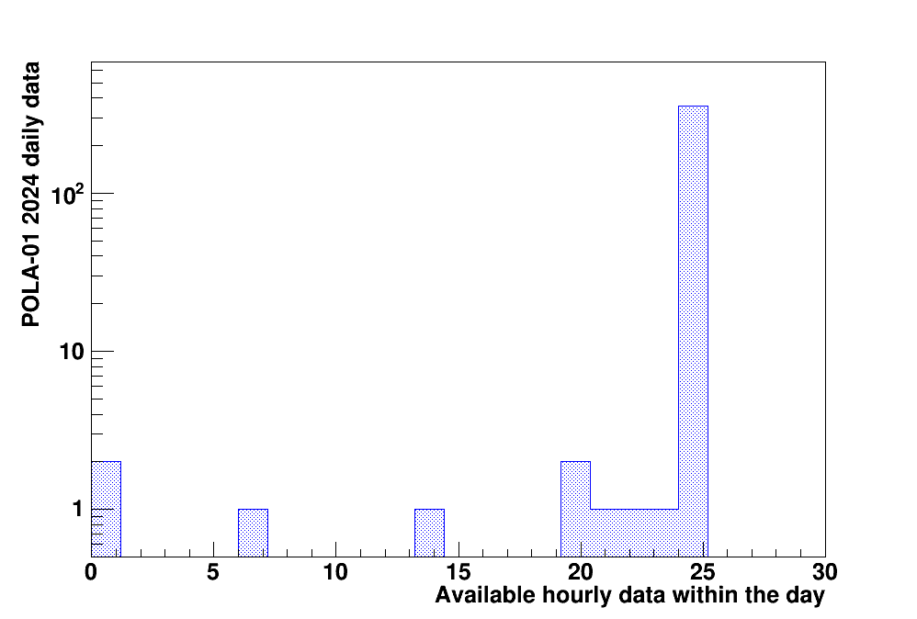
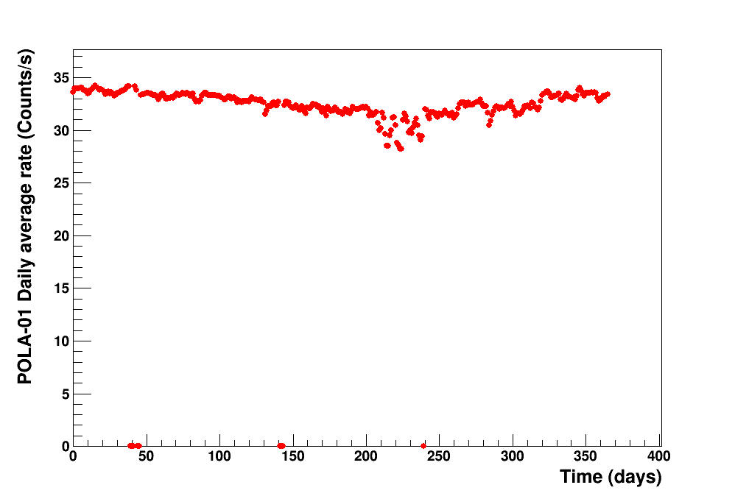
Dataset example: POLA-01 (Year 2024)
● A few days have hourly missing data
(357 over 366 in 2024 have a complete coverage).
● Only days with complete coverage (24 hours) retained for daily analysis
● All data corrected by pressure variations
1 hour step
Daily average

Slide 10
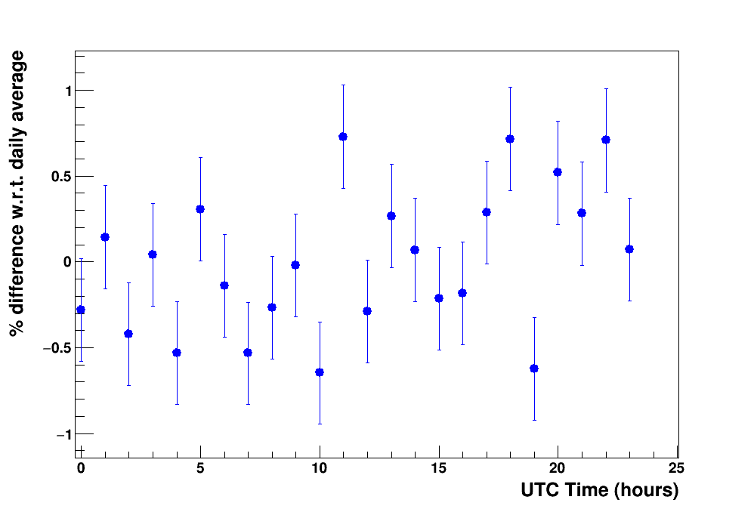
Analysis strategy
● Daily averages considered, with selection of full-coverage days
● Evaluate the hourly difference w.r.t. average
1 day
● Statistical fluctuations in each point of the order of 0.3-0.5 % (about 100k events collected in 1 hour).
● No defined trend seen in a single day, due to the small expected effect (0.1% or less).
● Increase statistics over many days

Slide 11
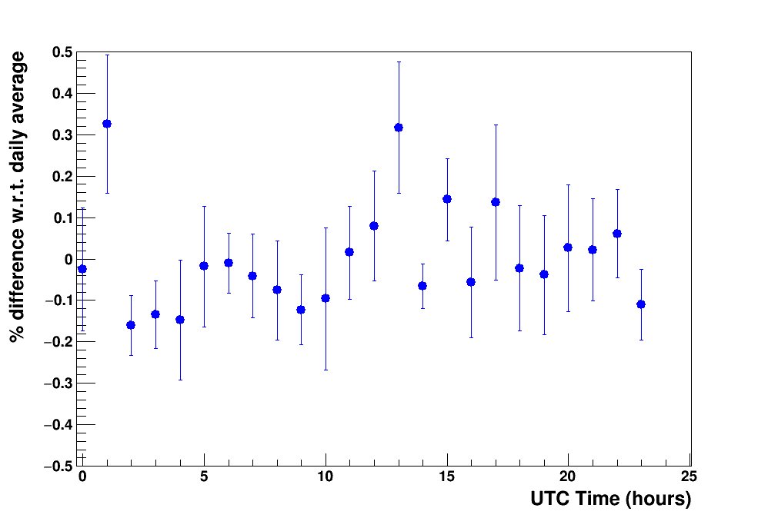
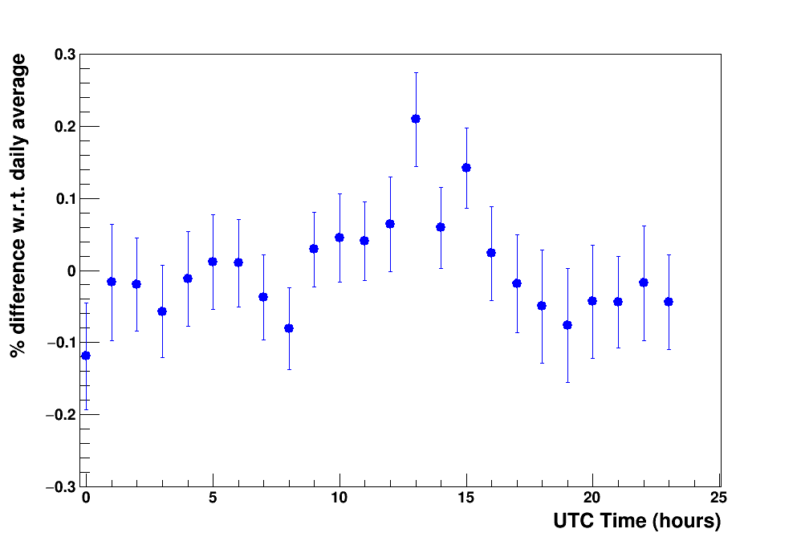
Increase statistical significance
10 days
50 days

Slide 12
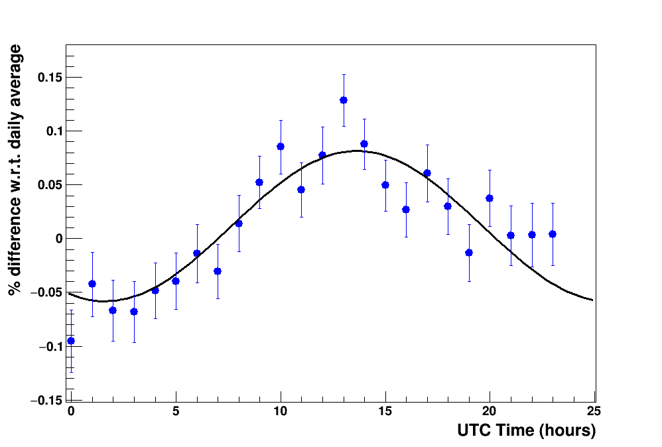
Increase statistical significance
10 days
1 year
50 days

Slide 13
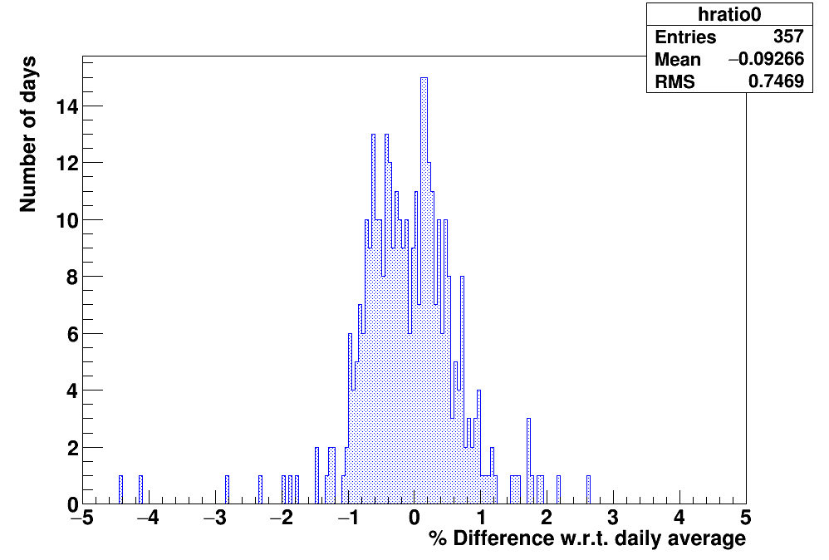
Mean and Error estimate
● For each of the 24 hourly interval (0-24), distribution of the differences w.r.t. daily average evaluated day-by-day.
● Cut within (-1.5 %, +1.5%), about 3 σ
● Extract centroid and its error RMS/√N_{entries}
UTC time=
00:00 – 01:00

Slide 14
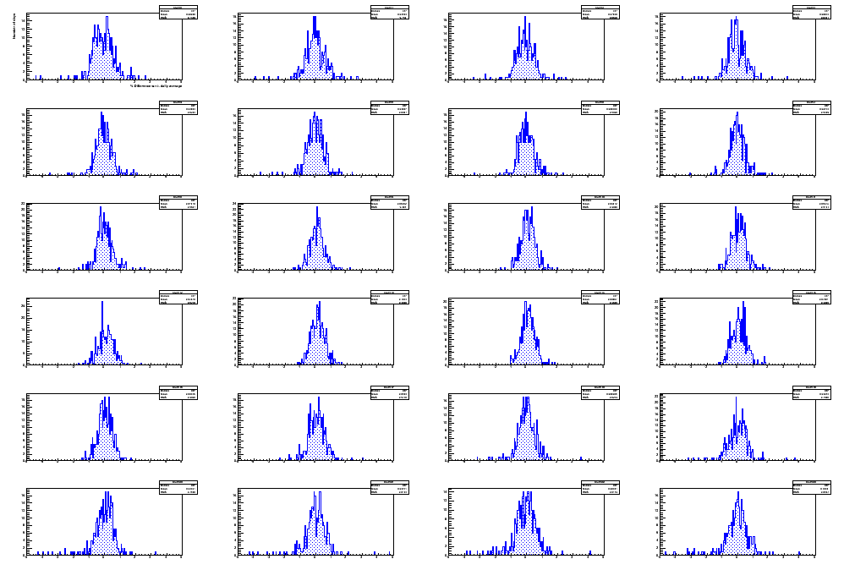
Error estimate
Procedure replicated
for all 24 1-h intervals
and for each day
00:00 – 01:00
01:00 – 02:00
23:00 – 24:00

Slide 15
Amplitude and phase extraction
Amplitude and phase extracted by a single harmonic fit
F(t) = A + B cos ( ω (t - φ) )
ω = 2 π /24, φ in hours
Amplitude B = (0.070 ± 0.007) %
Phase φ = (13.6 ± 0.4) UTC time
Local Time ~ 14h 25’
2024 data (POLA-01)
φ
B

Slide 16
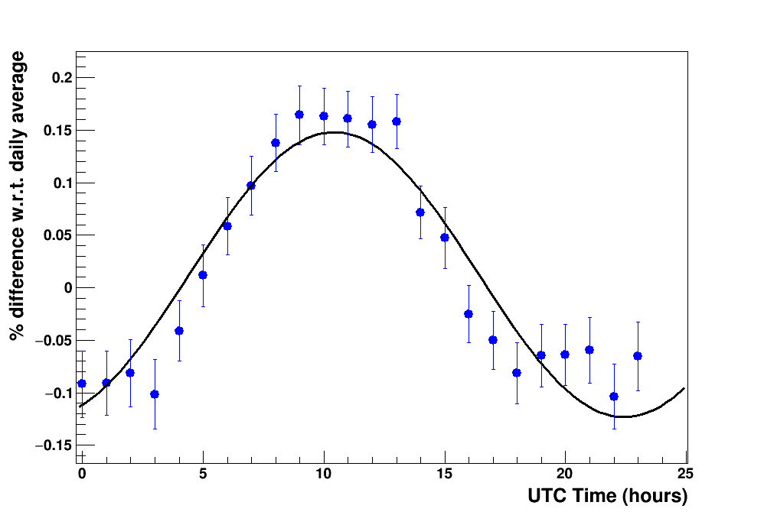
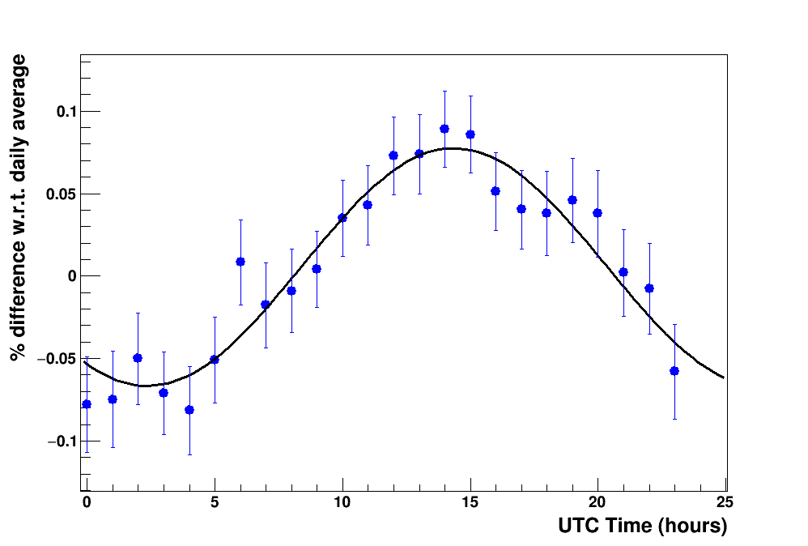
Results for POLA-01, POLA-03 and POLA-04 (Year 2024)
Detector | Amplitude (%) | Phase (UTC Time)
POLA-01 | 0.070 ± 0.007 | 13.6 ± 0.4
POLA-03 | 0.136 ± 0.008 | 10.4 ± 0.2
POLA-04 | 0.072 ± 0.007 | 14.3 ± 0.4
2024 data (POLA-01)
2024 data (POLA-03)
2024 data (POLA-04)

Slide 17
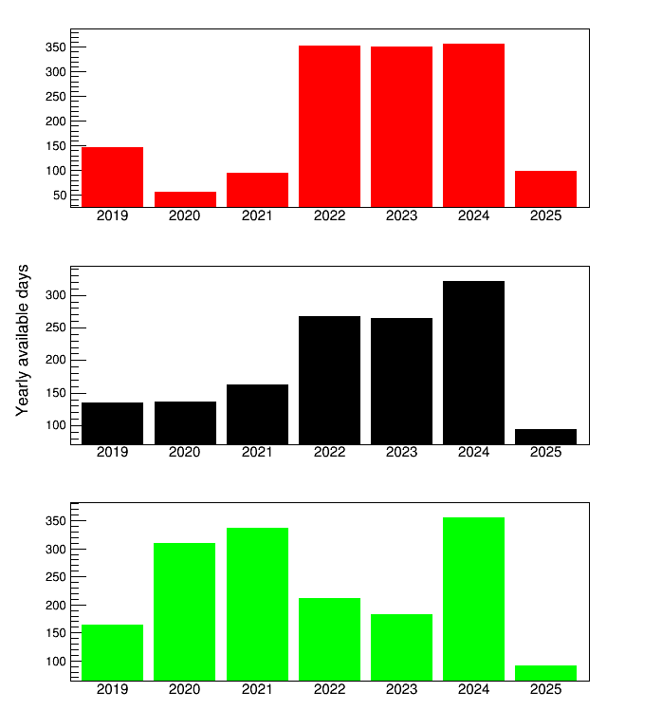
POLA-R results over the years: Available days for analysis
POLA-01
POLA-03
POLA-04

Slide 18
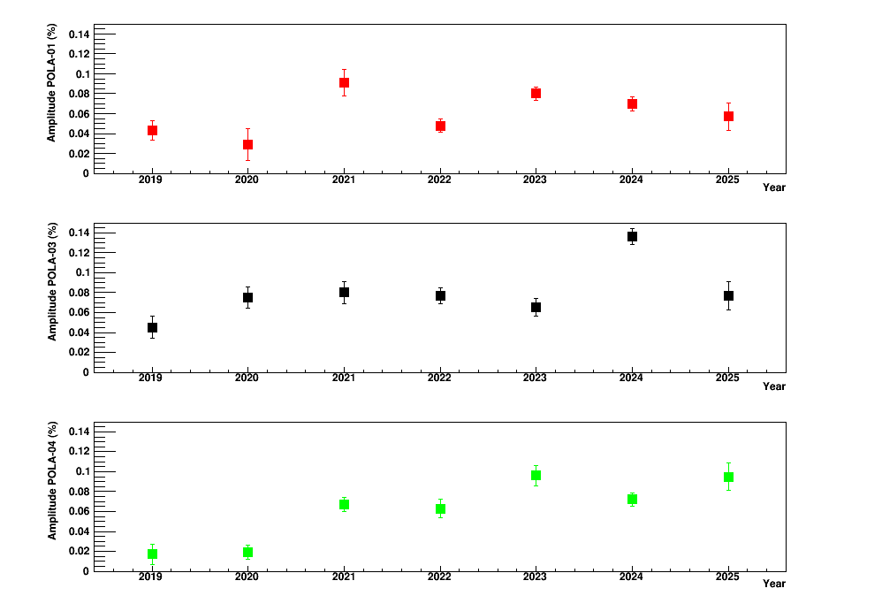
POLA-R results over the years: Amplitude
POLA-01
POLA-03
POLA-04

Slide 19
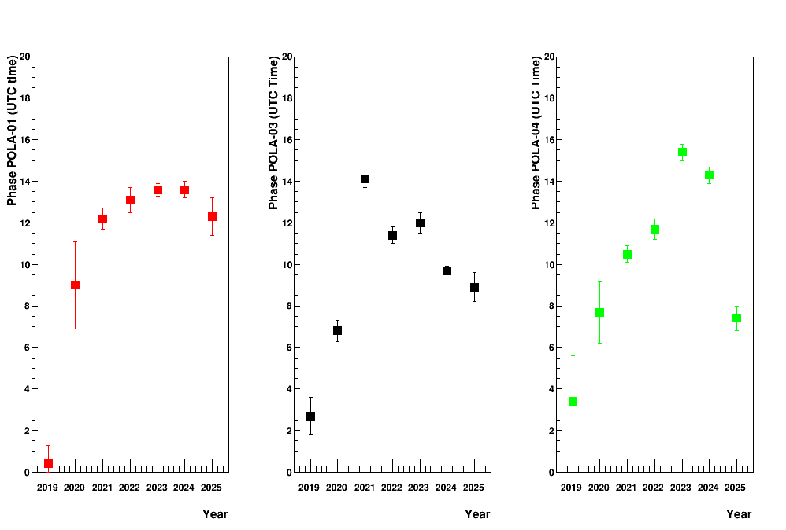
POLA-R results over the years: Phase
POLA-01
POLA-03
POLA-04

Slide 20
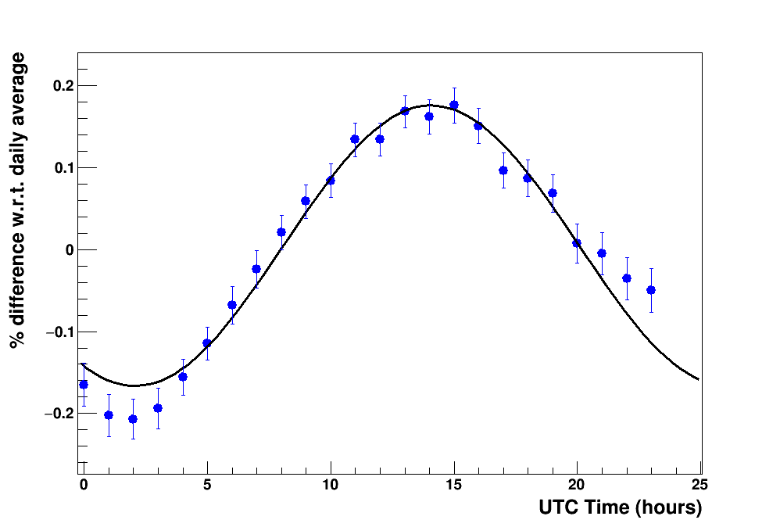
What about neutrons from NM stations at high latitudes?
Barentsburg Neutron Monitor
(not far from POLA-R detectors)
Same analysis strategy applied
2024 data (BARE NM)
Amplitude B = (0.171 ± 0.006) %
Phase = (14.1 ± 0.2) UTC time
Local Time ~ 15h 10’

Slide 21
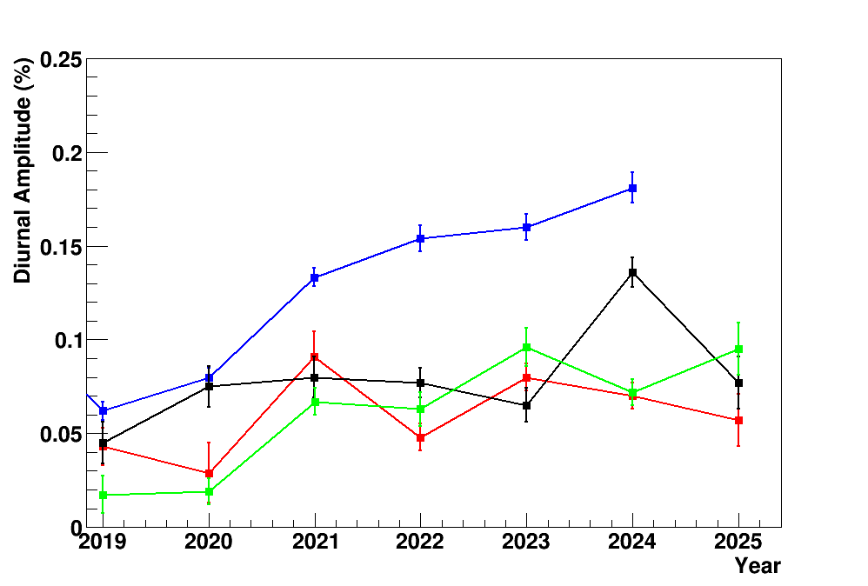
Neutron and muon comparison
● Amplitudes for neutrons are generally higher (0.1-0.2 %) than for muons (0.05-0.1 %), as observed by other authors
● Increasing trend of the amplitude over the last years (Solar Cycle 25) both for neutrons and muons
Neutron Monitor
POLA-01 POLA-03 POLA-04

Slide 22
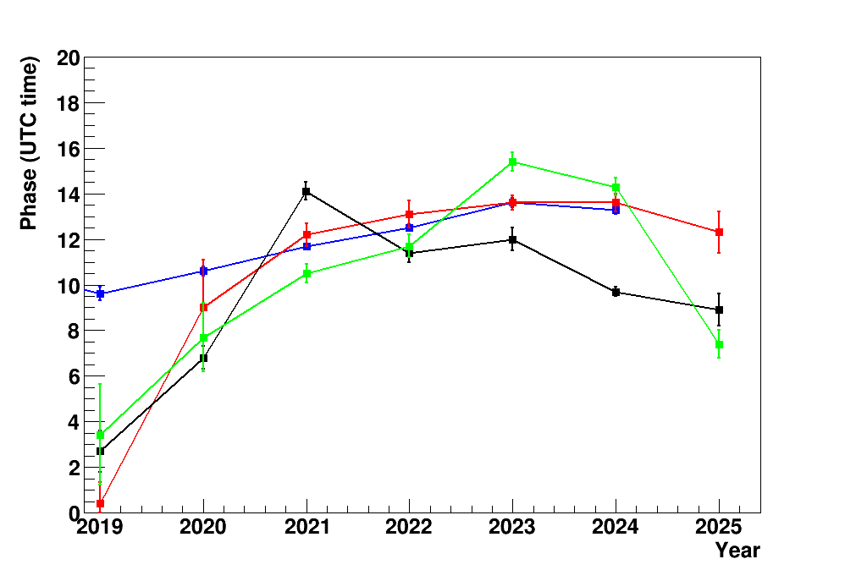
Neutron and muon comparison
Phase (time of maximum) also shows some evidence of variations along the years.

Slide 23
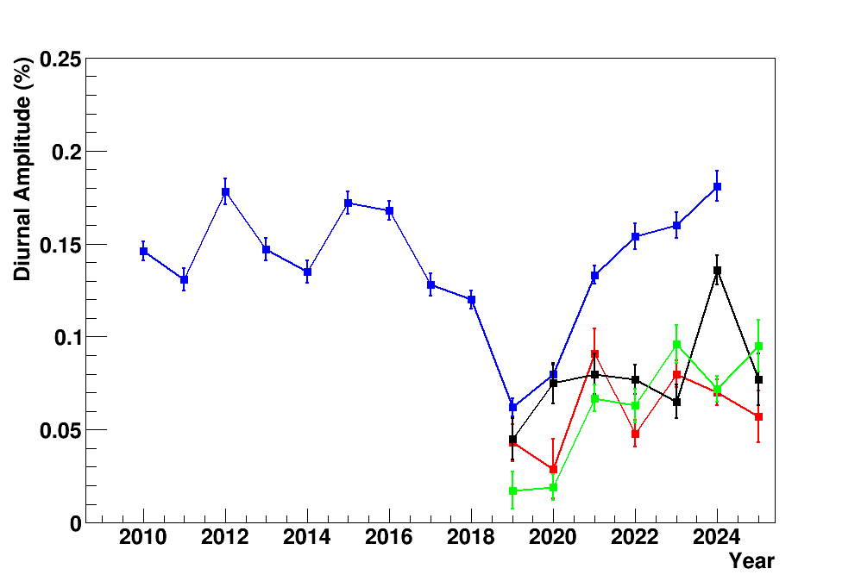
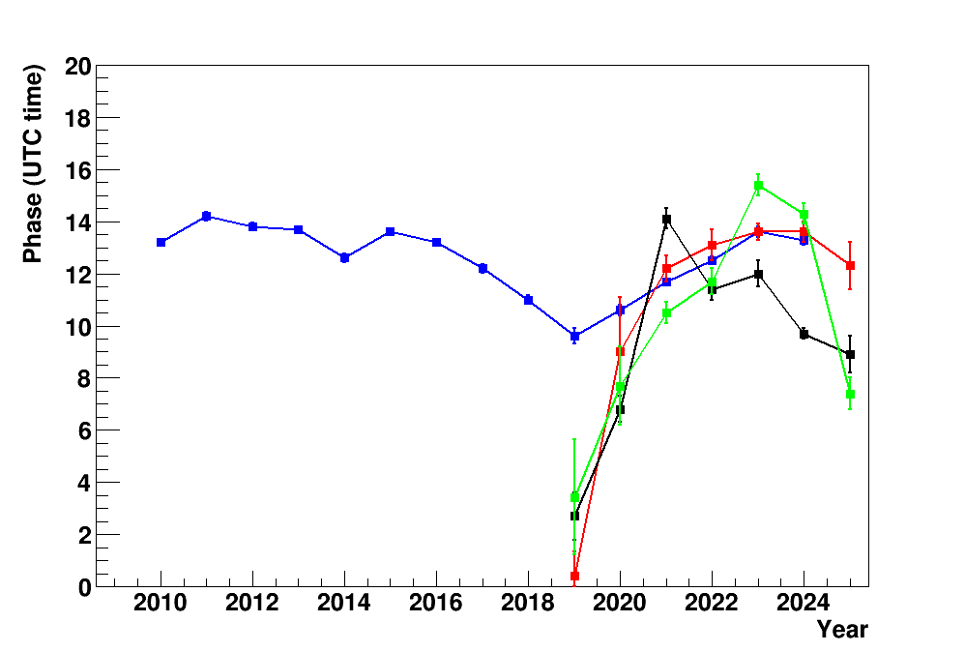
Neutron and muon comparison
Long term (15-years) trend for neutrons (2010-2025). Minima observed near 2019.
Amplitude
Phase

Slide 24
Preliminary summary
● Complete analysis of the POLA-R dataset (2019-2025) in Ny-Ålesund carried out to search for diurnal variations.
● Small increase in the CR flux (as small as 0.1% or less) observed at UTC Time mostly around 10h-14h.
● Results from muons compared with those from neutrons at similar latitude.
● Amplitude and phase extracted for all years 2019-2025, some trend observed.
In progress
● Further check on data quality (residual influence of pressure and temperature)
● Correlation analysis between various POLA-R and POLA-R/NM
● Possible extension to other high latitude NM stations
● Plan to prepare a draft for a paper

