Slide 1
SALE-01 and SALE-02:
issues with HV
D. De Gruttola
26/04/2017
EEE collaboration meeting

Slide 2
SALE-02
this telescope is new (working correctly for ~1 month)
oxidation in ch 2 (+) and 3 (+)
HV+ connector has been changed 2 weeks ago (problem fixed)
same operation to be done in ch 2 (tomorrow?)
SALE-01
this telescope is active since ~10 years
the rate is lower than usual (~1/3)
issues with HV (high currents and unstable HV)
chamber 1 and 2 are problematic
oxidation in ch 2 (+)
white substance produced close to the negative HV connector in ch 1
26/04/2017
EEE collaboration meeting
2

Slide 3
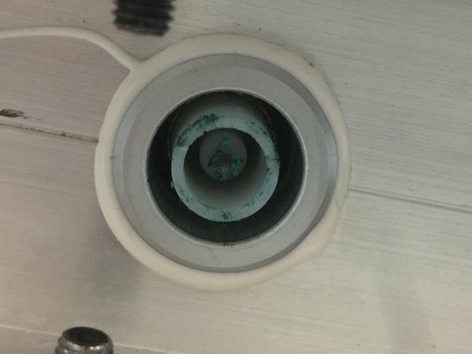
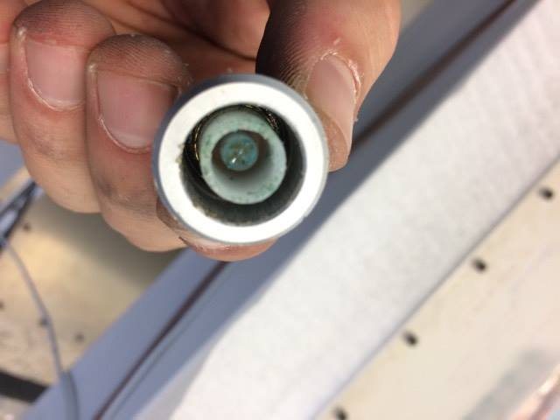
SALE-02
oxidation in ch 3 (+)
similar status for the connector of the HV box
while trying to clean it, the connector went completely broken
the connector inside the
chamber has been replaced
the chamber is correctly working now
26/04/2017
EEE collaboration meeting
3

Slide 4
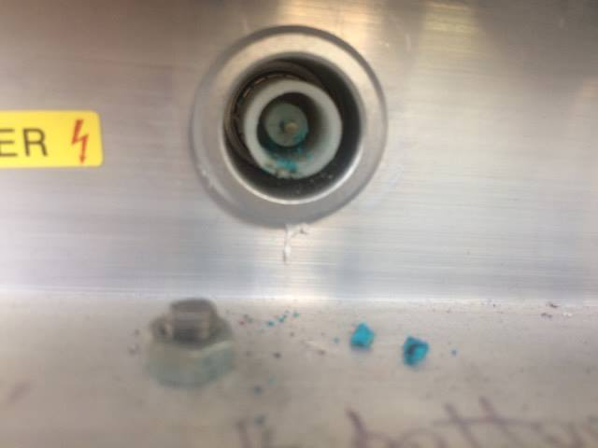
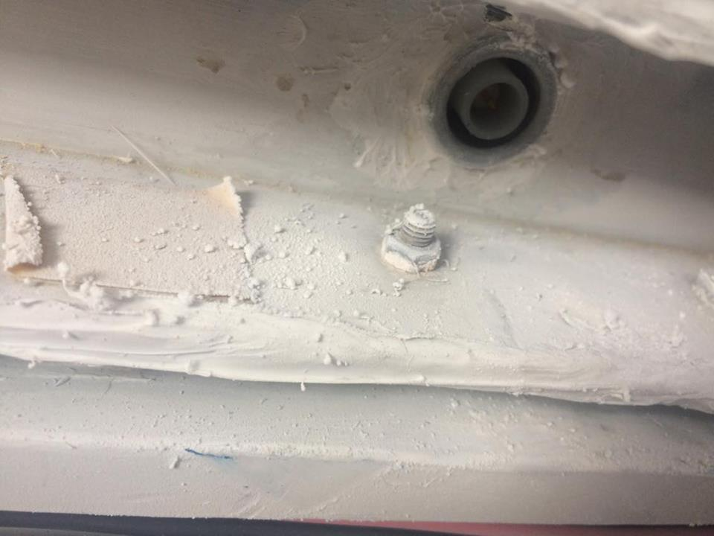
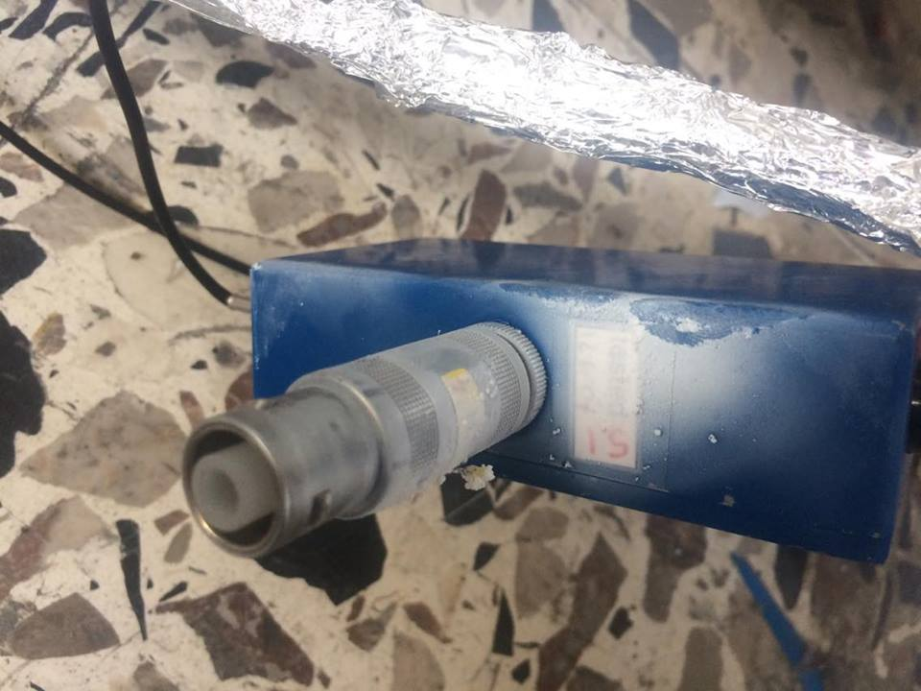
SALE-01
oxidation in ch 2 (+)
connector to be cleaned or replaced
at the moment it is possible to power on the chamber, but the current is high (~10 μA)
what reaction did occur?
this happened in the past on some telescopes
current is high (~10 μA) and the chamber is noisy
26/04/2017
EEE collaboration meeting
3

Slide 5
Conclusions
the two telescopes have so different ages (SALE-02 is new)
they show similar issues at the same time
the freon bottle was changed more or less at the same time
is this happening on other telescopes? (should we be worried about the gas in this case?)
two connectors have most likely to be replaced in the two telescopes
one is available (not sure it works, as it is an old one taken by a chamber..)
at least one is needed (to be ordered at CERN?)
26/04/2017
EEE collaboration meeting
5

