Slide 1
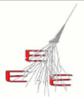
Performance of MRPC telescopes of the EEE Project
E. Bossini, C. Cicalò, D. De Gruttola,
I. Gnesi, M. Garbini, S. Grazzi, M.P. Panetta
26/04/2017
EEE meeting

Slide 2
Status
time slewing correction applied
σ_{t} < 200 ps
a few results to be reviewed (too high σ_{t})
some big contribution outside the peak (most likely related to clock)
many telescopes show an offset in the Δt distribution
some examples in the next slides (data from Run 3)
26/04/2017
EEE meeting
2

Slide 3
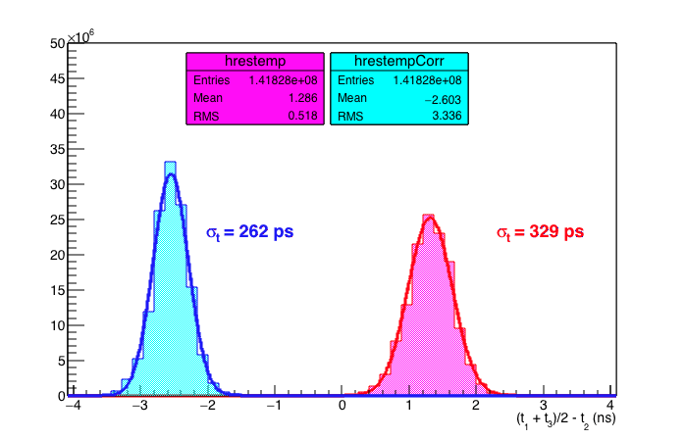
ALTA-01
σ_{t} = 214 ps
σ_{t} = 270 ps
26/04/2017
EEE meeting
3

Slide 4
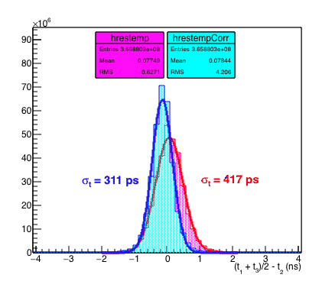
BOLO-01
σ_{t} < 255 ps
σ_{t} < 342 ps
σ_{t} = 209 ps
σ_{t} = 280 ps
26/04/2017
EEE meeting
4

Slide 5
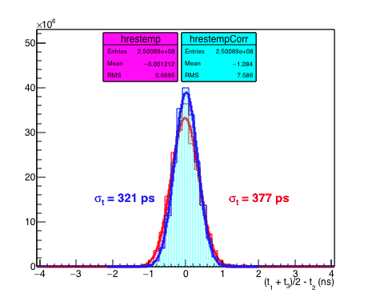
BARI-01
σ_{t} = 263 ps
σ_{t} = 309 ps
26/04/2017
EEE meeting
5

Slide 6
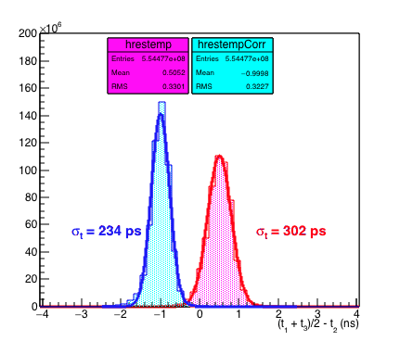
TORI-01
σ_{t} = 192 ps
σ_{t} = 247 ps
26/04/2017
EEE meeting
6

Slide 7
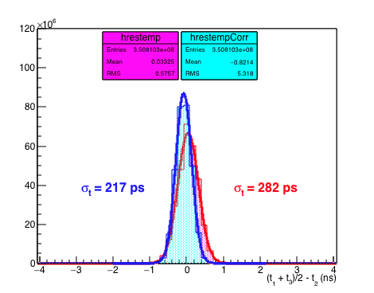
BOLO-03
σ_{t} = 178 ps
σ_{t} = 231 ps
26/04/2017
EEE meeting
7

Slide 8
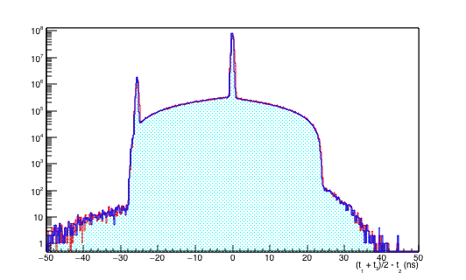
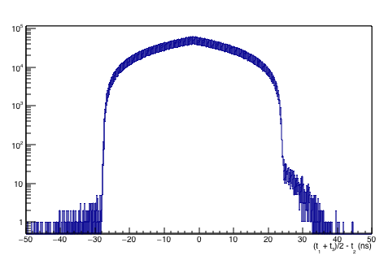
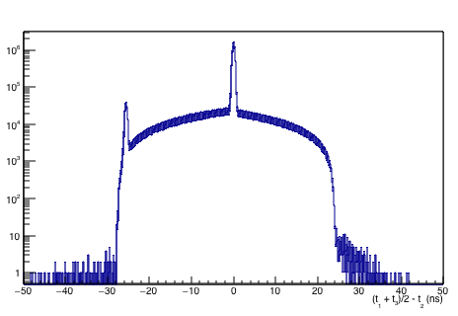
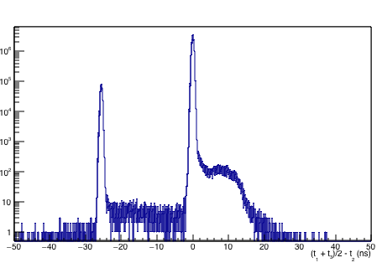
BOLO-03 (log y scale)
whole Run 3
Nov 2016
Dec 2016
Jan 2017
no clock card here
no clock card here
in part of this period
clock card ok
but what is the other peak? →
→ trigger arriving at the next clock?
26/04/2017
EEE meeting
8

Slide 9
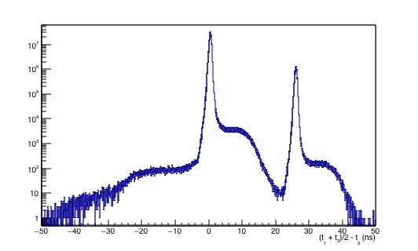
TORI-03 (log y scale)
whole Run 3
clock card ok
but what is the other peak? →
→ trigger arriving at the next clock?
26/04/2017
EEE meeting
9

Slide 10
Status
time slewing improves time res of about 20%
different values to be understood
offsets to be understood
ALTA01 offset
ANCO01 forse bad clock
AREZ01 ok
BARI01 ok
BOLO01 ok
BOLO02 small offset
BOLO03 ok
BOLO04 small offset
CAGL01 small offset
CAGL02 forse bad clock
CAGL03 forse bad clock
CATA01 ok
CATA02 ok
CATZ01 ok
CERN01 small offset
CERN02 forse bad clock
GROS01 small offset
GROS02 forse bad clock
LAQU01 small offset
LAQU02 forse bad clock
LECC01 small offset
LECC02 small offset
LODI01 small offset
LODI02 small offset
PATE01 small offset
PISA01 offset
REGG01 forse bad clock
SALE01 forse bad clock
SALE02 forse bad clock
SAVO01 ok
SAVO02
SAVO03 small offset
TERA01 small offset
TORI01 offset
TORI03 small offset
TORI04 ok
TRAP01 small offset
TREV01 ok
TRIN01 ok
VIAR01 offset
VIAR02 forse bad clock
this table is not final
(to be studied in different periods)
26/04/2017
EEE meeting
10

Slide 11
Trending plots
data from Run 2 and Run 3
stability garanteed for a few telescopes in the same period
possibility to chose different shorter periods in order to include other telescopes
need to think to a clever way to plot stops in the acquisition
26/04/2017
EEE meeting
11

Slide 12
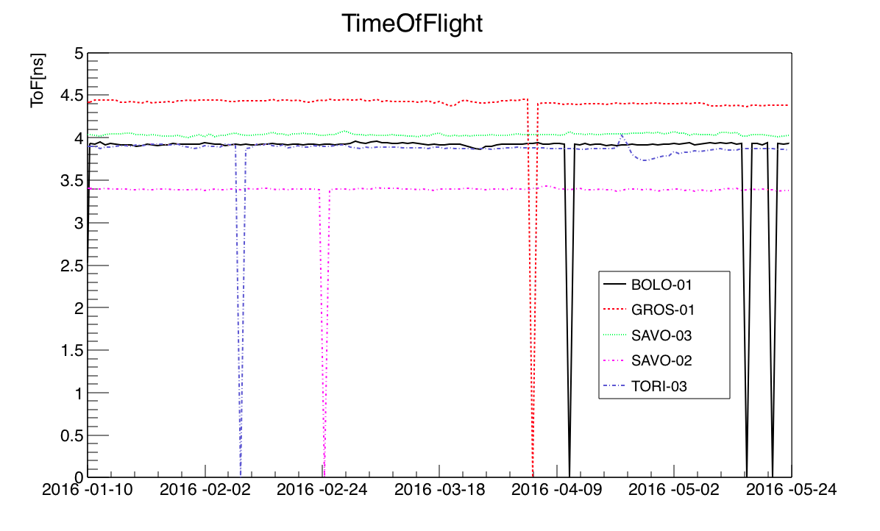
Trending plots
26/04/2017
EEE meeting
12

Slide 13
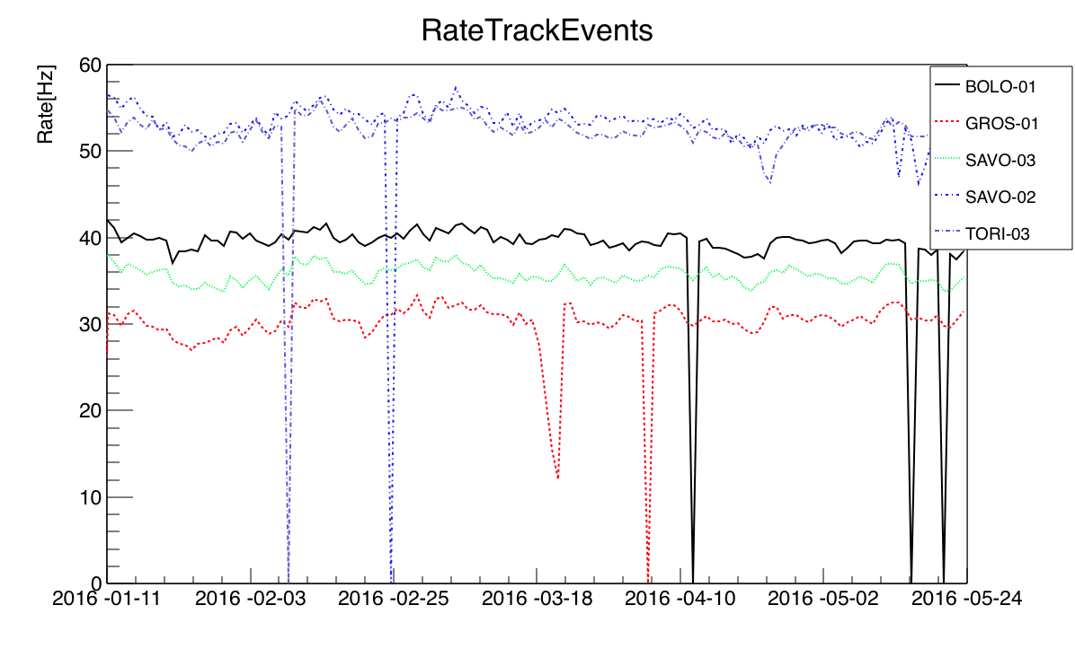
Trending plots
26/04/2017
EEE meeting
13

Slide 14
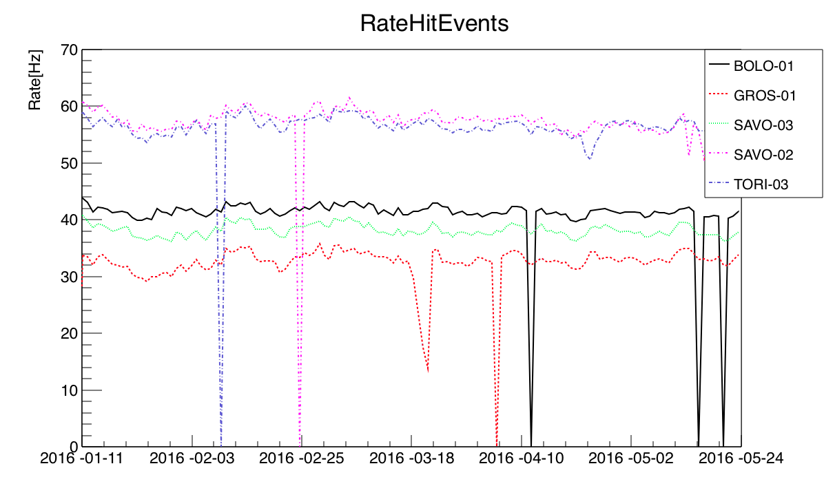
Trending plots
26/04/2017
EEE meeting
14

Slide 15
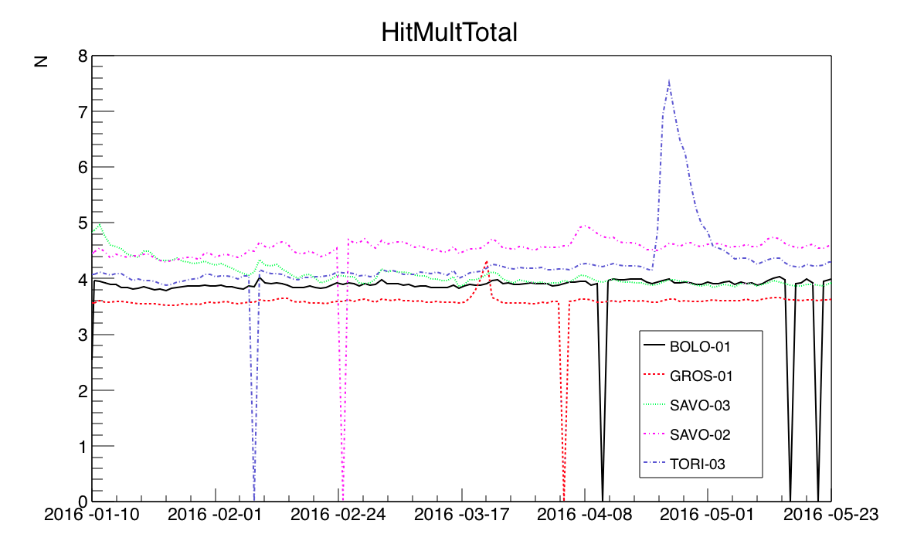
Trending plots
26/04/2017
EEE meeting
15

Slide 16
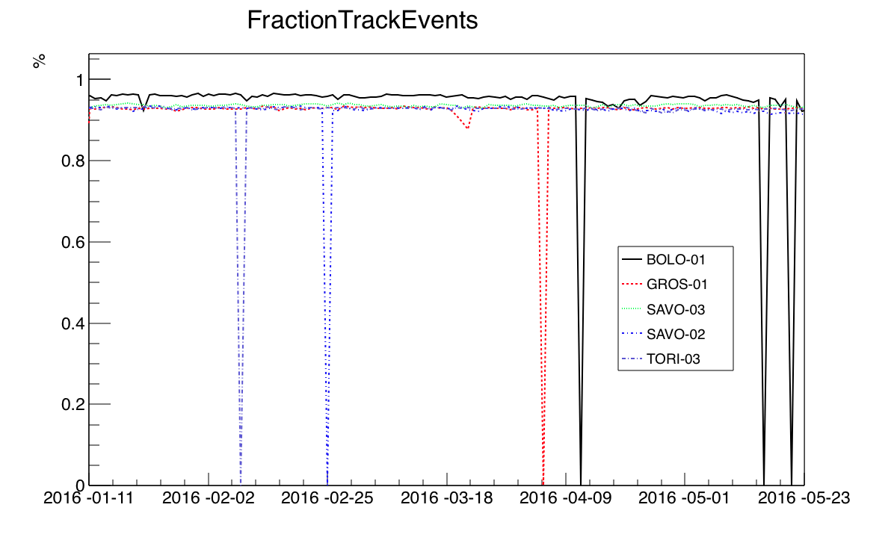
Trending plots
26/04/2017
EEE meeting
16

Slide 17
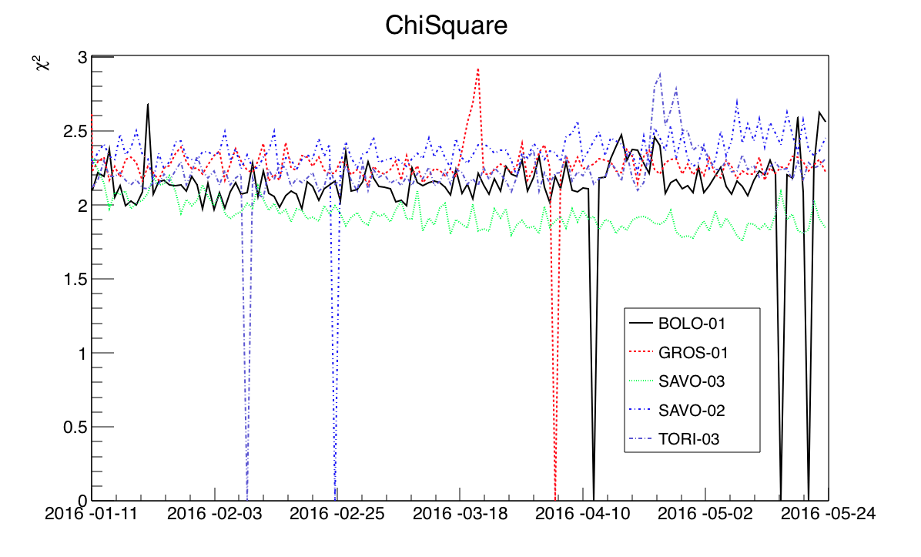
Trending plots
26/04/2017
EEE meeting
17

Slide 18
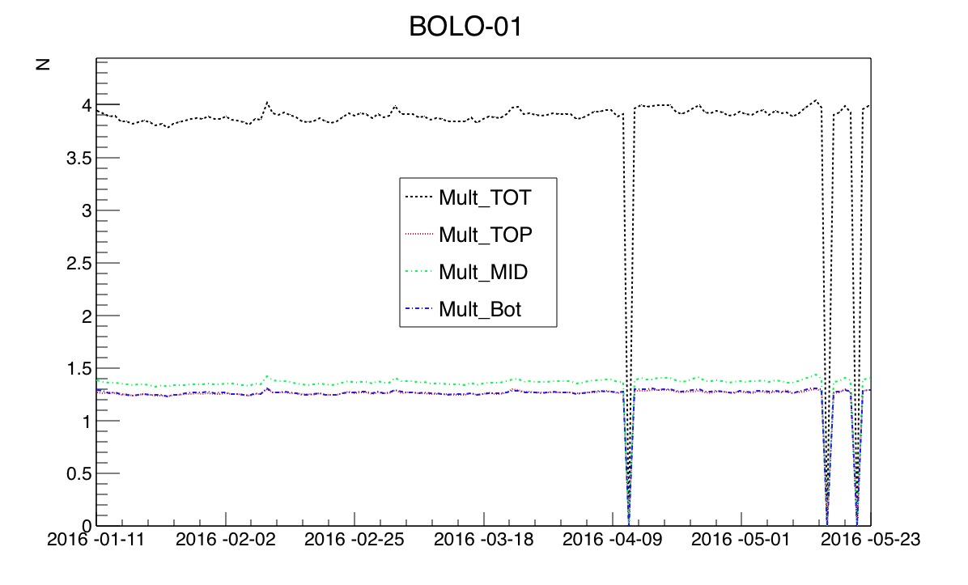
Trending plots
26/04/2017
EEE meeting
18

Slide 19
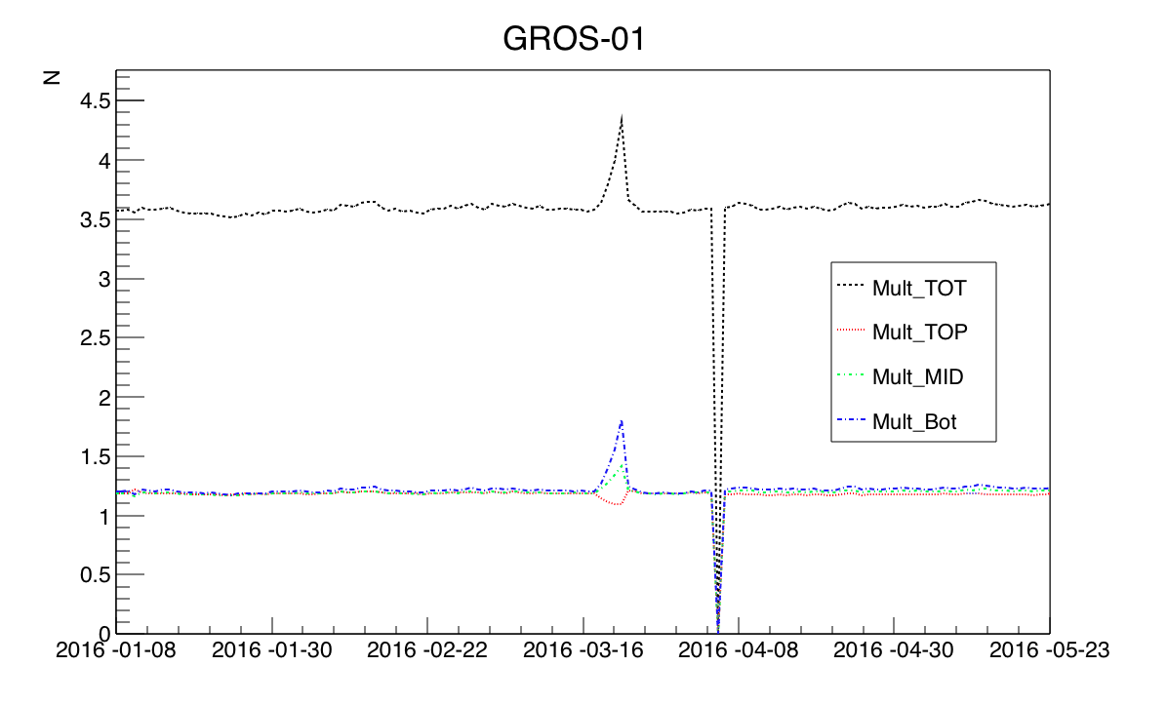
Trending plots
26/04/2017
EEE meeting
19

Slide 20
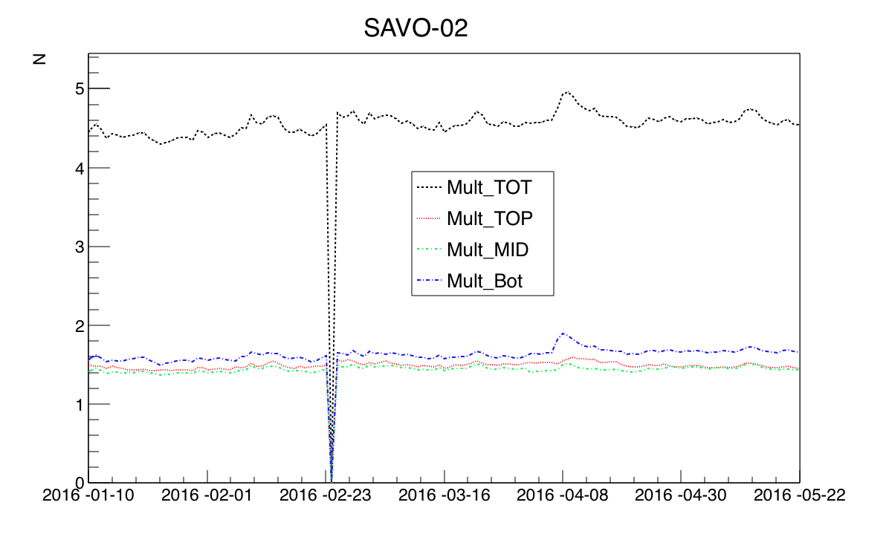
Trending plots
26/04/2017
EEE meeting
20

Slide 21
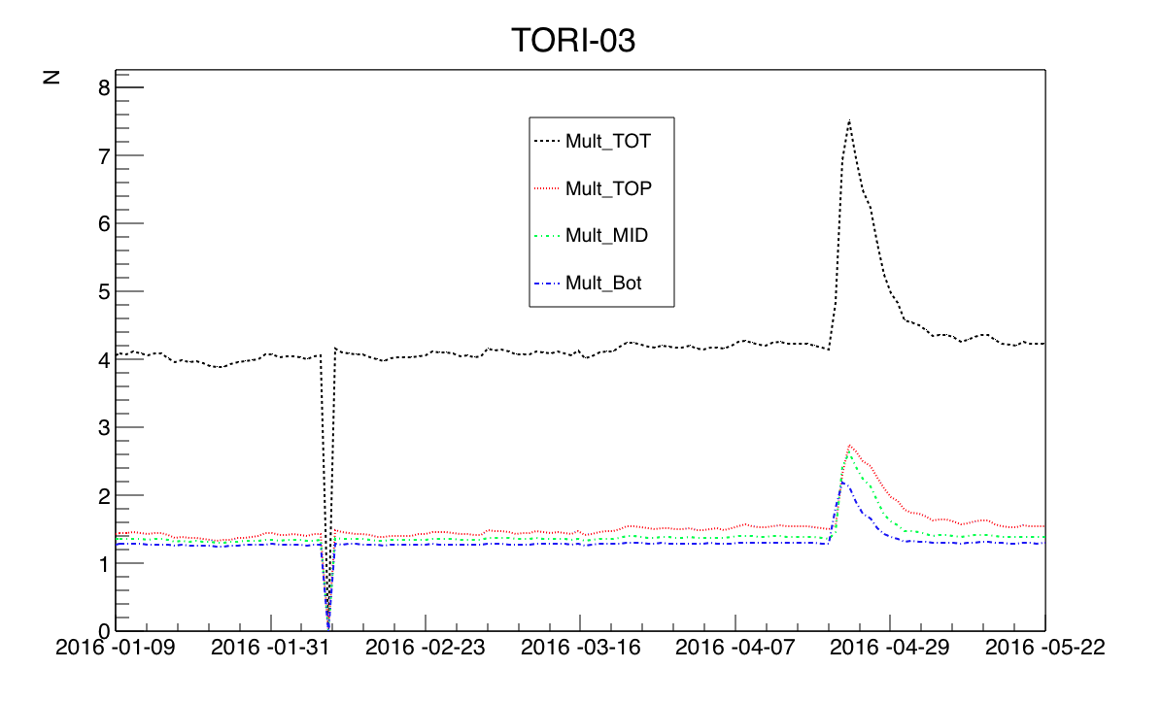
Trending plots
26/04/2017
EEE meeting
21

Slide 22
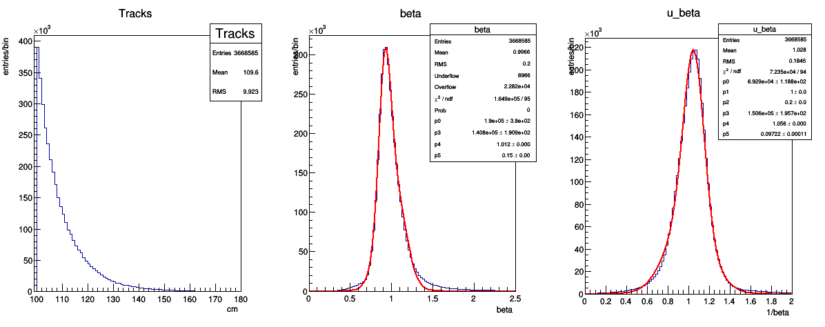
Beta distributions
SAVO-02
TORI-03
26/04/2017
EEE meeting
22

Slide 23
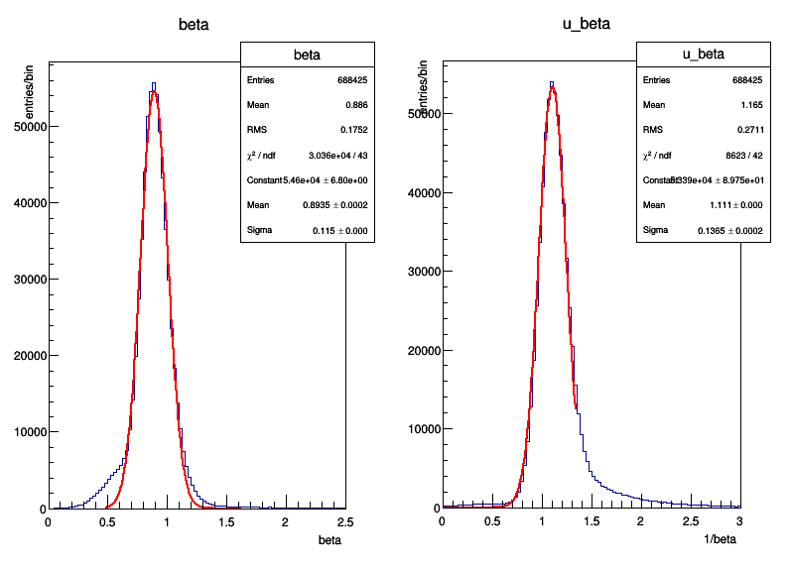
Beta distributions
TRAP-01
in general we need to fit the β and 1/β distributions with two gaussians
26/04/2017
EEE meeting
23

Slide 24
Conclusions
data from Run 2 and Run 3 provide good data for the paper
still room for improvements for time and spatial resolution
need to decide a policy to better show trending plots
efficiency plots shortly ready
currents and HV trendings to be done
finalizing writing in the coming weeks
26/04/2017
EEE meeting
24

