Slide 1
Combined analysis of muon and neutron results from Ny Ȧlesund: preliminary results
O.Pinazza & F.Riggi
in collaboration with L.Hertle & M.Schrön (Leipzig)

Slide 2
A series of intense events, with solar flares and geomagnetic storms occurred since May 10, 2024
This was the largest in the last 20 years
NB: A new large solar flares just occurred on October 5
Precursor of the event: Sun region AR13664, with huge dimension (200,000 km, 15 times the Earth), producing several intense flares

Slide 3
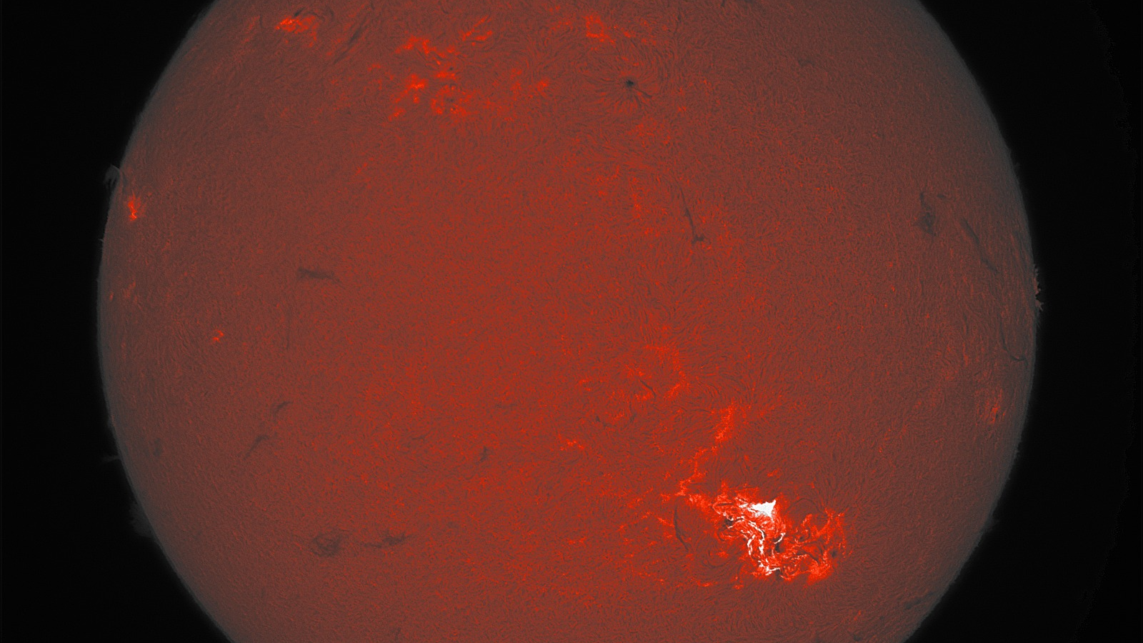
Earth
Picture of the AR13664 Sun region (Catania Solar Telescope), May 10, 2024

Slide 4
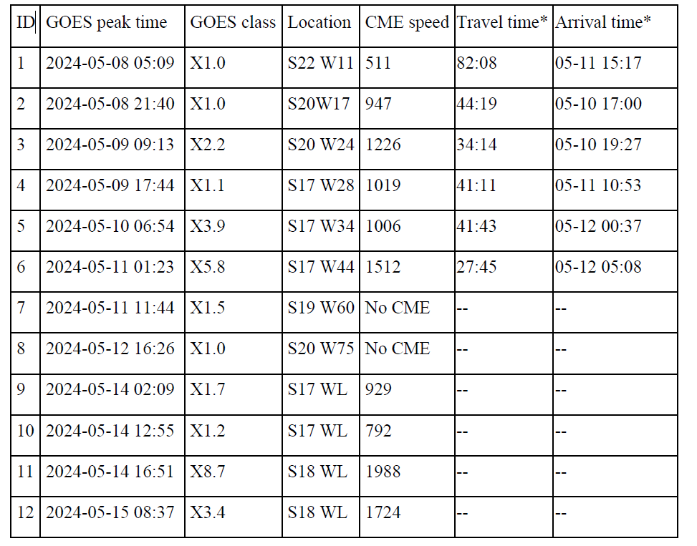
Km/s hours
Solar flares during mid-May 2024: complex evolution after the first event

Slide 5
Major effects:
- Negative impact on ground-based broadcasting and radio shortwave communications
- GPS navigation was also affected in a few cases
- Some weather satellites stopped transmitting data.
- Starlink fleet of low-orbiting satellites, some degradation in their performance
and also
- Aurorae borealis (Northern lights)
- Forbush decrease in cosmic ray flux at ground

Slide 6
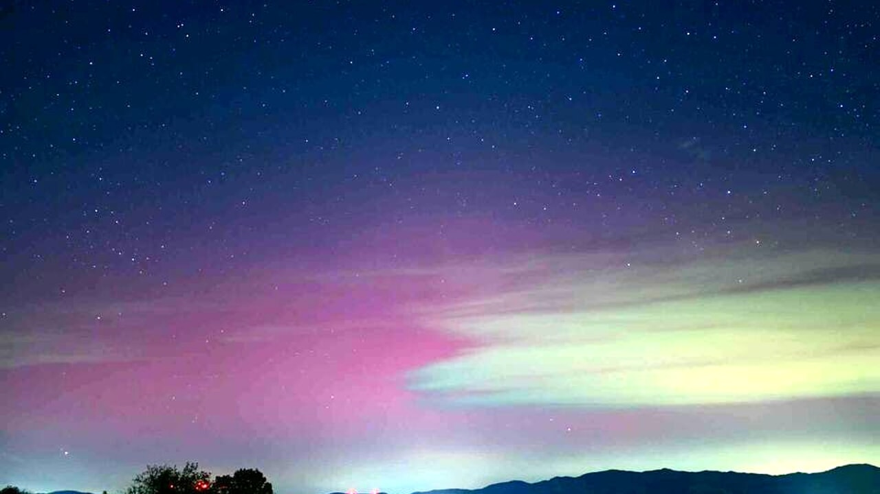
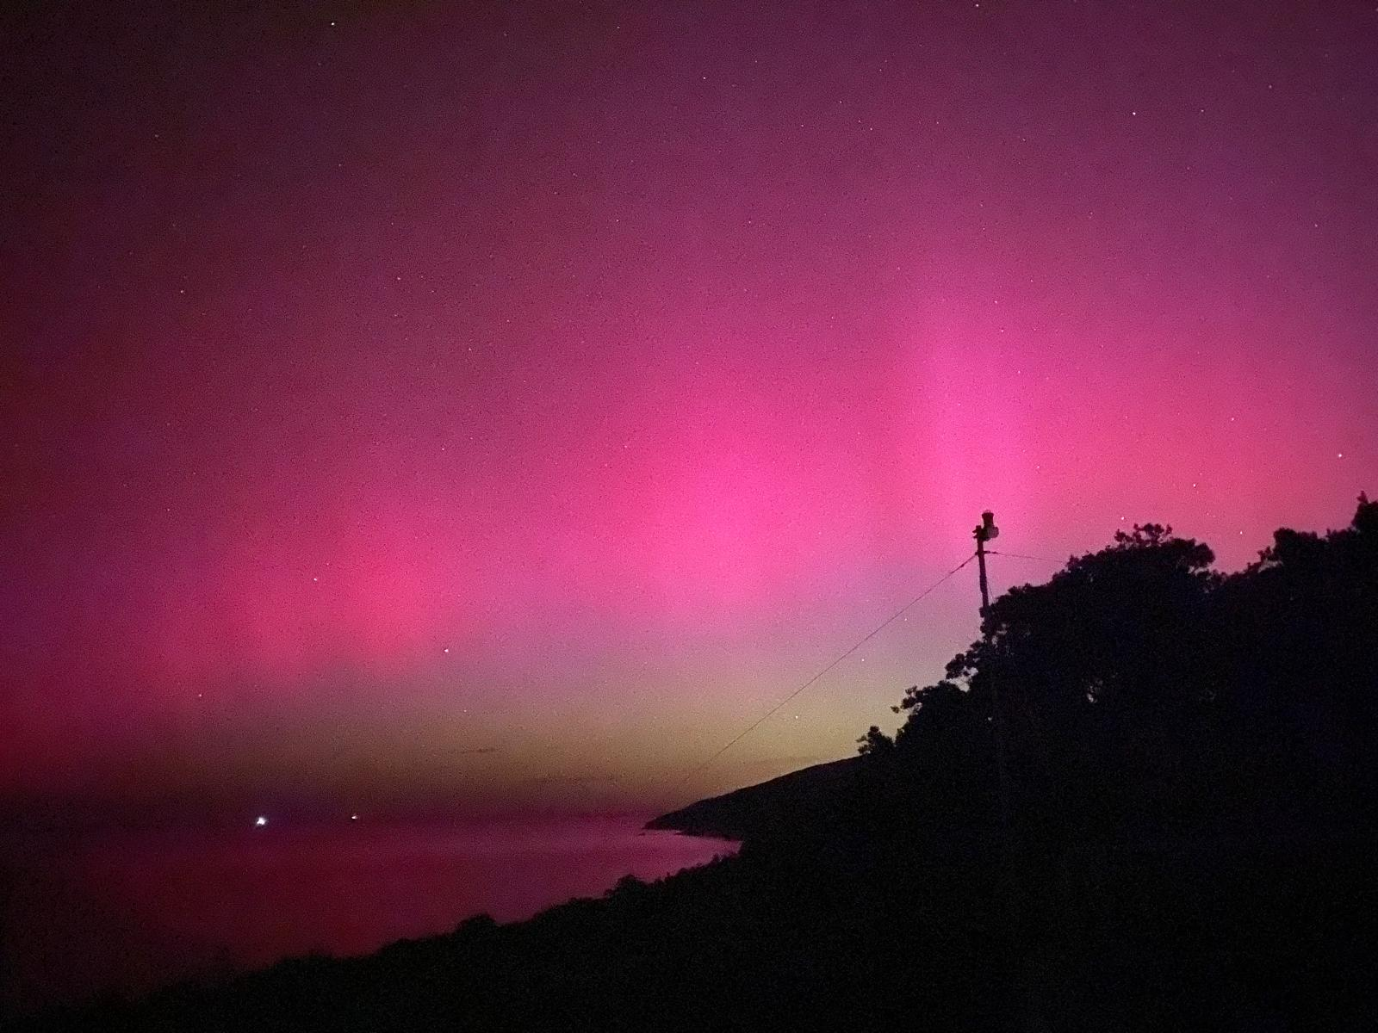
Aurorae borealis seen even at small latitudes over the world
Aurora borealis in Tuscany
Aurora borealis on Mt.Etna (Lat. 37° N)

Slide 7
And now, our main task: to investigate the Forbush variation in cosmic ray flux at high latitudes
Possibility to include in this analysis
- Muon data from POLA-R detectors in Ny-Ȧlesund
- Neutron data from the Barentsburg Neutron Monitor, very close to Ny-Ȧlesund
- Neutron data from the Bonner Sphere Spectrometer in Ny-Ȧlesund
- Epithermal/thermal neutron data from additional sensors in the same area
Last two datasets come from a close collaboration with L.Hertle and M.Schrön (Leipzig)

Slide 8
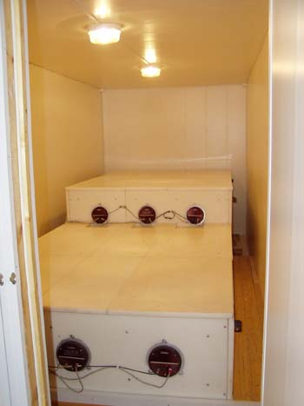
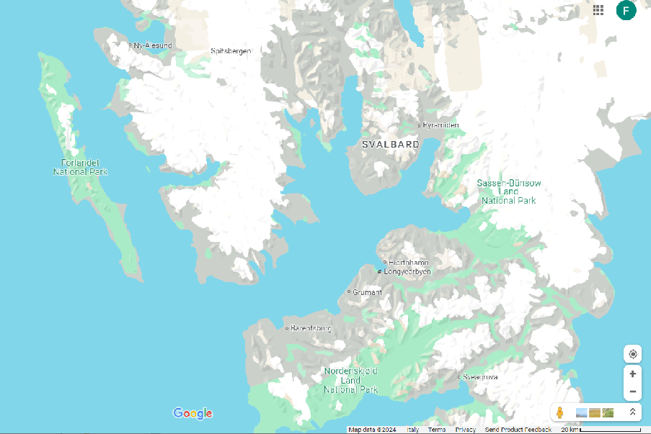
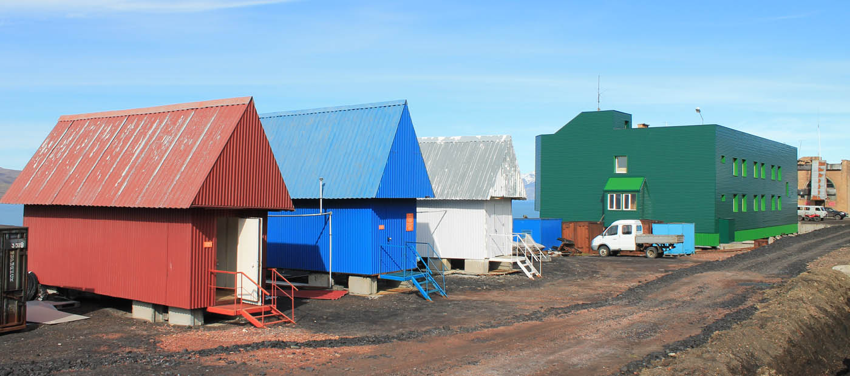
About 100 km
18 NM-64 detectors (proportional counters surrounded by moderator and lead
(sensitive to CR 0.5-20 GeV)
Location of Barentsburg with respect to Ny Ȧlesund

Slide 9
Neutron monitors distributed over the world are usually employed to investigate variations in the cosmic ray flux due to solar events
The amplitude of the decrease also depends on the geomagnetic cutoff of the site.
4 different NM stations with different geomagnetic cutoff

Slide 10
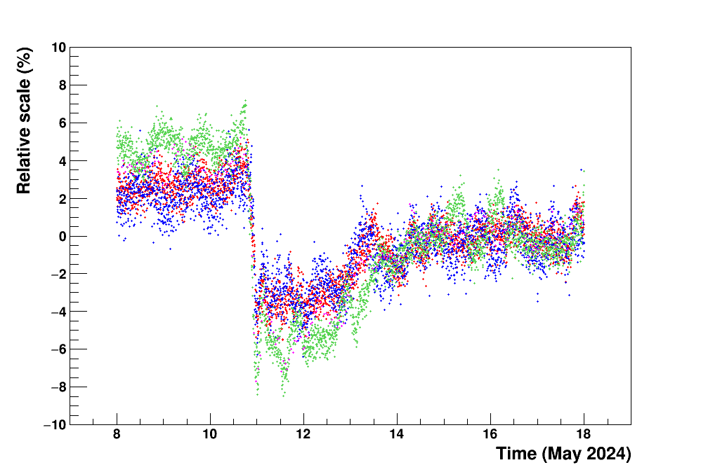
Similar trend, with different amplitudes observed in the various stations

Slide 11
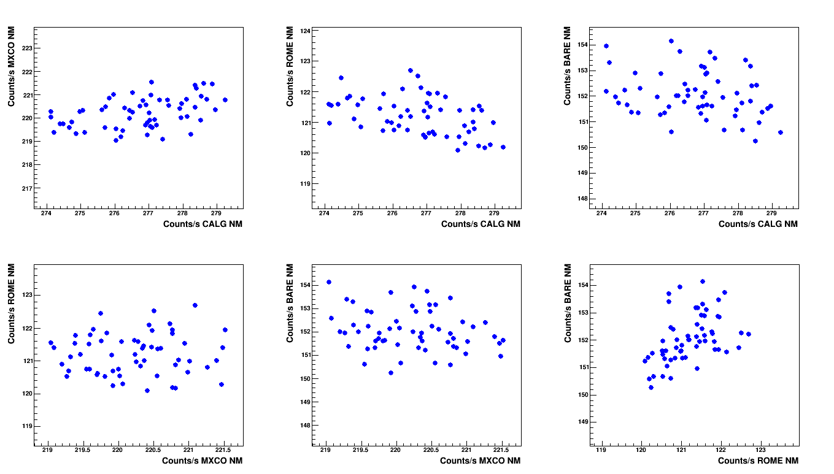
Correlation between the 4 NM detectors (6 pairs) studied in the pre-Forbush and during the Forbush periods
Pre-Forbush period
(still to be better defined)
r = 0.44
r = -0.43
Correlation is not so good in the pre-Forbush period, with large dispersion of correlation coefficients (sometimes even negative…)
r = -0.25
r = 0.04
r = -0.21
r = 0.45

Slide 12
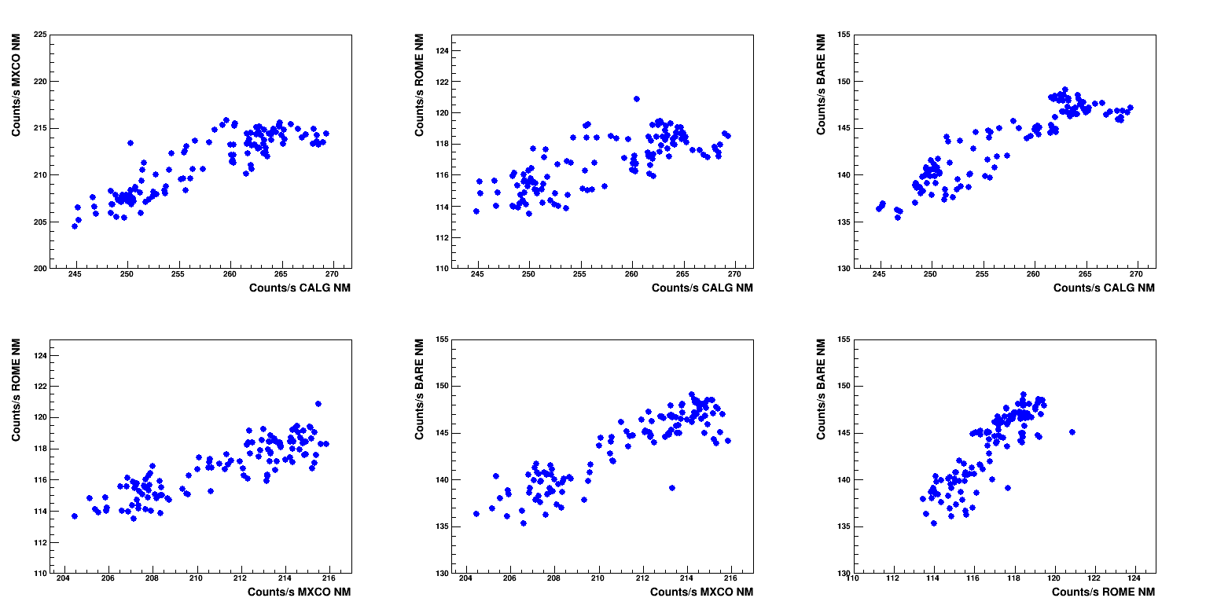
But is very good (coefficients 0.75-0.90) during the Forbush event.
Forbush period
(May 10-15)
r = 0.75
r = 0.91
r = 0.89
Here, the common origin of the flux variation in different detectors dominate over the statistical fluctuations.
This suggested a method for investigate even muon-neutron correlations
r = 0.87
r = 0.90
r = 0.87

Slide 13
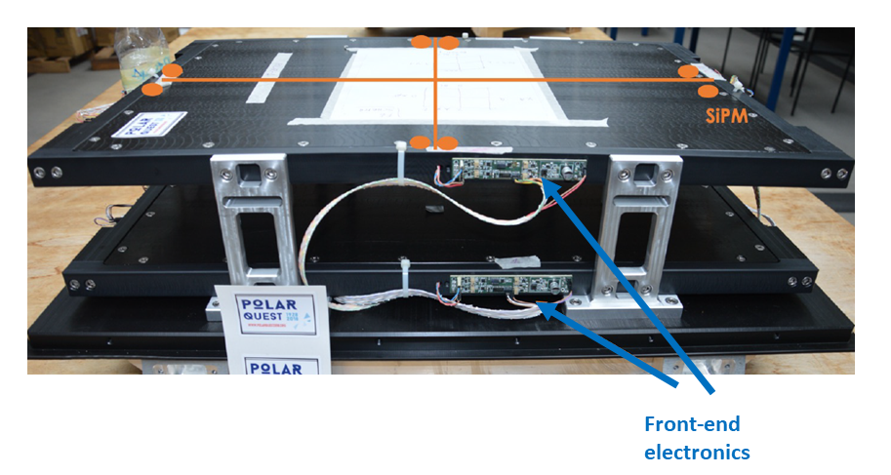
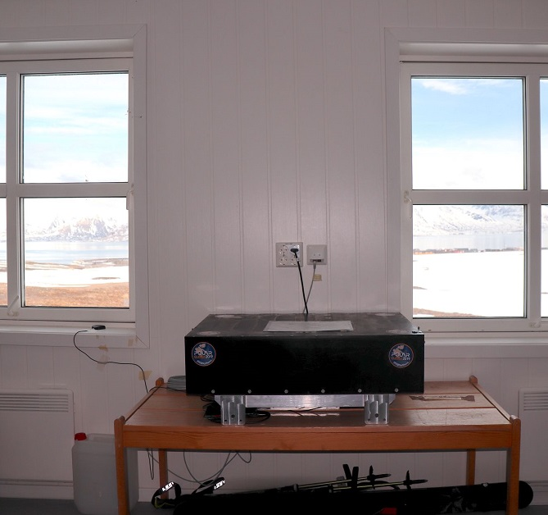
POLA-R detectors made by two segmented (2x2) scintillator planes
3 similar detectors taking data in Ny Ȧlesund since 5 years
On going analyses of annual periodicity
Detection of extensive air showers by GPS-tagged coincidence events

Slide 14
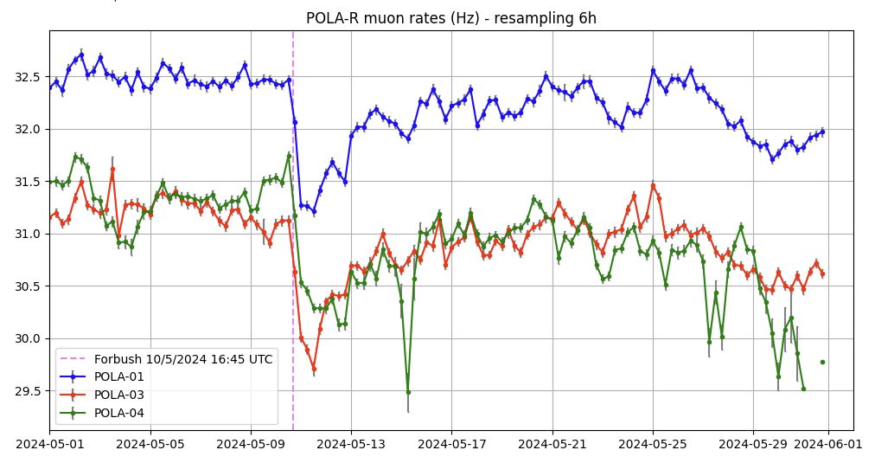
Data from our POLA-R detectors during May 2024 (corrected by pressure variation)
Strong similarity between the three detectors
Some spike in POLA-04 still being checked

Slide 15
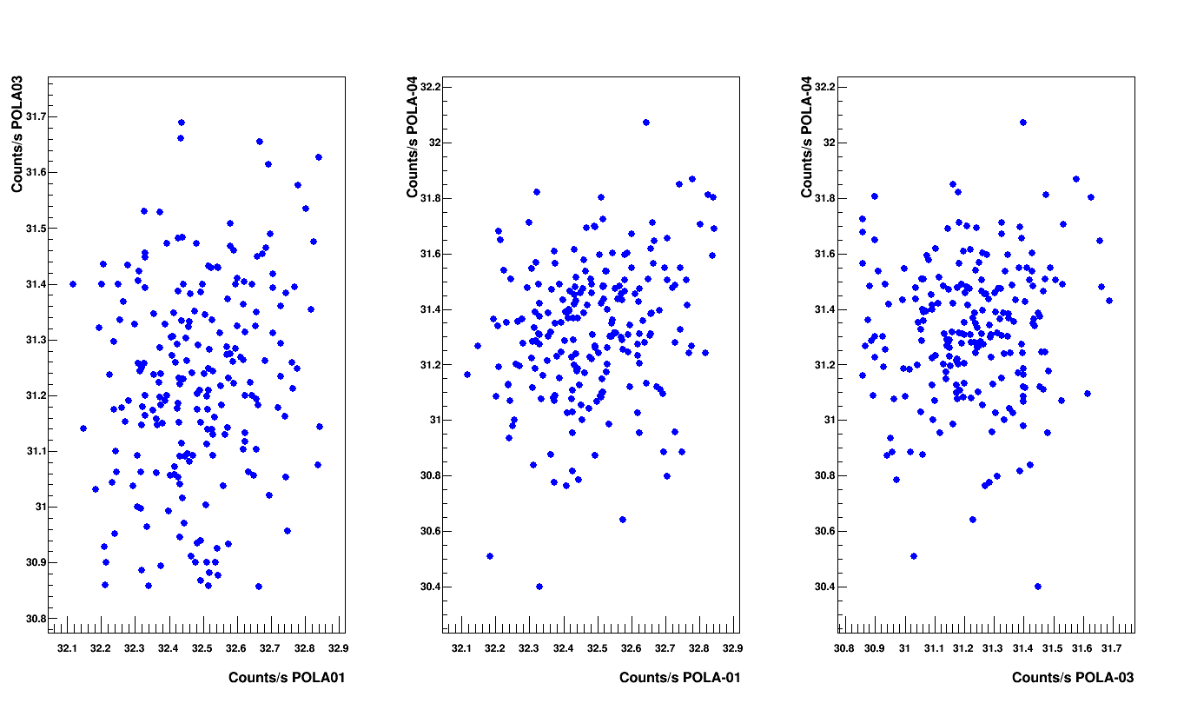
Correlation between the data from POLA-01, -03 and -04 detectors studied in the pre-Forbush period and during the Forbush (1-hour step)
r = 0.19
r = 0.25
r = 0.08
Pre-Forbush period
(April 30- May 9)

Slide 16
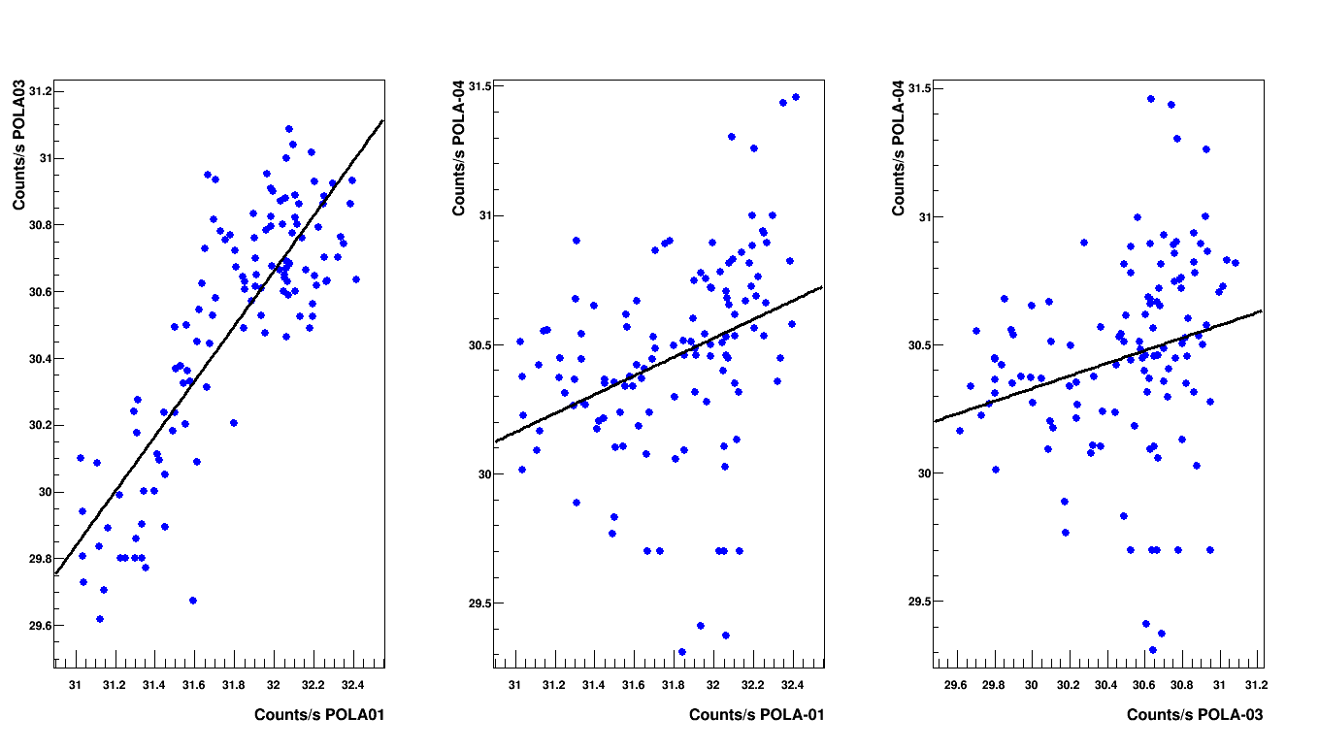
Correlation coefficients are larger during the Forbush period
(similar to Neutron Monitors data)
r = 0.83
r = 0.35
r = 0.24
Forbush period
(May 10-15)

Slide 17
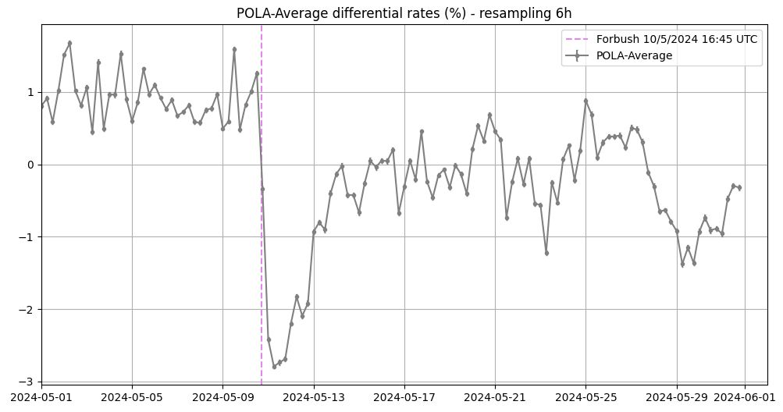
Due to uniformity in the response of the three POLA-R detectors, we may employ their average also to look for correlations to other detectors.
Differential rate with respect to the average over 1-31 May
Amplitude variation around 3%
The topology of the recovery phase is complex in this event, due to the many solar flares and CMEs after May 10th

Slide 18
Due to uniformity in the response of the three POLA-R detectors, we may employ their average also to look for correlations to other detectors.
Differential rate with respect to the average over 1-31 May
Amplitude variation around 3%
To compare correlation results from different detector combinations we are defining two or more windows for the «quiet» behaviour (pre-Forbush period) and for the Forbush period

Slide 19
Due to uniformity in the response of the three POLA-R detectors, we may employ their average also to look for correlations to other detectors.
Differential rate with respect to the average over 1-31 May
Amplitude variation around 3%
To compare correlation results from different detector combinations we are defining two or more windows for the «quiet» behaviour (pre-Forbush period) and for the Forbush period

Slide 20
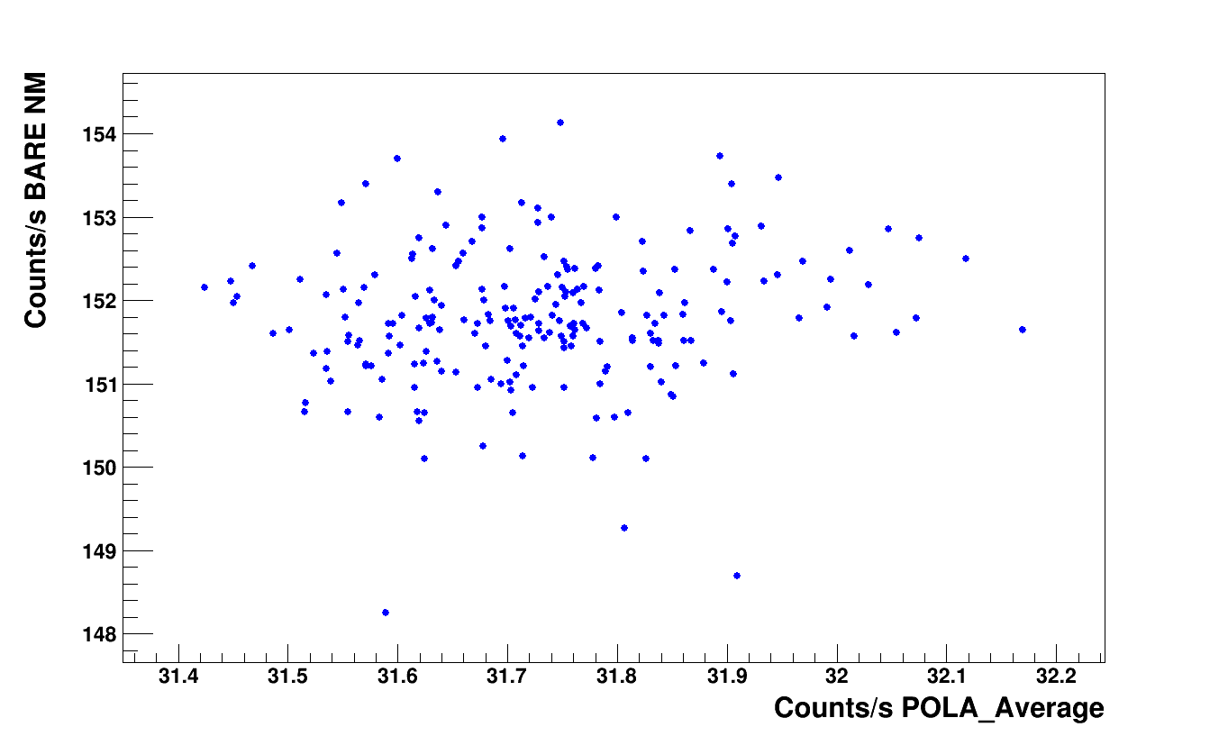
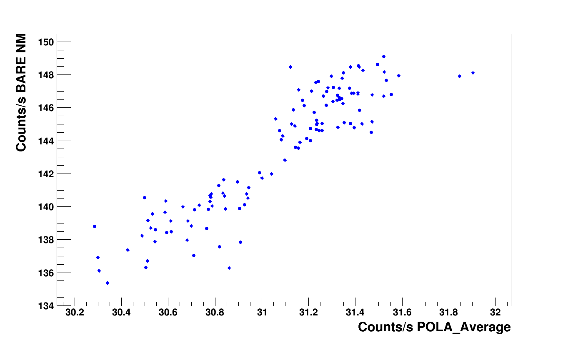
Correlation between POLA-R detectors (average) and Barentsburg Neutron Monitor
Pre-Forbush
Forbush
r = 0.12
r = 0.91

Slide 21
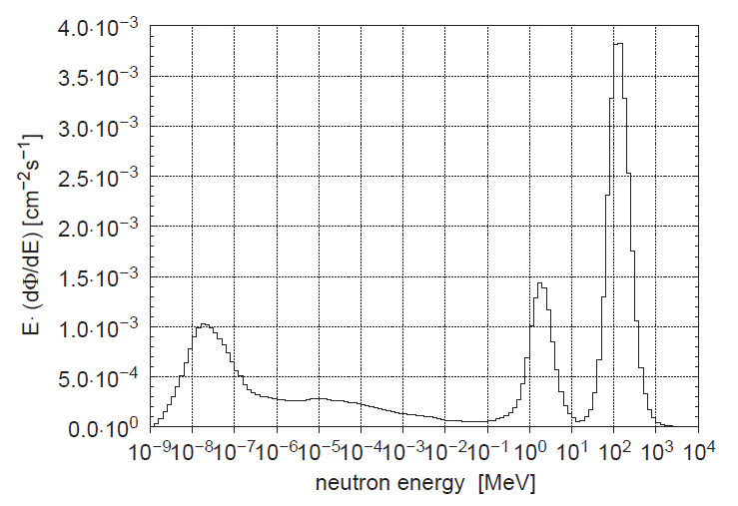
Thermal peak (E<0.1 eV)
Neutrons thermalized, resulting from elastic collisions with materials surrounding the detector (floor, environment), with a Maxwell-Boltzmann distribution
Lethargy
E (dφ/dE)
Typical cosmic neutron spectrum

Slide 22
Epithermal region (E< 100 keV)
Neutrons dominated by elastic collisions
(~1/E energy dependence)
Typical cosmic neutron spectrum

Slide 23
Fast neutrons peak (E=1-2 MeV)
Neutrons evaporated by excited residual nuclei
Typical cosmic neutron spectrum

Slide 24
Cascade peak (E=100-200 MeV)
Neutrons with a small interaction cross section with air, hence able to traverse a large air thickness
Typical cosmic neutron spectrum

Slide 25
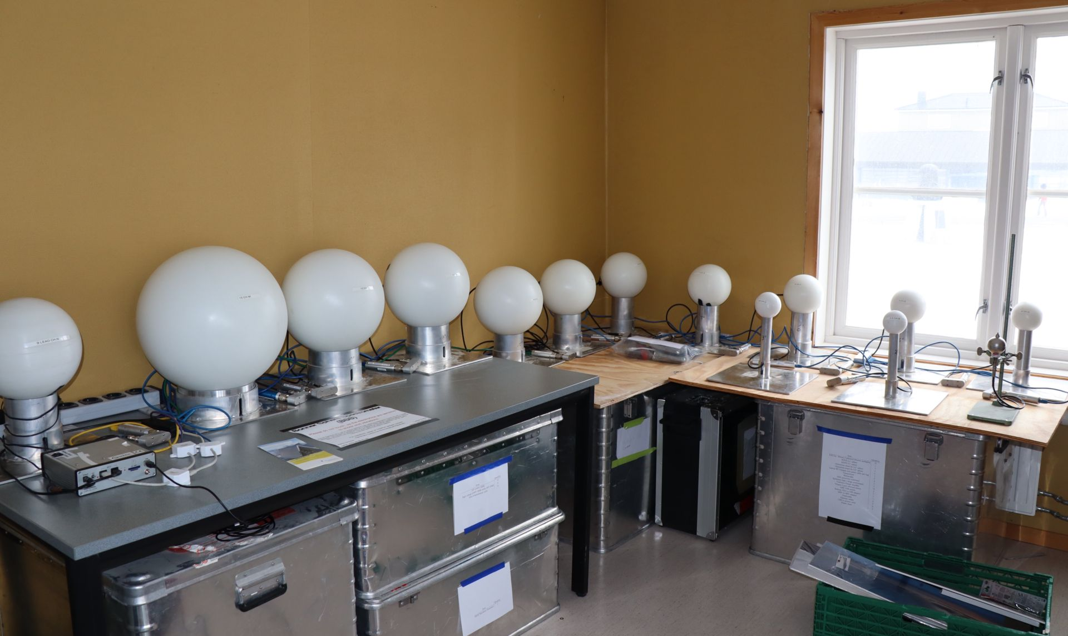
BSS installation in Ny-Alesund

Slide 26
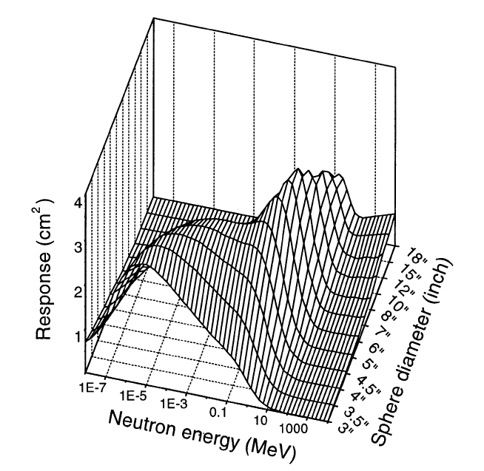
Typical response of a Bonner Sphere Spectrometer to different neutron energies
BSS detector in Ny-Alesund
Channel Diameter
01 bare detector
02 2.5" Sphere
03 3.5" Sphere
04 4" Sphere
05 5" Sphere
06 6" Sphere
07 7" Sphere
08 8" Sphere
09 9" Sphere
10 10" Sphere
11 11" Sphere
12 12" Sphere
13 15" Sphere
14 9" Sphere with 1" lead

Slide 27
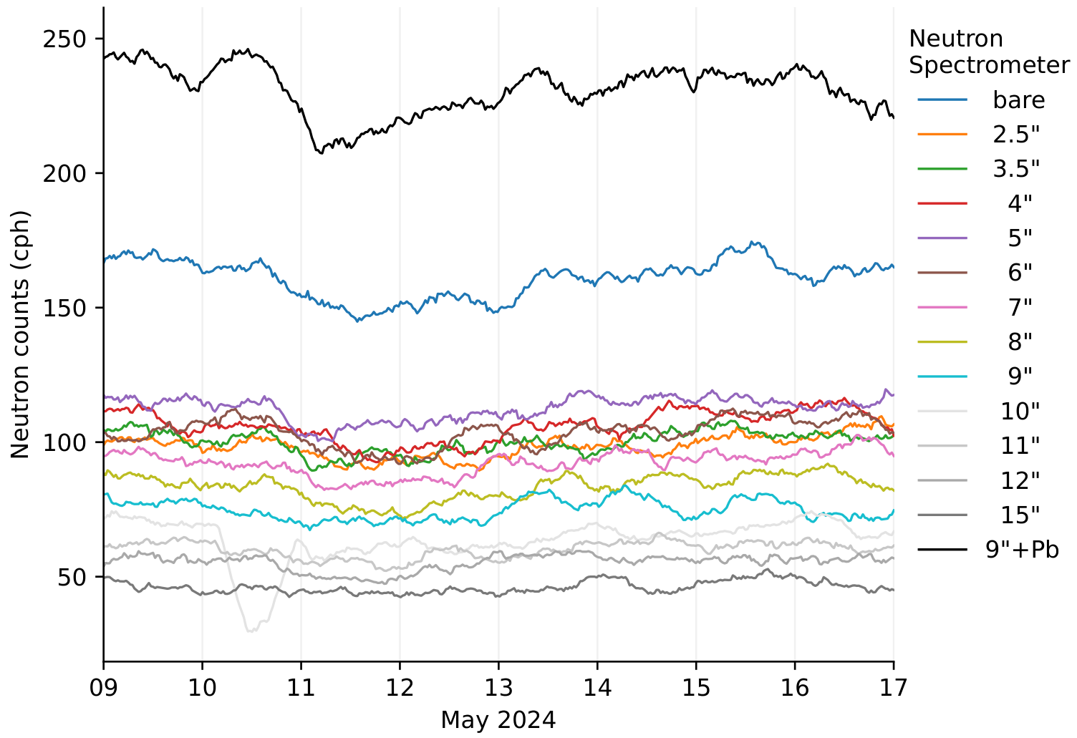
Data trend for the Bonner Sphere Spectrometer around mid-May
Different channels correspond to moderator spheres with a different diameter, hence sensitive to different ranges of neutron energies

Slide 28
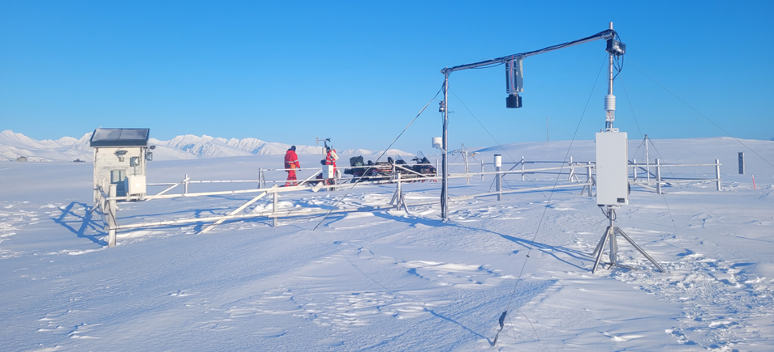
Thermal and epithermal neutrons are also measured by additional neutron sensors in Ny-Ȧlesund (SVEN)
Data need to be corrected for different weather parameters and presence of snow

Slide 29
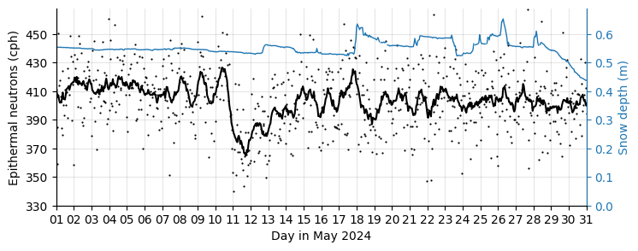
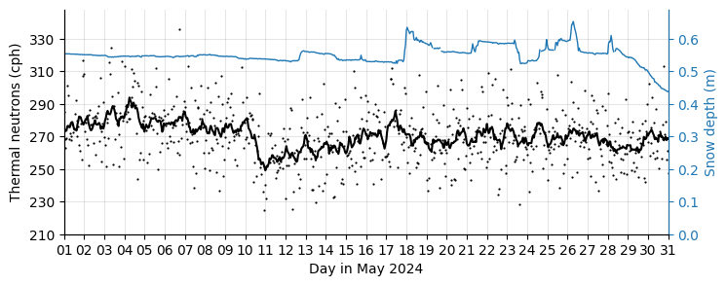
Data trend for the epithermal
and thermal neutrons

Slide 30
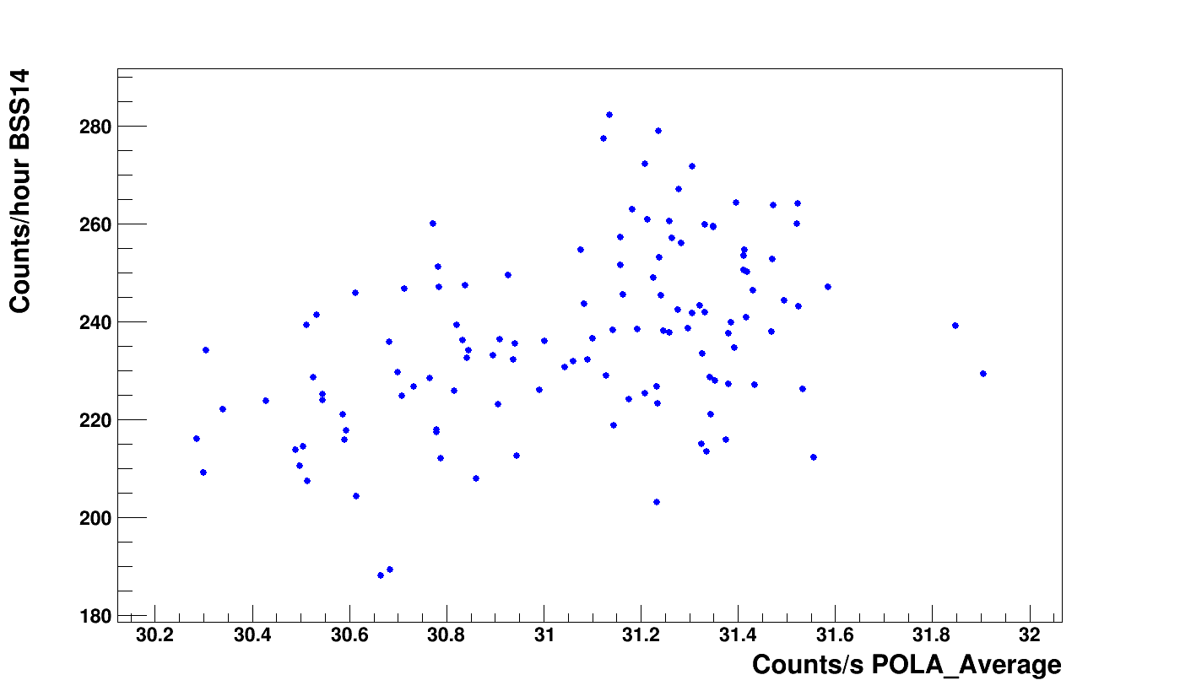
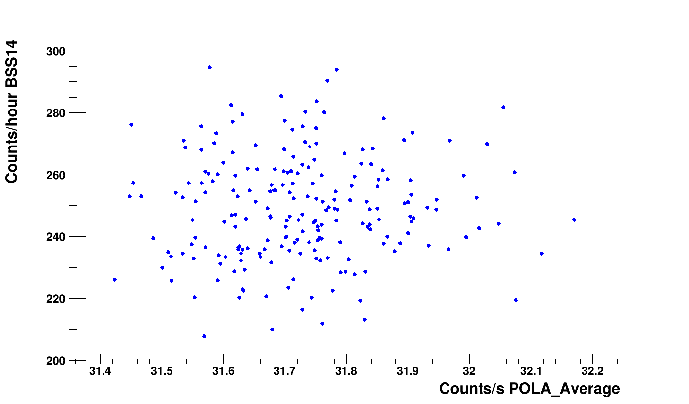
Preliminary correlation study between POLA-R and BSS (various channels)
Forbush
r = 0.43 ± 0.07
BSS channel with
9’’ sphere + 1’’ lead
Pre-Forbush
r = 0.04 ± 0.07

Slide 31
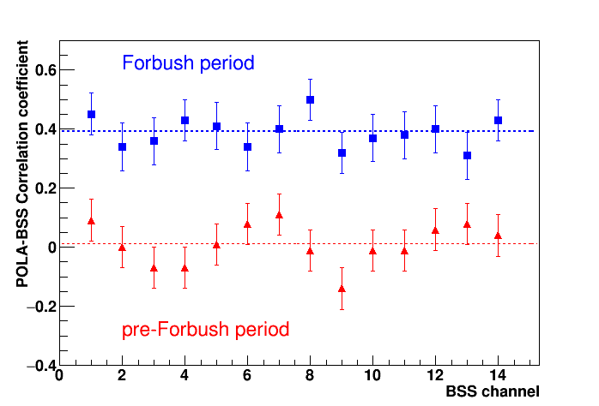
Correlations between muons and neutrons from different BSS channels (different energy ranges)
● Correlation is certainly higher during Forbush
● Correlation is negligible during (short) quiet periods
● Apparently, no detailed trend of the correlation with neutron energy is seen

Slide 32
Work in progress
Set up uniform conditions for correlations studies (better define pre-Forbush and Forbush periods)
Estimate sensitivity of the information to the selected period
Explore different integration times
Study the correlation of muons with epithermal/thermal neutrons
Study the correlation between different neutron energies
Estimate uncertainties ( & p-values) on correlation coefficients
Work on the draft of the paper (Several parts already written, shared Overleaf structure )

