Slide 1
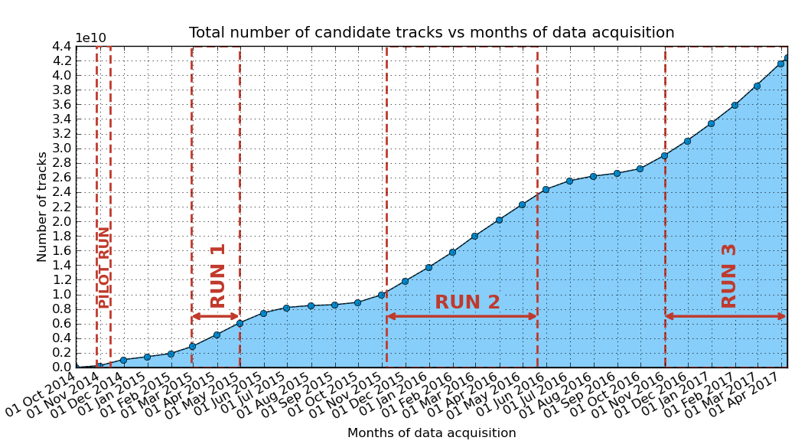
Data taking
An exceptional month of March!

Slide 2
Many schools still have to:
Perform the measure of telescope angle wrt. North
Last update: 34 schools out of 52 stations
Answer the doodle by prof. Picchi about EEE activities
Last update: about 50% of the schools
Measure the time up to C2H2F4 bottle exhaustion
None arrived up to now!
All these activities are an essential part of the EEE project

Slide 3
7th Conference of the Centro Fermi projects
Devoted to EEE
ERICE: 29-31 May 2017
Schools can present their activity in EEE:
Slides in English!
Presentation either in English or in Italian

Slide 4
Agenda for today
The ESA-EEE tool (prof. Liguori)
Data acquisition and analysis for EEE Cosmic Box (Liceo Galileo Ferraris - Torino)
Rate pressure/correlation (Liceo Pacinotti - Cagliari)

