Slide 1
New EEE Weather Station development
EEE Collaboration Meeting, 22/3/2017

Slide 2
Oregon Scientific WMR88
Price: ~ 150€
All EEE telescopes use this WS
Proprietary Software
Several sensors, we use only pressure and temperature (internal and external).
VWS write a CSV file (read by DAQ at the beginning of each run).
This model is no longer in production.

Slide 3
Oregon Scientific WMR89
Price: ~ 150€
Proprietary Software
Same look of WMR88
WMR89 has a data logger for 7 days: driven via that virtual serial port; does not support VWS (probably not even in the future);
I had a test sample for a week: data transfer works only with queries by an interface; you get an excel file.

Slide 4
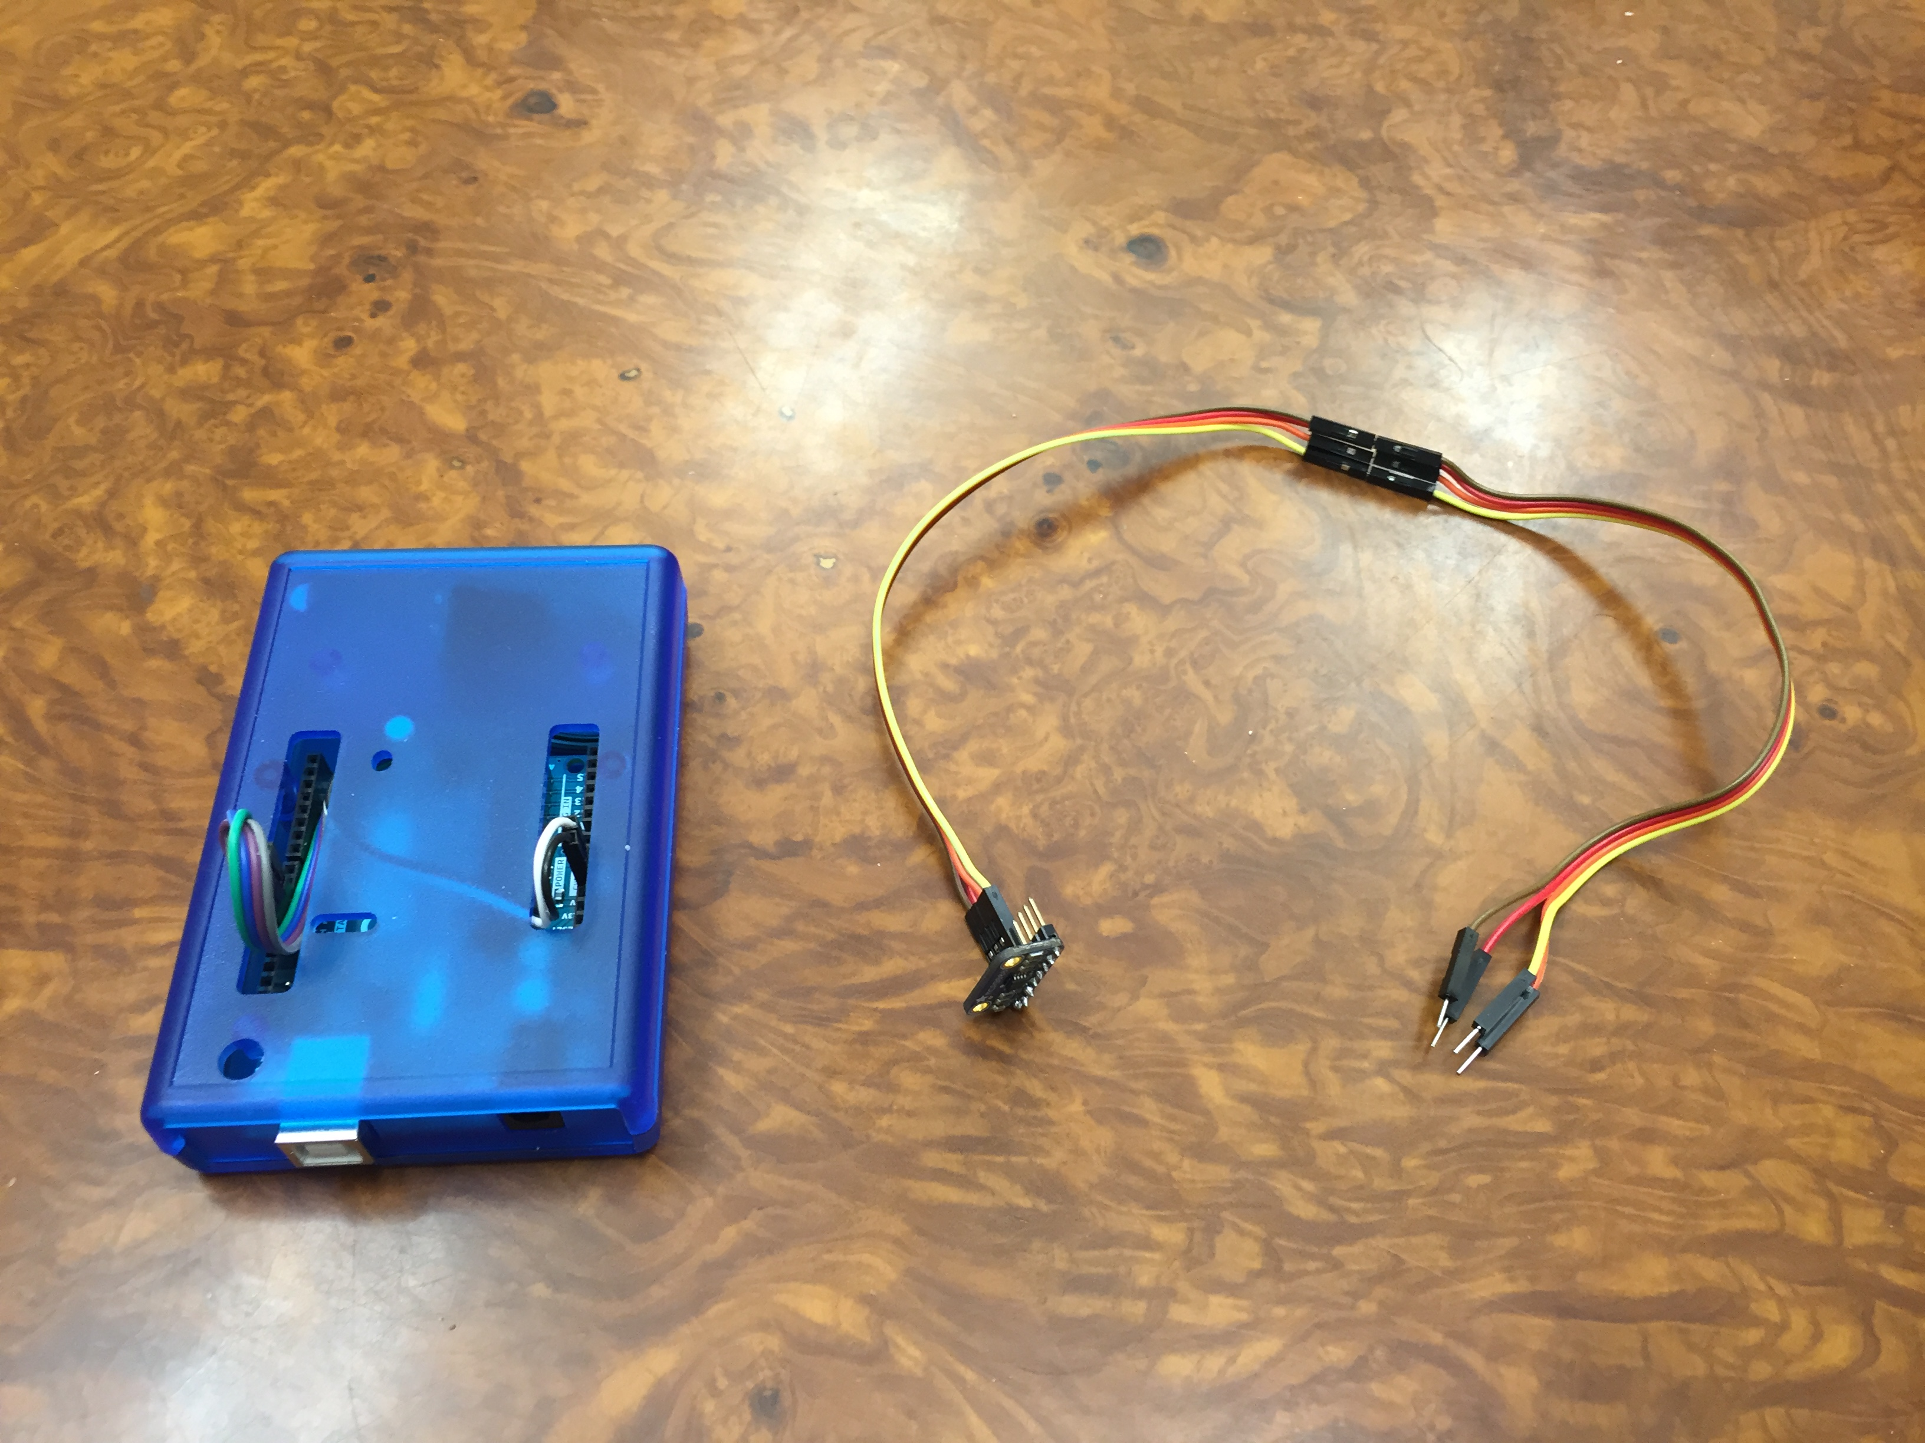
We have to move on a different weather station
Continue to use Virtual Weather Station
Develop a new EEE Weather Station
Probably overkilling for our needs

Slide 5
The purpose of the working group
Develop an EEE Weather Station with three sensors:
Pressure
Internal temperature
External temperature (two solutions: RF sensor or wired sensor, so schools will be able to chose what they prefer).
Determine good practices to improve installation (Weather Instrument Shelter howto)

Slide 6
Steps
Determine the list of platforms to try (arduino, stm32, NI).
Determine which sensors to use (Ivan Gnesi is in contact with INRIM) and how to calibrate sensors.
Choose the RF module
Build and test the EEE Weather Station

Slide 7
Possible platforms
NI USB-6000

Slide 8
Example: Arduino Weather Station
Prices (one unit):
Microcontroller Arduino: 20 €
Thermistor MCP9808: 5 €
Pressure/T/Humidity Bosch BME280: 19 €
Can be assembled by students !!
Full control of the software
Much better sensors than than Oregon Scientific

Slide 9
Oregon Scientific WMR88 Specs
Barometer:
Measuring range: 700 – 1050mb/hPa
Accuracy: +/- 7 mb/hPa
Indoor Temperature
Operating range: 0°C to 50°C
Accuracy: 0°C - 40°C: +/- 1°C; 40°C - 50°C: +/- 2°C
Relative Humidity
Operating range: 25% to 90%
Accuracy : +/- 7%
Outdoor Temperature
Operating range: -30°C to 60°C
Accuracy: not specified

Slide 10
New sensors (example)

Slide 11
Bosch BME280 and Microchip MCP9808
Barometer BME280:
Measuring range: 300...1100 mb/hPa
Accuracy: < +/- 1 mb/hPa (RMS Noise 0.2 Pa, equiv. to 1.7 cm; Offset temperature coefficient ±1.5 Pa/K, equiv. to ±12.6 cm at 1 °C temperature change )
Indoor Temperature
Operating range: -40 +85 °C
Accuracy: < +/- 1°C
Relative Humidity
Operating range: 0% to 100%
Accuracy : +/- 3%
Outdoor Temperature
Operating range: -40°C +125°C
Accuracy: tipical 0.25°C (from -20 to 100 C); 0.0625°C resolution

