Slide 1
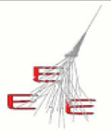
Performance of MRPC telescopes of the EEE Project
E. Bossini, C. Cicalò, D. De Gruttola,
I. Gnesi, M. Garbini, S. Grazzi, M.P. Panetta
22/03/2017
EEE meeting

Slide 2
Status
beta ditributions for all telescopes → almost done for all telescopes
trending for HV and currents → ongoing
duty cycle by trending the rate → ongoing
multiplicity (hits and clusters) distributions → ongoing
χ² → ongoing
time-of-flight → ongoing
other trending variables (see starting from slide 5)
time resolution (shown here)
spatial resolution
time slewing correction applied
~20% improvement
offset to be addressed in some telescopes
time slewing correction to be applied
22/03/2017
EEE meeting
2

Slide 3
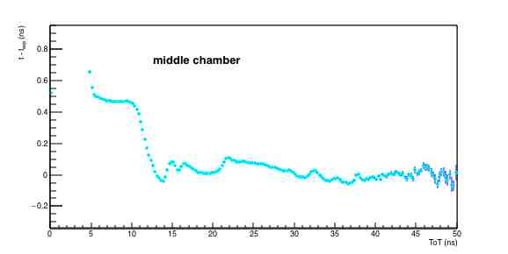
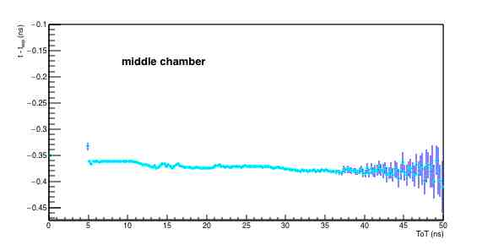
TOT – time slewing correction
middle chamber of TORI-02 as an example
before correction
after correction
the correction works
offset to be understood
22/03/2017
EEE meeting
3

Slide 4
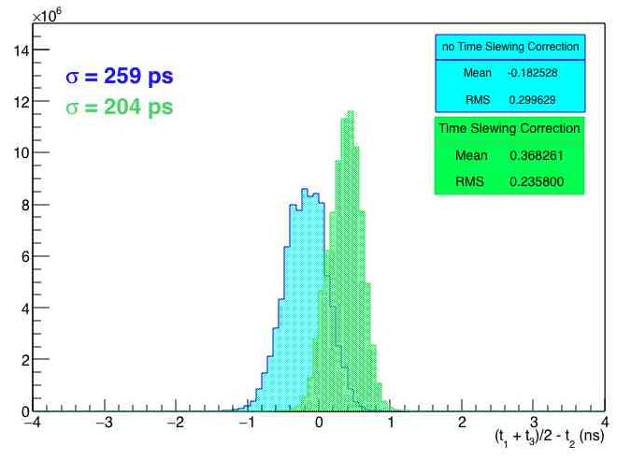
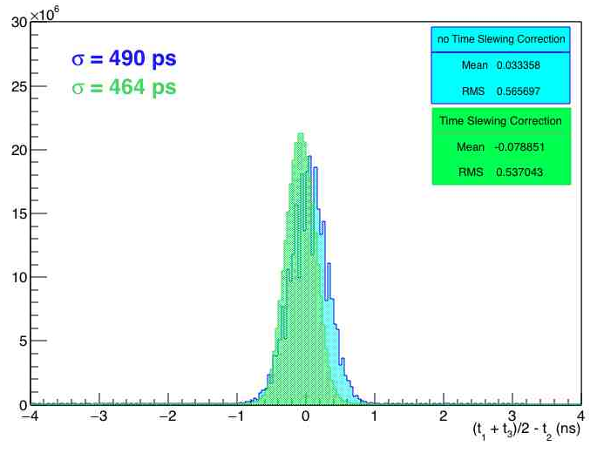
TOT – time slewing correction
TORI-02
~20% improvement by applying time slewing correction
value obtained with RMS - fit has to be done
TORI-02
BOLO-03
~5% improvement by applying time slewing correction
worst time resolution wrt other telescopes (not shown here)
value obtained with RMS - fit has to be done
BOLO-03
TOT correction to be refined and applied to other telescopes (at the moment results are available
from TORI-02 TORI-03 PISA-01 BOLO-01 BOLO-03)
offset to be studied
more details on the analysis at the next meeting (once it will be refined)
22/03/2017
EEE meeting
4

Slide 5
Study of the long term stability of the array
Goal: monitor of the interesting parameter for all the telescope during long period
now we are extrapolating:
track rate
reconstruction efficiency (event with candidate tracks/triggered events)
trigger rate
average time of flight
average multiplicity (both single chamber and global)
average number of tracks
number of satellites seen
more can be added…suggestions?
period currently analyzed: from September 2016 up to yesterday (ongoing also for run 1 and run 2)
method:
data are extrapolated from the fist run acquired every N days (N set to 1 in the next slides)
check on file → more than 1K events
if telescope was not online a value of zero is put in the graphs
22/03/2017
EEE meeting
5

Slide 6
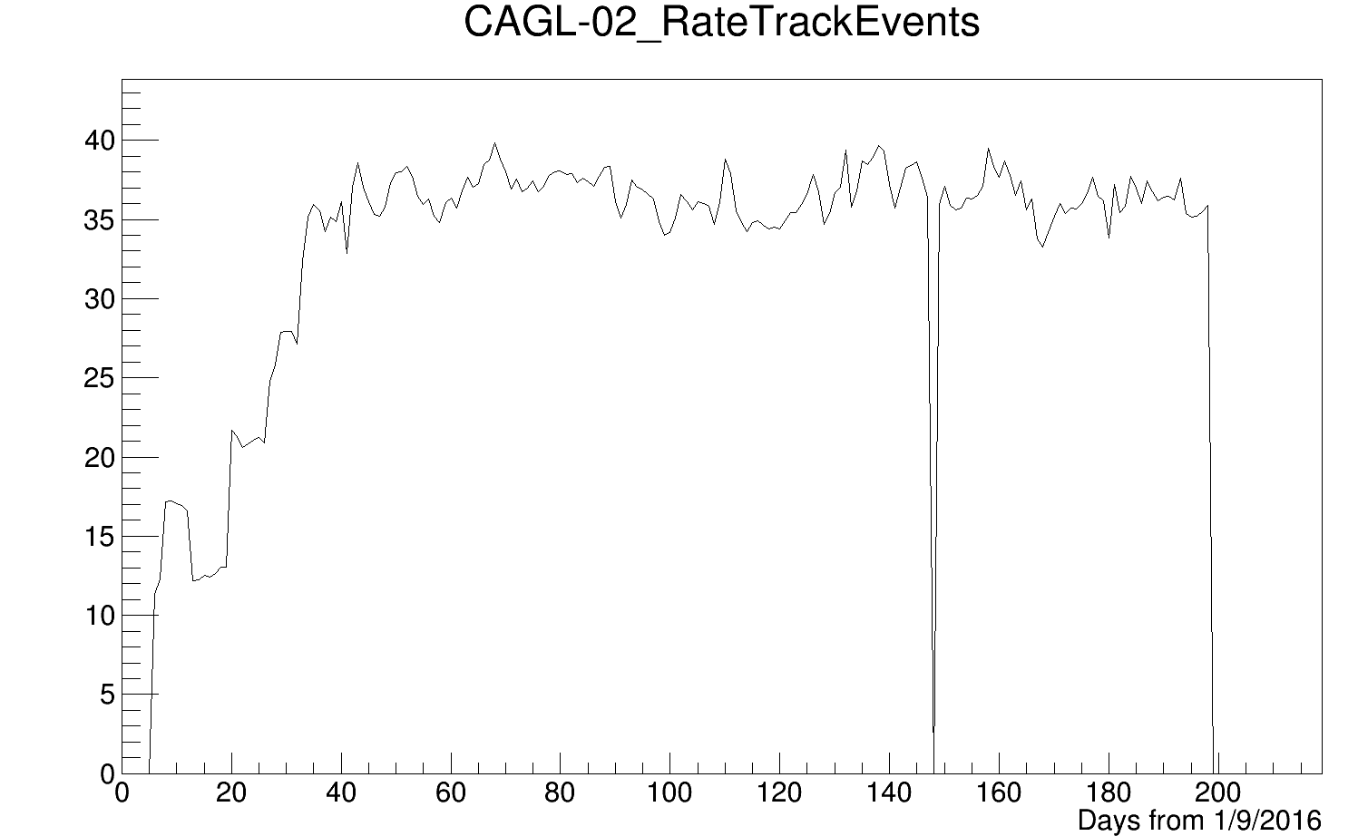
Good candidate track rate stability
CAGL-02 as an example
Rate [Hz]
No data found
(not trasmitted or
short run)
Run 3
Commisioning
Days from 1-09-2016
Run 3
22/03/2017
EEE meeting
6

Slide 7
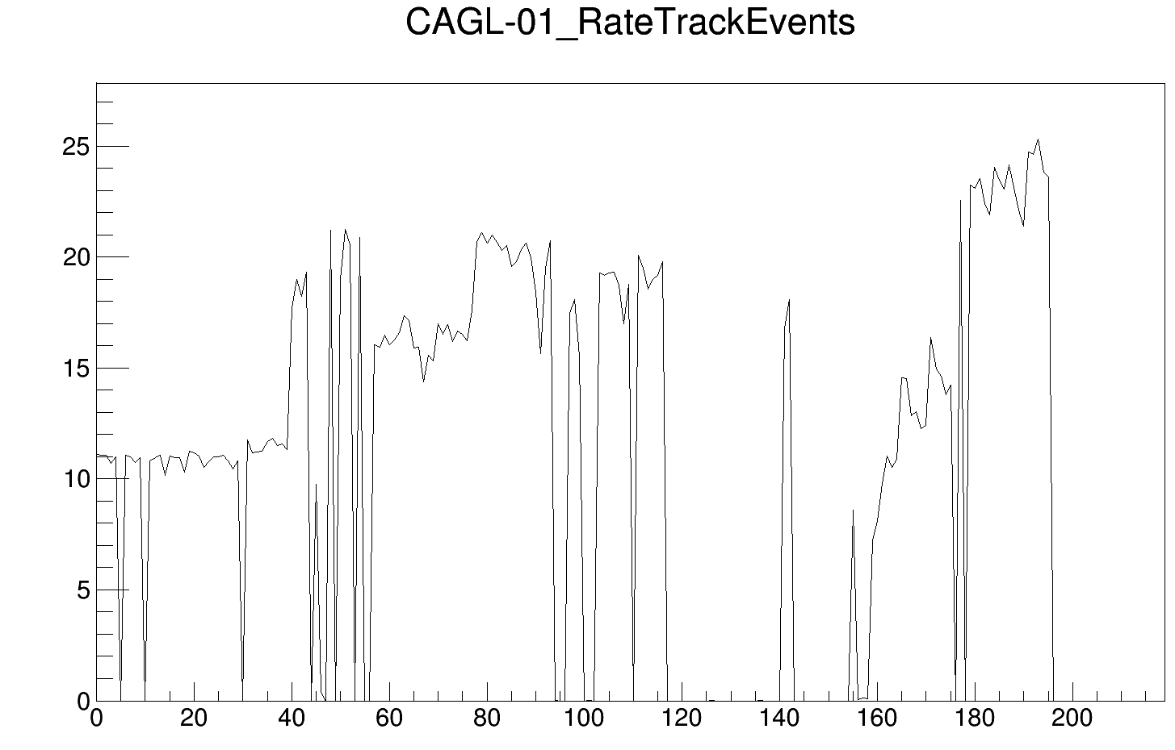
Poor candidate track rate stability
CAGL-01 as an example
Rate [Hz]
Days from 1-09-2016
22/03/2017
EEE meeting
7

Slide 8
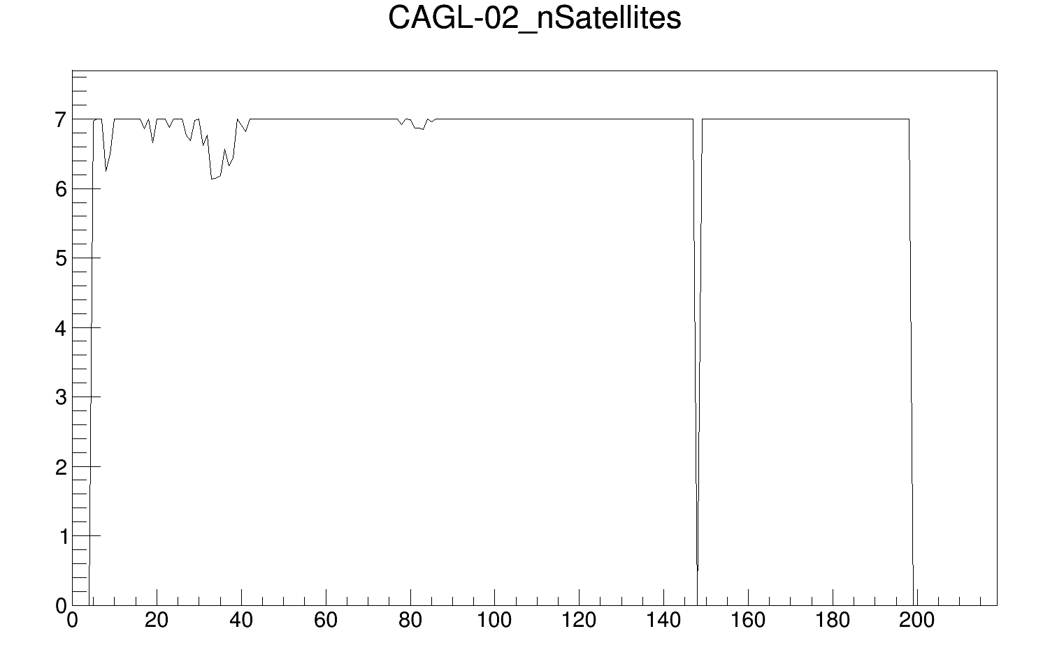
GPS monitoring
CAGL-02 as an example
In the DAQ if satellites >= 7, the value is fixed to 7 (only 3 bits available)
Days from 1-09-2016
22/03/2017
EEE meeting
8

Slide 9
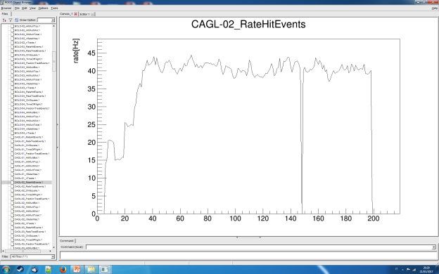
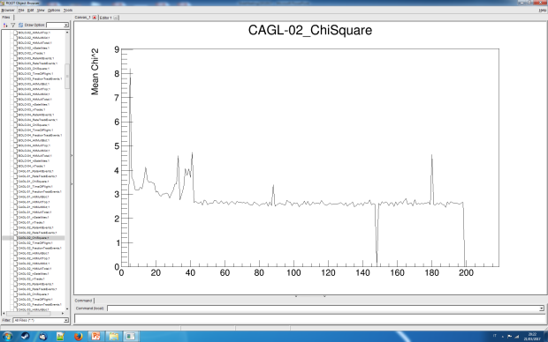
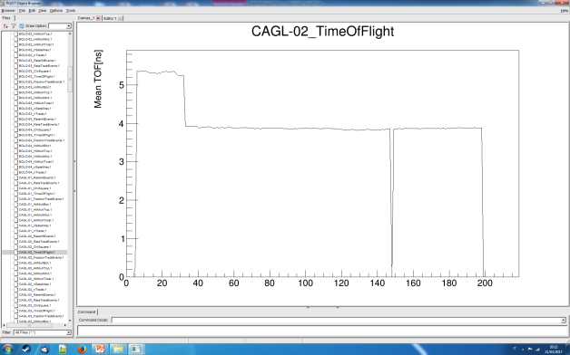
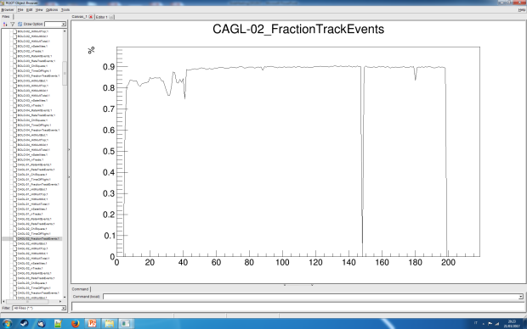
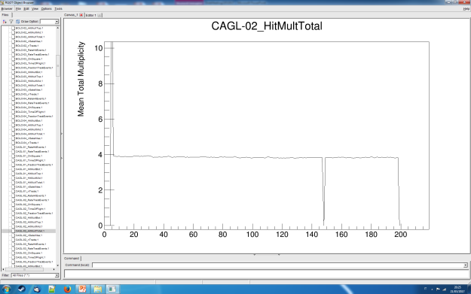
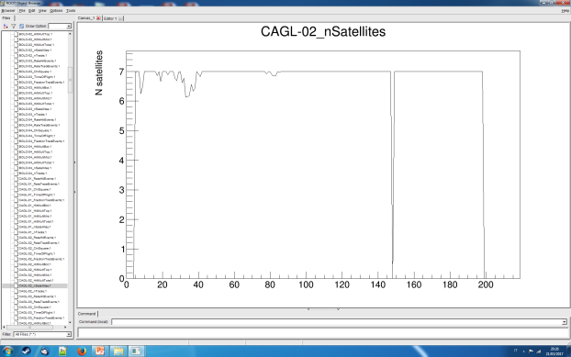
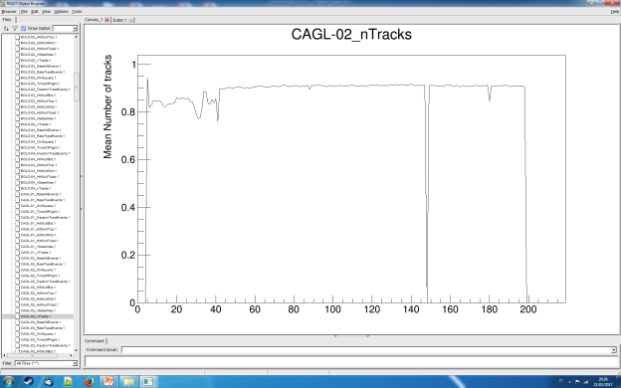
CAGL-02 all data
room for other variables!
22/03/2017
EEE meeting
9

Slide 10
Summary
several trending plots available
need to find a consistent way to present them
more plots available at the next meeting
time and spatial resolution ready (including time slewing correction, to be refined)
22/03/2017
EEE meeting
10

