Slide 1
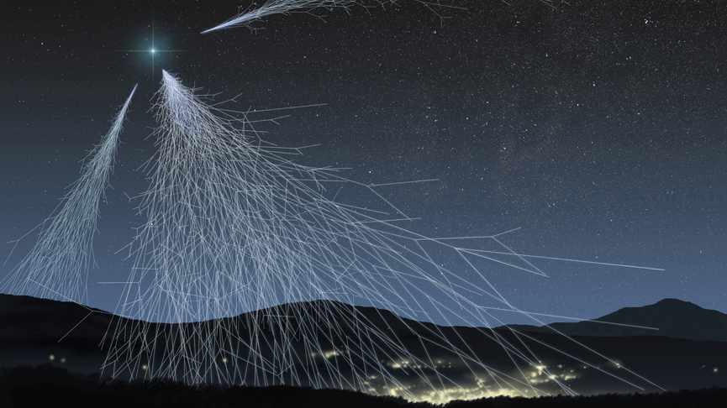
DATA ANALYSIS AND MEASUREMENT OF THE EFFICIENCY OF THE LNLE-01 DETECTOR
Liceo Vittoria Colonna e IIS Primo Levi
Group 10: Coluccini Giorgia, Corvini Tommaso, Scano Riccardo, Zucca Michele.

Slide 2
Hands-on 1
The first goal was to take the old data and to graph the efficiency trend of those values (Bottom Layer, Middle Layer and Top Layer).

Slide 4
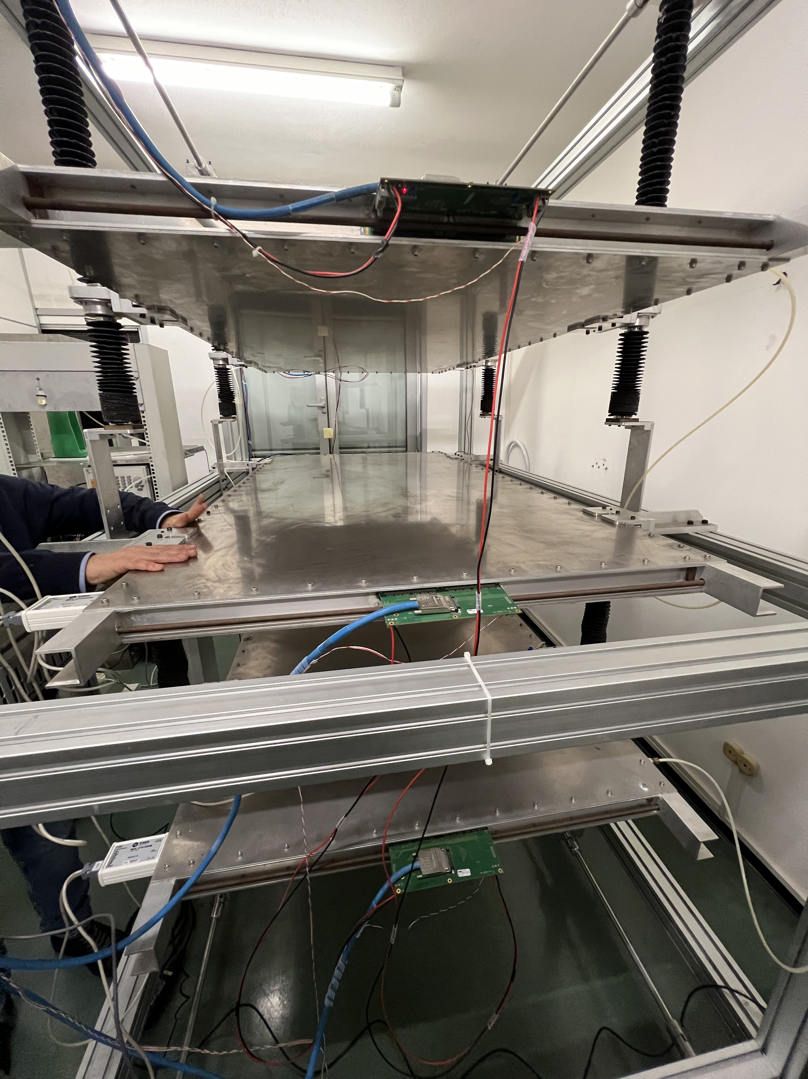
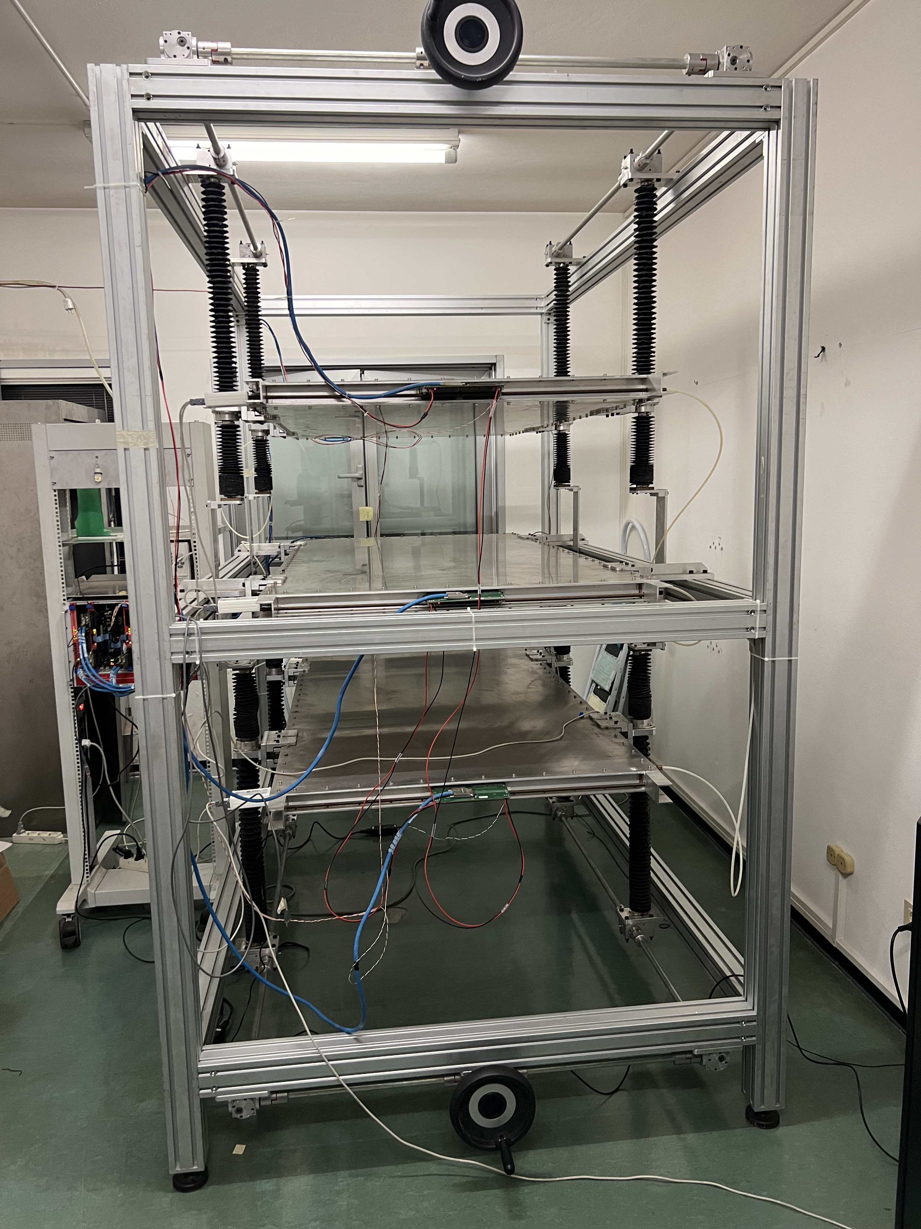
Hands-on 2 part 1
The second goal was to calculate the efficiency value of the measurement we did in the lab.
To do this we collected data from the cosmic ray detector
The cosmic ray detector consists in three layers: Bottom, Middle and Top.
Each layer is made up of a capacitor with a positively and negatively charged anode and cathode.
Software that receives datas
Cosmic ray detector

Slide 5
Hands-on 2 part 2
We calculated the efficiency through the formula
$\frac{detected particles}{detectable particles}$
Detected particles: n. of particles detected by the middle layer.
Detectable particles: n. of particles detected by the top and bottom layers.
The efficiency of our data with an 19000 HV is of 92% and it’s high! The percentual of the error of the efficiency is 0,36%.

Slide 6
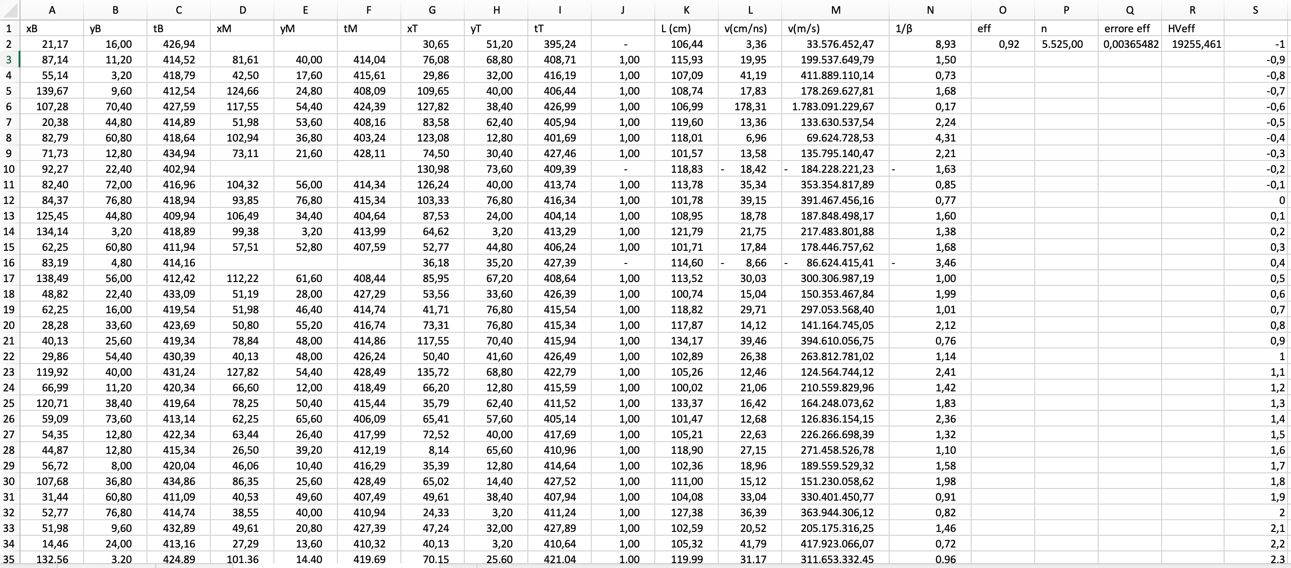

Slide 8
Group | HV correct (V) | Efficiency
1 | 14630 | 12,57%
2 | 15186 | 35,63%
3 | 16199 | 76,64%
4 | 17211 | 85,75%
5 | 17717,57579 | 88,72%
6 | 17970,68401 | 89,56%
7 | 18225 | 95,45%
8 | 18477 | 82,60%
9 | 18748 | 91%
10 | 19255,46 | 92%
11 | 19509 | 97%
12 | 19695 | 92,30%
13 | 19903 | 99,02%

Slide 9
GRAZIE!

