Slide 1
EEE Masterclass
LNL Telescope measurements
Project EEE- Blaise Pascal (RM) , Marconi (PI) Colatei, Gerardi, Pizzi, Reali

Slide 2
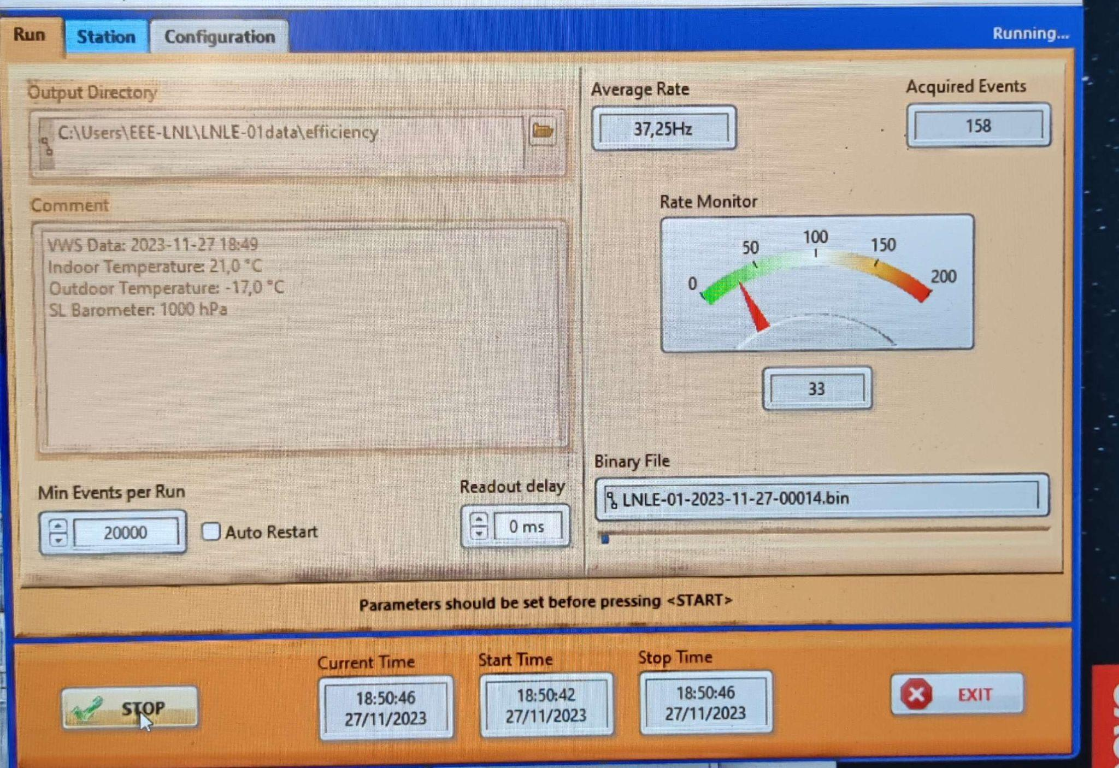
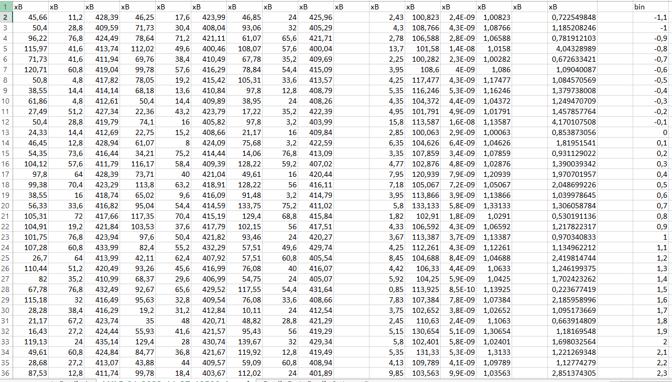
Data taking
We collected the data from the detector making sure to note the values of Pression and Indoor Temperature. We also checked the Trigger Output.
Here’s what we’ve got:
(we reached about 8000 Events)

Slide 3
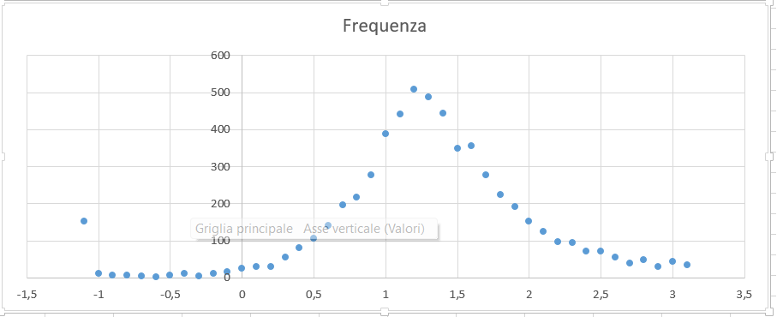
Data Analysis :Adjusting the Data with 1/𝛃
we calculated the 𝛃 values using the speed of light, the track length and the time of flight. These last two values come from the Data we took with the MRPC detector.
We then adjusted the measurements using the dispersion plot and selecting the values between 0.9 and 1.7

Slide 4
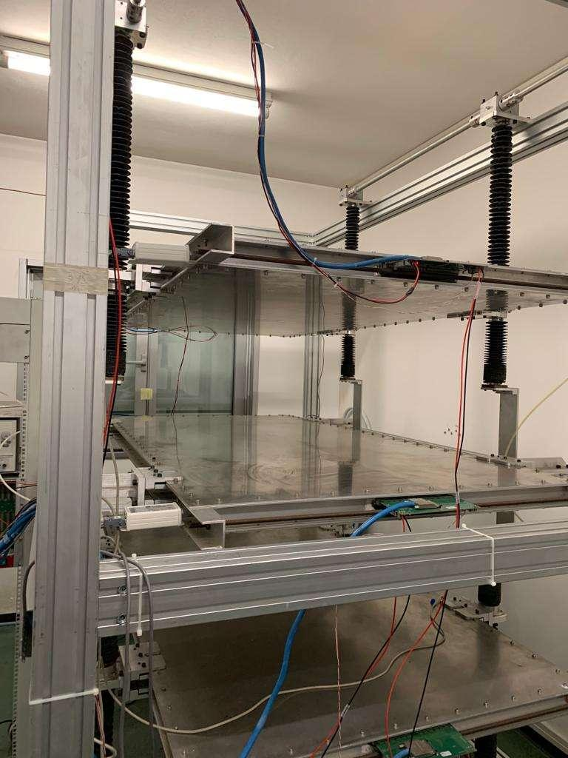
Data Analysis:
Efficiency , HVeff and the uncertainty
Knowing the particles detected and the detectable particles passing through the detector, we find the efficiency of the “under study” chamber (middle one). The efficiency uncertainty (%) 0,3572%
Then we determined the effective HV using the Pressure and Temperature conditions of measurements.
Our efficiency:
91,1746%
HV | HVeff
18500 V | 18748,74 V

Slide 5
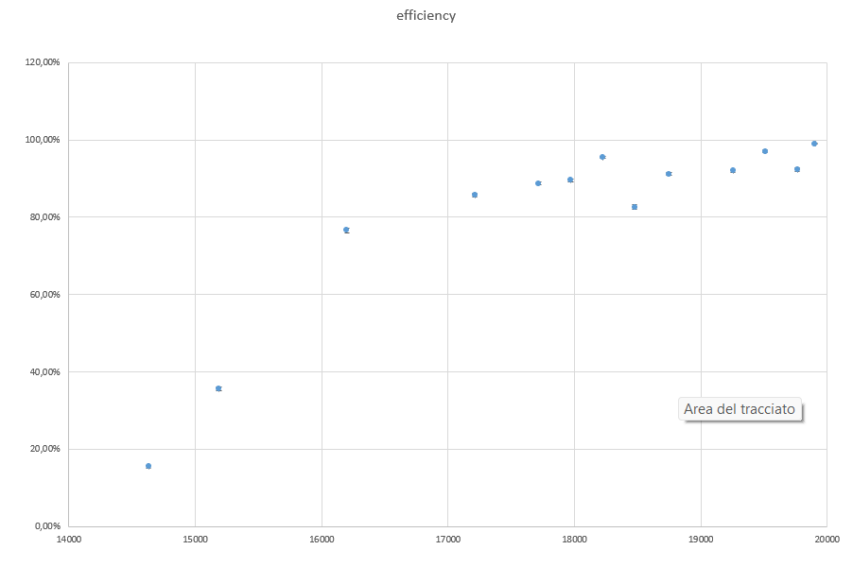
Efficiency curve with the HVeff
We placed in a pointed graph the efficiency points determined by all the groups:

