Slide 1
Fisica e medicina: radionuclidi e radiofarmaci
gaia.pupillo@lnl.infn.it
Notes:
15 min talk + 5 min domande (20 min)
ISOLPHARM + LARAMED + INFN e Prospettive
Intro 3 min
ISOLPHARM 5 min
LARAMED 10 min
Finale 2 min , con prospettive

Slide 2
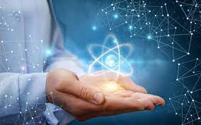
Why am I here?
Please ask questions!

Slide 3
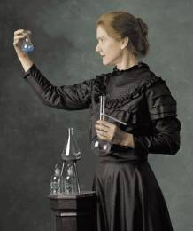
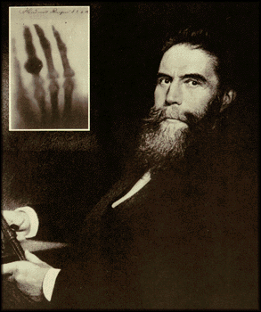
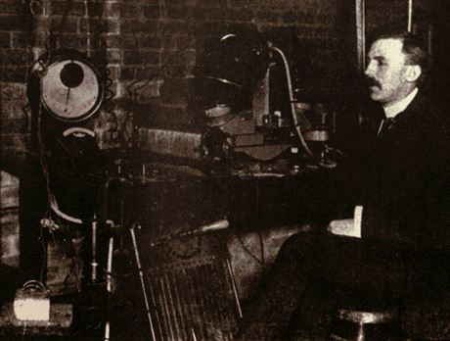
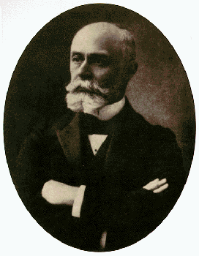
The role of physics in medicine.. a long love story
1895 Röntgen
X – ray discovery
1897 Rutherford
α and β discovery
1896 Becquerel
Radioactivity discovery
1900-1908
M.me Curie
Ra and Po discovery
(both more radioactive than uranium)
Marie Skłodowska was born in Warsaw, Poland, to a family of teachers who believed strongly in education. She moved to Paris to continue her studies and there met Pierre Curie, who became both her husband and colleague in the field of radioactivity. The couple later shared the 1903 Nobel Prize in Physics. Marie was widowed in 1906, but continued the couple's work and went on to become the first person ever to be awarded two Nobel Prizes. During World War I, Curie organized mobile X-ray teams. The Curies' daughter, Irene, was also jointly awarded the Nobel Prize in Chemistry alongside her husband, Frederic Joliot.

Slide 4
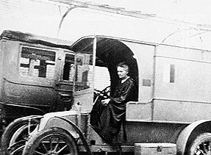
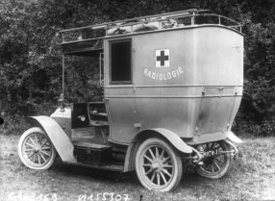
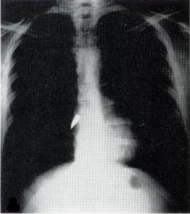
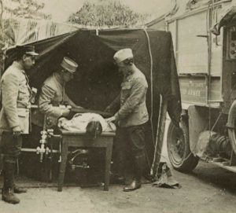
Something you may not know.. Crowdfunding!
M.me Curie was a great researcher, Nobel prize in Physics (1903) and in Chemistry (1911) ..
.. But it is not well known how active she was also in the application of radiation to medicine.
During 1° world war, she developed the Petites Curie, cars equipped with x-ray systems able to make diagnosis for injured soldiers. The Petites Curie were equipped with an x-ray syistem and a dark chamber.
To develop them, M.me Curie get the money with a «crowfunding» system and trained many nurses to drive and use the Petites Curie.
M.me Curie during I World War driving a Petit-Curie
It was estimated that the total number of injured soldiers that received x-ray exams during the war was more than 1 million!

Slide 5
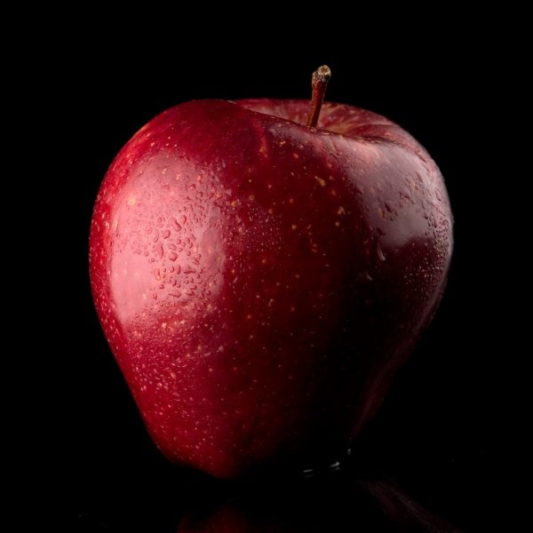
How do x-rays work?

Slide 6
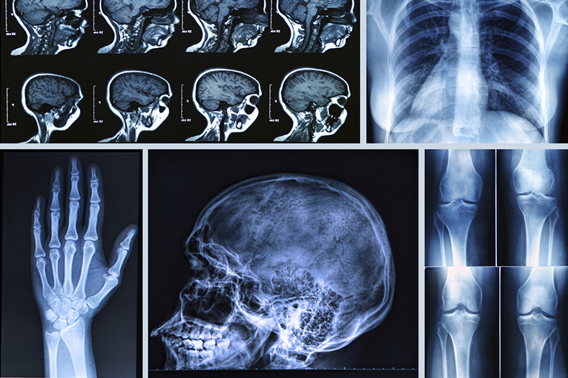
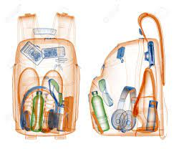
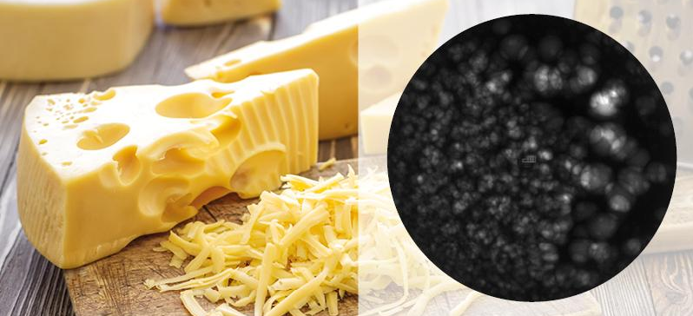
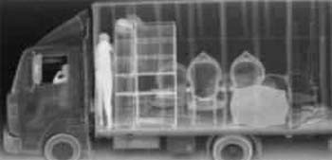
When are x-rays useful?

Slide 7
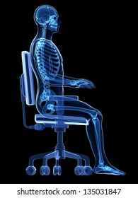
Are you able to say if he is alive?
Physicians need a different tool to investigate the biological behaviour of the cells

Slide 8
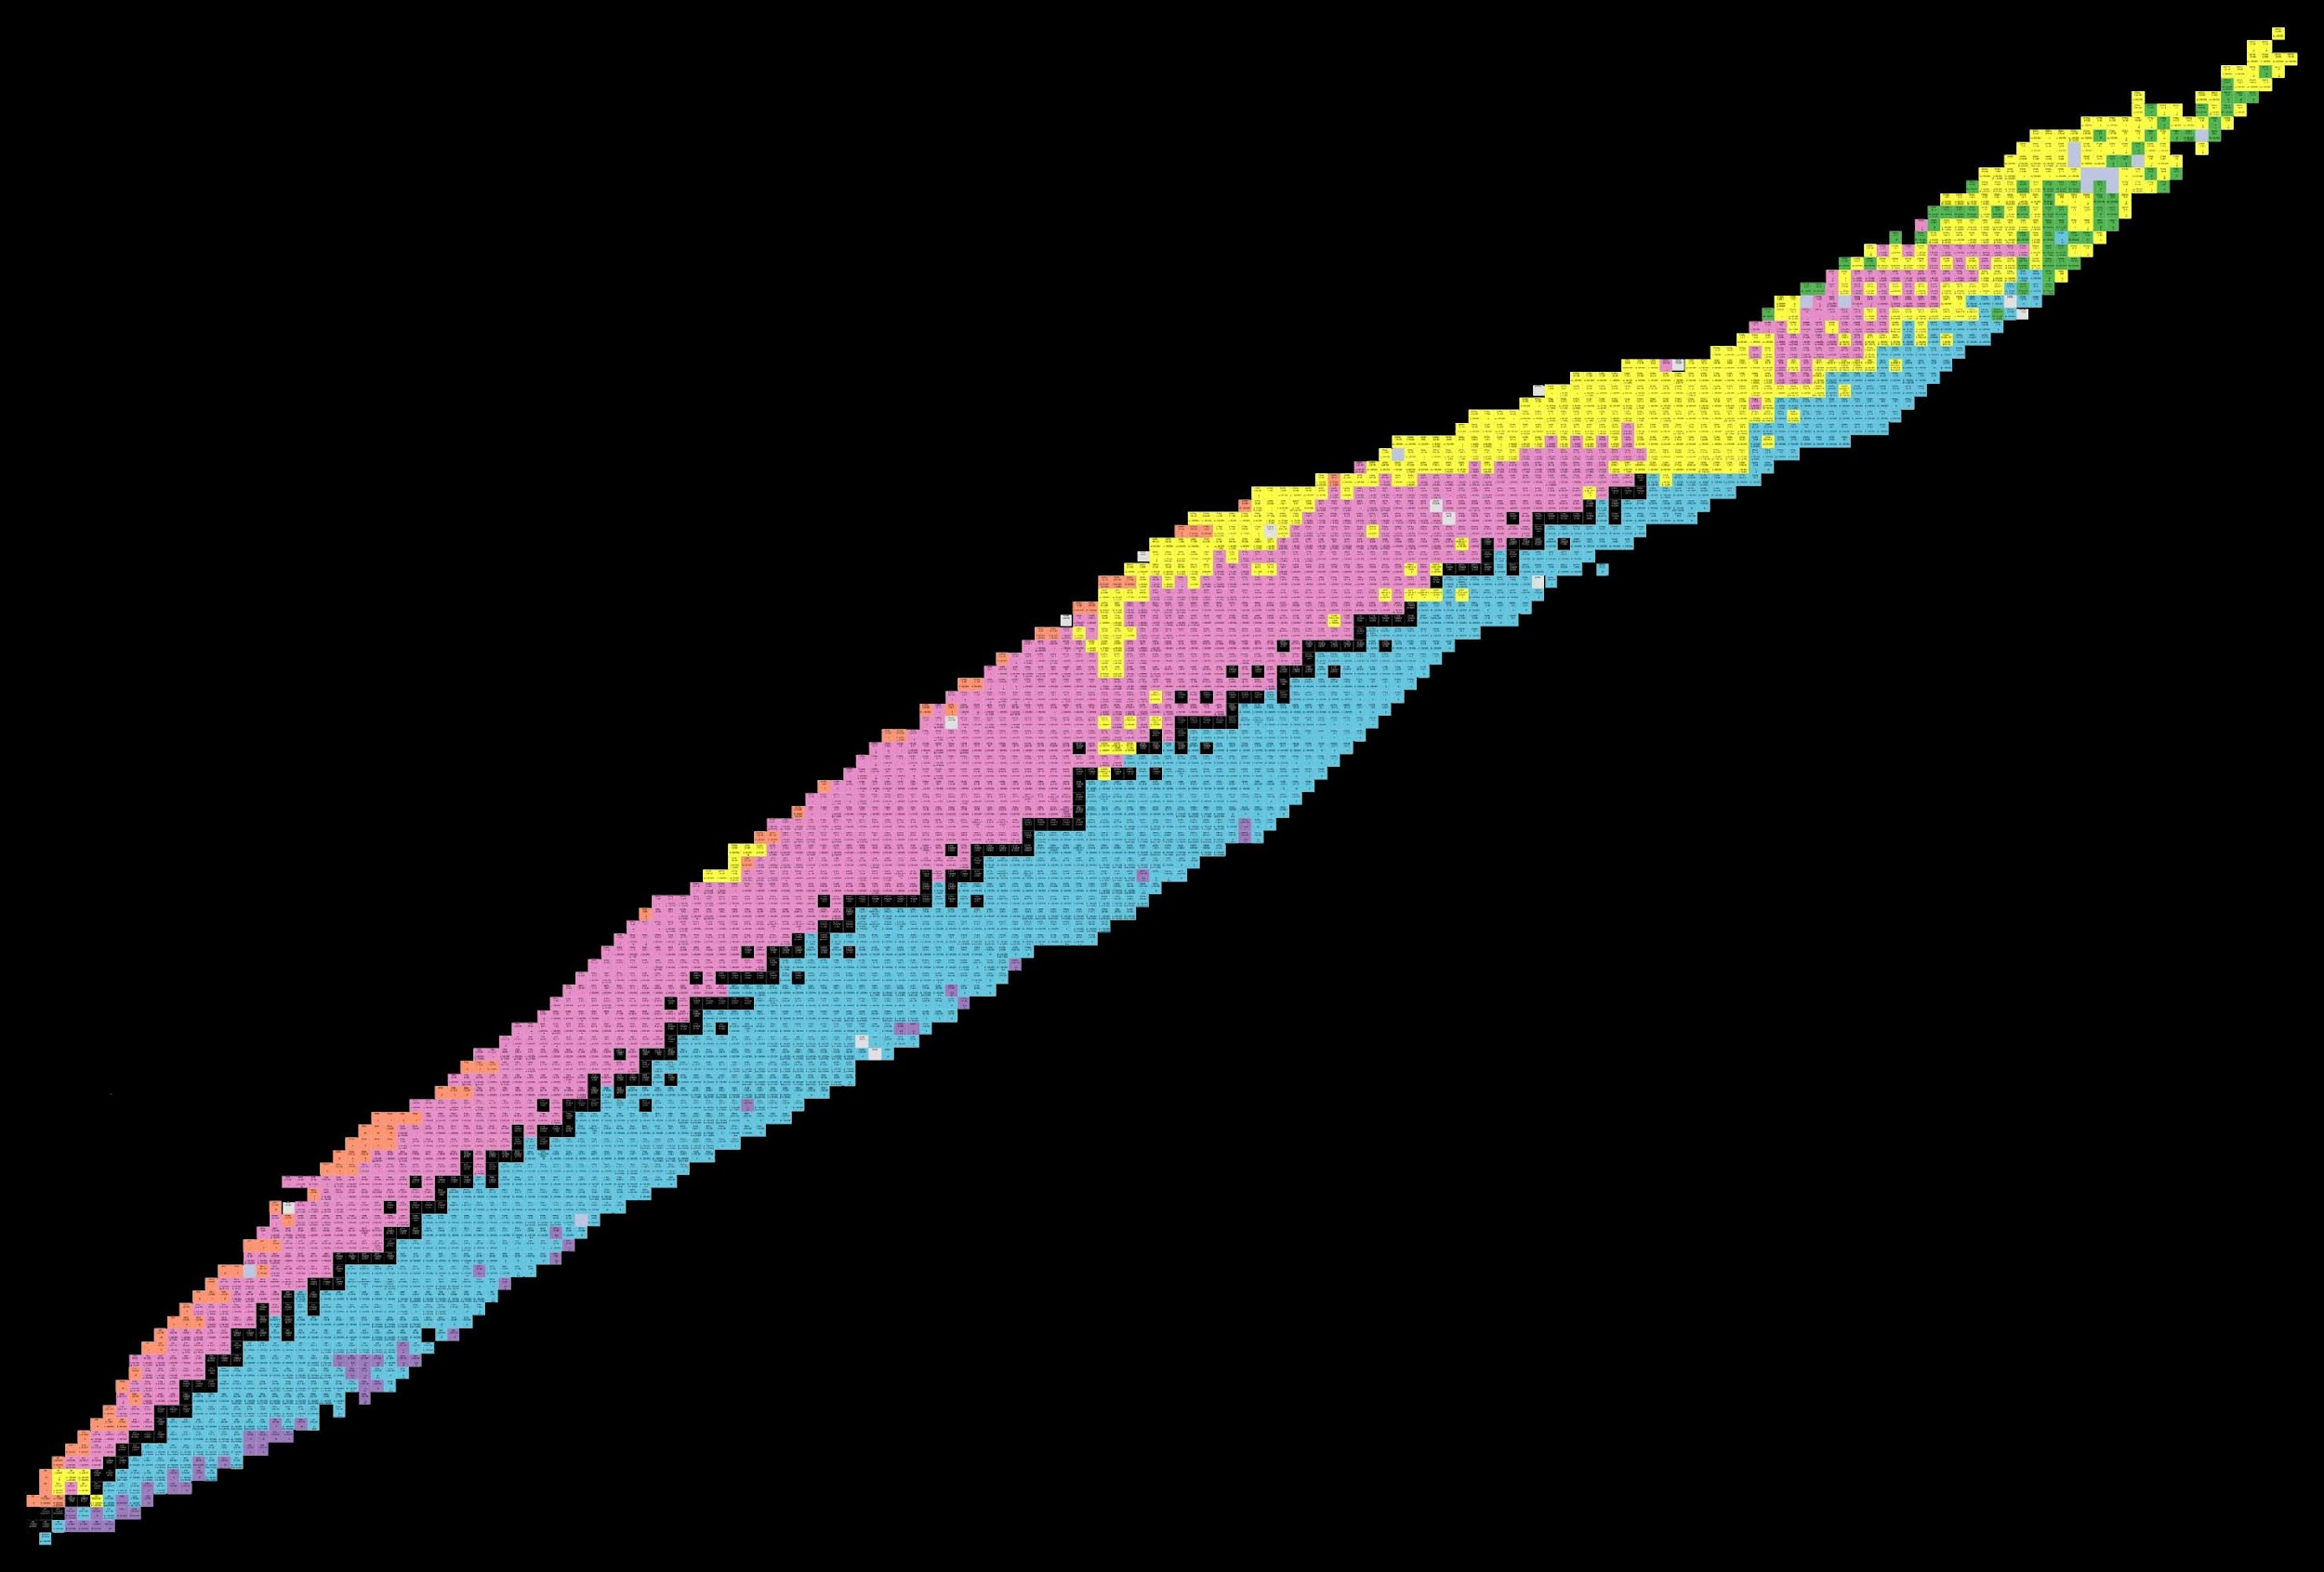
Radionuclides
Alfa
Fission
Beta +
Numero di protoni Z
Stable ~ 279
Radioactive ~ 5000
Beta -
Numero di neutroni N

Slide 9
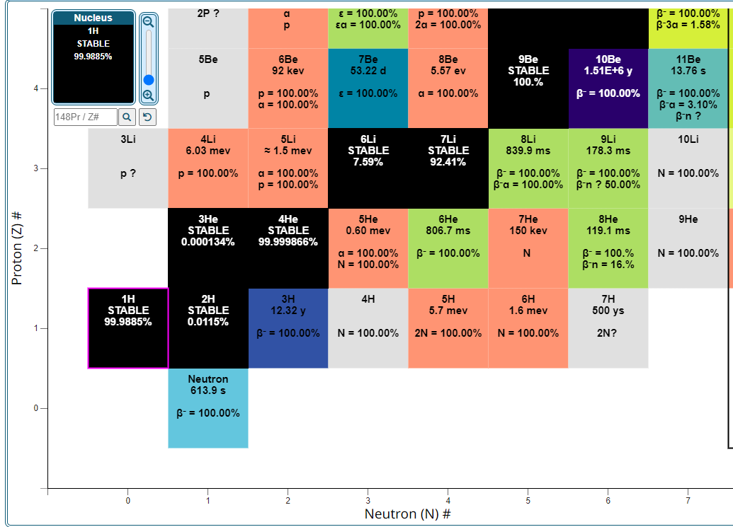
Radionuclides

Slide 10
Radionuclides
Half-life
12.32 years (Y)
Emitted radiation:
Beta-

Slide 11
Interaction of radiation and matter
Alpha
Beta
Gamma
Neutron
Paper
Al
Pb
H₂O

Slide 12
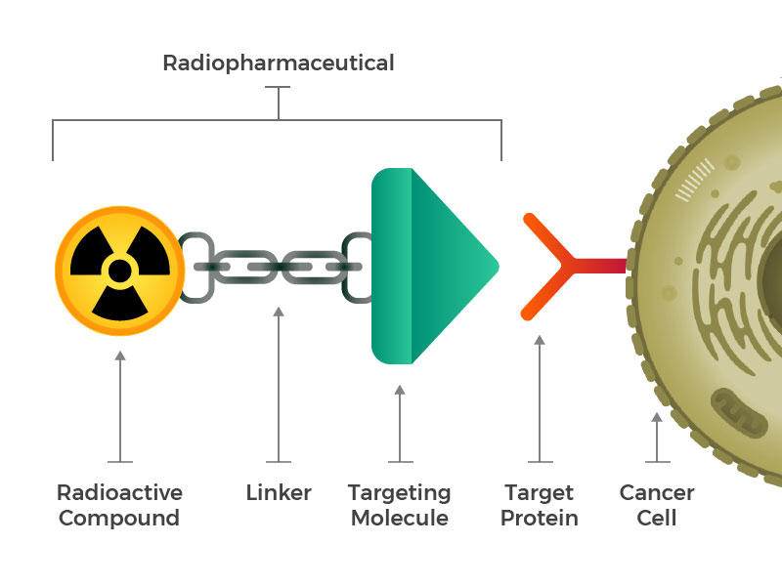
Radionuclides and radiopharmaceuticals
Radionuclide with suitable physical and chemical properties
Capacity to localize the radionuclide in the specific, desired biological target

Slide 13
Radionuclides and radiopharmaceuticals
imaging

Slide 14
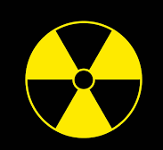
How do radiopharmaceuticals work?
Useful decay radiation for imaging: photon (γ) or positron (β⁺)

Slide 15
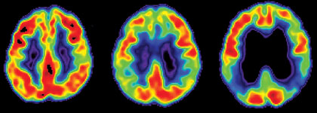
Are you able to say what is this?

Slide 16
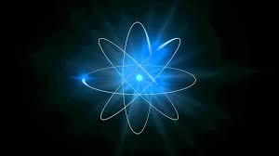
How does SPECT imaging work?
SPECT_Single Photon Emission Tomography
Useful decay radiation for SPECT imaging: photon (γ)

Slide 17
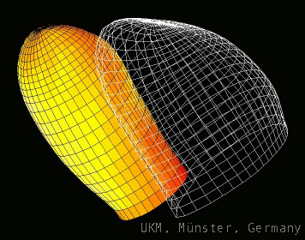
Cardiac SPECT imaging

Slide 18
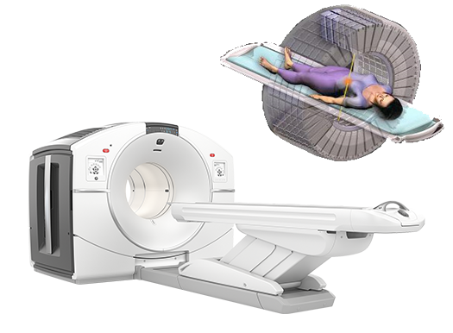
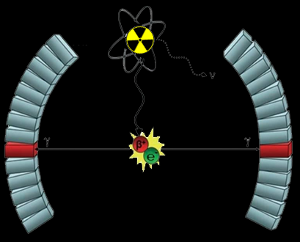
How does PET imaging work?
PET_Positron Emission Tomography
ν_{e}
Beta⁺
gamma
gamma
Useful decay radiation for PET imaging: positron (β⁺)

Slide 19
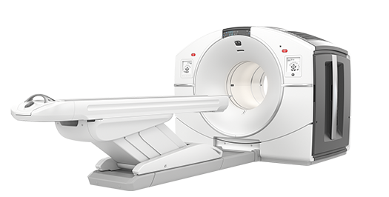
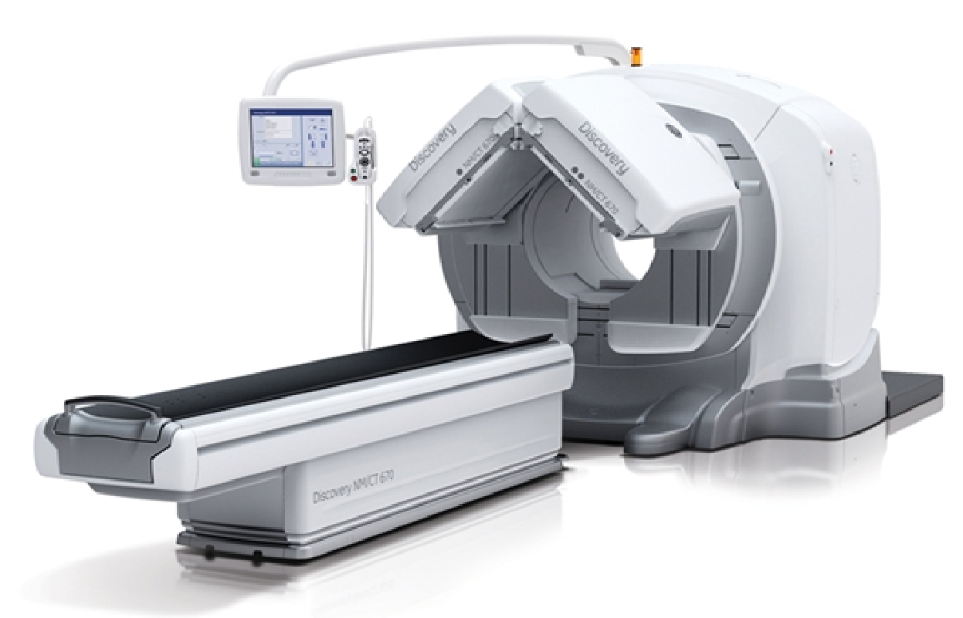
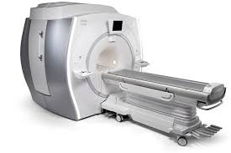
Multi-modality imaging
Morphology + Biochemistry = Localization of the disease
+
=
PET-CT
SPECT-CT
PET-MRI

Slide 20
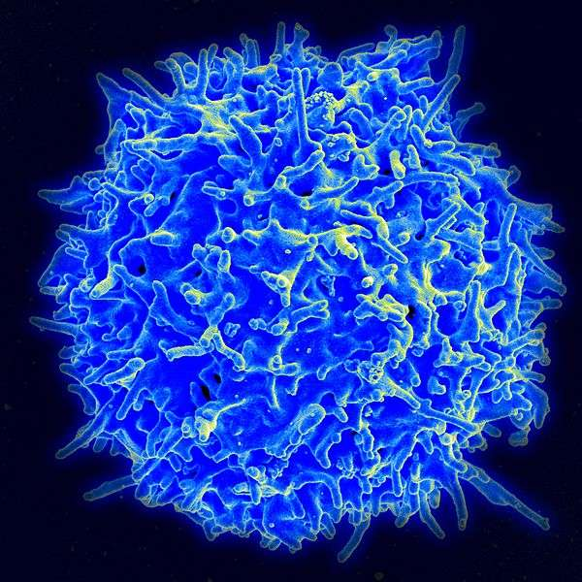
How does therapy with radiopharmceuticals work?
Useful decay radiation for theraphy: alpha (α), beta (β⁻) and Auger e⁻

Slide 21
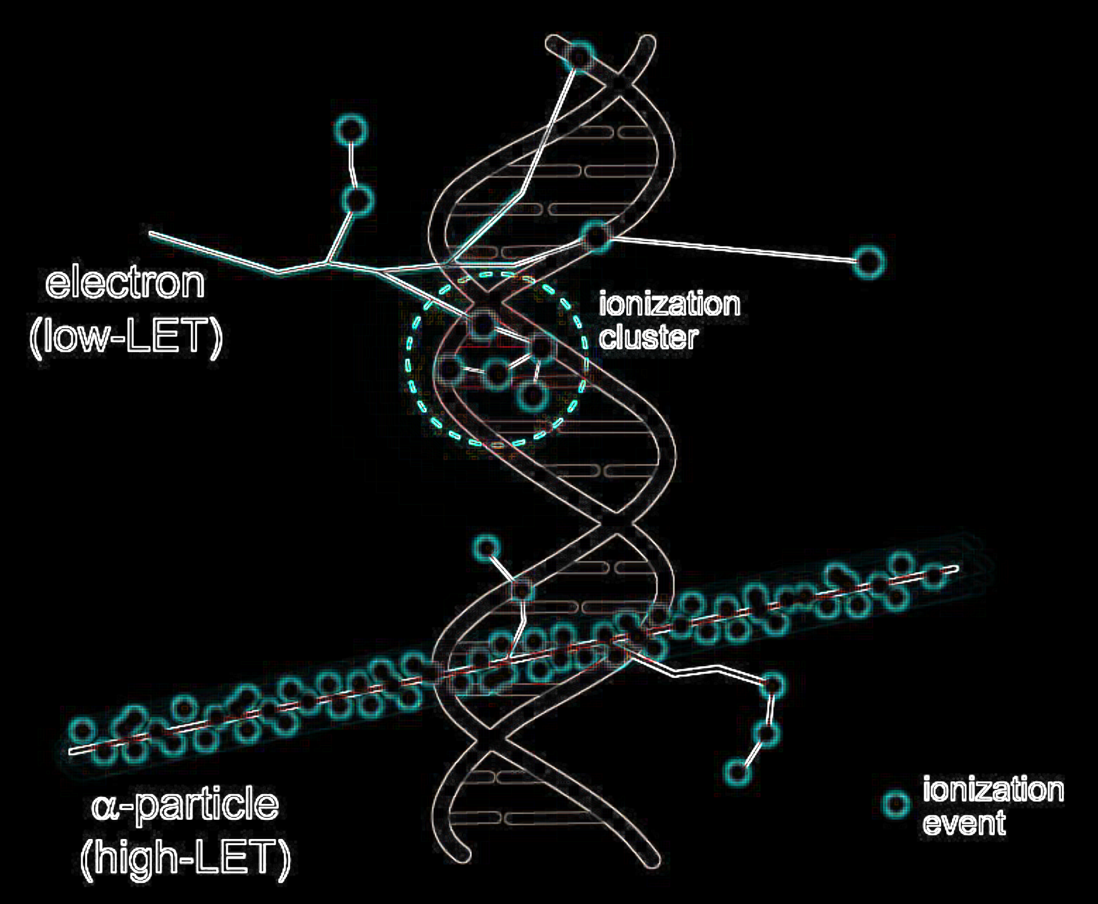
How does therapy with radiopharmceuticals work?
Elettroni (β⁻)
Alfa (α)
Useful decay radiation for theraphy: alpha (α), beta (β⁻) and Auger e⁻

Slide 22
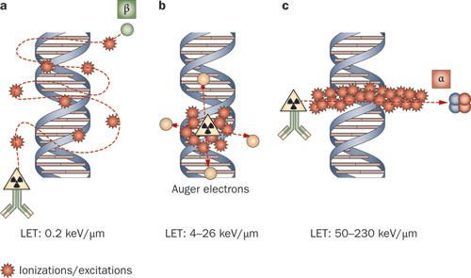
Radionuclides and radiopharmaceuticals
THERAPY
therapy

Slide 23
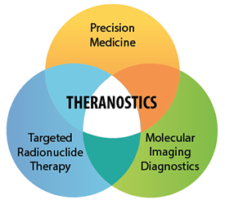
Radionuclides and radiopharmaceuticals
Selection of patients!

Slide 24
Radionuclides and radiopharmaceuticals
It’s very important to have a variety of medical radionuclides

Slide 25
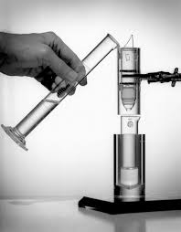
Medical radionuclides production
Direct:
For example ¹⁸F, ¹¹C , ¹³¹I, …
Production routes
Generator:
For example ⁹⁹Mo/^{99m}Tc, …

Slide 26
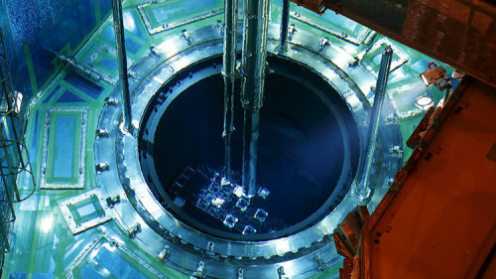
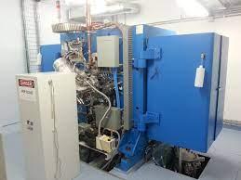
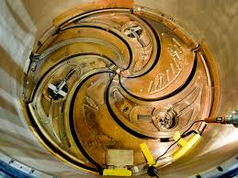
Medical radionuclides production
Nuclear reactors
Particle accelerators
Medical cyclotron at the Sacro Cuore Don Calabria hospital (Protons 19 MeV)

Slide 27
The SPES project
SPES-α
The cyclotron and related infrastructure.
SPES-β
The ISOL facility and the acceleration of neutron-rich unstable nuclei.
SPES-γ
The production of radionuclides for applications.
SPES-δ
The multidisciplinary neutron sources.

Slide 28
SPES-γ
ISOL technique
A. Andrighetto
Resp. ISOLPHARM
Direct activation
J. Esposito
Resp. LARAMED
SPES-γ
The production of radionuclides for applications
https://isolpharm.pd.infn.it/web/
https://www.lnl.infn.it/en/spes-laramed-range

Slide 29
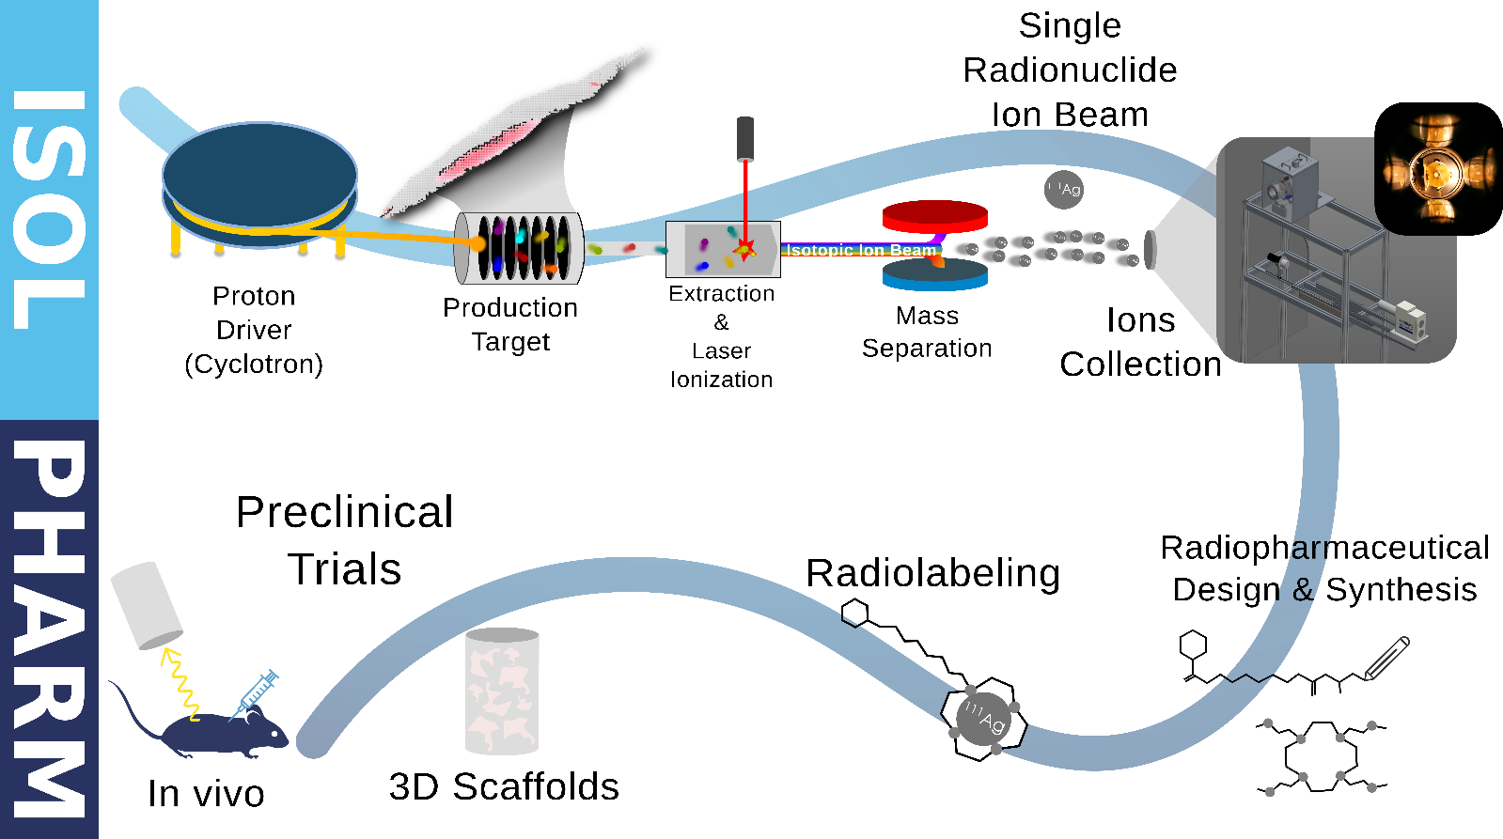
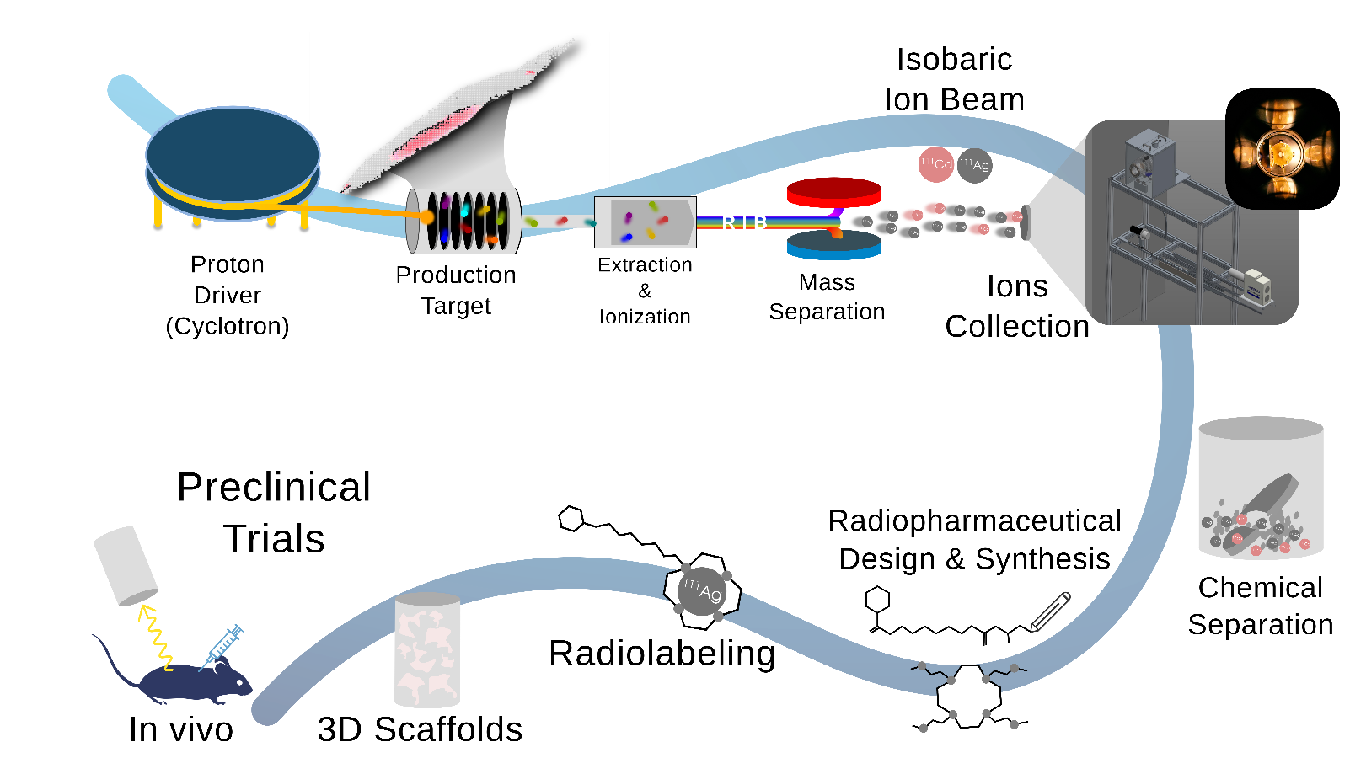
ISOLPHARM: the Method
ISOLPHARM method is capable of selecting and isolating a
SINGLE RADIO-ISOTOPE
+ high specific activity
+ radionuclidic purity
The ISOLPHARM Method is an INFN Patent

Slide 30
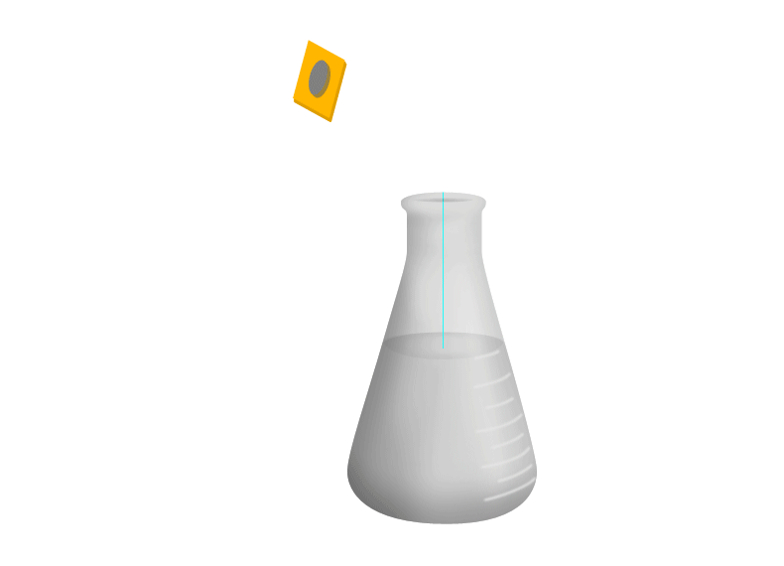
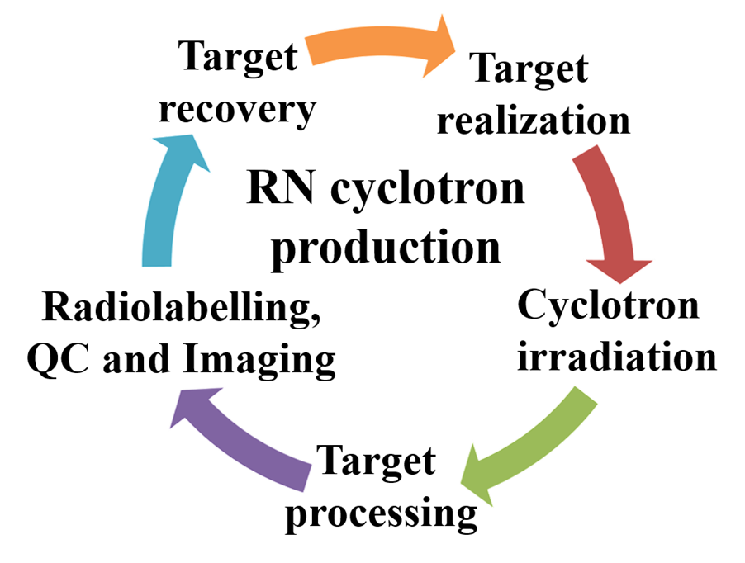
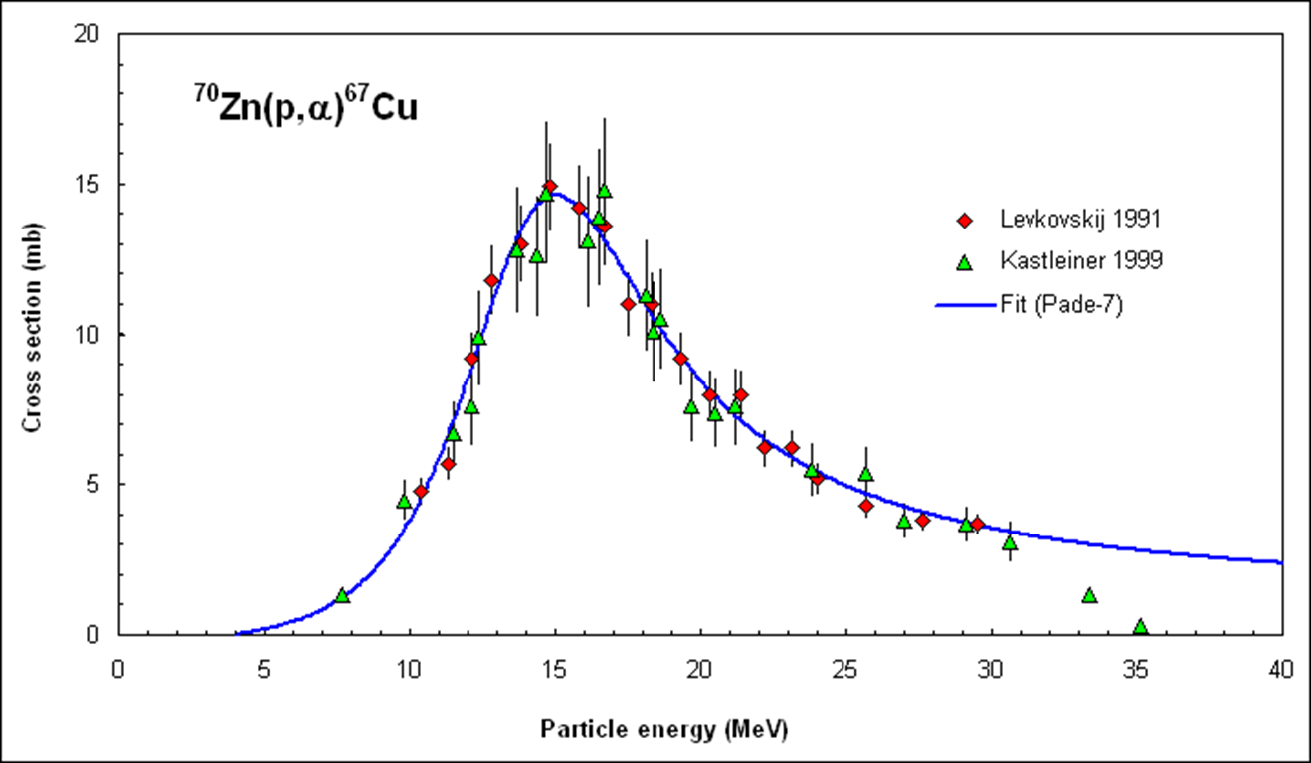
LARAMED: Production steps
Cyclotron Radioisotope production
Radiochemical processing
Quality controls
Labelling
Target
Radioisotope of interest
Contaminants
Pure radioisotope
Irradiation
Radio-
pharmaceutical preparation
Target activation
Dissolution
Nuclear physics
Extraction/
separation
Purification

Slide 31
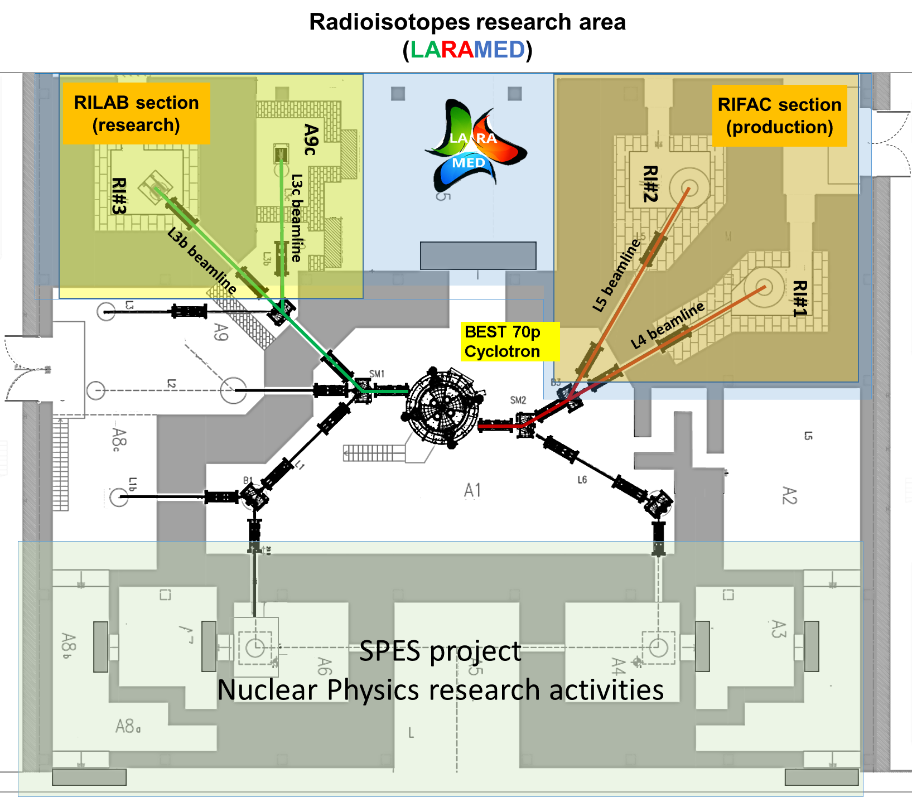
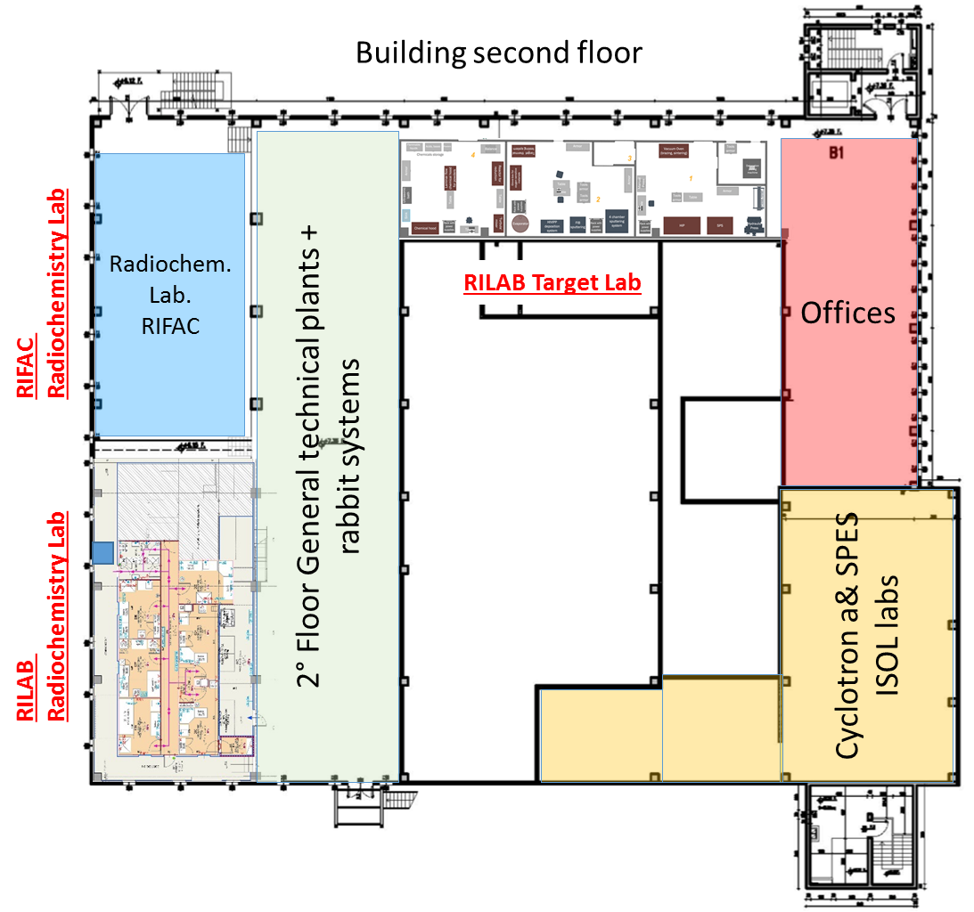
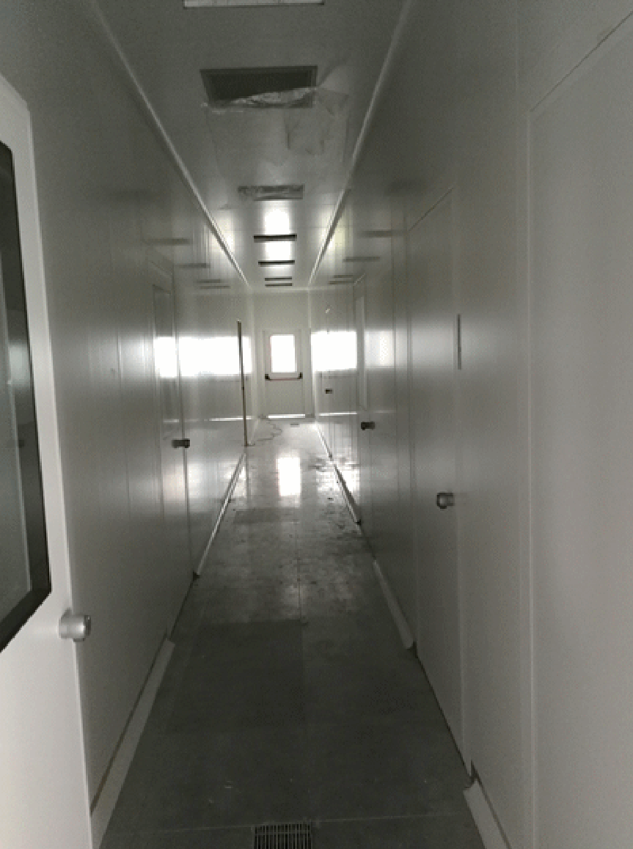
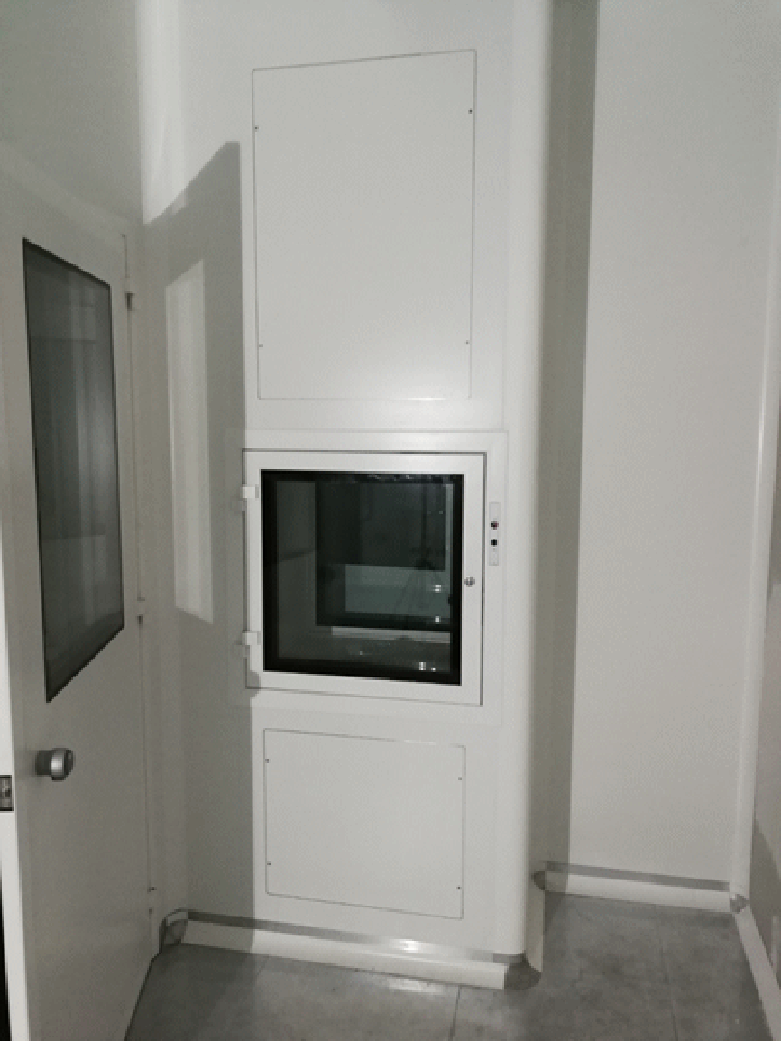
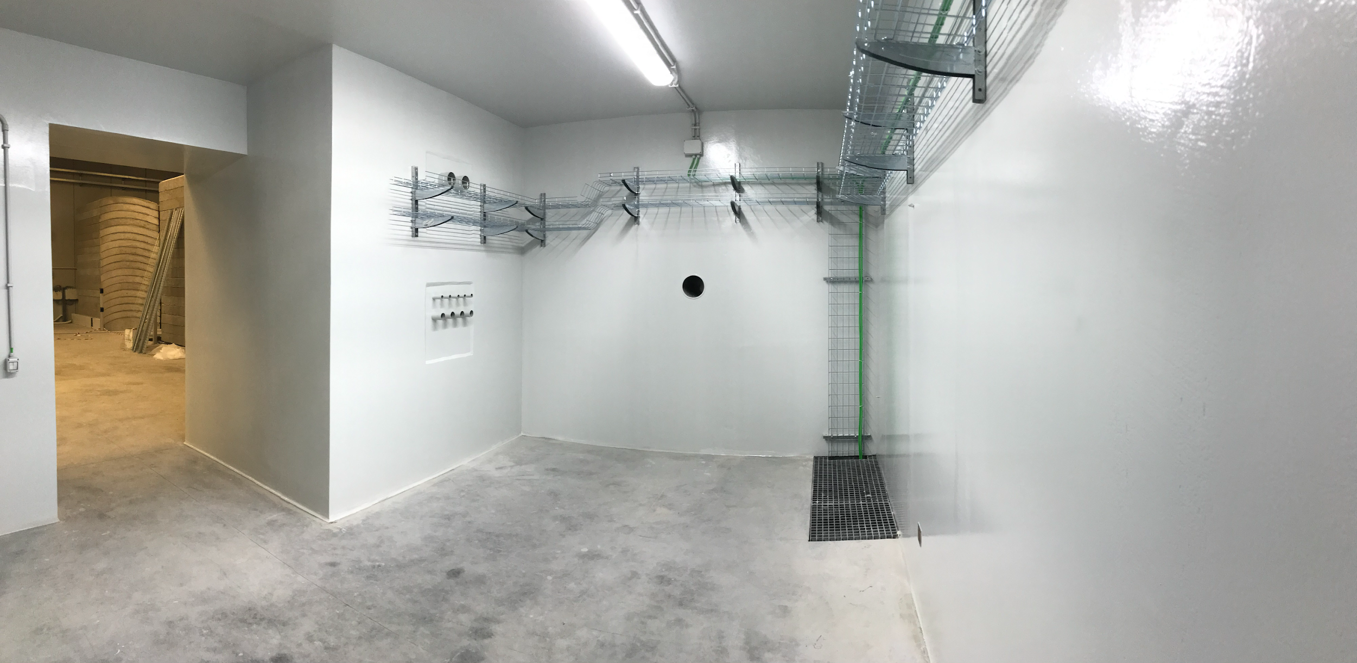
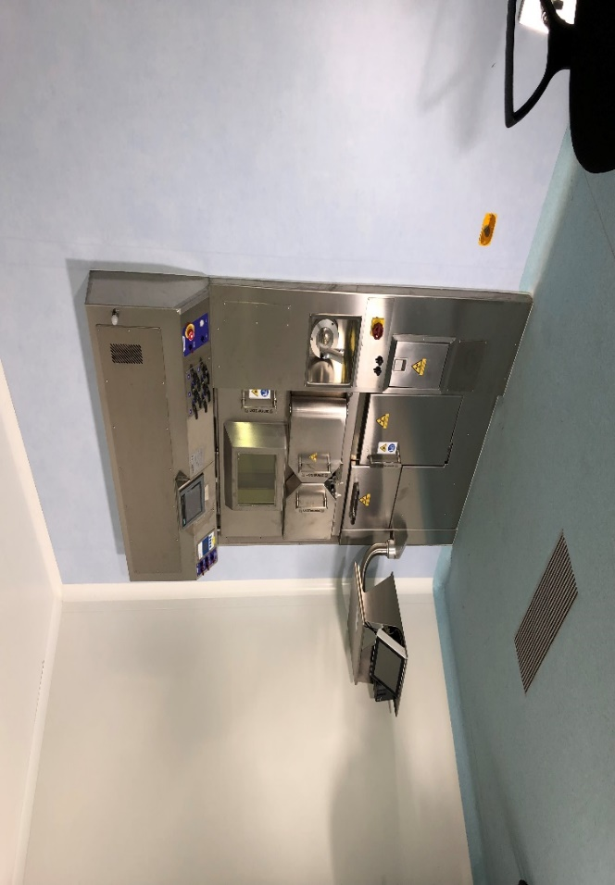
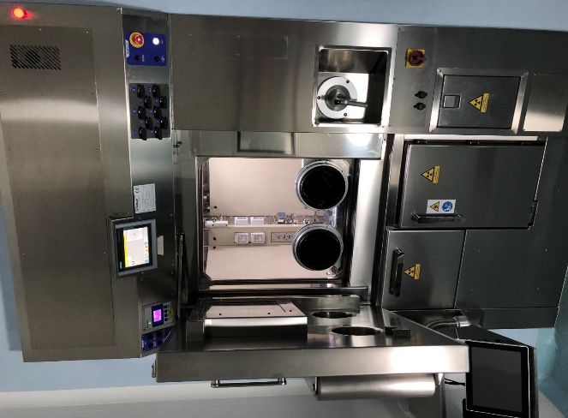
LARAMED facility
RILAB chemistry / targetry labs
Pass box
Central corridor
RILAB Radiochemistry labs
Cyclotron
Bunker A9c
Hot Cell

Slide 32
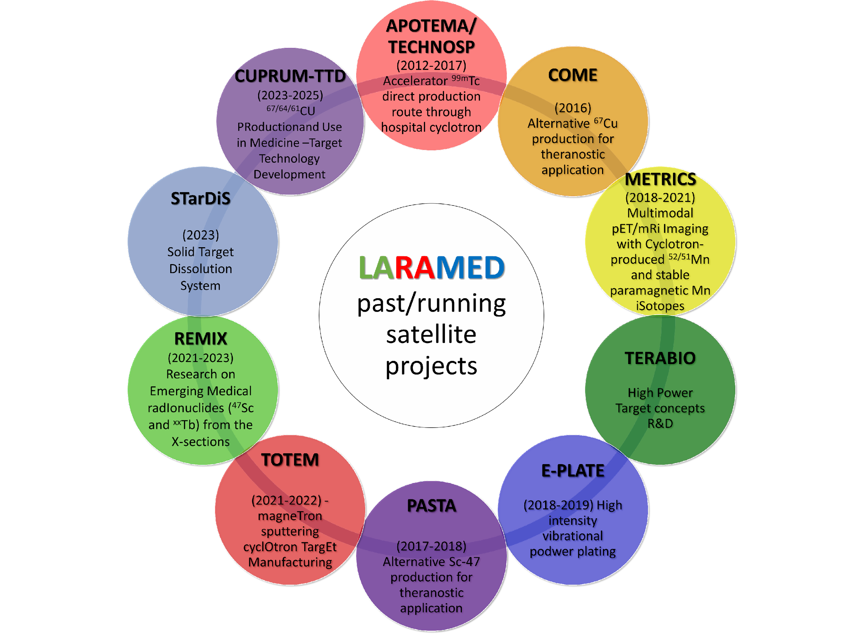
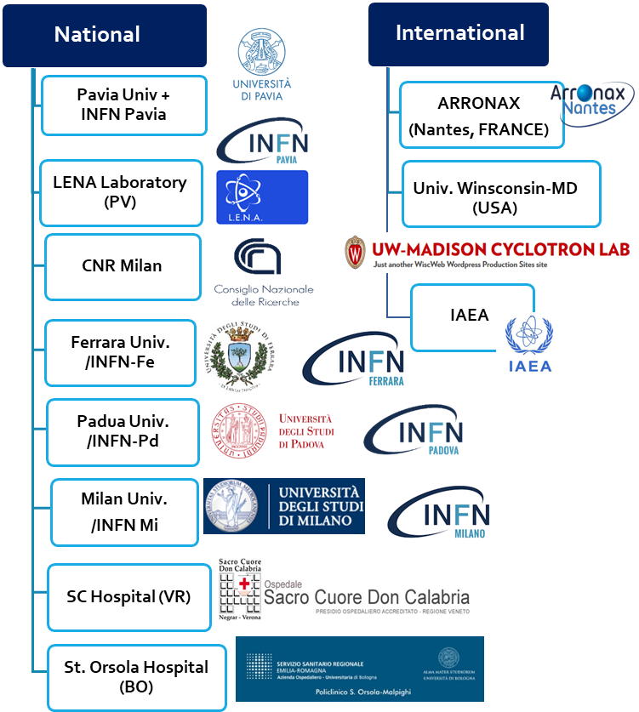
LARAMED projects & network
^{99m}Tc
⁶⁷Cu
⁶⁴Cu
⁴³Sc
⁴⁷Sc
^{44m}Sc
⁵²Mn
¹⁵²Tb
¹⁴⁹Tb
¹⁵⁵Tb
¹⁶¹Tb

Slide 33
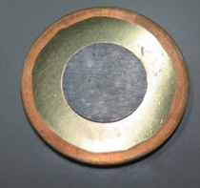
^{99m}Tc direct production cycle
^{99m}Tc
Closed-loop technology developed at LNL: recovery of costly target material
International Patent
n° WO2019053570
Target manufacturing
¹⁰⁰Mo recovery
APOTEMA
TECHN-OSP
Direct production exploiting the
¹⁰⁰Mo(p,2n)^{99m}Tc
reaction
Cyclotron irradiation
Radiopharmaceuticals, QC & imaging
Radiochemistry processing
CRP on ⁹⁹Mo/^{99m}Tc suppy (2011/2015)

Slide 34
⁵²Cr target manufacturing technology by SPS
⁵²Mn and the METRICS project
⁵²Mn | E_{β+} _{(avg)} 250 keV | PET
⁵¹Mn | E_{β+} _{(avg)} 960 keV
Mn²⁺ | Paramgnetic properties | MRI contrast agent
⁵²Mn
Development of ^{52/51}Mn/Cr efficient separation

Slide 35
⁶⁷Cu as theranostic agent
Most used targets for ⁶⁷Cu production: ⁶⁸Zn
⁶⁷Cu: 2.58 d
Mean β- energy: 141 keV (100%)
Main γ-ray 184 keV (48.7%)
→ SPECT
⁶⁷Cu
⁶⁸Zn(p,2p)⁶⁷Cu
⁶⁴Cu
10
⁶⁴Cu: 12.7 h
Mean β- energy: 191 keV (38.5%)
Mean β+ energy: 278 keV (17.49%)
→ PET
⁶⁸Zn(p,x)⁶⁴Cu
COME project
INFN-CSN3 2016
60
20
CRP on ⁶⁷Cu, ⁴⁷Sc, ¹⁸⁶Re (2016/2020)

Slide 36
⁶⁷Cu cross section measurements
Scheme of a typical stacked-foils target
Stacked-foils target assembly
Beam setting with alumina
Enriched ⁷⁰Zn targets produced at LNL by lamination
Irradiation runs on the AX3 beam-line
Data analysis
γ-spectrometry
Radiochemistry
Target disassembly

Slide 37
γ-spectrometry @ Arronax facility
xGa-xx-0cm
Activity at the End of Instantaneous Bombardment (EOIB)
$${Act}_{EOIB}=\frac{C}{ε_{d}\left(E_{γ}\right)I\left(E_{γ}\right)t_{l}}∙e^{λt_{D}}∙\left(\frac{λt_{irr}}{1−e^{−λt_{irr}}}\right)\left(\frac{λt_{r}}{1−e^{−λt_{r}}}\right)$$
Activity
measured
Correction for the decay during the time between the end of irradiation and the start of the measurement with HPGe
Correction for the decay during the irradiation
xZn-xx-0cm
Correction for the decay during the measurement with HPGe
HPGe detector
$$\left\{\begin{aligned}C=number of counts registered by a detector at the energy E \\ ε\left(E\right)=detector efficiency at the energy E \\ I\left(E\right)=Branching Ratio \\ t_{L}=live time (s) \\ λ=decay constant \left(1/s\right) \\ t_{EOB}=time of the end of irradiation \\ t_{meas}=start of the measurement with HPGe \\ t_{D}= t_{meas}− t_{EOB} \\ t_{irr }=radiation duration\end{aligned}\right.$$
MIX-xx-19cm
xCu-xx-0cm
Before radiochemical separation
After radiochemical separation

Slide 38
Results

Slide 39
⁶⁷Cu as theranostic agent
G. Pupillo, L. Mou et al., Production of ⁶⁷Cu by enriched ⁷⁰Zn targets…, Radiochim. Acta 108 (8) 2020

Slide 40
⁶⁷Cu as theranostic agent
Cross section ratio ⁶⁷Cu/⁶⁴Cu
a.d.u.
“A method and a target for the production of ⁶⁷Cu”
Mou, Pupillo, Martini, Pasquali
⁶⁷Cu/⁶⁴Cu ratio favourable from ⁷⁰Zn target above 56 MeV
International Patent
n° WO 2019/220224 A1
November 2019

Slide 41
CUPRUM_TTD (2023-2025)

Slide 42
STarDiS: Solid Target Dissolution System
AIM: Development of a solid target dissolution system integrable on automatic commercial modules for radiopharmaceuticals synthesis
A complete solution for processing, separation, purification and radiolabelling within a single cassette-based module
Module’s motor
Vial
Mounting rods
Target holder
Module’s heater

Slide 43
⁴⁷Sc as theranostic agent
SPECT
THERAPY
Sc-47 3.3492 d | γ-ray [keV] | γ-ray [%] | β- energy [keV] | β- int [%] | Auger e-[keV] | Auger e- [%]
β⁻ : 100 % | 159.381 | 68.3 | 142.6 | 1.11 | 0.42 | 0.461
(Ti-47) |  |  | 203.9 | 31.6 | 4.0 | 0.215
 |  |  |  |  | 154.415 | 0.277
CRP on ⁶⁷Cu, ⁴⁷Sc, ¹⁸⁶Re (2016/2020)
Mean β⁻ : 162 keV
PASTA project
INFN-CSN5
2017-2018
⁴³Sc
⁴⁷Sc
^{44m}Sc
The limiting factor for clinical and preclinical studies is the lack of ⁴⁷Sc availability
¹⁵²Tb
¹⁴⁹Tb
REMIX project
INFN-CSN5
2021-2023
¹⁵⁵Tb
¹⁶¹Tb
APHRODITE project on ¹⁵⁵Tb
MUR, PRIN PNRR (2024-2025)

Slide 44
WP1. Production & target characterization
Sara Cisternino (INFN-LNL & UniPD)
WP7. Devices for INFN-LNL beam-line
Gabriele Sciacca (INFN-LNL & UniPD)
WP2. XS measurements ⁴⁹Ti,⁵⁰Ti
Liliana Mou (INFN-LNL)
WP3. XS measurements ^{nat}Dy,¹⁵⁹Tb, ^{nat}Eu
Simone Manenti (UniMI & INFN-MI)
WP6. ¹⁵⁵Tb TTY production
@ SCDC hospital
Petra Martini (UniFE & INFN-FE)
WP4. Nuclear codes (TALYS, EMPIRE, FLUKA)
Luciano Canton (INFN-Padova)
Andrea Fontana (INFN-Pavia)
WP5. Dosimetric calculations
Laura De Nardo (UniPD & INFN-PD)
Laura Melendez-Alafort (IOV)

Slide 45
Many medical radionuclides of interest!
Young team of researchers with different expertise
(targetry, nuclear physics, engineering, radiochemistry, etc.)
Wide national & international network of collaborations +
High potential impact exploiting both ISOL and DIRECT production @ SPES
Possibility to have a off-line mass-separator for medical radionuclides production

Slide 46
Thanks for the attention!
gaia.pupillo@lnl.infn.it

