Slide 1
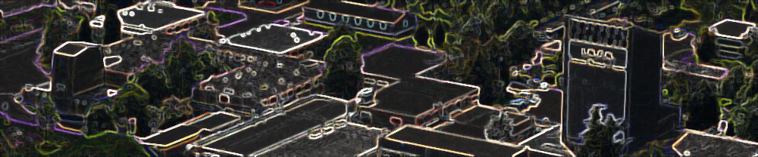
20 years of the EEE activity (2004-2024)
F.Riggi
Dept.Physics & Astronomy and INFN, Catania
EEE Meeting, LNL, November 27-29, 2023

Slide 2
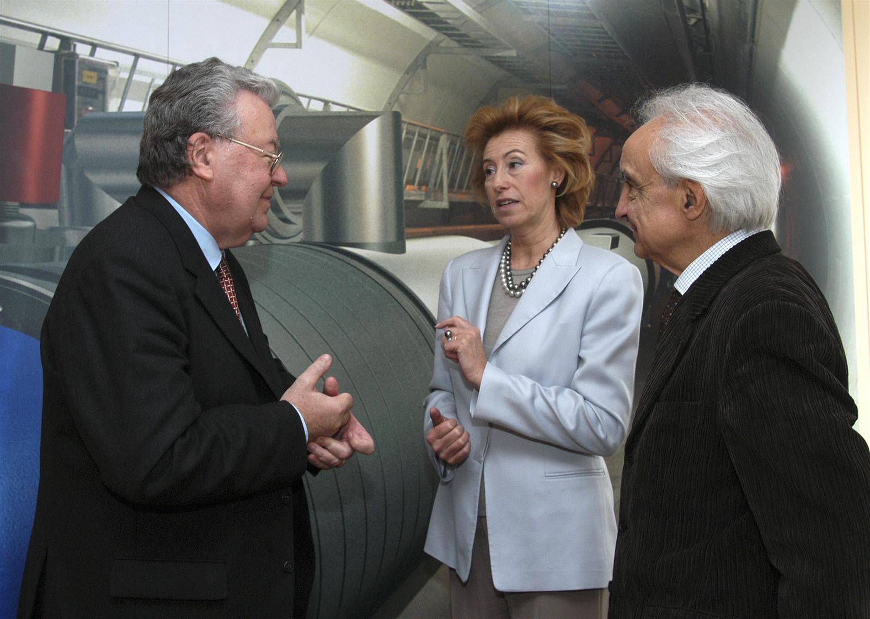
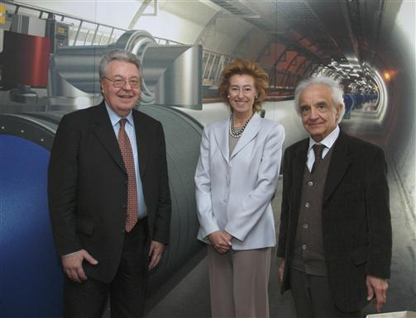
Once upon a time…
May 3rd, 2004: The EEE Project officially presented to MIUR at CERN
Letizia Moratti (Ministry for Education and Research), Robert Aymar (CERN Director) and Antonino Zichichi meet at CERN
The year 2024 will mark 20-years activity of the EEE Project

Slide 3
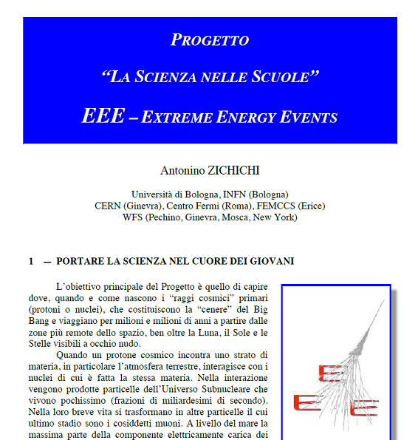
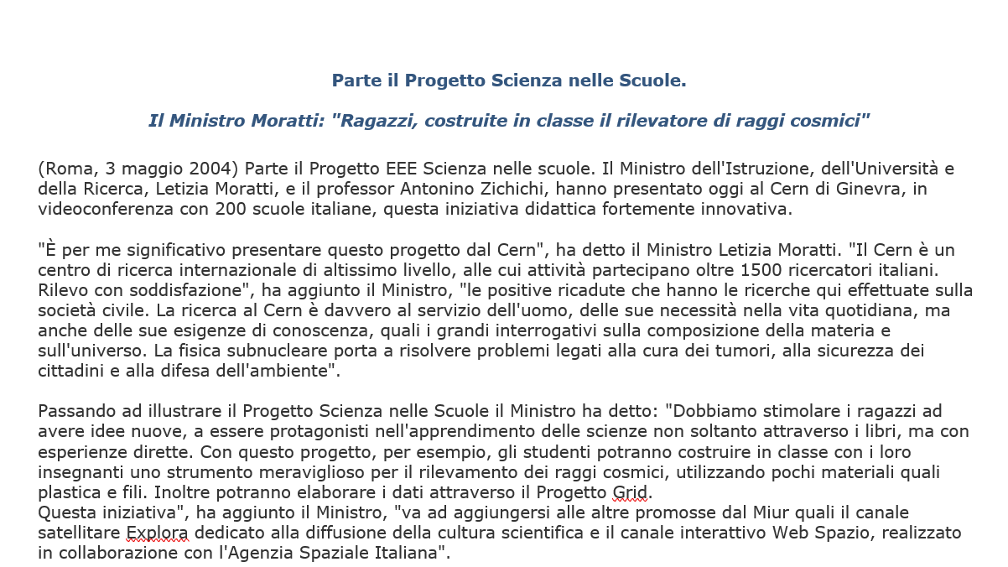
When all this began
MIUR Newspress, 2004

Slide 4
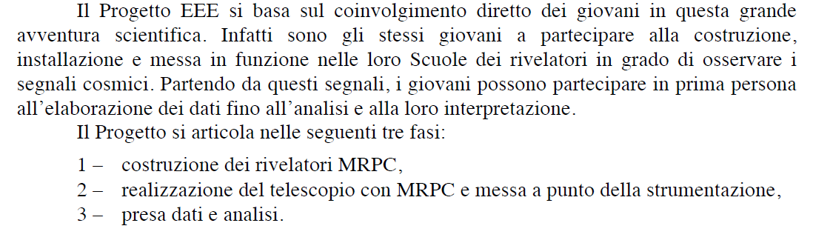
The goals of the Project
The main goals of the Project and the planned steps were already clearly stated in this early document

Slide 5
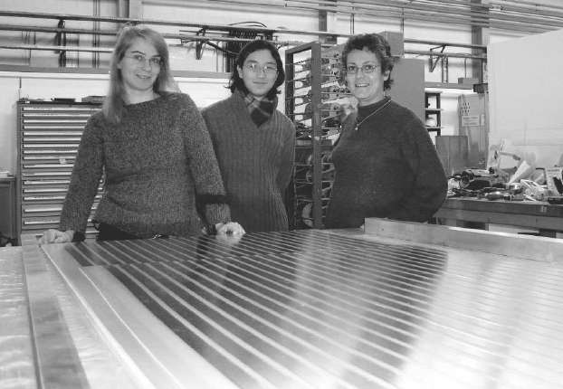
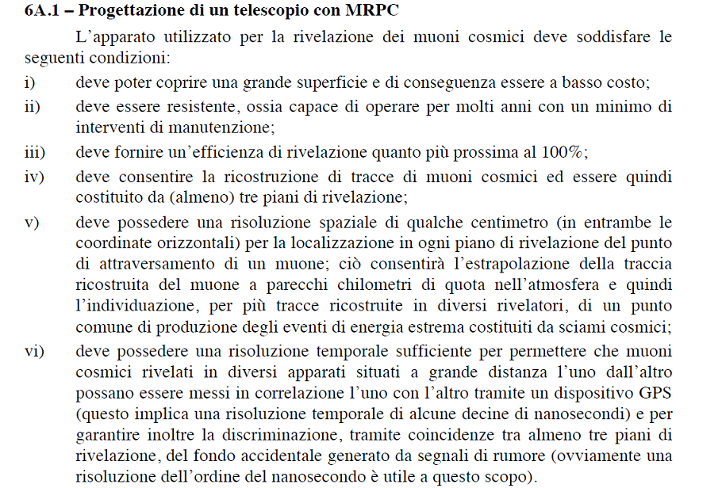
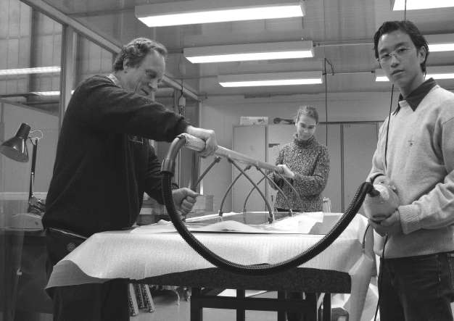
The goals of the Project
Together with the required performance of the setup

Slide 6
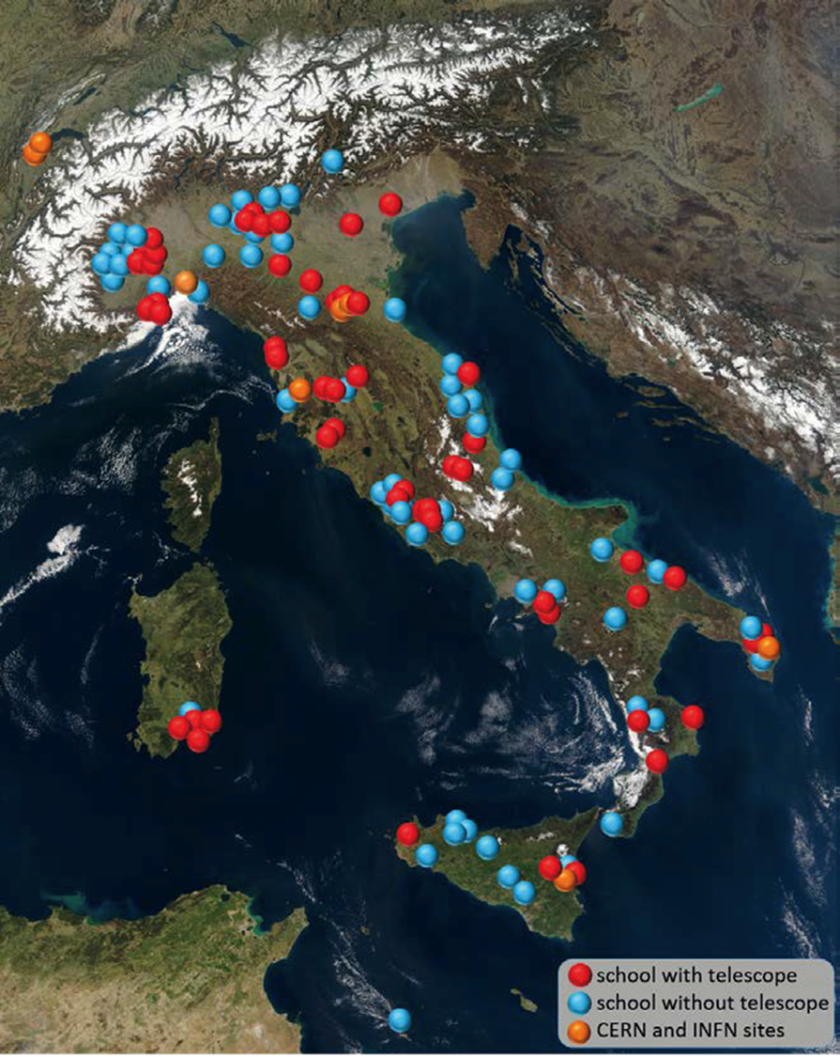
Involving scientific Institutions and high school teams
● A large effort since the beginning to involve scientific Institutions (CERN, INFN, Centro Fermi, University Physics Depts, Majorana Center, SIF, INGV, CNR, INRIM, Foreign institutions,…)
● … and High Schools, with the 7 pilot schools which firstly joined, up to the present number (about 100) of participating teams over the Italian territory.
● EEE project mainly handled by Centro Fermi over the past years
● October 2020: INFN-Centro Fermi agreement signed to share contributions from the two Institutions for equipment, consumables, personnel, travel and meeting organization, fellowship,…

Slide 7
The architecture of the EEE detector network
How to accomplish the scientific and educational goals of the Project?
The overall architecture of the EEE network planned to have
● MRPC telescopes + Electronics to reconstruct muon tracks from the cosmic radiation
● A synchronized system, based on GPS, to correlate data from distant stations
● Data acquisition and storage
● Data reconstruction and analysis framework
and, more important,
● Manpower to build, install, test, operate, repair, improve,.. hardware and software
● A large community of researchers, teachers and students to analyze and discuss results
● A flexibile system to disseminate knowledge within and outside the Collaboration

Slide 8
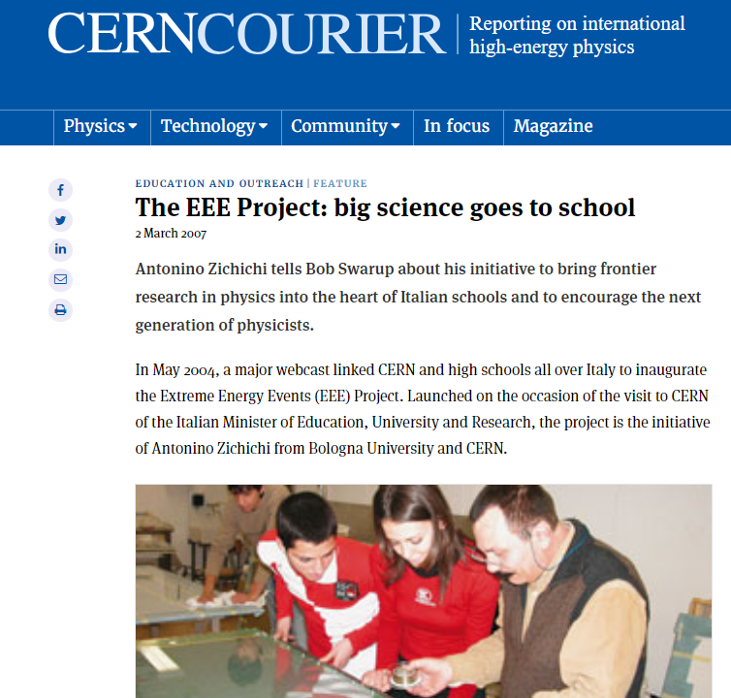
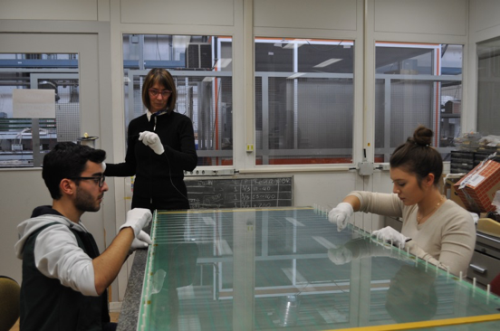
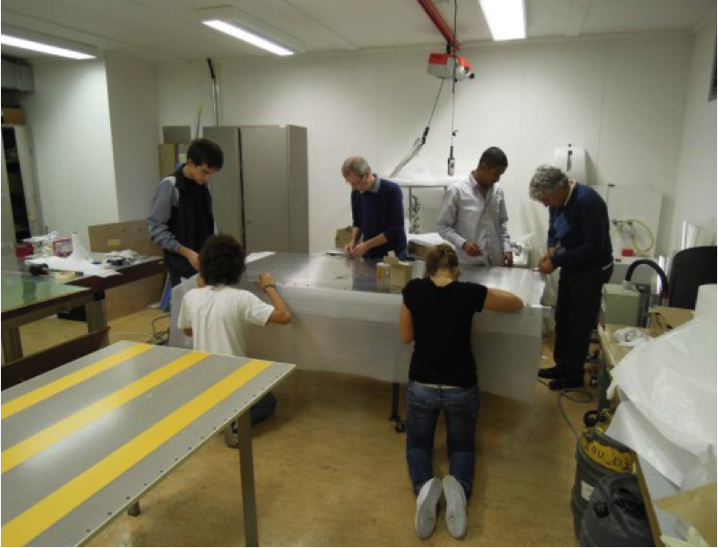
Construction of the MRPC telescopes @ CERN
● 2005: A first batch of MRPC built at CERN for the first 7 pilot school installation
● Since then, a long term involvement of researchers and school teams at CERN
● For many years, high school teams spent typically one week at CERN, being involved in the different steps of the construction of the MRPC chambers, and at the same time having a first-hand experience of CERN, its technology and physics
CERN Courier, 2007

Slide 9
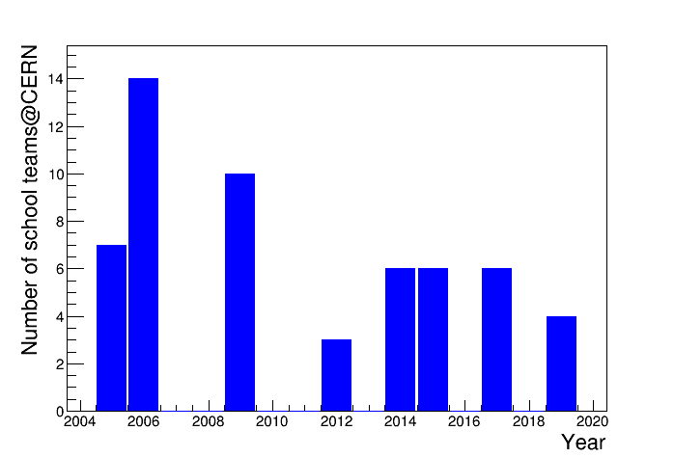
Construction of the MRPC telescopes @ CERN
● From 2005 to 2019 56 school teams came to CERN
● Each team from 5 to 10 students & 1-2 teachers
● A total of 300-400 students and 60-90 teachers participated to MRPC construction
● In addition, we had students from Albania, Russia, France, Sweden, Greece, Austria, Norway, Germany,…
● High school teams also followed 1-3 weeks internship programs (HSSIP), visits to CERN and ALICE and other activities

Slide 10
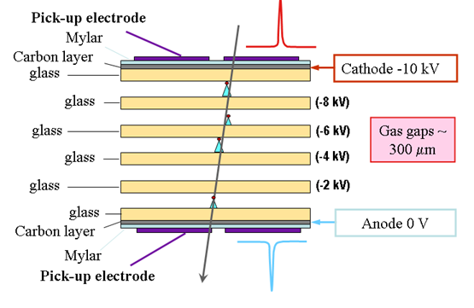
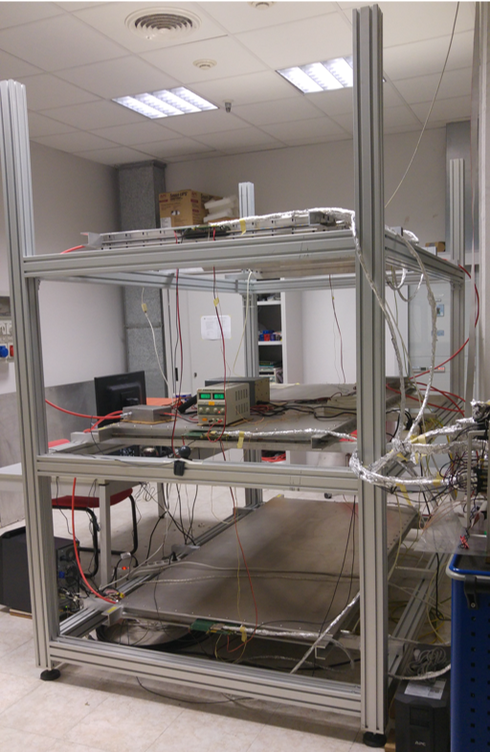
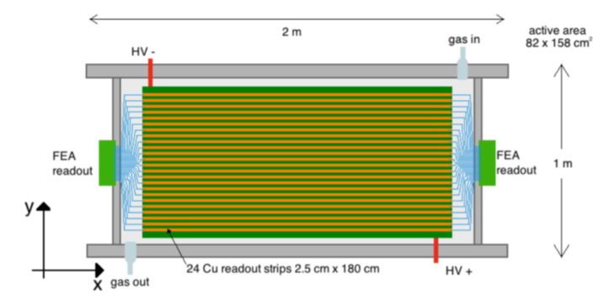
The MRPC Chambers

Slide 11
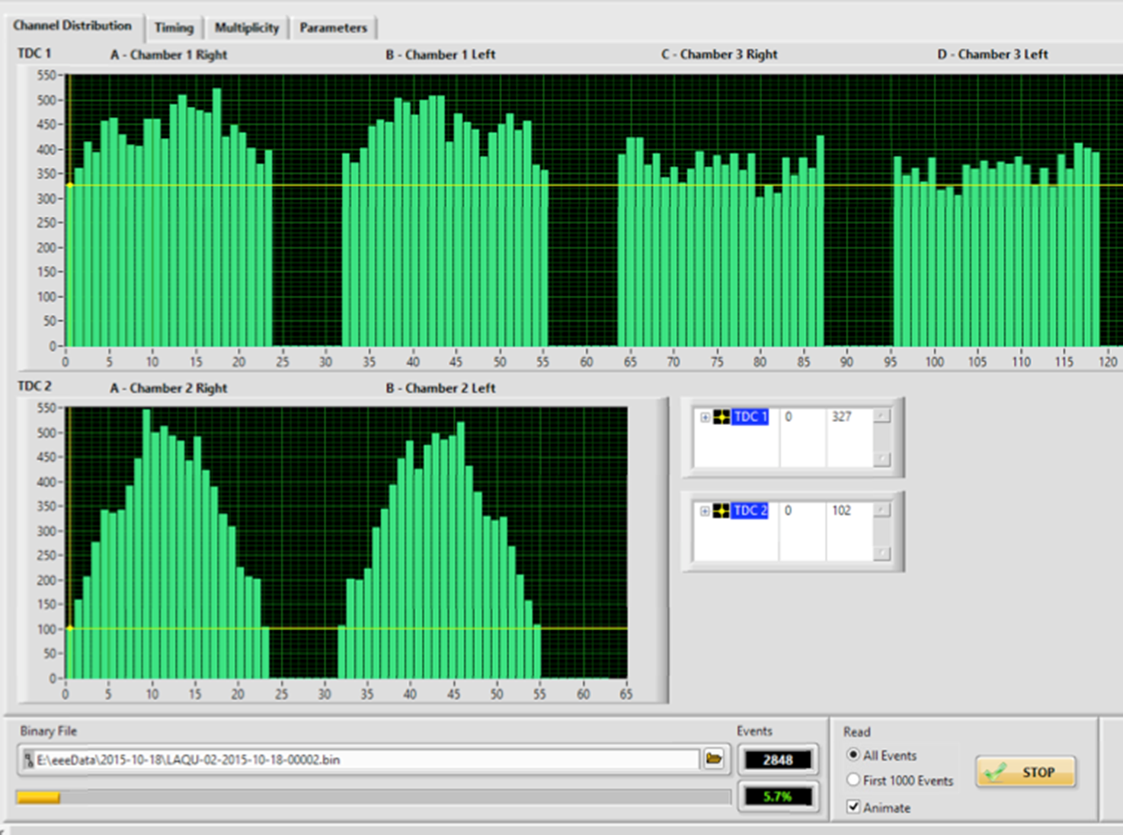
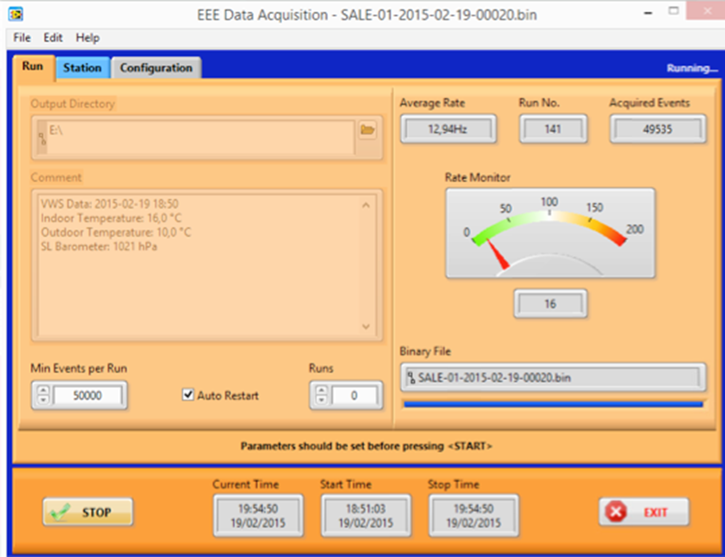
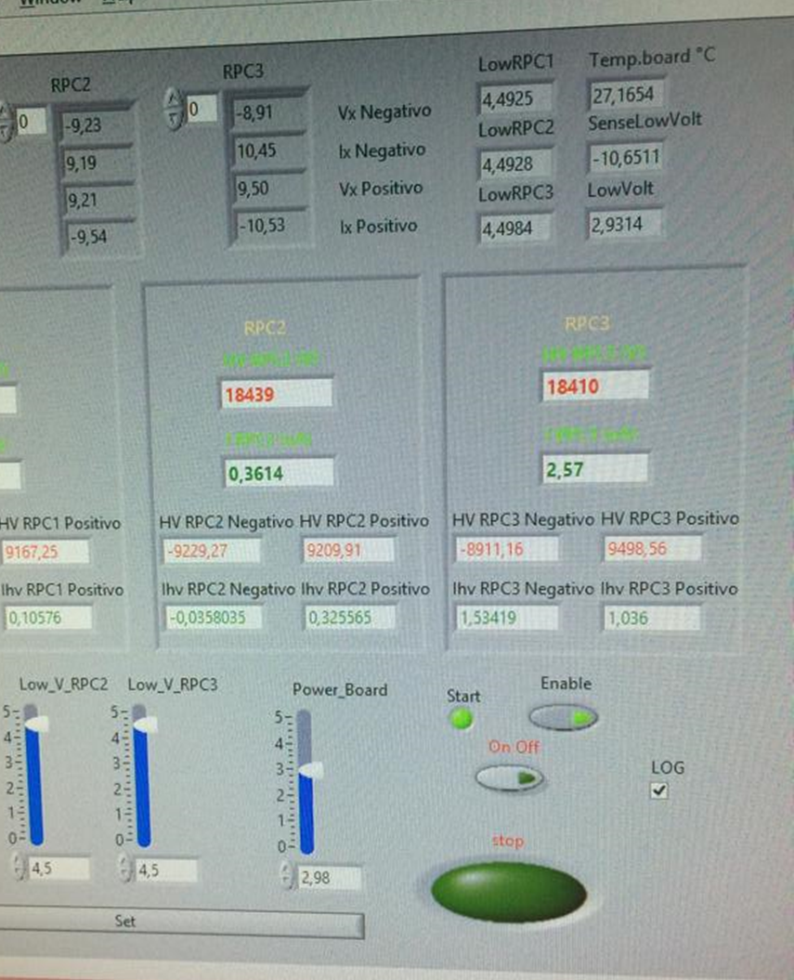
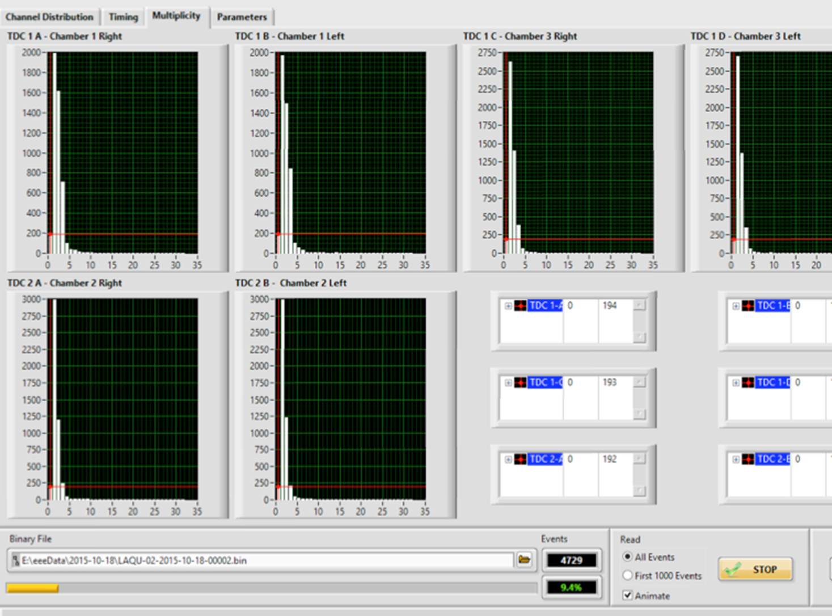
Electronics and data acquisition
● Fast electronics (suited to the optimal time performance of MRPC)
● Data acquisition and visualization developed under LabVIEW
● Slow control of voltage, gas, weather station
● On-line monitoring of data quality

Slide 12
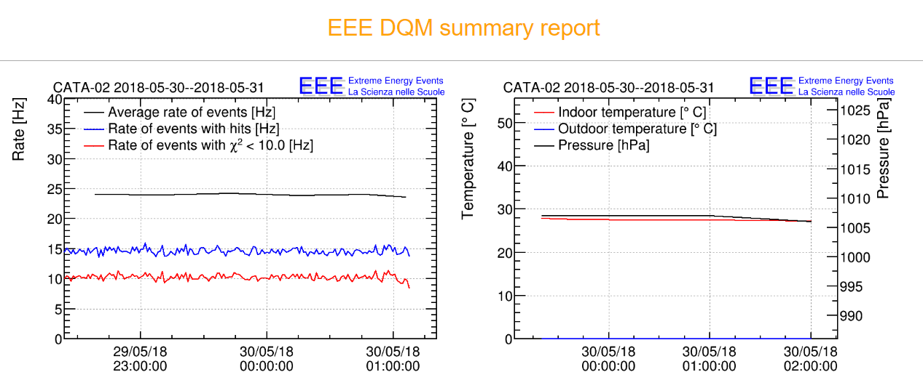
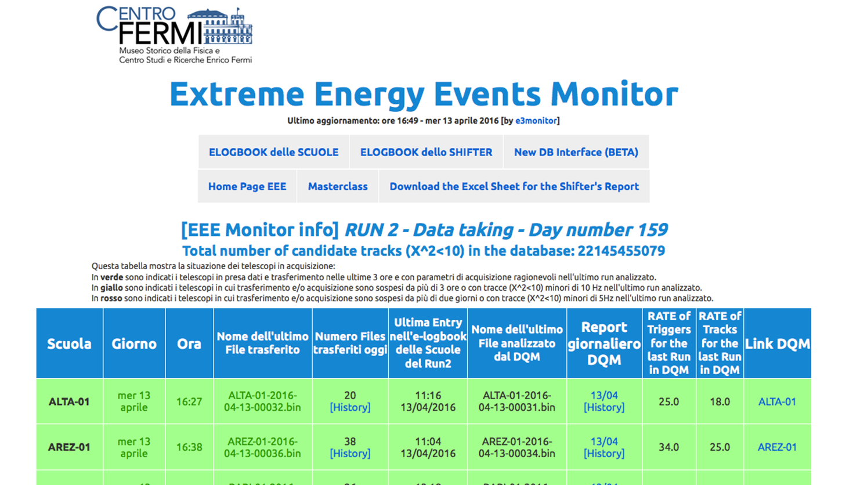
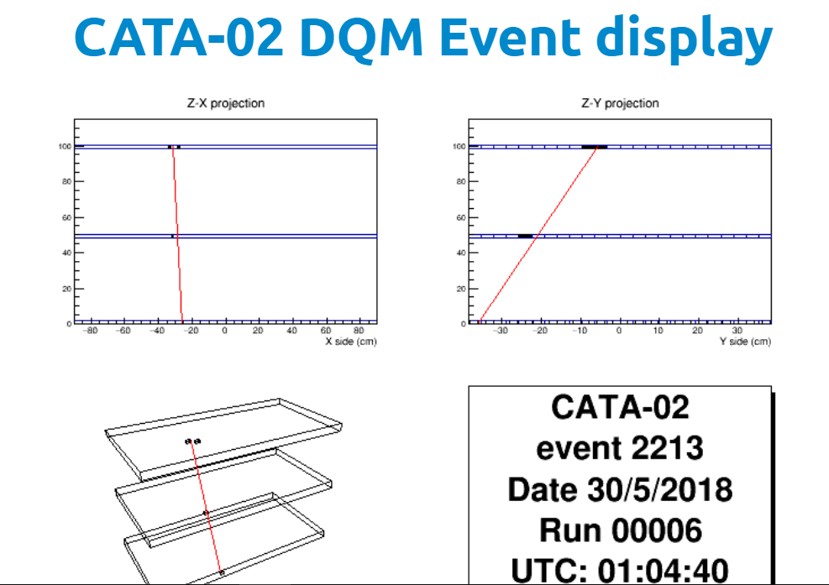
Off line data retrieval and monitoring
Procedures introduced to check data storage, monitor data quality and perform basic analyses

Slide 13
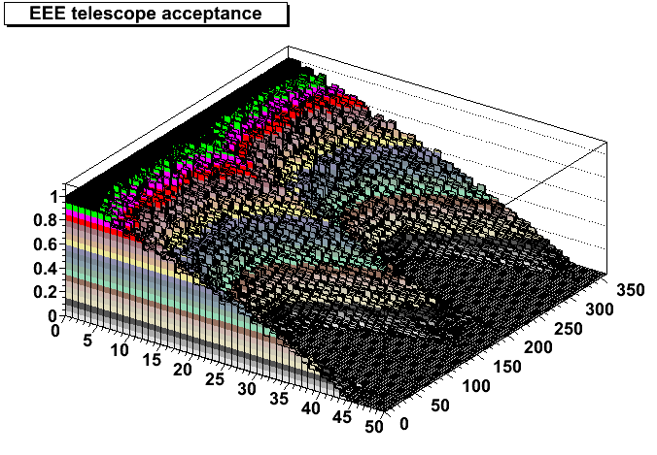
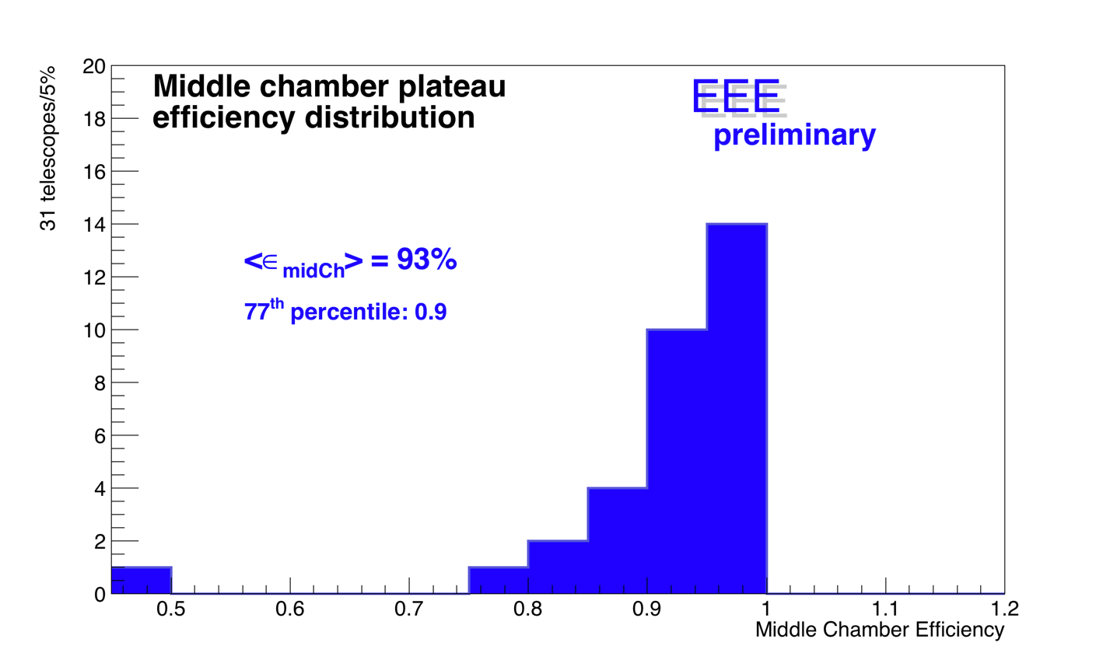
Geometrical acceptance and efficiency
Due to its geometry the telescope is sensitive to a wide angular region (0-360° in φ), (0-50° in ϑ) with a (ϑ, φ)-dependent acceptance.
Detection efficiency measured both with cosmics from RUN2 & 3, and with particles from accelerators at CERN in 2006, under many conditions (gas, voltage, …) and found larger than 90% for most of the telescopes

Slide 14
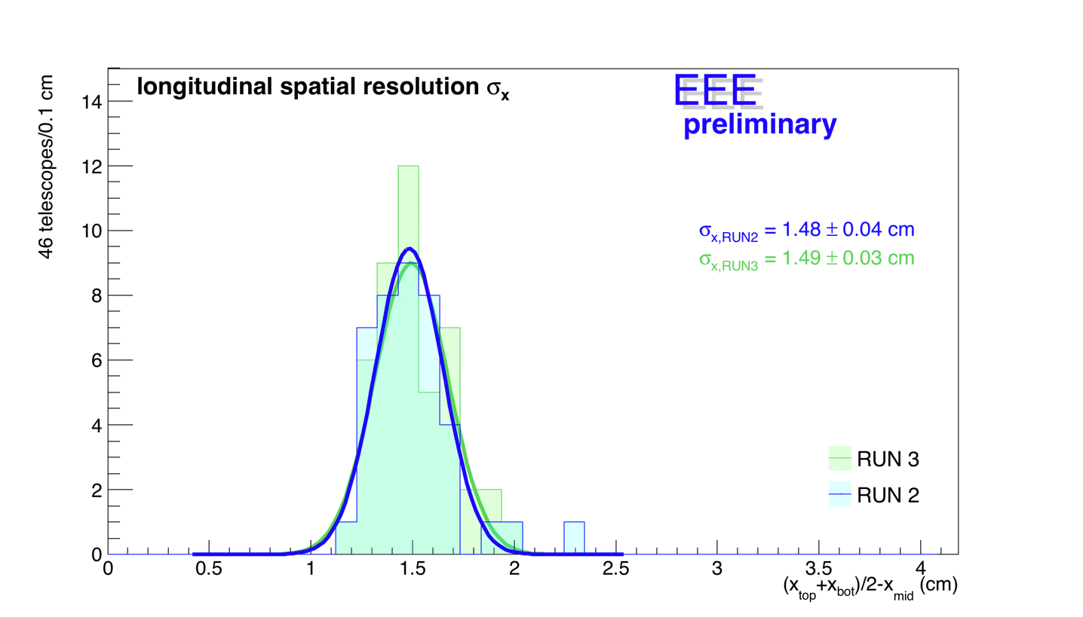
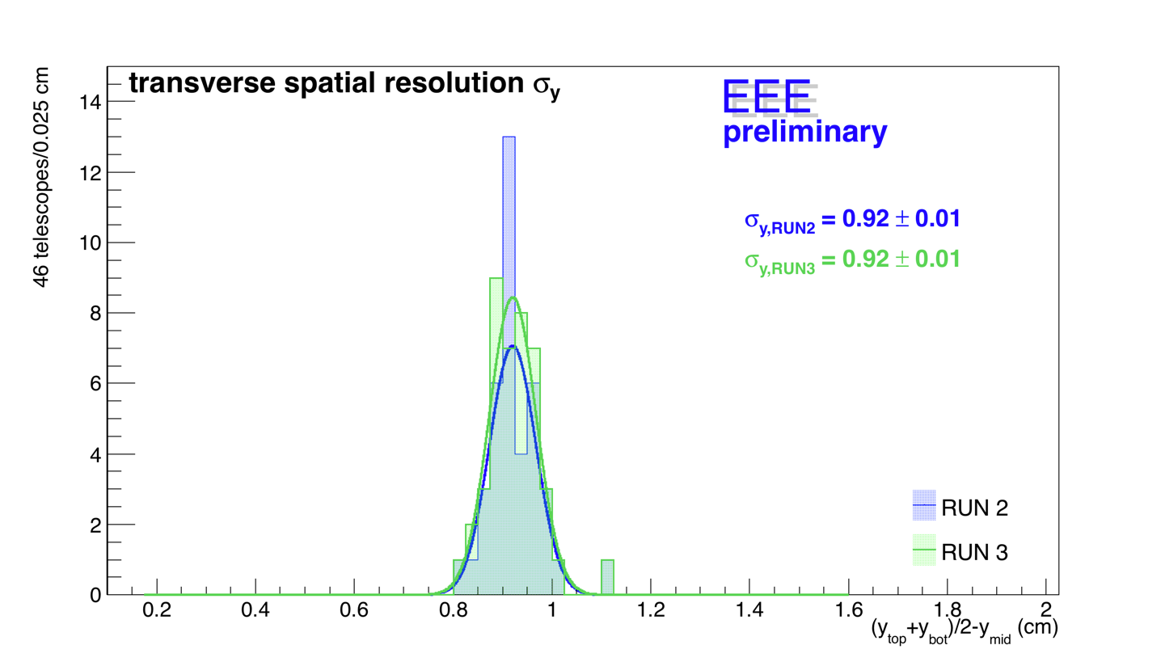
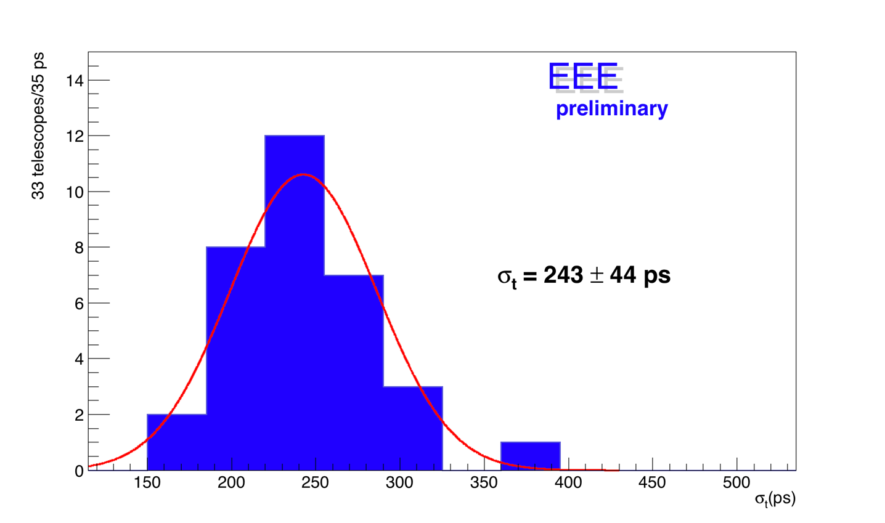
Spatial and time resolution
Spatial (longitudinal and transverse) resolution
Many telescopes have been successfully operated for more than 15 years
Time resolution

Slide 15
Reconstruction and analysis software
Each EEE telescope is a tracking device, able to reconstruct particle trajectories
Especially for multi-hit events, this requires careful software algorithms
From hits to clusters
From clusters to tracks
Events with 10 or more tracks reconstructed

Slide 16




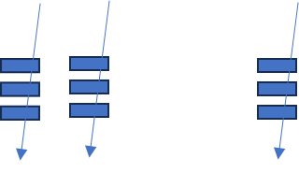
Computing resources @ CNAF
About 300 Mb/day for a single telescope
About 15 Gb/day for 50 telescopes
……
A few Tb/year for the EEE network
● Automatic data transfer and storage for raw data
● Reconstruction (several steps)
● Interactive analysis
● Monitoring
….

Slide 17
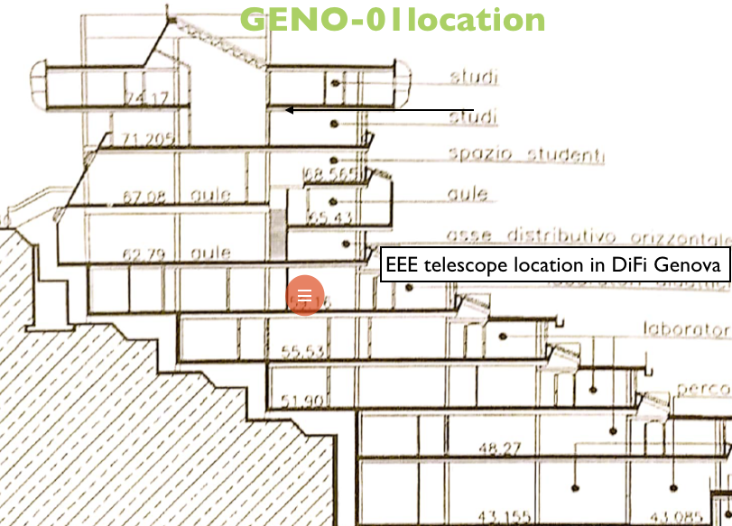
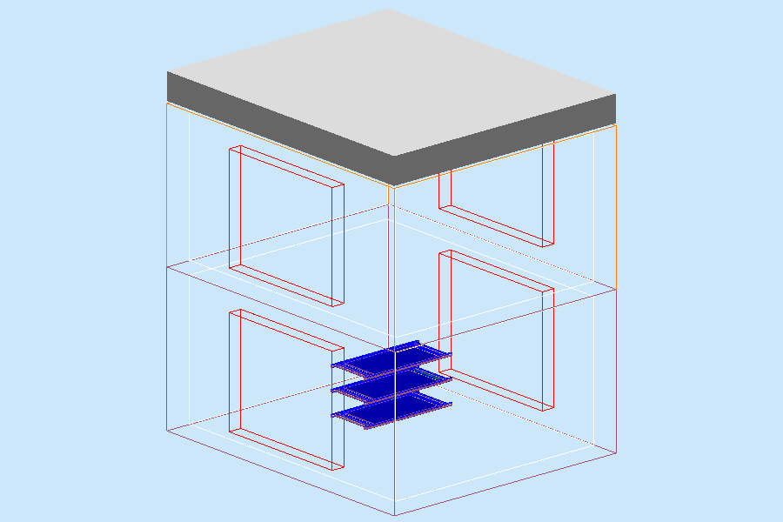
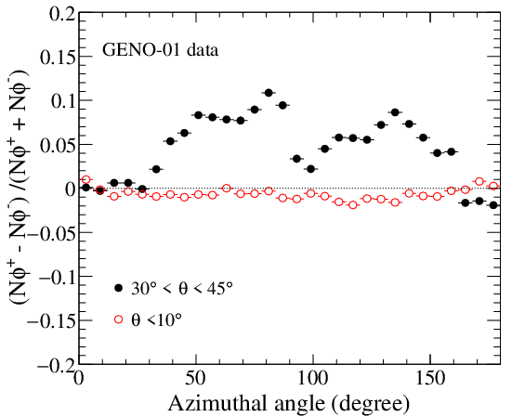
Understanding detectors: simulation procedures
From the study of the response of a single chamber…
… to detailed simulations of the muon interaction in the surrounding environment

Slide 18
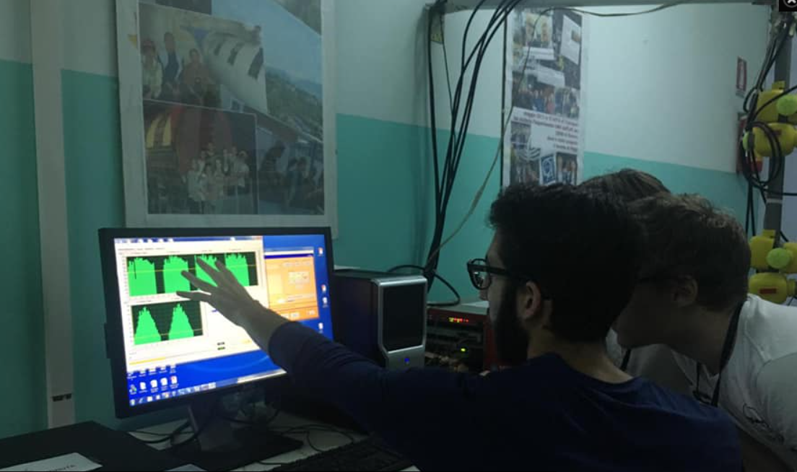
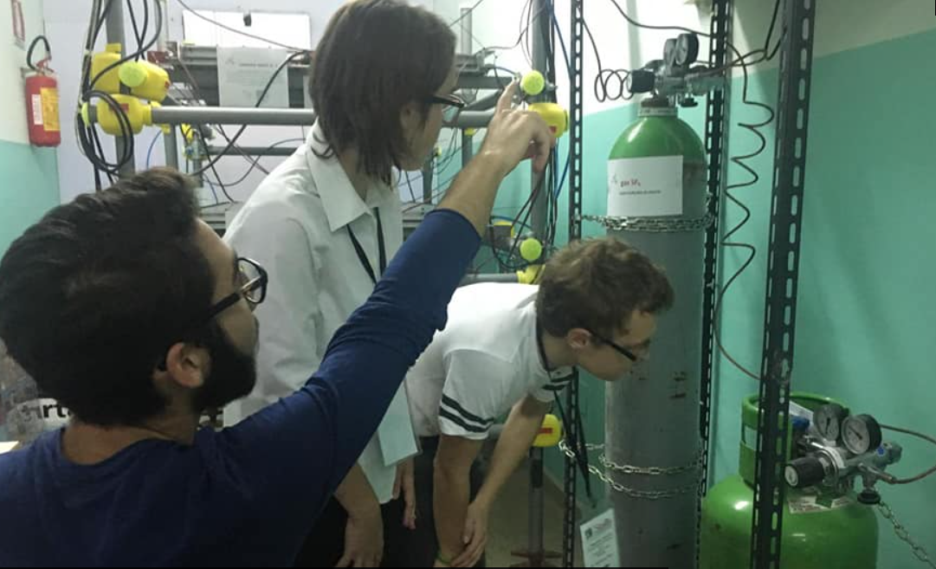
Installing telescopes and be ready for data taking
Since 2005, following the MRPC construction at CERN, school teams and EEE researchers have installed and commissioned telescopes at home
Many aspects required a lot of work and careful solutions
● Political and administration issues
● Technical problems with gas handling
● Electrical noise and ground connections
● Monitoring the working conditions
● Take care of the setup also during weekends and summer
● Train new students and teachers over the years
….

Slide 19
Finally, measuring cosmic rays!
The EEE telescopes are able to measure the cosmic ray flux as a function of the
● Zenithal direction (polar angular distribution)
● Azimuthal direction (azimuthal angular distribution)
● Time
● Geographical location (lat. & long.)
● Elevation above the sea level
● Possible time correlations with additional detector and/or telescopes
These (and other) possibilities allow to carry out a variety of different investigations
… in a sort of N-dimensional space

Slide 20
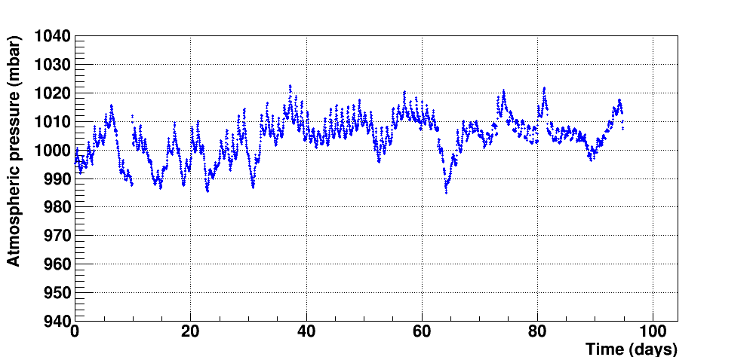
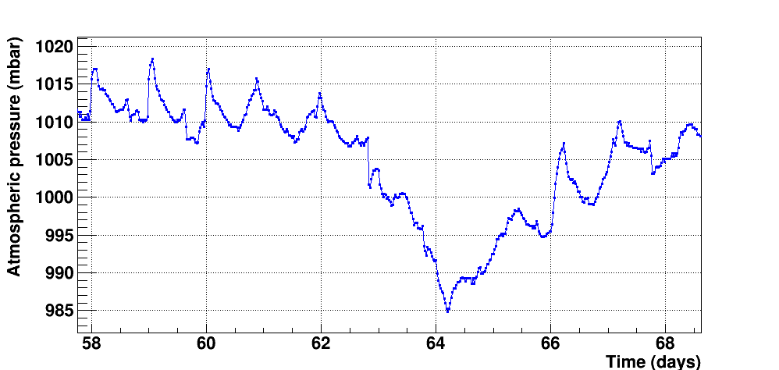
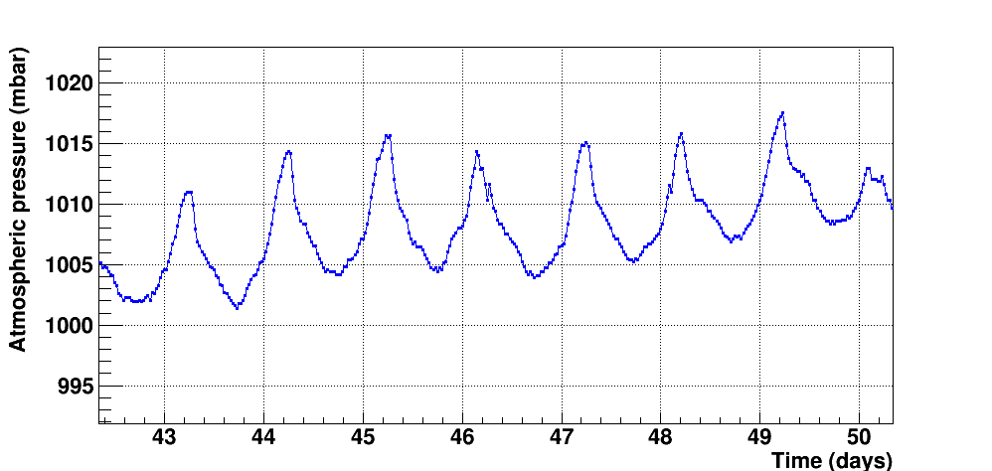
Cosmic ray flux and the effect of the atmospheric pressure
One important aspect of the cosmic ray flux measured with a detector at ground is the influence of the atmospheric pressure
Aperiodic variations due to local weather
Atmospheric pressure over 3 months
Daily variations…

Slide 21
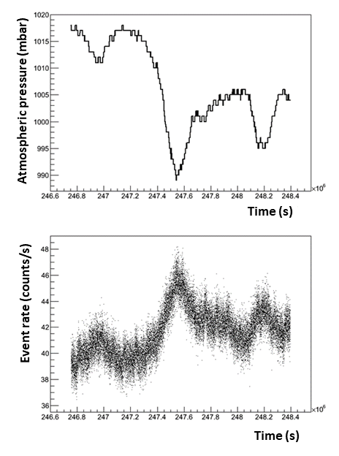
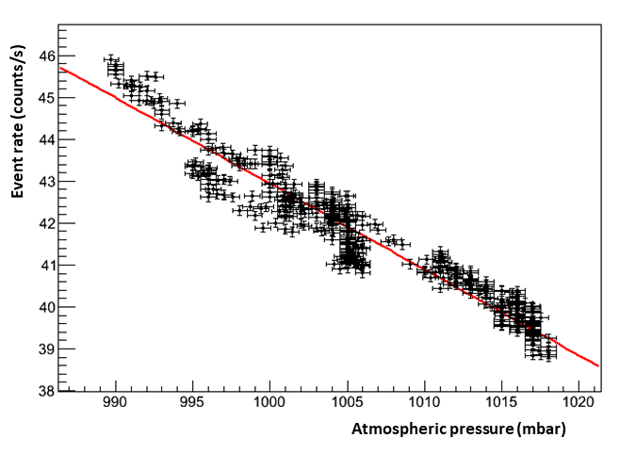
Cosmic ray flux and the effect of the atmospheric pressure
An anticorrelation with the pressure variations is expected
A «barometric» coefficient may be extracted from data
School teams involved in such analysis from the very beginning..

Slide 22
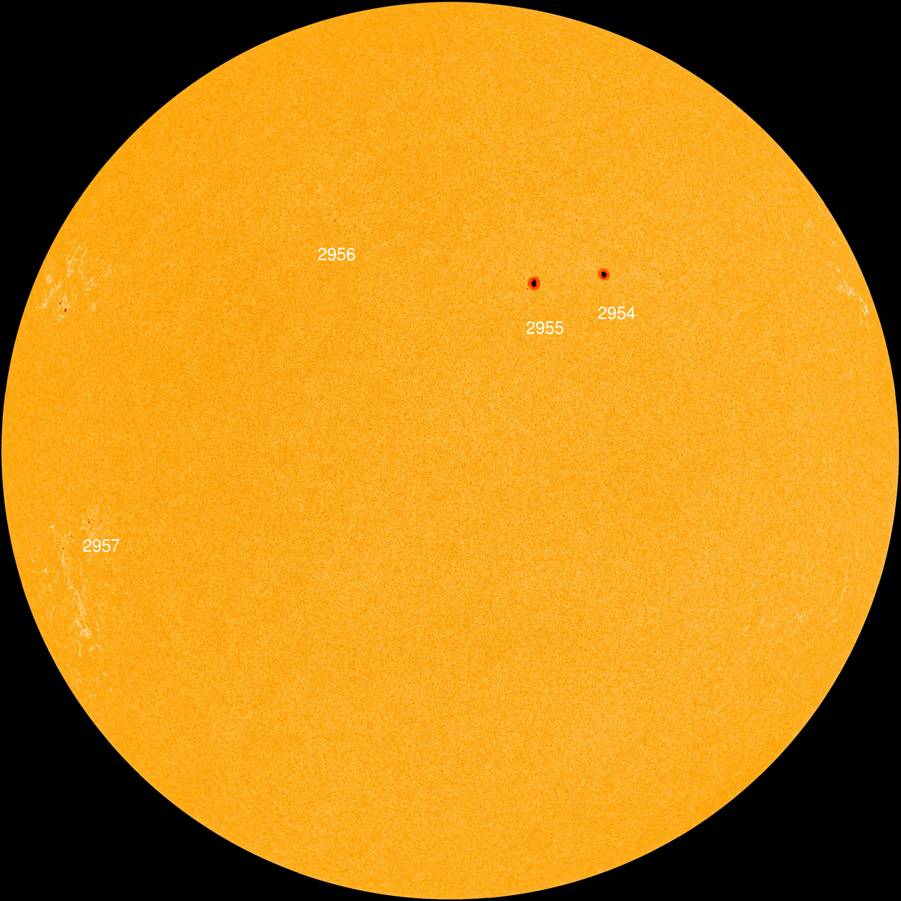
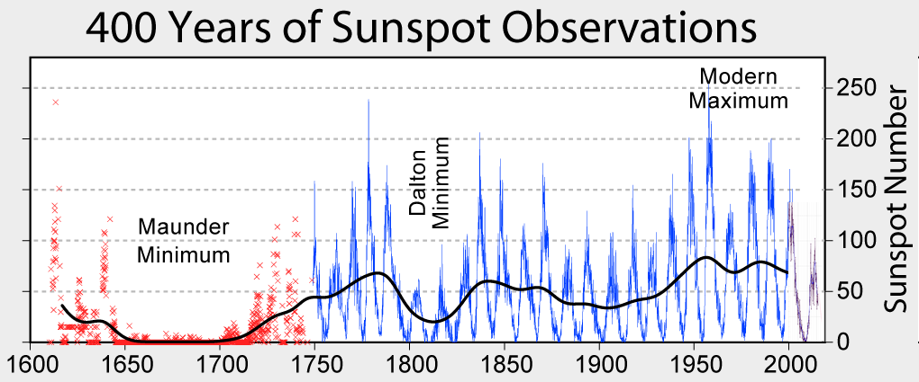
The influence of the Sun
The Sun also affects in different ways the cosmic ray flux through its periodic and catastrophic (aperiodic) phenomena

Slide 23
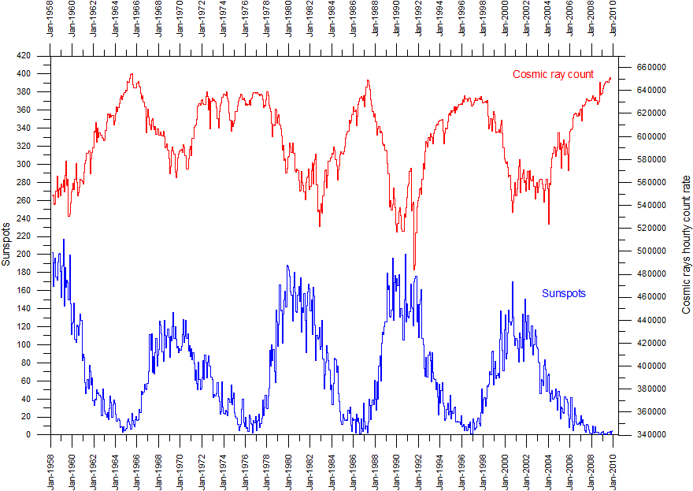
The influence of the Sun
The cosmic ray flux on Earth is anticorrelated with the number of sunspots

Slide 24
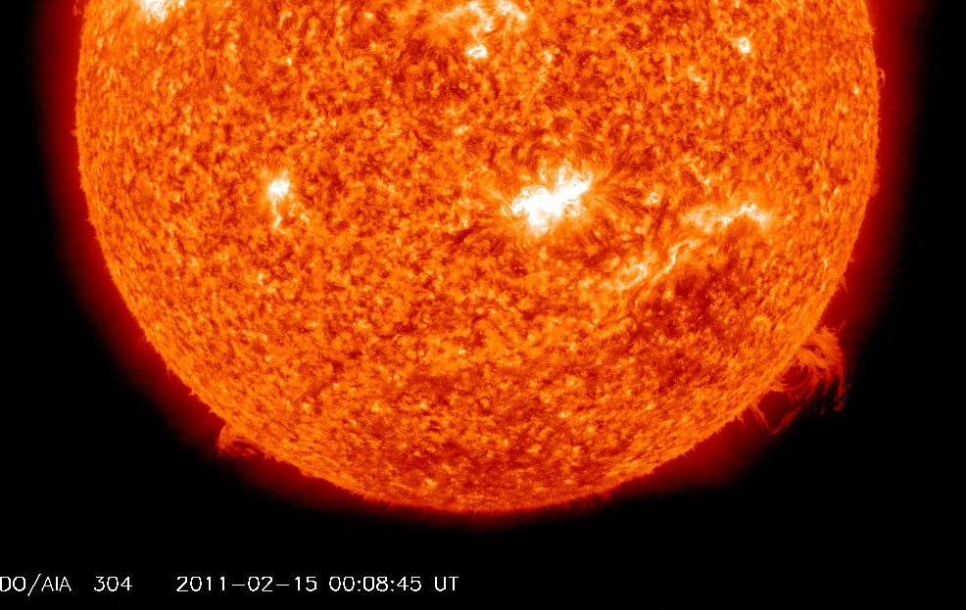
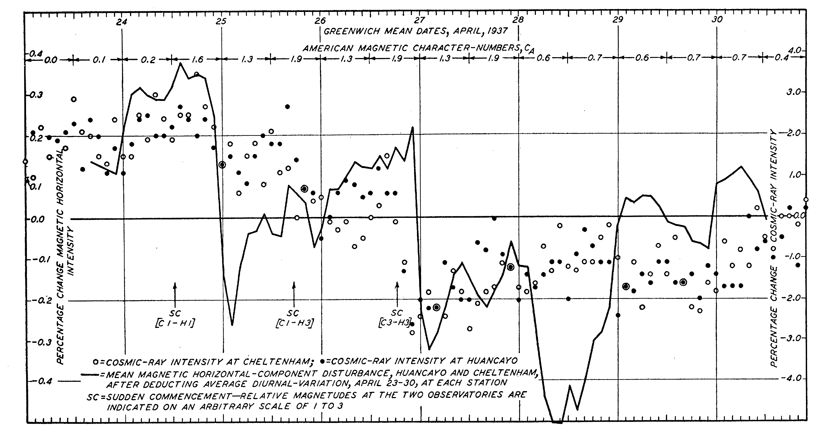
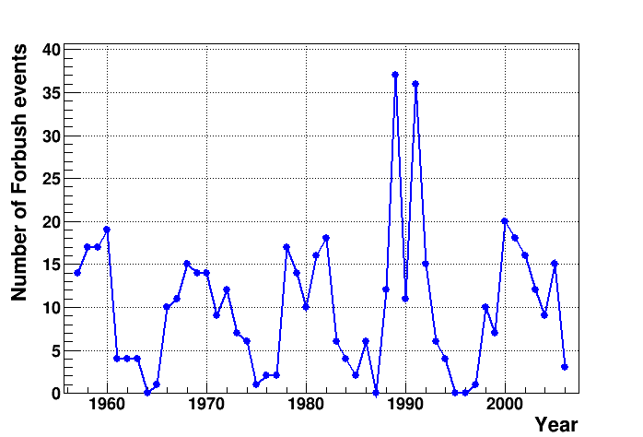
Aperiodic phenomena: the Forbush decreases
Catastrophic (aperiodic) phenomena also occur. Among these, Forbush decreases are observed in connection with solar flares/coronal mass ejection.
They are planetary (not only local) phenomena
Scott Forbush
First observation of Forbush effect, 1937
Yearly number of Forbush events
(> 3%)

Slide 25
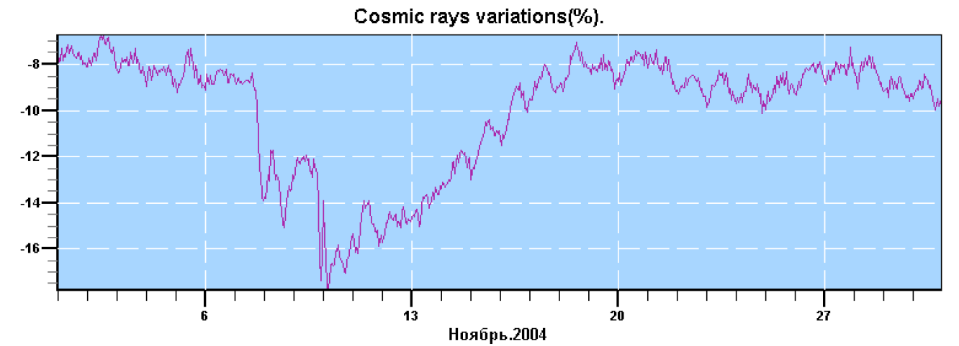
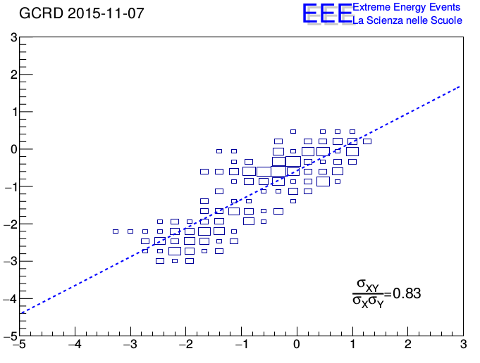
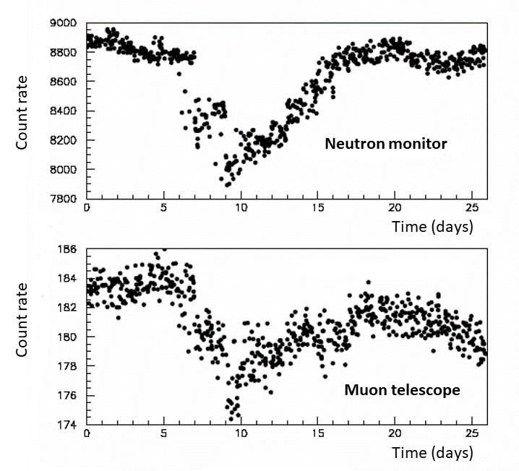
Aperiodic phenomena: the Forbush decreases
Forbush decreases are usually observed through neutron monitor stations. Most of them make their historical data freely available
However, also the muon flux is affected, with a reduced amplitude.
Possibility for EEE to observe such events
Correlation EEE muon flux- Oulu neutron flux

Slide 26
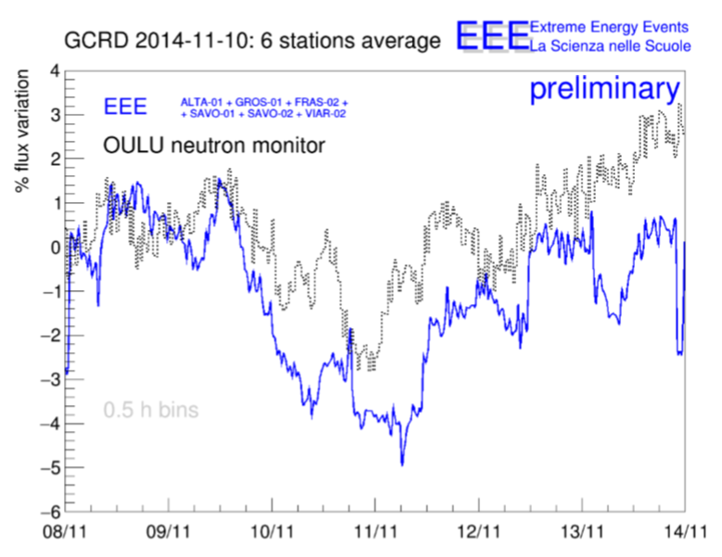



Aperiodic phenomena: the Forbush decreases
The first Forbush event observed by two EEE telescopes in 2011
Additional events observed over the years

Slide 27

Extensive air showers by telescope coincidences
What we observe on Earth is the result of extensive air showers induced by primary particles (mostly protons) in the Earth atmosphere.
While detecting single (or multiple) muons in a telescope, we may also have coincidence events in two or more telescopes some distance apart.
Time correlation (through GPS) between individual telescopes is an essential part of the game.

Slide 28

Extensive air showers by telescope coincidences
First evidence of coincident particles from a shower observed with two high school telescopes located in L’Aquila at ~200 m distance (2008-2009)

Slide 29

Extensive air showers by telescope coincidences
Important steps to improve the analysis were:
a) the correction to the time difference between telescopes by the knowledge of the incoming direction of the particles
b) The selection of multitrack events
Something that simple scintillation detectors cannot do..
Background
Good events

Slide 30




Extensive air showers by telescope coincidences
Improvement of the signal/noise ratio allows to better observe events with a reduced yield
Original time spectrum
Corrected by orientation
Selection of nearly parallel tracks
Multitrack events

Slide 31






Extensive air showers by telescope coincidences
The yield of coincident events and the signal-to-noise ratio depend on the relative distance between telescopes
CERN, 15 m apart
Bologna, 96 m apart
Grosseto, 418 m apart
Frascati, 627 m apart
Torino, 1078 m apart
Savona, 1180 m apart

Slide 32

Extensive air showers by telescope coincidences
A lot of data already analyzed, but still some data waiting for analysis…
Moreover, (a few) triple coincidences also exist..
Telescope pair | Distance | Available statistics
TORI-02 - TORI-04 | 1165 m | 57 days
VIAR-01 - VIAR-02 | 1344 m | 159 days
SAVO-01 - SAVO-03 | 1367 m | 165 days
TORI-02 - TORI-03 | 1416 m | 66 days
CAGL-01 - CAGL-03 | 2350 m | 150 days
CAGL-02 - CAGL-03 | 2517 m | 133 days
SAVO-02 - SAVO-03 | 1710 m | 166 days
A general trend of the decoherence curve may be extracted

Slide 33

Searching for long distance correlations
The possibility to observe «exotic» events due to correlated showers at large distance has been debated, but no clear evidence found so far
The EEE network, with its sparse topology, has the capability at least to search for these events
Distribution of distances between EEE sites

Slide 34
Searching for long distance correlations
Several investigations performed over the last 10 years data, with different analysis strategies
Strategy 1: Search for coincidences between telescope pairs located in the same town (cluster sites)
Strategy 2: Search for two-fold coincidences between multitrack events in any telescope pair
Strategy 3: Search for n-fold coincidences between telescopes

Slide 35



Searching for long distance correlations
Strategy 1: Search for coincidences between telescope pairs located in the same town
10 cluster sites
3968 days overall measure time
5 candidate events with low p-value

Slide 36


Searching for long distance correlations
Strategy 2: Search for two-fold coincidences between multitrack events in any telescope pair
Distribution of multitrack events (CERN-01)
A slight excess found for multitrack-multitrack coincidence events below 100 μs

Slide 37


Searching for long distance correlations
Strategy 3: Search for n-fold coincidences between telescopes at distance >5 km
A slight excess over random background found for events with >10 telescopes in coincidence

Slide 38


Searching for small anisotropies in the cosmic ray flux
Is the primary cosmic ray flux isotropic?
Small anisotropies (10⁻³ or smaller) expected
To which level may we observe isotropy/anisotropy in the secondary muon flux?
We need equatorial coordinates (Declination and Right Ascension) instead of the local (ϑ, φ) coordinates
Raw measured data are not isotropic, due to the field of view of each telescope
CATA-01 map

Slide 39



Searching for small anisotropies in the cosmic ray flux
Data need to be corrected by the acceptance and exposure (a numerical technique called scrambling employed)
4 telescopes and 110M events, isotropy within 1%

Slide 40
Upgrade activities of the EEE network
Apart from gas mixture problem (next slides), a variety of upgrade activities undertaken along two decades:
● New trigger modules
● Different GPS system
● Weather stations
● MRPC with reduced (250 micron) gas gap
● Software upgrade (data acquisition, reconstruction, analysis framework,…)

Slide 41



The green transition: new ecological gas mixtures
In the last years considerable efforts spent by EEE to reduce GreenHouse Gas (GHG) emission
Total GHG emission
(in CO₂-equivalent)
Different gases contribute, not only CO₂
Global Warming Power (GWP) for the standard mixture employed in the past ~1880 (out of EU regulations)

Slide 42

The green transition: new ecological gas mixtures
Various steps followed in the last years, with a lot of work involving many people in the Collaboration
● Reduce gas leakage
All MRPC with leakage rate>0.1 liter/h cured
● Test working conditions with reduced gas flow
From the standard 2-3 liters/h to 1 liter/h, 50% reduction in gas waste, no degradation observed
● Test gas recirculation system
A prototype system tested at CERN, with a recovery fraction ~60%
● Test new, ecofriendly, gas mixtures
A variety of new gas mixtures tested in different sites for several years
Promising gas mixture: C₃H₂F₄ + He (GWP ~6), many others tested
Satisfactory results (efficiency, resolution,…)
Many telescopes now running with the new mixture
Students also involved in this activity

Slide 43

Coordinated data taking
● After the first phase of the project (2005-2014), special efforts put into organizing coordinated data taking runs
● More than 120 billion events collected so far
● RUN7 with the new eco-friendly gas mixture started

Slide 44

Complementing the EEE network with the POLA detectors
A set of small scintillator-based telescopes were also built and employed in different environments and measurement campaigns

Slide 45


Cosmic rays over a wide latitude range: The PolarquEEEst missions
● July-September 2018: POLA-01 detector travels on board of the Nanuq sailboat spanning the latitude range 66°-82° N.
● Twin detectors POLA-02 and POLA-03 simultaneously took data in Italy and Norway for reference
Cosmic ray flux stays constant within 1% in this lat.range

Slide 46


Cosmic rays over a wide latitude range: The PolarquEEEst mission
● November 2018 – April 2019: POLA-01 detector on the road from Lampedusa (35° N) to Hannover (52 ° N), complementing previous data at smaller latitudes

Slide 47





Installing and using POLA detectors at the Svalbard
● June 2019: 3 POLA detectors installed in Ny-Alesund (78°N) ● Taking data from 2019 to 2023
● Not easy environment, from hardware/software maintainance to security problems (polar bears moving around…)

Slide 48


Installing and using POLA detectors at the Svalbard
● Data analysis in progress
● Clear annual periodicities seen
● Comparison to neutron yields
● Advanced time series methods
● Time correlations (air showers) between the POLA detectors, in progress (recent student analyses also presented during ICD2023 a few days ago)

Slide 49



POLA detectors on board of Amerigo Vespucci
● POLA-02 detector also employed on board of the Italian training ship Amerigo Vespucci, collecting data in the Mediterranean, over 10° latitude range
Data analysis still in progress..

Slide 50

Observing the effect of the Hunga-Tonga volcanic eruption
Jan 15, 2022: A gigantic explosion following the Hunga-Tonga volcanic eruption took place
with an atmospheric shock wave propagating along the globe

Slide 51

Observing the effect of the Hunga-Tonga volcanic eruption
Jan 15, 2022: A gigantic explosion following the Hunga-Tonga volcanic eruption took place
with an atmospheric shock wave propagating along the globe

Slide 52

Observing the effect of the Hunga-Tonga volcanic eruption
Jan 15, 2022: A gigantic explosion following the Hunga-Tonga volcanic eruption took place
with an atmospheric shock wave propagating along the globe

Slide 53

Observing the effect of the Hunga-Tonga volcanic eruption
Jan 15, 2022: A gigantic explosion following the Hunga-Tonga volcanic eruption took place
with an atmospheric shock wave propagating along the globe

Slide 54


Observing the effect of the Hunga-Tonga volcanic eruption
● About 12h18’ after the explosion, an overpressure of 0.7 mbar observed by the pressure sensors of EEE installation at Ny-Alesund
(thanks to the small time step of 30’’)
● Multiple passages of the shock wave also observed, associated to much larger distances travelled
13519 km

Slide 55


Using MRPC telescopes to investigate building stability
Tracking capabilities of MRPC telescopes may be used to monitor small deformation of civil buildings on a long time scale
Prototype measurements performed with EEE telescope (CATA-01, underground floor) and additional scintillators, located on the 3° floor of Physics Dept.
31.03± 0.05
7.56 ±0.09
Precision (long) measurements of the angular distributions reveal even a small displacement of the structure, with a sensitivity of the order of 0.05°/cm for 1 week data taking.
Angular distribution of coincident events

Slide 56

MRPC telescopes as muon test facilities
Tracking capabilities of MRPC telescopes may also be employed to characterize the response of small detectors as a function of the hit point inside the detector, as reconstructed by the MRPC
Prototype measurements carried out in Genova

Slide 57



Additional detection tools: the COSMIC BOX
A number of additional detectors (Cosmic Box) were also built and employed in different measurements with cosmic rays, mostly built and operated by students
● Measurements at different altitudes
● Underground investigation of cosmic ray flux
● Many proposal from school teams
● Yearly contexts organized
2 planes 15x15x1 cm³ scintillators operated in single or coincidence mode

Slide 58



Underground measurements with the Cosmic Box
● A set of measurements with 3 Cosmic Box detectors carried out in the Nuraxi Figus-Seruci mine complex, close to Cagliari
● Data taken in 2018-2019 at 174 m (3 days), 339 m (9 days) and 512 m (62 days) underground and compared to outside results
● Involvement of several school teams
174 m
339 m
512 m
More than 3 orders of magnitude between outside and 512 m underground

Slide 59



The altitude dependence investigated by the Cosmic Box
The altitude dependence of the cosmic ray flux investigated several times by student teams
Several teams during one of the EEE meetings in Erice
IIS D’Aosta, L’Aquila

Slide 60




The altitude dependence investigated by the Cosmic Box
Scacchi school team, Bari
Calasanzio & Chiabrera school teams, Savona
Pascal school team, Pomezia

Slide 61



The altitude dependence investigated by the Cosmic Box
A cosmic box was also used on board of a small aircraft, up to 9000 ft altitude

Slide 62





Publishing scientific results
Results from the EEE activity have been submitted and published since the very beginning (2005) in International Conference and peer-reviewed Journals

Slide 63


Publishing scientific results
As of today, more than 70 scientific papers and ~ 100 contributions to international conferences from the EEE activity
Most of them acknowledge the helpful contribution of high school students and teachers
Yearly publications from EEE

Slide 64



Publishing scientific results
Some of them even report the name of students and teachers as coauthors
And many others..

Slide 65

Involving the high school community
● A large part of our project is addressed to involve the high school community in the scientific and technical aspects of an advanced research activity
● This is usually done through various channels
● Taking part in the construction, operation of detectors, checking the status of data taking,…
● Participate to monthly meeting and presenting the results of their work
● Attend general EEE meetings with lectures, masterclasses, exp.activities…
● Prepare and submit projects
● The pandemic has introduced a further challenge in all EEE activities

Slide 66

Involving the high school community
But we are restarting EEE events in presence, as it was done in the past…

Slide 67





Outreach activities outside the EEE environment
Lab boat, Sardegna
International Cosmic Day/International Muon Week
Science festival, Cagliari
2023 European Research Night

Slide 68




Outreach activities outside the EEE environment
Astronomy Olimpic Games
Exchange program Trinitapoli-Moscow
Day of the Art

Slide 69



Outreach activities outside the EEE environment
Several events locally organized during visits of EEE members to the schools

Slide 70
What next?
Not easy to predict what the future of EEE will be…
In the short term
● Restart as many telescopes as possible with the new gas (RUN7)
● Go on with studies on these new gas mixtures
● Maintain and organize new POLA measurement campaigns (Svalbard, moving installations)
● Take care of on going and upcoming data analysis
● Continue/expand outreach and dissemination events

Slide 71
What next?
Not easy to predict what the future of EEE will be…
In the short term
● Restart as many telescopes as possible with the new gas (RUN7)
● Go on with studies on these new gas mixtures
● Maintain and organize new POLA measurement campaigns (Svalbard, moving installations)
● Take care of on going and upcoming data analysis
● Continue/expand outreach and dissemination events
In the middle term
● Possible upgrades of the existing network
● Imagine/build new detection setup to complement the present equipment
● Involve new schools and Institutions
● Think of new physics analyses

Slide 72
What next?
Not easy to predict what the future of EEE will be…
In the short term
● Restart as many telescopes as possible with the new gas (RUN7)
● Go on with studies on these new gas mixtures
● Maintain and organize new POLA measurement campaigns (Svalbard, moving installations)
● Take care of on going and upcoming data analysis
● Continue/expand outreach and dissemination events
In the middle term
● Possible upgrades of the existing network
● Imagine/build new detection setup to complement the present equipment
● Involve new schools and Institutions
● Think of new physics analyses
In the long term
● Who knows?

Slide 73
It is up to all of us!

