Slide 1
Preparation of the EEE telescope for Forbush decrease observation
Marco S. and Ivan G.

Slide 2
CR rate measurements
2015, December 31th
6 days
Rate stability
HV stability
T and P corrections
Correction for barometric effect

Slide 3
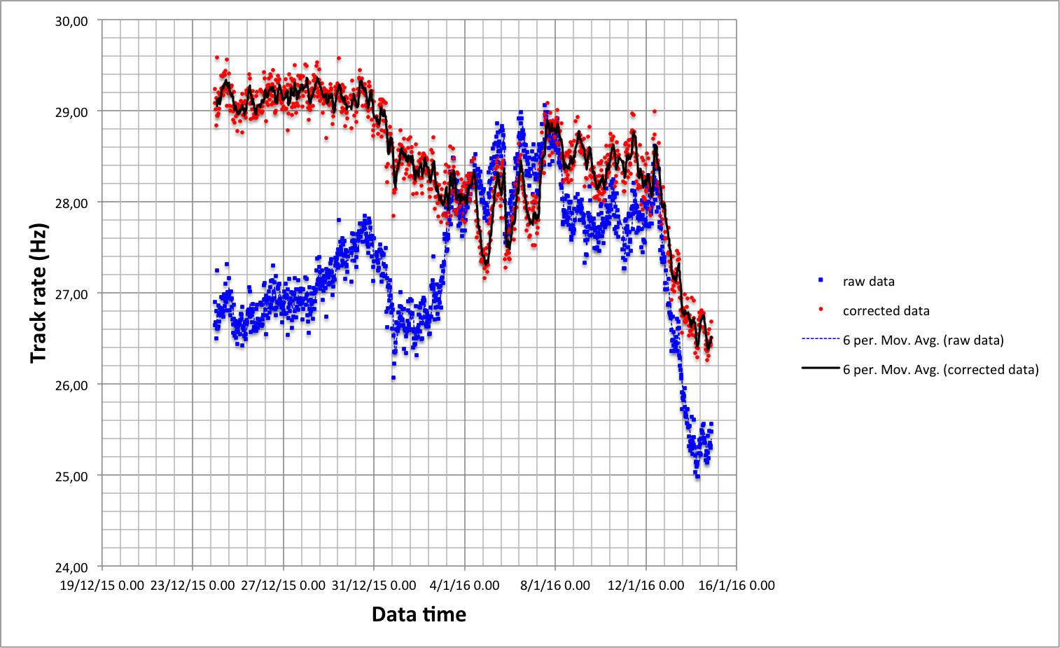
Forbush decrease
Barometric factor = -0.093 Hz/mbar
Barometric factor = -0.181 Hz/mbar

Slide 4
CR rate measurements
Good for BF measurement

Slide 5
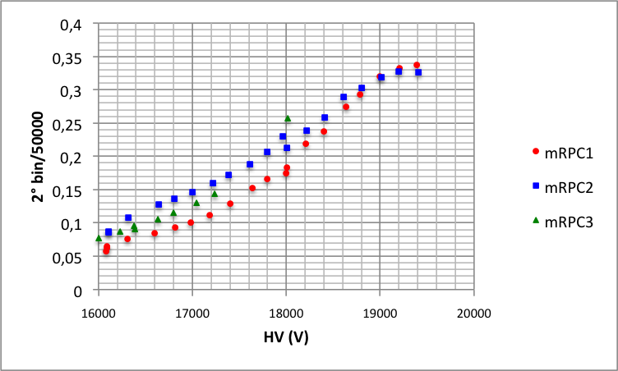
HV-multeplicity correlation
Saturazione ADC

Slide 6
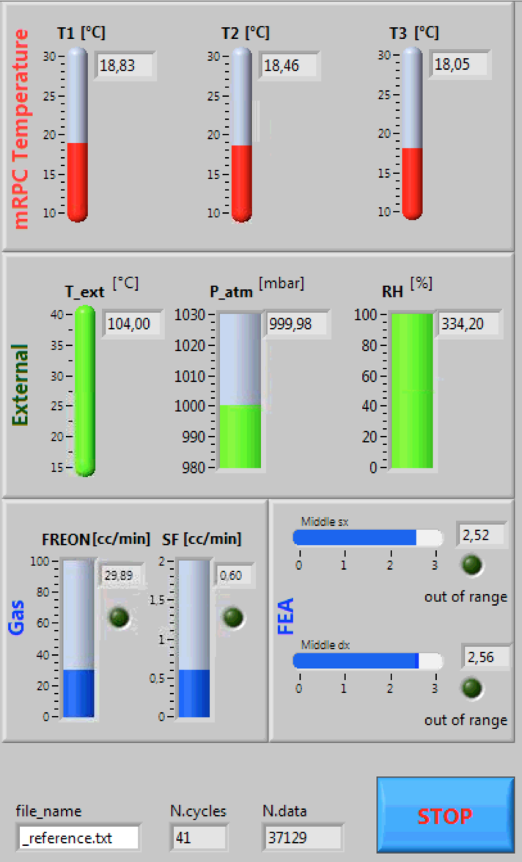
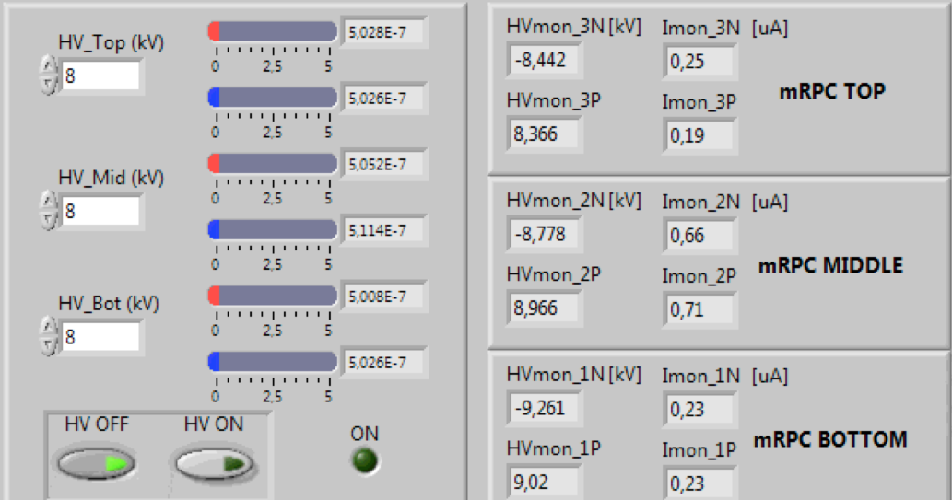
Monitor of the Telescope parameters

Slide 7
Gas components
Flux (cc/min)
Flux (cc/min)

Slide 8
Chamber temperatures
Resolution 0.01 C

Slide 9
Environmental conditions
Resolution 0.01mbar
Sensor to be installed
Sensor to be installed

Slide 10
HV (1)
2017, March 8th
Very stable (<5V)
Stable (<20V)
Unstable (up to 400 V variation)

Slide 11
HV (2)
2017, January 16th

Slide 12
Currents

