Slide 1

Update on multiple coincidences between EEE telescopes
F.Riggi
in collaboration with P.La Rocca & F.Noferini
EEE Analysis Meeting
May 04, 2023

Slide 2
Extension of previous analysis
Correlation between several telescopes over a period of about 5 months has been extended up to 760 days (more than 2 years, a factor 6 in time).
Previous analysis
(October 2018 – May 2019)

Slide 3
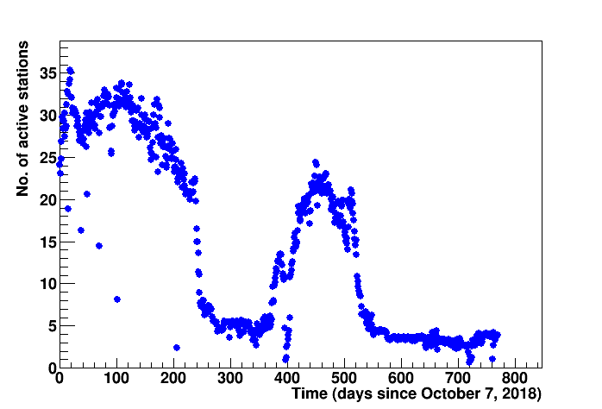
Extension of previous analysis
Correlation between several telescopes over a period of about 5 months has been extended up to 760 days (more than 2 years, a factor 6 in time).
March 2020
Unfortunately, from March 2020, only a few stations remained active to the Covid pandemic
Summer 2019
Previous analysis
Extended analysis (October 2018 – November 2020)

Slide 4
Distribution of multitelescope events
The number N of observed coincidences (within 1 ms) between k telescopes varies between about 10⁹ for k=3 to a few units for k=12
Log(N) approximately scales with k
Experimental distribution is in fair agreement with the expected random rate
A very slight excess in the exp/spurious rate observed for the largest k (11,12), but within errors still compatible with 1
Old results:

Slide 5
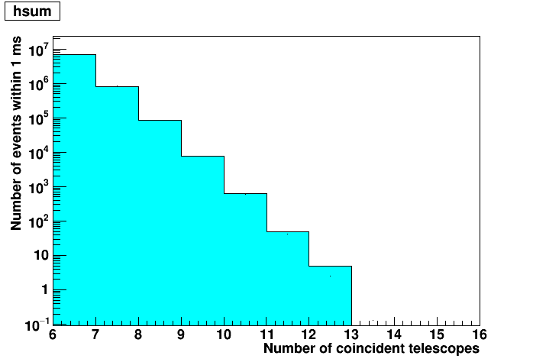
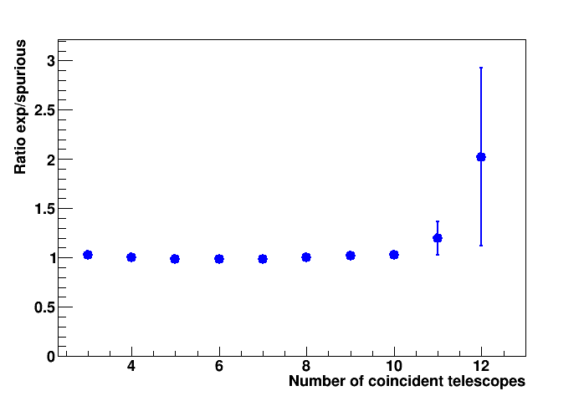
Distribution of multitelescope events
New results
Only 1 additional event observed with k=12 telescopes
Experimental distribution is in fair agreement with the expected random rate
A very slight excess in the exp/spurious rate observed for the largest k (11,12), but within errors still compatible with 1
New results:

Slide 6
Is there something else we can reasonably do for a further analysis?
At the last meeting we discussed two possibilities:
Increase the statistics
Done (>2 years data), but not so large improvement in statistics
Only observed 5 events with k=12 telescopes, none with k=13 telescopes in >2 years
b) Select events of interest according to some criteria
Possibility to search for coincident events in smaller geographical regions, i.e. in selected ranges of relative distances … or to introduce cuts in the observed events (number of tracks per telescope, …)
In progress

Slide 7
Selection of multi-track, multi-telescope events
Produce ROOT event tree with
N.telescopes, time cell (ms)
[Telescope code, ntracks, time individual telescope]_i i=1, 2, .. Ntelescopes
In order to analyze distributions with further selection on
- number of tracks in each telescope (average or min/max no. of tracks)
- geographical location of telescopes
- time difference between telescopes
- Coincidence window: 1 ms, events with at least 2 tracks in each telescope selected
Procedure for selection of events at CNAF started
Verified that processed files are within reasonable size, even with only 1 or 2 telescopes (no need to disregard them)
- A few days data taking processed
- First checks on the data quality and consistency of procedure on-going

Slide 8
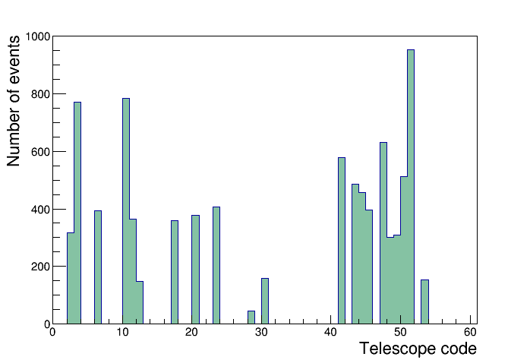

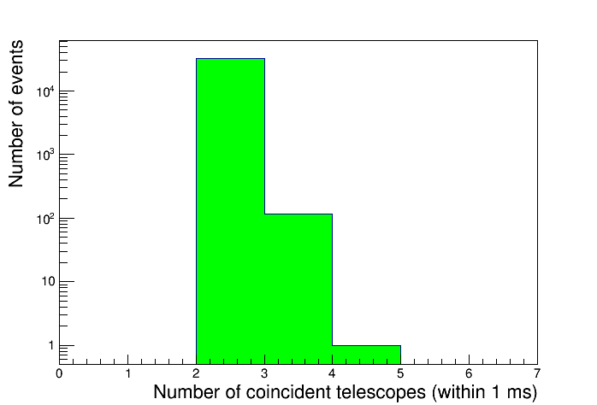
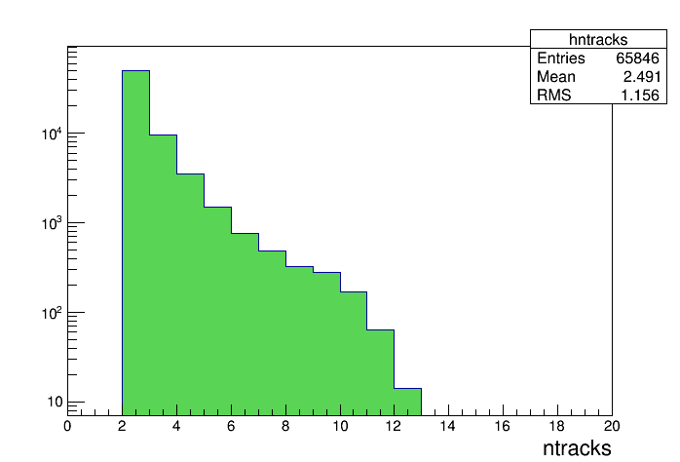
First plots from 6 days data taking…

