Slide 1

Multiple coincidences between EEE telescopes: a step forward?
F.Riggi
EEE Analysis Meeting
February 21, 2023

Slide 2
The problem
Search for multi-coincidence cosmic ray events over large distances with EEE telescopes
Where do they come from, if any?
Two different classes of mechanisms may in principle contribute:

Slide 3
Class 1 mechanisms
Two primary cosmic rays correlated from their origin and travelling over large paths without loosing their momentum correlation
Very difficult to accept:
It would imply primaries
a) travelling at the same speed (light speed), to keep the correlation
b) uncharged, to avoid deflections from magnetic fields
Hence photons or neutrinos

Slide 4
Class 2 mechanisms
A single primary particle interacts locally (within the Solar System) producing two or more correlated fragments which may in turn produce correlated showers.
Example of Class 2 mechanism: The Gerasimova-Zatsepin (GZ) effect: the photodisintegration of heavy nuclei in the solar field. In this case two fragments (showers) are expected.
Alternative hypothesis:
Cosmic dust grains: objects with 10⁶-10⁹ atoms with relativistic speed and fragmenting at the top of atmosphere, with the possibility to produce several nuclei and in turn correlated showers.
No calculations are available for this process to my knowledge, especially concerning probabilities for such events and size/distance of showers

Slide 5
Potential of the EEE network
Many cosmic ray telescopes distributed over a large territory and GPS synchronized
Broad distribution of locations and of relative distances, from 20 to 1200 km
Long data taking periods, although not with a constant number of stations

Slide 6
Potential of the EEE network
Many cosmic ray telescopes distributed over a large territory and GPS synchronized
Broad distribution of locations and of relative distances, from 20 to 1200 km
Long data taking periods, although not with a constant number of stations

Slide 7
Comparing to spurious rates
Searching for multi-coincident events benefits from a large number of combinations between several telescopes… but
even the overall spurious rate is very high!
In other words, although the spurious rate for a specific combinations of k telescopes is very low, the number of possible k-fold combinations is very high, and we have to consider the product of the two quantities.

Slide 8
What has been already done
With these considerations in mind, we have already analyzed (and published) a relatively large set of data, about 5-6 months (October 2018 to June 2019) on a daily basis, with the following result:
The number N of observed coincidences (within 1 ms) between k telescopes varies between about 10⁹ for k=3 to a few units for k=12
Log(N) approximately scales with k
Experimental distribution is in fair agreement with the expected random rate
A very slight excess in the exp/spurious rate observed for the largest k (11,12), but within errors still compatible with 1

Slide 9
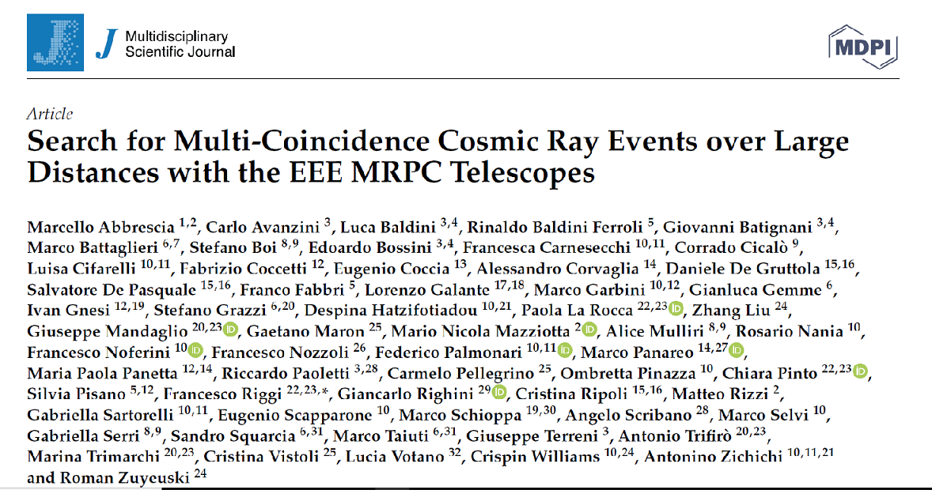
Previous considerations already published (2021)

Slide 10
Is there something else we can reasonably do for a further analysis?
Two possibilities:
Increase the statistics
However, due to log(N) ~ k, to observe just a few k=13 events would require a factor 10 in statistics (going from 5-6 months to 5 years).
Not clear if this is affordable, in terms of good (constant) data quality
b) Select events of interest according to some criteria
A possibility could be to search for coincident events in smaller geographical regions, i.e. in selected ranges of relative distances
… or to introduce cuts in the observed events (number of tracks per telescope, …)

Slide 11
Select regions with small, medium and large average distance between telescopes

Slide 12
Select events with small, medium and large average distance between telescopes
Evaluate the average relative distance between stations
20-200 200-500 500-1200 km

Slide 13
Select events with small, medium and large average distance between telescopes
Or (better) the average distance from their center-of-mass location

Slide 14
Additional cut possibilities?
Number of tracks in each telescope, or average number of tracks in all involved telescopes:

Slide 15
Access and selection of events
Performing all these analyses requires a large computational effort
Instead of (frozen) histograms (as in previous analysis) better employ trees for multidimensional analysis and easy possibility to modify analysis conditions
Data size of these structures could however be very high for all (>10¹⁰) correlation events.. Maybe consider only events with at least N (>5 or more) stations involved, since
events with only few telescopes involved are likely dominated
by spurious rate.
Preliminary considerations with Francesco Noferini already
started to understand possible strategies
This would reduce a factor 100 the number of events

