Slide 1
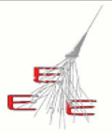
Performance of MRPC telescopes of the EEE Project
E. Bossini, C. Cicalò, D. De Gruttola,
I. Gnesi, M. Garbini, S. Grazzi, M.P. Panetta
08/02/2017
EEE meeting

Slide 2
Status
time resolution
spatial resolution
beta ditributions for all telescopes (ongoing, not shown here)
trending for HV and currents (ongoing, not shown here)
duty cycle by trending the rate (ongoing, not shown here)
writing (well advanced, not shown here)
meeting 30 Nov 2016
time slewing correction
comparison between old and new analyzer
time slewing correction
comparison between old and new analyzer
08/02/2017
EEE meeting
2

Slide 3
Time Over Threshold
strategy for the time slewing correction
understand all contributions
08/02/2017
EEE meeting
3

Slide 4
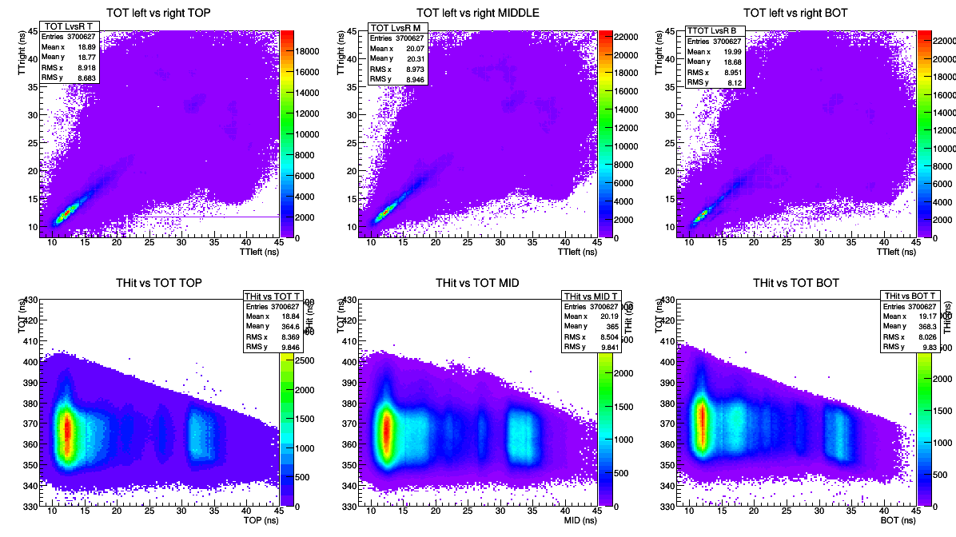
TOT
TOT vs time to get time slewing corrections
next
use the mean of distribution bin by bin (at the moment we use the mean of the profile)
clarify possible reflections (peaks in the TOT distribution)
apply time slewing correction and measure again the time resolution
apply correction on single signals (left and right) rather than to the mean of TOT in a chamber
08/02/2017
EEE meeting
4

Slide 5
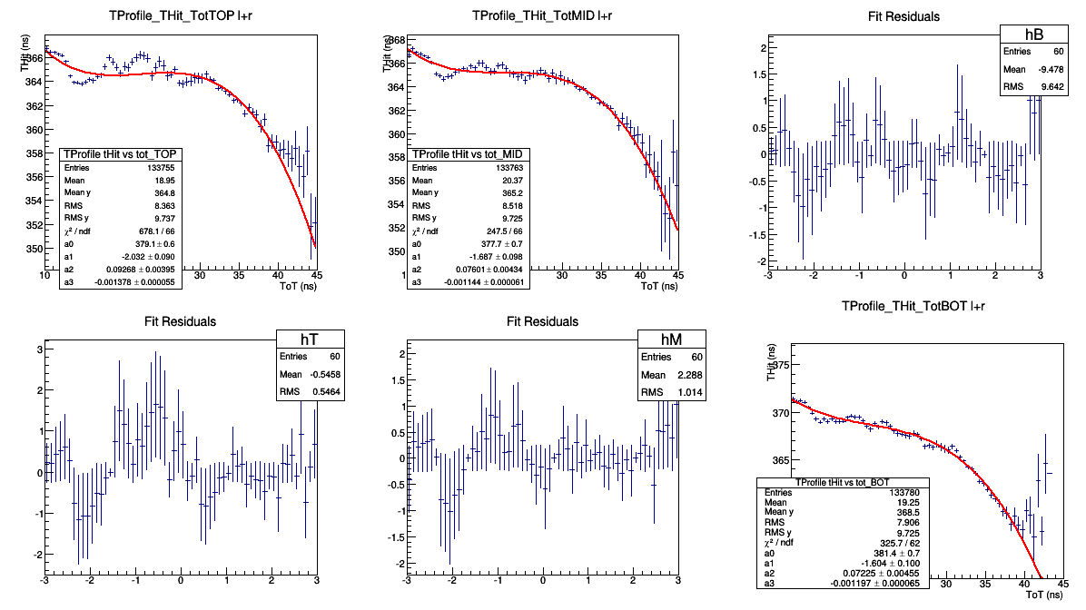
TOT
TOT vs time to get time slewing corrections
next
use the mean of distribution bin by bin (at the moment we use the mean of the profile)
clarify possible reflections (peaks in the TOT distribution)
apply time slewing correction and measure again the time resolution
apply correction on single signals (left and right) rather than to the mean of TOT in a chamber
08/02/2017
EEE meeting
5

Slide 6
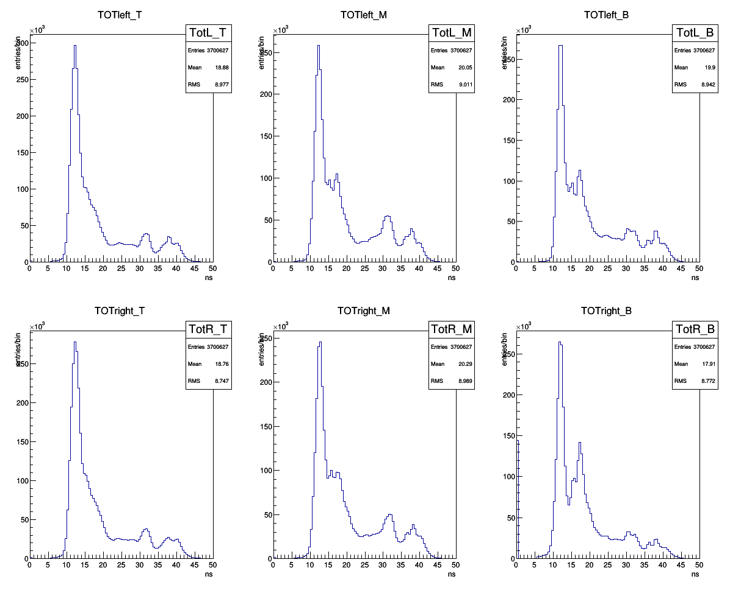
TOT
TOT distributions (secondary peaks are visible → signal reflections)
08/02/2017
EEE meeting
6

Slide 7
TOT
TOT distributions (secondary peaks are visible → signal reflections)
TOT vs strip show no dependence on the strip
is it correct to use the mean of TOT_{L} and TOT_{R}?
it should work, but taking reflections into account (NINO and electronic
chain) the correction should be done on single signals (left and right)
→ check has been done (see next slides)
time slewing correction has been done by using:
meeting 30 Nov 2016
the mean of TOT_{L} and TOT_{R}
TOT_{L} and TOT_{R} for t_{L} and t_{R} respectively
the min value between TOT_{L} and TOT_{R} (in order not to assign a wrong TOT, due to reflections)
08/02/2017
EEE meeting
7

Slide 8
mean TOT associated to hit time
08/02/2017
EEE meeting
8

Slide 9
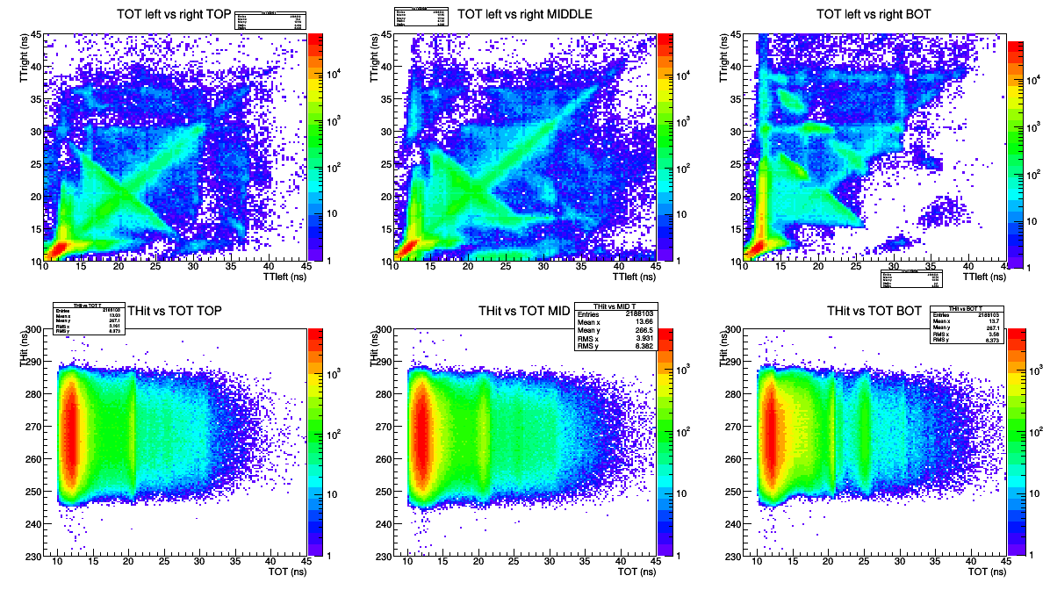
TORI-02-2016-01-21(3M events)
χ²<5
signal
reflections
(entries out
of the diagonal)
08/02/2017
EEE meeting
9

Slide 10
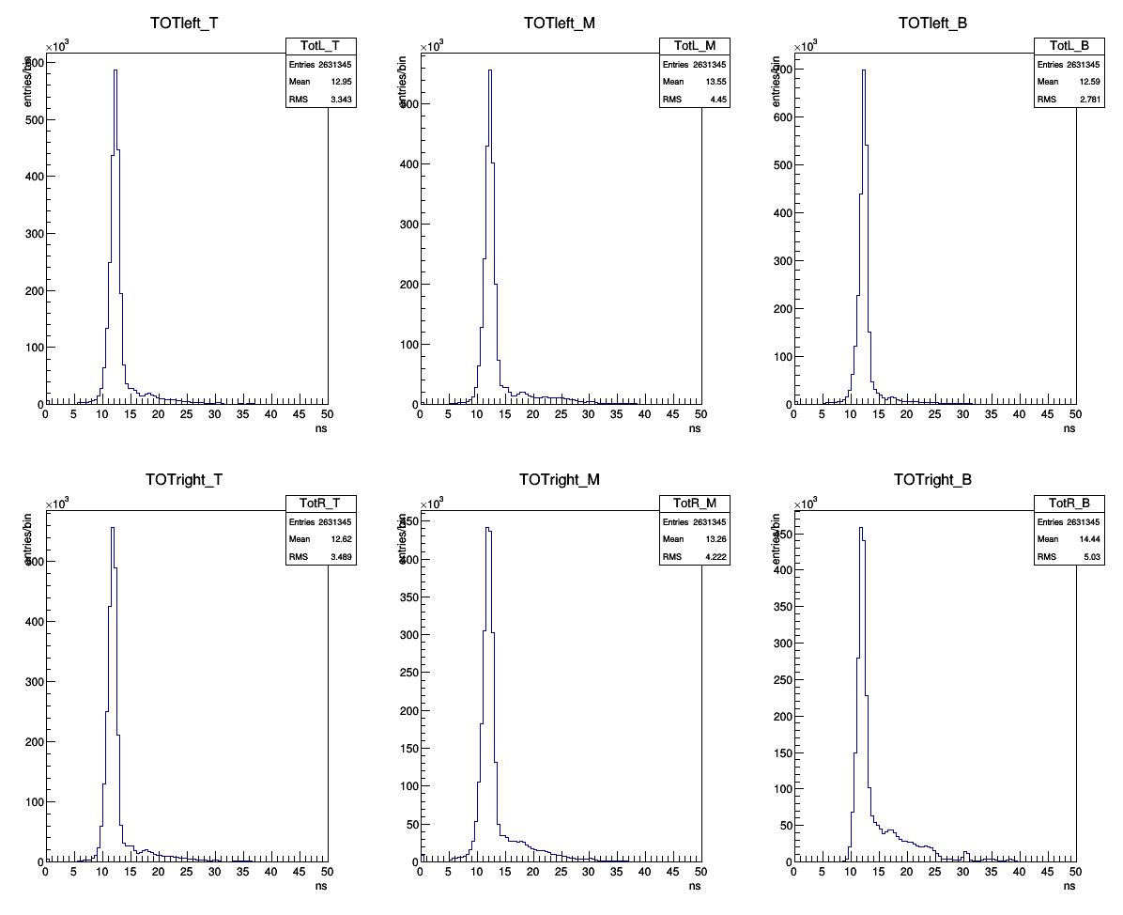
TORI-02-2016-01-21(3M events)
χ²<5
signal
reflections
08/02/2017
EEE meeting
10

Slide 11
TORI-02-2016-01-21(3M events)
χ²<5
2D histogram profile mean(RMS)
08/02/2017
EEE meeting
11

Slide 12
TORI-02-2016-01-21(3M events)
χ²<5
corrected time
corrected time
08/02/2017
EEE meeting
12

Slide 13
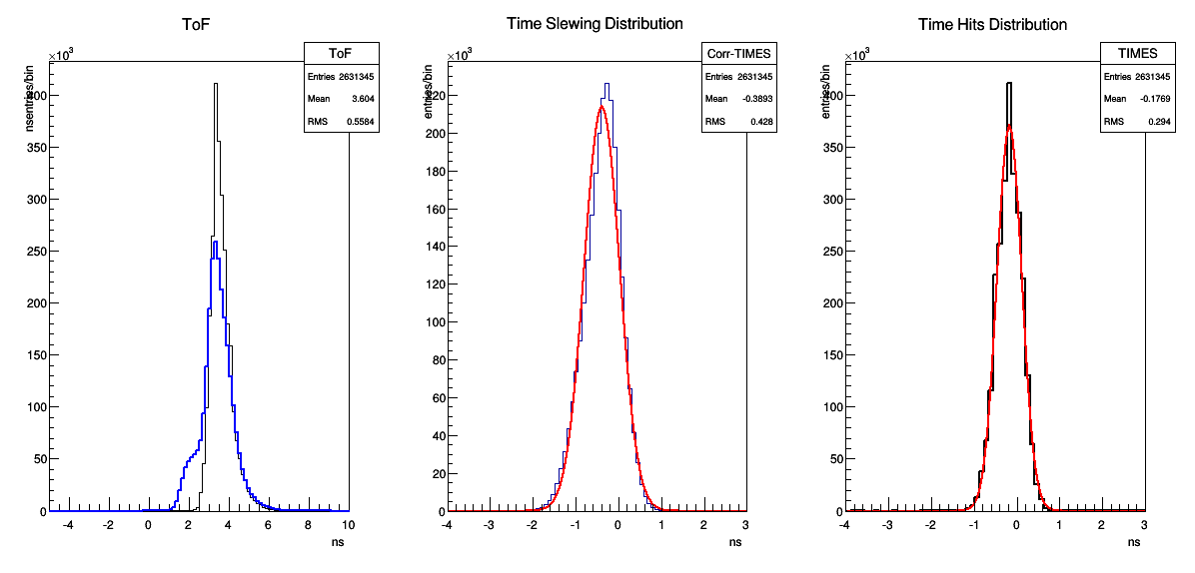
TORI-02-2016-01-21(3M events)
χ²<5
σ_{t} = 339 ps
σ_{t} = 236 ps
bad correction!
08/02/2017
EEE meeting
13

Slide 14
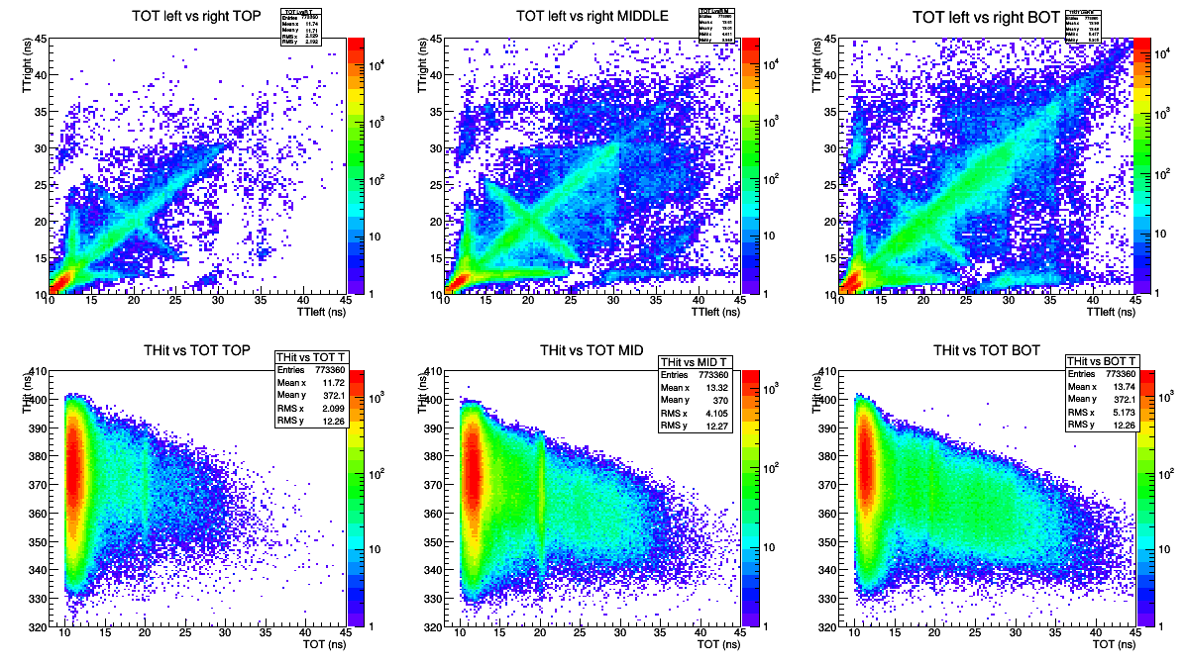
LECC-01-2016-11-19(2.5 M events)
χ²<5
08/02/2017
EEE meeting
14

Slide 15
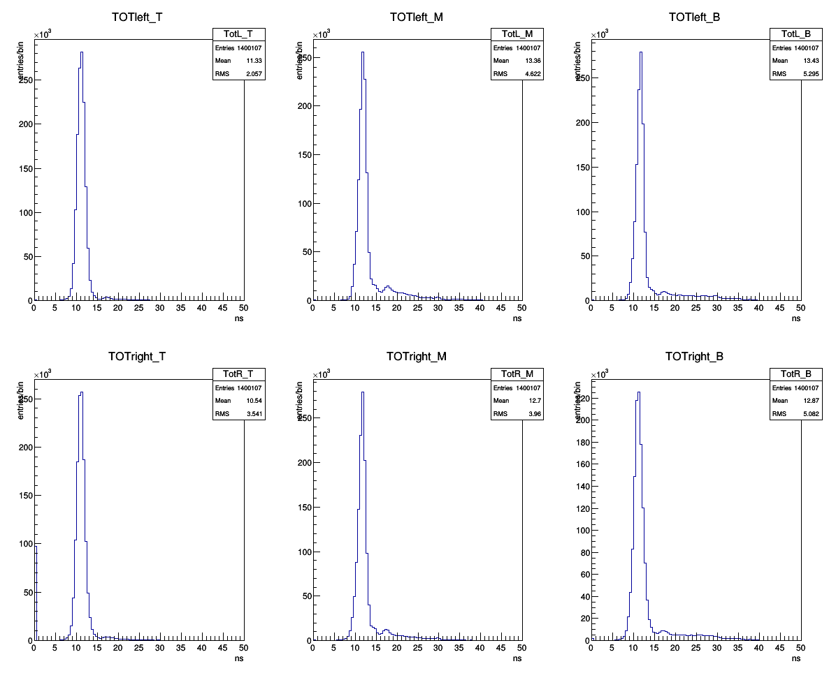
LECC-01-2016-11-19(2.5 M events)
χ²<5
08/02/2017
EEE meeting
15

Slide 16
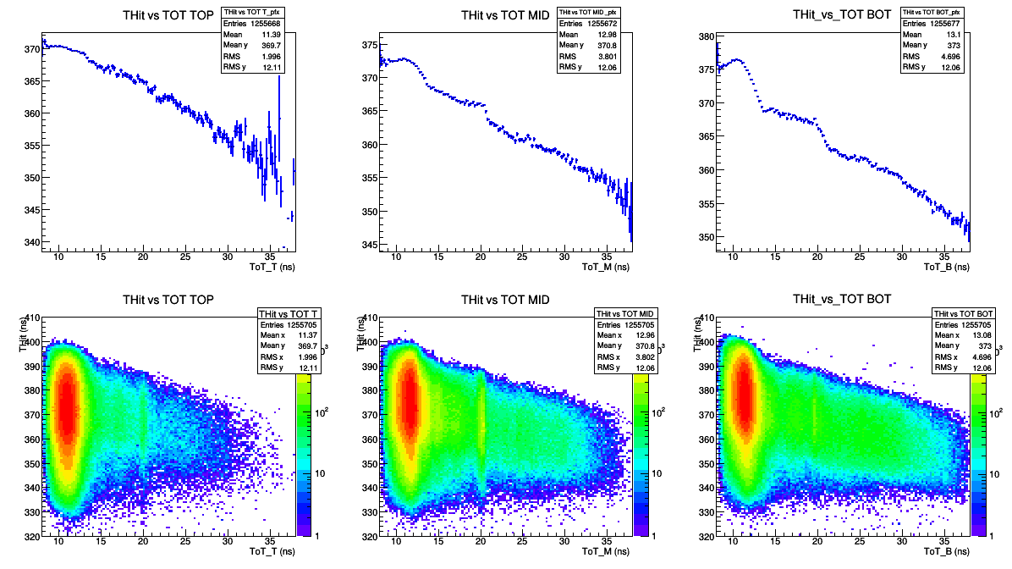
LECC-01-2016-11-19(2.5 M events)
χ²<5
08/02/2017
EEE meeting
16

Slide 17
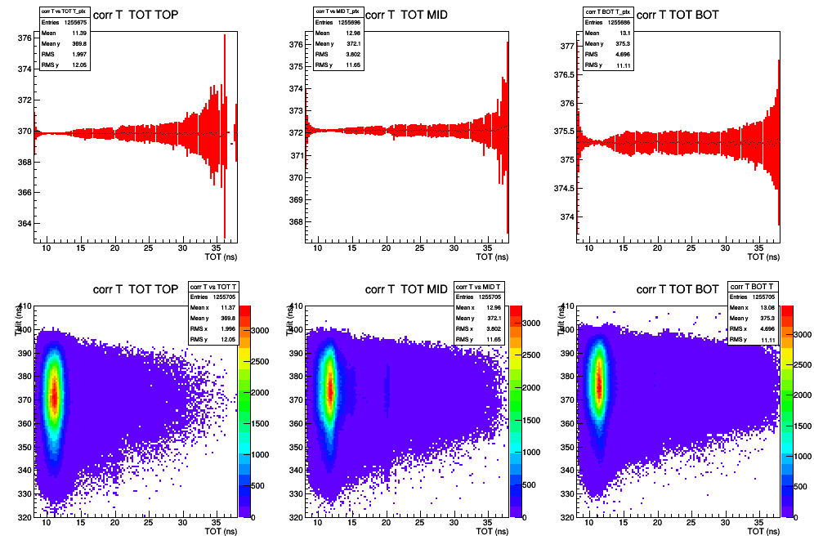
LECC-01-2016-11-19(2.5 M events)
χ²<5
corrected time
corrected time
08/02/2017
EEE meeting
17

Slide 18
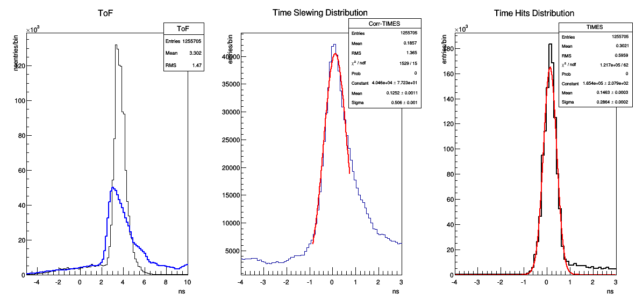
LECC-01-2016-11-19(2.5 M events)
χ²<5
σ_{t} = 413 ps
σ_{t} = 216 ps
bad correction!
08/02/2017
EEE meeting
18

Slide 19
TOT_{L} and TOT_{R} for t_{L} and t_{R} respectively
08/02/2017
EEE meeting
19

Slide 20
TORI-02-2016-01-21(3M events)
χ²<5
right
08/02/2017
EEE meeting
20

Slide 21
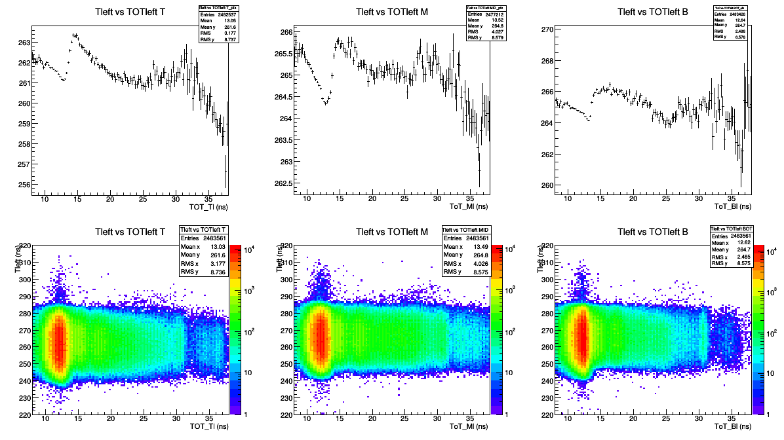
TORI-02-2016-01-21(3M events)
χ²<5
left
08/02/2017
EEE meeting
21

Slide 22
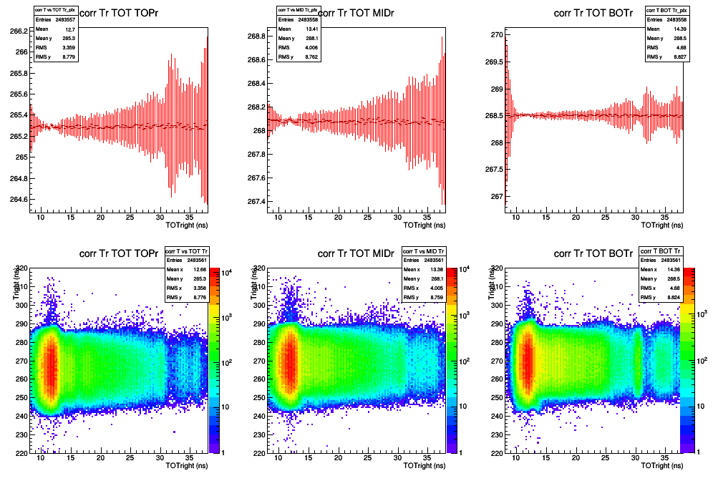
TORI-02-2016-01-21(3M events)
χ²<5
right
corrected time
08/02/2017
EEE meeting
22

Slide 23
TORI-02-2016-01-21(3M events)
χ²<5
left
corrected time
08/02/2017
EEE meeting
23

Slide 24
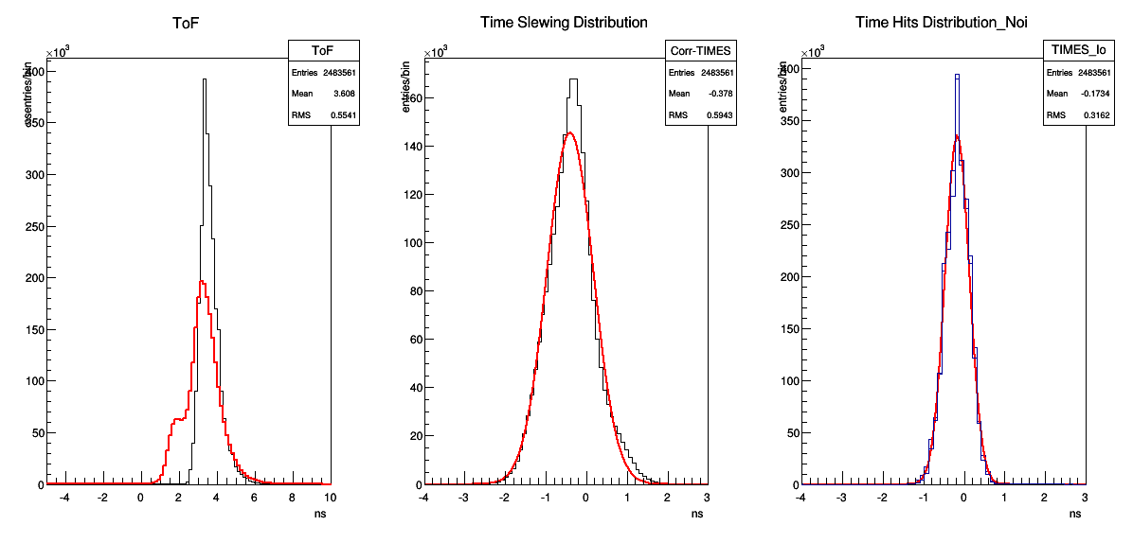
TORI-02-2016-01-21(3M events)
χ²<5
σ_{t} = 429 ps
σ_{t} = 216 ps
bad correction!
08/02/2017
EEE meeting
24

Slide 25
min value between TOT_{L} and TOT_{R}
08/02/2017
EEE meeting
25

Slide 26
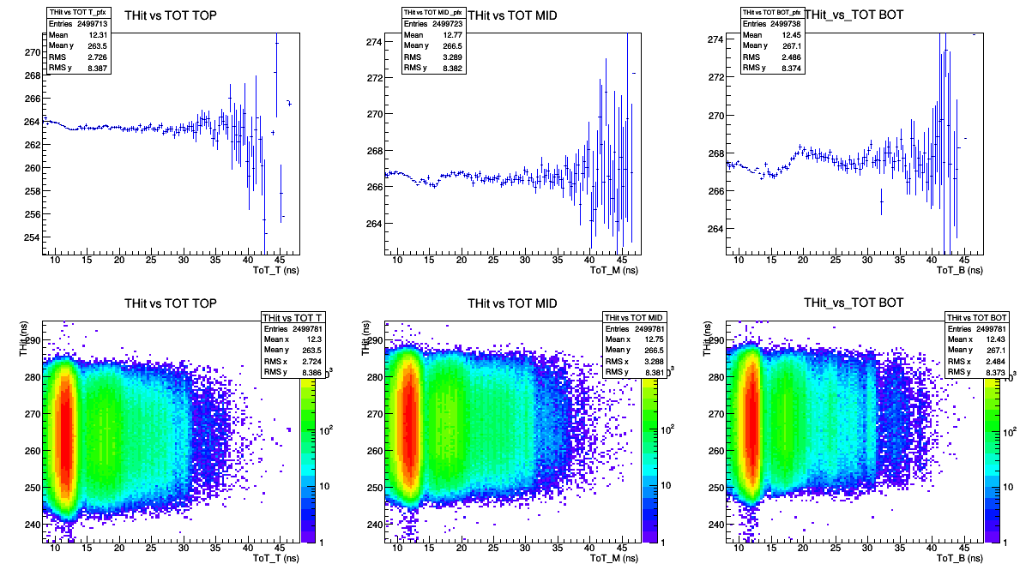
TORI-02-2016-01-21(3M events)
χ²<5
08/02/2017
EEE meeting
26

Slide 27
TORI-02-2016-01-21(3M events)
χ²<5
corrected time
corrected time
08/02/2017
EEE meeting
27

Slide 28
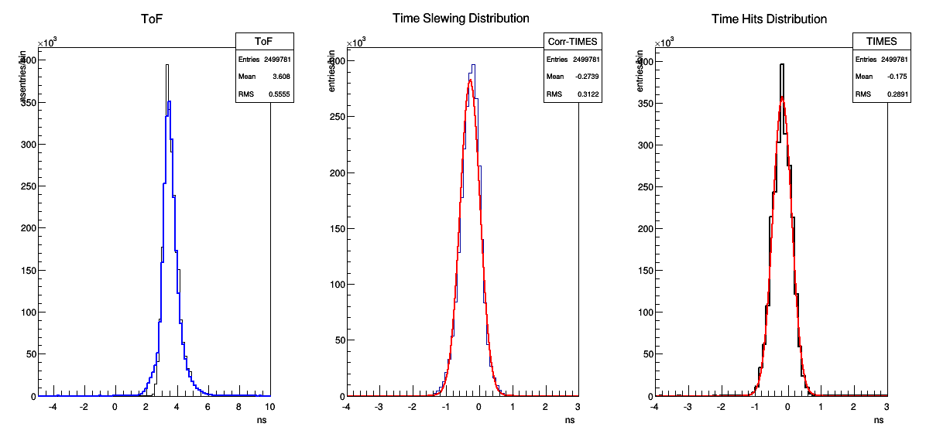
TORI-02-2016-01-21(3M events)
χ²<5
σ_{t} = 239 ps
σ_{t} = 236 ps
no bad correction here, but the resolution still does not improve after time slewing correction
08/02/2017
EEE meeting
28

Slide 29
Summary
meeting in Rome in person
3 different approach to apply time slewing correction
no improvement on the time resolution (to be understood)
to be done:
many things were understood
time slewing correction still not working
other items to be completed (including writing of the paper)
another meeting in person soon
the work should finish in the next weeks
select only events without reflections
select only vertical tracks crossing the telescope in the center
08/02/2017
EEE meeting
29

