Slide 1
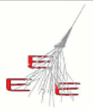
Performance of MRPC telescopes of the EEE Project
E. Bossini, C. Cicalò, D. De Gruttola,
I. Gnesi, M. Garbini, S. Grazzi, S.M. Panetta
01/06/2016
EEE meeting

Slide 2
Status
time resolution (almost final)
spatial resolution (almost final)
efficiency (ongoing measurement)
comparison with 3 indipendent analysis (consistent)
writing (well advanced)
01/06/2016
EEE meeting
2

Slide 3
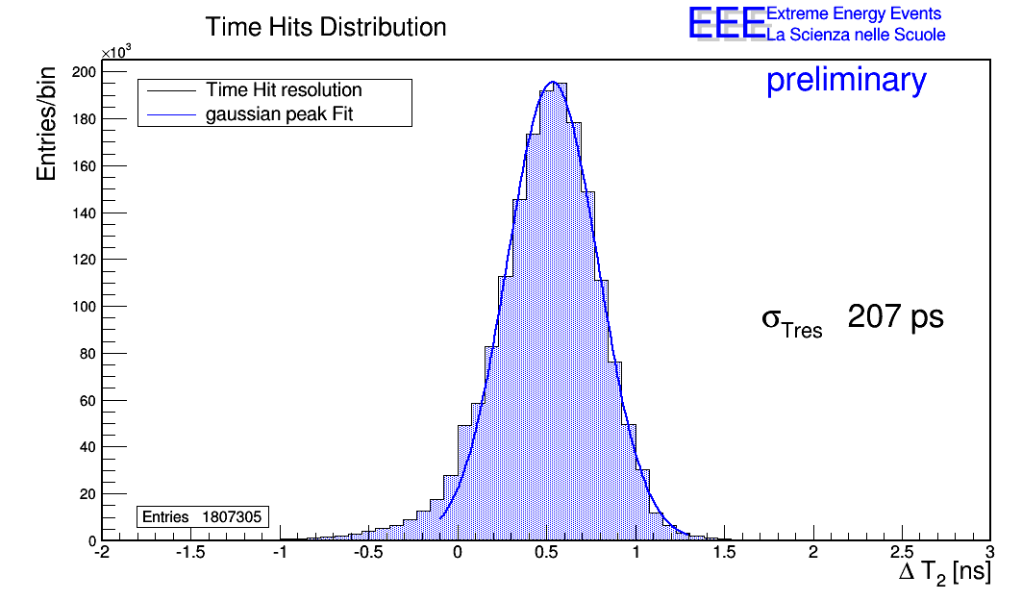
Time resolution
no selection on events w/o clusters
cut on reconstructed tracks χ² < 10
strip by strip calibration applied
result obtained on TORI-03 (same clock distributed to both TDCs)
available results from telescopes with different clocks on TDCs
results recently presented at a conference (RPC 2016)
ΔT_{hit} = (T_{H_bot} + T_{H_top})/2 - T_{H_mid}
σ_{T} = √3/2σ_{ΔT} ~ 207 ps
time slewing correction to be applied (soon)
01/06/2016
EEE meeting
3

Slide 4
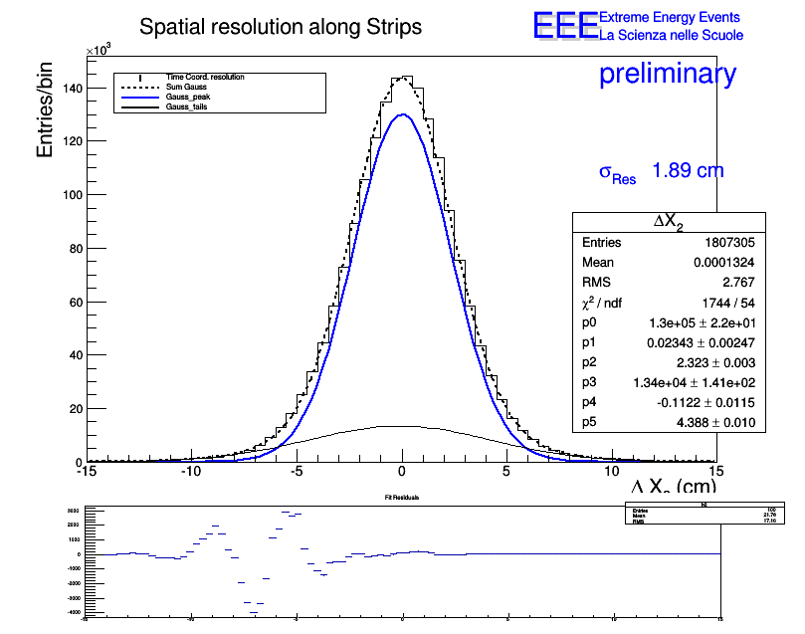
Spatial resolution (long side)
no selection on events w/o clusters
cut on reconstructed tracks χ² < 10
strip by strip calibration applied
result obtained on TORI-03 (same clock distributed to both TDCs)
available results from telescopes with different clocks on TDCs
results recently presented at a conference (RPC 2016)
ΔX = (X_{bot} + X_{top})/2 – X_{mid}
σ_{X} = √3/2σ_{ΔX} ~ 1.9 cm
two contributions are visible → to be
understood
two gauss ditributions used for the fit
using only one gauss σ_{X} = 2.05 cm
σ_{Xexp} ~ v_{signal}*(ΔT_{lef}²+ΔT_{right}² )² ~ 0.68 cm
(TDC resolution 100 ps → v_{signal} ~ 15.6 cm/ns)
01/06/2016
EEE meeting
4

Slide 5
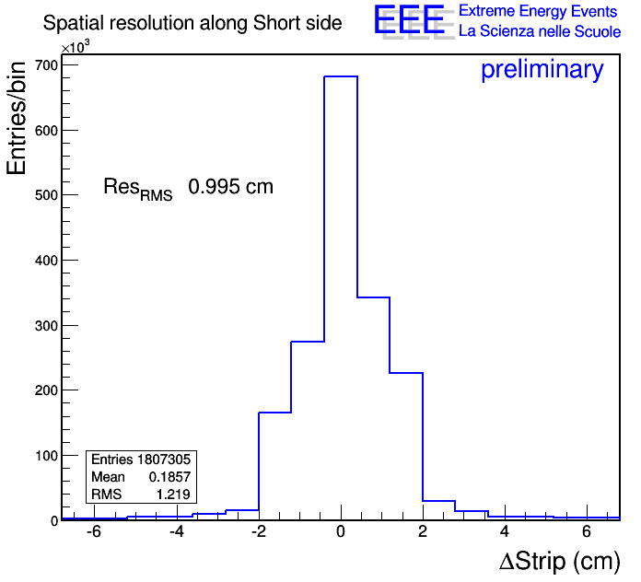
Spatial resolution (short side)
no selection on events w/o clusters
cut on reconstructed tracks χ² < 10
strip by strip calibration applied
result obtained on TORI-03 (same clock distributed to both TDCs)
available results from telescopes with different clocks on TDCs
results recently presented at a conference (RPC 2016)
ΔY = (Y_{bot} + Y_{top})/2 – Y_{mid}
σ_{Y} = √3/2σ_{ΔY} ~ 1 cm
σ_{Yexp} ~ pitch/√12 ~ 0.92 cm
(pitch 3,2 cm)
study fit procedure in detail (triangular function?)
01/06/2016
EEE meeting
5

Slide 6
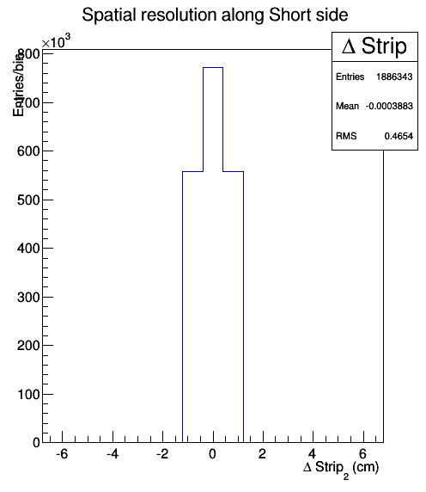
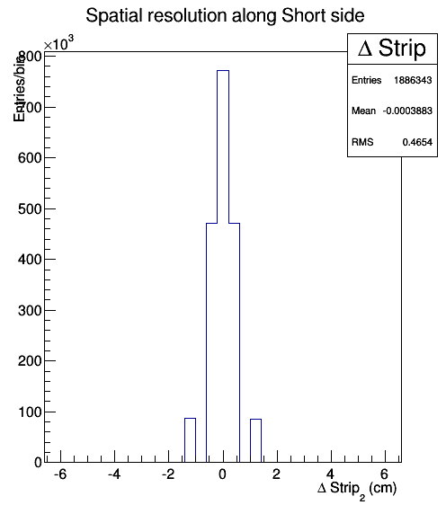
MC spatial distribution
simulation ready → to be optimized
1 hit and 2 angles are simulated at the moment
events with 2 hits to be added
bin width 8 mm
bin width 4 mm
01/06/2016
EEE meeting
6

Slide 7
Efficiency
measurement ongoing on TORI-03
external trigger used (two 15x15 cm² scintillators)
5 areas on the chambers are scanned
results of eff vs HV performed after Run 2 can be included
01/06/2016
EEE meeting
7

Slide 8
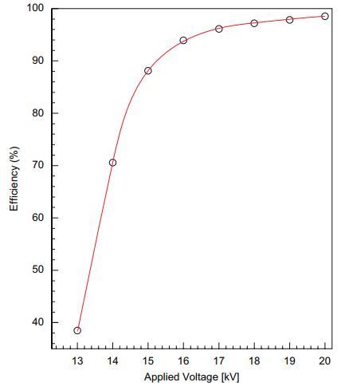
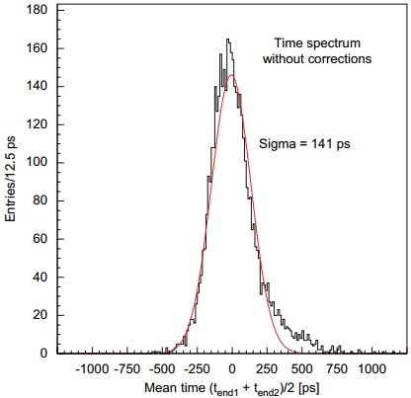
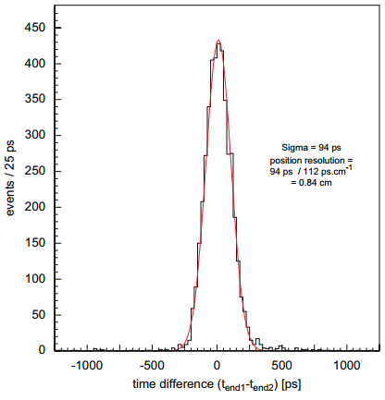
Results from test beam (2006)
TEST BEAM at CERN
Efficiency vs HV for a single MRP Chamber (Triggered by scintillators) Efficiency plateau$\sim$100%
TDCs 25ps bins , scintillators system time resolution 30 ps
σ_{T} ~ 141 ps in the center of the strip
with time slewing correction
and scintillators time resolution
σ_{T} ~ 94 ps
spatial resolution along strips 8 mm
01/06/2016
EEE meeting
8

Slide 9
Comparison with indipendent analysis
3 indipendent analysis:
results are compatible with analysis from “performance working group”
recent analysis from degree students in Pisa
old analysis for degree in 2008 in Bologna
recent analysis on multitrack events from F. Nozzoli
01/06/2016
EEE meeting
9

Slide 10
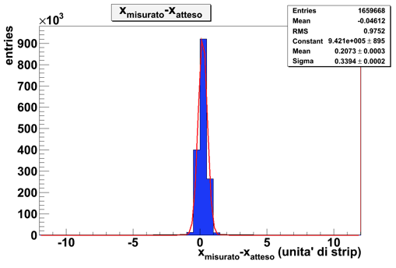
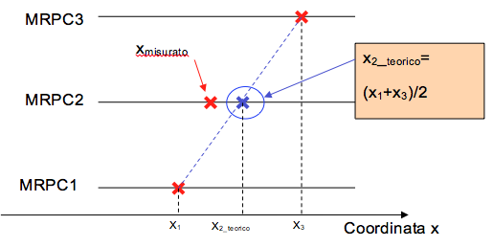
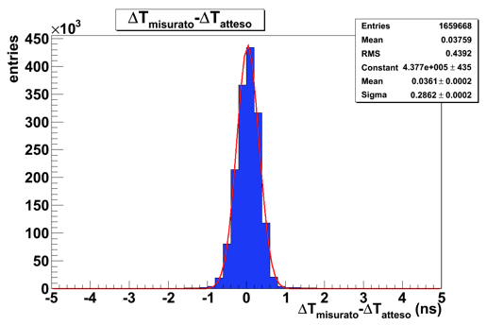
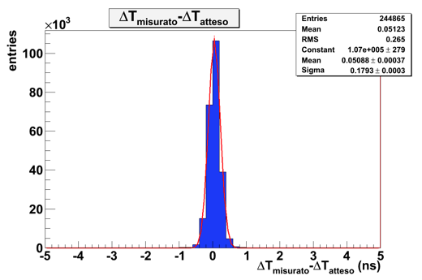
Bologna
analysis done in Bologna in 2008 (graduate student)
σ_{x}=0.9 cm
σ_{y}=2.1 cm
σ_{y}=1.3 cm
vertical tracks
01/06/2016
EEE meeting
10

Slide 11
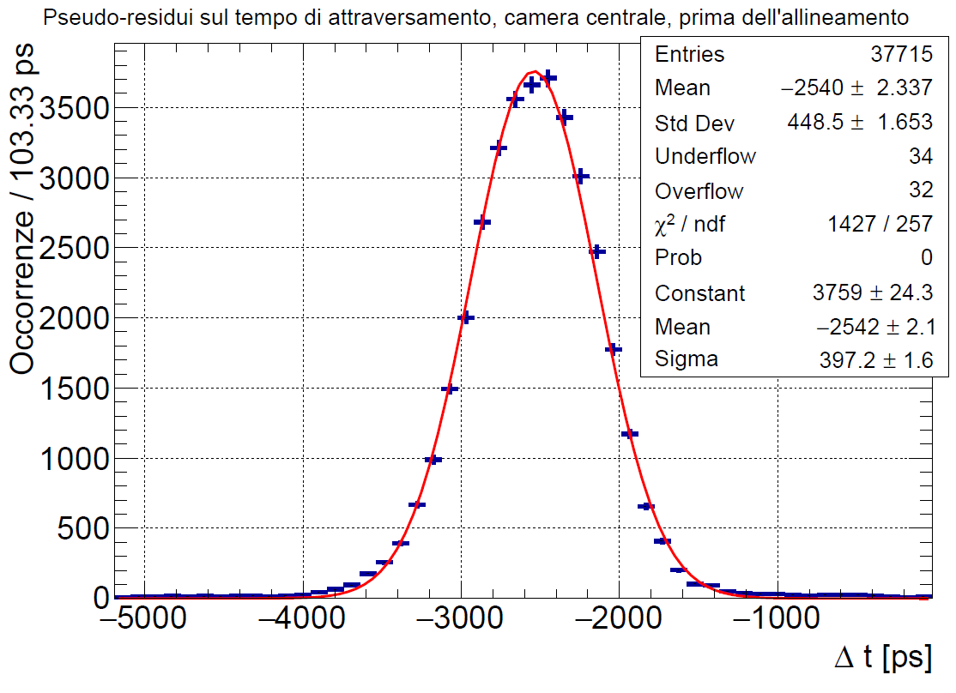
Pisa
analysis done by graduate students
raw alignment with the box distribution
track cuts applied after the alignment (1 hit/chamber, χ²/d.o.f. < 4)
align the middle chamber with the residual distribution
iterate
re-scan all events with the new calibration
hit position obtained by correcting the offset of the box distribution
hit raw time of the middle chamber centered wrt the external chambers
similar results for spatial resolution
(σ_{x}~ 1.4 cm, σ_{y} ~ 1.2 cm)
very good time resolution
$$σ\sim 192 ps$$
01/06/2016
EEE meeting
11

Slide 12
Multitrack events
analysis by F. Nozzoli and recently presented at the reco&analysis meeting
SAVO-01
residual x
residual y
time residual
similar results on SAVO-02 and FRAS-02
01/06/2016
EEE meeting
12

Slide 13
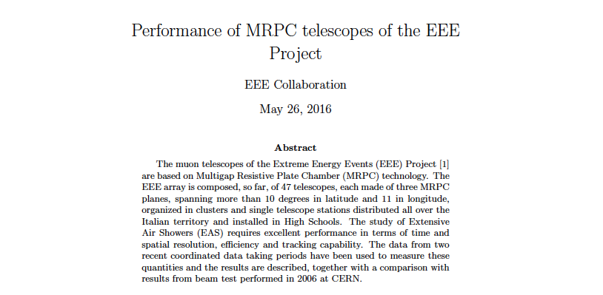
Paper
01/06/2016
EEE meeting
13

Slide 14
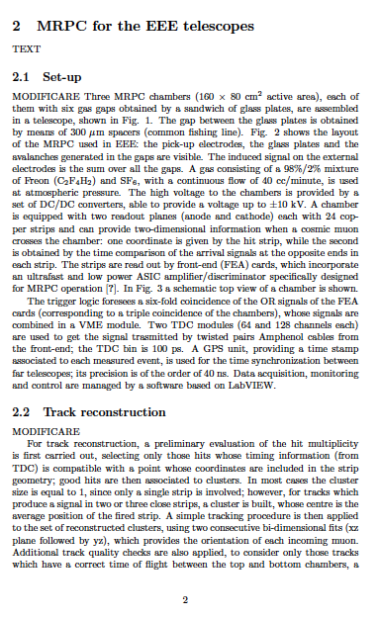
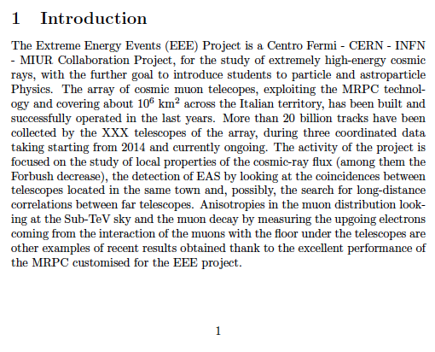
Paper
introduction and description of the setup done
(to be revised)
01/06/2016
EEE meeting
14

Slide 15
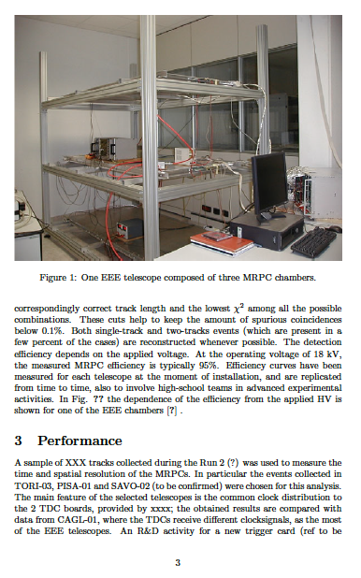
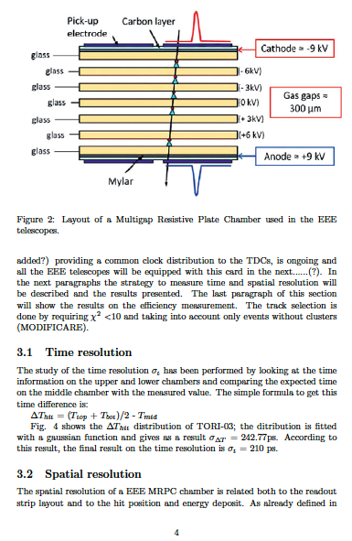
Paper
section on
strategy and
results well
advanced
figures to be changed
01/06/2016
EEE meeting
15

Slide 16
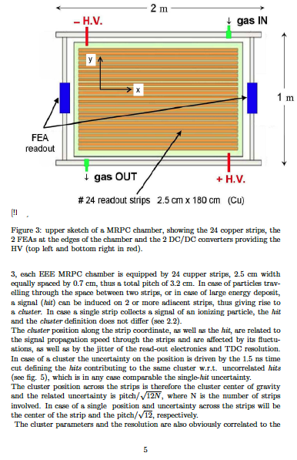
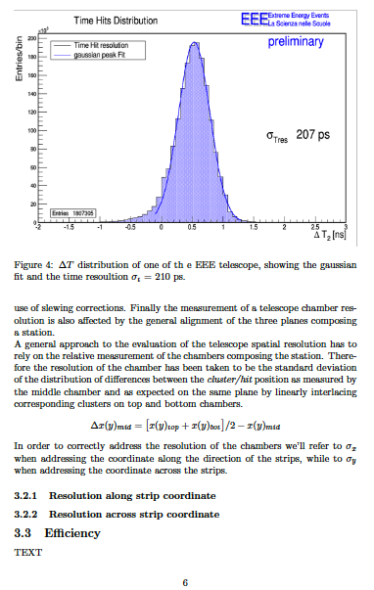
Paper
section on
strategy and
results well
advanced
01/06/2016
EEE meeting
16

Slide 17
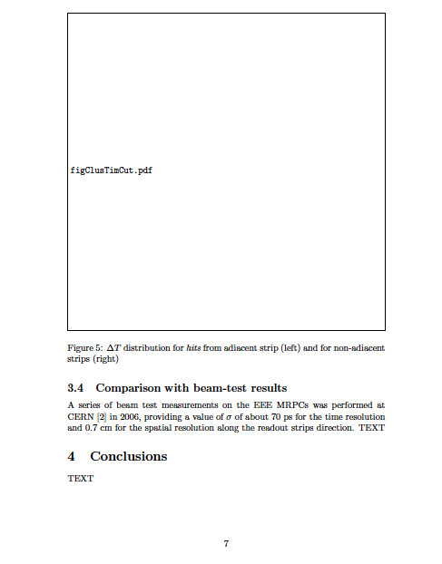
Paper
comparison with results from beam test to be written
01/06/2016
EEE meeting
17

Slide 18
Conclusions
analysis → almost final
paper writing → advanced status
TOT and slewing correction to be included (ongoing)
01/06/2016
EEE meeting
18

