Slide 1
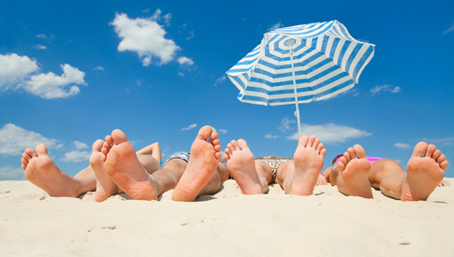
Welcome back from holidays!
…for a new year of exciting data taking

Slide 2
News: New indico page!
Set up by Fabrizio – many thanks! ☺
You can find it at the following address: http://agenda.centrofermi.it/indico/
Category “EEE meetings” created
EEE general meetings at the moment, you can create any kind of meeting you want (analysis, hardware, etc.)
You need to sign-up to this new indico
All the material presented easily accessible
For the moment, we will use the usual vidyo room:
http://vidyoportal.cern.ch/flex.html?roomdirect.html&key=yYVPeLNKqCjY

Slide 3
Activities in preparation for Run-3
Run-3 should start during the meeting in Bari: 13-14 October
Under local responsibles’ responsability:
Bring, wherever possible, distance between chambers at 50 cm
When this operation is done, please communicate it
Check gas system and gas supply, bring the flux at ≈ 2 l/h
Wherever possible, have the two bottles needed for Run-3
Check, and possibly solve, all the problems known and appearing at start-up
Noise, difference between trigger rate and reconstructed track rate, …
Install the clock distribution card, as soon as available (around beginning of October)
It will arrive with instructions and cables

Slide 4
Activities in preparation for Run-3
Under central group responsability:
Reconstruct all the data with Analyzer v.2.0
Provide the new DB, new DQM chain and web page
see talk by Francesco Noferini today
Provide automatic e-log and cancel shifts
Fabrizio working on this
Under schools’ responsability, but local responsible should inquire about progresses and provide support if needed:
Measure the telescope angle wrt. North
See document prepared by Federico et al.

Slide 5
General strategy
Plan is to have all 52 stations taking data smoothly Two actions needed:
Replace broken chambers where necessary
Four spare chambers ready, maybe one more needed
Organize chamber expedition (not easy at all)
Install new chambers (not easy at all)
Provide trigger cards for five new stations
They just need these cards
In perspective, add the GPS functionality and replace all trigger and GPS cards in the network
See talk by Marco Panareo et al.

Slide 6
Meeting in Bari
Start 13 October, 15.00 – End 14 October 13.30
Times chosen accoding to trip schedules
Schools (and you) will received all information shorty
Hotel accomodation will be handled centrally, trips should be arranged by yourselves
Foreseen three masterclasses, one hour each
They should be simpler and slower than the previous ones, as per the feedback received
No EEE collaboration meeting foreseen

