Slide 1
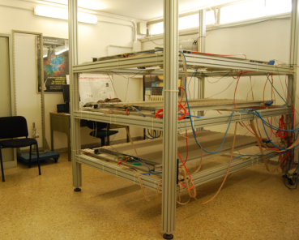
Preliminary results from the Eco-friendly gas
measurements campaign
M. P. Panetta * for the EEE Collaboration
INFN sezione di Lecce

Slide 2
New Eco-friendly mixture measurements
4 Test Stations
We use 2 MRP Chambers for triggering the chamber under test
Mixture based on HFO + He
COSENZA (High gas Flow)
PISA (Low gas Flow)
Trigger → Double Ch. coincidences
Mixture based on HFO + CO₂
CERN
BOLOGNA
TOP ch.
MIDDLE ch
BOTTOM ch

Slide 3
Analysis method
Clusterization process
as an example for test
on MIDDLE Chamber →
”Good event” :
β → 0.8 < β < 1.18 (β = (T_Top – T_Bottom ) /Track Lenght )
fiducial area for the extrapolated Point in the tested chamber
→ 5 cm < Pos Y < 75 cm ∧ -60 cm < Pos X < 60 cm
θ → cos θ > 0.9 (θ < 51.6 ° )
“Efficiency Events” : Good events with a Cluster in the Middle Chamber + ( |P_{extrapolated} - P_{cluster}| < 10 cm)
Efficiency : -------------------------
TOP Chamber 1 Cluster
Middle Chamber
No constrains in the clusterization Process
BOTTOM Chamber 1 Cluster
# Efficiency Events
# Good events
Notes:
(Middle cluster dimension < 50 cm ) other ch. 7cm and 5ns

Slide 4
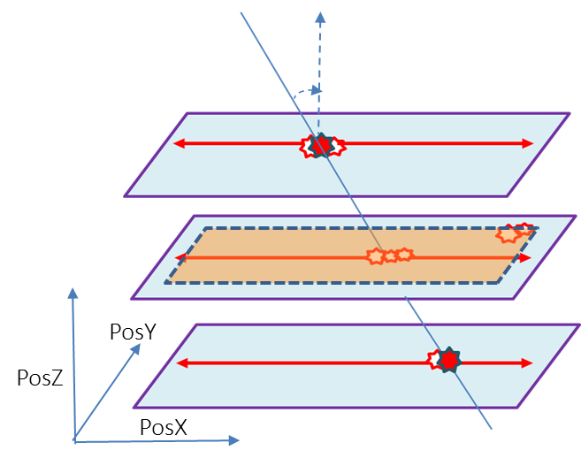
Analysis method
Clusterization process
as an example for test
on MIDDLE Chamber →
”Good event” :
β → 0.8 < β < 1.18 (β = (T_Top – T_Bottom ) /Track Length )
fiducial area for the extrapolated Point in the tested chamber
→ 5 cm < Pos Y < 75 cm ∧ -60 cm < Pos X < 60 cm
θ → cos θ > 0.9 (θ < 51.6 ° )
“Efficiency Events” : Good events with a Cluster in the Middle Chamber + ( |P_{extrapolated} - P_{cluster}| < 10 cm)
Efficiency : -------------------------
TOP Chamber 1 Cluster
Middle Chamber
No constrains in the clusterization Process
BOTTOM Chamber 1 Cluster
# Efficiency Events
# Good events
Notes:
(Middle cluster dimension < 50 cm ) other ch. 7cm and 5ns

Slide 5
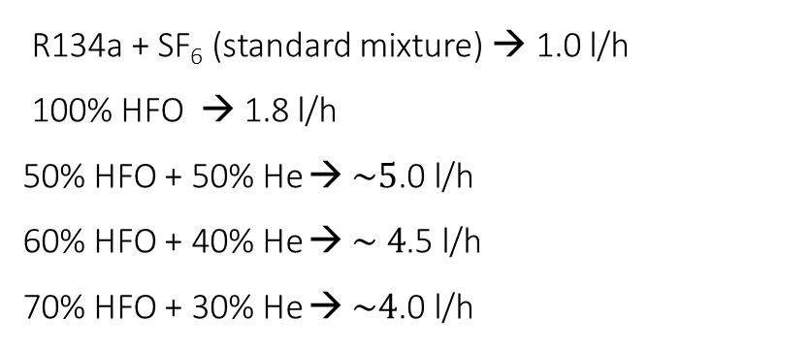
Some Results : Mixture based on HFO + He
RENDE-01 → High gas Flow
R134a + SF₆ (standard mixture) → 1.0 l/h
100% HFO → 1.8 l/h
50% HFO + 50% He → $\sim 5$.0 l/h
60% HFO + 40% He → $\sim 4$.5 l/h
70% HFO + 30% He → $\sim 4$.0 l/h

Slide 6
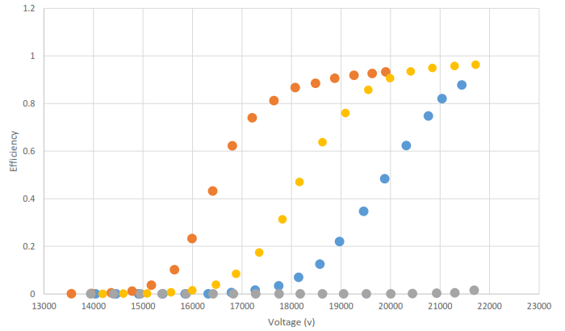
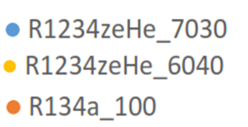
Some Results : Mixture based on HFO + He
PISA-01 → Low gas Flow (Standard Flowmeter )
(thanks to Dott. E. Bossini)
R134a → 1.0 l/h
60% HFO + 40% He → $\sim 1$.2 l/h
70% HFO + 30% He → $\sim 1$.2 l/h
Efficiency for chambers filled with HFO + He gas mixtures $\sim$ 90%

Slide 7
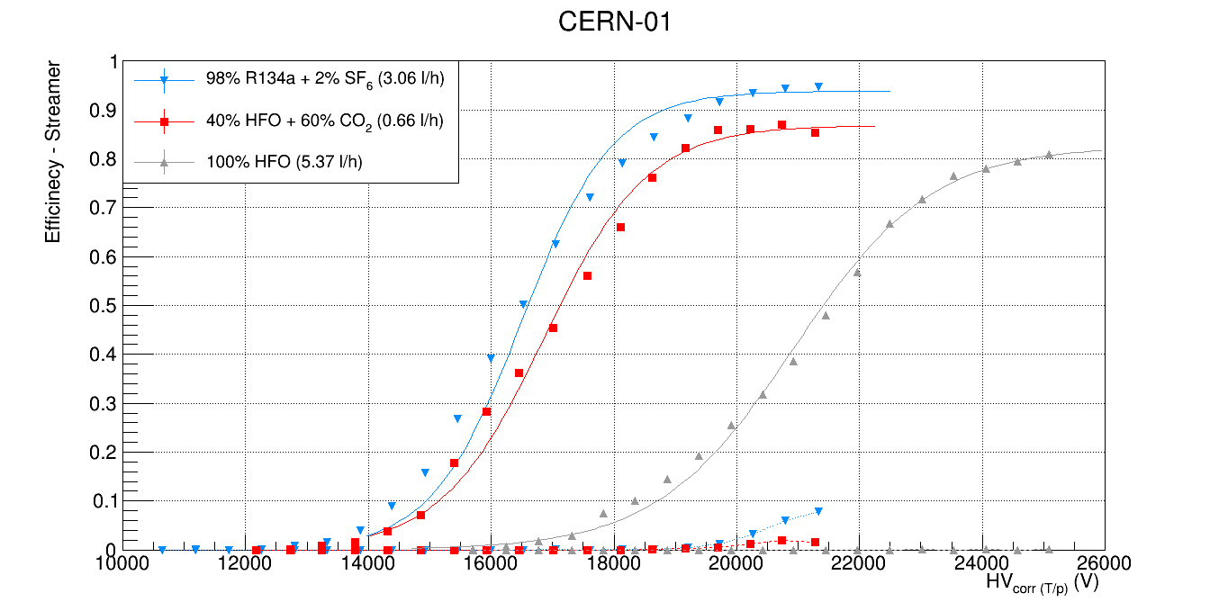
Some Results: Mixture based on HFO + CO₂
CERN-01 →
250 µm gaps
Efficiency for chambers filled with HFO + CO₂ gas mixtures $\sim$ 90%

Slide 8
Thanks for your attention
8

Slide 9
PosZ
….Spares

