Slide 1




Local Neuronal Microcircuits
Egidio D’Angelo
Dept. Brain & Behavioral Sciences
University of Pavia
Centro Fermi
Roma
March 1, 2017

Slide 2
“Modeling the Brain” to “Understand the Brain”
The brain is a COMPLEX ADAPTIVE SYSTEM and is probably the most complex structure of the Universe. But we are missing the “project” as well as “critical data”.
What we have is information sufficient to start the reconstruction of brain functions in a model and the computational power required to simulate it... From the analyisis of model spatio-temporal dynamics , we will formulate hypothesis on how the brain works.
Reverse Enginering proceeds through steps:
Strategic data
Rescostruction
Validation
Propagation
Prediction
HYPOTHESIS
.

Slide 3
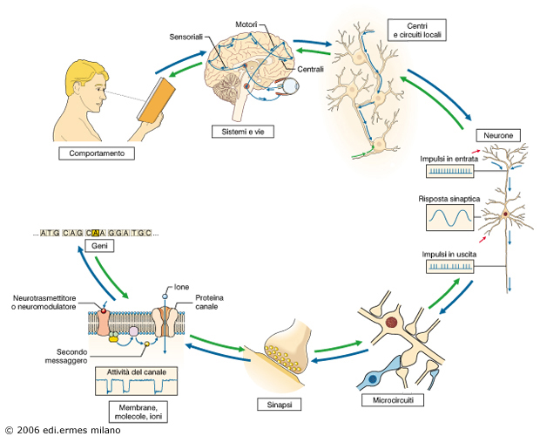
“Bottom-Up” vs. “Top-Down”
Theoretical models Hypothesis
Realistic models Biological data
Construction molecular/sub-cellular
Validation neuronal level
Propagation microcircuit level
Embedding meso-macrocircuit level
Closed-loop
Notes:
I could go on ...
Many nic pieces ...
Bu may nice ieces do not necessailiy give an effective picture
We need a funcitonal framework.
This a real strategy
Bottom-up
Ciecumvents the indeterminacy problem
Free from assumptions
Prone to upgrade
Crossing scales
Main problems
No direct insight into the structure of computation
Results limited by the details that are implemented

Slide 4
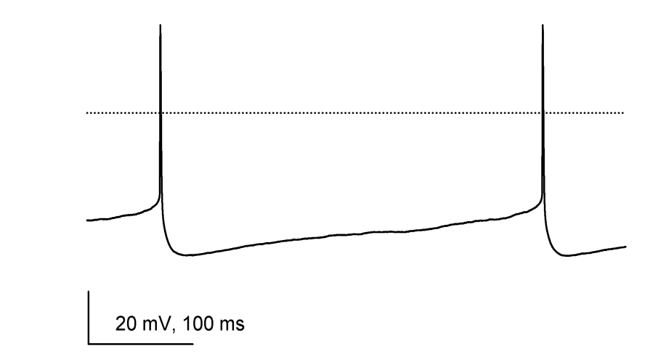
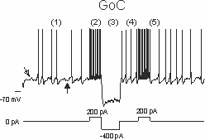
How to generate brain models
Biological recordings
I_{DR}, I_{A}, (I_{BK} )
I_{Na}
I_{SK}
I_{h}
I_{NaP}
I_{M-loke}
Molecular-level plasticity models
Reslistic neuron models
Detailed neuronal microcircuits
Simplified neuron and micorcircuit models
Interconnected detailed large-scale circuits
Simplified whole-brain models
Detailed large-scale network dynamics with plasticity
Models embodyment
/
neurorobots
CLOSED LOOP TESTING
Simulated behavior and Control theory

Slide 5
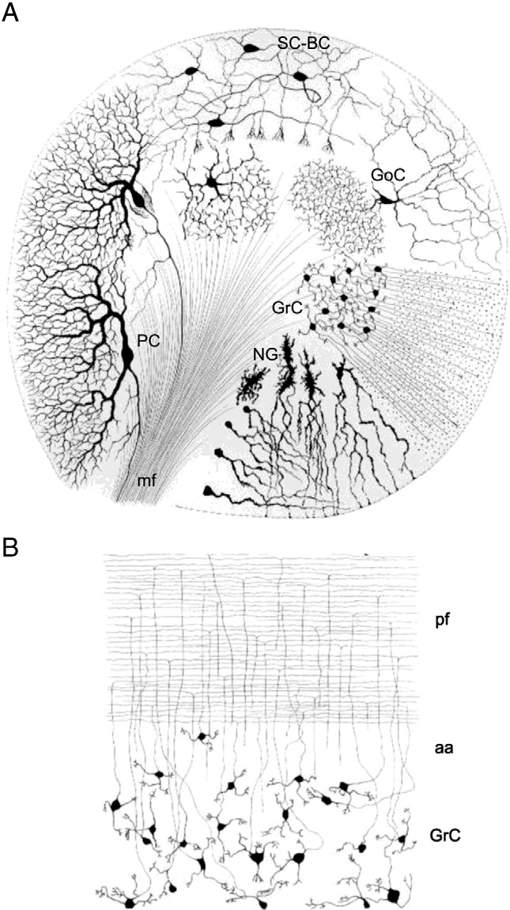

Camillo Golgi e Santiago Ramon y Cajal provided the first descriptions on the nature of neurons and circuits in the cerebellum
Galliano, Mzzarello and D’Angelo, 2010; D’Angelo et al.,2011
; Tritto Locatelli and D’Angelo, in preparation

Slide 6
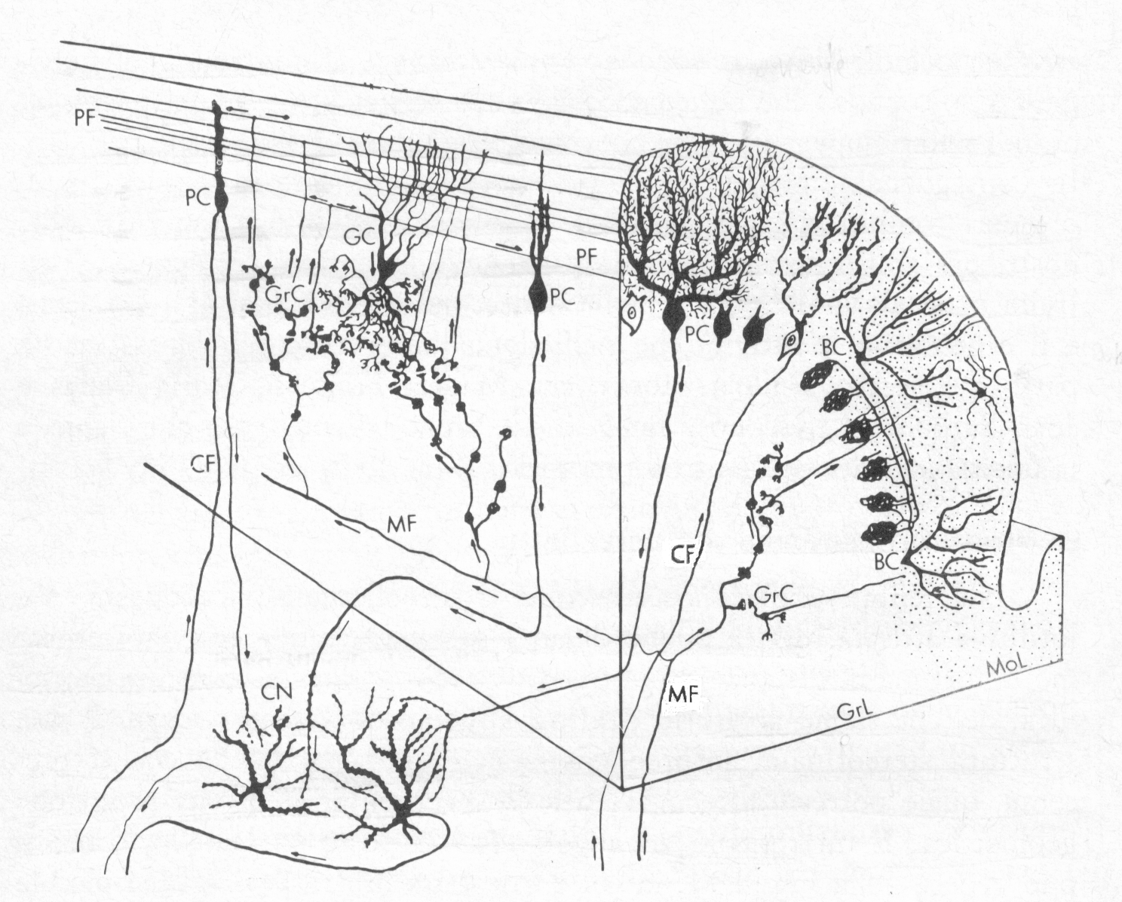
La Motor Learning Theory (Marr-Albus-Ito) suggerisce che l’apprendimento nel cervelletto avviene alla sinapsi PF-PC sotto il controllo della sinapsi CF
“For me the most significant property of the cerebellar circuitry would be its plastic ability, whereby it can participate in motor learning, that is the acquisition of skills. This immense neuronal machine with the double innervation of Purkinje cells begins to make sense if it plays a key role in motor learning… it could be optimistically predicted that the manner of operation of the cerebellum in movement and posture would soon be known in principle” (J.C. Eccles, from the foreword to Ito, 1984).
But Marr: (D’Angelo, in Ito and Vaina 2016)
!!) does not consider other forms of plasticity
!!) does not consider neuronal firing dynamics and molceular complexity
!!) does not consider geometry (only topology and statistics)

Slide 7
Complex non-linear neuronal dynamics
Purkinje cells
Fast- and slow-spiking
Fast pacemaking (~50Hz)
Strong compartmentalization
Differential dendritic processing
AIS processing
Granule cells
Near.-threhold oscillations
Resonance (~6Hz)
Spike-frequency adaptation
Important non-linear dynamics
Golgi cells
Pacemaking and resonnce (~6Hz)
Phase-reset
Postinhibitory Rebound Excitation
Spike-frequency adaptation
DCN
Bidirectional PC-DCN LTP/LTD
Bidirectional MF-DCN LTP/LTD
DCN Intrinsic excitability
MLIs
Pacemaking (~10Hz)
Postinhibitory Rebound Excitation
Spike-frequency adaptation
(D’Angelo et al., FCN 2016)

Slide 8
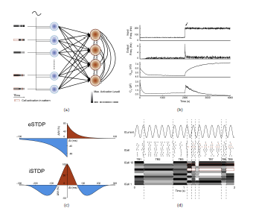
> 15 forms of plasticity
Molecular layer
Postsynatpic PF-PC LTD
Postsynatpic PF-PC LTD
Presynatpic PF-PC LTP
Presynatpic PF-PC LTP
Bidirectional PF-PC LTP/LTD
PC Intrinsic excitability
CF-PC LTD
PF-MLI LTP / LTD
MLI-PC LTP/LTD
Dynamic organization of synaptic plasticity
DCN
Bidirectional PC-DCN LTP/LTD
Bidirectional MF-DCN LTP/LTD
DCN Intrinsic excitability
Granular layer
Bidirectional MF-GrC LTP/LTD
GrC Intrinsic excitability
PF-GoC LTD
GoC Intrinsic excitability
Garrido, Luque, Tolu, D’Angelo , JNC 2016
Prestori ... D’Angelo, J Neuroci, 2016

Slide 9
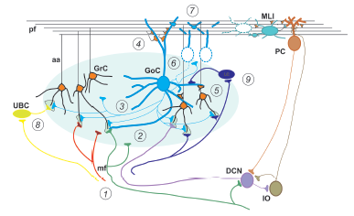
New complex wiring properties
Granular layer
GoC-GoC network
Glomerular integration: single or multiple GoC innervation
Multiple MFs origin and multimodal granule cell activation
Lugaro cell microcircuit
UBC microcircuit
Molecular layer
MLI-MLI network
PC-GrC inhibition
PC activation (AA / PF)
Distribution of SC and BC axons
Cerebellar glomerulus (courtesy of J. DeFelipe)
DCN and IO
DCN-IO / IO-DCN communicaiton
DCN – granular layer connections
MESOSCALE
MICROZONES, ZEBRIN STRIPES

Slide 10
Multi-scale realistic modeling of the cerebellar network
Biological experiments
Model construction
Model optimization
Model validation
Model predictions

Slide 11
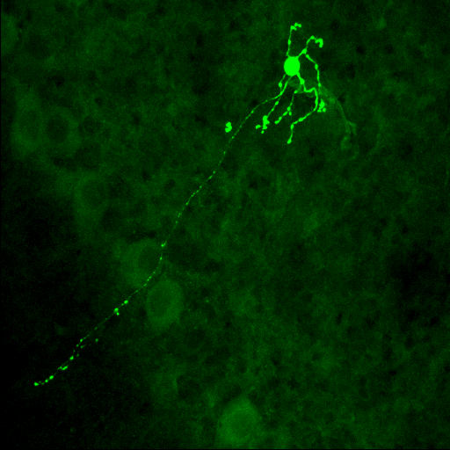
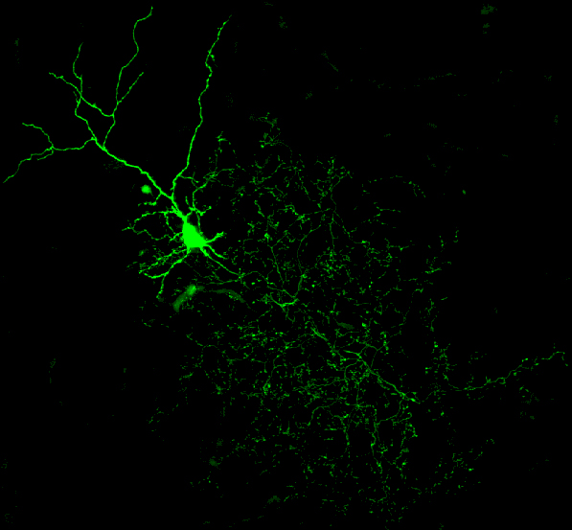
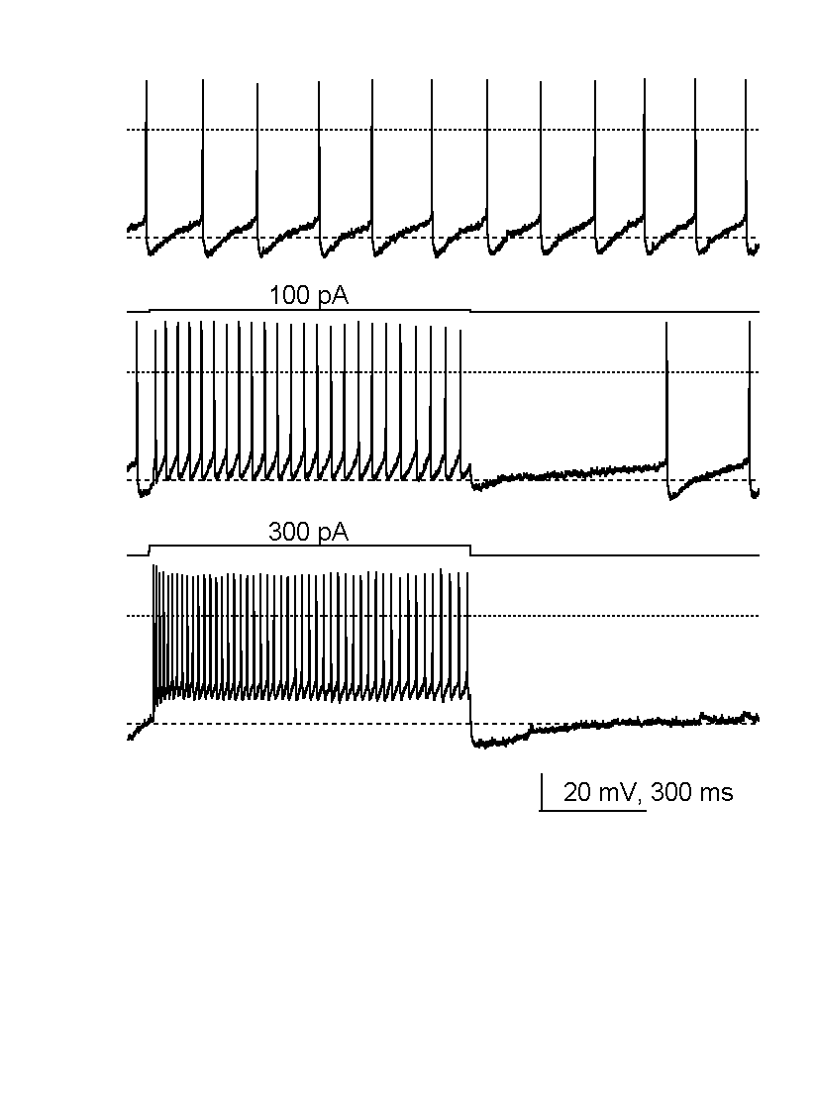
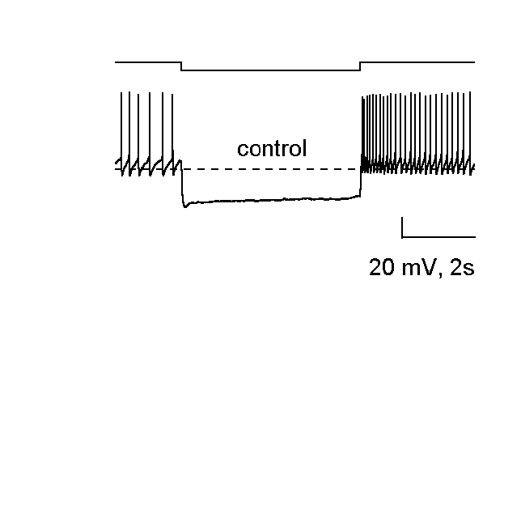
NEURON
Granule cell
D’Angelo et al., 1995, 1998, 2001
Golgi cell
Forti et al., 2006.
Kindly provided by B. Barbour
Notes:
I could go on ...
Many nic pieces ...
Bu may nice ieces do not necessailiy give an effective picture
We need a funcitonal framework.
This a real strategy
Bottom-up
Ciecumvents the indeterminacy problem
Free from assumptions
Prone to upgrade
Crossing scales
Main problems
No direct insight into the structure of computation
Results limited by the details that are implemented

Slide 12
MICROCIRCUIT
Gandolfi, Mapelli, Pozzi, Tognolina, D’Angelo , 2014, 2015

Slide 13
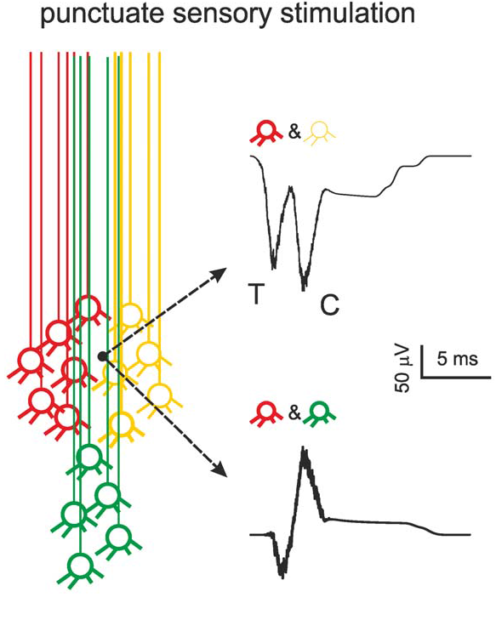
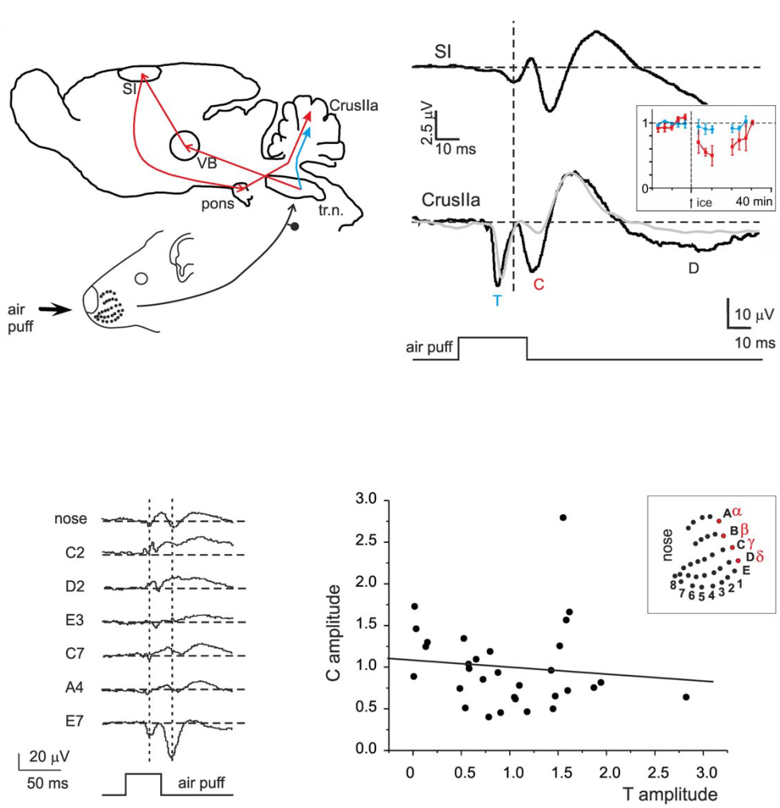
MESOCIRCUIT
(Diwakar et al., PLOS 2011)

Slide 14
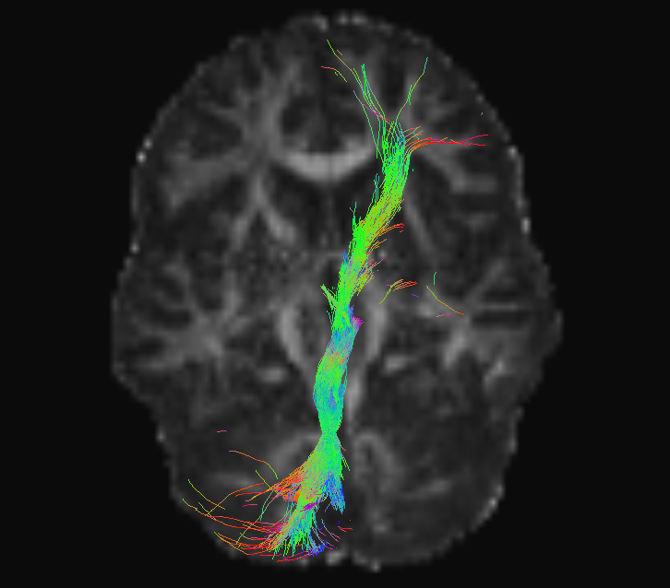
MACROCIRCUIT
Palesi et al., , 2014

Slide 15
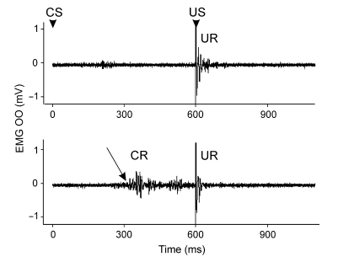
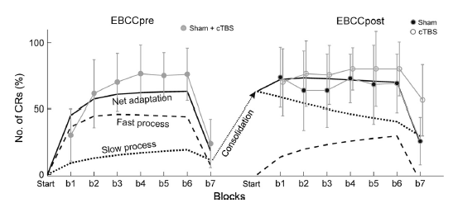
INTEGRATED SYSTEM
Monaco et al. EJN (2014)

Slide 16
Mathematical methods for realistic modeling
X
recovered resource
u
1/ τ_{R}
Y
active resource
1/ τ₁
Z
inactive resource
D’Angelo et al., J Neurosci 2001, 2013, 2017
Notes:
I could go on ...
Many nic pieces ...
Bu may nice ieces do not necessailiy give an effective picture
We need a funcitonal framework.
This a real strategy
Bottom-up
Ciecumvents the indeterminacy problem
Free from assumptions
Prone to upgrade
Crossing scales
Main problems
No direct insight into the structure of computation
Results limited by the details that are implemented

Slide 17
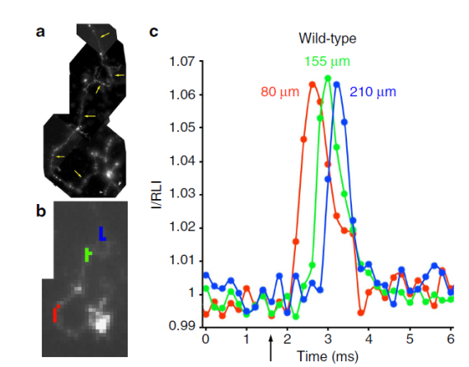
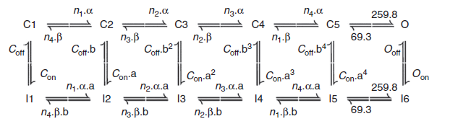
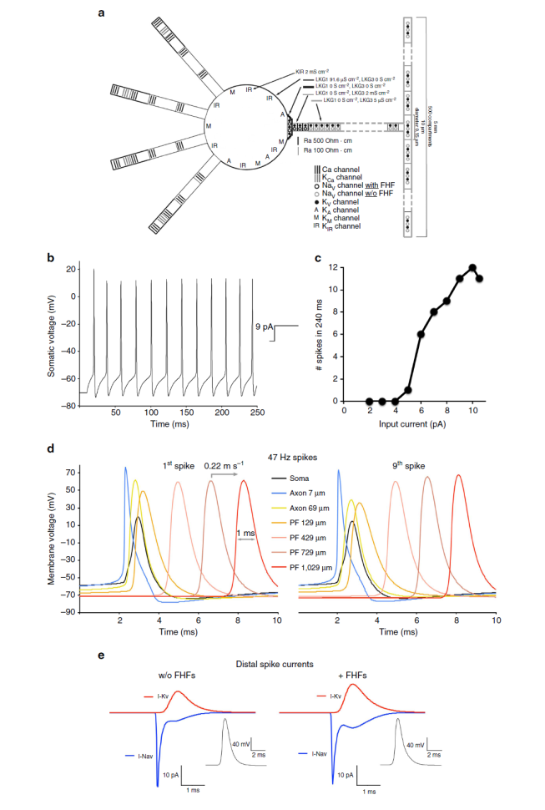
Na channel modeling in Granule cell axons
Detailed description and hypothesis on ionic current dynamics .
D’Angelo e al. (1998) J Neurophys
Na channel kinetics, localization, modulation.
Magistretti et al. (2006) J Physiol; Goldfarb et al., (2007) Neuron
Na channel modulation by FHF in the axon Dover et al. (2016) Nature comm
PROBLEM 1:
Spike generation an ionic channel balance
PROBLEM 2:
Distribution of electrical propetries:
PROBLEM 3:
Axonal properties :
Plasticity of AIS ?
Monocompartmental model - D’Angelo et al. (2001) J Neuroscience
Multicompartmental model - Diwakar et al. (2009) J Neurophysiology
Multicompartmental model - Dover et al. (2016) Nature comm
Prediction & discovery of a new current and of dynamics phenomena
Prediction of AP generation and amplitude
Prediction of AP propagation
BUT:
AP amplitude does not match !!
BUT:
AP propagation does not match !!
New properteis in Na channel regulation and axonal resistance change the view in AP generation
Plasticity of intrinsic excitabity (2000, 2006)
Dover, ... D’Angelo, Goldfarb, Nature Comm. 2016

Slide 18
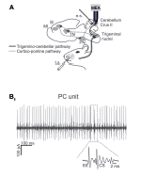
→ RECONSTRUCTION of PC model
Morphology and channels from literature
RECONSTRUCTION
Advanced validation in vivo
Validation against complex firing patterns
VALIDATION

Slide 19
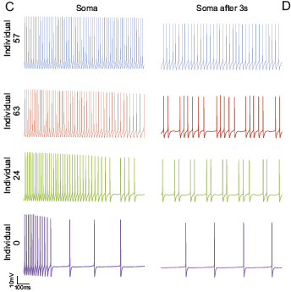
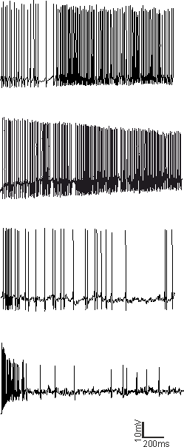
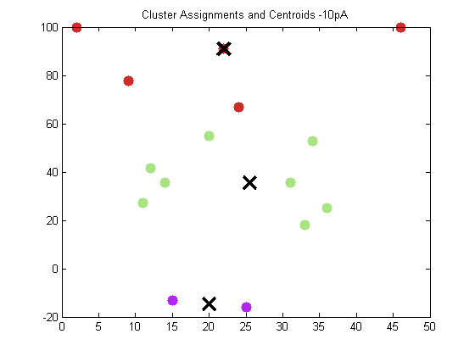
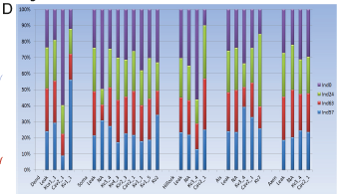
Automatic optimization of a Granule Cell models
Experimental testing
WCR
10 pA, 3 cluster
% adaptation
# spikes (first 500ms)

Slide 20
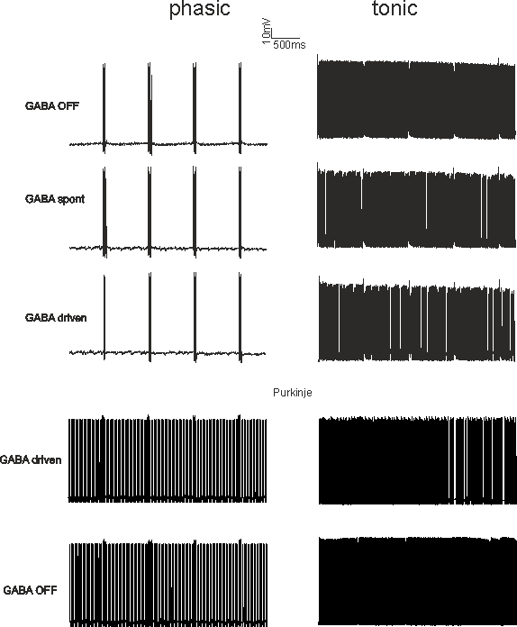
PREDICTION of PC responses from different Granule Cell models
Generation of phasic and tonic transmission channels acting as high-pass and low-pass filters.
10 pA, 3 cluster
PC model
% adaptation
# spikes (first 500ms)

Slide 21
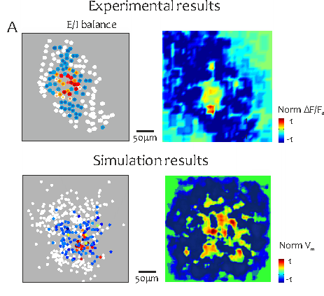
→ PROPAGATION to MICROCIRCUIT
Validation against complex output space

Slide 22
Molecular and Cellular Neurophysiology ...
Neurology....
Biological recordings
EBCC, manipulation task, obstacle avoidance, task force-field, VOR ...
Molecular-level plasticity models
Realistic neuron models
Detailed neuronal microcircuits
Simplified neuron and micorcircuit models
Interconnected detailed large-scale circuits
Simplified whole-brain models
Detailed large-scale network dynamics with plasticity
Embedding in large-scale networks
NEUROROBOTIC EMBODIMENT & CLOSED LOOP TESTING
Simulated behavior and Control theory
MRI, EEG, Connectomics ...

Slide 23
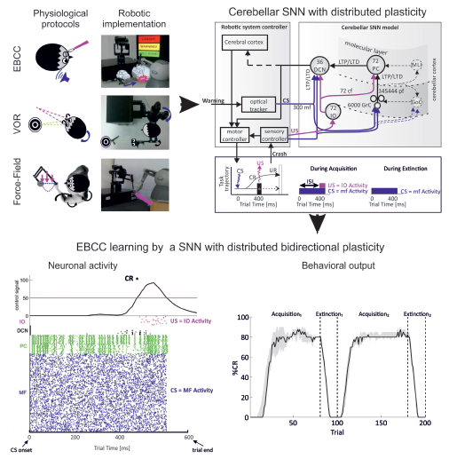

SIMPLIFICATION & EMBEDDING in a ROBOTIC SYSTEM

Slide 24
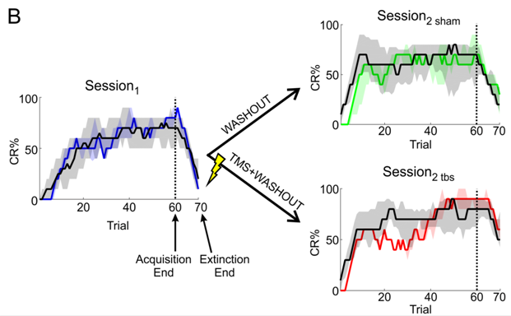
SIMULATION of human behavior

Slide 25
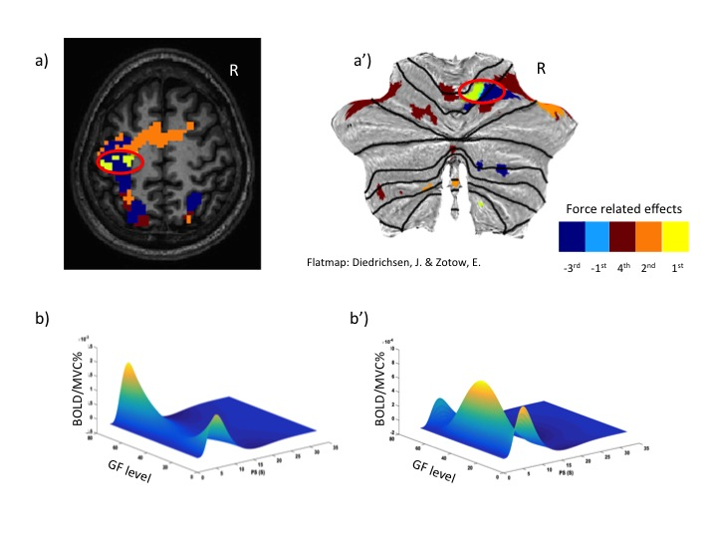
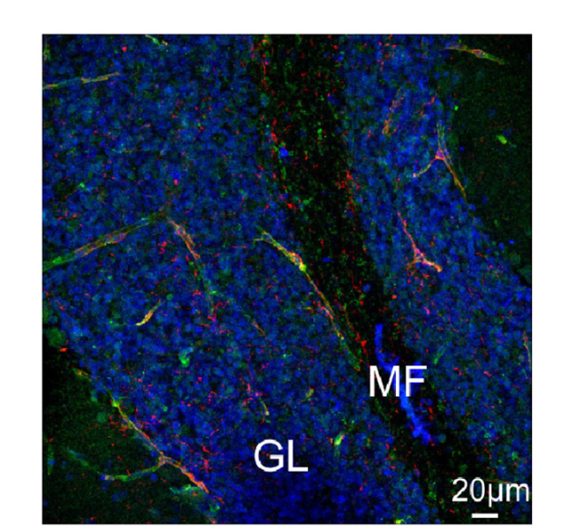
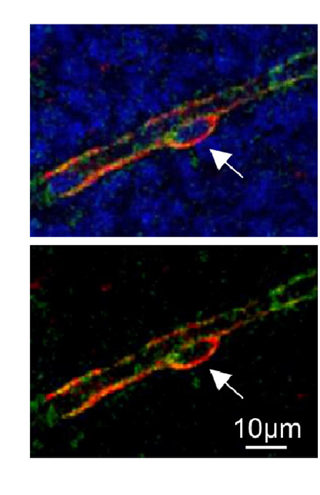
Multiscale reconstruction of BOLD signals
FORCE-RELATED effects in fMRI signals in the motor cortex and cerebellum
Alhamadi, D’Angelo, Friston, Gandini Wheeler-Kingshott
2014, 2015, 2016
Mapelli et , J Neurosci 2017
Alhamadi, D’Angelo, Gandini W-K, submitted

Slide 26
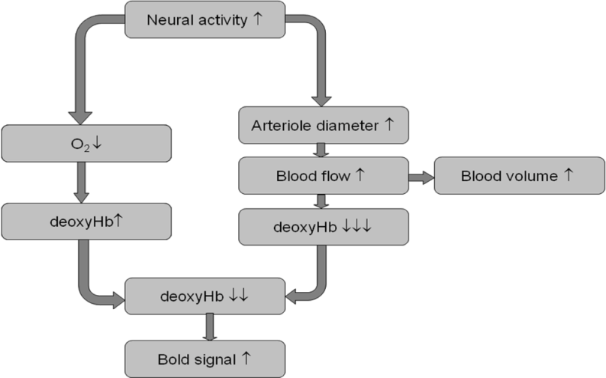
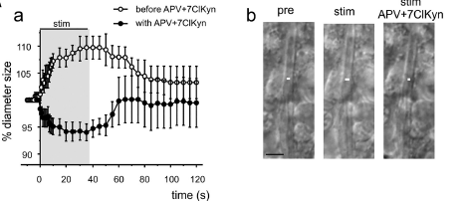
Neuronal modulation of neurovascular coupling

Slide 27
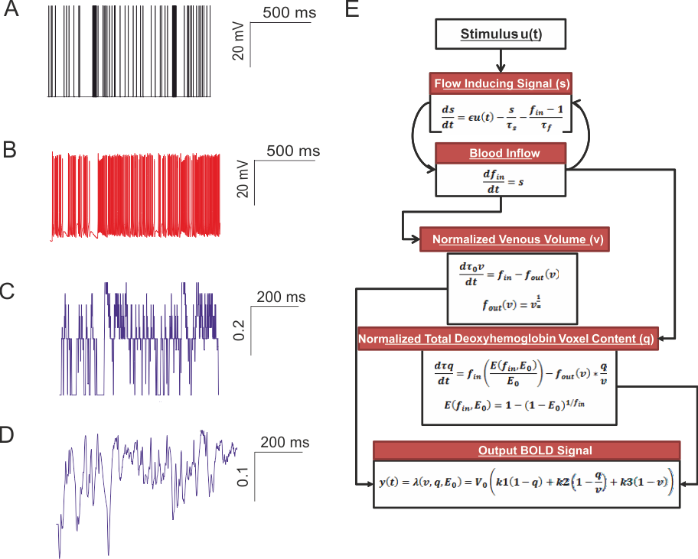
Modeling BOLD starting from subcellular / cellular data and microcircuit activity
Microcircuit model
JN 2017
BALLOON model (Friston 2008) on preliminary data taken from the cerbellar granular layer
Diwakar and D’Angelo, in preparation

Slide 28
NMC papers, 2016
E. D’Angelo, E. Galliano, C.I. De Zeeuw. The Editorial: The Olivo-Cerebellar System. Front Neural Circuits. 2016 Jan 12;9:66. doi: 10.3389/fncir.2015.00066. eCollection 2015.2
K. B. Ramakrishnan, K. Voges, L. De Propris, C.I. De Zeeuw, E. D’Angelo. Tactile Stimulation Evokes Long-Lasting Potentiation of Purkinje Cell Discharge In Vivo. Front. Cell. Neurosci., 2016 Feb 18;10:36. doi: 10.3389/fncel.2016.00036. eCollection 2016.3
A. Antonietti, C Casellato, JA Garrido, NR Luque, F Naveros, E Ros, E D’Angelo, A Pedrocchi. Spiking Neural Network With Distributed Plasticity Reproduces Cerebellar Learning in Eye Blink Conditioning Paradigms. IEEE Trans Biomed Eng. 2016 Jan;63(1):210-9. doi: 10.1109/TBME.2015.2485301. Epub 2015 Oct 1.4
N. R. Luque, J. A. Garrido, F. Naveros, R. Carrillo, E. D’Angelo, E. Ros. Distributed Cerebellar Motor Learning: A Spike-Timing-Dependent Plasticity Model. Front. Comput. Neurosci., 2016 Mar 2;10:17. doi: 10.3389/fncom.2016.00017. eCollection 2016.5
C. Lega, T. Vecchi, E D’Angelo, Z Cattaneo. A TMS investigation on the role of the cerebellum in pitch and timbre discrimination. Cerebellum Ataxias. 2016 Mar 2;3:6. doi: 10.1186/s40673-016-0044-4. eCollection 2016.6
JA Garrido, NR Luque, S Tolu, E D’Angelo. Oscillation-Driven Spike-Timing Dependent Plasticity Allows Multiple Overlapping Pattern Recognition in Inhibitory Interneuron Networks. Int J Neural Syst. 2016 Aug;26(5):1650020. doi: 10.1142/S0129065716500209. Epub 2016 Apr 15.7
H. Parasuram, B. Nair, E. D’Angelo, M. Hines, G. Naldi, S. Diwakar. Computational Modeling of Single Neuron Extracellular Electric Potentials and Network Local Field Potentials using LFPsim. Front. Comput. Neurosci., 28 June 2016 http://dx.doi.org/10.3389/fncom.2016.00065.8
G. Florimbi, E. Torti, S. Masoli, E. D’Angelo, G. Danese, F. Leporati. The Human Brain Project: Parallel technologies for biologically accurate simulation of Granule cells. Microprocessors and Microsystems (2016).http://dx.doi.org/10.1016/j.micpro.2016.05.015
H. Parasuram, B. Nair, E. D’Angelo, M. Hines, G. Naldi, S. Diwakar. Computational Modeling of Single Neuron Extracellular Electric Potentials and Network Local Field Potentials using LFPsim. Frontiers in Computational Neuroscience, 2016 Jun 28;10:65. doi: 10.3389/fncom.2016.00065. eCollection 2016.10
A.A. Alahmadi, R.S. Samson, D. Gasston, M. Pardini, K.J. Friston, E. D’Angelo, A.T. Toosy, C.A.M. Wheeler-Kingshott. Complex motor task associated with non-linear BOLD responses in cerebro-cortical areas and cerebellum. Brain Struct Funct. 2016 Jun;221(5):2443-58. doi: 10.1007/s00429-015-1048-1. Epub 2015 Apr 29.1120
Palesi F, Castellazzi G, Casiraghi L, Sinforiani E, Vitali P, Gandini Wheeler-Kingshott CA, D’Angelo E. Exploring Patterns of Alteration in Alzheimer’s Disease Brain Networks: A Combined Structural and Functional connectomics Analysis. Front Neurosci. 2016 Sep 7;10:380. doi: 10.3389/fnins.2016.00380.122
K. Dover, C. Marra, S. Solinas, M. Popovic, S. Subramaniyam, D. Zecevic, E. D’Angelo, M. Goldfarb. FHF-independent conduction of action potentials along the leak-resistant cerebellar granule cell axon. Nature Communications. 26 September 2016 doi:10.1038/ncomms12895132016
G.Z. De Vidovich, R. Muffatti, J. Monaco, N. Caramia, D. Broglia, E. Caverzasi, F. Barale, E. D’Angelo. Repetitive TMS on Left Cerebellum Affects Impulsivity in Borderline Personality Disorder: A Pilot Study. Front Hum Neurosci. 2016 Dec 5;10:582 10.3389/fnhum.2016.0058214
F. Palesi, JD Tournier, F Calamante, N. Muhlert, G. Castellazzi, D. Chard D, E. D’Angelo, C.G.Wheeler-Kingshott. Reconstructing contralateral fiber tracts: methodological aspects of cerebello-thalamocortical pathway reconstruction. Funct Neurol. 2016 Oct/Dec;31(4):229-238.15
A. Antonietti, C. Casellato, E. D’Angelo, A. Pedrocchi. Model-Driven Analysis of Eyeblink Classical Conditioning Reveals the Underlying Structure of Cerebellar Plasticity and Neuronal Activity. IEEE Transactions on Neural Networks and Learning Systems, in press.

Slide 29

Ettore Majorana Foundation for Scientific Culture
School of Brain Cells and Circuits “Camillo Golgi”
ERICE 2016 course
“The cerebellum inside-out: neurons , circuits and functions”
School Directors: Egidio D’Angelo & Claudia Gandini W-K
Course Directors: Egidio D’Angelo, Claudia Gandini W-K, Chris De Zeeuw

Slide 30








Slide 31
NMC project funding
Present funding:
University of Pavia – personnel and infrastructure
HBP – microricorcuit modeling and experiments
Politecnico di Milano – Neurorobotics
Centro Fermi – Neurovascular coupling
IRCCS Mondino – TMS and MRI facilities
Financial support requested to Centro Fermi :
Centro Fermi is currently supporting the NMC project by giving a 3-year grant for a post-doc (Assegno di Ricerca). The grant is now in the second year. In order to ensure the continuation, our request is that the grant is reassigned for the next year as well.

Slide 32
Brain Connectivity Center
(Egidio D’Angelo (DIRECTOR)
Neurophysiology lab
Francesca Presttri
Lisa Mapelli
Francesca Locatelli
Marialuisa Ttognolina
(Ramakrishna Bhuvanasundaram) (A. Einstein Coll. NY)
(Martina Sgritta) (EBRI, Rome)
Letizia Moscato
Simona Tritto
Teresa Soda
Giuseppe Gagliano
Neurocomputation lab
(Sathyaa Subramaniyam) (Uni Bangalore, India)
Stefano Masoli
Martina Rizza
Stefano Casali
TMS lab
Jessica Monaco
Licia De Propris (UNIMI)
Silvia Marchese (UNIMI)
Neuroimging lab and CHT
Claudia Gandini Wheeler-Kingshott (DIRECTOR)
Fulvia Palesi
Gloria Castellazzi
Letizia Casiraghi
Giovanni Savini
ERASMUS-MC
Chris DeZeeuw
NMR research and Dept of Neuroinflammation
UCL Institute of Neurology
Claudia Gandini Wheeler-Kingshott
Adnan Alahmadi
Neuroengineering Lab, Politecnico di Milano
Alessandra Pedrocchi
Claudia Casellato
Alberto Antonietti
Neuorocmputation Lab, University of Granda
Eduardo Ros
Jesus Garrido
Niceto Luque
AMRITA University
Shyam Diwakar

Slide 33
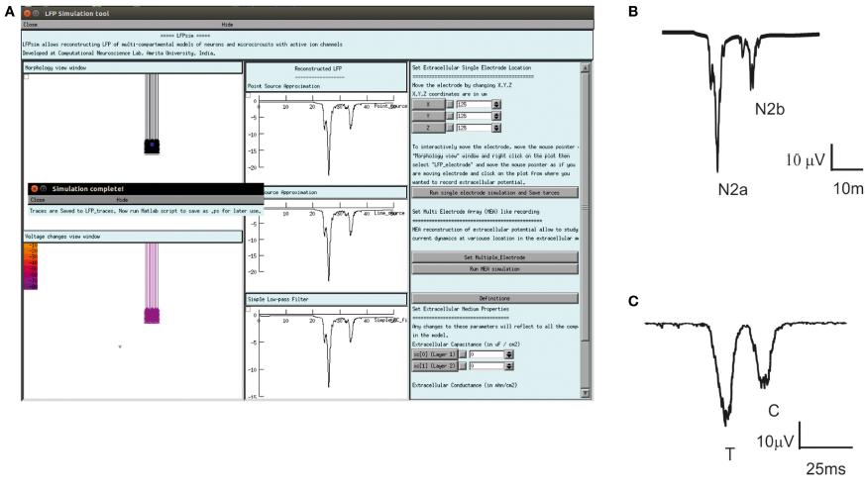
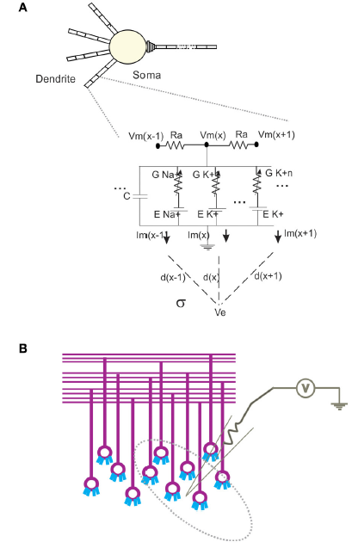
LFP module
LFP
Na module
[Na]

