Slide 1
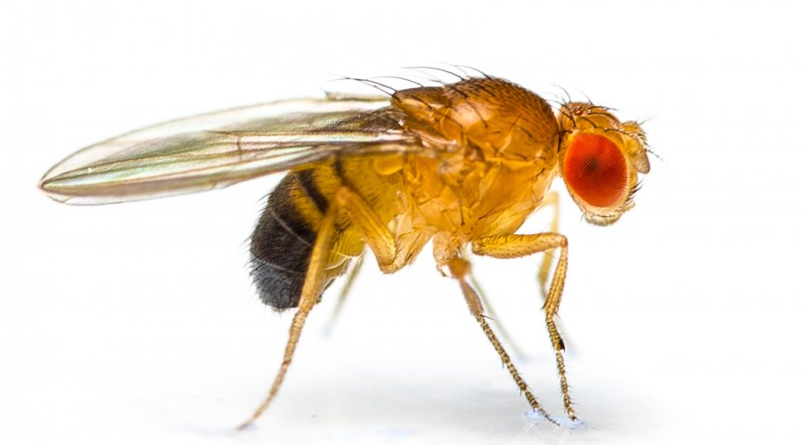
FLYINGLOW
Other Logo
Coordinator:
Maria Antonella Tabocchini (ISS, INFN-Roma1)
Participants:
G. Cenci, F. Cipressa, P. Morciano, A. Porrazzo (SAPIENZA University of Rome)
G. Esposito (ISS, INFN-Roma1)
E. Alesse, R. Iorio, D. Iovino (University of L’Aquila)
L. Satta, (Centro Fermi)
Place of Work & Collaborations:
Places of work: INFN-LNGS; University of L’Aquila; ISS, Rome; SAPIENZA University of Rome
Collaborations:: E. Bortolin, C. De Angelis P. Fattibene, C. Nuccetelli (ISS)
M. Balata, L. Ioannucci (LNGS); A. Esposito, M. Chiti, O. Frasciello (INFN-LNF)

Slide 2
FLYINGLOW
Other Logo
Project main goal and results so far achieved
Natural background radiation of Earth and cosmic rays played a relevant role during the evolution of living organisms. However, how chronic low doses of radiation can affect biological processes is still unclear.
The FLYNGLOW program aims at exploiting Drosophila melanogaster as a model for evaluating the effects of low doses/dose rates of radiation at the organismal level.
The results so far achieved suggest the reduced radiation environment (i.e., underground LNGS) can influence Drosophila development and, depending on the genetic background, may affect viability for several generations even when flies are moved back to reference background radiation.
As flies are considered a valuable model for human biology, our results might shed some light on understanding the effect of low dose radiation also in humans.

Slide 3
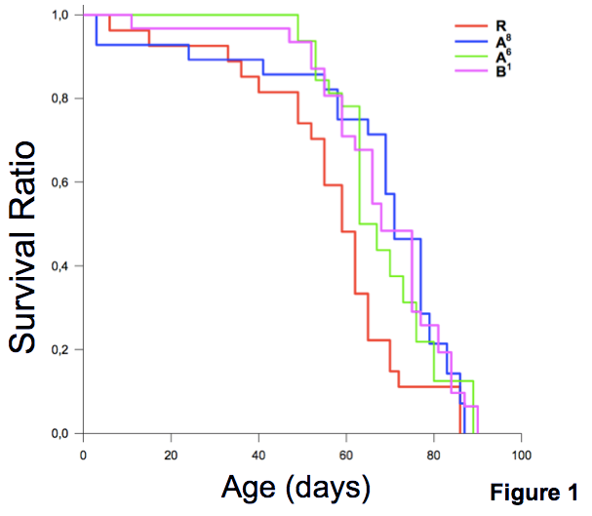
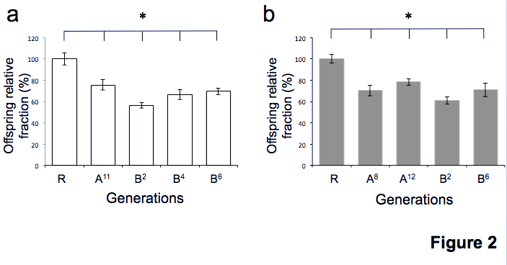
FLYINGLOW
Other Logo
Figure 1. Reduced background radiation extends the lifespan of males flies. Kaplan-Meier survival curves are shown for the reference (R) and LNGS Oregon flies from generation A⁸, A⁶, and B¹.
Univaq (R)
LNGS (A, B)
R
A⁸
A⁶
B¹
Figure 2. Flies at LNGS exhibit reduced fertility Fertility tests of Oregon females (a) and males (b) that were isolated from two independent lines (A and B) after different generations (exponents) kept at LNGS.
*p values calculated using the log-rank test.
(Morciano et al., 2017; Journal of Cellular Physiology -accepted)
(Morciano et al., 2017 JCP accepted)

Slide 4
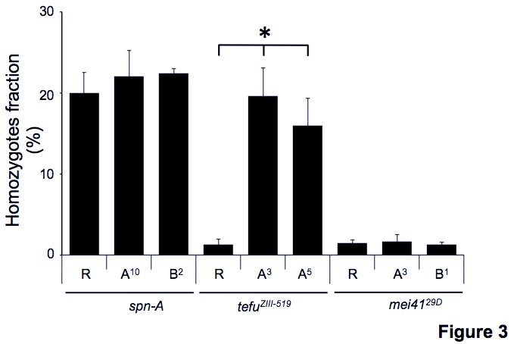
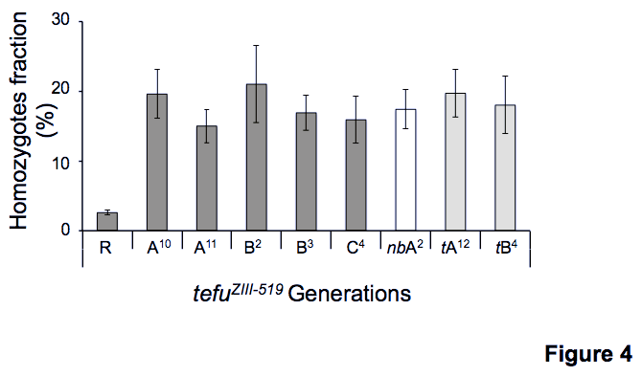
FLYINGLOW
Other Logo
Figure 3. Effects of reduced background radiations on DNA-repair gene mutants. Columns show the percentage of homozygotes/total progeny from independent spn-A, tefu and mei41 lines maintained either at LNGS (A, B) or at Univaq (R). Homozygotes were scored at different generation times (exponents).
Figure 4. LRE is beneficial to tefu mutants. Columns indicate the proportion (%) of tefu homozygotes obtained from mating ten 3-day old tefu heterozygous females to ten 3-day old tefu heterozygous males. Each column represents results from at least 4 independent crosses.
(Morciano et al., 2017 JCP accepted)

Slide 5
FLYINGLOW
Other Logo
Plan of activities 2017 – 2019
Understanding the molecular bases that underlie life span extension of flies kept at LNGS.
Dissecting the effects of LNGS on fertility.
Investigating the effects of low radiation doses on adaptive response to genotoxic stresses (LNGS and LIBIS)

Slide 6
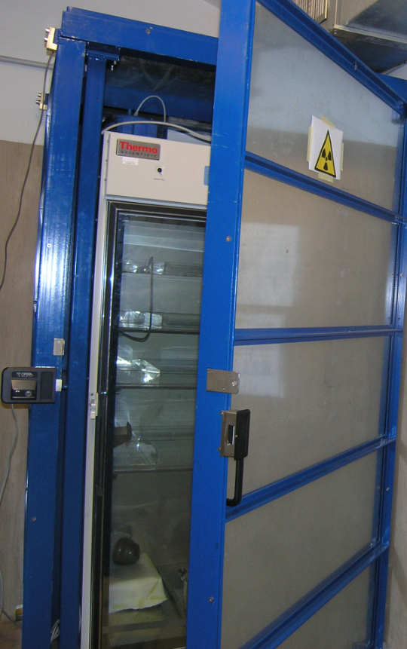
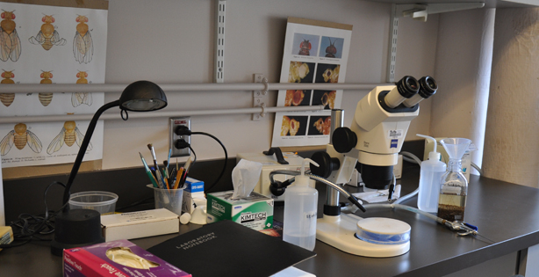
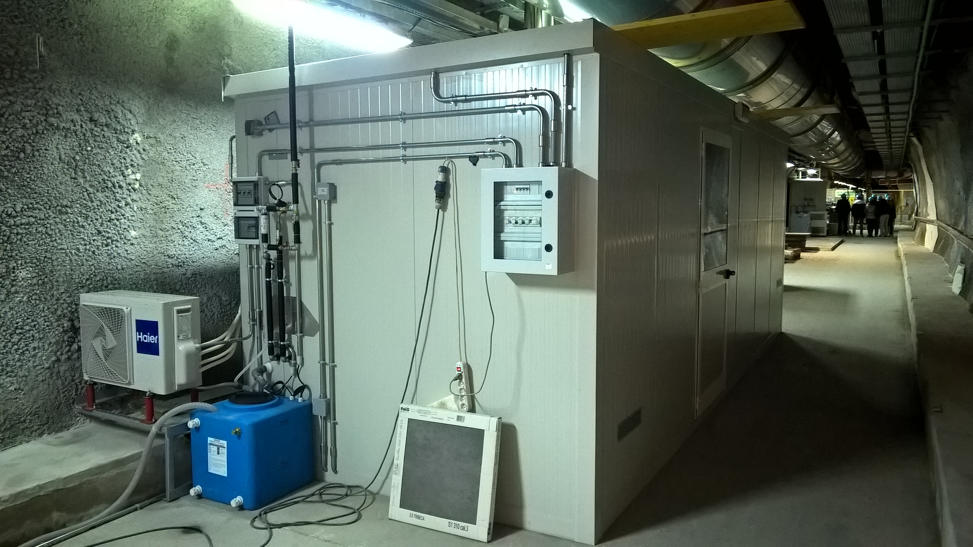
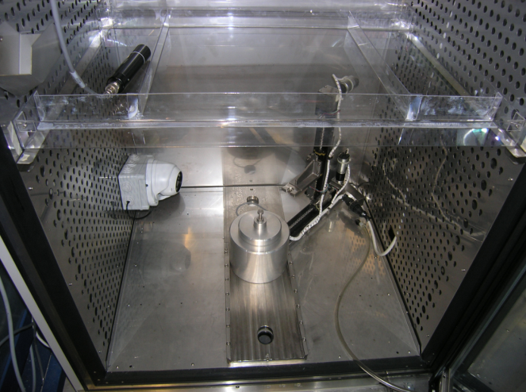
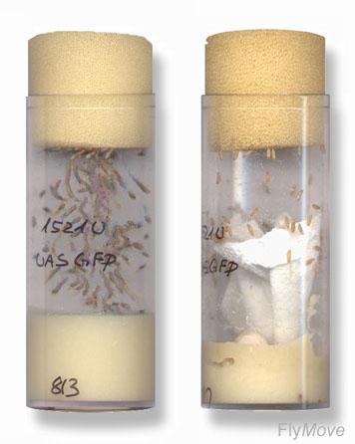
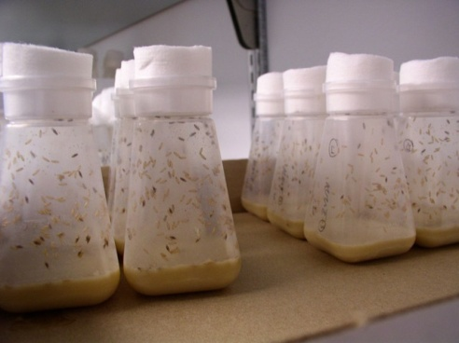
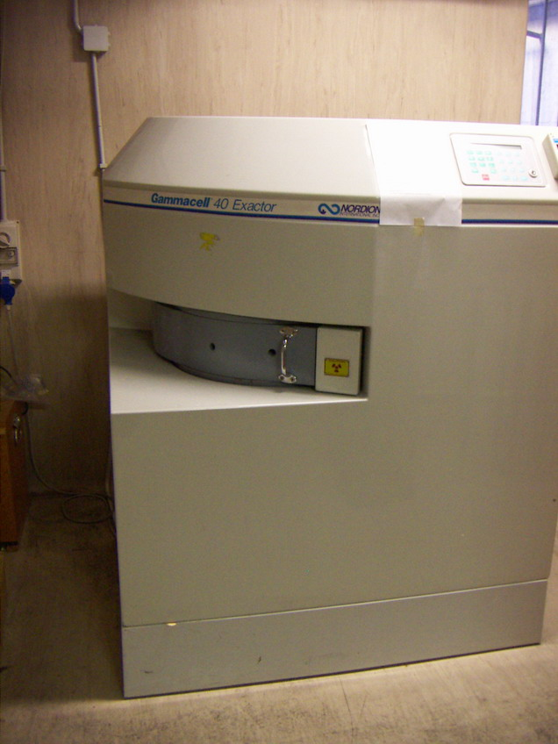
FLYINGLOW
Other Logo
Facilities are available for systematic studies at increasing
dose/dose rate exposure
Deep underground laboratories
Environmental background
Low dose/dose rate facilities
[< 10⁻⁵ mGy/h]
[10⁻⁴ mGy/h]
[> 10⁻³ mGy/h]
Reduction of 10⁻⁶ cosmic ray flux and 10⁻³ neutron flux respect to the surface
Drosophila workstation
LIBIS
The low dose/dose rate gamma irradiator facility at ISS
Acute gamma ray irradiator at ISS
The COSMIC SILENCE facility for organisms
at LNGS
6

Slide 7
FLYINGLOW
Other Logo
Plan of activities 2017 – 2019
Understanding the molecular bases that underlie the extension of life span in flies kept at LRE.
Comparative Metabolomics and RNA seq on 30 day’s and 60 day’s old LNGS and Univaq flies.
Structural analysis of muscle integrity, role of HP1 and epigenetic regulation of rRNAs transcription in preventing aging-related muscle degeneration.
Effects of LNGS on mutant flies with accelerated aging.

Slide 8
FLYINGLOW
Other Logo
Plan of activities 2017 – 2019
2. Dissecting the effects of LNGS on fertility.
Detailed genetic and cytological analyses of male and female meiosis of LNGS flies.
Comparative Proteomics (SILAC, 2D Gel) and RNA seq analysis from reproductive tracts of LNGS and Univaq flies.
Molecular analysis of fertility genes and proteins that are responsive to modulation of background radiation.

Slide 9
FLYINGLOW
Plan of activities 2017 – 2019
3. Investigating the effects of low radiation doses on adaptive response to genotoxic stresses.
Completion of cytogenetic and molecular characterization of DNA damage response (upon acute 10Gy irradiation) in LNGS flies and in flies chronically exposed to low dose radiation (20cGy and 40cGy)
Comparative Proteomics (SILAC, 2D Gel) and RNA seq analysis from somatic tissues of flies eliciting LDR-induced resistance (adaptive response) after chronic exposure to 40cGy.
Quantitative Genetic Analyses of variation in LDR-induced resistance

Slide 10
FLYINGLOW
Other Logo
Expected funding in the 3-year period:
Request of funding by Centro Fermi (per year)
1 (+1) Post doctoral researcher fellowships
5 k€ for genomic, RNA seq and proteomic analyses
10 k€ for consumables
4000 € for 1 Drosophila small incubator
(Potential) external funding
Sapienza Ateneo Research Project 2016 (funded)
Italy-Argentina bilateral research Project (pending)
Pasteur Institute “Programmes Transversaux de Recerche” (PTR) (pending)
INFN (LNGS and CSN-5)
ISS, Sapienza Università di Roma e Univaq

Slide 12
Publications 2016
G. Esposito, P. Anello, I. Pecchia, M.A. Tabocchini, A. Campa. (2016) Facility for gamma irradiations of cultured cells at low dose rates: design, physical characteristics and functioning. Appl. Radiat. Isot. 115: 227-234, 2016
Cicconi A, Micheli E, Vernì F, Jackson A, Gradilla A, Cipressa F, Raimondo D Bosso G, Wakefield J, Ciapponi L, Cenci G, Gatti M, Cacchione S, Raffa G. (2016) The Drosophila telomere-capping protein Verrocchio binds single-stranded DNA and protects telomeres from DNA damage response . Nucleic Acids Res. 2016 Dec 9. pii: gkw1244. [Epub ahead of print]
P. Morciano, R. Iorio, D. Iovino, F. Cipressa, G. Esposito, A. Porrazzo, L. Satta, E. Alesse, M.A. Tabocchini and G. Cenci (2017). Effects of reduced natural background radiation on Drosophila melanogaster growth and development as revealed by the FLYINGLOW program. Journal of Cellular Physiology (accepted)

