Slide 1
Photonic Technologies for Biomedicine
Coordinator: Stefano Pelli
Participants:
Giancarlo Righini associato Centro Fermi
Ambra Giannetti IFAC-CNR, Ricercatore
Silvia Soria IFAC-CNR, Ricercatore
Gualtiero Nunzi Conti IFAC-CNR, associato al Centro Fermi
Francesco Baldini IFAC-CNR, Primo ricercatore,
Simone Berneschi IFAC-CNR, Ricercatore TD
Andrea Barucci IFAC-CNR, Ricercatore TD
Cosci, Alessandro assegnista Centro Fermi (07/2014 – 06/2017)
Gianfreda, Mariagiovanna* assegnista Centro Fermi (12/2016 – 11/2018)
Maurizio Ferrari IFN-CNR, associato al Centro Fermi
Andrea Chiappini IFN-CNR, Ricercatore Post-doc
Laura Pasquardini IMEM-CNR, Ricercatore Post-doc
* also with PATISS project (2017)

Slide 2



Photonic Technologies for Biomedicine
Places of Work:
Istituto di Fisica Applicata Nello Carra (IFAC-CNR), Firenze
Istituto di Fotonica e Nanotecnologie (IFN-CNR), Trento
Collaborations:
Istituto di Fisica Applicata “Nello Carrara” – CNR, Firenze
Istituto di Fotonica e Nanotecnologie – CNR, Trento
Istituto di Biofisica – CNR, Trento
Fondazione Bruno Kessler, Trento
Finmeccanica S.p.A., Roma
Thales, Toulouse
Institute Ruder Boskovic, Zagreb
Washington University at Saint Louis, Missouri (USA)

Slide 3
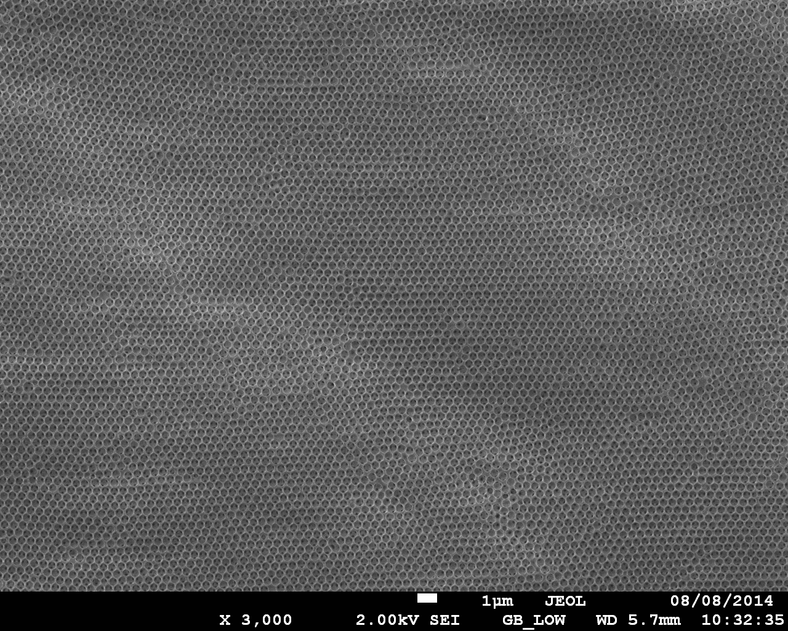
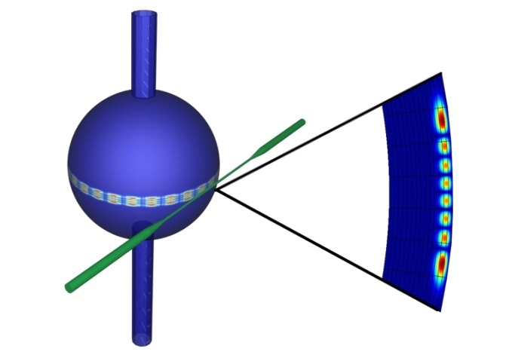
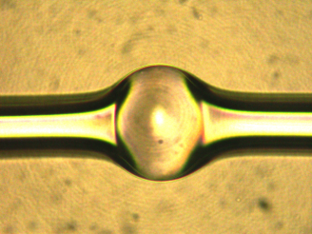
Photonic Technologies for Biomedicine
Main motivation: obtaining a sensitive biosensor by using novel resonant microstructures
Microbubble resonators
3D light confinement:
Whispering gallery modes
Inverse opals
Light is resonantly confined by total internal reflection.

Slide 4
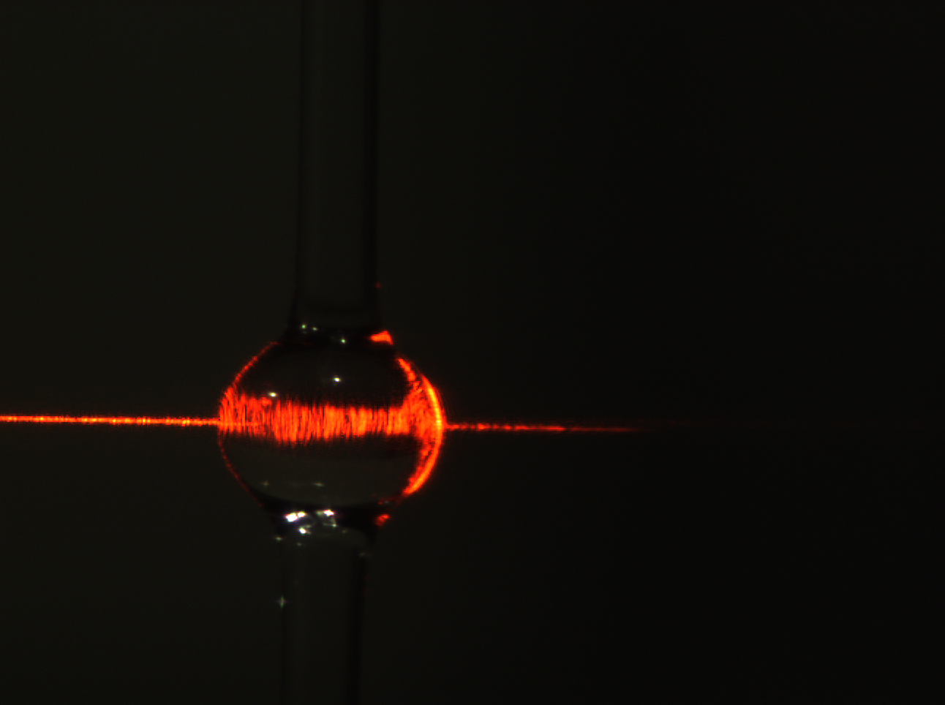
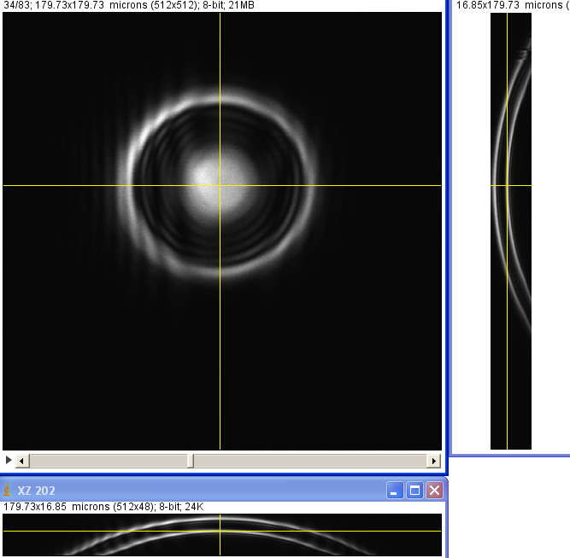
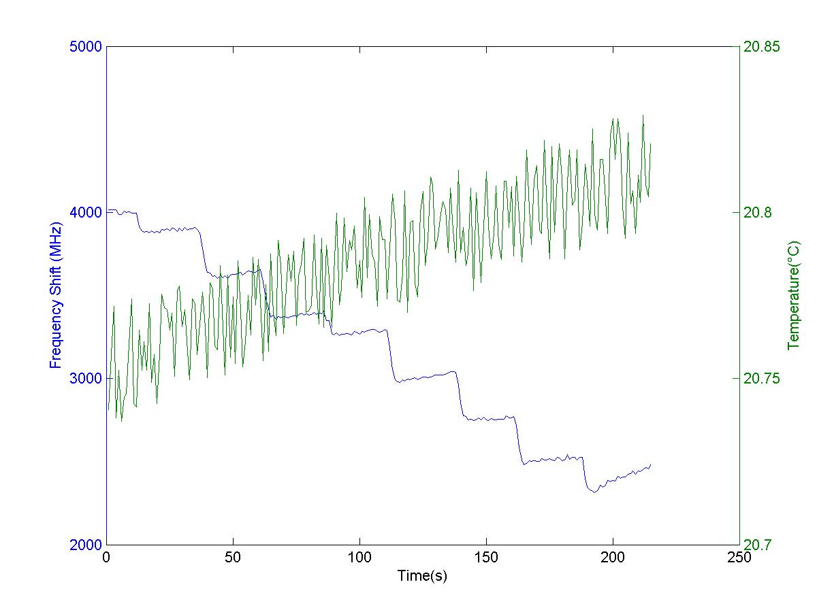
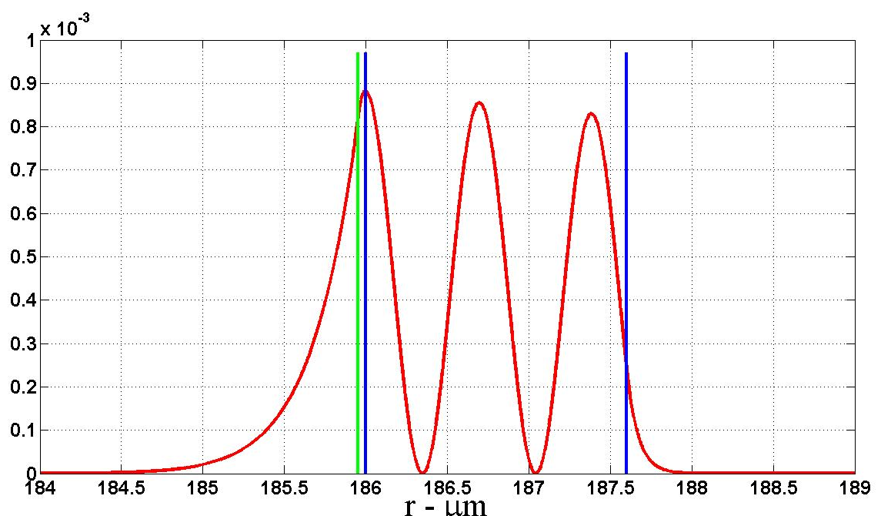
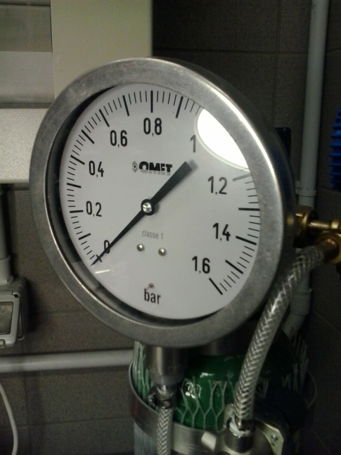
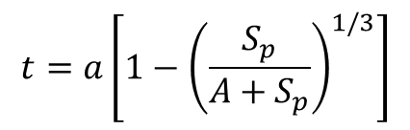

Photonic Technologies for Biomedicine
Thickness of microbubble wall
a)
b)
$$t=a\left[1−{\left(\frac{S_{p}}{A+S_{p}}\right)}^{1/3}\right]$$
a = external radius
A= material constant
A. Cosci, Opt. Express 23, 16693 (2015).
Q. Lu, Opt. Express 24, 20855-20861 (2016)
$t≈$ 5 $μ$m

Slide 5
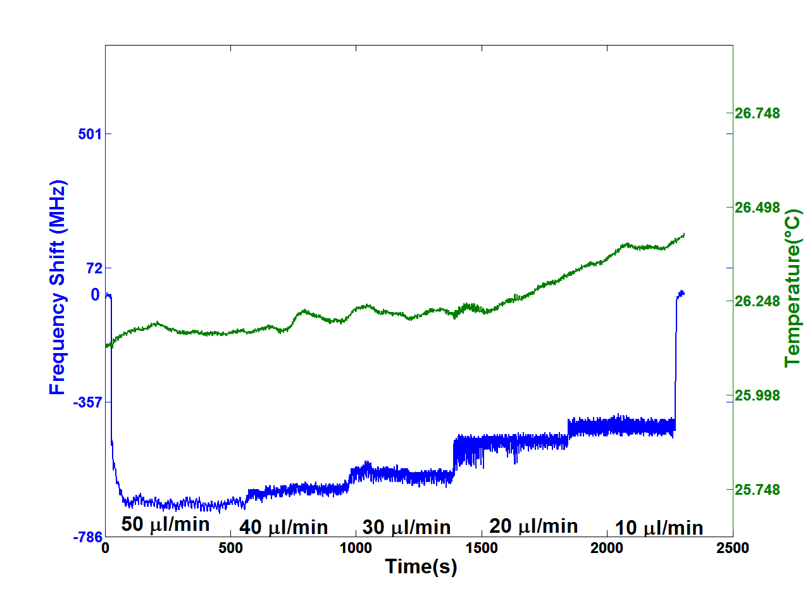
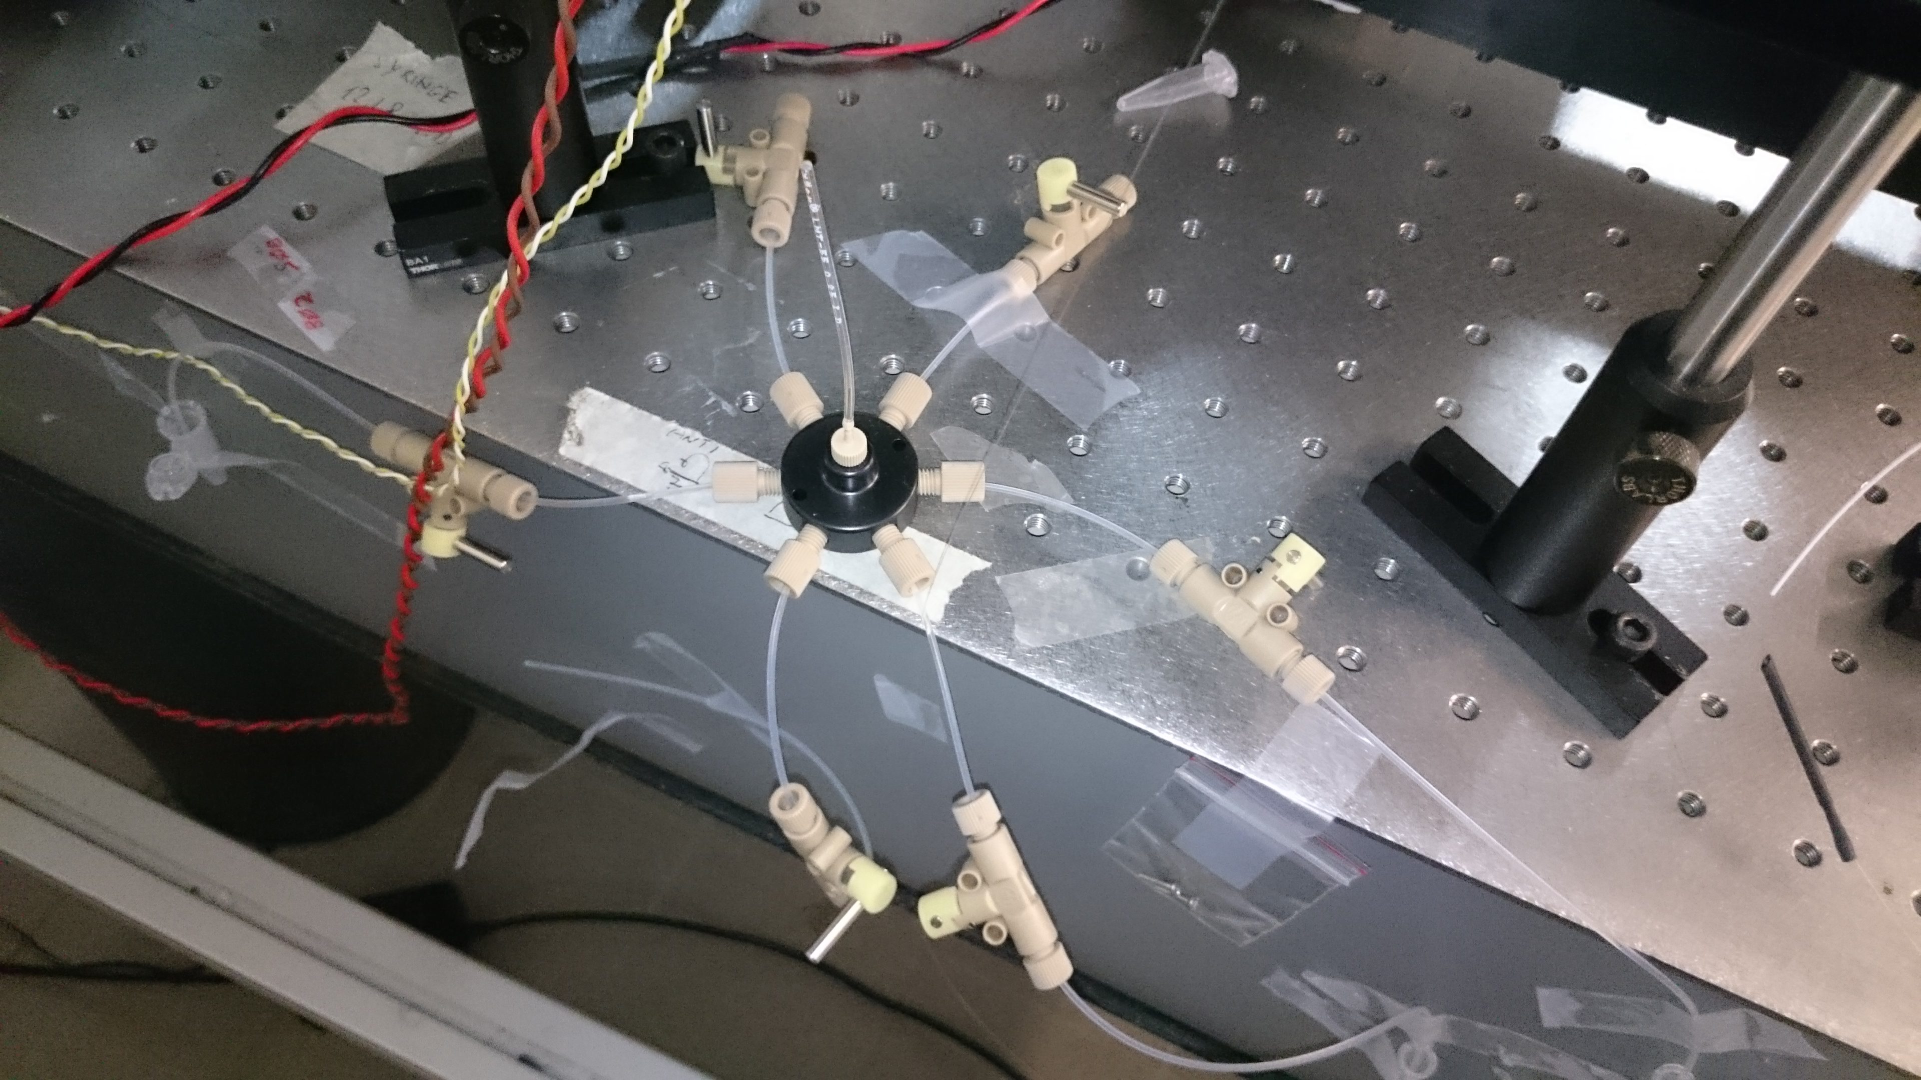
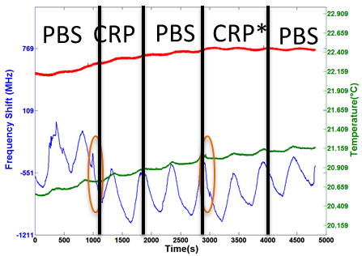
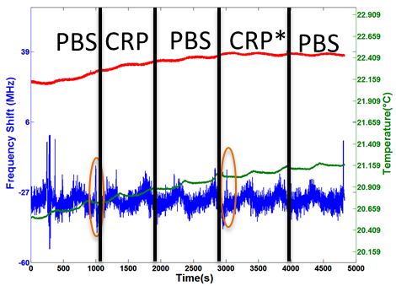
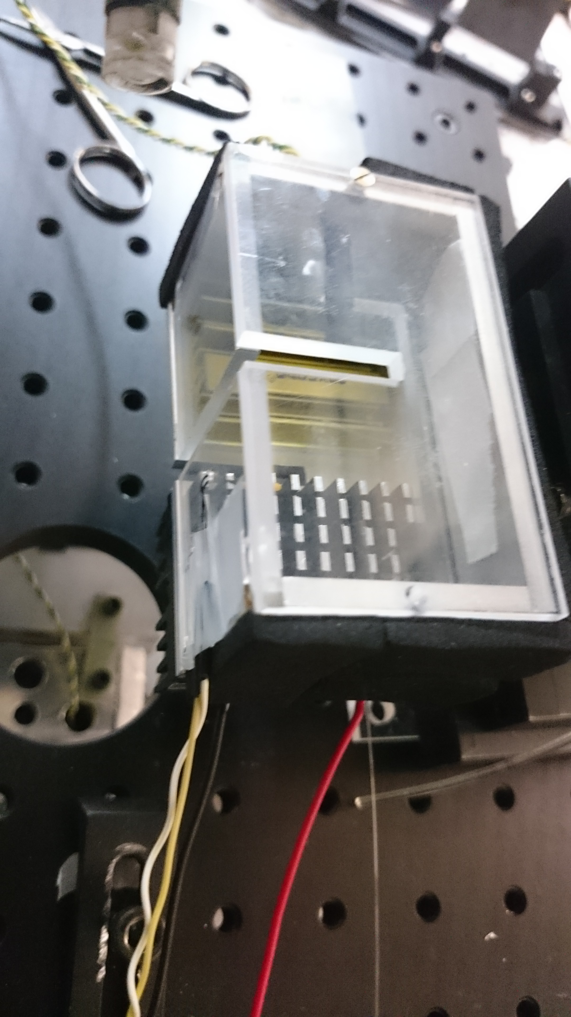
Photonic Technologies for Biomedicine
Measurements Stability
A. Cosci, et al . Sensors 16, 1405 (2016).

Slide 6
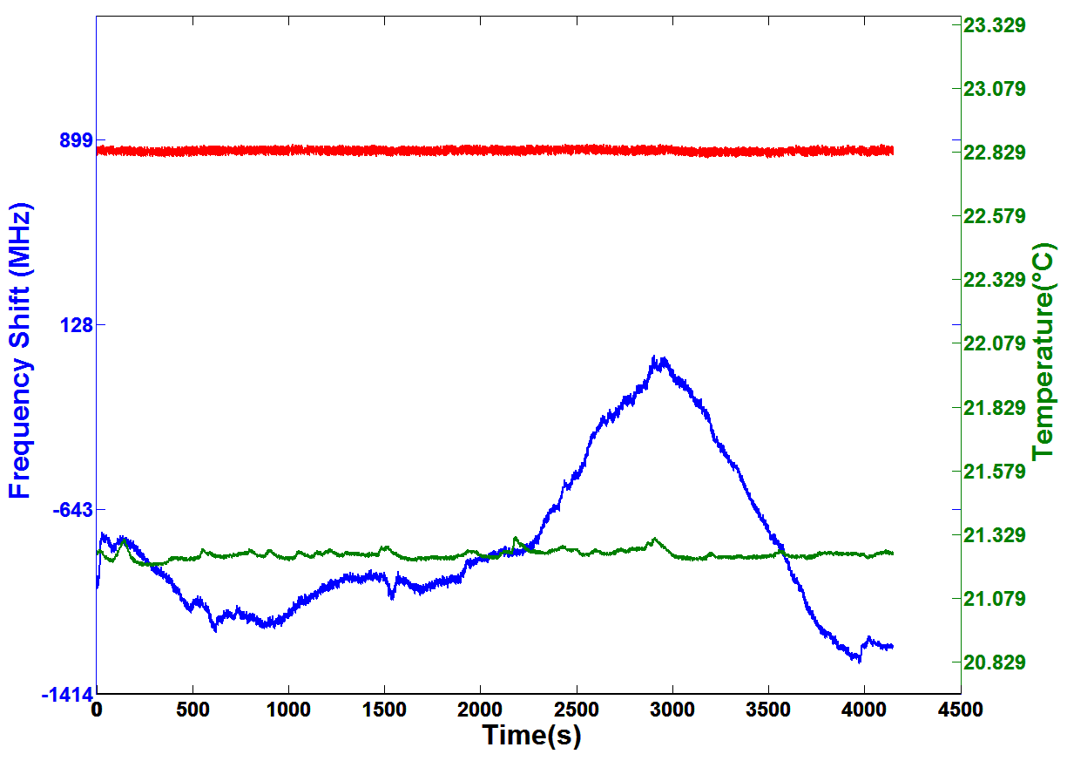


Photonic Technologies for Biomedicine
Bioassay
Assay response!
Fresh
bubble
Regenerated
bubble
Open C7
(1 μg/ml) valve
CRP = C-reactive Protein
C7 = C Reactive Protein antibody
Open CRP
(10 μg/ml) valve
Close CRP
(10 μg/ml) valve and open PBS valve

Slide 7
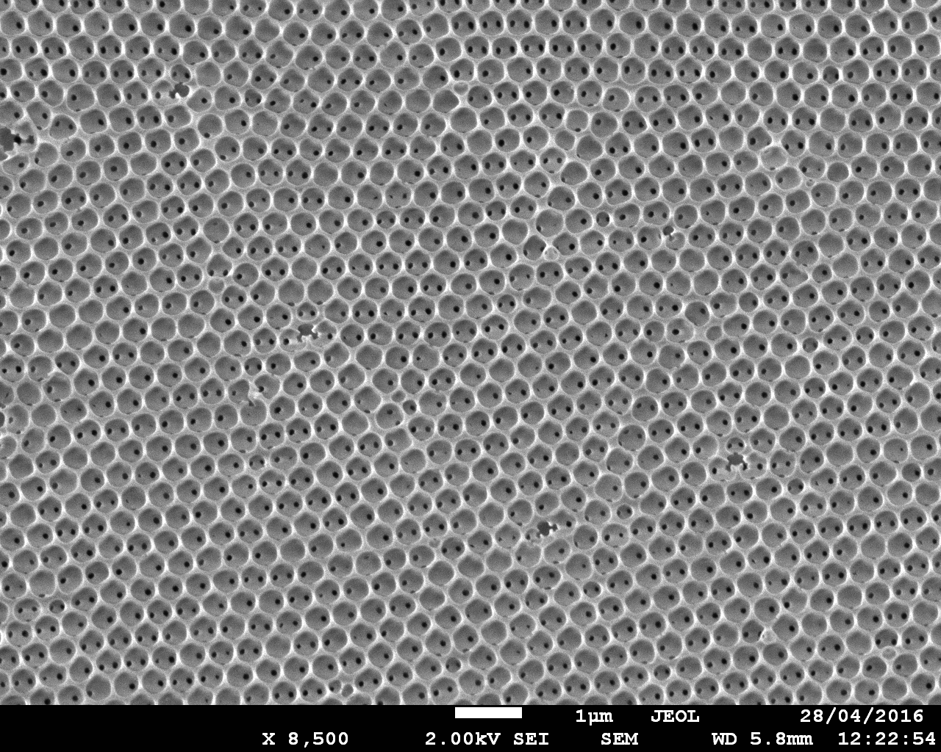
Photonic Technologies for Biomedicine
Colloidal Systems / Inverse Opal Photonic Crystals

Slide 8
Effect of the lower band edge
Photonic Technologies for Biomedicine
A
Pure Cy3-DNA
Cy3-DNA in opal
B
To quantify the effect of the photonic crystal on the emission spectrum the intensity ratio
compared with Pure Cy3-DNA sequence
Frequency gap
Intensity ratio 1.4
8

Slide 9
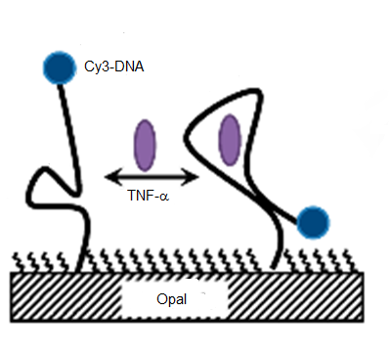
Response to TNF-α marker
Confocal microscopy image
Initial : Emission fluorescence inverse opal functionalized with Cy3-DNA
TNF-alpha: After incubation for 1 hr with TNF-α 100nM

Slide 10
Photonic Technologies for Biomedicine
Publications (ISI)
1. A. Cosci, M. Cerminara, G. N. Conti, S. Soria, G. Righini, and S. Pelli, "THz bolometer detector based on LiNbO₃ whispering gallery mode microdisc resonator," 7–9 (2017).
2. A. Cosci, S. Berneschi, A. Giannetti, D. Farnesi, F. Cosi, F. Baldini, G. Nunzi Conti, S. Soria, A. Barucci, G. Righini, and S. Pelli, "Resonance Frequency of Optical Microbubble Resonators: Direct Measurements and Mitigation of Fluctuations," Sensors 16, 1405 (2016).
3. S. Berneschi, F. Baldini, A. Cosci, D. Farnesi, G. Nunzi Conti, S. Tombelli, C. Trono, S. Pelli, and A. Giannetti, "Fluorescence biosensing in selectively photo–activated microbubble resonators," Sensors Actuators B Chem. (2016).
4. A. Cosci, M. S. Nogueira, S. Prataviera, A. Takahama, R. de S. Azevedo, and C. Kurachi, "Time-resolved fluorescence spectroscopy for clinical diagnosis of actinic cheilitis," Biomed. Opt. Express 7, 4210–4219 (2016).
5. A. Cosci, A. Takahama, K. Bianca, C. Fontes, A. Cosci, A. Takahama, J. Wagner, R. Correr, R. S. Azevedo, and K. Bianca, "Automated algorithm for actinic cheilitis diagnosis by wide-field fluorescence imaging by wide-field fluorescence imaging," 3, (2016).
6. G. Gorni, A. Cosci, S. Pelli, L. Pascual, A. Durán, and M. J. Pascual, "Transparent Oxyfluoride Nano-Glass Ceramics Doped with Pr³⁺ and Pr³⁺–Yb³⁺ for NIR Emission," Front. Mater. 3, (2017).
A. Barucci, S. Berneschi, A. Giannetti, F. Baldini, A. Cosci, S. Pelli, D. Farnesi, G. Righini, S. Soria, and G. Nunzi Conti, "Optical Microbubble Resonators with High Refractive Index Inner Coating for Bio-Sensing Applications: An Analytical Approach," Sensors 16, 1992 (2016).
A. Chiappini, C. Armellini, A. Carpentiero, L. Pasquardini, L. Lunelli, A. Vaccari, S. Pelli, A. Lukowiak, C. Pederzolli, G.C. Righini, R. Ramponi, M. Ferrari,"Glass-Derived Photonic Crystal Structures", Advances in Science and Technology 98, pp. 11-25, ISSN: 1662-0356 (2017).
D. Farnesi, S. Berneschi, F. Cosi, G. C. Righini, S. Soria, G. Nunzi Conti, “Stimulated Stokes and Antistokes Raman Scattering in Microspherical Whispering Gallery Mode Resonators”, J. Vis. Exp. 110, e53938 (2016).
D. Farnesi, G. Righini, G. Nunzi Conti, S. Soria “Efficient frequency generation in phoXonic cavities based on hollow whispering gallery mode resonators”, Scientifci Reports (in print).
11. A. Chiappini, C. Armellini, A. Carpentiero, L. Pasquardini, A. Vaccari, S. Pelli, V. Piccolo, A. Lukowiak, G. C. Righini, R. Ramponi, D. Zonta, and M. Ferrari "Glass nanospheres and artificial opals“ Chapter Pan Book (in preparation).
12. A. Chiappini, L. Pasquardini, C. Armellini, L. Lunelli, A. Vaccari, S. Pelli, A. Lukowiak, C. Pederzolli, G. C. Righini, R. Ramponi, M. Ferrari " Fluorescent aptamer immobilization on inverse colloidal crystals " (in preparation).

Slide 11
Photonic Technologies for Biomedicine
Plan of activities 2017 (the project is going to close by the end of 2017)
WGMRs:
Results: First positive label free bioassay obtained
Further efforts to reduce interferences by environment.
Analysis of the last results and further tests with different concentrations to have a more detailed assessment of the behaviour and performance of the device.
Tests with labelled (fluorescence) approach.
Colloidal systems:
Results: Response, though partial, of the colloidal system to a TNF-α marker has been observed.
The use of a double helix dye labeled aptamer, exploiting the following mechanism, can increase the selectivity.
TNF-α

Slide 12
Project Name
Expected funding in 2017:
Request of funding by Centro Fermi
25,000 € for reagents, fluidics, optical components
Potential external funding
CNR Institutes co-fund the research in-kind, by covering the cost of their personnel (besides the listed collaborators) and of the laboratories which are made available for the research activities (estimated total 50 K€).

