Slide 1
G-quadruplex potassium sensors and oncogenic regulators
Coordinator: Simonetta Croci, Dipartimento di Medicina e Chirurgia, Unità di
Neuroscienze, Università di Parma - Professore Associato
Participants:
Luca Bruni: grant Centro Fermi giugno 2014 - 2017; fellowship end – July 2017
Massimo Manghi – Dip. Medicina e Chirurgia, Università di Parma - Ricercatore
Camilla Baratto - CNR – INO – Sezione di Brescia – Ricercatore
Francesco Tommasino – TIFPA – Trento - Ricercatore
Walter Tinganelli – TIFPA – Trento – Ricercatore
Place of Work & Collaborations:
Dipartimento di Medicina e Chirurgia, Unità di Neuroscienze, Università di Parma
CIM – Centro Interdipartimentale Misure – Università di Parma
CNR – INO Sezione di Brescia
INBB – Istituto Nazionale Biostrutture e Biosistemi - Roma
TIFPA - Trento Institute for Fundamental Physics and Applications. A collaborative center for translational physics research

Slide 2
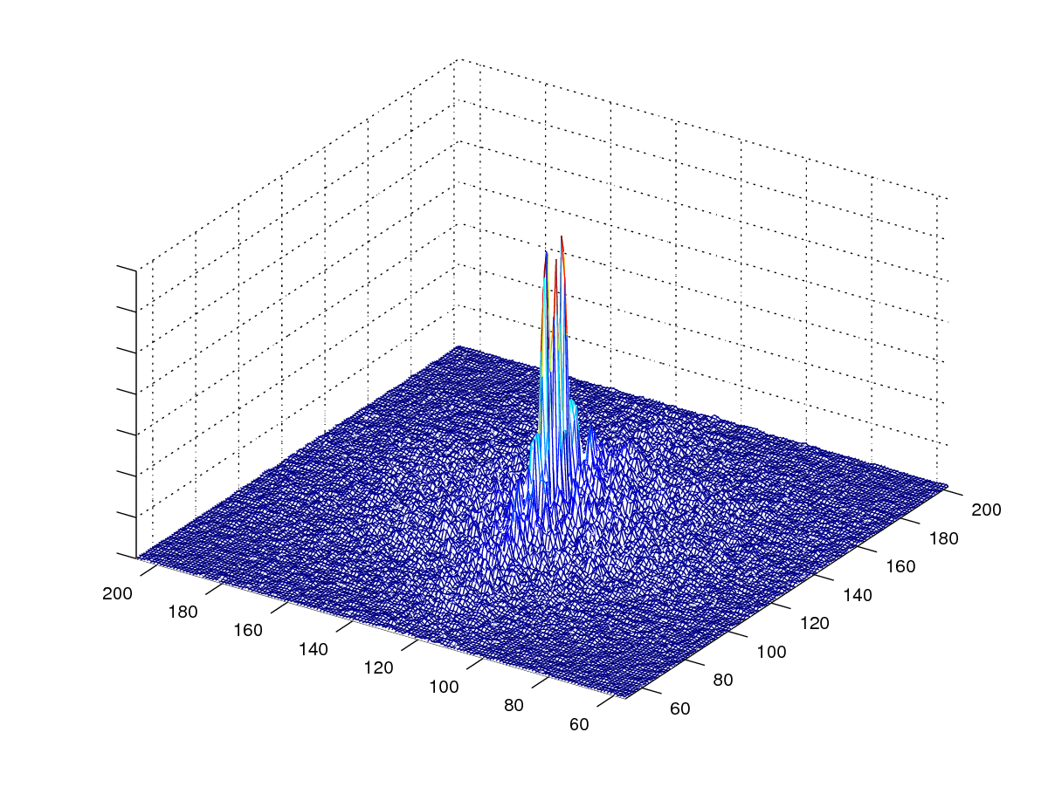
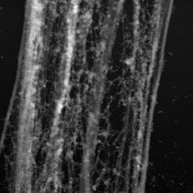
G-quadruplex potassium sensors and oncogenic regulators
Aims
This project aims to find out a K⁺ biosensor to be used on complex solution such as extracellular medium of irradiated cells and at the same time
to define an integrity dosimetric parameter of cytoskeleton when cells are irradiated
Results (end of 2016):
Define a new dosimetric parameter MDI
Set to use the G4 biosensor without probe leading to important applications in complex solution - innovation respect to literature studies
New protocol that ensures the response reproducibility link with biosensor ACCURACY
??? Calibration curve ???
M.Manghi, L.Bruni and S.Croci MDI: integrity index of cytoskeletal fibers observed by AFM. Eur. Phys. J. Plus (2016) 131: 213
0<MDI<1
MDI=0.35

Slide 3
G-quadruplex potassium sensors and oncogenic regulators
Aims
This project aims to find out a K⁺ biosensor to be used on complex solution such as extracellular medium of irradiated cells and at the same time
to define a integrity dosimetric parameter of cytoskeleton when cells are irradiated
Results (end of 2016):
Define a new dosimetric parameter MDI
Set to use the G4 biosensor without probe leading to important applications in complex solution -innovation respect to literature studies
New protocol that ensures the response reproducibility link with biosensor ACCURACY
??? Calibration curve ???
PS2.M
5'-GTGGGTAGGGCGGGTTGG-3’
Independent samples
Constant [Na⁺] = 78.2mM
Increasing [K⁺]

Slide 4
G-quadruplex potassium sensors and oncogenic regulators
Aims
This project aims to find out a K⁺ biosensor to be used on complex solution such as extracellular medium of irradiated cells and at the same time
to define a integrity dosimetric parameter of cytoskeleton when cells are irradiated
Results (end of 2016):
Define a new dosimetric parameter MDI
Set to use the G4 biosensor without probe leading to important applications in complex solution -innovation respect to literature studies
New protocol that ensures the response reproducibility link with biosensor ACCURACY
??? Calibration curve ???
PS2.M
5'-GTGGGTAGGGCGGGTTGG-3’
Independent samples
Constant [Na⁺] = 78.2mM
Increasing [K⁺]

Slide 5
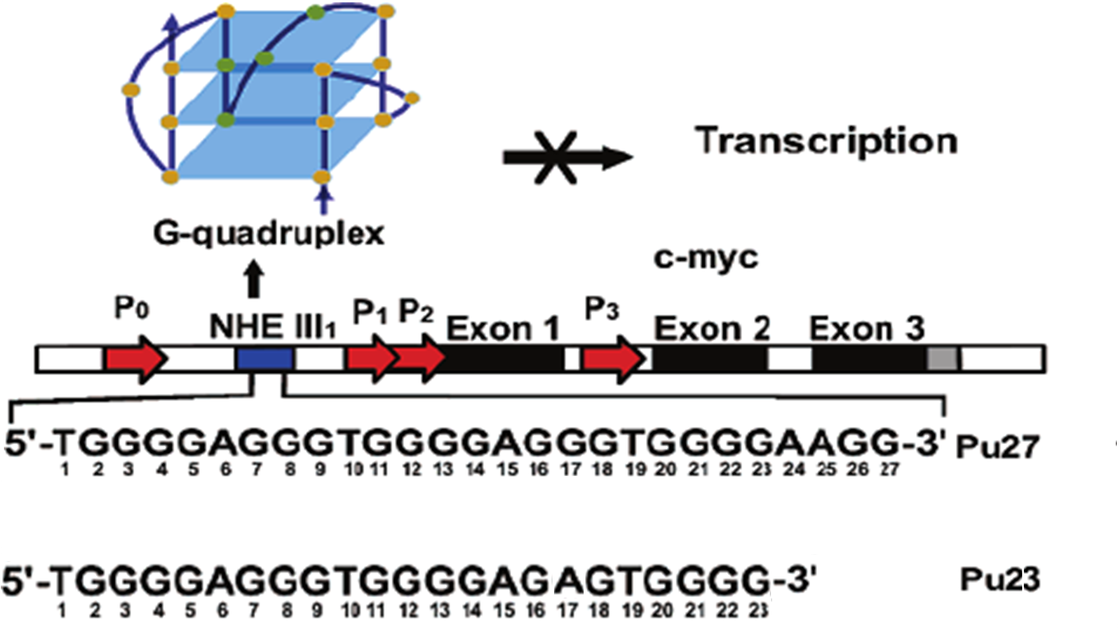
G-quadruplex potassium sensors and oncogenic regulators
Ellipticity (mdeg)
λ (nm)
Error bars : signal variation in
[Na⁺] range 30 -70 mM
Calibration curve of Pu27
Sensitivity = 0.35mdeg/mM
Ellipticity (mdeg)
Resolution = 1.4mM
[K⁺ ] (mM)

Slide 6
G-quadruplex potassium sensors and oncogenic regulators
Pu23
5’-TGGGGAGGGTGGGGAGAGTGGGG-3’
Calibration curve
Ellipticity (mdeg)
[K⁺ ] (mM)
Error bars : signal variation in
[Na⁺] range 30 -70 mM
Sensitivity = 0.27 mdeg/mM
Resolution = 3.1mM
Results (end of 2016):
Define a new dosimetric parameter MDI
Set to use the G4 biosensor without probe leading to important applications in complex solution -innovation respect to literature studies
New protocol that ensures the response reproducibility link with biosensor ACCURACY
Calibration Curve PU27 with variable [ Na⁺] 30 -70 mM

Slide 7
G-quadruplex potassium sensors and oncogenic regulators
Plan of activities 2017
We plan to:
Improve MDI parameter
one crucial point of this parameter is the choice of the cell part which must be scanned. The fields within the cell cytoskeleton have to show a pattern of rectilinear nearly parallel filaments. Therefore we are working on the develop of other indexes to analyze different cytoskeletal structures, or to take into account the rectilinear but not parallel fibers.
Better define the calibration curve for PU27
Test the PU27 biosensor on supernatants harvested from treated and not treated cells with K:D-rib (planned for 2016 shifted to 2017)
Our previous study showed K:D-rib 5mM (water solution of KHCO₃ and D-ribose) had a cytostatic effect on breast cancer cell line with decreasing of its malignancy potential. It is believed these effect are made by K⁺ uptake of cancer cells.
To accomplish biosensor’s project the we will participate to Conference such as 5th International Conference on Bio-Sensing Technology and/or Biodetection & Biosensors 2017 to look for some collaboration with research groups to implement and functionalize the biosensor.

Slide 8
G-quadruplex potassium sensors and oncogenic regulators
Plan of activities 2017
And also to:
use biosensor to detect [K⁺] into human cell line Hs 578Bst supernatant, after cell irradiation with X-ray doses. The purpose is to check if the damaged membrane let K⁺ outflowing.
The irradiation experiments it is planned to be performed at TIFPA – Trento, with 250 KVp X-ray tube, while the measures on supernatant analysis will be carried out at Parma University.
An experimental proposal has just been submitted (first dead line is 1st march 2017) to TIPFA asking for X-ray irradiation time with doses from 4 to 20Gy.
If the proposal will be accepted the beam time is scheduled by July.
In details this proposal is focused on the computation of a quantitative parameter (named MDI) that evaluates the integrity of protein fibers with absorbed doses (range 2-20 Gy ). Since many assays aim to evidence DNA or nucleus damages, the parameter that we have been working on is focused on cytoskeletal damage

Slide 9
G-quadruplex potassium sensors and oncogenic regulators
Activity 2018 -2019
The aim of this parameter is to quantify cytoskeletal damage with radiation dose and and radiation type. We want to correlate the different Relative Biological Effectiveness (RBE) of X-ray and protons with the MDI values.
The proton beam suited for cell irradiation will be ready in next few mouths therefore the proposal to use protons has not be submitted. However the next deadline is on July 1st and the beam time can not be is scheduled before november 2017 .
Therefore the proposal for proton irradiation will be submitted as the beam will be ready
we will plan to:
Improve MDI parameter
Irradiate with protons Hs 578Bst cells (TIFPA – Trento)
use biosensor to detect [K⁺] into human cell line Hs 578Bst supernatant, after cell irradiation protons. The purpose is to check if there is K⁺ outflowing cause by irradiations.
MDI computation from Atomic Force Microscopy images of cell line irradiated with protons.

Slide 10
G-quadruplex potassium sensors and oncogenic regulators
Expected funding in the 3-year period:
Request of funding by Centro Fermi
In the last three years since this research was at the beginning we did not attend many conferences and also the cost of consumables goods (cell line, AFM tip, laboratory reagents..) have been really restrained ≈ 4K€/year (allocated 15K€)
For the next three year we plan to:
Attend at least three or four conference /year also to find some collaboration to implement and functionalize the biosensor
Additional cost for mission expenses to TIFPA ≈ 15K€
Among the consumable we will buy more cell line since they we be irradiated the amplification it is not easy because they are not-cancer cells. ≈ 2K€
buy a basic optic microscope for everyday cells preparations ≈ 30K€
therefore we would like ask for a funding for the Three Years ≈ 45K€ / 50K€
In addition we will ask to continue to be supported with a grant position

Slide 11
G-quadruplex potassium sensors and oncogenic regulators
Co-funding and - Potential external funding
At the moment we are not able to plan Co-funding and also Potential external founding although would like to participate
Transnational call for proposals on “Radiation Protection Research in Europe” through the EJP CONCERT 2017 – 02 May 2017 17:00 CET
Expected Products
1 paper will be summited in a some weeks with results on PS2.M biosensor
In addition we think we could at least produce another paper to the end of the year

Slide 12
G-quadruplex potassium sensors and oncogenic regulators
Aims
This project aims to find out a K⁺ biosensor to be used on complex solution such as extracellular medium of irradiated cells and at the same time
to define a integrity dosimetric parameter of cytoskeleton when cells are irradiated
Results (end of 2016):
Define a new dosimetric parameter MDI
Set to use the G4 biosensor without probe leading to important applications in complex solution -innovation respect to literature studies
New protocol that ensures the response reproducibility link with biosensor ACCURACY
??? Calibration curve ???
PS2.M
5'-GTGGGTAGGGCGGGTTGG-3’
Independent samples
Constant [Na⁺] = 78.2mM
Increasing [K⁺]

Slide 13
G-quadruplex potassium sensors and oncogenic regulators
Pu27
5'-TGGGGAGGGTGGGGAGGGTGGGGAAGG-3'
G-quadruplex folded at the lowest [Na⁺]
Ellipticity (mdeg)
K⁺ titration with [KCl] = 50mM
λ (nm)
Pu27
5'-TGGGGAGGGTGGGGAGGGTGGGGAAGG-3'
G-quadruplex folded at the highest [K⁺]
Ellipticity (mdeg)
Na⁺ titration with [NaCl] = 500mM
λ (nm)

Slide 14
G-quadruplex potassium sensors and oncogenic regulators
Pu27
5'-TGGGGAGGGTGGGGAGGGTGGGGAAGG-3'
G-quadruplex folded at the lowest [K⁺] and [Na⁺]
Ellipticity (mdeg)
Na⁺ titration with [NaCl] = 500mM
λ (nm)
Error bars arise from highest
[Na⁺] titration difference : 30mM
Calibration curve of Pu27
Ellipticity (mdeg)
Sensitivity = 0.35
Resolution = 1.4mM
[K⁺ ] (mM)

