Slide 1





CPV: Concentrated
Photovoltaic
Coordinator:
Prof. Sandro Centro, University of Padua
Participants:
Dr. Nardello Marco, Centro Fermi, Research fellow, 09/06/2016-now
Place of Work & Collaborations:
Dept. of Physics and Astronomy “Galileo Galilei” University of Padua

Slide 2
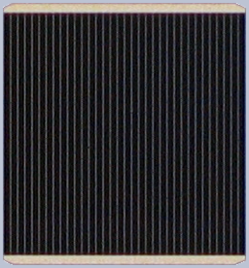
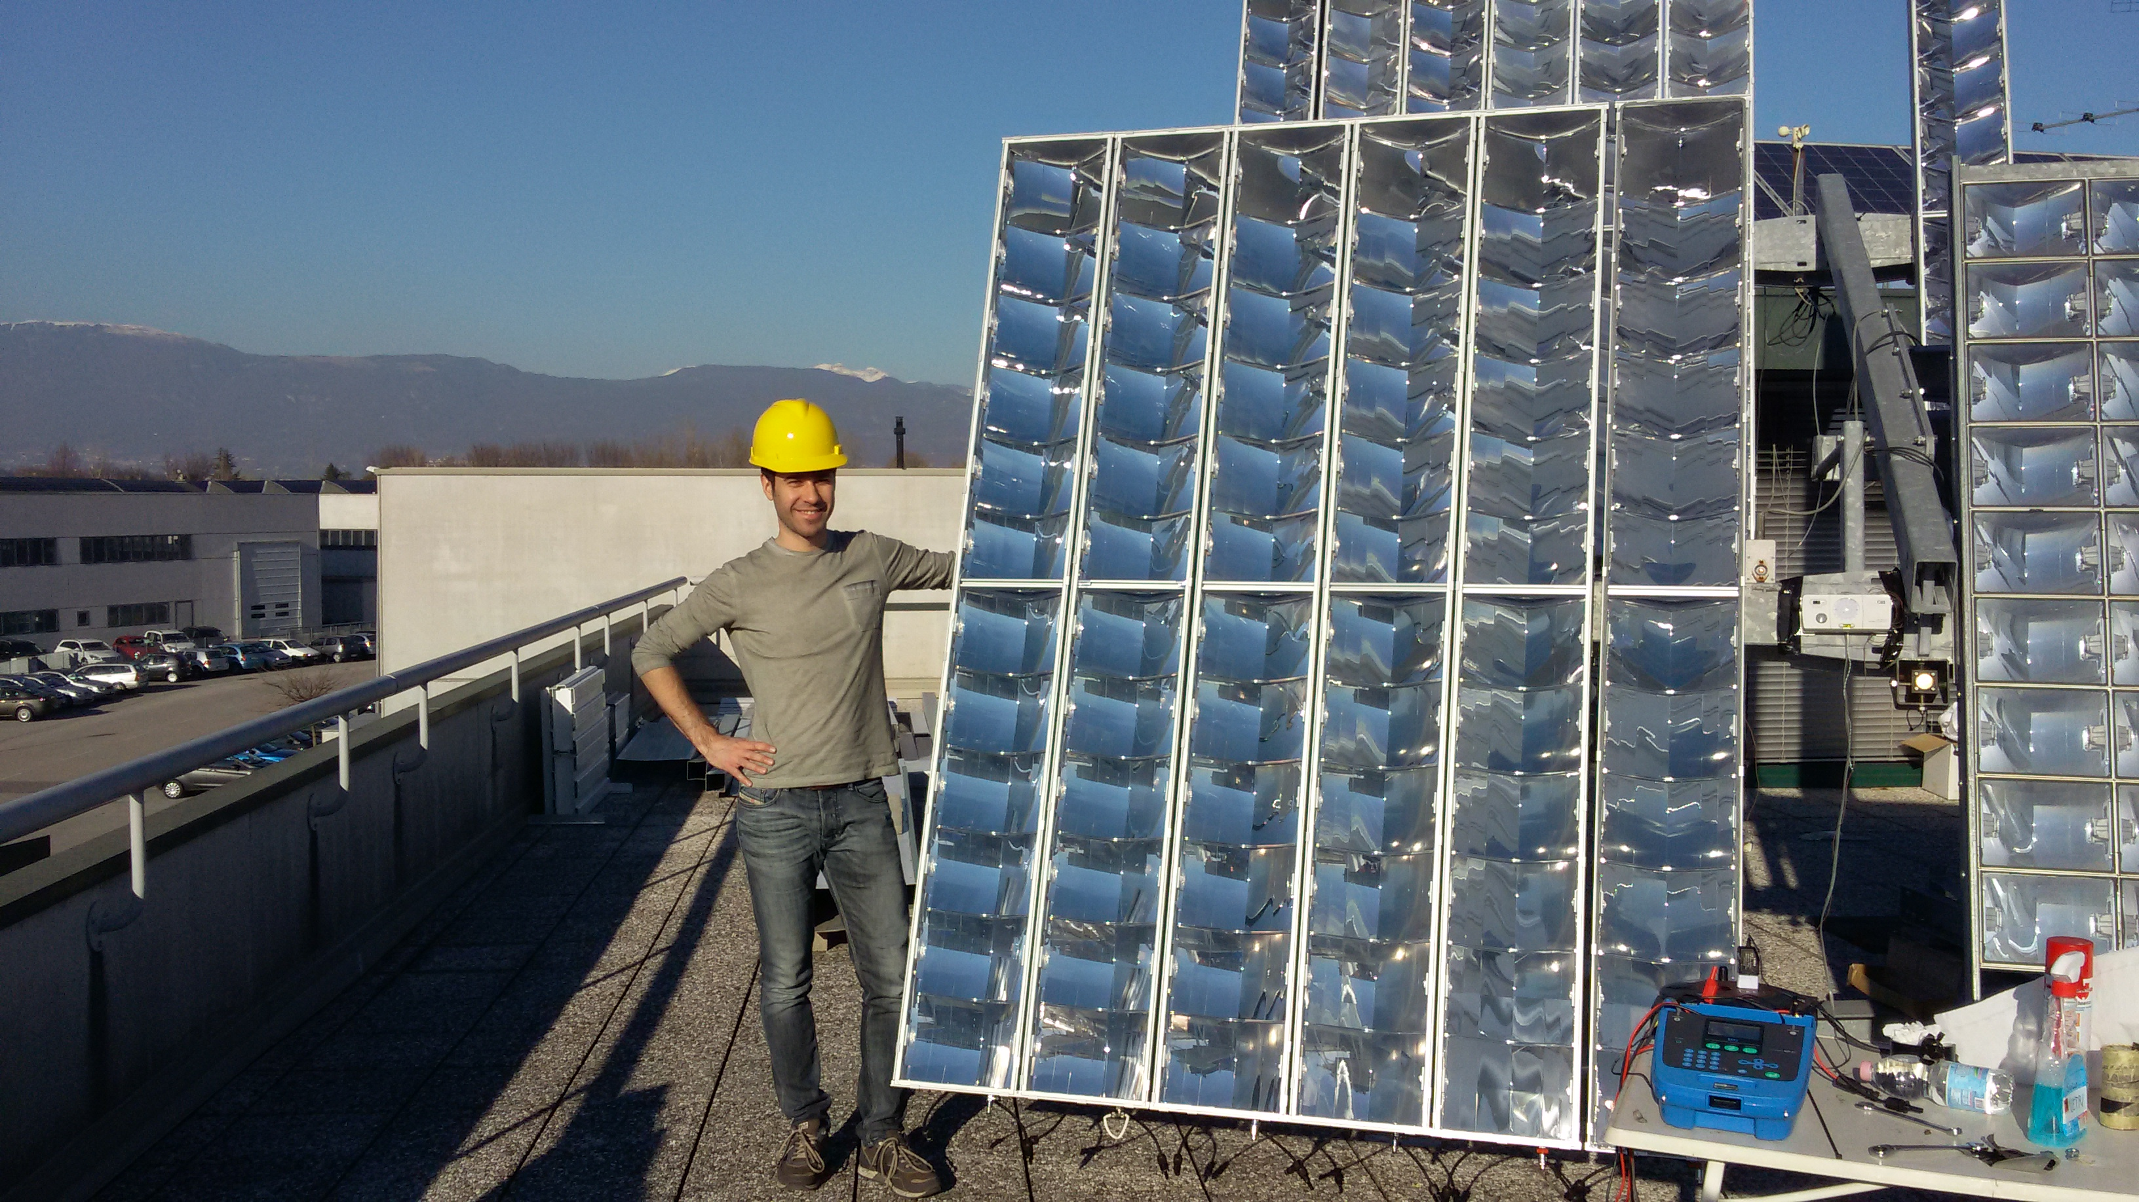
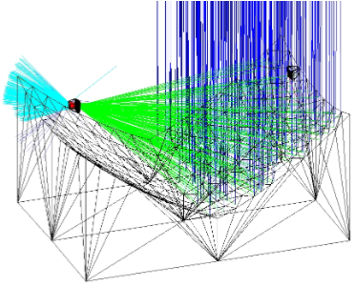
CPV: Concentrated
Photovoltaic
Project main goal
Producing an industrial CPV photovoltaic system
3J solar cells
  High efficiency (ƞ=44%)
  Small surface (5,5x5,5mm)
  Allow for light concentration
  Better behavior at high temperature
Recyclable materials
  Avoids problems of Si decommissioning
Concentration (700x)
  Al mirrors, PC substrate
  SiO₂ prism as a secondary optic
  Low cost
  Better quality than lenses
  Low volumes
Solar tracking
  Higher light collection
  Higher complexity and costs

Slide 3
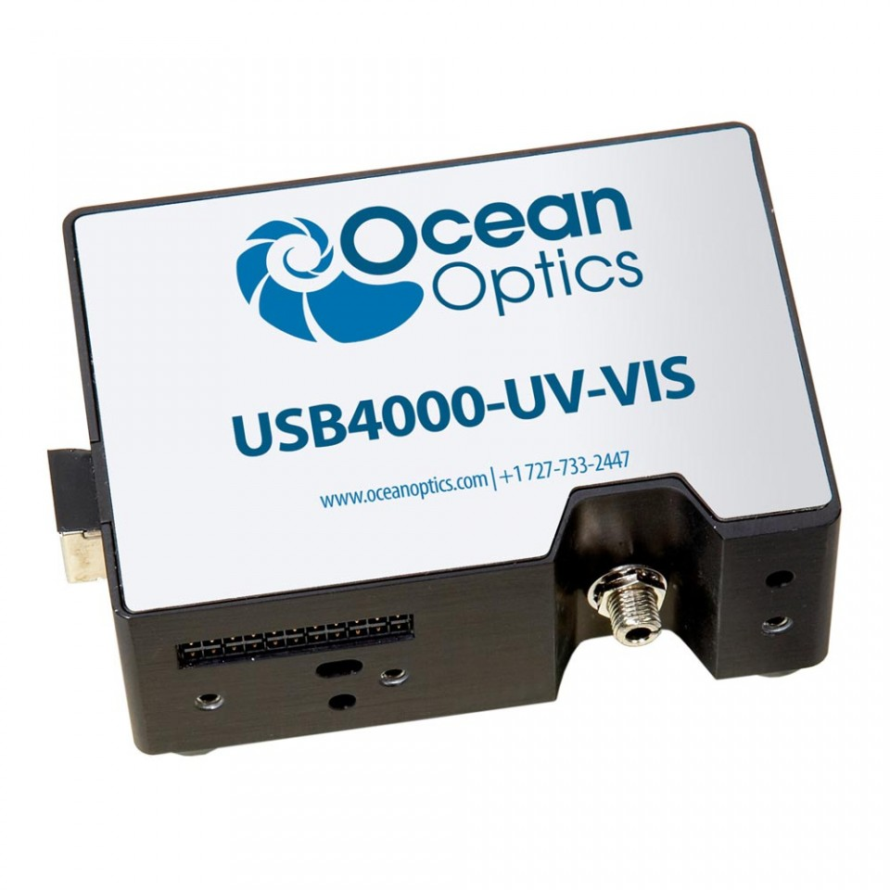
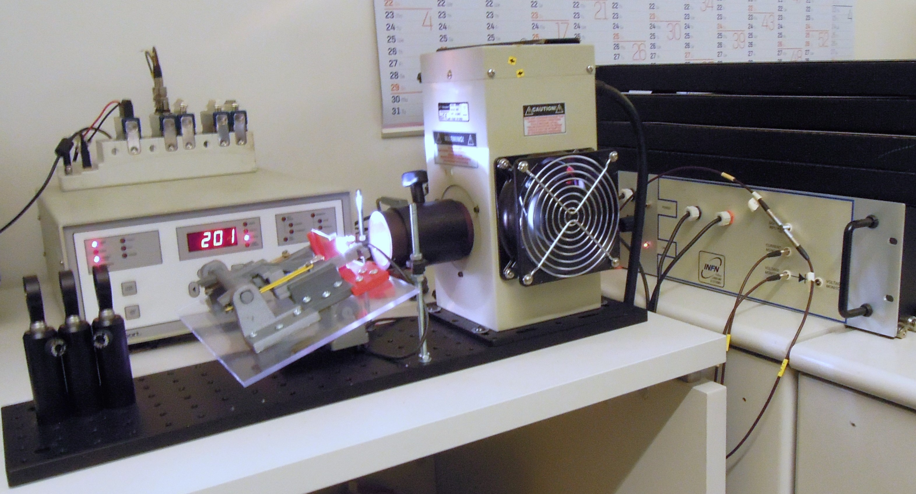
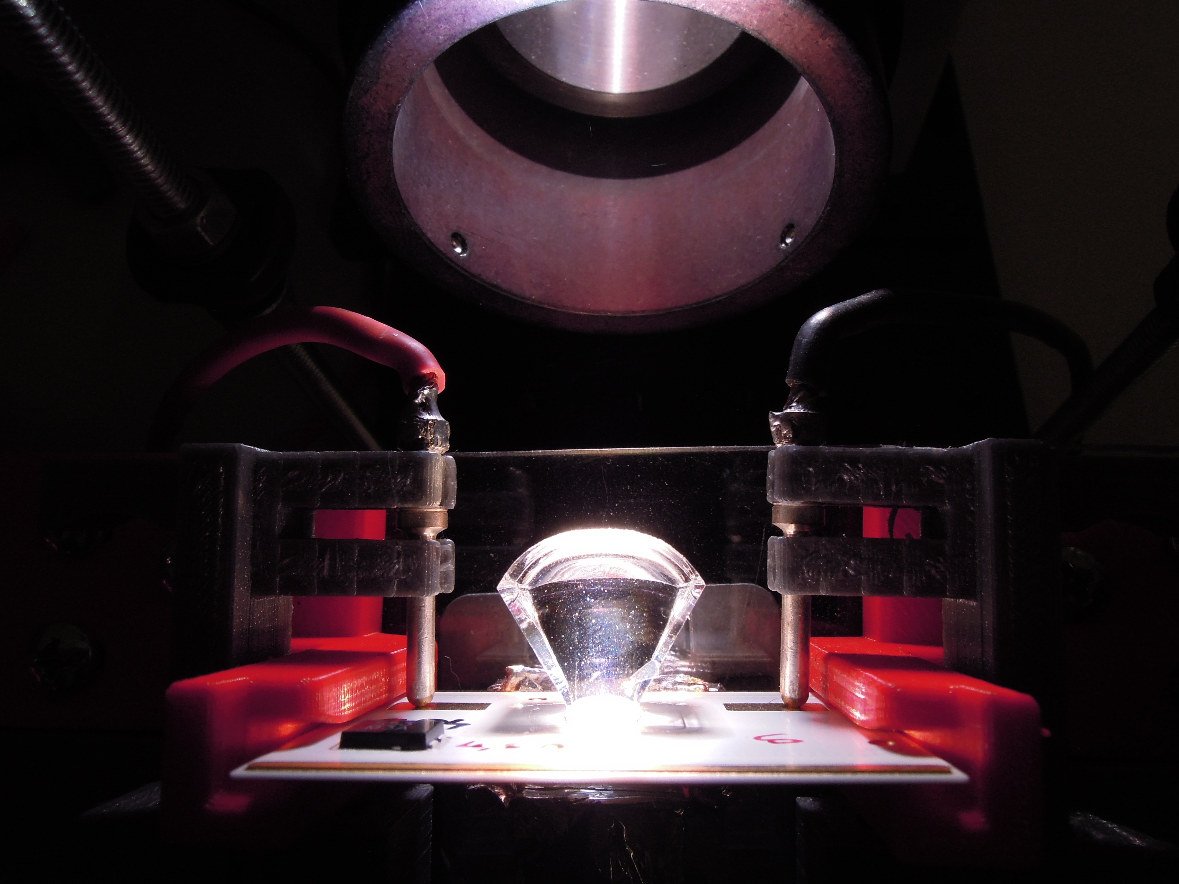
CPV: Concentrated
Photovoltaic
Results so far achieved
Realization of an optical setup for indoor testing of receiver behaviour
Xe lamp for solar spectrum simulation
Optical elements to regulate light path and intensity
Solar cell support
Active load for electrical analysis
Spectrophotometer for reflectivity measurement

Slide 4
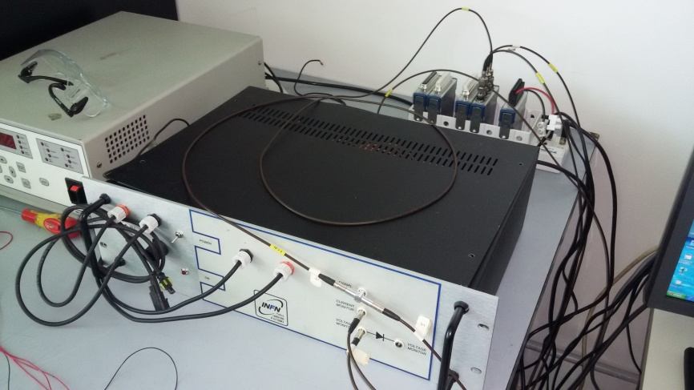
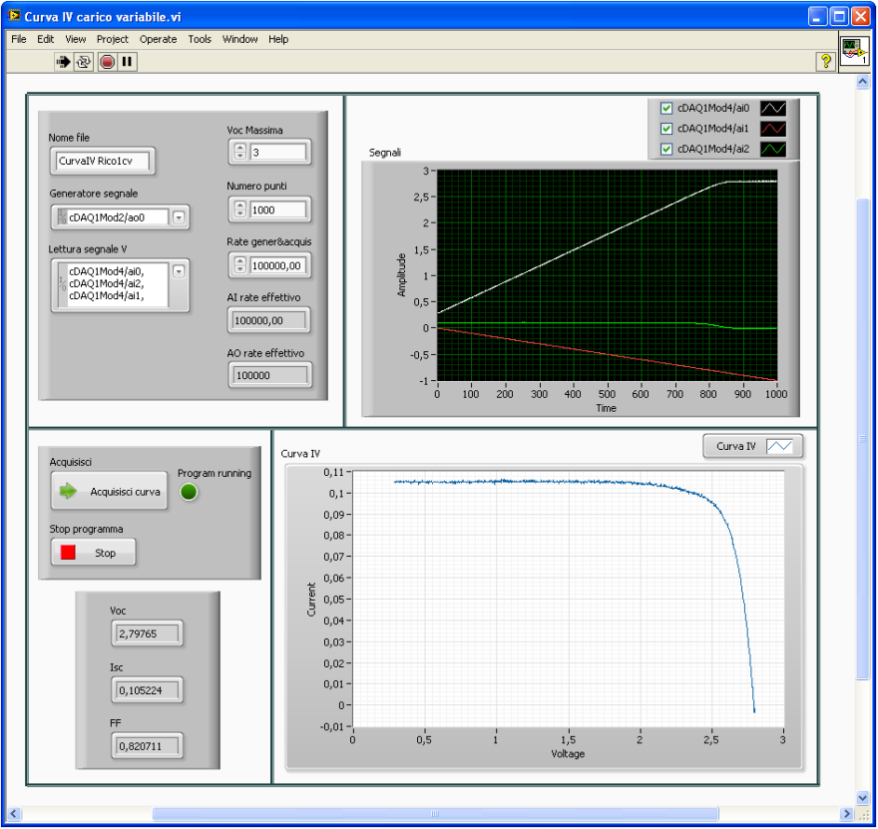
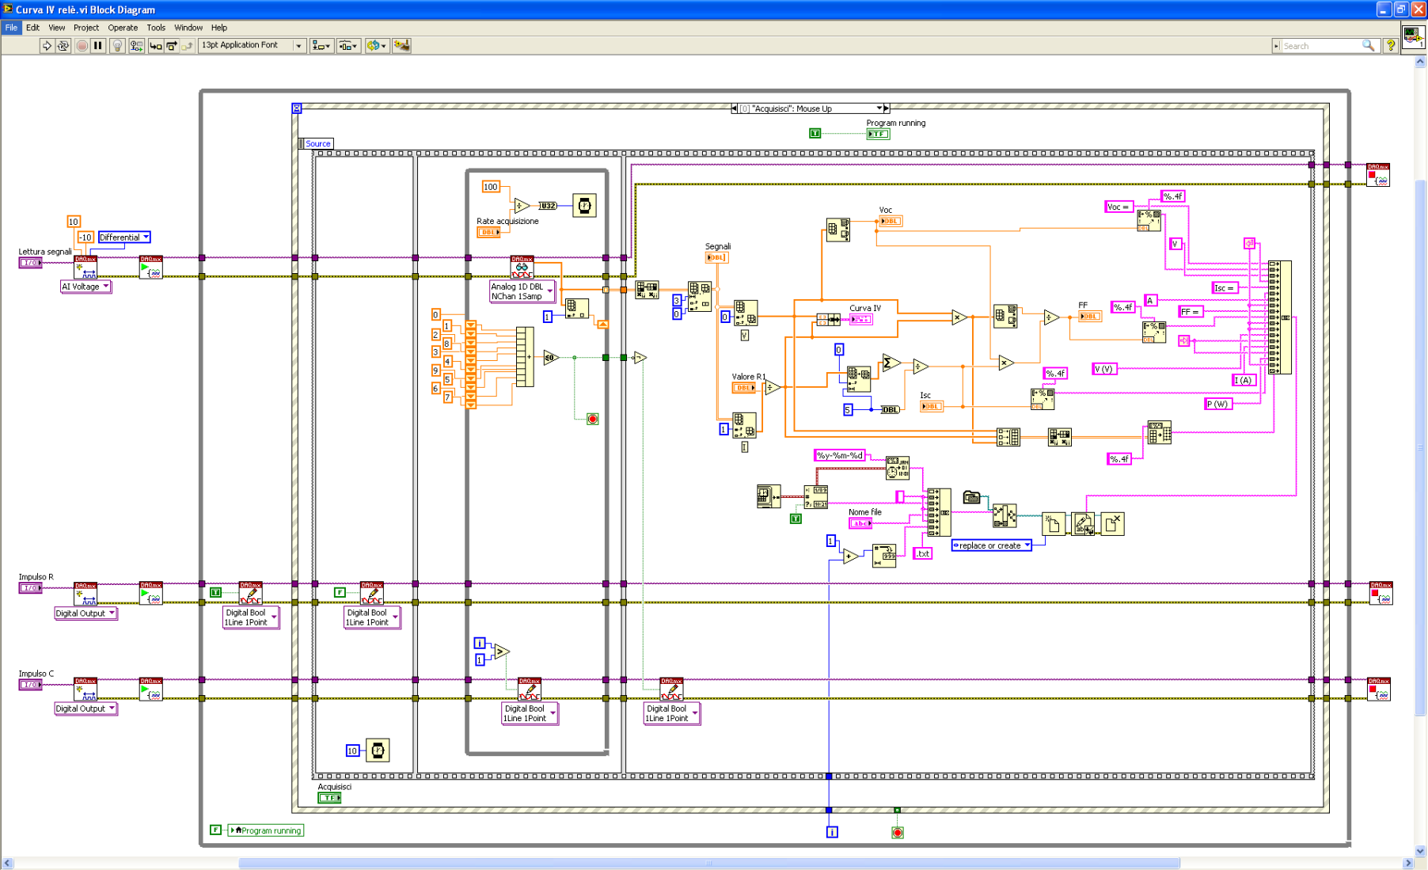
CPV: Concentrated
Photovoltaic
Results so far achieved
Software for testing of electrical behaviour

Slide 5
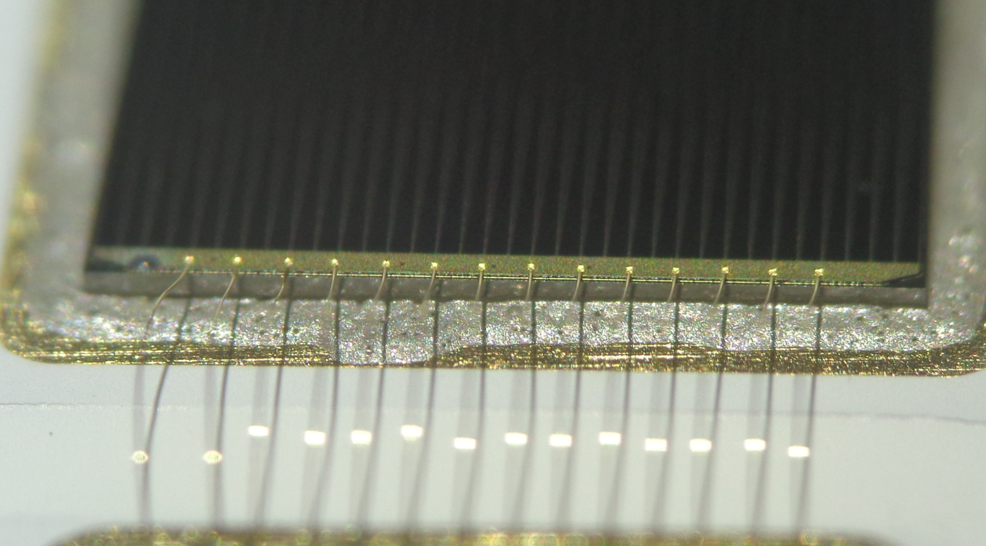
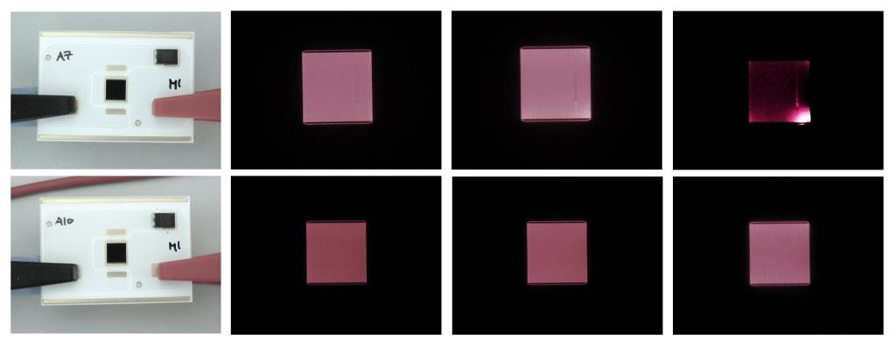
CPV: Concentrated
Photovoltaic
Results so far achieved
Analysis of infant mortality due to shunt currents
Malfunctioning of cells when exposed to sun irradiation
Electroluminescence test
Presence of thermal runaway
  Areas (corners) with higher thermal resistance
  Greater current concentration
  Joule heating
  Feedback effect
  Thermal runaway and shunt current
Control of die attach deposition
Changing of glueing process

Slide 6
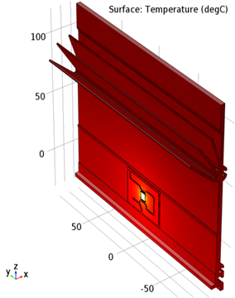
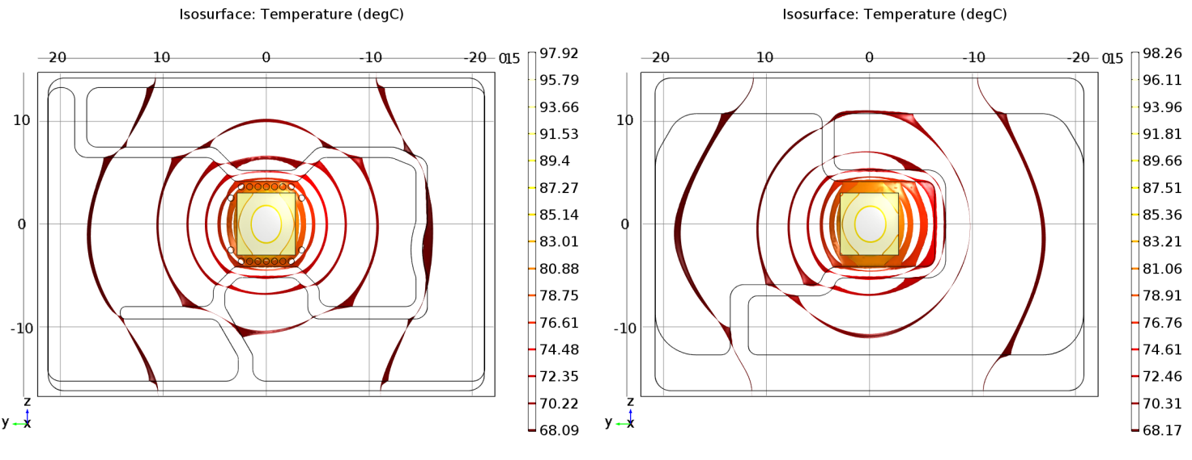
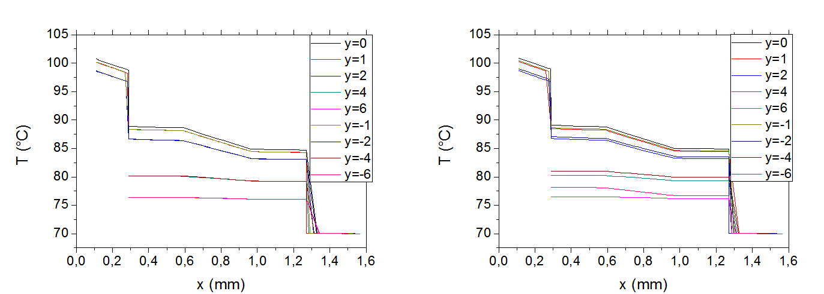
CPV: Concentrated
Photovoltaic
Results so far achieved
Simulation of thermal behaviour
Lower temperatures lead to increased performances
Simulations to foresee cell’s behaviour
Study of possible improvements
  DBC geometry
  Shape and dimensions of the heat sink
  Thickness and type of die attach
  Thickness and type of gap filler

Slide 7
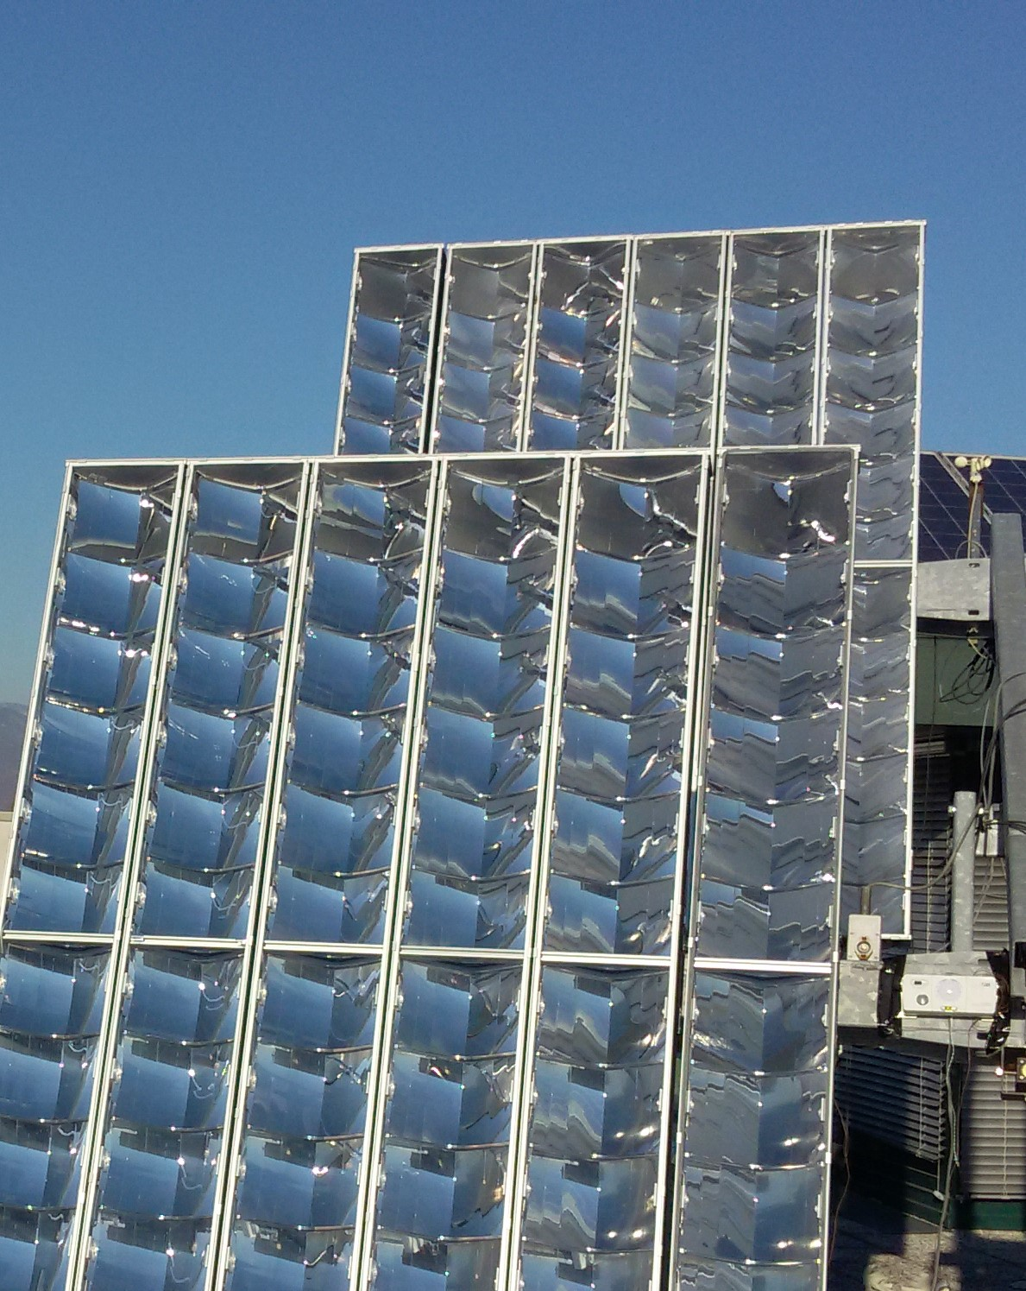
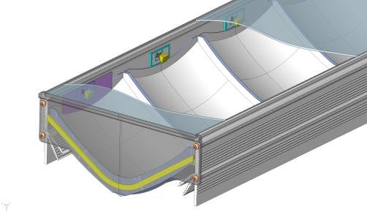
CPV: Concentrated
Photovoltaic
Results so far achieved
Realization of a prototype
Modules with 12 optical elements
24 cells connected in series
Efficiency up to 28%
Impermeability IP67

Slide 8
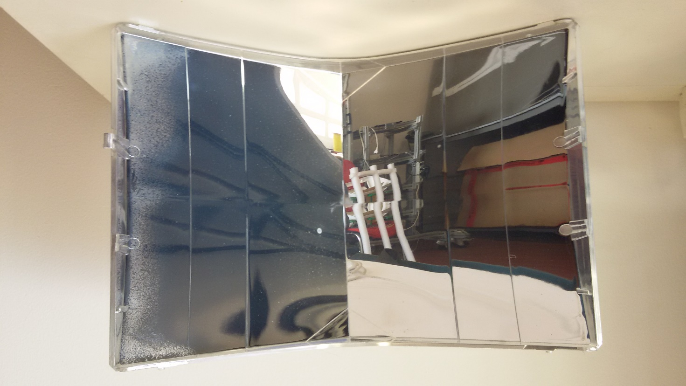
CPV: Concentrated
Photovoltaic
Plan of activities 2017 - 2019
Humidity damages to the primary optics
Al-PC adhesion
PC permeability
Adoption of a protective coating
Testing of different deposition methods
Collaboration with UniPD (matter physics group)
  SIMS
  RBS
  SEM

Slide 9
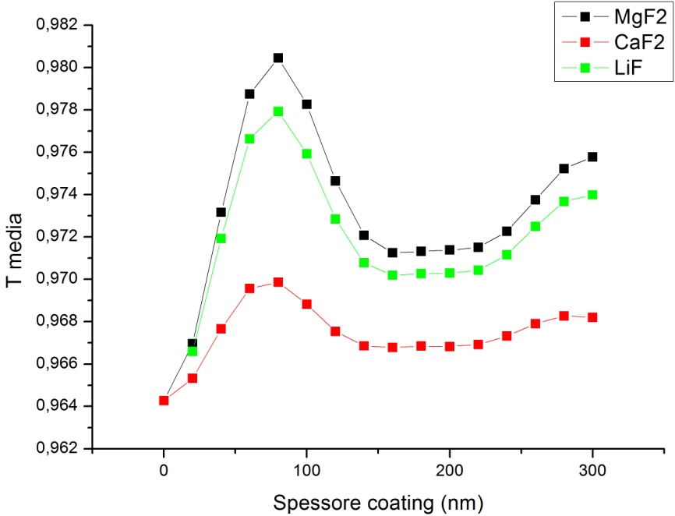
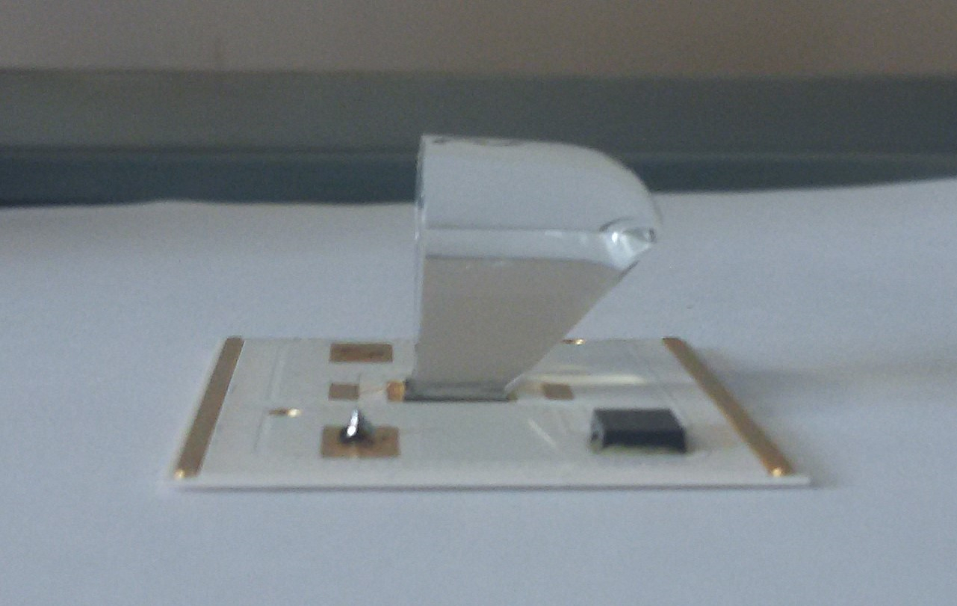
CPV: Concentrated
Photovoltaic
Plan of activities 2017 - 2019
Adoption of an AR coating for the secondary optic
Maximise amount of light collection
Simulations of optical behaviour
  Material choice
  Thickness
Deposition method
  Evaporation
  Sputtering
Analysis of results
  Improvement of optical setup for transmission measurements

Slide 10
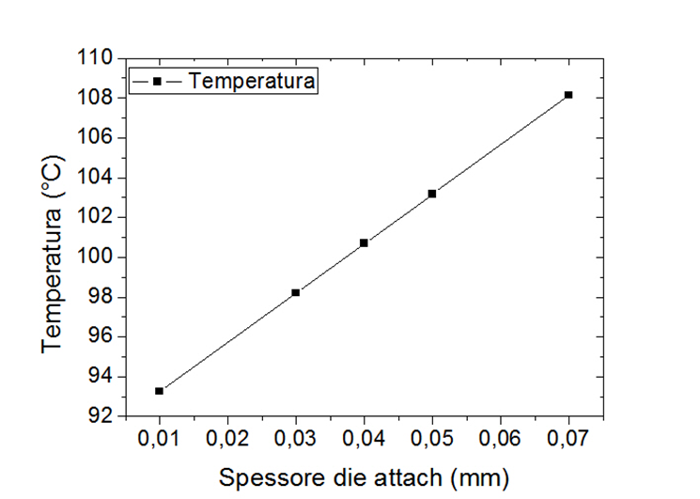
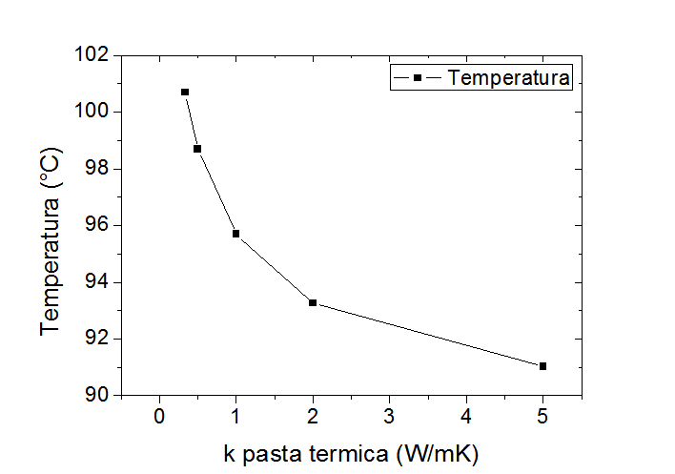
CPV: Concentrated
Photovoltaic
Plan of activities 2017 - 2019
Thermal behaviour
Use of simulation to optimise dissipation
Adoption of the best glueing method (soldering?)
Adoption of the right gap filler
  Compromise between thermal dissipation and strength
Temperatura di esercizio cella solare esposta a 900 DNI di radiazione solare
Temperatura di esercizio cella solare esposta a 900 DNI di radiazione solare

Slide 11
CPV: Concentrated
Photovoltaic
Plan of activities 2017 - 2019
Certifications
IEC 6218
Installation of pre-industrial trackers in Sicily
Study of the electroluminescence emission of triple junction solar cells to develop advanced and innovative procedures for the characterization and diagnostic of CPV modules
Improvements in the manufacturing process
Improvement of the chain interconnection between the solar receivers
Automatization

Slide 12
CPV: Concentrated
Photovoltaic
Expected funding in the 3-year period:
Request of funding by Centro Fermi
Grant: 1 grant, for the 3-year period of the plan (75k€)
Consumables/inventory per year (35k€)
Potential external funding
Possible funding through special agreements with the industries involved in the project (e.g. specific
modelling or analysis).
In 2016 42.7k€ collected through provided industrial consulting.

