Slide 1
T-MENS MRI Techniques for brain investigation
Coordinators: Dr. Federico Giove, Prof. Bruno Maraviglia
Participants:
Name | Position | Research | Funds | Until…
Federico Giove | Primo ricercatore TD (lead researcher, fixed term) | PAMINA, MICROBRADAM, TMENS | PAMINA | 8/2017
Tommaso Gili | Ricercatore TD (researcher, fixed term) | PAMINA | PAMINA | 9/2017
Fabrizio Piras | Ricercatore TD (researcher, fixed term) | PAMINA | PAMINA | 9/2017
Daniele Mascali | Assegno di ricerca (postdoc fellowship) | TMENS; MICROBRADAM | TMENS; MICROBRADAM | 1/2018
Fabio Mangini | Assegno di ricerca (postdoc fellowship) | PAMINA; TMENS | PAMINA | 12/2017
Francesca Assogna | Assegno di ricerca (postdoc fellowship) | PAMINA | PAMINA | 12/2017
Marta Moraschi | Assegno di ricerca (postdoc fellowship) | TMENS | PAMINA | 8/2017
Michela Fratini | Associate | TMENS | CNR; MDS through Fondazione Santa Lucia
Laura Maugeri | Associate | TMENS | MDS through Fondazione Santa Lucia
Bruno Maraviglia | Associate | TMENS

Slide 2
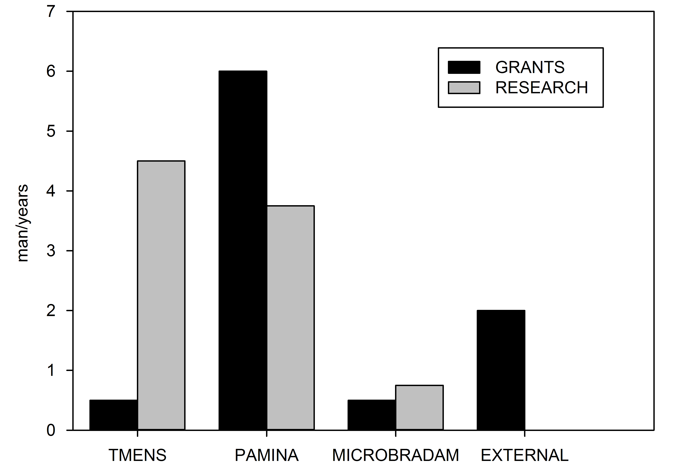

Slide 3

Place of Work & Collaborations:
Centro Fermi MARBILab @ Santa Lucia Foundation
Company/Consortium/Public-servicecorporation/Research infrastructure
University/research institution
Charles River Oy, Kuopio, Finland | ENIGMA (Enhancing Neuro Imaging Genetics through Meta Analysis) | Fondazione Santa Lucia IRCCS, Roma
Policlinico S. Andrea, Roma | Policlinico Umberto I, Roma | Siemens Medical Solutions Italy
Cardiff University Brain Research Imaging Centre (CUBRIC), Cardiff, UK | Center for Magnetic Resonance Research (CMRR), University of Minnesota, Minneapolis, MN, USA | CNR, Istituto dei sistemi complessi, Roma
CNR, Istituto di Nanotecnologia, Roma | Department of Physics, University of Kuopio (Finland) | Dipartimento di Neuroscienze, Università Tor Vergata, Roma
Dipartimento di Scienze Biomediche, Università di Modena e Reggio Emilia | Dipartimento di Scienze Neurologiche, Università La Sapienza, Roma | Dept Computer Science, University College London
Dipartimento di Medicina Interna, dell'Invecchiamento e Malattie Nefrologiche, Università di Bologna | Dipartimento di Medicina Sperimentale, Università di Genova | Dipartimento di Neuroscienze, Università Tor Vergata, Roma
IMT Lucca | Lorentz Institute, University of Leiden

Slide 4
Project main goal and results so far achieved
TMENS
MICROBRADAM
New techniques for assessment of brain damage
PAMINA
Platform for advanced applications to clinical research
Brain metabolism and energetics
(f)MRS, fMRI (Physiology, epilepsy, cancer)
Computational approaches/simulation
Advanced MRS methods
Brain steady state networks
fMRI (physiology, neurodegeneration)
Methods
Spinal cord fMRI
function, microstructure
Biophysics

Slide 5
Publications 2016-now
Gili T, Fiori V, De Pasquale G, Sabatini U, Caltagirone C, Marangolo P Right sensory-motor functional networks subserve action observation therapy in aphasia. Brain Imaging Behav 2016. DOI: 10.1007/s11682-016-9635-1.
Marangolo P, Fiori V, Sabatini U, De Pasquale G, Razzano C, Caltagirone C, Gili T Bilateral transcranial direct current stimulation language treatment enhances functional connectivity in the left hemisphere: preliminary data from aphasia. J Cogn Neurosci. 2016, 28(5): 724-38.
Punzi M, Gili T, Petrosini L, Caltagirone C, Spalletta G, Sensi S. Modafinil-induced changes in functional connectivity in the cortex and cerebellum of healthy elderly subjects. Frontiers in aging neuroscience. In print
Orfei MD, Piras F, Banaj N, Di Lorenzo G, Siracusano A, Caltagirone C, Bandinelli PL, Ducci G, Spalletta G. Unrealistic self-overconfidence in schizophrenia is associated with left presubiculum atrophy and impaired episodic memory. Cortex. 2017 Jan;86:132-139. doi: 10.1016/j.cortex.2016.10.017
Ciavardelli D, Piras F, Consalvo A, Rossi C, Zucchelli M, Di Ilio C, Frazzini V, Caltagirone C, Spalletta G, Sensi SL. Medium-chain plasma acylcarnitines, ketone levels, cognition, and gray matter volumes in healthy elderly, mildly cognitively impaired, or Alzheimer's disease subjects. Neurobiol Aging. 2016 Jul;43:1-12. doi: 10.1016/j.neurobiolaging.2016.03.005.
Simonetti A, Sani G, Dacquino C, Piras F, De Rossi P, Caltagirone C, Coryell W, Spalletta G. Hippocampal subfield volumes in short- and long-term lithium-treated patients with bipolar I disorder. Bipolar Disord. 2016 Jun;18(4):352-62. doi: 10.1111/bdi.12394.
Chiapponi C, Piras F, Piras F, Caltagirone C, Spalletta G. GABA System in Schizophrenia and Mood Disorders: A Mini Review on Third-Generation Imaging Studies. Front Psychiatry. 2016 Apr 19;7:61. doi: 10.3389/fpsyt.2016.00061.
Maffei V, Mazzarella E, Piras F, Spalletta G, Caltagirone C, Lacquaniti F, Daprati E. Processing of visual gravitational motion in the peri-sylvian cortex: Evidence from brain-damaged patients. Cortex. 2016 May;78:55-69. doi: 10.1016/j.cortex.2016.02.004.
Phillips OR, Joshi SH, Piras F, Orfei MD, Iorio M, Narr KL, Shattuck DW, Caltagirone C, Spalletta G, Di Paola M. The superficial white matter in Alzheimer's disease. Hum Brain Mapp. 2016 Apr;37(4):1321-34. doi: 10.1002/hbm.23105.
Sani G, Chiapponi C, Piras F, Ambrosi E, Simonetti A, Danese E, Janiri D, Brugnoli R, De Filippis S, Caltagirone C, Girardi P, Spalletta G. Gray and white matter trajectories in patients with bipolar disorder. Bipolar Disord. 2016 Feb;18(1):52-62. doi: 10.1111/bdi.12359.
Spalletta G, Cravello L, Gianni W, Piras F, Iorio M, Cacciari C, Casini AR, Chiapponi C, Sancesario G, Fratangeli C, Orfei MD, Caltagirone C, Piras F. Homotaurine Effects on Hippocampal Volume Loss and Episodic Memory in Amnestic Mild Cognitive Impairment. J Alzheimers Dis. 2016;50(3):807-16. doi: 10.3233/JAD-150484.
De Gennaro L, Lanteri O, Piras F, Scarpelli S, Assogna F, Ferrara M, Caltagirone C, Spalletta G. Dopaminergic system and dream recall: An MRI study in Parkinson's disease patients. Hum Brain Mapp. 2016 Mar;37(3):1136-47. doi: 10.1002/hbm.23095.
Piras F, Piras F, Orfei MD, Caltagirone C, Spalletta G. Self-awareness in Mild Cognitive Impairment: Quantitative evidence from systematic review and meta-analysis. Neurosci Biobehav Rev. 2016 Feb;61:90-107. doi: 10.1016/j.neubiorev.2015.10.002.
Inna Bukreeva, Gaetano Campi, Michela Fratini, Raffaele Spanò, Domenico Bucci, Giuseppe Battaglia, Federico Giove, Alberto Bravin, Antonio Uccelli, Consuelo Venturi, et al. Quantitative 3D investigation of Neuronal network in mouse spinal cord model. Sci Rep 7 (2017), 41054. : 10.1038/srep41054
DiNuzzo M. Astrocyte-Neuron Interactions during Learning May Occur by Lactate Signaling Rather than Metabolism. Front Integr Neurosci. 2016. doi: 10.3389/fnint.2016.00002.
Petr Bednařik, Ivan Tkáč, Federico Giove, Lynn E Eberly, Dinesh K Deelchand, Felipe R Barreto, Silvia Mangia. Neurochemical Responses to Chromatic and Achromatic Stimuli in the Human Visual Cortex. J Cereb Blood Flow Metab (2017). In press
Mauro DiNuzzo, Federico Giove, Bruno Maraviglia, Silvia Mangia. Computational Flux Balance Analysis Predicts that Stimulation of Energy Metabolism in Astrocytes and their Metabolic Interactions with Neurons Depend on Uptake of K+ Rather than Glutamate.Neurochemical Research 4 2(2017), 202–216.:10.1007/s11064-016-20480.
Mauro DiNuzzo, Daniele Mascali, Marta Moraschi, Giorgia Bussu, Bruno Maraviglia, Silvia Mangia, and Federico Giove. Temporal information entropy of the Blood–Oxygenation Level–Dependent signals increases in the activated human primary visual cortex. Frontiers in Physics 5 (2017), 7. : 10.3389/fphy.2017.00007.
+ About 10 submitted
+ about 20 communications to congress (oral, invited, contributed)
+ 1 edited book, 1 journal special issue
+ 1 Workshop (Erice, April-May 2016)

Slide 6
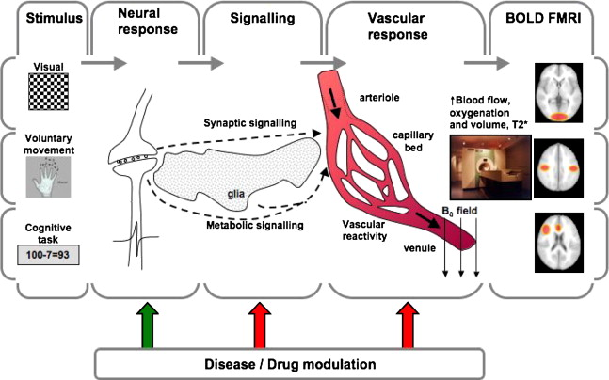
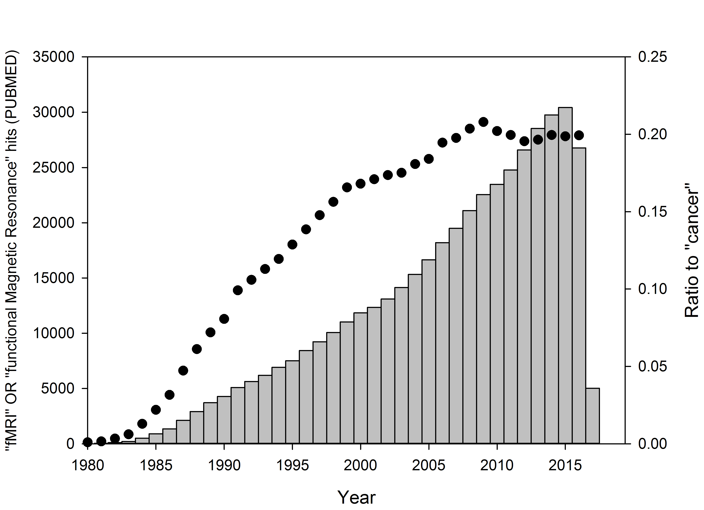
Iannetti & Wise, MRI, 2007
Goense et al, 2006

Slide 7
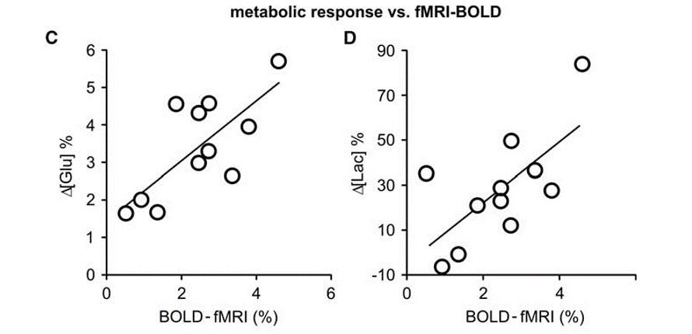
TMENS
Bednarik et al, JCBFM, 2015

Slide 8
Bednarik et al, JCBFM, 2016

Slide 9
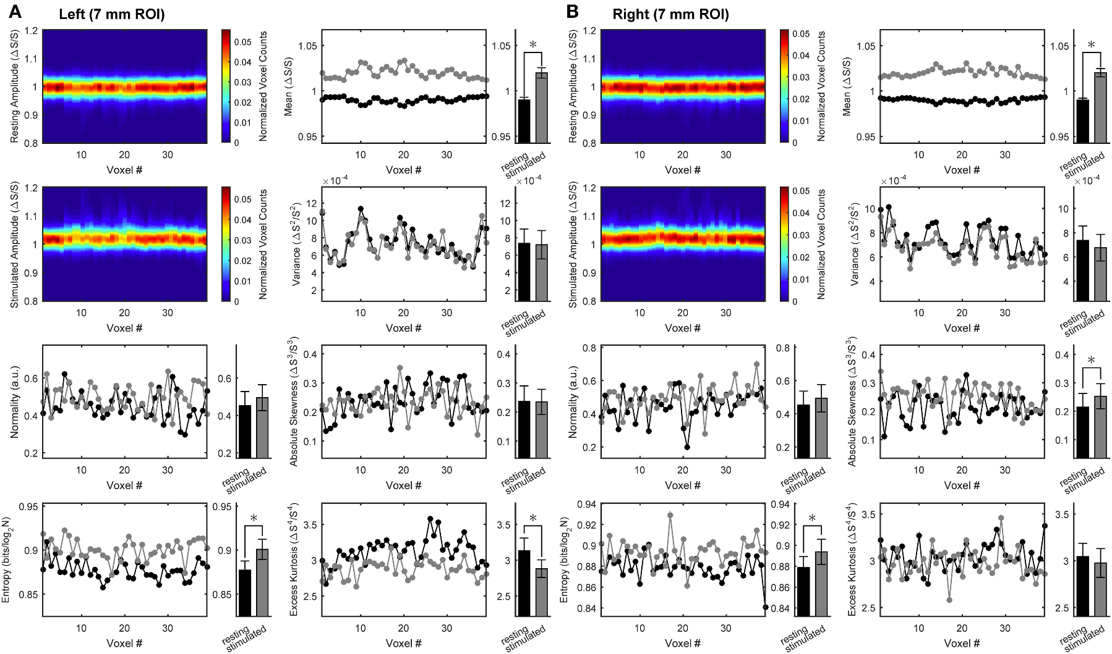
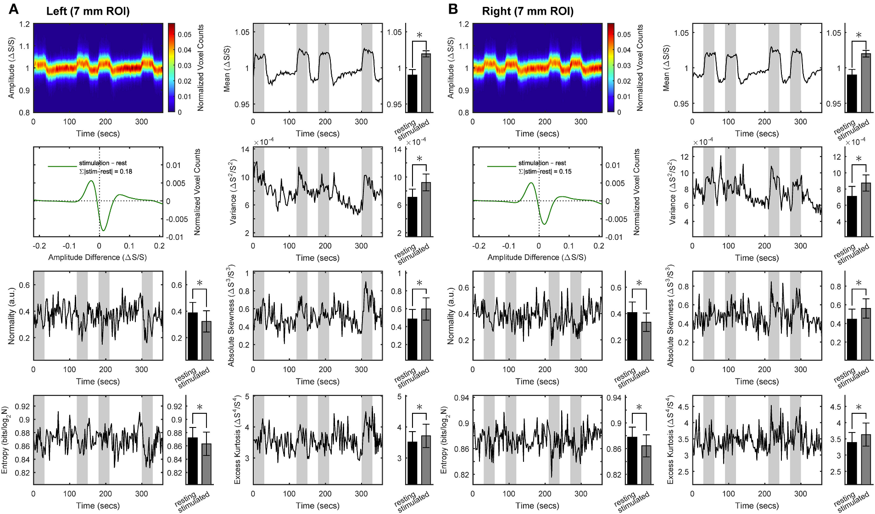
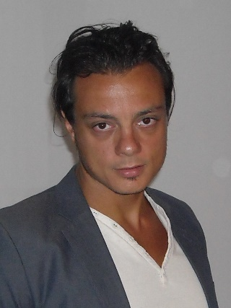
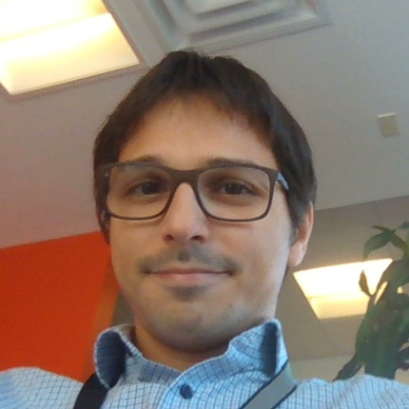
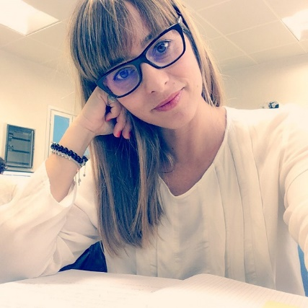
DiNuzzo et al, Frontiers in Physics, 2017

Slide 10
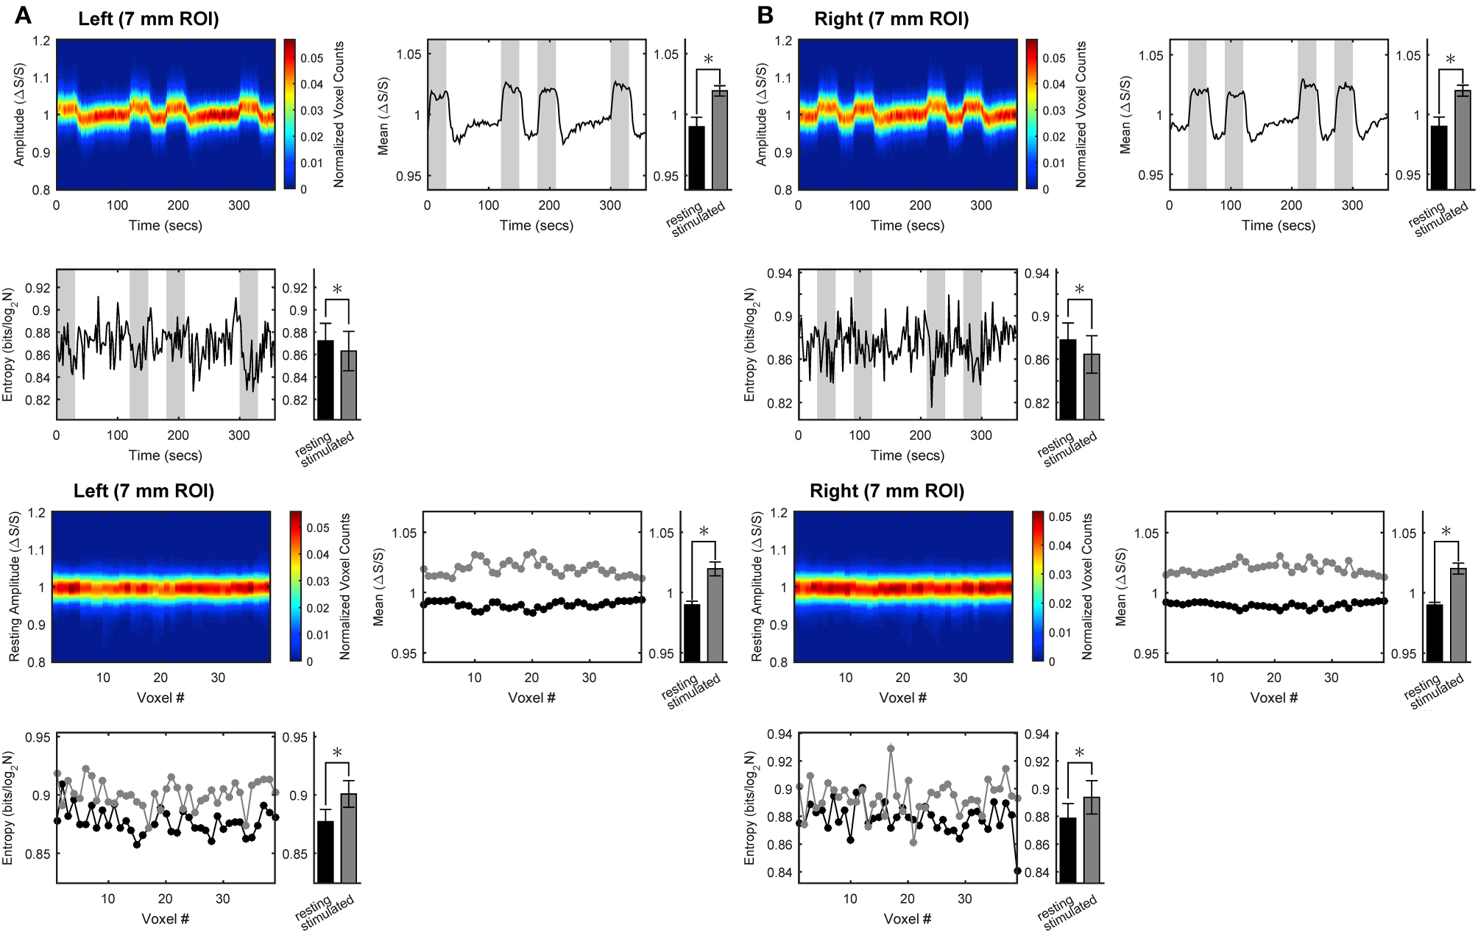
DiNuzzo et al, Frontiers in Physics, 2017

Slide 11
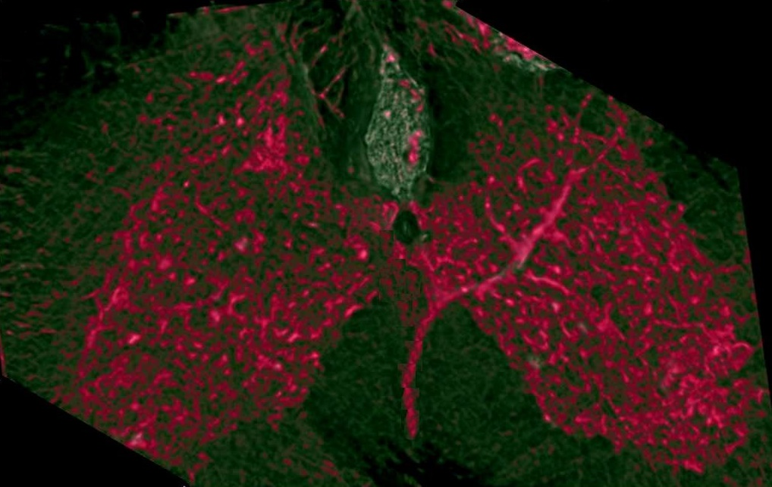
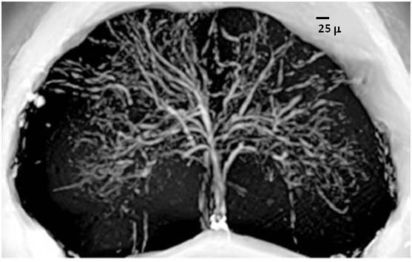
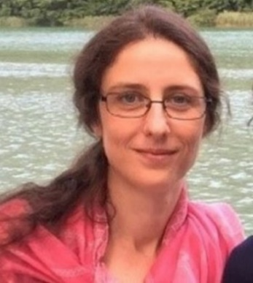
Bukreeva et al, Scientific Reports, 2017
Fratini et al, Scientific Reports, 2015
Notes:
Phase contrast tomographic volume, 700 μm thick of (A) healthy (CTRL) and (B) EAE samples. (C) K-Ripley function of the motor neurons calculated in a typical volume of (red line) EAE and (black line) CTRL samples. The thick green lines represent the K-Ripley function of randomly located neurons. (D) K/K_{CSR} ratio, of the motor neurons calculated in the same volume of EAE (red line) and CTRL samples (black line). In the white region (ρ > 1) the neurons tend to clusterize within the range lengths, L_{c}, indicated by the dashed lines at 145 μm and at [185–330] μm in EAE and CTRL samples, respectively

Slide 12
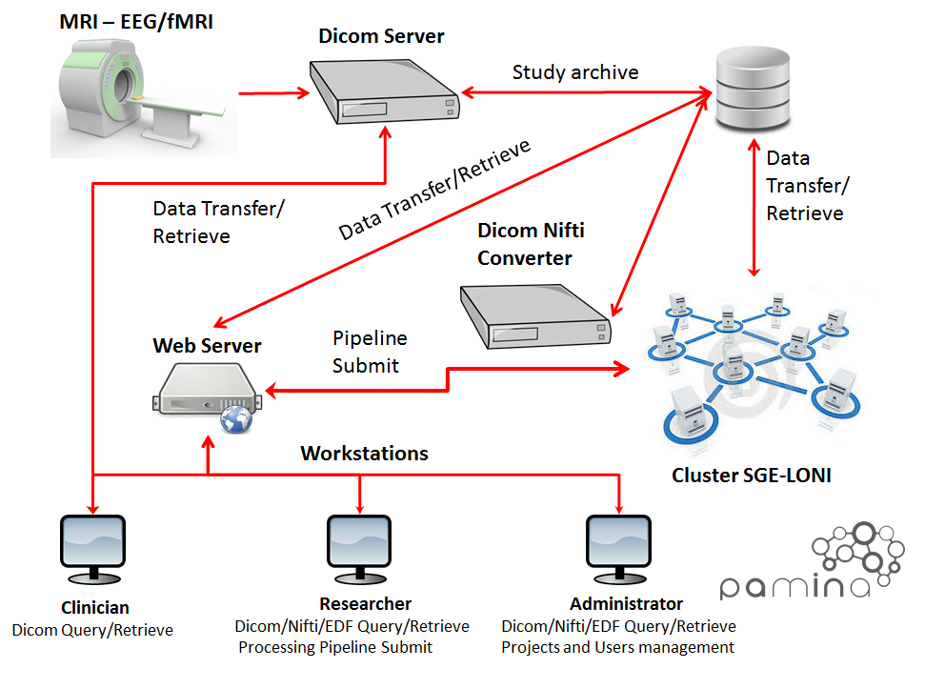
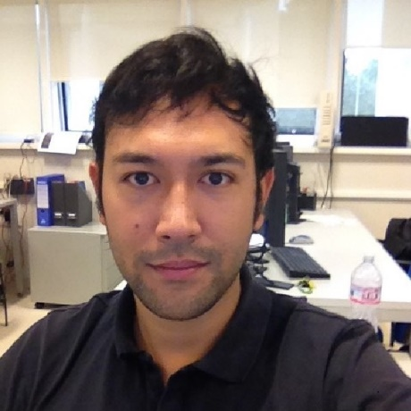
PAMINA

Slide 13
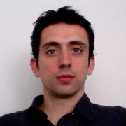
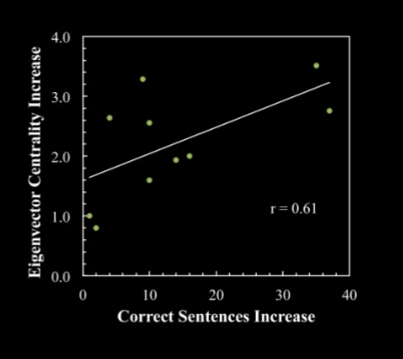
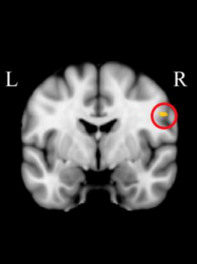
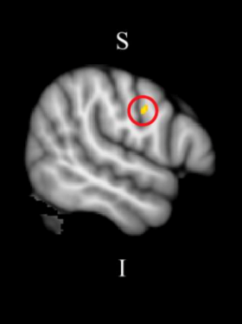
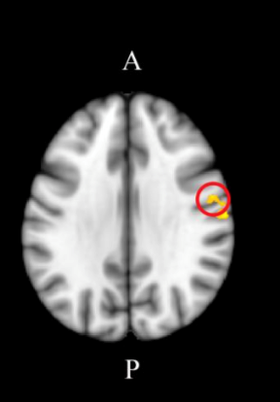
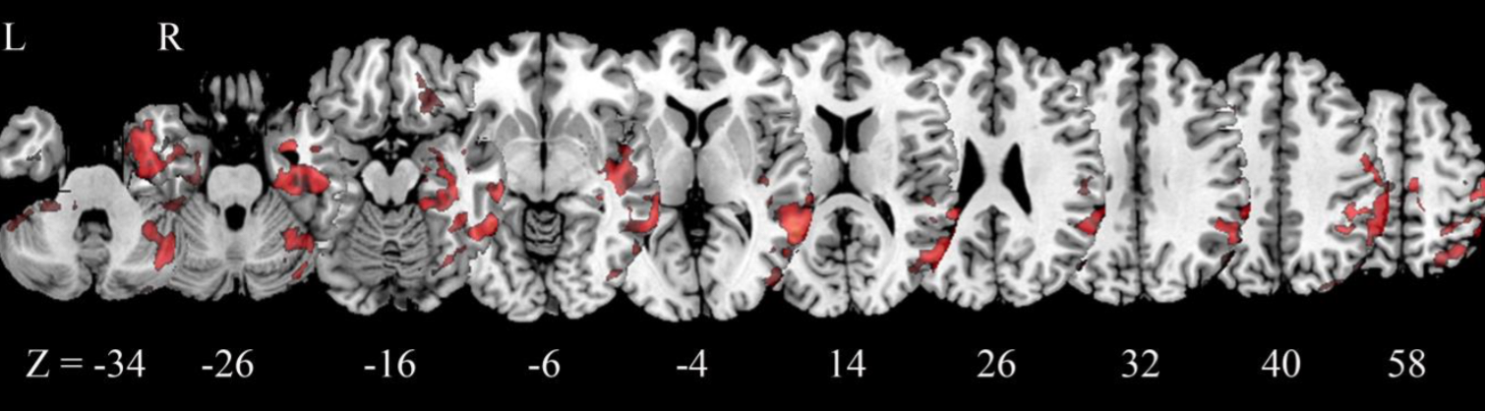
SUPPLEMENTARY MOTOR AREA
TOPOLOGICAL CHANGES DUE TO ACTION OBSERVATION TREATMENT IN NON FLUENT APHASIA
Gili et al, Brain Imaging and behaviour, 2016

Slide 14
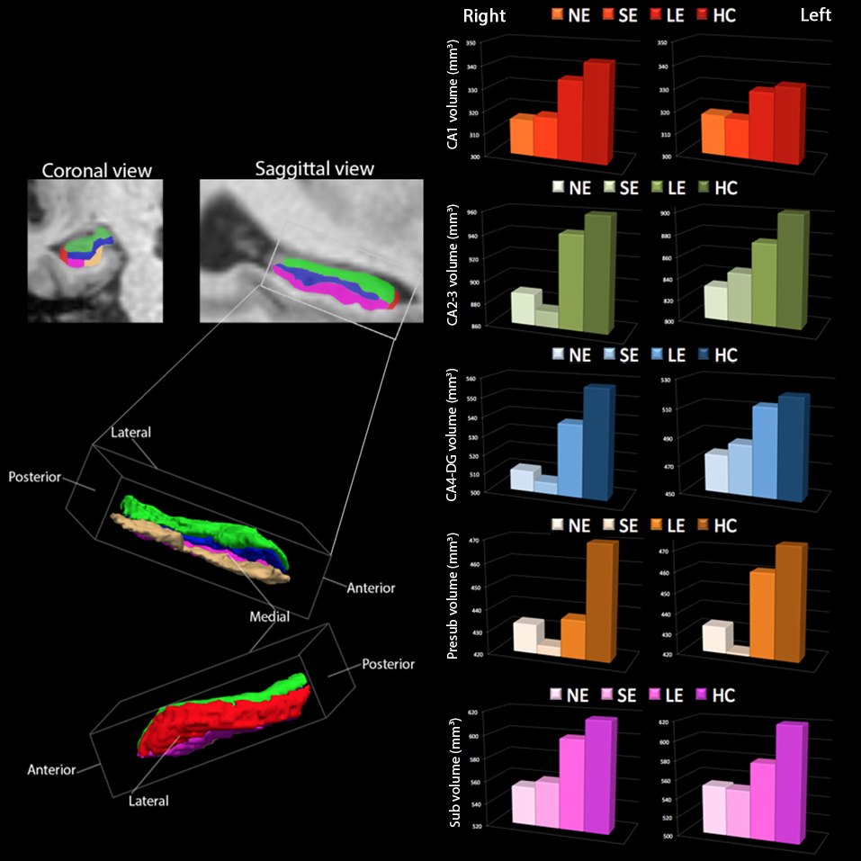
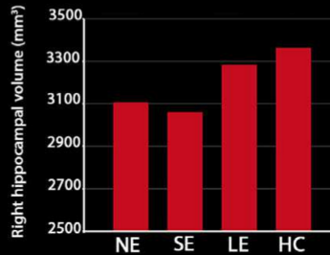
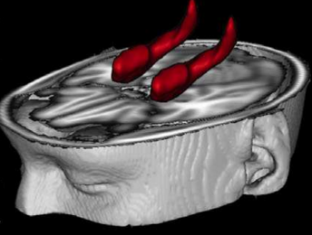
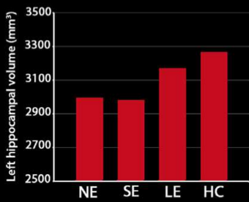
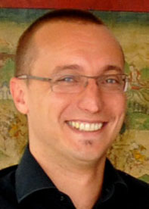
Simonetti et al, Bipolar disorders, 2016
Notes:
Volumi medi della formazione ippocampale totale e dei relativi sottocampi (Corno di Ammone 1, Corni di Ammone 2-3, Corno di Ammone 4 e Giro Dentato, Presubiculum e Subiculum) in quattro gruppi di soggetti: pazienti Bipolari senza esposizione a trattamento con Litio (NE), pazienti Bipolari con esposizione breve (SE), pazienti Bipolari con esposizione lunga (LE) e soggetti sani (HC). Si noti come in diverse aree i pazienti LE mostrano volumi paragonabili ai soggetti sani, a testimoniare il potenziale effetto neuroprotettivo del litio

Slide 15
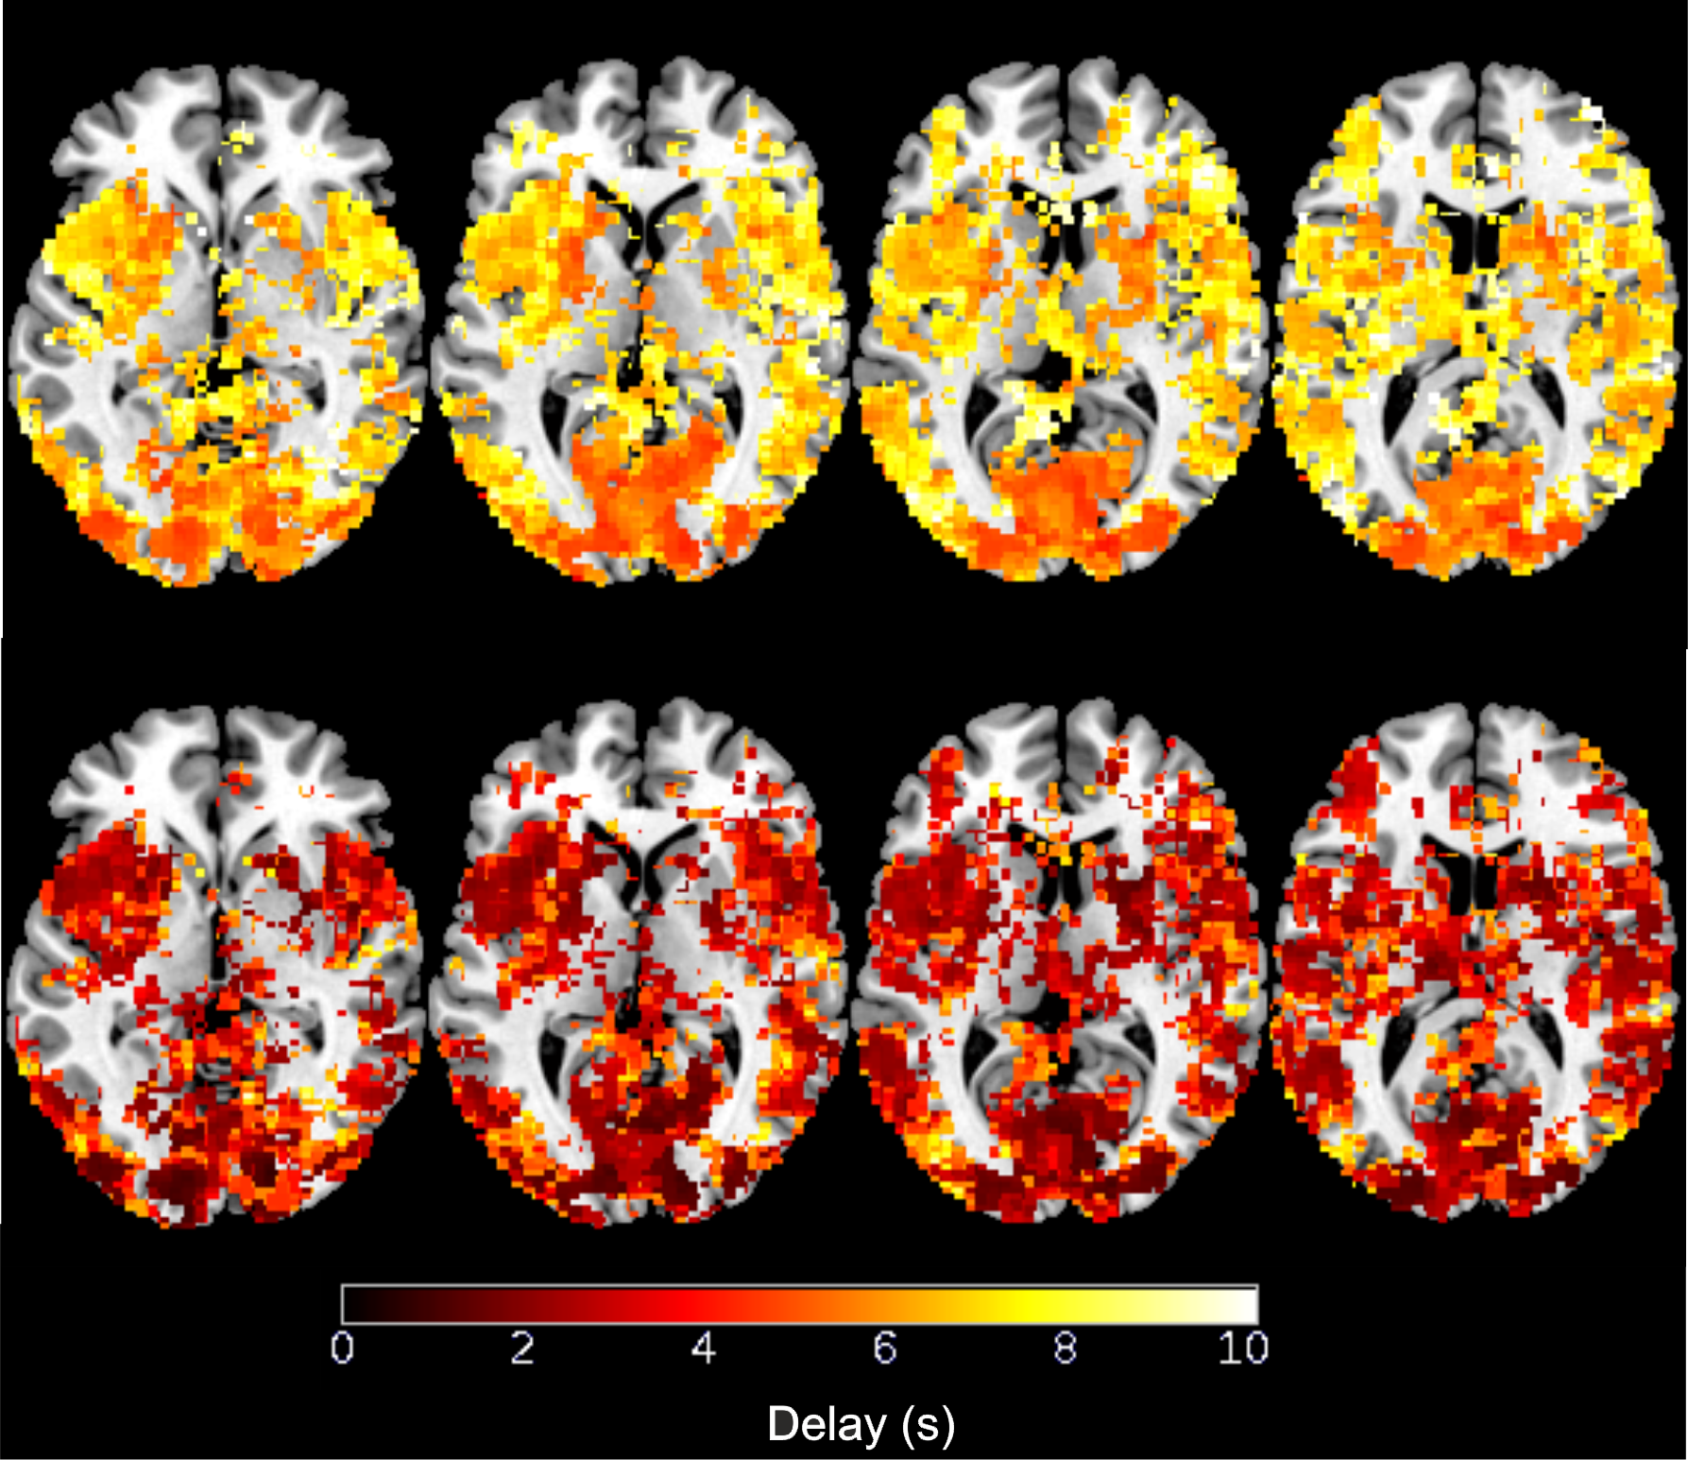
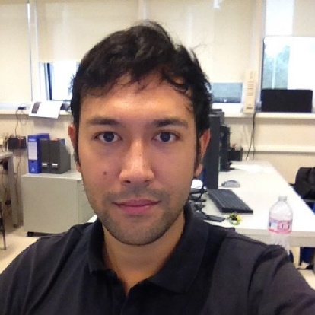
PLAN 2017-2019
Objective: to develop functional MRI approaches for the study of human brain function:
  Exploit higher spatial and temporal resolution …to map hrf response
    Increased fMRI sensitivity (single subjecy, pathology…)
Mangini et al., in preparation
FG, FM, DM, MM, coll. CMRR: S. Mangia

Slide 16
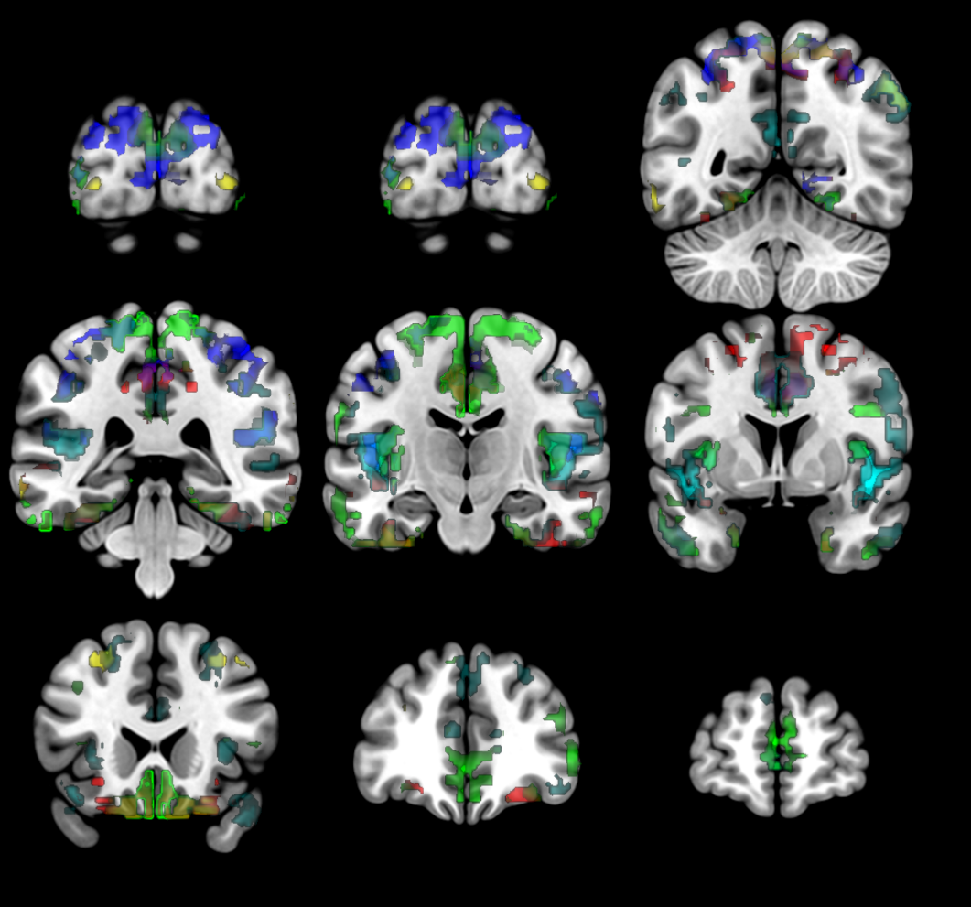
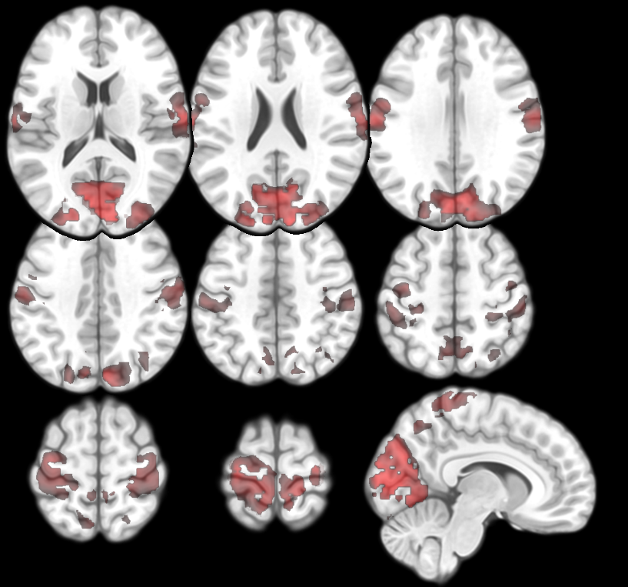
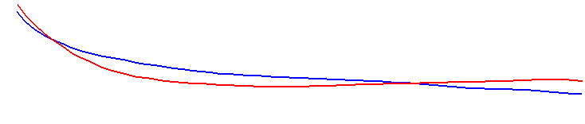

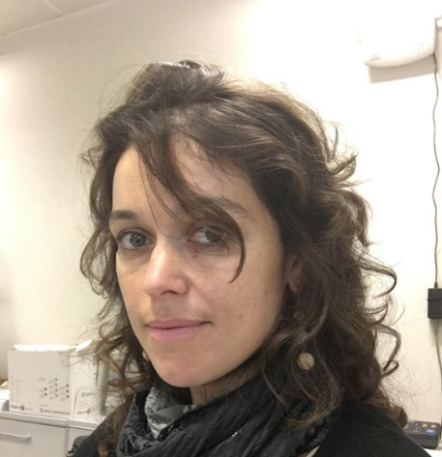
PLAN 2017-2019
Objective: to develop functional MRI approaches for the study of human brain function:
  Exploit higher spatial and temporal resolution …to map hrf response
    Increased fMRI sensitivity (single subjecy, pathology…)
  … to better understand the network properties of brain function
    New diagnostic tool? Implications for pathology assessment, prediction power (evolution from MCI to AD)
FC
r
FG, TG, DM, MM, coll. CMRR: S. Mangia, Fondazione Santa Lucia

Slide 17
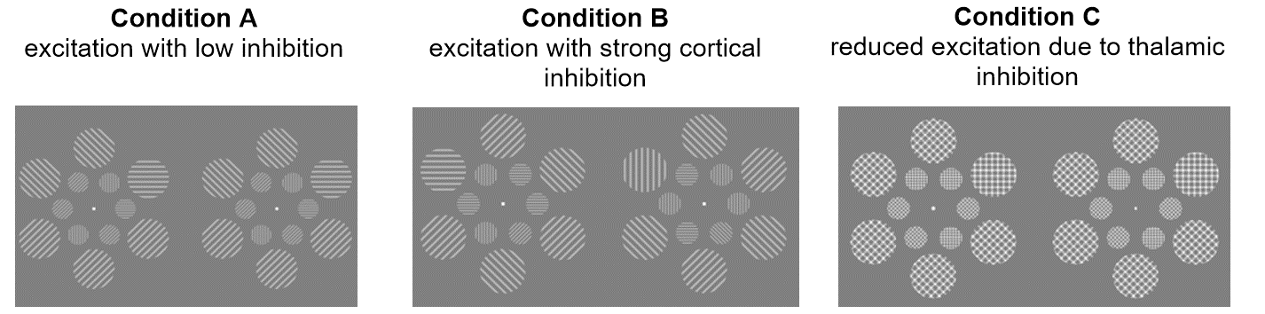

PLAN 2017-2019
Objective: to develop functional MRI approaches for the study of human brain function:
  Exploit higher spatial and temporal resolution …to map hrf response
    Increased fMRI sensitivity (single subjecy, pathology…)
  … to better understand the network properties of brain function
    New diagnostic tool? Implications for pathology assessment, prediction power (evolution from MCI to AD)
  … to explore brain energetics in presence of neuromodulation
    Assessing the neurometabolic coupling (applications to epilepsy)
FG, FM, DM, MM, coll. CMRR: S. Mangia

Slide 18

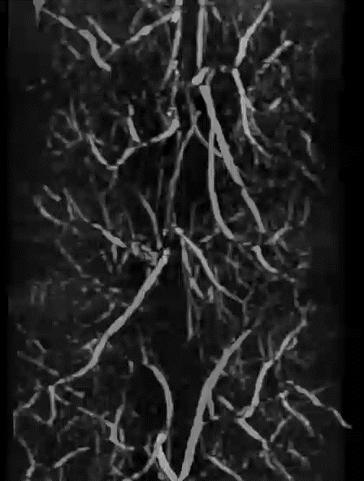
PLAN 2017-2019: Spinal cord fMRI
(funds: MDS)
Objective: to develop the functional imaging of the human spinal cord
  Realistic biophisical modeling based on high resolution tomography
  Application to patients
    Assessment of functional damage, effect of therapy…
FG, MF, LM, MM coll. CNR Nanotech/Tomalab: A. Cedola, I Bukreeva et al

Slide 19
PLAN 2017-2019: MICROBRADAM
(funds: h2020)
MICROBRADAM: Research and Innovation Staff Exchange
Objective: to establish the ability of several innovative techniques (RAFFn, T1ρ and T2ρ, functional connectivity) to assess structural and functional changes related to myelin content
  Continue exchange with CMRR, UEF
    Denoising of fMRI maps
  Project meeting in May 2017 (public event)
FG, DM, MM, coll. CMRR: S. Mangia, S. Michaeli

Slide 20
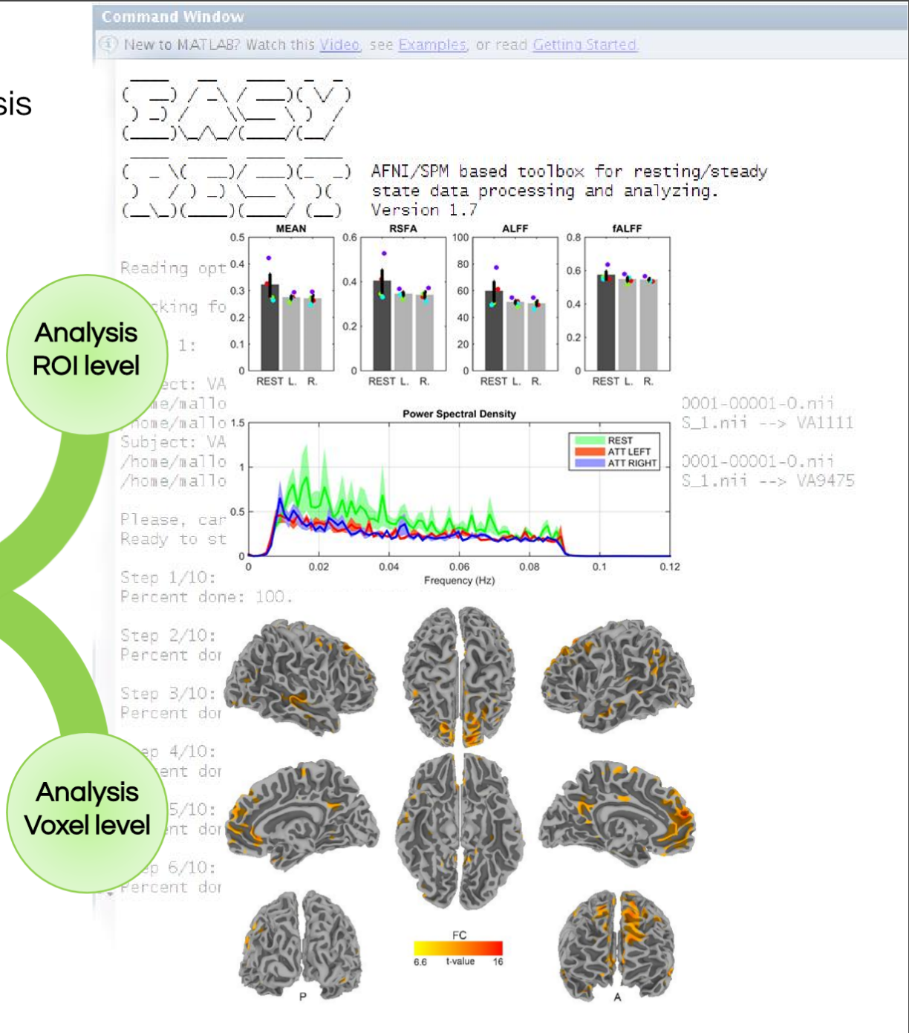
PLAN 2017-2019: PAMINA
(funds: Regione Lazio)
PAMINA: Infrastructural platform
Objective: to improve research in clinical neuroscience by means of a high performance platform, allowing several advanced processing approaches
  Implementation: software section
  Validation
  Application to multiple brain diseases
  “Open doors” in Autumn 2017
FG, TG, FP, FM, FA, coll. Fondazione Santa Lucia and others

Slide 21
Expected funding in the 3-year period:
Request of funding by Centro Fermi
Grants : complement the external grants, in order to have always at least 4 researchers involved (one senior, 3 postdocs) => 2017: +1 from August (ideally +2, including needs of MICROBRADAM)
Consumables/inventory per year: about 10 k€+ contribution for the organization of the biennial Erice Workshop (next date: 22-29 April 2018)
External funding, current
PAMINA (PI Federico Giove), ends 2018. k€ 862
H2020 691110 MICROBRADAM (PI Federico Giove), ends 2019. k€ 175
MDS GR-2013-02358177 (PI Michela Fratini), ends 2019. k€ 382
From industry (EMS), una tantum, k€ 9
From Fondazione Santa Lucia and CMRR, in kinds: k€/yr about 50
Potential external funding, future
Regione Lazio Research groups grant, applied for (APPREND)
H2020: ERANET precall, FET open (January 2018)
Other h2020 (Health, MSCA)

