Slide 1



Photonic Microcavities
Microcavità Fotoniche (MiFo)
Project Leader: Giancarlo Righini
Coordinator: Gualtiero Nunzi Conti
Participants:
Coccetti, Fabrizio primo tecnologo Centro Fermi
Cosci, Alessandro* assegnista Centro Fermi (07/2014 – 07/2017)
Enrichi, Francesco** assegnista Centro Fermi (04/2016 – 04/2018)
Ferrari, Maurizio CNR, associato al Centro Fermi
Gianfreda, Mariagiovanna§ assegnista Centro Fermi (12/2016 – 12/2018)
Nunzi Conti, Gualtiero CNR, associato al Centro Fermi
Pelli, Stefano CNR, associato al Centro Fermi
Quandt, Alexander Wits Univ., associato al Centro Fermi
Righini, Giancarlo associato al Centro Fermi
Zur, Lidia** assegnista Centro Fermi (12/2015 – 12/2018)
* also with TFB project (2017) § also with PATISS project (2017)
** also with PLANS project (2017)

Slide 2
Photonic Microcavities
Places of Work & Collaborations:
CNR – IFAC (Istituto di Fisica Applicata Nello Carrara), Sesto Fiorentino
CNR – IFN (Istituto di Fotonica e Nanotecnologie), Unità di Trento
CNR – NANO (Istituto Nanoscienze), Pisa
Dipartimento di Scienze Molecolari e Nanosistemi, Università Ca' Foscari Venezia
Dipartimento di Ingegneria Industriale, Università di Padova
ENSSAT, Université de Rennes 1, Lannion (Francia)
Luleå University of Technology, Luleå (Svezia)
School of Physics, University of Witwatersrand, Johannesburg (Sud Africa)
Washington University at Saint Louis, Missouri (USA)

Slide 3
Photonic Microcavities
Background
2 previous projects TFB: Tecniche Fotoniche per Biomedicina [biosensing with Whispering Gallery Mode Resonators (WGMR)]
  PLANS [photonic materials and systems for more efficient solar cells]
Strong experience at IFAC-CNR on WGMR for parametric and non-parametric NL optics, RF photonics, active gain control; at IFN-CNR on passive and active optical materials and on photonic crystals.
Goals
Short term (2017/18): photonic microcavities with focus on WGMR or integrated optical resonators and photonic crystals. Two main topics:
  PT-Symmetric Systems in Photonics: the PATISS (PArity TIme Symmetric Systems) project is being carried on by a CF fellow (MG)
  Development of THz sensors based on WGMR
Second phase (2018-2019): other topics will be faced, including:
  new photorefractive materials
  synthesis of quantum nano-objects
  quantum information and shaped light

Slide 4
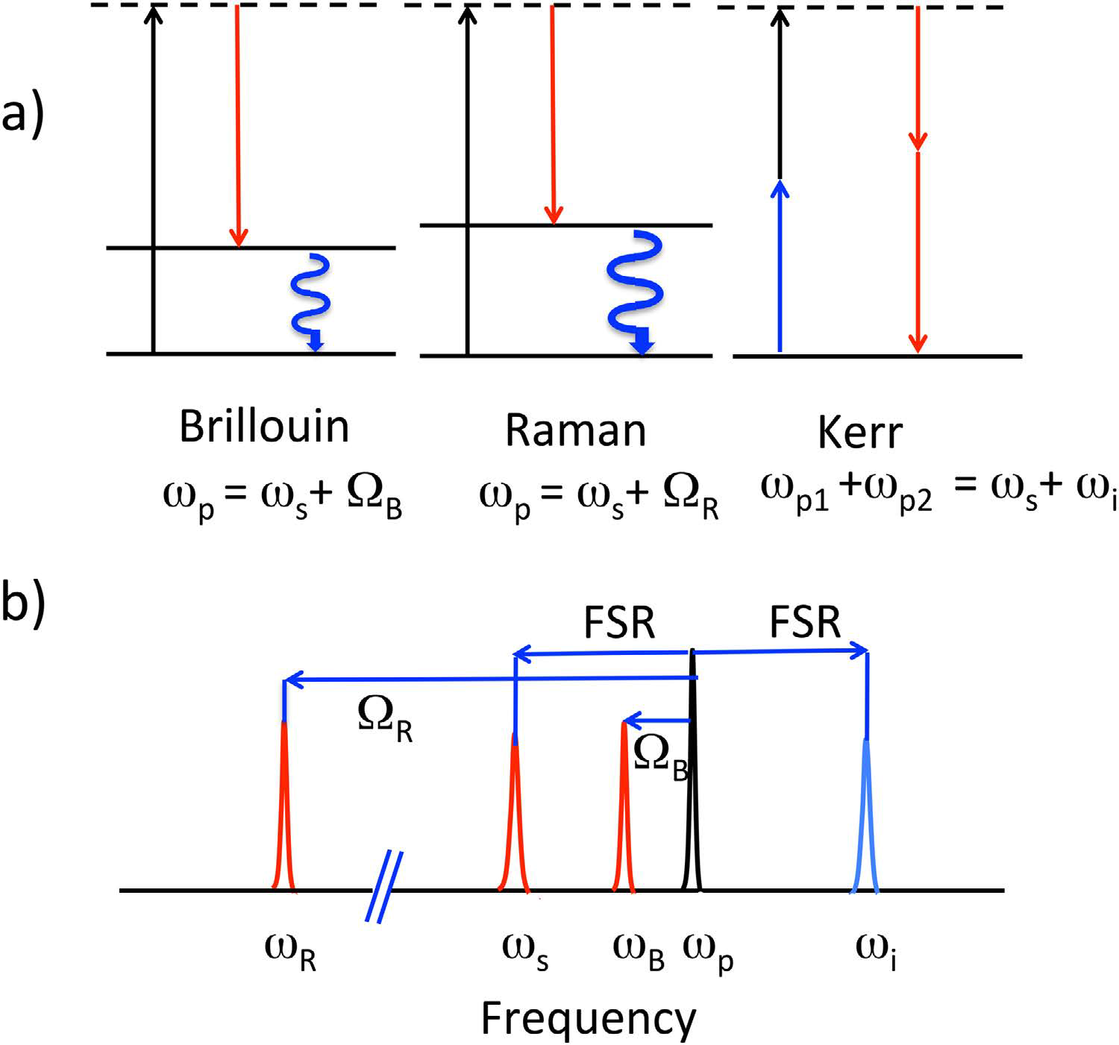



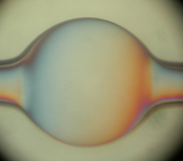
Photonic Microcavities
Background: non-parametric and parametric third order NLO in SiO₂
Raman Scattering Δν_{R}= 10 THz, BDW_{R}= 5 THz, g_{R}
(interaction with an optical phonon)
Brillouin Scattering Δν_{B}= 10 GHz, BDW_{B}= tens of MHz, g_{B}= 500 g_{R} (interaction with an acoustic phonon)
Four Wave Mixing: hyperparametric interaction g_{P}= 2 g_{R}
MM fiber
Att
TLD
1.55 μm
EDFA
OSA
Polarizer
DET
SCOPE
Notes:
@ 1550 nm

Slide 5
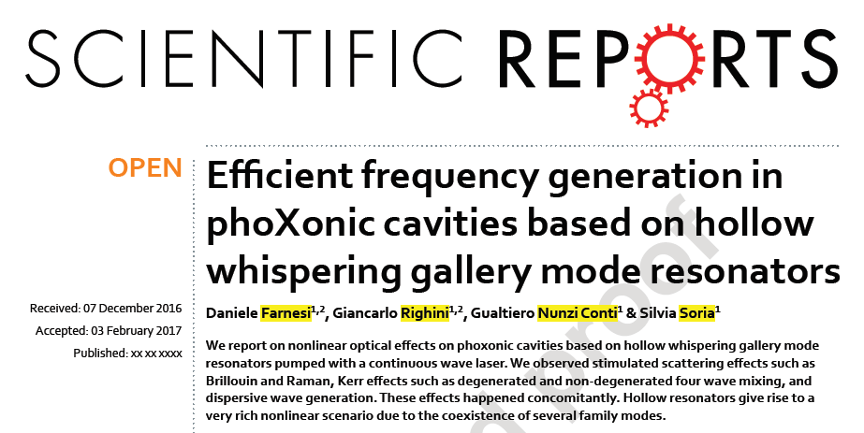
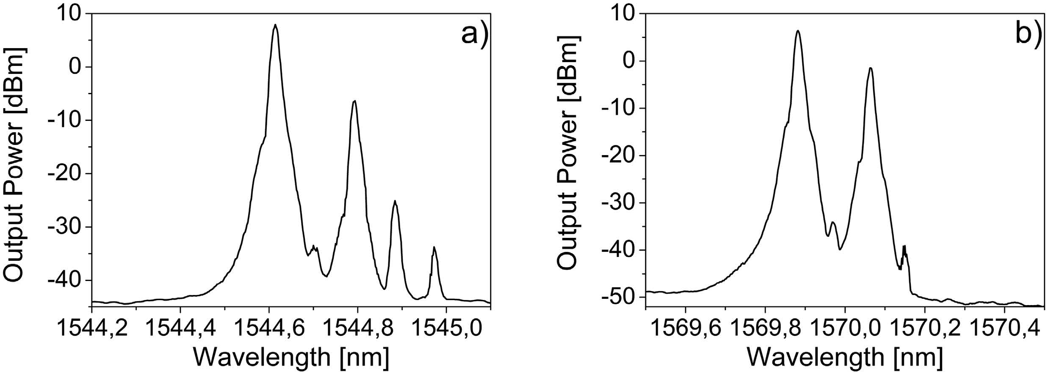
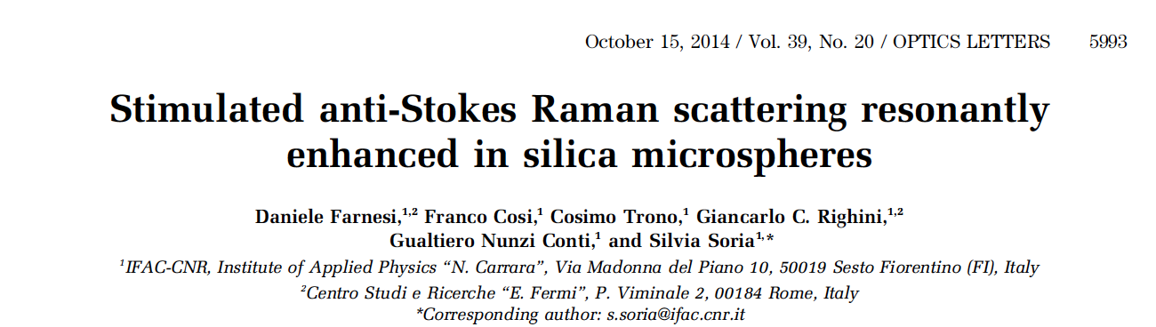
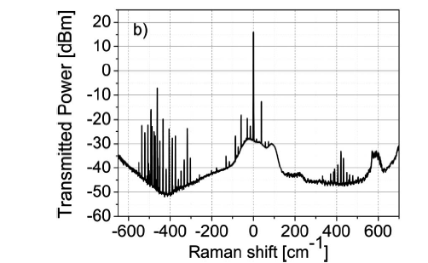
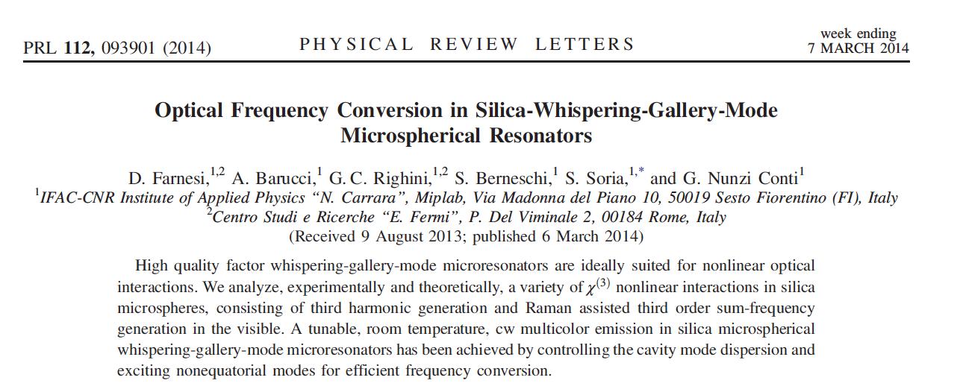
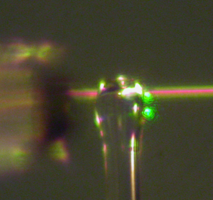
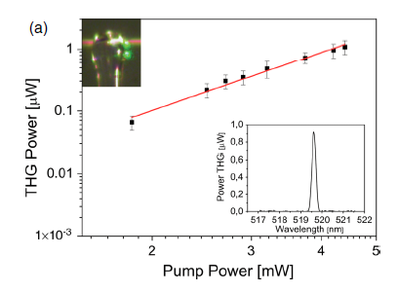
Photonic Microcavities
Background, NLO with WGMR

Slide 6
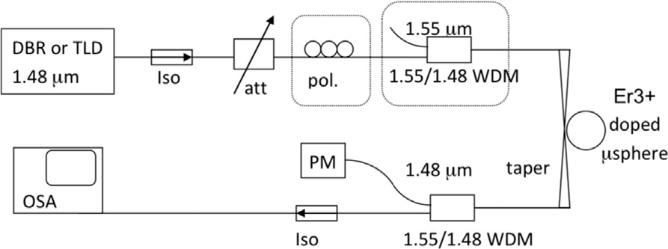
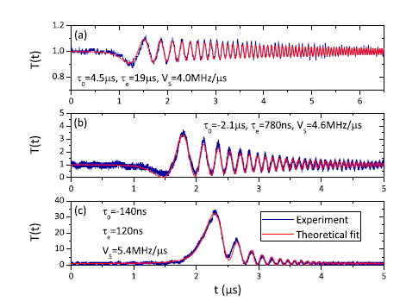
Photonic Microcavities
Background: amplification in WGMR
Lasing and selective amplification in Er³⁺ doped microspheres

Slide 7
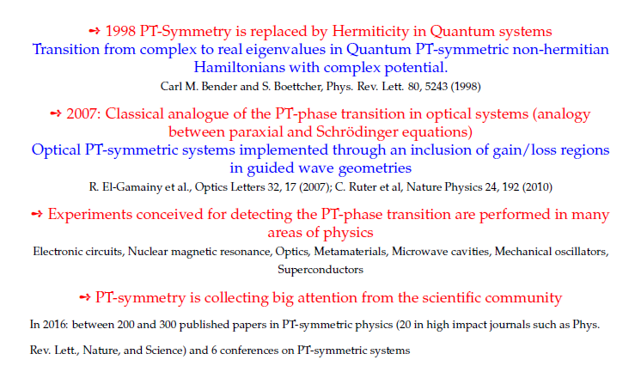
Photonic Microcavities
PATISS PT-symmetry from Quantum to Experimental Physics

Slide 8
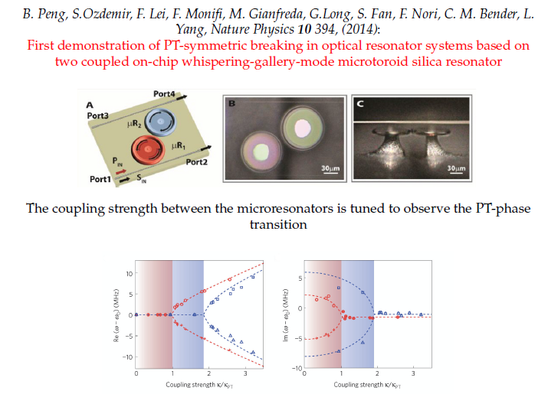
Photonic Microcavities
PT -phase transition in optical resonators

Slide 9
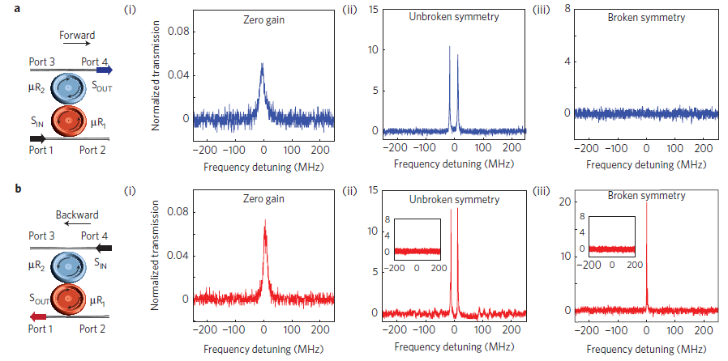
Photonic Microcavities
PT -phase transition in optical resonators

Slide 10
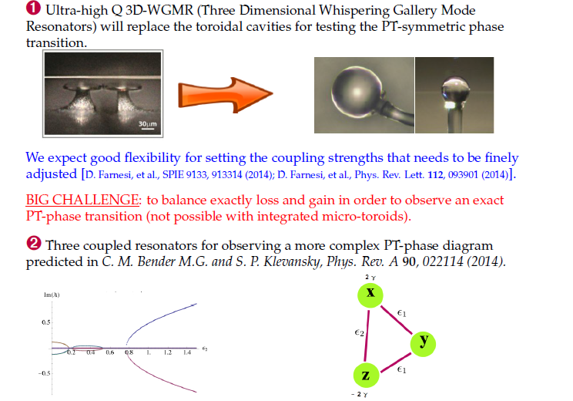
Photonic Microcavities
PATISS - Proposed experiments at CNR IFAC

Slide 11
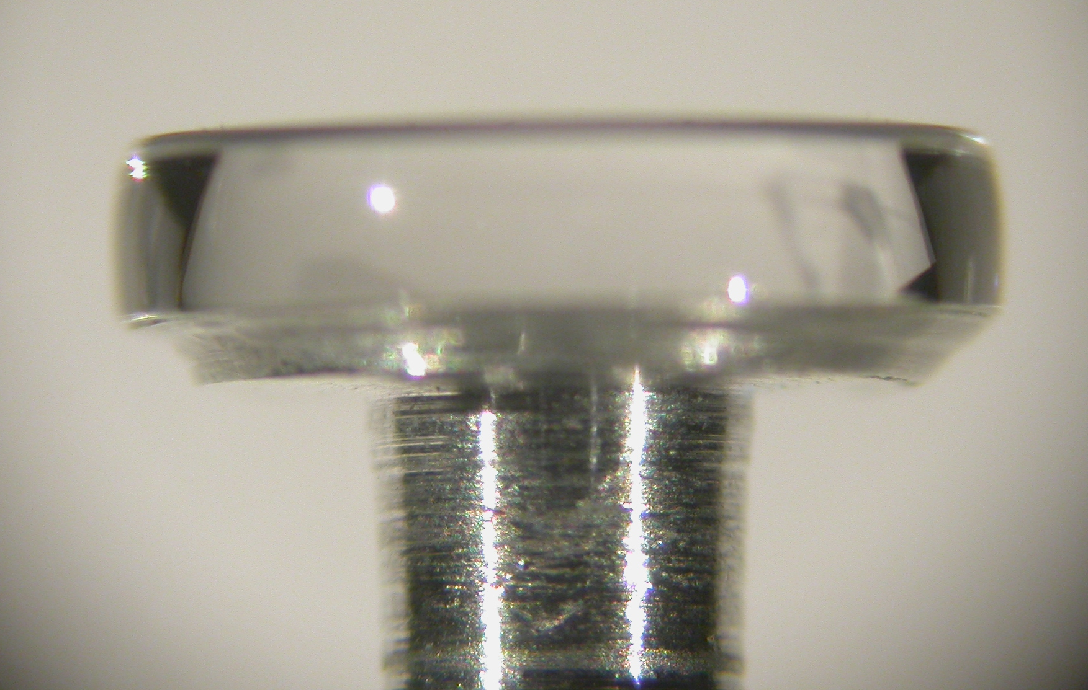
Photonic Microcavities
Background: thermal effects control in WGMR
Thermal effects in LN disks
  state of the art high Q (>10⁸) lithium niobate disks
  coupled to LN waveguides
The differential shift can be assessed

Slide 12
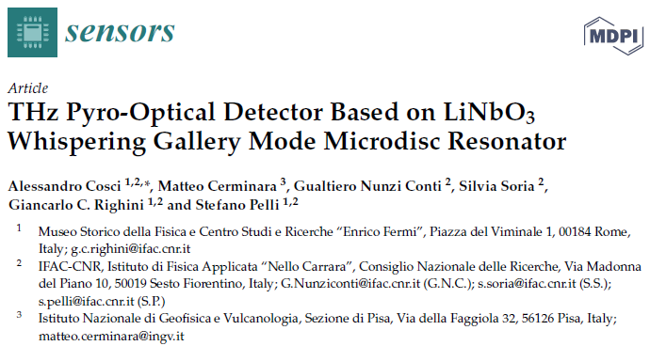
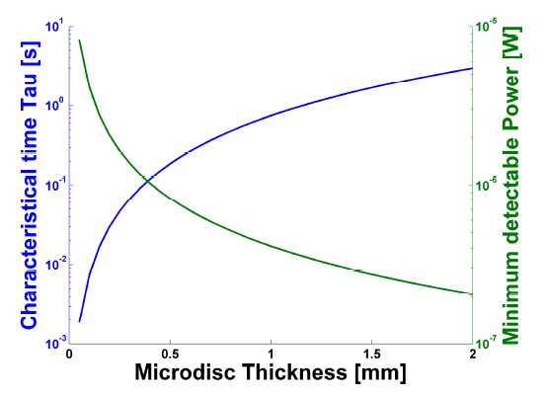


Photonic Microcavities
(THz sensors)
Thermal drift Δλ/λ(°K⁻¹) can be induced by THz light absorption in LN
3.1·10⁻⁵ for TE mode (shift is 48.5 pm°K⁻¹ or −6.06 GHz/°K⁻¹)
1.5·10⁻⁵ for TM mode (shift is 24.0 pm°K⁻¹ or −3.00 GHz/°K⁻¹)
But pyro-electric charges also contributes to a refractive index variation $∆n_{py}$
$$∆n_{py}=−\frac{1}{2}n^{3}∙r_{eff}∙E_{py}$$
$$E_{py}=−p\frac{∆T}{ε_{r}ε_{o}}$$

Slide 13
Photonic Microcavities
Expected funding in the 3-year period:
Request of funding by Centro Fermi
Grants (number and period requested):
- none in 2017
- 2 renewals in 2018 (Gianfreda and Zur) + 1 new Grant (2018-2019)
Consumables/inventory per year
5,000 € in 2017; 25,000 € in 2018 and 2019
Potential external funding
Collaborating CNR Institutes and Universities co-fund the research in-kind, by covering the cost of their personnel (besides the listed collaborators) and of the laboratories which are made available for the research activities (estimated total 40 K€/year).
Application to external Calls for proposals (Italian or EU) is envisaged.

