Slide 1
Quark-Gluon Coloured World ALICE
Project Leader: A. Zichichi, L. Cifarelli
Participants:
Place of Work & Collaborations:
Andrea Alici TOF System Run Coordinator, Beam Condition convener
Francesca Carnesecchi PhD student
Despina Hatzifotiadou outreach convener (also in EEE)
Luisa Cifarelli
Fabrizio Coccetti
Daniele De Gruttola DQM Coordinator (also in EEE)
Francesco Noferini PID convener
Rosario Nania
very strong connection with the other TOF institutes, Bologna and Salerno
(about 30 researchers)
ALICE is one of the big 4 experiments at LHC at CERN
~900 signatures, > 140 institutes in Europe, America, Asia, Africa
strong collaboration with University of Salerno, Bologna and Kangnung and ITEP
other institutes working in ALICE: INFN and Università of Alessandria, Bari, Bologna, Cagliari, Catania, LNF, Padova, Pavia/Brescia, Salerno, Torino, Trieste

Slide 2
Quark-Gluon Coloured World ALICE
QCD predicts a phase transition into a state where quarks and gluons are deconfined under extreme conditions of temperature and/or net baryon density
QGCW is a world totally different from our world made of QCD vacuum with colourless baryons
and mesons and totally unexpected phenomena may show up
…...
are the coloured quark masses the same as the values we derive from the fact that baryons and
mesons need to be in a colourless state?
See A. Zichichi Nuclear Physics A 805 (2008) 36c–53c

Slide 3
ALICE in Run 2

Slide 4
ALICE in Run 2

Slide 5
ALICE in Run 2
ALICE setup improved during Long Shutdown 1
TRD completed (5 modules)
PHOS completed (4th module)
CPV (Charged Particle Veto) added
DCal installed back-to-back to EMCal
ALICE Diffractive detector (AD)
installed on each side (4.9<η<6.3 and -7<η<-4.8)

Slide 6
Data recorded in Run 2

Slide 7
ALICE performance
excellent PID capabilities down to p~100 MeV/c in the central barrel (almost all known detection techniques)
jets in Pb-Pb collisions (EMCal - DCal)
excellent track impact parameter resolution for reconstruction of secondary vertices
quarkonium measurements down to p_{T}=0
centrality determination
charged-particle multiplicity measurement over a wide rapidity range

Slide 8
ALICE highlights
Bulk particle production: charged-particle multiplicity
~20% increase in central (0-5%) Pb-Pb collisions at √s_{NN}= 5.02 TeV compared to √s_{NN}= 2.76 TeV
measurement consistent with trend from lower energies
Bulk particle production: identified particle spectra (ITS, TPC, TOF, HMPID used for PID)
spectra become harder with increasing centrality
largest expansion velocity ever measured
parameters follow trends from lower energies
Identified-particle nuclear modification factor
R_{AA} at high p_{T} significantly < 1 for central collisions indicates strong medium effects
Heavy-flavour production: open-heavy-flavour nuclear modification factor
Heavy quarks are produced at early collision stages, and cross the hot and dense medium before
hadronising → “x-ray” of the medium
similar suppression as at 2.76 TeV
much reduced uncertainties → better constraints for models
(details in the back up)

Slide 9
ALICE highlights
Heavy flavour production: J/ψ and ψ(2S) nuclear modification factor
quarkonium suppression by colour screening
excited states suppressed at lower temperature (sequential suppression) → “thermometer”
of the plasma
flat R_{AA} vs centrality for high centralities compatible with regeneration scenarios
larger suppression for ψ(2S) wrt J/ψ
Heavy flavour production: Y and Y(2S) nuclear modification factor
quarkonium suppression by colour screening
excited states suppressed at lower temperature (sequential suppression) → “thermometer”
of the plasma
flat R_{AA} vs p_{T}→ no clear signature for regeneration
larger suppression for Y(2S) wrt Y
Vector meson photo-production: ultra-peripheral collisions (UPC)
data seem to prefer a scenario with moderate gluon shadowing (Pb-Pb collisions)
study of gluon saturation in the proton (p-Pb collisions)
(details in the back up)

Slide 10
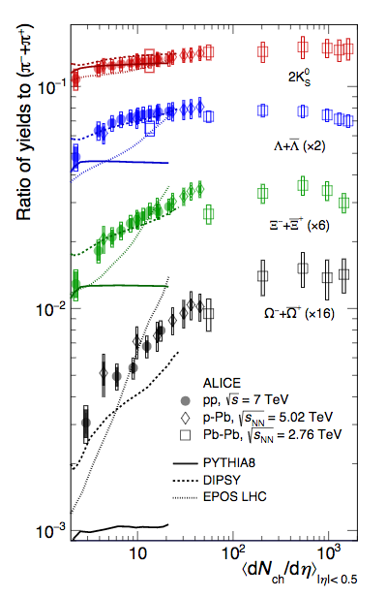
Quark-Gluon Coloured World ALICE
Run I, √s = 7 TeV
Particle ratios vs multiplicity: pp, p-Pb, Pb-Pb
striking similarities across different systems
similar ratios in pp, p-Pb and Pb-Pb
smooth evolution of particle ratios as a function of multiplicity, regardless of the collision system
hint for collectivity in small systems
enhancement of strangeness production relative to non-strange towards high-multiplicity pp and p-Pb

Slide 11
Quark-Gluon Coloured World ALICE

Slide 12
Quark-Gluon Coloured World ALICE

Slide 13
Quark-Gluon Coloured World ALICE
Plan of activity 2017-2019
data taking with proton-proton at 13 TeV TOF hardware/online-offline software, shifts
data taking with proton-proton at 5 TeV as reference run for 2015 and 2018 Pb-Pb run:
TOF hardware/online-offline software, shifts
data taking with Pb-Pb at 5 TeV (2018): TOF hardware/online-offline software, shifts
calibration/analysis of 2016 pp and p-Pb data at 5.0 and 8 TeV:
basic measurements for PID-spectra, resonances, centrality dependence, UPC
finalize Run 1 data analysis:
K* production in p-Pb, deuterium production vs multiplicity, Λ_{c} production in pp and pPb,
effective energy
TOF paper in preparation:
T_{event} determination + T_{TOF} with clustering
data analysis with new data: PID-spectra, resonance production, Λ_{c} production in Pb-Pb with
improved event-by-event Bayesian PID, UPC, light nuclei-antinuclei production, exotic states
(di-baryons, tetraquarks....)
TOF upgrade: new readout modules construction (prototype finalized in 2016)

Slide 14
Quark-Gluon Coloured World ALICE
possible links to other projects (internal or external to Centro Fermi):
expected funding in the 3-year period:
EEE Exchange of knowledge on MRPC operations
ALICE is one of the big experiment at CERN LHC so naturally linked to an international
network of laboratories
request of funding by Centro Fermi
70 k€/year, including:
- 35 k€ MOFA-ALICE contribution
- 15 k€ Consumables/stores and missions 20 K€ Contribution for Common Fund Upgrade
1 Grant
co-funding
INFN contributes to missions expenses and TOF maintenance/upgrade

Slide 15
Quark-Gluon Coloured World ALICE
expected Products
impact of the research and outreach initiatives
several pubblications in scientific journals
6 over 20 most cited paper on LHC are from ALICE
seminars/visits with schools (~4000 visitors per year)
MasterClasses
activities with elementary schools
activities with high-schools
activities with local communities
newsletters
social media
brochures, posters, videos, photographs
exhibition at Point 2 (experiment site)

Slide 16
back up

Slide 17
Quark-Gluon Coloured World ALICE

Slide 18
Quark-Gluon Coloured World ALICE

Slide 19
Quark-Gluon Coloured World ALICE

Slide 20
Quark-Gluon Coloured World ALICE

Slide 21
Quark-Gluon Coloured World ALICE

Slide 22
Quark-Gluon Coloured World ALICE

Slide 23
Quark-Gluon Coloured World ALICE

Slide 24
Quark-Gluon Coloured World ALICE

Slide 25
Quark-Gluon Coloured World ALICE

