Slide 1

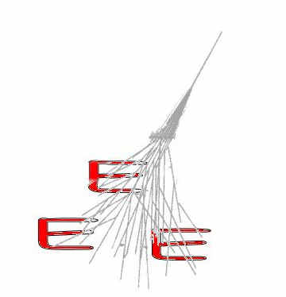
Extreme Energy Events
la Scienza nelle Scuole
Scienfic responsible: prof. Antonino Zichichi
Coordinator: Marcello Abbrescia
Participants: 87 people among which:
2 borse di studio CF
7 assegni di ricerca CF
1 researcher + 1 tecnologo t.i. CF
(see list in the slides at the end of the talk)
Place of Work & Collaborations:
Centro Fermi + 17 INFN sections and/or Physics Departments + CERN + INFN/CNAF + around 100 high schools in Italy

Slide 2
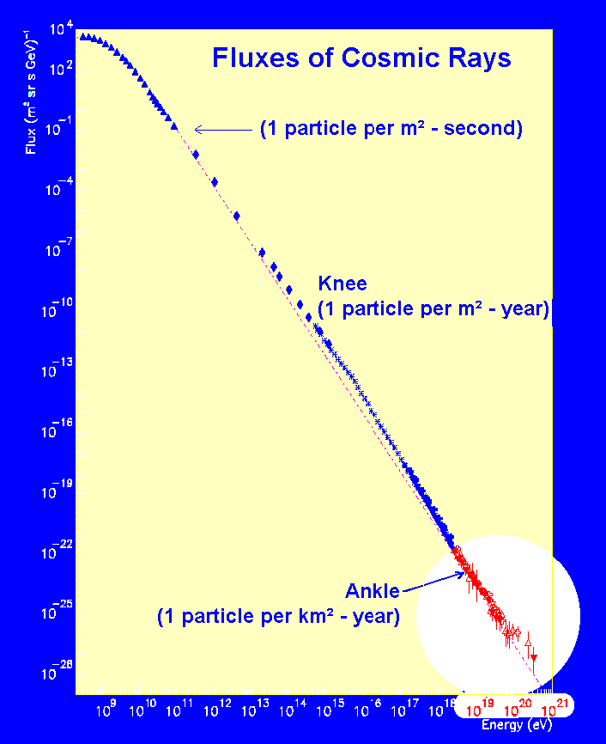
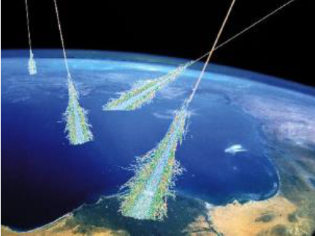
EEE: scientific goals
Aims at covering the most interesting, and still unexplored, region of the cosmic ray spectrum
EAS revealed by the time coincidence of cosmic muons detected in EEE telescopes

Slide 3
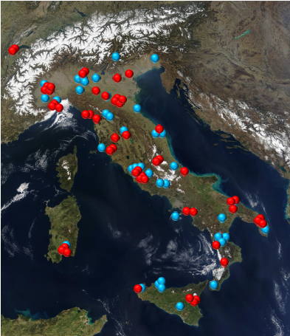
EEE: present status
46 telescope at High Schools
+ 2 telescopes at CERN
+ 4 at INFN Units
Total: 52 telescopes
Another ≈ 50 schools in the waiting list
- Largest (in terms of area) system using MRPCs
Largest cosmic rays experiment in Europe
Stations in operation
Schools on the waiting list

Slide 4
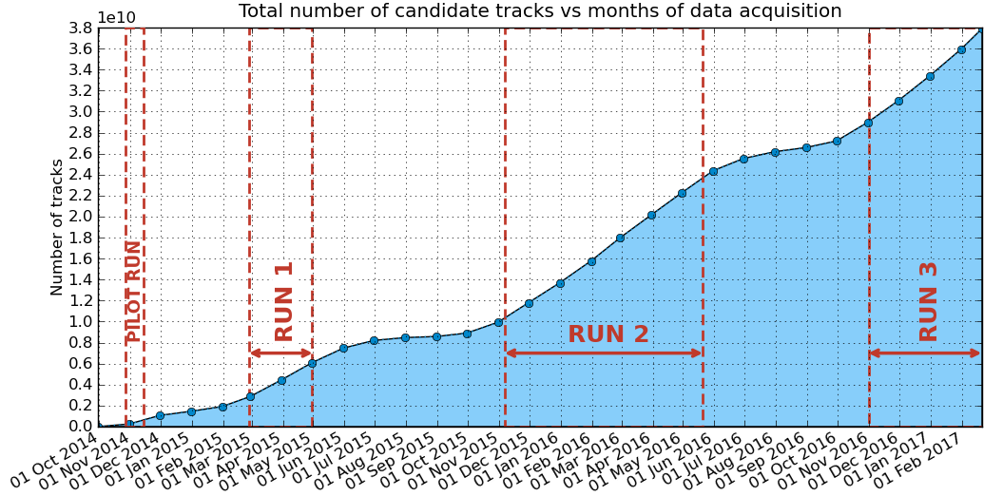
EEE: data taking
Almost 40 billions candidate tracks collected!
Since 2014 EEE organizes coordinating runs, with all stations taking data at the same time

Slide 5
EEE: improvements in data flow
Recently the 100 Mtracks/day threshold reached!
Reconstrution chain upgraded in 2016, and all data reconstructed again with Analyzer 2.0
Handles multi-tracks
improves the data flow (directly produces .root file for DQM and analysis)
Data transfer tool (from schools to CNAF) upgraded
From BtSync to SyncThing

Slide 6
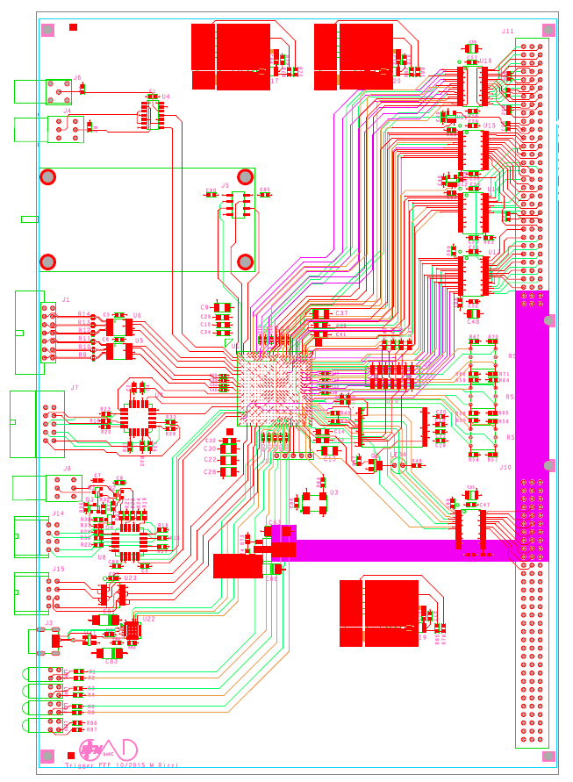
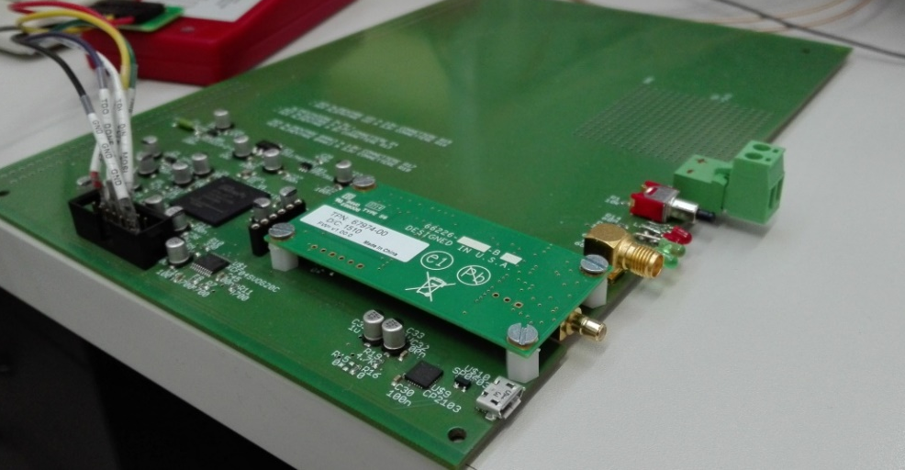
EEE: new trigger/GPS card
Joins the functionalities of the present trigger
board and GPS (+ GPS interface)
Simplification of the system
Cost reduction (almost a factor 10)
More functionalities
(clock distribution, VME remotely accessible,
Trigger programmable via VME)
One board already installed and working at LODI-02
(with external GPS)
Libraries to read GPS and integrate into
the EEE DAQ in preparation
Seven more boards under construction
Board layout
Piggy back GPS

Slide 7
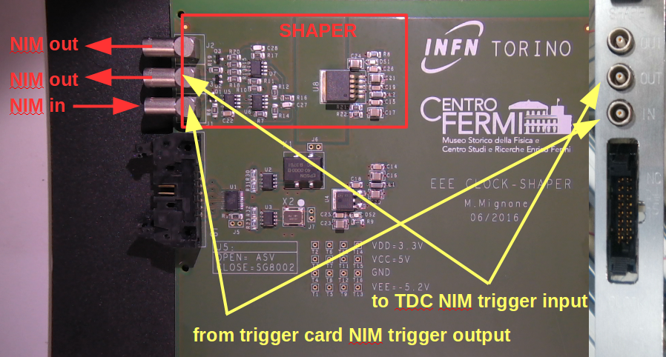
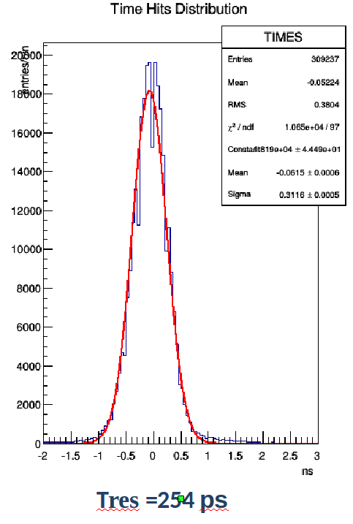
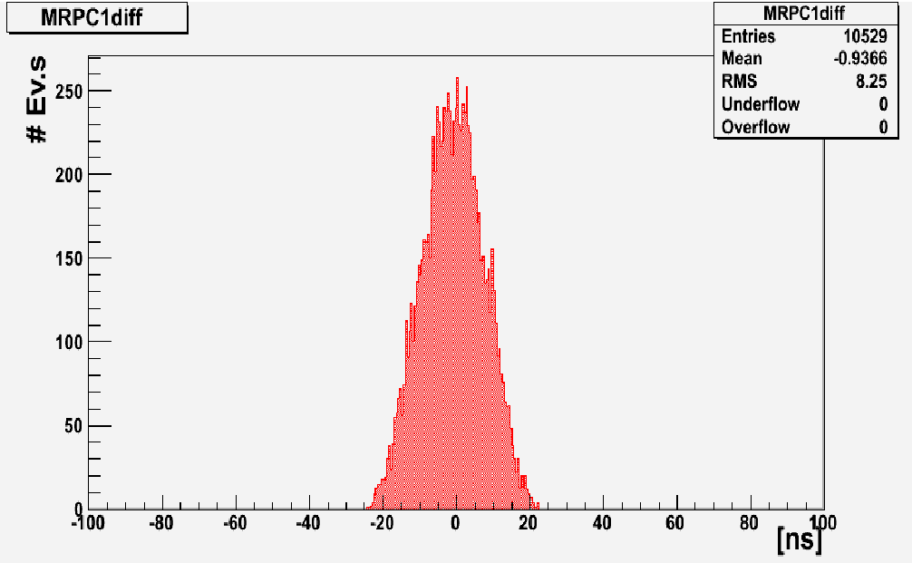
EEE: clock distribution card
Designed at INFN Torino
Distributes the same clock at the two
TDC of the EEE readout
Built and installed in all EEE telescopes
Works perfectly
Essential for exploiting time
info from middle chamber
σ_{t} ≈ 8 ns
σ_{t} ≈ 0.25 ns

Slide 8
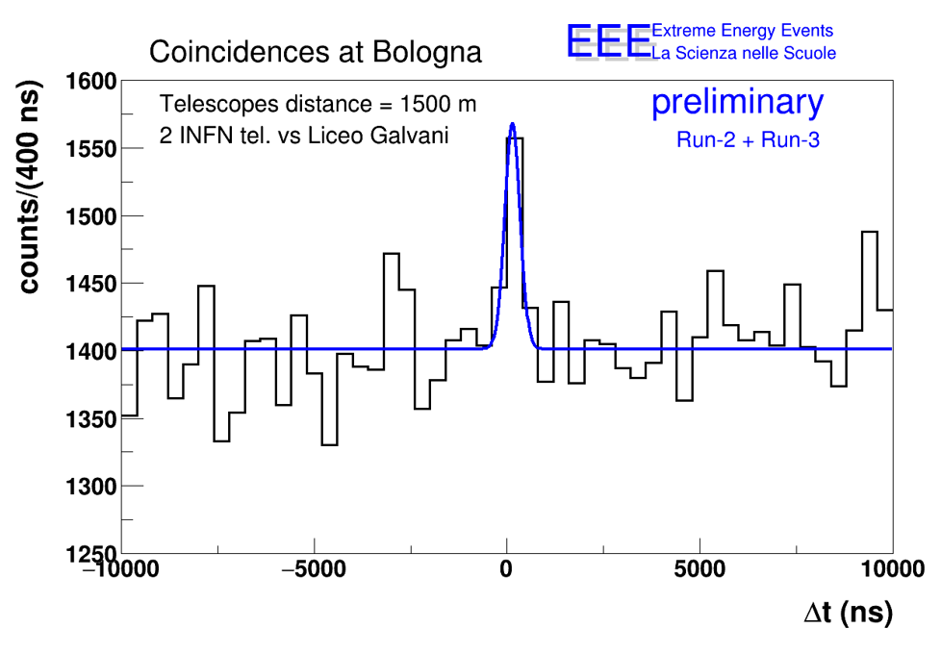
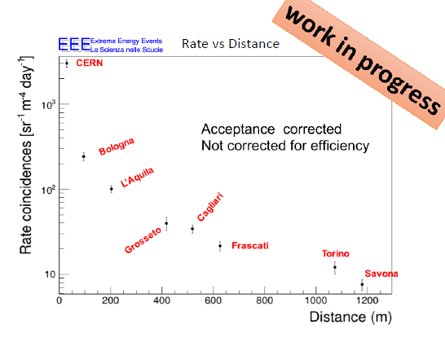
EEE: coincidences search
Detected coincidences at 1.5 km
Higher distance → higher energy
Coincidence rate vs. distance
Each cluster is sensitive to showers
of Energy high enough to involve both
stations
Need an accurate Monte Carlo
Simulate shower development
Simulate environmental effects

Slide 9
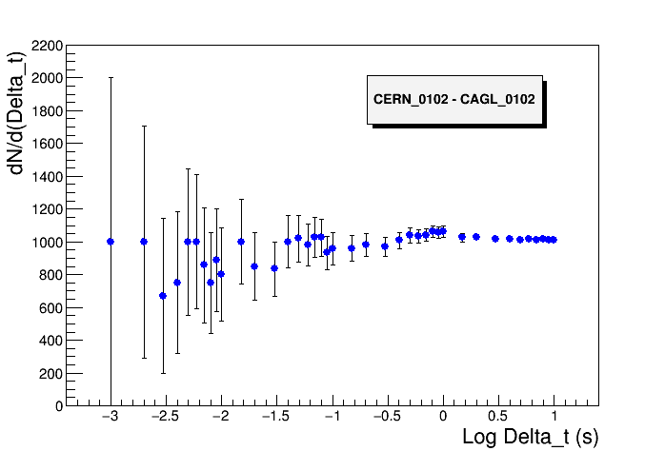
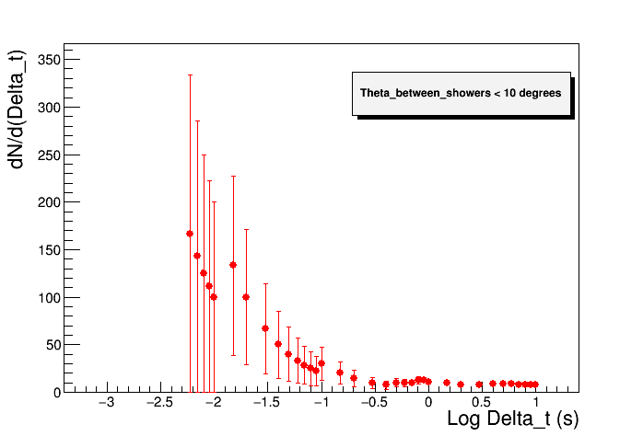
EEE: long distance correlations
Strategy: correlations between individual showers in telescopes clusters
Shower rate: 0.001 - 0.04 Hz (depending on cluster and S/N ratio)
Spurious rate in 1 ms: 10⁻⁸ - 10⁻⁷ Hz (0.001 - 0.01/day)
Number of events dN/d(Δt) for decreasing time window
No cut on relative angle between showers
Cut on relative angle< 10
Not the same results for all pairs of clusters: studies ongoing!
10 ms

Slide 10
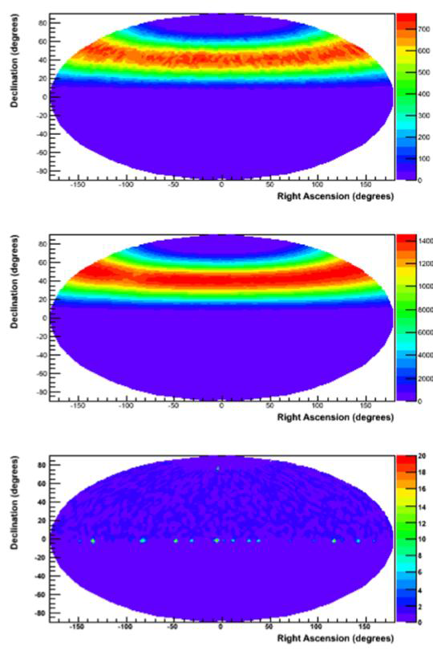
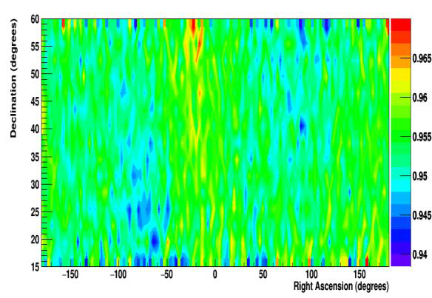
EEE: search for cosmic anysotrophies
Analysis on about 100 Mtracks collected by four EEE telescopes
Mostly sub-TeV events
Corrected data maps compatible with an isotropic distributions at 1% level
Raw data
Scrambled data
for reference

Slide 11
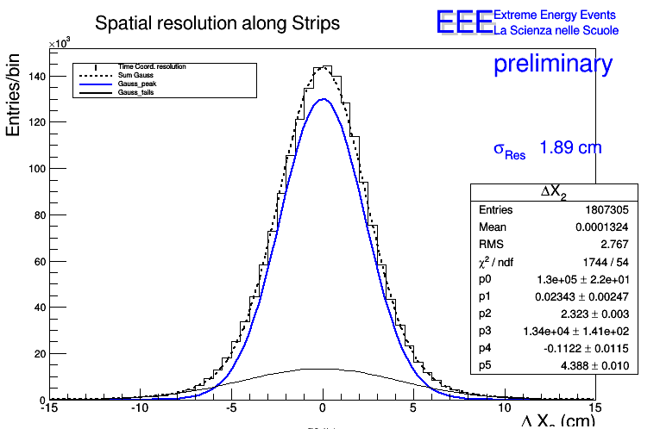
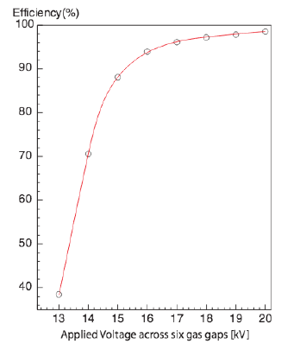
EEE: chamber and telescopes performance
Investigating on chamber performance:
HV scan performed in May 2016, to be
Repeated in 2017
Efficiency, time and spatial resolution

Slide 12
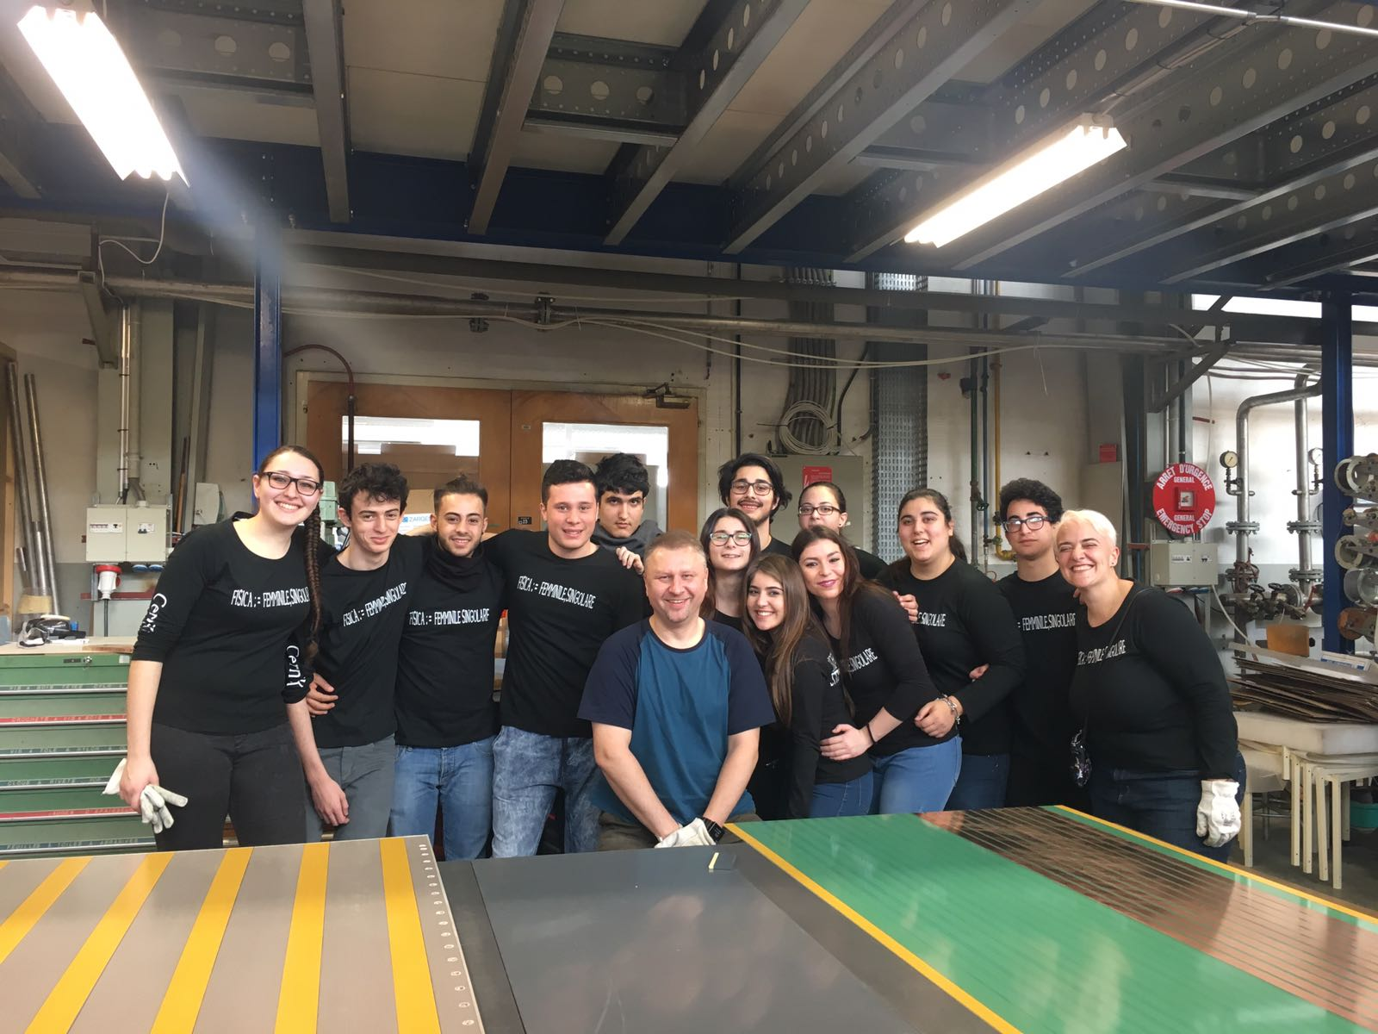
EEE: network upgrade
Plans to build another ≈ 20 telescopes
Will increase the capability of the EEE network to
study the high-energy part of the cosmic rays spectum
Huge effort for 2017-18!
First bunch already on going:
20-27 February → Lampedusa
12-18 March → INFN Genova
2-8 April → SIEN-02
23-29 April → Cariati
7-13 May → TORI-05
21-27 May → LODI-03
9-15 July → CAGL-04
Second bunch in autumn (4-5 other stations)
Some of the stations built with local contribution (INFN sections…)

Slide 13
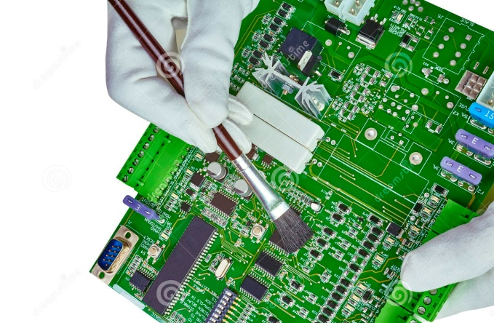

EEE: new chambers for new telescopes
250 µm gap chambers for the new telescopes
Conceived for new eco-friendly gas mixtures
Reduce operating voltage (good!) and loose some primaries (not so good)
Maybe some 300 µm chambers for old telescopes
Improved front-end boards
Amphenol cables and connectors replaced by Nugent ones
Design complited, pre-production to start soon
Test protocol at CERN for new chambers
Each chamber will leave CERN after certification
Tests on gas tightness
Tests on electrical (strip) connectivity (Bossini’s magic box)
Tests on current, rate and efficiency vs. HV (probably using NIM electronics and CERN-01)
Everything stored in a dedicated DB

Slide 14

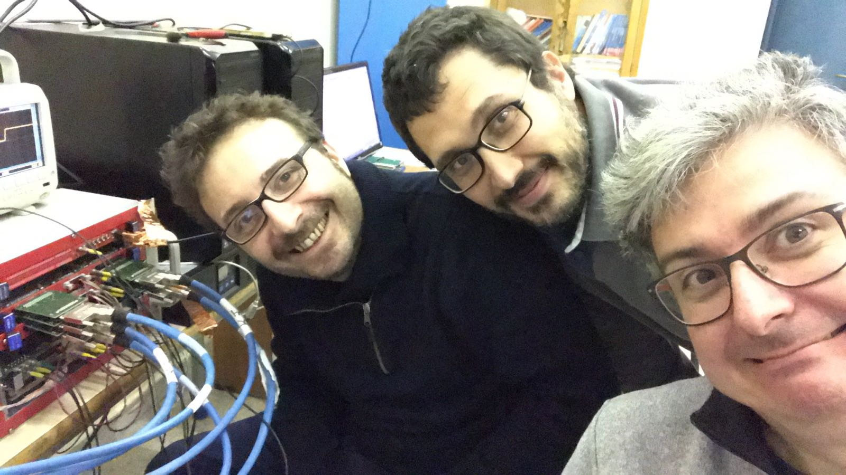
EEE: the taskforce
A task force of hardware experts, to intervene where setting up/commissioning/reparation of an EEE telescope is needed
Started activity at beginning of 2017
Already interventions at:
TREV-01 (commissioning, now telescope
taking part to the data taking)
VICE-01 (telescope set-up, waiting for trigger card)
ROMA-01 (testing and repairs)
FRAS-02, FRAS-03 (small repairs, now both telescopes taking part to the data taking)
Programming interventions at ROMA-02,
LECCE

Slide 15
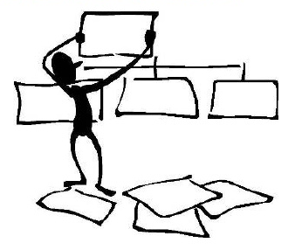
EEE: new organization
Need to assign specific tasks to optimize work and workflow,
in particular for the following positions:
Technical coordinator
Responsible for material management (DataBase)
and distribution to the EEE stations
Run coordinator
Responsible for assuring a smooth data taking, spot possible problems at specific stations and contact local responsibles
Upgrade coordinator
Responsible for all activities related to the upgrade of the EEE network, in particular new chambers construction and testing

Slide 16
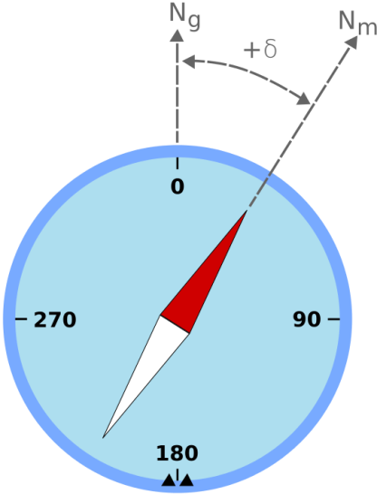
EEE: new organization
Editorial Board and Conference Committee
Responsible(s) for reviewing the papers and actively make sure that EEE researchers have the possibility to present at conferences
EEE local responsibles (alread existing)
EEE researchers taking care of the telescopes in his/her zone
EEE local school responsibles (already existing)
High school teachers taking care of the telescope
in his/her school
EEE zone school responsibles (new)
High school teachers taking care of coordinating measures performed by schools and needed by the EEE collaboration (i.e. measure of the telescope angle wrt. North), and improve collaboration among schools

Slide 17
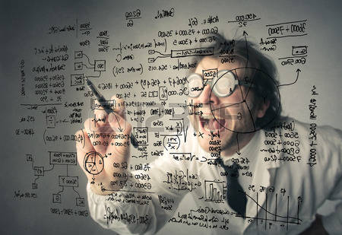

EEE: physics studies groups
Five analysis/reconstruction groups (each with the relative responsible)
Reconstruction and Data Quality Monitoring
Responsible for the whole data chain, from schools to CNAF
Coincidence searches
…and study the cosmic rays spectrum
Forbush or cosmic flux local variation searches
Chamber and telescope performance evaluation
“Exotica”
all the rest, Moon/Sun shadow, cosmics anisotropy, …
They report on rotation at the EEE general meetings

Slide 18
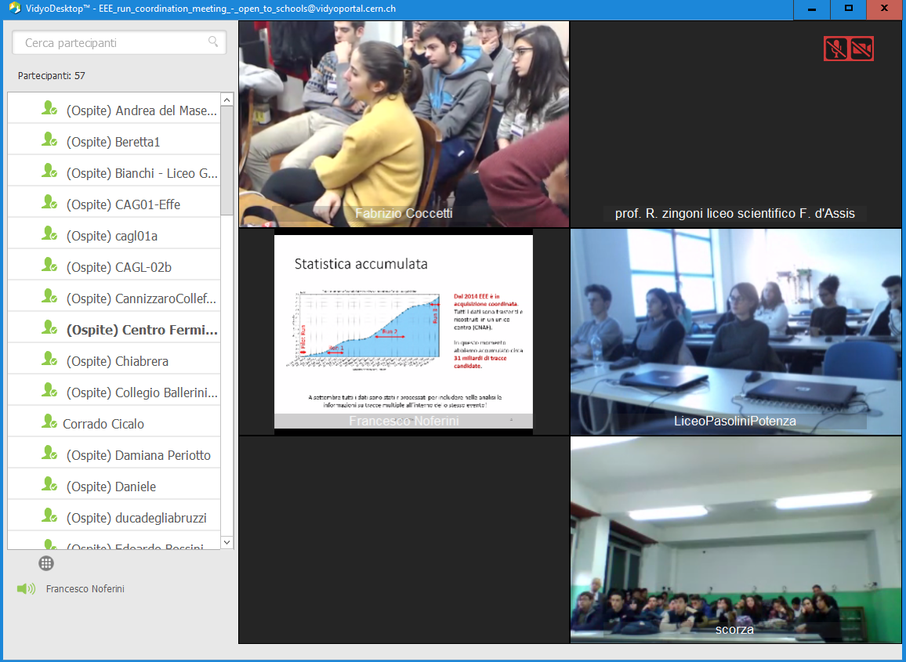
EEE: outreach
Since end of 2016 monthly EEE run coordination meetings open to schools
Using Vidyo room dedicated virtual rooms
Among 50-60 schools connected → hundreds of partecipants!

Slide 19
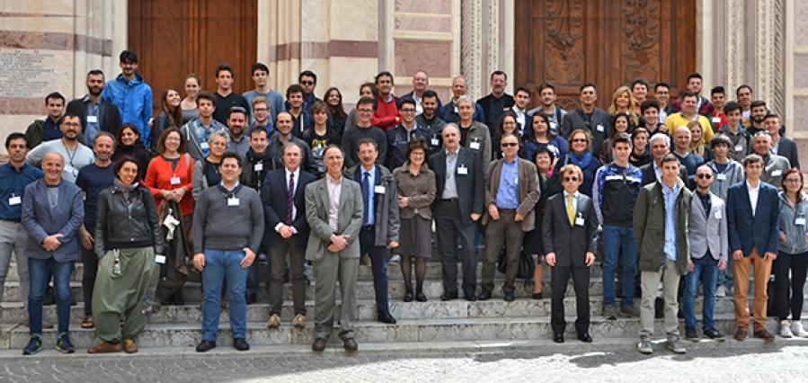
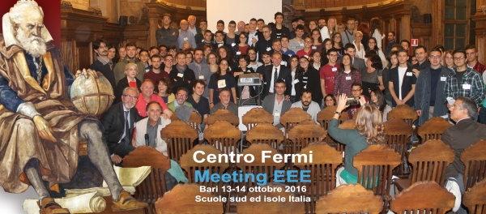
EEE: outreach
Since the beginning “plenary” meetings open to schools:
Bologna, November 6-7
North Italy schools
Grosseto, April 15-16
Center Italy schools
Bari, October 13-14
South Italy schools
For 2017 foreseen two meetings at Erice:
May, 29, 30 and 31
December, 6, 7 and8

Slide 20

EEE: funding
Expected funding in the 3-year period:
Request of funding by Centro Fermi
Consumables/inventory: Stay at the current level
Grants: needed a couple more units for the upgrade
- Potential external funding
In 2014 funding for 1.3 M€ from Bandi Premiali 2012 MIUR → Upgrade
Schools contributing in-kind
Request for funding (around 1.4 M€ ) presented for a EEE project upgrade aiming to put part of the EEE data in “open access” mode in the framework of Bandi Premiali 2016 MIUR
Project presented by one of EEE collaborators to study long distance correlations using the EEE network and other experiments in the framework of the ERC “Consolidator grants” (around 2 M€)

Slide 21


EEE: external collaborations
EGO-VIRGO collaboration interested in having one (or more) EEE telescopes hosted at their lab in Cascina
As a veto for cosmic ray showers in coincidence with possible signals coming from gravitational waves
  There is a similar device at LIGO
  There is some literature on that
Possibility to sign up an agreement
University of Santiago de Compostela (Spain) interested in anaylizing EEE data looking for correlations between the cosmic rays flux and temperature and pressure conditions in the throposphere
Possibility to sign up an agreement

Slide 22
EEE: publications in 2016
M. Abbrescia et al. (EEE collaboration), A study of upward going particles with the Extreme Energy Events telescopes, Nucl. Instr. and Meth. A816 (2016) 142-148
E. Bossini of behalf of the EEE collaboration, Test and characterization of multigap resistive plate chambers for the EEE project, Il Nuovo Cimento 39 C (2016) 294, DOI 10.1393/ncc/i2016-16294-9
M. Abbrescia et al. (EEE collaboration), EEE - Extreme Energy Events: an astroparticle physics experiment in Italian High Schools, Journal of Physics: Conference Series, Volume 718, Outreach and education
M. Abbrescia et al. (EEE collaboration), Recent results and performance of the multi-gap resistive plate chambers network for the EEE Project, Journal of Instrumentation 2016, 11 (11), C11005
F. Coccetti, D. De Gruttola, I. Gnesi, F. Pilo, Masterclasses del Progetto EEE, Giornale di Fisica - Year 2016 - Vol. 057 - Issue 02, pp. 123-154, Published online 7 September 2016, DOI: 10.1393/gdf/i2016-10244-y
M. Abbrescia et al. (EEE collaboration), Results from the observations of Forbush decreases by the Extreme Energy Events experiment, PoS ICRC2015 (2016) 097

Slide 23
EEE: publications in 2016
D. De Gruttola et al. (EEE collaboration), A Multigap Resistive Plate Chambers array for the Extreme Energy Events Project, Nuclear and Particle Physics Proceedings Volumes 279–281, October–December 2016, Pages 31–38, Proceedings of the 9th Cosmic Ray International Seminar
M. P. Panetta for the EEE collaboration, The EEE Project: An extended network of muon telescopes for the study of cosmic rays, Nucl. Instrum. Meth. A824 (2016) 642-643, DOI: 10.1016/j.nima.2015.10.073
F. Noferini for the EEE collaboration, The computing and data infrastructure to interconnect EEE stations, Nucl. Instrum. Meth. A824 (2016) 329-330
M. Abbrescia et al. (EEE collaboration), Operation and performance of the EEE network array for the detection of cosmic rays, proceedings of VCI 2016, corrected proofs, in press on Nucl. Instr. and Meth in Phys. Res. A
P. La Rocca et al. (EEE collaboration), The EEE Project: a sparse array of telescopes for the measurement of cosmic ray muons, proceedings of IPRD2016, 2016 JINST 11 C12056
M. Abbrescia et al. (EEE collaboration), The EEE Project: State and Results, in press on Elsevier Nuclear Physics B - Proceedings Supplement

Slide 24
EEE: partecipants
Abbrescia Marcello, incarico R. S. del Centro Fermi
Avanzini Carlo, incarico di C. T. del Centro Fermi
Baldini Luca, incarico di C. R. del Centro Fermi
Baldini Ferroli Rinaldo
Batignani Giovanni, incarico R. S. del Centro Fermi
Battaglieri Marco, incarico di C. R. del Centro Fermi
Bazzichi Andrea - borsa di studio Centro Fermi, 16/06/16 -15/06/17
Bencivenni Giovanni
Bossini Edoardo - assegno di ricerca Centro Fermi, 01/04/15 - 31/03/17
Carnesecchi Francesca - borsa di studio Centro Fermi, 16/02/17 - 15/02/18
Chiavassa Andrea
Cicalò Corrado, incarico R. S. del Centro Fermi
Cifarelli Luisa, incarico R. S. del Centro Fermi
Coccetti Fabrizio - tecnologo Centro Fermi, t.i.
Coccia Eugenio
Corvaglia Andrea, incarico di C. T. del Centro Fermi
De Gruttola Daniele - ricercatore Centro Fermi, t.i.
De Pasquale Salvatore
A.Di Giovanni
D’Incecco Marco
Dreucci Marco
F.L.Fabbri
Fattibene Enrico, incarico di C. R. del Centro Fermi
Ferraro Andrea, incarico di C. R. del Centro Fermi
Frolov Victor
Galeotti Piero, incarico R. S. del Centro Fermi
Garbini Marco - assegno di ricerca Centro Fermi, 16/01/17 -15/01/18
Gemme Gianluca
Gnesi Ivan - assegno di ricerca Centro Fermi, 01/05/16 - 30/04/17
Grazzi Stefano - assegno di ricerca Centro Fermi, 16/12/16 -15/12/17
Gustavino Carlo
Hatzifotiadou Despina, incarico R. S. del Centro Fermi
La Rocca Paola, incarico di C. R. del Centro Fermi
Liciulli Francesco
Maggiora Angelo, incarico R. S. del Centro Fermi
Mandaglio Giuseppe
Maragoto Rodriguez Oscar
Maron Gaetano
Martelli Barbara
Mazziotta Mario Nicola, incarico di C. R. del Centro Fermi
Miozzi Silvia, incarico di C. R. del Centro Fermi
Nania Rosario, incarico R. S. del Centro Fermi
Noferini Francesco, incarico di C. R. del Centro Fermi
Nozzoli Francesco, incarico di C. R. del Centro Fermi
Panareo Marco, incarico R. S. del Centro Fermi

Slide 25
EEE: partecipants
Panetta Maria Paola - assegno di ricerca Centro Fermi, 01/02/17 - 31/01/18
Paoletti Riccardo, incarico di C. R. del Centro Fermi
W.Park
Pepe Marta - assegno di ricerca Centro Fermi, 01/03/17 - 28/02/2018
Perasso Laura, incarico di C. R. del Centro Fermi
Pilo Federico, incarico di C. R. del Centro Fermi
Piragino Guido, incarico R. S. del Centro Fermi
Riggi Francesco, incarico R. S. del Centro Fermi
Righini Gian Carlo, incarico R. S. del Centro Fermi
Rizzi Matteo, incarico di C. T. del Centro Fermi
Sartorelli Gabriella, incarico R. S. del Centro Fermi
Scapparone Eugenio
Schioppa Marco, incarico R. S. del Centro Fermi
Scribano Angelo,
Selvi Marco
Serci Sergio
E.Siddi
Squarcia Sandro
Stori Luisella, incarico di C. R. del Centro Fermi
Taiuti Marco
Terreni Giuseppe
Trimarchi Marina
Trifirò Antonio
O.B.Visnyei
Vistoli Maria Cristina, incarico R. S. del Centro Fermi
Votano Lucia
Williams M. Crispin S.
Zani Stefano
Zichichi Antonino, incarico R. S. del Centro Fermi
Zucchini Andrea, incarico di C. T. del Centro Fermi
Zuyeuski Roman - assegno di ricerca Centro Fermi, 01/05/15 - 30/04/17

Slide 26


