Slide 1



Quantum Gravity : from Black Holes to Quantum Entanglement
Grantee: Alessio MARRANI
Current expiration of the Grant: 31/12/2017
Work Institution:
Dip. Astronomia e Fisica,
Università di Padova
Scientific Supervisor:
Prof. Gianguido DALL’AGATA

Slide 2



Slide 3


Slide 4
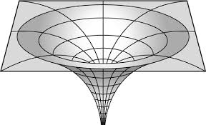
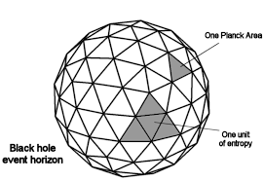

Slide 6
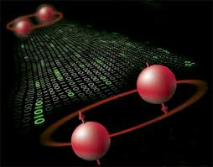

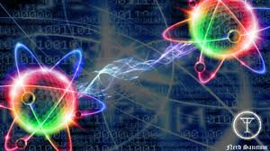
Quantum entanglement (or Quantum Correlation)
Physical phenomenon – with no classical analogue - that occurs when pairs or groups of particles are generated or interact in ways such that the quantum state of each particle cannot be described independently — instead, a quantum state may be given for the system as a whole.
Thus, the measure of an observable of a particle instantaneously determines the value of such an observable for the other particles/part of the system.
Experimentally, it may occur that the different parts of the physical system under consideration are spatially separated. In such a framework, the quantum entanglement implies – in a pretty counter-intuitive way – a correlation at a distance, and thus the intrinsically non-local character of quantum theory.

Slide 7
Black Hole – Qubit Correspondence

Slide 8
My research is focussed on black holes in theories of gravity (superstrings / M-theory, or more precisely in their low-energy limit, named supergravity), with special emphasis on the role of non-compact, global duality symmetries : in particular, electric-magnetic duality (or its discrete version, namely U(nified)-duality in string theory).
The aim is to exploit the symmetries of gravity systems and their similarities to entanglement structures in QIT systems, and thus to unravel more fascinating facets of the Black Hole – Qubit Correspondence mentioned above.
Indeed, advances in the understanding of black holes in M-theory can yield results in QIT, which would be otherwise hard to obtain (e.g., classification of 3-qubits and 4-qubits entanglement, Attractor Mechanism as distillation protocol, etc.), and vice versa.
Exceptional Lie algebras, naturally appearing in M-theory, have turned to play a key role in the structure and dynamics of black holes, as well as in the description of entanglement in some n-qubits and n-qutrits systems.

Slide 9
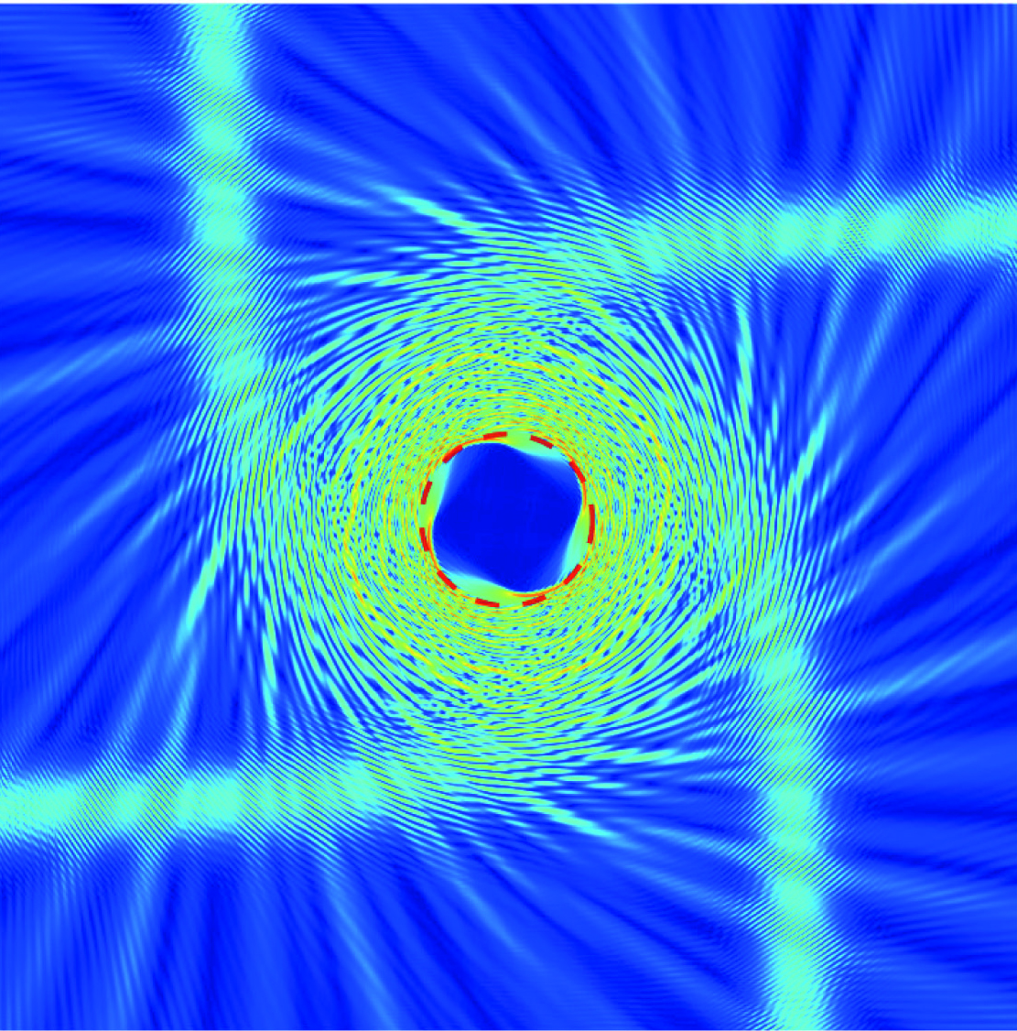
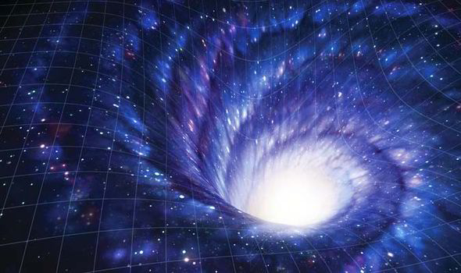
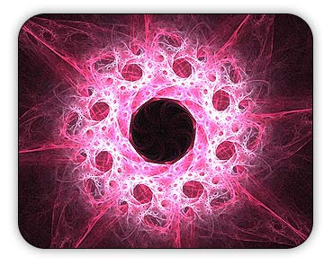
Challenges in the QIT-characterization of Black Hole Physics :
1. the Attractor Mechanism as a “distillation protocol” at the horizon of extremal BHs;
2. the higher-dimensional origin of qubits as determined by “wrapping rules” of
spatially extended non-perturbative objects (such as branes);
3. Role of intrinsically non-linear symmetries, such as the recently discovered Freudenthal
Duality (symmetry of the black hole entropy), in the QIT dual picture of black holes

Slide 10

Thank You!

Slide 11

Remark
In collaboration with Prof. Michael J. Duff (Imperial College, UK) and his research team, I co-authored
Four-qubit entanglement from string theory, Phys. Rev. Lett. 105, 100507;
On the Black Hole / Qubit Correspondence, Eur. Phys. J. Plus 126, 37,
which study and exploit the Black Hole / Qubit Correspondence.
In fact, a longstanding problem, namely the classification of the independent ways to entangle four qubits, was solved by exploiting the duality between stringy black holes and QIT.
Since the entanglement of four qubits can be experimentally measured :
this (apparently) formal result turned out to be the first “yes/no" test involving string theory !
There are some QIT experimental groups working on the determination and study of 4-qubit states : they might soon be able to test the theoretical prediction given in the above papers, proving/disproving the expected result from string theory !

