Slide 1
Research and development
Coordinator: Francesco Sylos Labini Enrico Fermi Center & Institute of Complex Systems (National Research Council), Rome Italy
Place of Work & Collaborations:
Andrea Gabrielli Institute of Complex Systems (National Research Council), Rome Italy
Giulio Cimini Institute of Complex Systems (National Research Council), Rome Italy
Luciano Pietronero Institute of Complex Systems (National Research Council), Rome Italy & U. Sapienza Rome

Slide 2
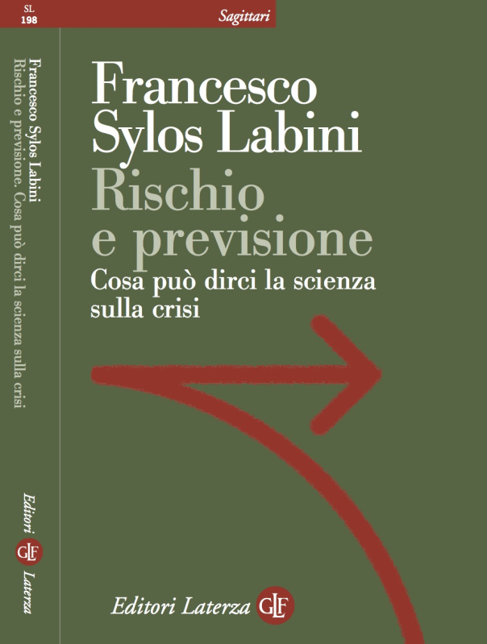
Research and development

Slide 3
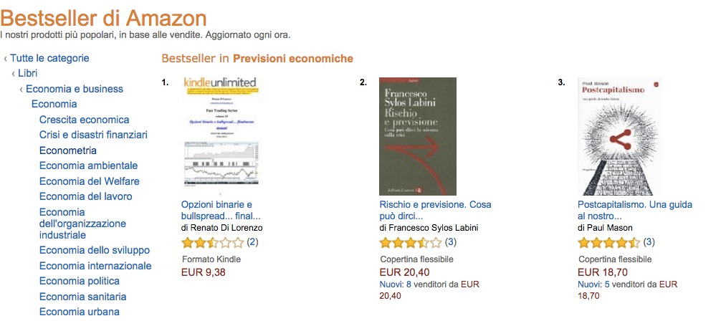
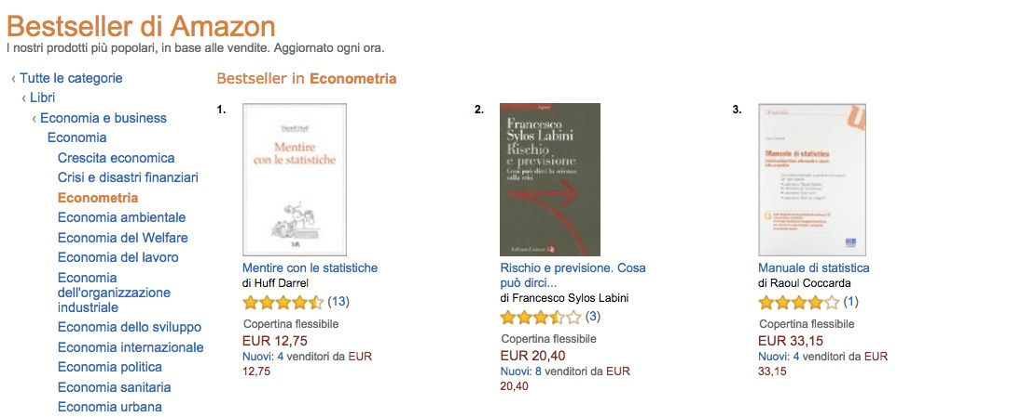
Research and development

Slide 4
Research and development
Research
Patents
Innovation
Spending
Time

Slide 5
Complex self-gravitating structures
Coordinator:
Francesco Sylos Labini Enrico Fermi Center, Institute of Complex Systems (CNR), INFN (Roma1) Rome Italy
Participants:
David Benhaiem Institute of Complex Systems (National Research Council), Rome Italy
Michael Joyce Laboratoire de Physique Nucleaire et de Hautes Energies, UMR 7585, Universite Pierre et Marie Curie Paris 6, Paris, France
Tirawut Worrakitpoonpon Faculty of Science and Technology, Rajamangala University of Technology Suvarnabhumi, Thailand
Place of Work & Collaborations:
Institute for Complex System CNR Rome
Laboratoire de Physique Nucleaire et de Hautes Energies, UMR 7585, Universite Pierre et Marie Curie Paris 6, Paris, France
Faculty of Science and Technology, Rajamangala University of Technology Suvarnabhumi, Thailand

Slide 6
Complex self-gravitating structures
Other Logo
Project main goal and results so far achieved
Why relaxation to QSS ?
Is occurrence of QSS generic for any LRI?
When QSS exist, how does lifetime depend on details of interaction?
Do QSS survive when the system is coupled or perturbed?

Slide 7
Complex self-gravitating structures
Other Logo
Project main goal and results so far achieved
Finite and infinite systems
Fluctuations and instabilities: finite N fluctuations trigger instabilities in the non linear regime
Spherical Symmetry Breaking in gravitational collapse
Stationary vs. non stationary mechanisms of spherical symmetry breaking
Radial Orbit Instability vs. amplification of initial fluctuations
Generation of angular momentum

Slide 8
Complex self-gravitating structures
Other Logo

Slide 9
Complex self-
gravitating structures

Slide 10
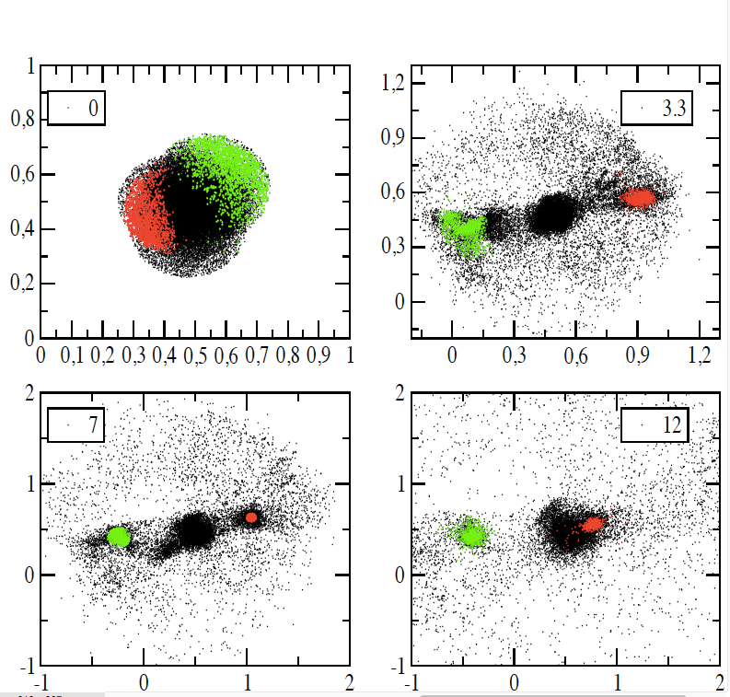
Complex self-
gravitating structures

Slide 11
Complex self-gravitating structures
Other Logo
Plan of activities 2017 – 2019

Slide 12
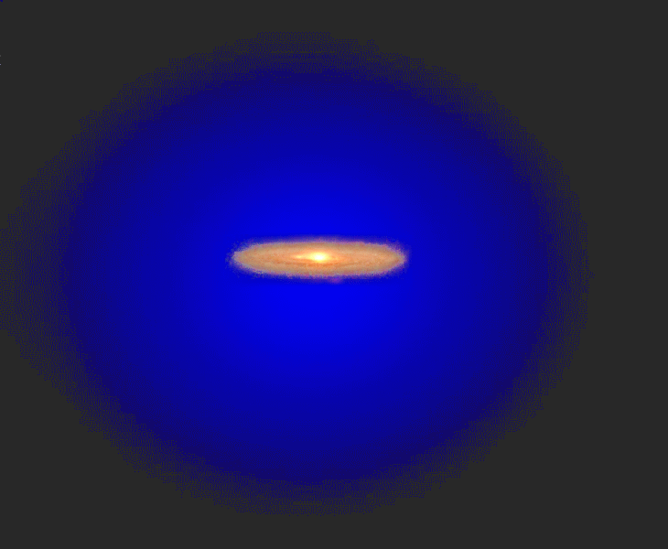
Complex self-gravitating structures
Other Logo
Plan of activities 2017 – 2019

Slide 13
Complex self-gravitating structures
Other Logo
Plan of activities 2017 – 2019

Slide 14
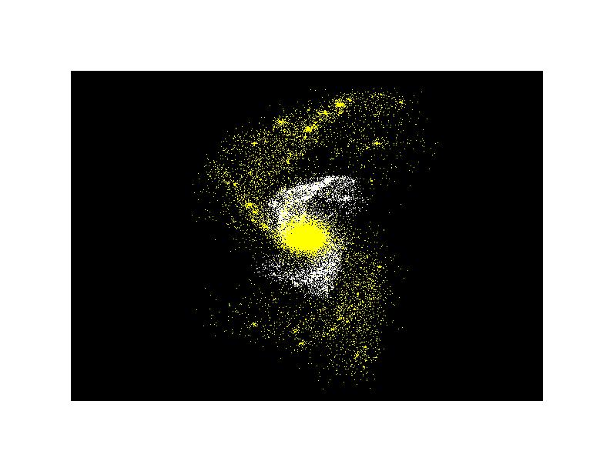
Complex self-gravitating structures
Other Logo
Plan of activities 2017 - 2019

Slide 15
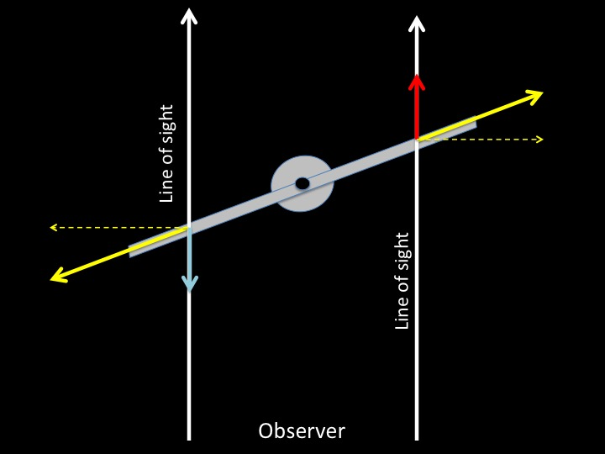
Complex self-gravitating structures
Other Logo
Plan of activities 2017 – 2019

Slide 16
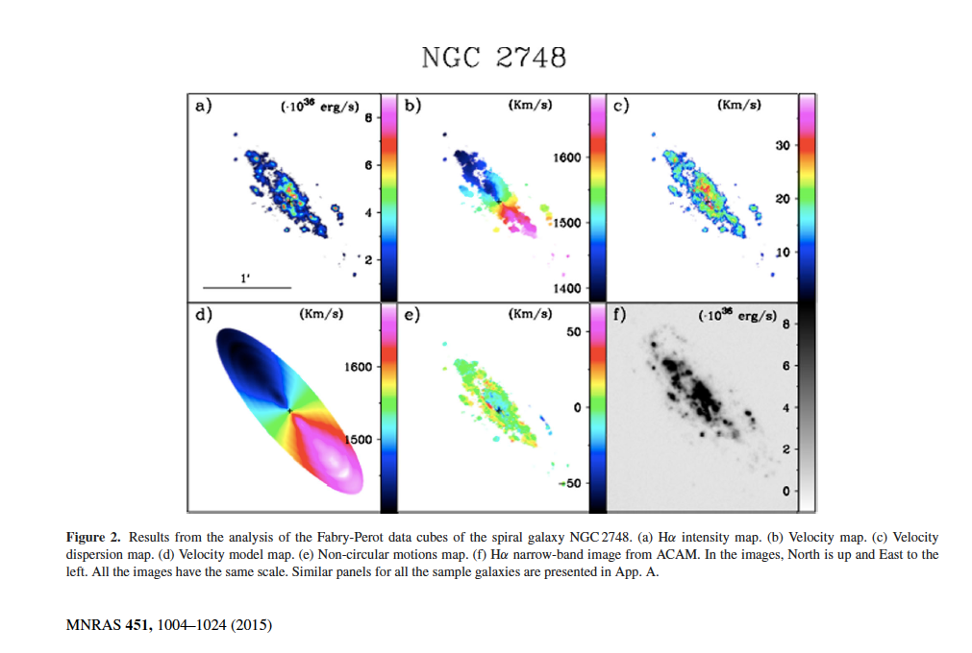
Complex self-gravitating structures
Other Logo
Plan of activities 2017 – 2019

Slide 17
Complex self-gravitating structures
Other Logo
Expected funding in the 3-year period:
Request of funding by Centro Fermi
Postdoc: about 50,000 euro/year * 3 years = 150,000
10,000 euro consumable
Potential external funding
ISC CNR 50,000 euro (assigned)
DYNamics and non equilibrium states of complex SYStems: MATHematical methods and physical concepts (INFN) 2000 euro (assigned)

