Slide 1
A Geometric Approach to Quantum Gravity
Grantee: Bianca Letizia Cerchiai
Expiration of the Grant: 05/2017
Work Institution: Politecnico di Torino, DISAT
Scientific Supervisor: Mario Trigiante
Other members: L. Andrianopoli, R. D’Auria, A. Anabalon
120-cell

Slide 2
A Geometric Approach to Quantum Gravity
Motivations of the project and background
General idea: Analysis of the geometrical structure of various groups acting as symmetries of physical models with the aim of getting information about the physical properties of these systems through their symmetries while at the same time gathering insight into the geometry of the symmetry algebras by means of their representations on the field spaces.
Objective: Study of the geometrical structure of quantum gravity, in particular of extended supergravity theories as low-energy limit of superstring theory around non perturbative vacua.
Method: Application of dualities as symmetries of extended supergravity and related models such as non-linear electrodynamics.
Rationale:
Dualities allow to access non perturbative sectors of the theory, e.g. strong/weak coupling duality;
Extended supergravity means that there is more supersymmetry, which is more restrictive and hence more predictive
⇒ Front-line research both in theoretical physics and in mathematics.

Slide 3
A Geometric Approach to Quantum Gravity
Some background
The extended ungauged supergravities are characterized by a global (on-shell) symmetry group which, at the classical level, is a non-compact, real Lie group acting on the electric field strengths and their magnetic duals as a generalized electric-magnetic duality. In particular, exceptional Lie groups, such as G₂, F₄, E₆, E₇ and E₈ play a prominent role in this context.
Quantum corrections generally break this group to a discrete subgroup, such as the group PSL(2,Z₇) discussed later. This global symmetry group (or duality group) encodes the known string dualities: T-duality, S-duality and the more general U-duality.
A gauged supergravity is constructed from an ungauged supergravity by promoting a suitable subgroup of the global symmetry group to gauge group. The embedding of the gauge group inside the global symmetry group is totally defined by an embedding tensor, which therefore encodes all the couplings and mass terms of the gauged theory.
Born-Infeld theories provide interesting examples non-linear realizations of supersymmetry and supersymmetry breaking appearing in this framework.

Slide 4
A Geometric Approach to Quantum Gravity
Synthesis of the results achieved in 2016
Multifield and non-Abelian generalizations of Born and Born-Infeld theories
[With M. Trigiante, JHEP 1610:160 (2016), arXiv:1609.07399]
We have studied n-fields generalizations of the Born and Born-Infeld theories in non-linear electrodynamics in a linear formalism in terms of auxiliary fields.
The symmetry properties, in particular the characteristic self-duality by Legendre transformation of the corresponding non-linear theory, are manifest and built-in as on-shell duality symmetries.
They depend on the choice of the (homogeneous) manifold M spanned by the auxiliary scalar fields and the symplectic frame.
⬇
A non-linear Born-Infeld type Lagrangian can be associated to any extended supergravity theory based on M.
We reproduce some known multi-field Born-Infeld theories (see A. Yeranyan’s talk) and derive new non-linear models, such as the n-field Born theory.
We discuss non-Abelian generalizations of these theories.
In the Euler parametrization the potential simplifies due to its duality invariance, explicitly showing the flat directions, similar to Goldstone bosons.

Slide 5
A Geometric Approach to Quantum Gravity
Born model [M. Born, Proc. Roy. Soc. Lond. A 143 (1934) 410]
μ=e/4πr₀², e electron charge, r₀ electron radius, F_{μν} = ∂_{μ}A_{ν} − ∂_{ν}A_{μ} Abelian field strength
Born-Infeld model [M. Born, Proc. Roy. Soc. Lond. A 143 (1934) 410]
∗F ^{µν} = ½ ε^{µνλσ}F_{λσ} dual field strength
•They were found as a generalization of electromagnetism in an effort to impose an upper bound on the electric field of a point charge, avoiding self-interaction.
•They describe the same static solutions, and coincide if B=0.
•They are non-linear Lagrangians, featuring Poincaré invariance and self-duality by Legendre transformation, and realize electric-magnetic duality in an interacting system [E. Schrödinger, Proc. Roy. Soc. Lond. A 150 (1935) 465].

Slide 6
A Geometric Approach to Quantum Gravity
Linear formulation [L. Andrianopoli, R. DAuria, M. Trigiante, arXiv:1412.6786]
The auxiliary fields g and θ are n × n symmetric matrices, which depend on a set of scalar fields {φ};
M [g,θ] is a symplectic, symmetric matrix describing the coset representative G/H (H on-shell duality group of the theory) and its embedding in Sp(2n)/U(n).
Integrating out the non-dynamical scalar (auxiliary) sector through its algebraic equations of motion yields a non-linear n-vector Born-Infeld type Lagrangian.
Upon different choices for M, we have been able to reproduce various previously known theories with U(1), U(1) x U(1) and SU(2) duality [S. Ferrara, A. Sagnotti, A. Yeranyan, arXiv: 1503.04731, arXiv:1602.04566, see A. Yeranyan’s talk], understanding systematically how they are related and why they are self-dual.
We have built a new Born-like theory with SO(n) duality obtained from the embedding GL(n)/SO(n) in Sp(2n)/U(n), which can be extended to non-Abelian fileld strengths.

Slide 7
A Geometric Approach to Quantum Gravity
Workshops and Conferences:
Workshop on ‘Algebraic Geometry and Physics’, organized by the FIRB ‘Moduli Spaces and Applications’ (P.I. G. Bini, U. Milano, Matematica), Como, 20-22/01/2016;
Visits at Cern, Geneva, 1-13/02, 15-18/03/2016 and 30/01-11/02/2017;
Cost Network Meeting ‘Quantum Structure of Spacetime’ (Chair R. Szabo, U. Edinburgh, UK; vice-chair P. Aschieri, U. Piemonte Orientale), Bayrischzell, Germany, 29/04-03/05/2016;
Talk at the Symposium ‘Cortona@GGI’, Galileo Galilei Institute, Arcetri, Firenze, 17-20/05/2016;
Poster at the 54 International School of Subnuclear Physics, Centro Ettore Majorana, Erice (TP), 14-23/06/2016;
Seminar at the “String Theory Group Meeting”, University of California Berkeley Center for Theoretical Physics, CA, USA, 15-25/08/2016;
Talk at the 102 Congress of the Società Italiana di Fisica, Università di Padova, 26- 30/09/2016;
Invited Talk at the XXII Conferenza della Società Italiana di Gravitazione, Cefalù, 11-17/09/2016;
M. Trigiante, Invited Talk at the workshop ‘Supergravity: what next’, Galileo Galilei Institute, Arcetri, Firenze,17-28/10/2016;
Cost Network Meeting ‘The String Theory Universe’ (Chair S. Penati, U. Bicocca; vice-chair Y. Lozano, U. Oviedo, ES), U. Bicocca, 20-24/02/2017

Slide 8
A Geometric Approach to Quantum Gravity
Plan of activities 2017 – 2018
Born-Infeld theories (continued)
• The original Born-Infeld theory admits a supersymmetric extension and it turns out there is a second hidden non-linearly realized supersymmetry.
⇒ The supersymmetric version represents the invariant action of the Goldstone multiplet in a N = 2 supersymmetric theory spontaneously broken to N = 1, with 1/µ² the supersymmetry breaking scale [J. Bagger, A. Galperin, hep-th/9608177]; S. Ferrara, M. Porrati, A. Sagnotti, arXiv:1411.4954]
⇒ Important to investigate possible supersymmetric extensions.
• It would be interesting to couple these models to matter fields and study their solitonic solutions, such as monopole solutions to the simple Born theory with gauge group SO(3) with a triplet of scalar fields in the adjoint of the gauge group, minimally coupled to the vectors. These would represent a generalization of the ’t Hooft Polyakov monopole.
• Another point to be clarified is the relation between the non Abelian theories discussed here and the non Abelian Born-Infeld models proposed in [C.-H. Liu, S.-T. Yau, arXiv:1606.08529], to describe the effective action of stacks of overlapping D3 branes.

Slide 9
A Geometric Approach to Quantum Gravity
2) Exceptional field theory and the embedding tensor
[With M. Trigiante, L. Andrianopoli, M. Ipinza]
Exceptional field theory is an attempt to make the U-duality symmetries described by the exceptional Lie groups in lower dimensions manifest in the 11-dimensional theory.
This requires the addition of a number of dual coordinates to the phase space, analogous to the double field theory formalism necessary to rewrite string theory in a manifestly T-dual covariant way.
⇒ A (section) constraint has to be imposed to reduce the degrees of freedom to the original ones.
But there is a no-go theorem [K. Lee, C. Strickland-Constable, D. Waldram, arXiv:1506.03457] implying the incompatibility of a certain family of ω-deformed SO(8) gauged N=8 D=4 supergravity theories [G. Dall’Agata, G. Inverso, M. Trigiante, arXiv:1209.0760 [hep-th]] with this constraint.

Slide 10
A Geometric Approach to Quantum Gravity
Idea: Uplifting solutions of the section constraint in a lower dimension to a higher dimension in order to recover the information from the embedding of the smaller duality group for a higher dimension in the bigger duality group for a lower dimension.
Simpler model: STU model in 4 dimensions (duality group SL(2)³) and its compactification to 3 dimensions (duality group SO(4,4)): SO(4,4) ➔ SL(2) x SL(2)³ ⇒ Role of Ehlers subgroup SL(2)
Outlook: Analysis of the embedding tensor corresponding to the SO(8)−gauging (ω-deformation) of the four dimensional E₇₍₇₎ theory in E8(8) ⊃ SL(2) × E7(7): we have already computed the little group.
⇒ Understanding a possible lower-dimensional origin of the ω-deformations, shedding light on a possible relation with the Nut charge in space-time and hence on the mixing of space-time and internal coordinates occurring for non-geometric fluxes.

Slide 11
A Geometric Approach to Quantum Gravity
3) Exceptional field theory and a model of supersymmetric M2−branes with Englert fluxes and PSL(2, Z₇)-symmetry
In the framework of exceptional field theory, we are also studying a N = 1 solution of 11-dim. supergravity including 7-dim. Englert fluxes found by P. Fré [P. Fré, arXiv:1601.02253], admitting a discrete non-Abelian symmetry PSL(2,Z₇).
This group leaves invariant the choice of a maximal torus in E₇ and applying the results of [BLC, B. van Geemen, arXiv:1003.4255], it is relevant for the description of the embedding of SL(2)⁷⊂ E₇₍₇₎ , which also defines the scalar manifold of a “curious” U(1)⁷ ⊂SU(8) 4−dim. N= 1 supergravity [S. Ferrara, M. Duff, arXiv:1010.3173, M. Duff, S. Ferrara, A. Marrani, arXiv:1610.08800].
Following [O. Hohm, H. Samtleben, arXiv:1308.1673; arXiv:1312.4542], we are writing the 11-dimensional solution devised by P. Fré in a (formally) E₇₍₇₎-covariant form, in order to understand its possible relation to U(1)⁷ ⊂ E_{7(7).}
⇒Direct application of exceptional field theory, allowing explicit construction of new solutions by applying symmetry transformations to a known one.

Slide 12
A Geometric Approach to Quantum Gravity
Possible links to other Projects (internal or external to Centro Fermi):
Other projects from the Centro Fermi related to quantum gravity
Cost networks:
"The String Theory Universe” (Chair S. Penati, U. Bicocca)
"Quantum Structure of Spacetime” (Chair R. Szabo, U. Edinburgh, UK; vice-chair P. Aschieri, U. Piemonte Orientale)
FIRB "Moduli Spaces and Applications” (P.I. G. Bini, U. Milano, Matematica)
ERC Advanced Grant “Fundamental Aspects of Strings and Gravity” (P.I. D.Lüst, ASC Munich, Germany)
Newly inaugurated Arnold-Regge Center for Algebra, Geometry and Theoretical Physics, Torino
Possible participation to external Call for Projects:
DAAD

Slide 13
A Geometric Approach to Quantum Gravity
Expected Products (Preliminary)
With M. Trigiante, Non symmetric spaces in supergravity
With L. Andrianopoli, M. Ipinza, M. Trigiante, The embedding tensor in exceptional field theory
With G. Bini, S. Cacciatori, G. Salvatori, Geometry of Amplitudohedron
Publication of the Mathematica program
http://www.mat.unimi.it/users/cerchiai/MathematicaProgram/
Research impact and science outreach
Experience with science outreach: Prize of the University of California Berkeley International House for science outreach in the schools and in the community (2005) and experience as Marie Curie Ambassador during reintegration grant
Applications of 3D printing for the visualization of mathematical concepts? (E.g. Cern has a group for help with libraries useful for working with 3D objects and an industry standard 3D-printer at the Polymers Laboratory)

Slide 14
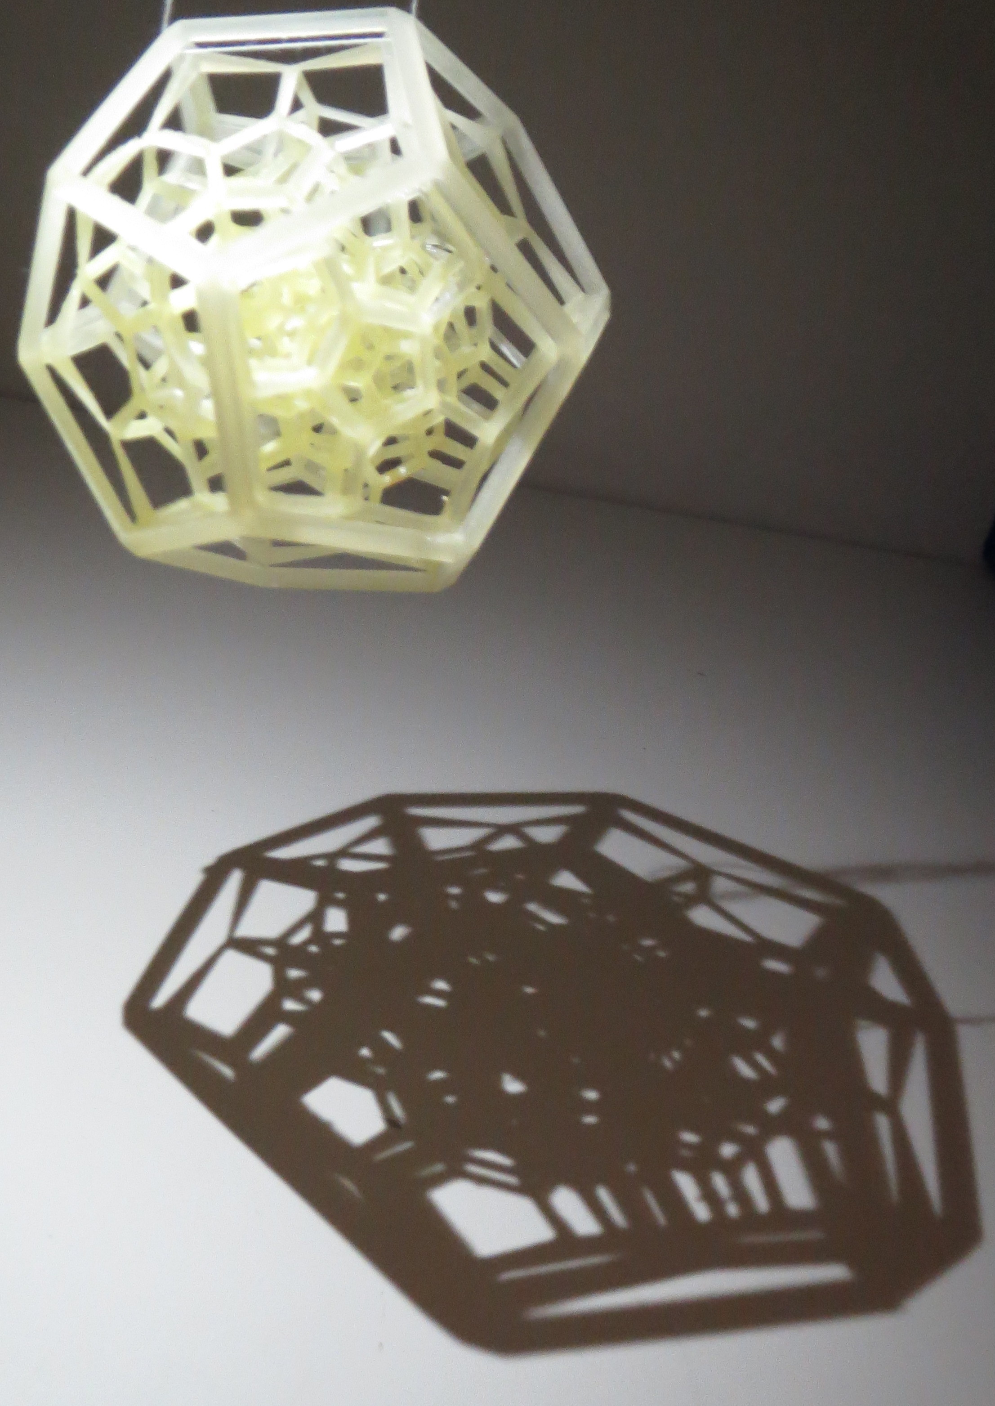
A Geometric Approach to Quantum Gravity
Thank you!

